Slide 1
CS 149: Operating Systems April 16 Class Meeting
Department of Computer Science San Jose State University Spring 2015 Instructor: Ron Mak
www.cs.sjsu.edu/~mak

Slide 2
Polling
Producer-consumer relationship.
The OS and the device controller share a handshaking protocol.
The controller sets a busy bit in its status register to indicate that it’s busy working.
The OS sets a command-ready bit in the controller’s command register to indicate that it has a command for the controller to execute.

Slide 3
The Polling Cycle
The OS repeatedly checks the busy bit.
Polling (busy waiting)
The OS sets the write bit in the command register and writes a byte into the data-out register.
The OS sets the command-ready bit.
The controller sees the command-ready bit is set and sets the busy bit.

Slide 4
The Polling Cycle, cont’d
The controller sees the write bit is set in the command register, reads the byte in the data-out register, and performs the I/O operation.
The controller clears the command-ready bit, clears the error bit in the status register, clears the write bit, and clears the busy bit.

Slide 5
I/O Interrupts
An I/O device triggers the CPU’s interrupt-request line.
An interrupt handler receives interrupts.
Some interrupts can are maskable to ignore or delay the interrupts.
Other interrupts are nonmaskable.
An interrupt vector dispatches the interrupt to the correct interrupt handler.
Based on priority.

Slide 6
OS-Level Interrupt Handlers
Interrupt priority levels
A high-priority interrupt can preempt a low-priority interrupt.
Used to handle system exceptions (errors).
Examples
divide by zero
accessing a protected or nonexistent memory address
executing a privileged instruction in user mode

Slide 7
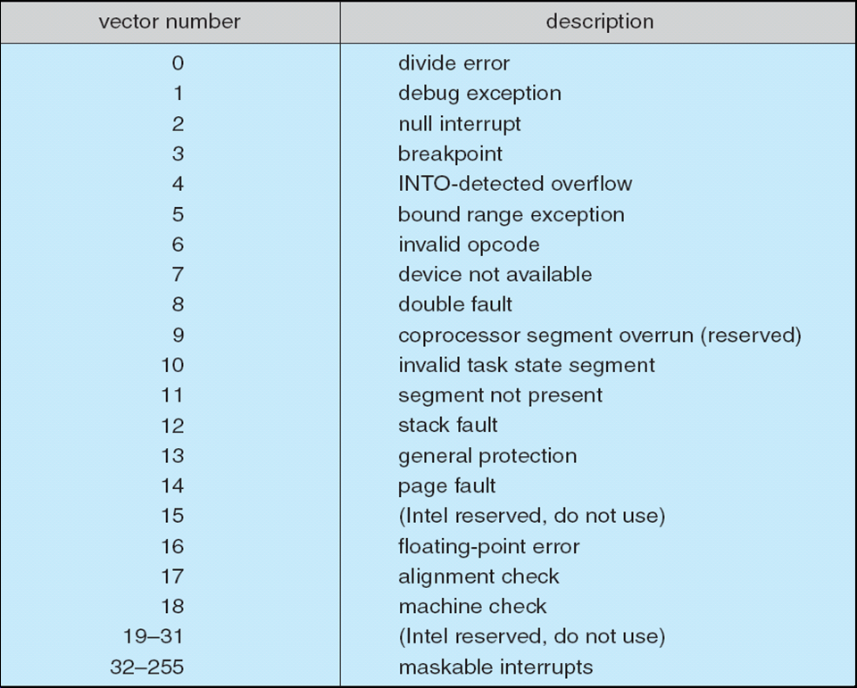
Intel Pentium Processor Event Vector Table

Slide 8
Application-Level Interrupt Handlers
Software interrupt (AKA trap)
A special instruction executed by a system call from a user application to request a kernel service.
User programs can include application-level interrupt handlers.

Slide 9
Application-Level Interrupt Handlers
void INThandler(int);
main()
{
signal(SIGINT, INThandler);
printf("Sleep #1\n");
sleep(1);
printf("Sleep #2\n");
sleep(1);
printf("Sleep #3\n");
sleep(1);
...
}
interrupt2.c

Slide 10
Application-Level Interrupt Handlers, cont’d
void INThandler(int);
...
void INThandler(int sig)
{
signal(sig, SIG_IGN);
printf("\nDo you really want to quit? [y/n] ");
int c = getchar();
if (c == 'y' || c == 'Y') {
exit(0);
}
else {
signal(SIGINT, INThandler);
getchar();
}
}
interrupt2.c
Demo

Slide 11
Clocks and Timers
Provide current time and elapsed time.
Programmable interval timer
Provide a timer to trigger operation X at time T.
Used for timings
Generate periodic interrupts
The UNIX ioctl() system call
Covers odd aspects of I/O such as clocks and timers.

Slide 12
Timer Example
#include <stdio.h>
#include <stdlib.h>
#include <assert.h>
#include <signal.h>
#include <sys/time.h>
int timedout = 0;
// The SIGALRM interrupt handler.
void SIGALRM_handler(int signo)
{
assert(signo == SIGALRM);
printf("\nTime's up!\nPress return for another.\n");
timedout = 1;
}
timers.c

Slide 13
Timer Example
timers.c
int main(void)
{
struct itimerval tval;
char string[BUFSIZ];
timerclear(& tval.it_interval);
timerclear(& tval.it_value);
tval.it_value.tv_sec = 3; // 3 second timeout
(void) signal(SIGALRM, SIGALRM_handler);

Slide 14
Timer Example, cont’d
for (;;) {
int i = rand()%10;
int j = rand()%10;
printf("Solve %d+%d=", i, j);
timedout = 0;
setitimer(ITIMER_REAL, &tval, NULL);
if (fgets(string, sizeof string, stdin) != NULL) {
if (!timedout) {
(void) setitimer(ITIMER_REAL, NULL, NULL);
printf(atoi(string) == i+j ? "Correct!\n" : "Wrong!\n");
}
}
else {
printf("\nGiving up?\n");
exit(0);
}
}
}
timers.c
Generate and display a math problem.
Set the timer.
Turn off the timer.

Slide 15
The select() System Call
Manage a set of file descriptors.
Returns information about the file descriptors.
Which have data waiting to be read.
Which can accept data to be written.
Eliminates the need for polling.

Slide 16
The select() System Call, cont’d
#include <sys/time.h>
#include <sys/select.h>
int select(int nfds, fd_set *readfds, fd_set *writefds,
fd_set *exceptfds, struct timeval *timeout);
Return the number of ready file descriptors, 0 on timeout, or -1 on error.
Block while waiting for at least one file descriptor to become ready or until timeout.

Slide 17
The select() System Call, cont’d
Macros FD_ZERO(), FD_SET(), and FD_CLEAR() manipulate file descriptor sets.
Macro FD_ISSET() tests whether a file descriptor is in a set.

Slide 18
Select Example
#include <stdio.h>
#include <stdlib.h>
#include <fcntl.h>
#include <unistd.h>
#include <sys/types.h>
#include <sys/time.h>
#include <sys/ioctl.h>
int main()
{
char buffer[128];
int result, nread;
fd_set inputs, inputfds; // sets of file descriptors
struct timeval timeout;
FD_ZERO(&inputs); // initialize inputs to the empty set
FD_SET(0, &inputs); // set file descriptor 0 (stdin)
...
}
select.c

Slide 19
select() Example, cont’d
for (;;) {
inputfds = inputs; // restore input fd set
timeout.tv_sec = 2;
timeout.tv_usec = 500000;
result = select(FD_SETSIZE, &inputfds,
(fd_set *) 0, (fd_set *) 0, &timeout);
switch(result) {
case 0: {
printf("@");
fflush(stdout);
break;
}
case -1: {
perror("select");
exit(1);
}
Wait for input on stdin for
a maximum of 2.5 seconds.
No input.
Error

Slide 20
select() Example, cont’d
default: {
if (FD_ISSET(0, &inputfds)) {
ioctl(0, FIONREAD, &nread);
if (nread == 0) {
printf("Keyboard input done.\n");
exit(0);
}
nread = read(0, buffer, nread);
buffer[nread] = 0;
printf("Read %d characters from the keyboard: %s",
nread, buffer);
}
break;
}
}
}
}
Got input! How many bytes
are available to read?
Demo

Slide 21
Sockets
Network socket interface.
An application creates a software socket.
Connects a local socket to a remote address.
The socket plugs the application into a socket created by another application.
Listen for data packets over the connection.

Slide 22
Socket Example
#include <stdio.h>
#include <unistd.h>
#include <stdlib.h>
#include <sys/types.h>
#include <sys/socket.h>
#include <sys/un.h>
#include "socket_name.h"
int main()
{
int server_sockfd, client_sockfd;
int server_len, client_len;
struct sockaddr_un server_address;
struct sockaddr_un client_address;
unlink(SOCKET_NAME);
server_sockfd = socket(AF_UNIX, SOCK_STREAM, 0);
...
}
server.c
Remove any old socket
and create an unnamed socket
for the server.

Slide 23
Socket Example, cont’d
#define SOCKET_NAME "CS149_socket"
server.c
main()
{
...
server_address.sun_family = AF_UNIX;
strcpy(server_address.sun_path, SOCKET_NAME);
server_len = sizeof(server_address);
bind(server_sockfd, (struct sockaddr *)&server_address, server_len);
listen(server_sockfd, 5);
for (;;) {
printf("Server waiting.\n");
client_len = sizeof(client_address);
client_sockfd = accept(server_sockfd,
(struct sockaddr *) &client_address,
(socklen_t *) &client_len);
...
}
}
socket_name.h
Name the socket.
Create a connection queue
and wait for clients.
Accept a socket connection.

Slide 24
Socket Example, cont’d
server.c
main()
{
...
for (;;) {
...
char ch;
read(client_sockfd, &ch, 1);
printf("Read character '%c'\n", ch);
ch++;
printf("Writing character '%c'\n", ch);
write(client_sockfd, &ch, 1);
// Close the socket.
close(client_sockfd);
}
}
Read a character from the socket.
Increment the character
and write it back to the socket.

Slide 25
Socket Example, cont’d
#include <stdio.h>
#include <unistd.h>
#include <stdlib.h>
#include <sys/types.h>
#include <sys/socket.h>
#include <sys/un.h>
#include "socket_name.h"
int main()
{
int client_sockfd, len, result;
struct sockaddr_un address;
char ch = 'A';
client_sockfd = socket(AF_UNIX, SOCK_STREAM, 0);
address.sun_family = AF_UNIX;
strcpy(address.sun_path, SOCKET_NAME);
len = sizeof(address);
...
}
client.c
Create a socket for the client.
Name the socket.

Slide 26
Socket Example, cont’d
main()
{
...
result = connect(client_sockfd, (struct sockaddr *)&address, len);
if (result == -1) {
perror("Error: client");
exit(1);
}
printf("Writing '%c' to the socket.\n", 'A');
write(client_sockfd, &ch, 1);
read(client_sockfd, &ch, 1);
printf("Read '%c' from the server.\n", ch);
close(client_sockfd);
exit(0);
}
client.c
Connect our socket to the server's socket.
Write 'A' to the
socket via sockfd.
Read what the
server sent back.
Demo

Slide 27
How Fast?
Speed of an electrical signal: ~20 cm/nsec in a copper wire or optical fiber.
Heat dissipation
Faster clock ➔ more heat
Smaller component ➔ harder to dissipate heat
Clock speed | Max distance per cycle
10 GHz | 2 cm
100 GHz | 2 mm
1 THz | 100 microns

Slide 28
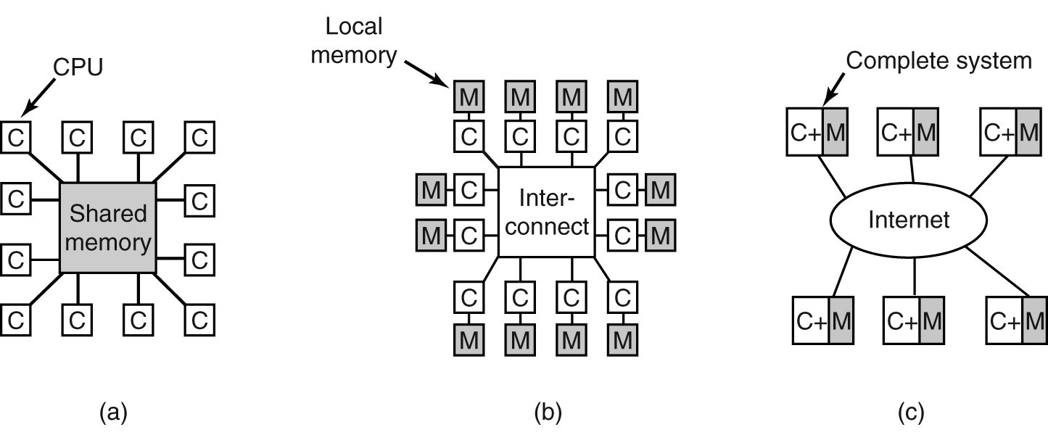
Multiprocessor Systems
Physical limits to how fast and how small it is possible to make the CPU.
Solution: Computers with multiple CPUs.
Massively parallel computers
Shared memory
Message-passing
Distributed
Modern Operating Systems, 3rd ed.
Andrew Tanenbaum
(c) 2008 Prentice-Hall, Inc.. 0-13-600663-9
All rights reserved

Slide 29
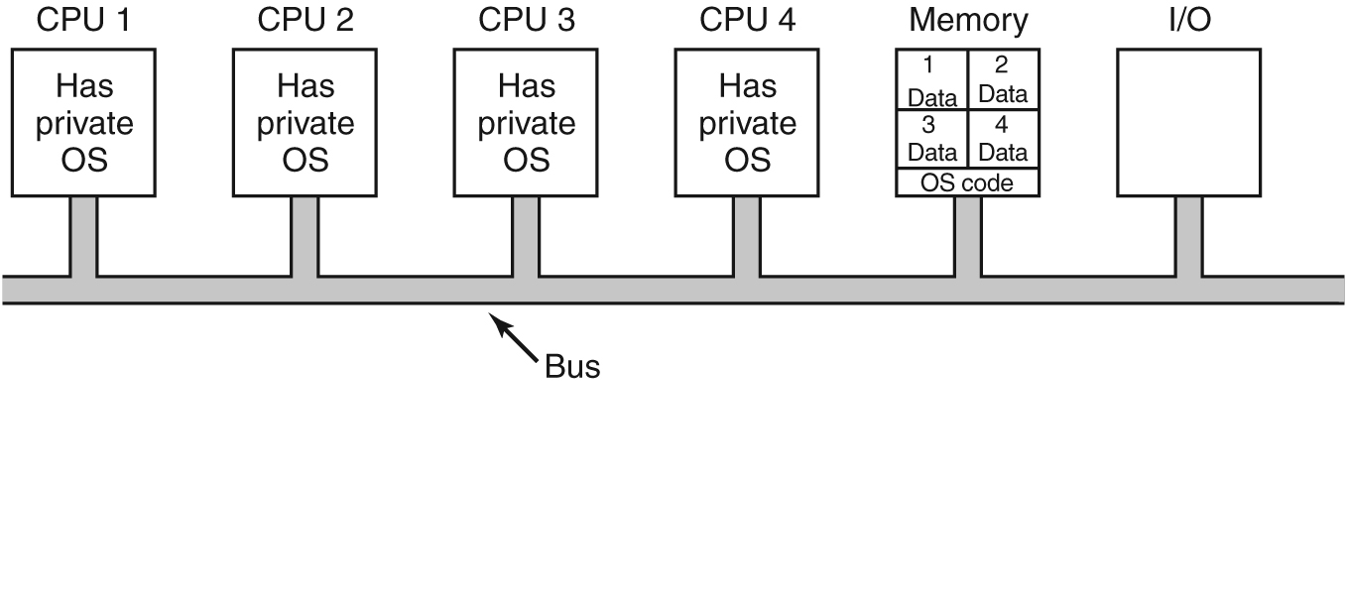
Multiprocessor Operating Systems
Each CPU has its own operating system.
Memory is partitioned.
Modern Operating Systems, 3rd ed.
Andrew Tanenbaum
(c) 2008 Prentice-Hall, Inc.. 0-13-600663-9
All rights reserved

Slide 30
Multiprocessor Operating Systems, cont’d
Master-slave multiprocessors
One copy of the OS runs on the master CPU.
Slave CPUs redirect system calls to the master CPU.
Modern Operating Systems, 3rd ed.
Andrew Tanenbaum
(c) 2008 Prentice-Hall, Inc.. 0-13-600663-9
All rights reserved

Slide 31
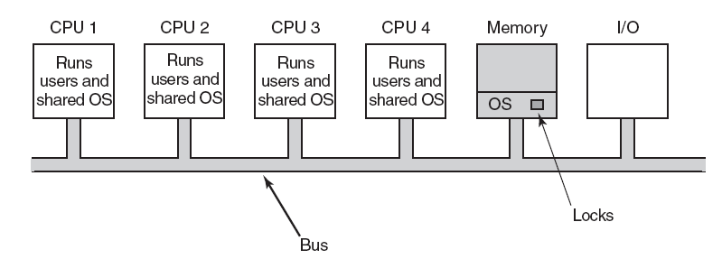
Multiprocessor Operating Systems, cont’d
Symmetric multiprocessor (SMP)
One copy of the OS.
Any CPU can run the OS.
First acquire a mutex lock.
Modern Operating Systems, 3rd ed.
Andrew Tanenbaum
(c) 2008 Prentice-Hall, Inc.. 0-13-600663-9
All rights reserved

Slide 32
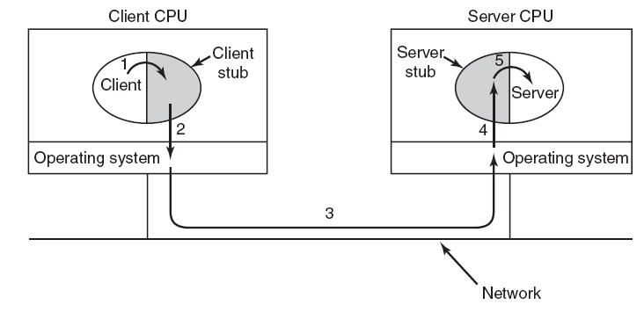
Remote Procedure Call (RPC)
Client calls stub.
Stub packages (marshals) data into a message.
Kernel sends message to the server CPU.
Server stub receives message and unmarshals data.
Server stub calls the server procedure.
Modern Operating Systems, 3rd ed.
Andrew Tanenbaum
(c) 2008 Prentice-Hall, Inc.. 0-13-600663-9
All rights reserved

Slide 33
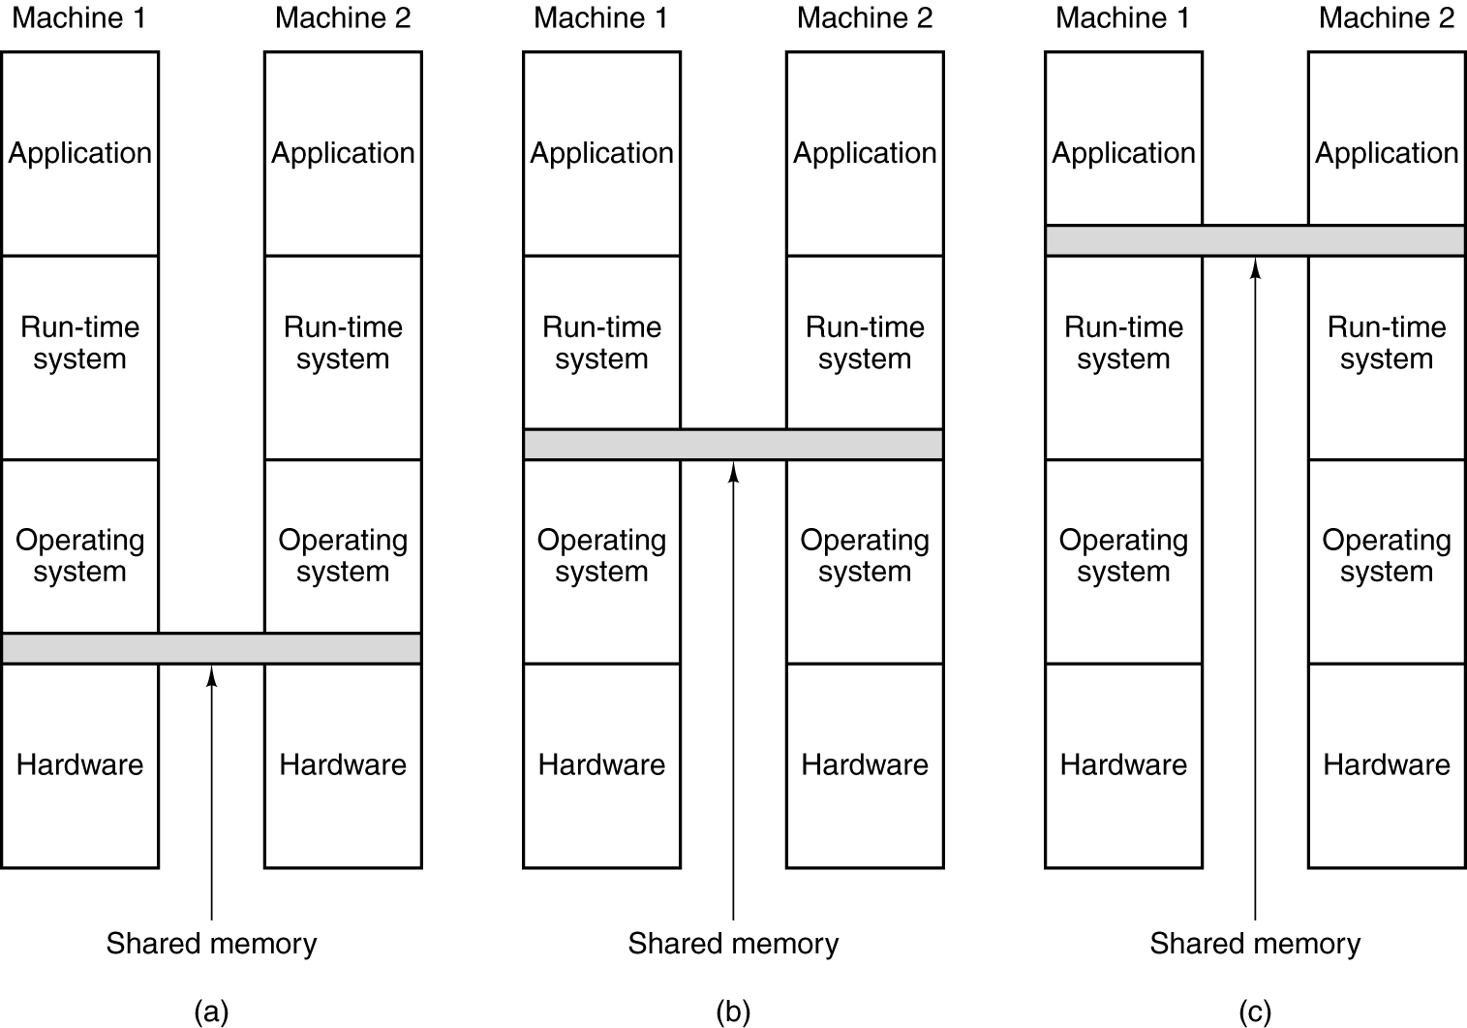
Distributed Shared Memory (DSM)
Hardware
Operating system
User-level
Modern Operating Systems, 3rd ed.
Andrew Tanenbaum
(c) 2008 Prentice-Hall, Inc.. 0-13-600663-9
All rights reserved

Slide 34
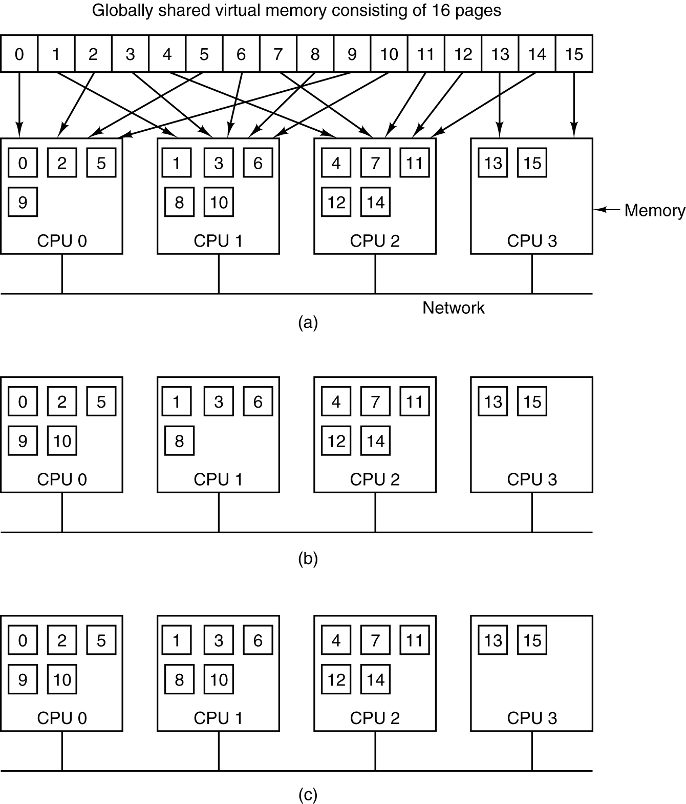
Distributed Shared Memory (DSM), cont’d
Pages of the address space are distributed among four CPUs. Page 10 is mapped to CPU 1.
CPU 0 references Page 10. It must wait for CPU 1 to release the page.
If Page 10 is read-only, it can be mapped to both CPU 0 and CPU 1.
Modern Operating Systems, 3rd ed.
Andrew Tanenbaum
(c) 2008 Prentice-Hall, Inc.. 0-13-600663-9
All rights reserved

