Slide 1
CS 149: Operating Systems April 14 Class Meeting
Department of Computer Science San Jose State University Spring 2015 Instructor: Ron Mak
www.cs.sjsu.edu/~mak

Slide 2
Journaling File Systems
Journaling file systems record each update to the file system as a transaction.
Becoming common on many operating systems.
All transactions are written sequentially to a log.
A transaction is considered committed once it is written to the log file.
The user process can continue execution.

Slide 3
Journaling File Systems, cont’d
The transactions in the log are asynchronously replayed to the file system structures.
When the file system structures are modified, the transaction is removed from the log.
If the file system crashes, all remaining transactions in the log must still be performed.
Faster recovery from a crash.
Removes the chance of inconsistency of metadata.

Slide 4
Virtual File System (VFS)
A UNIX Virtual File System (VFS) provides an object-oriented way to implement file systems.
VFS allows the same system call interface (the API) to be used for different types of file systems.
Separate file-system generic operations from implementation details.

Slide 5
Virtual File System (VFS), cont’d
The implementation can be one of many file systems types, or a network file system.
Implement vnodes which hold inodes or network file details.
The API is to the VFS interface, rather than any specific type of file system.
Dispatch an operation to the appropriate file system implementation routines.

Slide 6
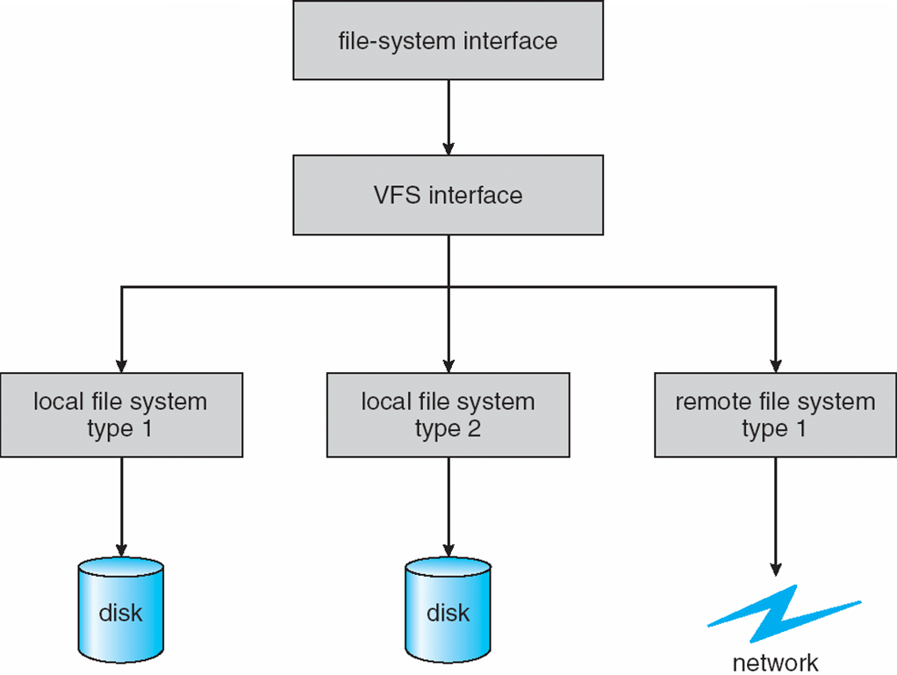
Virtual File System (VFS)
Schematic view of a virtual file system.
Operating Systems Concepts, 9th edition
Silberschatz, Galvin, and Gagne
(c) 2013 John Wiley & Sons. All rights reserved. 978-1-118-06333-0

Slide 7
Network File System (NFS)
Commonplace implementation of a client-server file system.
Access remote files across local-area networks (LANs) or wide-area networks (WANs).
Use the TCP or UDP/IP protocol.
Operate in a heterogeneous environment of different machines, operating systems, and network architectures.

Slide 8
Network File System (NFS), cont’d
Provide file sharing across a set of independent machines and independent file systems.
Mount a remote file system onto a local mount point.
Transparent sharing.

Slide 9
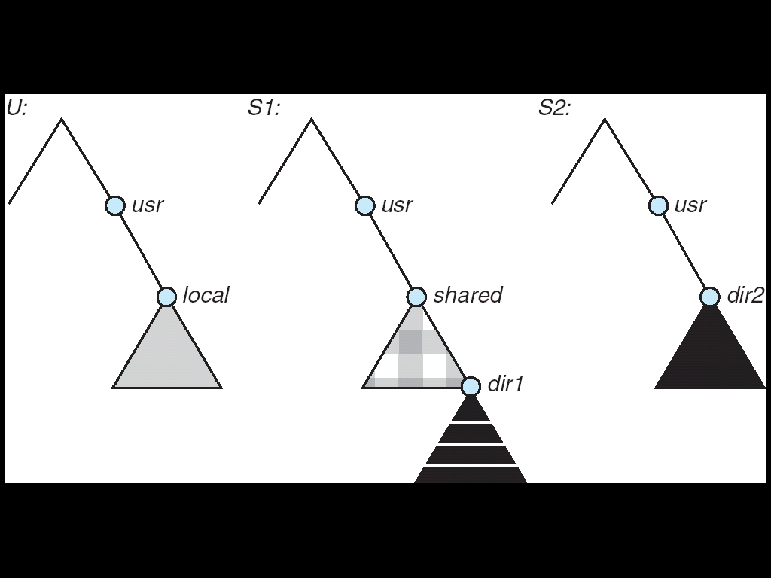
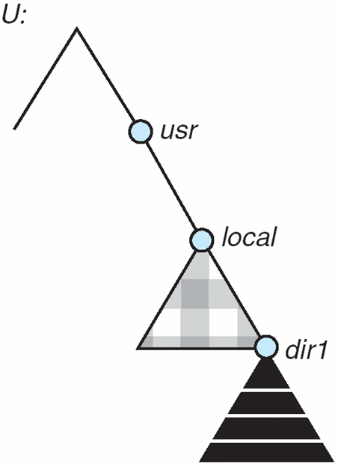
NFS Mounting
(a)
(b)
A local file system U and two remote file systems S1 and S2.
The result of mounting the remote /usr/shared from S1 onto /usr/local
Operating Systems Concepts, 9th edition
Silberschatz, Galvin, and Gagne
(c) 2013 John Wiley & Sons. All rights reserved. 978-1-118-06333-0

Slide 10
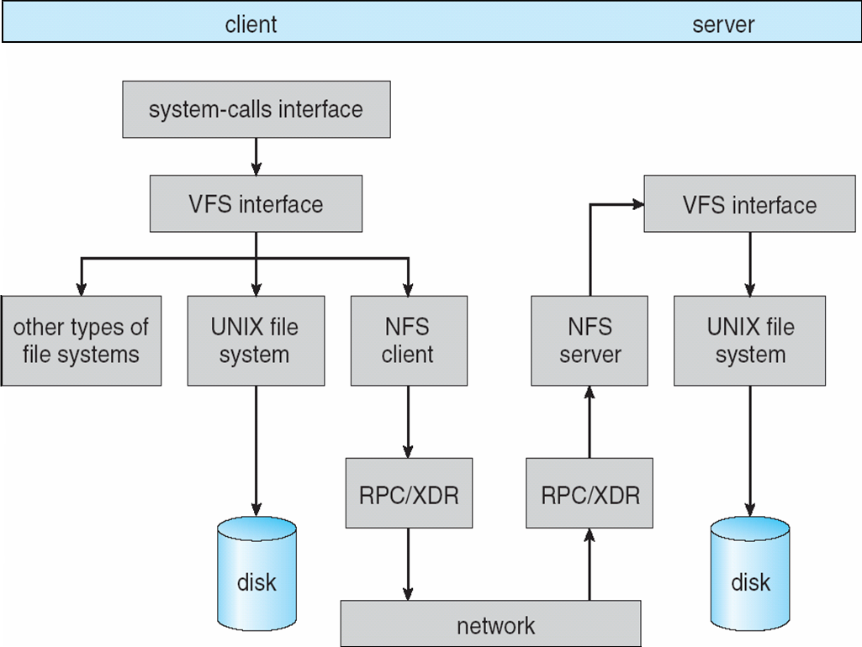
Network File System (NFS)
Schematic view of the NFS architecture.
Operating Systems Concepts, 9th edition
Silberschatz, Galvin, and Gagne
(c) 2013 John Wiley & Sons. All rights reserved. 978-1-118-06333-0

Slide 11
Assignment #6: UNIX I/O
The purpose of this assignment is to practice making UNIX I/O system calls in C.
In a multiplexed manner, your main process will
read from multiple files, and
read from the standard input (the terminal).
Create five pipes and spawn five child processes.
Connect a pipe to each child process.
Each child process should write to its pipe.
The parent process should read from all the pipes.

Slide 12
Assignment #6, cont’d
Each of the first four child processes should generate time stamped messages to the nearest 1000th of a second (time starts at 0): 0:00.123: Child 1 message 1 0:02.456: Child 1 message 2 etc. and write the messages one at a time to its pipe.
Sleep for a random time of 0, 1, or 2 seconds between messages.
Terminate the process after 30 seconds.

Slide 13
Assignment #6, cont’d
Meanwhile, the fifth child process should repeatedly prompt at the terminal (standard out) and read one line of input (standard in) typed by the user.
Write the message (with time stamp) to its pipe.
Immediately prompt for the next message.
Terminate the process after 30 seconds.

Slide 14
Assignment #6, cont’d
After spawning the child processes, the parent process should repeatedly read lines from the pipes.
Use the select() system call to determine whether any of the pipes has any input.
Read the “man” pages about select() .

Slide 15
Assignment #6, cont’d
Write the lines to an output file output.txt in the order that they were read.
Prepend each line with a time stamp to the nearest 1000th of a second.
Therefore, each line with have two time stamps.
The first time stamp from the parent process.
Followed by the child process’s time stamp.

Slide 16
Assignment #6, cont’d
File output.txt will contain a mixture of lines from the child processes.
Terminate the main process after all the child processes have terminated.

Slide 17
Assignment #6, cont’d
Email a zip file to ron.mak@sjsu.edu
Your C source files
Your output.txt file
A brief report describing any issues you encountered.
Name the zip file after your team.
Example: SuperCoders.zip
Subject line: CS 149-section number Assignment #6 team name
Due: Monday, April 27 at 11:59 PM

Slide 18
Types of I/O Devices
Block
Store data in fixed-sized blocks.
Each block has a separate address.
Common block sizes are 512 bytes to 32K bytes.
Each block can be read or written independently.
Example system calls: read(), write(), seek().
Example?
disk drive

Slide 19
Types of I/O Devices, cont’d
Character
Accept a stream of characters.
No block structure.
Example system calls: get(), put()
Higher-level routines implement line-oriented I/O.
Example?
keyboards, printers, mice, etc.

Slide 20
Types of I/O Devices, cont’d
Sequential access
Transfer data from storage in a fixed order as determined by the device.
Example?
tape drive, serial and parallel ports
Random access
Seek to any storage address to read or write data.
Example?
disk drive

Slide 21
Types of I/O Devices, cont’d
Shared
Multiple processes can use the device concurrently.
Example?
disk drive
Dedicated
Only one process at a time can use the device.
Example?
keyboard, mouse, tape drive

Slide 22
Types of I/O Devices, cont’d
Read only
Processes can only read from the device.
Example?
scanner
Write only
Processes can only write to the device.
Example?
printer

Slide 23
Types of I/O Devices, cont’d
Read-write
Processes can both read from and write to the device.
Examples?
disk drive, tape drive

Slide 24
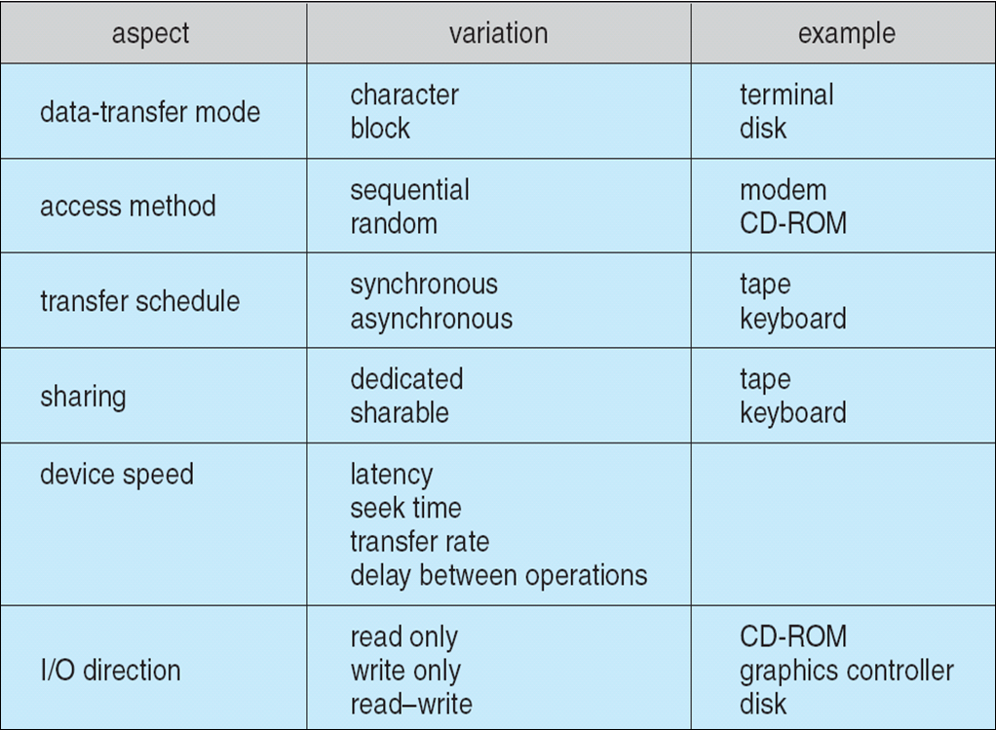
Types of I/O Devices, cont’d
Operating Systems Concepts, 9th edition
Silberschatz, Galvin, and Gagne
(c) 2013 John Wiley & Sons. All rights reserved. 978-1-118-06333-0

Slide 25
Hardware to Support I/O
Port
A connection point in the machine where a device or device cable plugs in.
Usually uses an industry-standard communications protocol.
Examples: serial port, parallel port, VGA port
Bus
A set of wires shared by multiple different devices.
Uses a rigidly defined protocol.
An expansion bus handles slow devices.
Example: PCI, SCSI

Slide 26
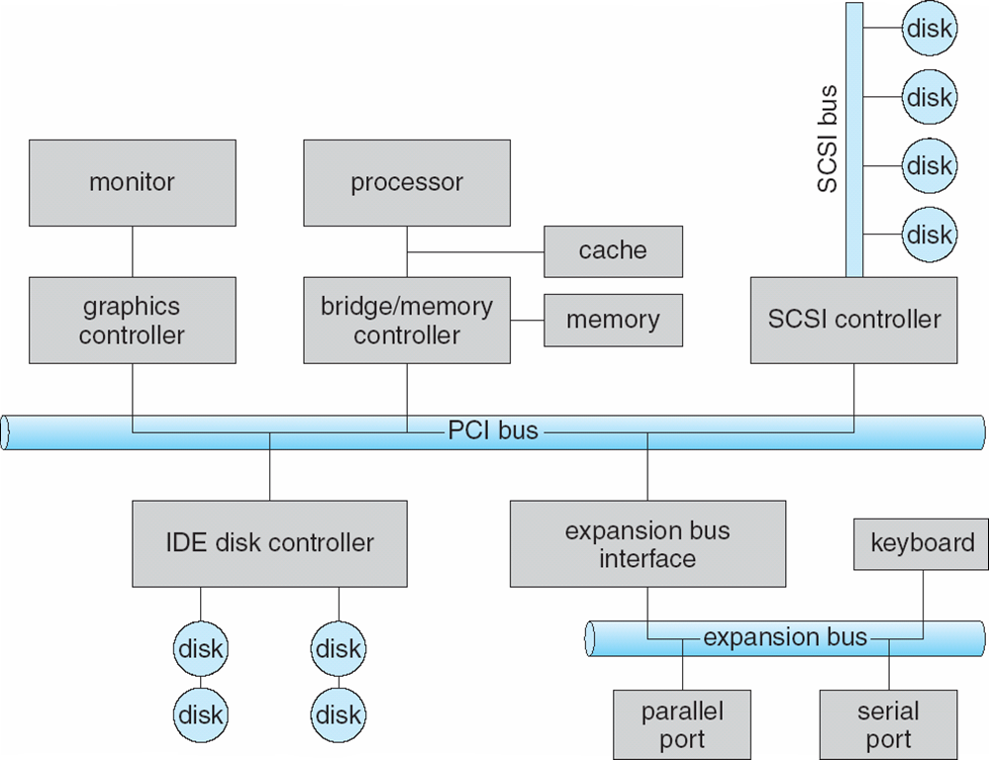
Typical Computer Bus Architecture
Operating Systems Concepts, 9th edition
Silberschatz, Galvin, and Gagne
(c) 2013 John Wiley & Sons. All rights reserved. 978-1-118-06333-0

Slide 27
Device Controllers
A separate hardware unit that interfaces with an I/O device.
A more modular and general machine design.
AKA device adapter
Typically a separate printed circuit card plugged into the system mother board.
A cable leads from the card to the device.
One controller can handle multiple identical devices.

Slide 28
Device Controllers, cont’d
Often uses an industry standard interface.
ANSI, IEEE, or ISO standard.
Example: Disk controllers use the IDE (Integrated Drive Electronics) or SCSI (Small Computer System Interface) standards.

Slide 29
Device Controllers, cont’d
Device controllers typically have built-in control registers and data buffers to use during I/O operations.
Each control register has a port number.
Special I/O instructions can read from such a port: or write to such a port:
IN REG,PORT
OUT PORT,REG

Slide 30
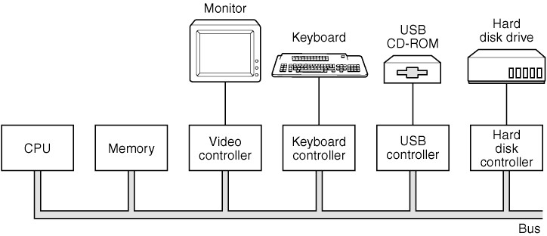
Device Controllers, cont’d
Modern Operating Systems, 3rd ed.
Andrew Tanenbaum
(c) 2008 Prentice-Hall, Inc.. 0-13-600663-9
All rights reserved

Slide 31
Memory-Mapped I/O
A device controller’s I/O registers can be part of the address space for main memory.
Each register is assigned a unique memory address.
Such addresses are not used by normal memory operations.
Whenever a process wants to read from memory, it puts the memory address out onto the system bus.
If the address is that of an I/O register, the corresponding device goes to get the data.
Otherwise, it’s a normal read from main memory.

Slide 32
Memory-Mapped I/O, cont’d
A hybrid scheme
Memory-mapped data buffers.
Separate I/O ports for control registers.
Example: Intel Pentium

Slide 33
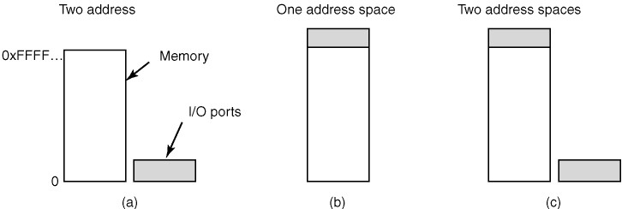
Memory-Mapped I/O
(a) Separate I/O and memory space. (b) Memory-mapped I/O.
(c) Hybrid.
Modern Operating Systems, 3rd ed.
Andrew Tanenbaum
(c) 2008 Prentice-Hall, Inc.. 0-13-600663-9
All rights reserved

Slide 34
Direct Memory Access (DMA)
Requires a DMA controller.
The DMA controller can be used by multiple I/O devices.
Regulates concurrent data transfers.
The controller accesses the system bus independently of the CPU.

Slide 35
Direct Memory Access (DMA), cont’d
The CPU can access the controller’s registers.
memory address register
byte count register
control registers
The DMA controller handles I/O upon instruction from the CPU.
Works in parallel with the CPU.

Slide 36
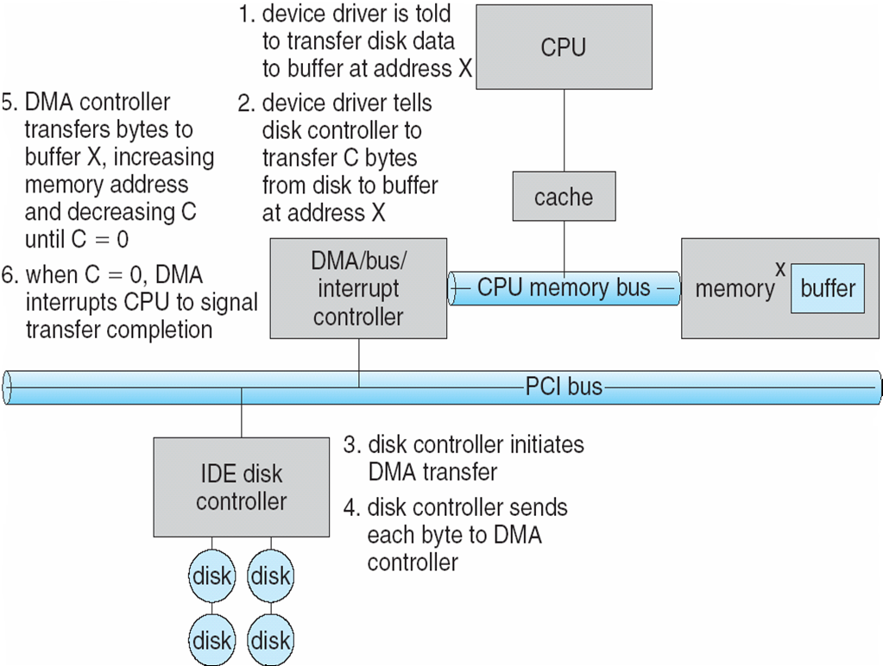
DMA Example: Data Read
Operating Systems Concepts, 9th edition
Silberschatz, Galvin, and Gagne
(c) 2013 John Wiley & Sons. All rights reserved. 978-1-118-06333-0

Slide 37
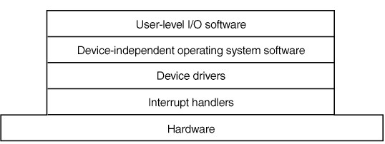
I/O Software Layers
Layers of the I/O software system:
Modern Operating Systems, 3rd ed.
Andrew Tanenbaum
(c) 2008 Prentice-Hall, Inc.. 0-13-600663-9
All rights reserved

Slide 38
Device Drivers
Device drivers are lower-level system software.
File systems deal with abstract block devices.
Provide uniform device access by the OS kernel to the I/O subsystem.
New devices are being invented all the time.
No hope of using the these devices without standard device driver interfaces.
Analogous to the OS system calls which provide a standard interface between applications and the OS.

Slide 39
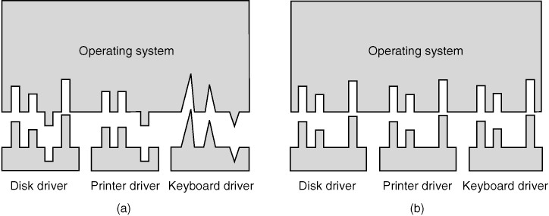
Device Drivers
Without a standard driver interface.
With a standard driver interface.
Modern Operating Systems, 3rd ed.
Andrew Tanenbaum
(c) 2008 Prentice-Hall, Inc.. 0-13-600663-9
All rights reserved

Slide 40
Device-Independent Software
Most I/O software is device-independent.
The remaining is device-specific.
Perform I/O operations that are common to all devices.
Provide a uniform interface to user-level applications software.
Operations that can be done in the device-independent layer may actually be done instead by a device driver.
More efficient, perhaps?

Slide 41
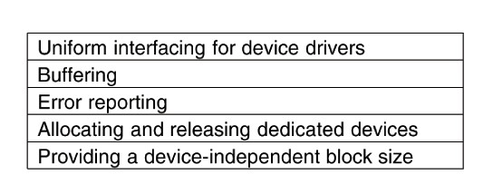
Device-Independent Software, cont’d
Functions of the device-independent I/O software.

Slide 42
I/O Interrupts
An I/O device triggers the CPU’s interrupt-request line.
An interrupt handler receives interrupts.
Some interrupts can are maskable to ignore or delay the interrupts.
Other interrupts are nonmaskable.
An interrupt vector dispatches the interrupt to the correct interrupt handler.
Based on priority.

Slide 43
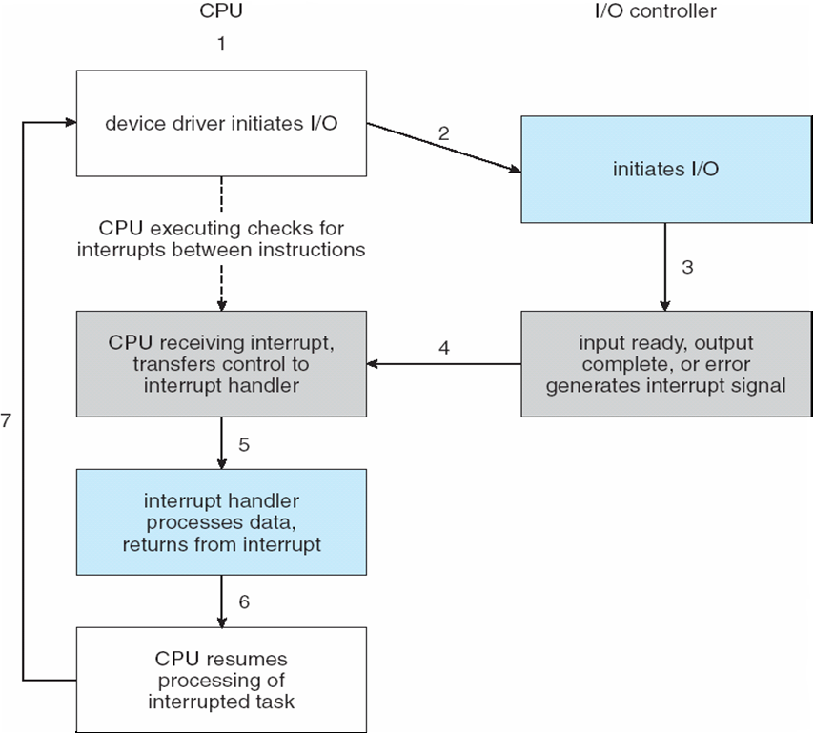
I/O Interrupts
Operating Systems Concepts, 9th edition
Silberschatz, Galvin, and Gagne
(c) 2013 John Wiley & Sons. All rights reserved. 978-1-118-06333-0

Slide 44
Synchronous I/O Operations
Synchronous (AKA blocking)
Perform I/O synchronized with the process.
The process waits for the I/O operation to complete.
Predictable response times.
Insufficient for some needs.

Slide 45
Asynchronous I/O Operations
Asynchronous (AKA nonblocking)
Requires multithreading.
Perform I/O not synchronized with the process.
After initiating an I/O operation, a process continues without waiting for completion.
The process receives an interrupt at an unpredictable time when the I/O operation completes.
Irregular or unpredictable response times.

Slide 46
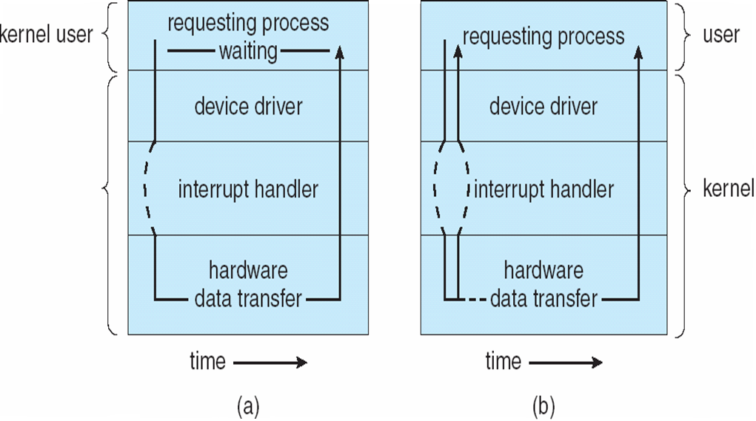
Types of I/O Operations
Synchronous
Asynchronous
Operating Systems Concepts, 9th edition
Silberschatz, Galvin, and Gagne
(c) 2013 John Wiley & Sons. All rights reserved. 978-1-118-06333-0

Slide 47
Kernel I/O Subsystem
Scheduling
Some I/O request ordering via per-device queues.
The OS attempts fairness.
Buffering
Store data in memory while transferring between devices.
Cope with device speed mismatch.
Cope with device transfer size mismatch.

Slide 48
Kernel I/O Subsystem, cont’d
Caching
Fast memory holding copy of data.
Always just a copy.
Key to performance.
Spooling
Hold output for a device if the device can serve only one request at a time.
Example: printing

Slide 49
Kernel I/O Subsystem, cont’d
Device reservation
Provide exclusive access to a device.
System calls for allocation and deallocation.
Watch out for deadlocks!

Slide 50
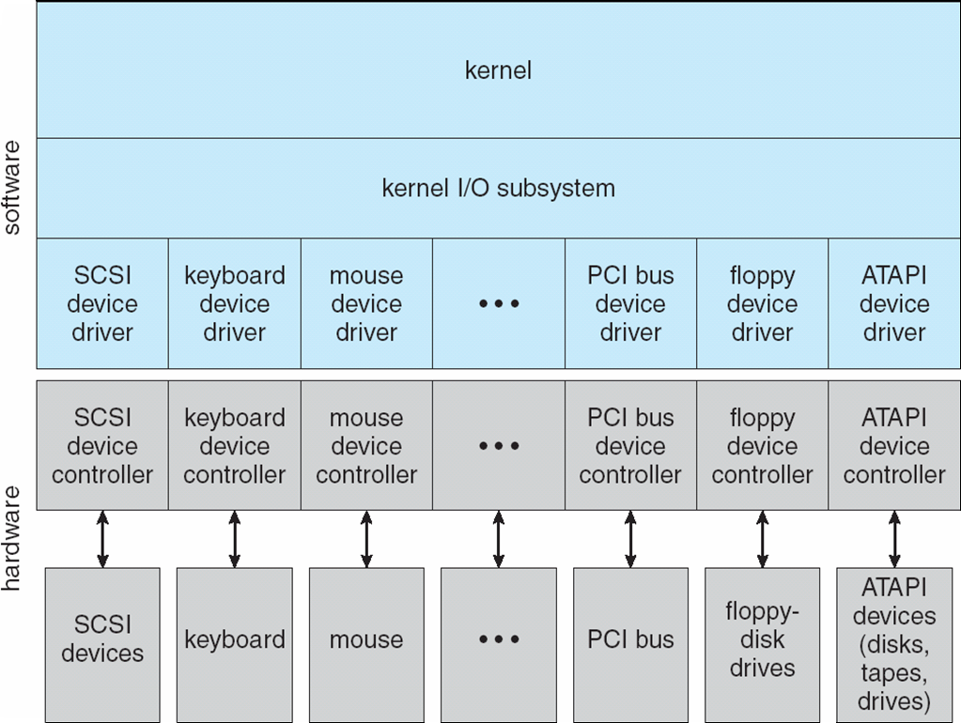
Kernel I/O Subsystem
Operating Systems Concepts, 9th edition
Silberschatz, Galvin, and Gagne
(c) 2013 John Wiley & Sons. All rights reserved. 978-1-118-06333-0

