Slide 1
CS 149: Operating Systems February 10 Class Meeting
Department of Computer Science San Jose State University Spring 2015 Instructor: Ron Mak
www.cs.sjsu.edu/~mak

Slide 2
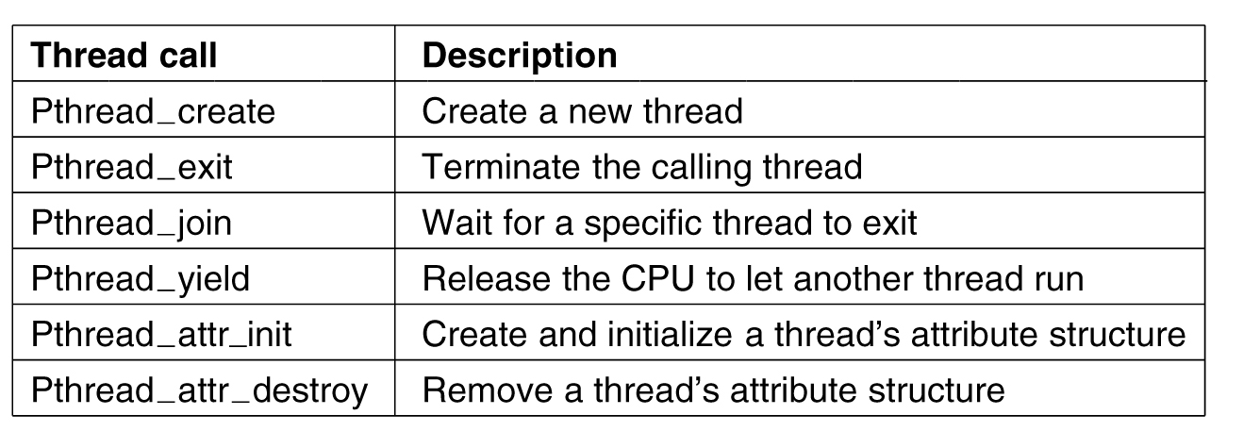
POSIX Threads
The POSIX standard for threads is implemented by the Pthreads package.
Actually, the PThreads function names are all in lower case: pthread_create, pthread_exit, pthread_attr_init, etc.
Modern Operating Systems, 3rd ed.
Andrew Tanenbaum
(c) 2008 Prentice-Hall, Inc.. 0-13-600663-9
All rights reserved

Slide 3
Thread Code Example: Parent
#include <stdio.h>
#include <stdlib.h>
#include <string.h>
#include <pthread.h>
char *greeting; // shared data
void *runner(void *parm); // the thread
int main(int argc, char *argv[])
{
pthread_t tid;
pthread_attr_t attr;
printf("Parent: Creating child thread.\n");
pthread_attr_init(&attr);
pthread_create(&tid, &attr, runner, argv[1]);
printf("Parent: Waiting for child to complete.\n");
pthread_join(tid, NULL);
printf("Parent: Child has completed, set greeting '%s'.\n", greeting);
printf("Parent: Terminating.\n");
exit(0);
}
threadtest.c
Pointer greeting is shared
by the parent and child thread.
Parent code.

Slide 4
Thread Code Example: Child
void *runner(void *parm)
{
printf("Child: Started with parm '%s'.\n", parm);
printf("Child: Creating greeting ... ");
greeting = malloc(strlen(parm) + 8);
sprintf(greeting, "Hello, %s!", parm);
printf("done!\n");
printf("Child: Terminating.\n");
pthread_exit(0);
}
Child thread.
Compile and link: gcc –pthread –o threadtest threadtest.c
Demo

Slide 5
Interprocess Communication
Processes within a system may be independent or cooperating.
A cooperating process can affect or be affected by other executing processes.
An independent process cannot affect or be affected by other executing processes.
Reasons for processes to cooperate:
Information sharing
Computation speedup
Modularity
Convenience

Slide 6
Interprocess Communication, cont’d
Interprocess communication (IPC)
Needed by cooperating processes.
Exchange data and information.
Two models of IPC:
Shared memory
Message passing

Slide 7
Interprocess Communication, cont’d
Message passing
Shared memory
Operating Systems Concepts, 9th edition
Silberschatz, Galvin, and Gagne
(c) 2013 John Wiley & Sons. All rights reserved.
978-1-118-06333-0

Slide 8
IPC: Shared Memory
Establish a shared-memory region.
Once established, all accesses to the region are treated the same as regular memory accesses.
No OS kernel intervention required to communicate.
Allows maximum speed and convenience.
Faster than message passing.
A shared-memory region typically resides in the address space of the process that created it.
Any other process that wishes to communicate using this region must attach the region to its address space.

Slide 9
IPC: Shared Memory, cont’d
With shared memory, cooperating processes:
Agree to override the protection mechanisms of the OS that prevent one process from addressing another process’s memory.
Exchange data by reading and writing in the shared-memory region.
Cooperating processes must arrange among themselves not to step on each other.
Don’t write simultaneously to the same location.

Slide 10
Shared Memory: Producer-Consumer
A “producer” process can pass data to a “consumer” process using shared memory.
Use the POSIX API for shared memory.
This API organizes shared memory as memory-mapped files, which associate the shared-memory region with a file.
The shared memory region must have a name.
It must be linked against librt real-time library using the gcc flag -lrt

Slide 11
Shared Memory: Producer
#include <stdio.h>
#include <stdlib.h>
#include <string.h>
#include <fcntl.h>
#include <sys/mman.h>
#include <sys/stat.h>
int main(int argc, char *args[])
{
const int SIZE = 4096; // size of shared memory object
const char *NAME = "OS"; // name of shared memory object
int shm_fd; // shared memory file descriptor
void *ptr; // pointer to shared memory object
// Create shared memory object and configure its size.
shm_fd = shm_open(NAME, O_CREAT | O_RDWR, 0666);
ftruncate(shm_fd, SIZE);
// Memory map the shared memory object.
ptr = mmap(0, SIZE, PROT_WRITE, MAP_SHARED, shm_fd, 0);
// Write to the shared memory object.
sprintf(ptr, "%s", args[1]);
return 0;
}
producer.c
Compile: gcc –lrt –o producer producer.c

Slide 12
Shared Memory: Consumer
#include <stdio.h>
#include <stdlib.h>
#include <string.h>
#include <fcntl.h>
#include <sys/mman.h>
#include <sys/stat.h>
int main()
{
const int SIZE = 4096; // size of shared memory object
const char *NAME = "OS"; // name of shared memory object
int shm_fd; // shared memory file descriptor
void *ptr; // pointer to shared memory object
// Open the shared memory object.
shm_fd = shm_open(NAME, O_RDONLY, 0666);
// Memory map the shared memory object.
ptr = mmap(0, SIZE, PROT_READ, MAP_SHARED, shm_fd, 0);
// Read from the shared memory object and then remove it.
printf("%s\n", (char *) ptr);
shm_unlink(NAME);
return 0;
}
consumer.c
Compile: gcc –lrt –o consumer consumer.c

Slide 13
Shared Memory: Producer-Consumer, cont’d
A more general producer-consumer model:
The producer process repeatedly adds data to the shared memory.
The consumer process repeatedly retrieves data from the shared memory.
Both processes run concurrently.
In order for this to work, both processes must be synchronized.
What could happen if they’re not synchronized?

Slide 14
Interprocess Communication, cont’d
Message passing
Shared memory
Operating Systems Concepts, 9th edition
Silberschatz, Galvin, and Gagne
(c) 2013 John Wiley & Sons. All rights reserved.
978-1-118-06333-0

Slide 15
IPC: Message Passing
Useful for exchanging small amounts of data.
Easier to implement than shared memory.
No conflicts involving one process stepping on the other.
Slower than shared memory.
Implemented with system calls.
Requires OS kernel intervention.

Slide 16
IPC: Message Passing, cont’d
Cooperating processes can communicate and synchronize their actions without sharing the same address space.
No shared memory regions.
Particularly useful in a distributed environment.
Communicating processes do not necessarily have to know where the other processes reside.

Slide 17
IPC: Message Passing, cont’d
Messages can be fixed or variable length.
Fixed length: Easier system-level implementation, but makes programming more difficult.
Variable length: Harder system-level implementation, but simpler programming.

Slide 18
Message Passing: Direct Communication
Cooperating processes must be able to refer to each other by their names.
The processes must establish a communications link.
Capacity?
Unidirectional? Bidirectional?

Slide 19
Message Passing: Direct Communication, cont’d
Send and receive primitives:
send(P, message) sends a message to process P.
receive(Q, message) receives a message from process Q.
receive(id, message) receives a message from any process, as identified by the process id.

Slide 20
Message Passing: Indirect Communication
Send and receive messages from mailboxes or ports shared by cooperating processes.
Send and receive primitives:
send(A, message) sends a message to mailbox A.
receive(A, message) receives a message from mailbox A.

Slide 21
Message Synchronization
Message passing may be blocking or nonblocking, AKA synchronous and asynchronous, respectively.

Slide 22
Message Synchronization, cont’d
Blocking send
The sending process is blocked until the message is received.
Nonblocking send
The sending process sends the message and continues operating.
Blocking receive
The receiver blocks until a message is available.
Nonblocking receive
The receive either retrieves a message or a null.

Slide 23
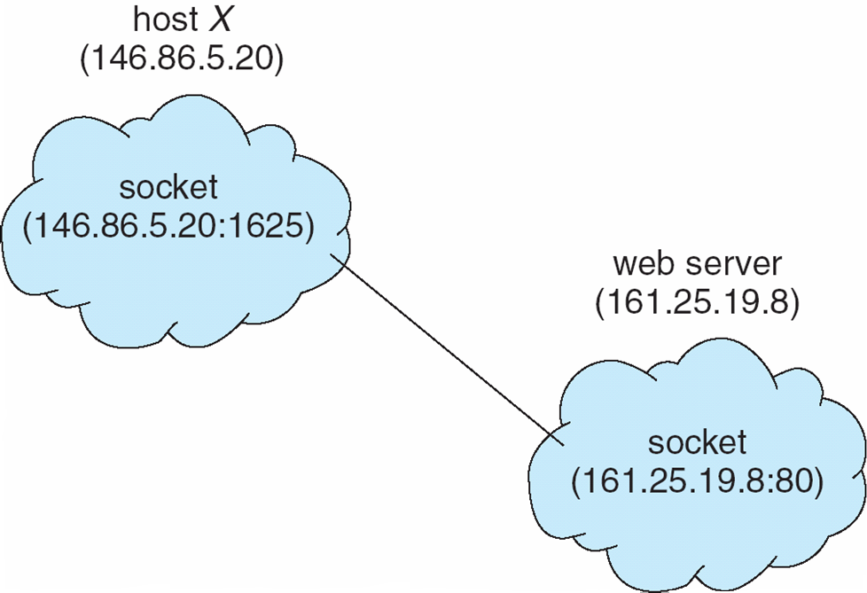
Client-Server Communications: Sockets
A socket is a communications endpoint.
Two processes can communicate over a network using a pair of sockets, one per process.
A socket has an IP address and a port number.
Silberschatz, Galvin, and Gagne
Operating Systems Concepts, 8th edition
(c) 2012 John Wiley & Sons. All rights reserved.
978-1-118-11273-1

Slide 24
Client-Server Communications: RPC
Remote Procedure Calls (RPC) abstract procedure calls between processes on networked systems.
Stub: Client-side proxy for the actual procedure that resides on the server.
The client-side stub locates the server and marshals the parameters.
Convert the parameter values to a form that can be transmitted over the network.

Slide 25
Client-Server Communications: RPC
The server-side skeleton receives this message, unmarshals the parameters, and performs the procedure on the server.

Slide 26
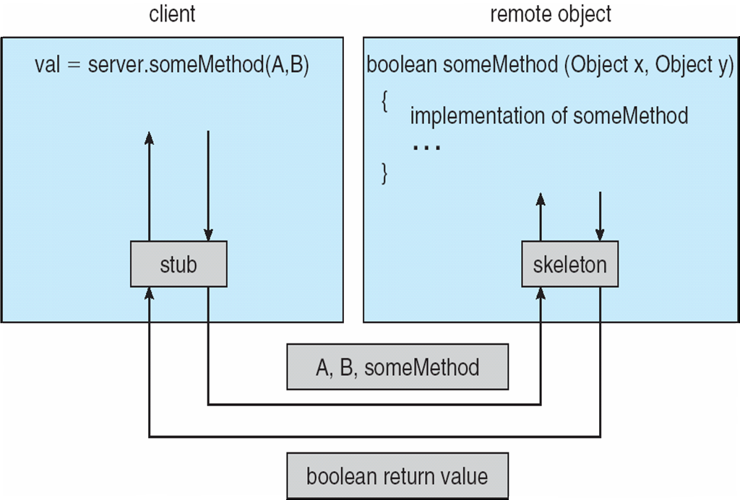
Remote Procedure Calls, cont’d
Marshalling and unmarshalling
Silberschatz, Galvin, and Gagne
Operating Systems Concepts, 8th edition
(c) 2012 John Wiley & Sons. All rights reserved.
978-1-118-11273-1

Slide 27
Client-Server Communications: Pipes
Pipes are communications conduits for cooperating processes.
A pipe is a special type of file accessed using ordinary read() and write() system calls.
Typically, a parent process creates a pipe and then forks a child process.
The parent process makes the pipe available to the child process to use in order to communicate with the child.

Slide 28
UNIX Pipe Example
Create an ordinary pipe using the system call pipe(int fd[]) where fd is an array of two file descriptors.
fd[0]: File descriptor of the read end of the pipe
fd[1]: File descriptor of the write end of the pipe
Pipe
Parent
x
fd[1] write
fd[0] read
Not used
Not used
x
fd[1] write
fd[0] read
Child

Slide 29
Pipe: Example C Code
#include <stdio.h>
#include <unistd.h>
#include <sys/types.h>
#include <string.h>
#define BUFFER_SIZE 25
#define READ_END 0
#define WRITE_END 1
int main(void)
{
char write_msg[BUFFER_SIZE] = "Hello, my child";
char read_msg[BUFFER_SIZE];
pid_t pid; // child process id
int fd[2]; // file descriptors for the pipe
if (pipe(fd) == -1) {
fprintf(stderr,"Pipe failed");
return 1;
}
...
}
pipe.c
Compile: gcc –o pipe pipe.c
Create the pipe.

Slide 30
Pipe: Example C Code, cont’d
int main(void)
{
...
pid = fork();
if (pid > 0) {
// Close the unused READ end of the pipe.
close(fd[READ_END]);
// Write to the WRITE end of the pipe.
write(fd[WRITE_END], write_msg, strlen(write_msg)+1);
printf("Parent: Wrote '%s' to the pipe.\n", write_msg);
// Close the WRITE end of the pipe.
close(fd[WRITE_END]);
}
...
}
Parent process

Slide 31
Pipe: Example C Code, cont’d
if (pid > 0) {
...
}
else if (pid == 0) {
// Close the unused WRITE end of the pipe.
close(fd[WRITE_END]);
// Read from the READ end of the pipe.
read(fd[READ_END], read_msg, BUFFER_SIZE);
printf("Child: Read '%s' from the pipe.\n", read_msg);
// Close the READ end of the pipe.
close(fd[READ_END]);
}
...
return 0;
}
Child process
Demo

Slide 32
Process Synchronization
Multiple cooperating processes executing concurrently must synchronize their operations.
Share information.
Shared memory or message passing.
Don’t step on each other.
Example: Don’t have multiple processes simultaneously modify the same memory location.

Slide 33
Process Synchronization, cont’d
Properly sequence their operations.
One process depends on another.
Example: Process B depends on output generated by Process A. Therefore, Process B must wait until Process A has produced its output.

Slide 34
Race Condition
A race condition occurs when
Multiple processes access and modify some shared data.
The final result depends on the order that the processes modified the data.
A very bad situation!
Results are often unpredictable and unrepeatable.
Extremely hard to debug.
Must avoid!

Slide 35
Race Condition Example
Suppose variable count is shared by two processes.
count++ can be implemented as:
register1 ⬅ count
register1 ⬅ register1 + 1
count ⬅ register1
count-- can be implemented as:
register2 ⬅ count
register2 ⬅ register2 – 1
count ⬅ register2
Suppose the value of count is 5 and that process P1 executes count++ at the same time that process P2 executes count--.

Slide 36
Race Condition Example, cont’d
count++
register1 ⬅ count
register1 ⬅ register1 + 1
count ⬅ register1
count--
register2 ⬅ count
register2 ⬅ register2 – 1
count ⬅ register2
Process | Operation | Result
P1 | register1 ⬅ count | register1 = 5
P1 | register1 ⬅ register1 + 1 | register1 = 6
P2 | register2 ⬅ count | register2 = 5
P2 | register2 ⬅ register2 - 1 | register2 = 4
P1 | count ⬅ register1 | count = 6
P2 | count ⬅ register2 | count = 4
Whether the value of count ends up as 4 or 6 depends on the order of execution of the last two instructions.

Slide 37
Mutual Exclusion
One way to avoid race conditions is to prevent more than one process from reading and writing the shared data at the same time.
This is called mutual exclusion.
Operating systems provide different primitives to enforce mutual exclusion.

Slide 38
Critical Region
A critical region (AKA critical section) is the part of a process’s code that operates on some shared data.
NOTE: A critical region is code, not data.
We must prevent two processes from being in their critical regions for the same shared data at the same time.

Slide 39
To Prevent Race Conditions
Mutual exclusion: No two processes may be simultaneously inside their critical regions for the same shared data.
Progress: No process running outside its critical region may block other processes.
Bounded waiting: No process should have to wait forever to enter its critical region.

Slide 40
To Prevent Race Conditions, cont’d
When a process is in its critical region, other processes must be blocked from entering their critical regions.
No assumptions may be made about the number of CPUs or their speeds.

Slide 41
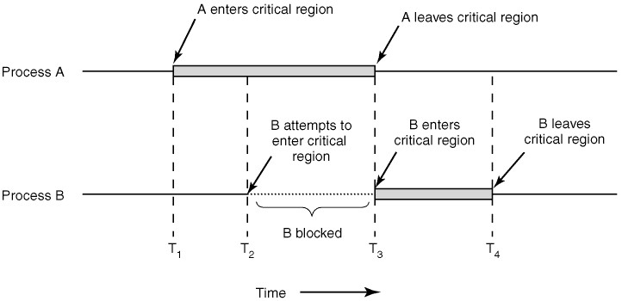
Critical Region, cont’d
Modern Operating Systems, 3rd ed.
Andrew Tanenbaum
(c) 2008 Prentice-Hall, Inc.. 0-13-600663-9
All rights reserved

Slide 42
Critical Region vs. Shared Memory
Do not confuse critical region with the shared data.
Two (or more) processes can share a piece of data.
The code in a process that accesses that shared data is that process’s critical region with respect to that shared data.

Slide 43
Critical Region, cont’d
The code in the critical region of each process can be different from the code in the critical region of another process.
What the code in the critical regions have in common is that they access the same shared piece of data.
Another piece of shared data would be associated with another set of critical regions within the processes that access that data.

