Slide 1
CS 144 Advanced C++ Programming April 25 Class Meeting
Department of Computer Engineering San Jose State University Spring 2019 Instructor: Ron Mak
www.cs.sjsu.edu/~mak

Slide 2
Assignment #11
Please note the corrections, as announced yesterday by email.
New CodeCheck URL.
Comparisons of all three sets of statistics from the STL vector, STL list, and STL map.

Slide 3
Unofficial Field Trip
Computer History Museum in Mt. View
http://www.computerhistory.org/
Provide your own transportation to the museum.
Saturday, May 4, 11:30 – closing time
Special free admission.
We will meet in the lobby. No backpacks.
Experience a fully restored IBM 1401 mainframe computer from the early 1960s in operation.
Do a self-guided tour of the Revolution exhibit.

Slide 4
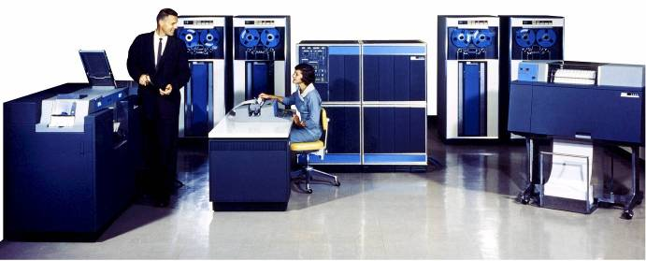
Unofficial Field Trip, cont’d
IBM 1401 computer, fully restored and operational.
A small transistor-based mainframe computer.
Extremely popular with small businesses in the late 1950s through the mid 1960s
Maximum of 16K bytes of memory
800 card/minute punched card reader (reads holes with wire brushes)
600 line/minute line printer (impact)
6 magnetic tape drives, no disk drives

Slide 5
Unofficial Field Trip, cont’d
Information on the IBM 1401:
General info: http://en.wikipedia.org/wiki/IBM_1401
My summer seminar: http://www.cs.sjsu.edu/~mak/1401/
Restoration: http://ed-thelen.org/1401Project/1401RestorationPage.html

Slide 6
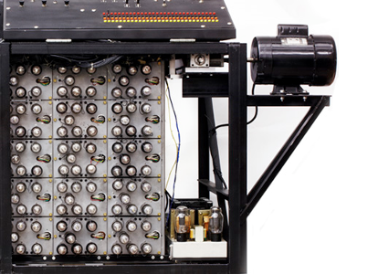
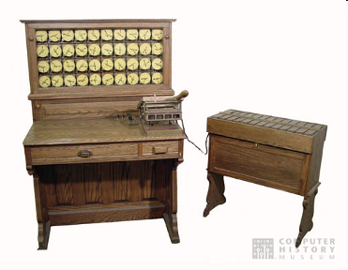
Unofficial Field Trip, cont’d
See the extensive Revolution exhibit!
Walk through a timeline of the First 2000 Years of Computing History.
Historic computer systems, data processing equipment, and other artifacts.
Small theater presentations.
Hollerith
Census
Machine
Atanasoff-Berry
Computer

Slide 7
Hash Tables
Consider an array or a vector.
To access a value, you use an integer index.
The array maps the index to a data value stored in the array.
The mapping function is very efficient.
As long as the index value is within range, there is a strict one-to-one correspondence between an index value and a stored data value.
We can consider the index value to be the key to the corresponding data value.

Slide 8
Hash Tables, cont’d
A hash table also stores data values.
Use a key to obtain the corresponding data value.
The key does not have to be an integer value.
For example, the key could be a string.
There might not be a one-to-one correspondence between keys and data values.
The mapping function might not be trivial.

Slide 9
The STL map Template Class
The C++ Standard Template Library (STL) provides the map template class.
Hides its implementation from programmers.
Two datatype parameters, one for the keys and one for the associated values.
Example: Variable birthdays is a map where the keys are strings (such as persons’ names) and the values are Birthday objects.
#include <map>
...
map<string, Birthday> birthdays;

Slide 10
The STL map Template Class, cont’d
An overloaded subscript operator []:
If the subscript operator refers to a nonexistent key ("Jim"), an entry will be made with that key and the value’s default constructor.
MapTest.cpp
birthdays["Ron"] = Birthday(1983, 7, 12);
birthdays["Bob"] = Birthday(1997, 3, 25);
birthdays["Sal"] = Birthday(1985, 8, 10);
cout << "Some birthdays:" << endl;
cout << " Ron's birthday is " << birthdays["Ron"] << endl;
cout << " Jim's birthday is " << birthdays["Jim"] << endl;
cout << " Sal's birthday is " << birthdays["Sal"] << endl;
Some birthdays:
Ron's birthday is 7/12/1983
Jim's birthday is 0/0/0
Sal's birthday is 8/10/1985

Slide 11
The STL map Template Class, cont’d
You can use the at() member function instead of the subscript operator.
If a key doesn’t exist, at() will throw an out_of_range exception.
try
{
cout << " Bob's birthday is " << birthdays.at("Bob") << endl;
cout << " Tom's birthday is " << birthdays.at("Tom") << endl;
cout << " Sal's birthday is " << birthdays.at("Sal") << endl;
}
catch (const out_of_range& ex)
{
cout << endl << endl << "***** STL map out of range error: "
<< ex.what() << endl << endl;
}
Bob's birthday is 3/25/1997
Tom's birthday is
***** STL map out of range error: map::at: key not found

Slide 12
The STL map Template Class, cont’d
Use the insert() member function.
Entries of a map are pair<key, value> objects.
cout << endl << "Inserting Ada's birthday:" << endl;
auto adas_pair = pair<string, Birthday>("Ada", Birthday(1815, 12, 10));
birthdays.insert(adas_pair);
cout << " Ada's birthday is " << birthdays["Ada"] << endl;
Inserting Ada's birthday:
Ada's birthday is 12/10/1815

Slide 13
The STL map Template Class, cont’d
Member function insert() will not insert an element if the key already exists in the map.
The existing entry in the map is unaffected.
cout << endl << "Inserting Ron's birthday again:" << endl;
cout << " Ron's birthday is " << birthdays["Ron"] << endl;
Birthday rons_new_bd = Birthday(1900, 12, 18);
auto rons_pair = pair<string, Birthday>("Ron", rons_new_bd);
birthdays.insert(rons_pair);
cout << " Ron's birthday is " << birthdays["Ron"] << endl;
Inserting Ron's birthday again:
Ron's birthday is 7/12/1983
Ron's birthday is 7/12/1983

Slide 14
The STL map Template Class, cont’d
The STL map has forward and reverse iterators.
Iterate over the pairs in the map.
The pairs are ordered by their keys.
Use pair member variables first and second.
cout << endl << "Iterating over the birthdays:" << endl;
for (auto it = birthdays.begin(); it != birthdays.end(); it++)
{
cout << " " << it->first << ": " << it->second << endl;
}
cout << "There are " << birthdays.size() << " birthdays." << endl;
Iterating over the birthdays:
Ada: 12/10/1815
Bob: 3/25/1997
Jim: 0/0/0
Ron: 7/12/1983
Sal: 8/10/1985
There are 5 birthdays.

Slide 15
The STL map Template Class, cont’d
Erase an element (remove it from the map).
Position an iterator to the element.
cout << endl << "Erase Bob's birthday:" << endl;
auto it = birthdays.find("Bob");
birthdays.erase(it);
if (birthdays.find("Bob") == birthdays.end())
{
cout << " Bob's birthday is now unknown." << endl;
}
else
{
cout << " Bob's birthday is " << birthdays["Bob"] << endl;
}
Erase Bob's birthday:
Bob's birthday is now unknown.

Slide 16
The STL map Template Class, cont’d
Count how many entries have a given key.
Since the entries of a map must have unique keys, the count is always either 0 or 1.
For the STL or any other C++ APIs, visit http://www.cplusplus.com/
cout << endl << "How many birthday entries:" << endl;
cout << " Ron: " << birthdays.count("Ron") << endl;
cout << " Bob: " << birthdays.count("Bob") << endl;
How many birthday entries:
Ron: 1
Bob: 0

Slide 17
Quiz
Quiz 5 – 2019 Apr 25
20 questions
20 minutes

Slide 18
STL Algorithms
Besides template classes, the STL also contains some useful algorithms.
random_shuffle
AlgorithmsTest.cpp
vector<int> v;
cout << "Original vector:" << endl;
for (int i = 0; i < 10; i++) v.push_back(10*i);
print(v);
cout << endl << "Randomly shuffled vector:" << endl;
random_shuffle(v.begin(), v.end());
print(v);
Original vector:
0 10 20 30 40 50 60 70 80 90
Randomly shuffled vector:
60 0 30 50 70 80 40 10 20 90

Slide 19
STL Algorithms, cont’d
sort
reverse
cout << endl << "Sorted vector:" << endl;
sort(v.begin(), v.end());
print(v);
Sorted vector:
0 10 20 30 40 50 60 70 80 90
cout << endl << "Reversed vector:" << endl;
reverse(v.begin(), v.end());
print(v);
Reversed vector:
90 80 70 60 50 40 30 20 10 0

Slide 20
STL Algorithms
for_each
The third parameter is a function that operates on each element of the container.
You can pass a lambda expression.
cout << endl << "Use for_each with a lambda expression:" << endl;
for_each(birthdays.begin(), birthdays.end(),
[] (pair<string, Birthday> p)
{
cout << " " << p.first << ": " << p.second << endl;
});
MapTest.cpp
Use for_each with a lambda expression:
Ada: 12/10/1815
Jim: 0/0/0
Ron: 7/12/1983
Sal: 8/10/1985

