Slide 1
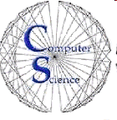
CS 144 Advanced C++ Programming March 26 Class Meeting
Department of Computer Engineering San Jose State University Spring 2019 Instructor: Ron Mak
www.cs.sjsu.edu/~mak

Slide 2
Java Interfaces
Java uses an interface to define a totally abstract class.
It cannot be instantiated.
A Java interface declares methods but does not implement them.
A Java class that implements an interface must then either implement the interface’s methods, or have them implemented by subclasses.

Slide 3
Java Interface Example
public interface Animal
{
String identify();
String speak();
String go();
}
public class Bird implements Animal
{
@Override
public String identify()
{
return "bird";
}
@Override
public String speak()
{
return "Chirp!";
}
@Override
public String go()
{
return "Fly!";
}
}
@Override is optional.

Slide 4
Java Interface Example, cont’d
public interface Animal
{
String identify();
String speak();
String go();
}
public class Cat implements Animal
{
@Override
public String identify()
{
return "cat";
}
@Override
public String speak()
{
return "Meow!";
}
@Override
public String go()
{
return "Run!";
}
}

Slide 5
Java Interface Example, cont’d
public class AnimalTester
{
public static void main(String args[])
{
Animal cat = new Cat();
print(cat);
Animal bird = new Bird();
print(bird);
}
private static void print(Animal anim)
{
System.out.println();
System.out.printf("I'm a %s!\n", anim.identify());
System.out.printf("Speaking: %s\n", anim.speak());
System.out.printf("Going: %s\n", anim.go());
}
}
public interface Animal
{
String identify();
String speak();
String go();
}
I'm a cat!
Speaking: Meow!
Going: Run!
I'm a bird!
Speaking: Chirp!
Going: Fly!

Slide 6
C++ Interfaces
C++ does not have an explicit interface construct as does Java.
In C++, the equivalent to a Java interface is a pure abstract class.
It cannot be instantiated.
Each member function of a pure abstract class must be a pure virtual function.
Each pure virtual member function must be defined in a subclass of the abstract class.

Slide 7
C++ Pure Abstract Class Example
class Animal
{
public:
virtual string identify() const = 0;
virtual string speak() const = 0;
virtual string go() const = 0;
};
#include "Animal.h"
using namespace std;
class Bird : public Animal
{
public:
string identify() const override { return "bird"; }
string speak() const override { return "Chirp!"; }
string go() const override { return "Fly!"; }
};
override is optional.

Slide 8
C++ Pure Abstract Class Example, cont’d
class Animal
{
public:
virtual string identify() const = 0;
virtual string speak() const = 0;
virtual string go() const = 0;
};
#include "Animal.h"
using namespace std;
class Cat : public Animal
{
public:
string identify() const override { return "cat"; }
string speak() const override { return "Meow!"; }
string go() const override { return "Run!"; }
};

Slide 9
C++ Pure Abstract Class Example, cont’d
#include "Animal.h"
#include "Bird.h"
#include "Cat.h"
using namespace std;
void print(Animal *ptr);
int main()
{
Animal *cat = new Cat();
print(cat);
Animal *bird = new Bird();
print(bird);
return 0;
}
class Animal
{
public:
virtual string identify() const = 0;
virtual string speak() const = 0;
virtual string go() const = 0;
};
I'm a cat
Speaking: Meow!
Going: Run!
I'm a bird
Speaking: Chirp!
Going: Fly!
void print(Animal *ptr)
{
cout << endl;
cout << "I'm a " << ptr->identify() << endl;
cout << "Speaking: " << ptr->speak() << endl;
cout << "Going: " << ptr->go() << endl;
}

Slide 10
Principle of Coding to the Interface
#include "Animal.h"
#include "Bird.h"
#include "Cat.h"
using namespace std;
void print(Animal *ptr);
int main()
{
Animal *cat = new Cat();
print(cat);
Animal *bird = new Bird();
print(bird);
return 0;
}
class Animal
{
public:
virtual string identify() const = 0;
virtual string speak() const = 0;
virtual string go() const = 0;
};
Note the Principle of Coding to the Interface.
Increases flexibility.
void print(Animal *ptr)
{
cout << endl;
cout << "I'm a " << ptr->identify() << endl;
cout << "Speaking: " << ptr->speak() << endl;
cout << "Going: " << ptr->go() << endl;
}

Slide 11
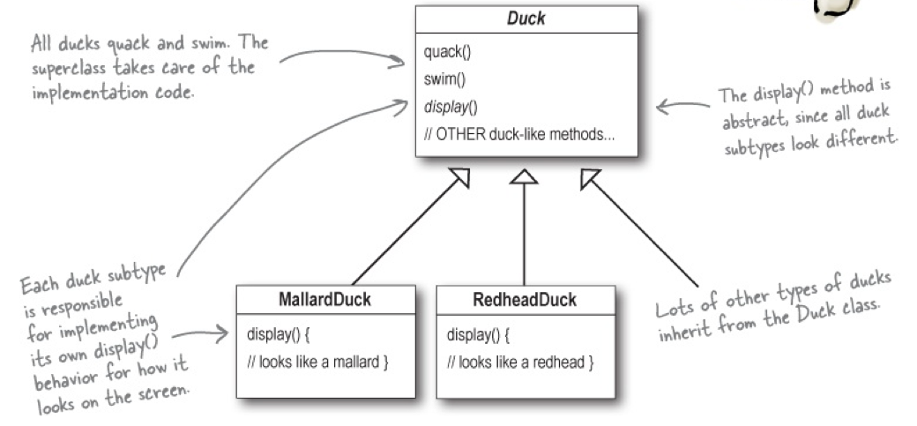
SimUDuck Simulation Game
Use object-oriented design techniques to create a duck simulation game.
Head First Design Patterns
by Eric & Elisabeth Freeman
O’Reilly, 2004

Slide 12
SimUDuck Simulation Game, cont’d
We need to make the ducks fly.
Head First Design Patterns
by Eric & Elisabeth Freeman
O’Reilly, 2004

Slide 13
Something Went Wrong
Head First Design Patterns
by Eric & Elisabeth Freeman
O’Reilly, 2004

Slide 14
Joe Thinks about Inheritance
Head First Design Patterns
by Eric & Elisabeth Freeman
O’Reilly, 2004

Slide 15
What about Interfaces?
Head First Design Patterns
by Eric & Elisabeth Freeman
O’Reilly, 2004

Slide 16
What about Interfaces? cont’d
Head First Design Patterns
by Eric & Elisabeth Freeman
O’Reilly, 2004

Slide 17
What about Interfaces? cont’d
Head First Design Patterns
by Eric & Elisabeth Freeman
O’Reilly, 2004

Slide 18
Encapsulate What Varies
Head First Design Patterns
by Eric & Elisabeth Freeman
O’Reilly, 2004

Slide 19
Design the Duck Behaviors
In C++, an interface is a superclass,
which is often (but not necessarily) abstract.
Head First Design Patterns
by Eric & Elisabeth Freeman
O’Reilly, 2004

Slide 20
Implement the Duck Behaviors
Head First Design Patterns
by Eric & Elisabeth Freeman
O’Reilly, 2004

Slide 21
Code Reuse
With this design, other types of objects can reuse our fly and quack behaviors because these behaviors are no longer hidden away in our Duck classes.
We can add new behaviors without modifying any of our existing behavior classes or touching any of the Duck classes that use flying behaviors.
So we get the benefit of reuse without all the baggage that comes along with inheritance.

Slide 22
Delegate Duck Behaviors
A Duck can delegate its flying and quacking behavior, instead of using quacking and flying member functions defined in the Duck class or in the subclasses.

Slide 23
Delegate Duck Behaviors, cont’d
Head First Design Patterns
by Eric & Elisabeth Freeman
O’Reilly, 2004

Slide 24
Fly Behaviors
FlyBehavior.h
class FlyBehavior
{
public:
virtual ~FlyBehavior() {}
virtual void fly() = 0;
};
The interface
Fly.h
#include "FlyBehavior.h"
class Fly : public FlyBehavior
{
public:
void fly() { cout << " I can fly!" << endl; }
};
class NoFly : public FlyBehavior
{
public:
void fly() { cout << " I can't fly!" << endl; }
};
Specific
implementations

Slide 25
Quack Behaviors
QuackBehavior.h
class QuackBehavior
{
public:
virtual ~QuackBehavior() {}
virtual void quack() = 0;
};
The interface
Quack.h
#include "QuackBehavior.h"
class Quack : public QuackBehavior
{
public:
void quack() { cout << " Quack!" << endl; }
};
class Squeak : public QuackBehavior
{
public:
void quack() { cout << " Squeak!" << endl; }
};
class Mute : public QuackBehavior
{
public:
void quack() { /* silent */ }
};
Specific
implementations

Slide 26
The Abstract Duck Superclass
Duck.h
#include "QuackBehavior.h"
#include "FlyBehavior.h"
class Duck
{
public:
virtual ~Duck() {}
void perform_quack() { quack_behavior->quack(); }
void perform_fly() { fly_behavior->fly(); }
virtual void identify() = 0;
protected:
QuackBehavior *quack_behavior;
FlyBehavior *fly_behavior;
};
The interface
for a duck
Quacking is delegated to
the QuackBehavior object.
Flying is delegated to
the FlyBehavior object.

Slide 27
Create Ducks
#include "Duck.h"
#include "Quack.h"
#include "Fly.h"
class MallardDuck : public Duck
{
public:
MallardDuck()
{
quack_behavior = new Quack();
fly_behavior = new Fly();
}
void identify() { cout << "Mallard duck" << endl; }
};
class RubberDuck : public Duck
{
public:
RubberDuck()
{
quack_behavior = new Squeak();
fly_behavior = new NoFly();
}
void identify() { cout << "Rubber duck" << endl; }
};
DuckTypes.h
Specific duck
implementations

Slide 28
Test Ducks
DuckTest.cpp
#include "DuckTypes.h"
int main()
{
MallardDuck *mallard = new MallardDuck();
RubberDuck *rubber = new RubberDuck();
mallard->identify();
mallard->perform_quack();
mallard->perform_fly();
cout << endl;
rubber->identify();
rubber->perform_quack();
rubber->perform_fly();
return 0;
}
Set behavior
at run time.
Mallard duck
Quack!
I can fly!
Rubber duck
Squeak!
I can't fly!
Set behavior
at run time.

Slide 29
The Big Picture on Encapsulated Behaviors
Head First Design Patterns
by Eric & Elisabeth Freeman
O’Reilly, 2004

Slide 30
“Has a” is Often Better Than “Is a”
Design principle:
Composition is more flexible.
A duck is composed of quack and fly behaviors.
You can set and change behavior at run time.
Favor composition over inheritance.
“has a”
“is a”

Slide 31
Assignment #8. Install wxWidgets
See the useful tutorials at http://www.cs.sjsu.edu/~mak/tutorials/index.html
Install the VirtualBox virtual machine manager.
Install the Ubuntu OS in a virtual machine.
Give the virtual machine at least 32 GB of disk space.
Give the virtual machine at least 4 GB of memory, but not more than half of your physical memory.
Install wxWidgets on Ubuntu.

Slide 32
Assignment #8, cont’d
After you’ve successfully built and installed wxWidgets:
Go into the gtk-build/samples directory.
Try to make some of the sample program, especially program “minimum”.
Make sample program widgets.
Submit to Canvas a screenshots of the minimum and widgets sample programs running on Ubuntu.
Due Tuesday, April 9 at 8:30 AM.

Slide 33
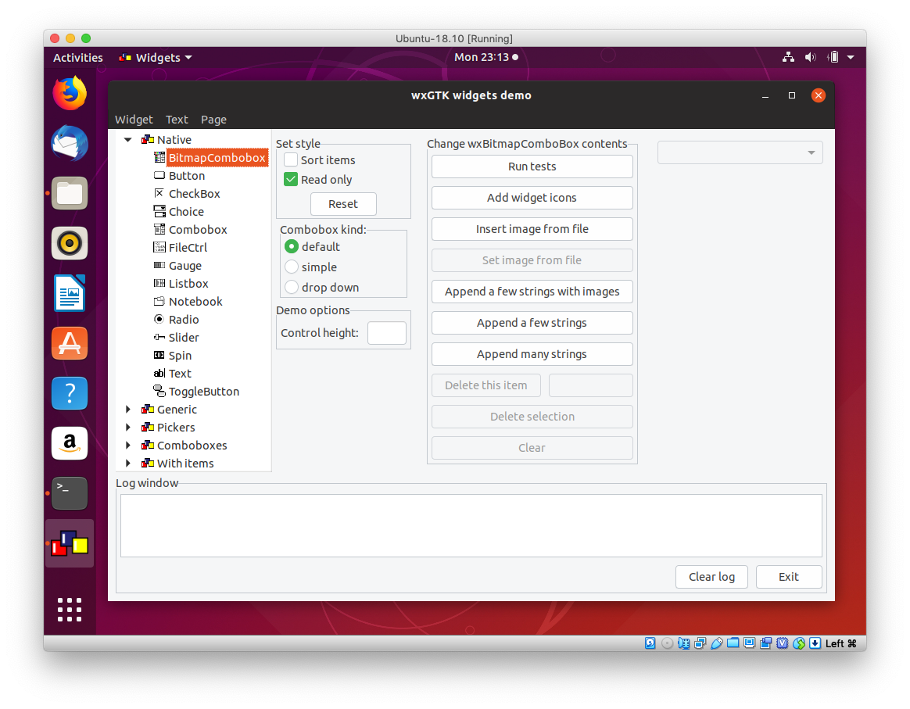
Assignment #8, cont’d

