Slide 1
CMPE 280 Web UI Design and Development April 21 Class Meeting
Department of Computer Engineering San Jose State University Spring 2020 Instructor: Ron Mak
www.cs.sjsu.edu/~mak

Slide 2
Presentation Schedule
Tuesday, Apr. 28
WELL
GoBully
Front Enders
Thursday, Apr. 30
The Impact
Akali
Backup
Tuesday, May 5
Seekers
Immortal
Minions
Thursday, May 7
Simpsons
Formation
BruteForce
Think Tanks

Slide 3
AngularJS Filters
Filter | Function
currency | Format a number to a currency format.
date | Format a date to a specified format.
filter | Select a subset of items from an array.
json | Format an object to a JSON string.
limitTo | Limits an array/string to a specified number of elements/characters.
lowercase | Format a string to lower case.
number | Format a number to a string.
orderBy | Orders an array by an expression.
uppercase | Format a string to upper case.

Slide 4
AngularJS Filters, cont’d
FilterUpperCase.html
<head>
<script src="https://ajax.googleapis.com/.../angular.min.js">
</script>
<script src="PersonController.js"></script>
<script>
angular.module('myApp', [])
.controller('personCtrl', function($scope)
{
$scope.firstName = "John",
$scope.lastName = "Doe"
});
</script>
</head>
<body>
<div ng-app="myApp" ng-controller="personCtrl">
<h2>The name is {{ lastName | uppercase }}</h2>
</div>
</body>

Slide 5
AngularJS Filters, cont’d
<head>
<script src="https://ajax.googleapis.com/.../angular.min.js">
</script>
<script>
angular.module('myApp', [])
.controller('namesCtrl', function($scope)
{
$scope.names = [
{name:'Jani',country:'Norway'},
{name:'Carl',country:'Sweden'},
{name:'Margareth',country:'England'},
{name:'Hege',country:'Norway'},
{name:'Joe',country:'Denmark'},
{name:'Gustav',country:'Sweden'},
{name:'Birgit',country:'Denmark'},
{name:'Mary',country:'England'},
{name:'Kai',country:'Norway'}
];
});
</script>
</head>
FilterPipe.html

Slide 6
AngularJS Filters, cont’d
FilterPipe.html
<body>
<div ng-app="myApp" ng-controller="namesCtrl">
<h1>Sorted by country</h1>
<table border='1'>
<tr>
<th>Name</th>
<th>Country</th>
</tr>
<tr ng-repeat="x in names | orderBy:'country'">
<td> {{ x.name }} </td>
<td> {{ x.country }} </td>
</tr>
</table>
</div>
</body>

Slide 7
Services
AngularJS has around 30 built-in services.
A service is a function, or object that is available for, and limited to, your AngularJS application.

Slide 8
Location Service
ServiceLocation.html
<head>
<script src="https://ajax.googleapis.com/.../angular.min.js">
</script>
<script>
var app = angular.module('myApp', []);
app.controller('myCtrl', function($scope, $location)
{
$scope.myUrl = $location.absUrl();
});
</script>
</head>
<body>
<div ng-app="myApp" ng-controller="myCtrl">
<h1>The url of this page is:</h1>
<h3>{{myUrl}}</h3>
</div>
<p>
This example uses the built-in $location service
to get the absolute url of the page.
</p>
</body>

Slide 9
$http Service
The service makes a request to the server.
Your application handles the response.
welcome.htm
Hello AngularJS Students

Slide 10
$http Service, cont’d
ServiceHttp.html
<head>
<script src="https://ajax.googleapis.com/.../angular.min.js">
</script>
<script>
var app = angular.module('myApp', []);
app.controller('myCtrl', function($scope, $http)
{
$http.get("welcome.htm").then(function(response)
{
$scope.myWelcome = response.data;
});
});
</script>
</head>

Slide 11
$http Service, cont’d
ServiceHttp.html
<body>
<div ng-app="myApp" ng-controller="myCtrl">
<p>Today's welcome message is:</p>
<h1>{{myWelcome}}</h1>
</div>
<p>
The $http service requests a page on the server,
and the response is set as the value of the
"myWelcome" variable.
</p>
</body>

Slide 12
AngularJS Tables
TablesStyles.css
table {
font-family: "Trebuchet MS", Arial, Helvetica, sans-serif;
}
table, th, td {
border: 1px solid grey;
border-collapse: collapse;
padding: 5px;
}
table th {
padding-top: 12px;
padding-bottom: 12px;
text-align: left;
background-color: #4CAF50;
color: white;
}
table tr:nth-child(odd) {
background-color: #f2f2f2;
}

Slide 13
AngularJS Tables, cont’d
Table.html
<head>
<link rel="stylesheet" href="TableStyles.css" />
<script src="https://ajax.googleapis.com/.../angular.min.js"></script>
<script src="PersonController.js"></script>
<script>
angular.module('myApp', [])
.controller('customersCtrl', function($scope)
{
$scope.names = [
{name:'Jani',country:'Norway'},
{name:'Carl',country:'Sweden'},
{name:'Margareth',country:'England'},
{name:'Hege',country:'Norway'},
{name:'Joe',country:'Denmark'},
{name:'Gustav',country:'Sweden'},
{name:'Birgit',country:'Denmark'},
{name:'Mary',country:'England'},
{name:'Kai',country:'Norway'}
];
});
</script>
</head>

Slide 14
AngularJS Tables, cont’d
Table.html
<body>
<div ng-app="myApp" ng-controller="customersCtrl">
<table>
<tr>
<th>Name</th>
<th>Country</th>
</tr>
<tr ng-repeat="x in names | orderBy:'country'">
<td> {{ x.name }} </td>
<td> {{ x.country }} </td>
</tr>
</table>
</div>
</body>

Slide 15
AngularJS Events
ng-blur
ng-change
ng-click
ng-copy
ng-cut
ng-dblclick
ng-focus
ng-keydown
ng-keypress
ng-keyup
ng-mousedown
ng-mouseenter
ng-mouseleave
ng-mousemove
ng-mouseover
ng-mouseup
ng-paste

Slide 16
AngularJS Events, cont’d
Events.html
<head>
<script src="https://ajax.googleapis.com/.../angular.min.js">
</script>
<script>
angular.module('myApp', [])
.controller('myCtrl', function($scope)
{
$scope.count = 0;
});
</script>
</head>
<body>
<div ng-app="myApp" ng-controller="myCtrl">
<h1 ng-mousemove="count = count + 1">Mouse over me!</h1>
<h2>{{ count }}</h2>
</div>
</body>

Slide 17
Forms: Checkbox
FormCheckbox.html
<head>
<script src="https://ajax.googleapis.com/.../angular.min.js">
</script>
</head>
<body>
<div ng-app="">
<h2>Check to see a secret message:</h2>
<form>
<input type="checkbox" ng-model="myVar">
</form>
<h1 ng-show="myVar">See this only when checked.</h1>
</div>
</body>
The ng-show attribute is true
only when the checkbox is checked.

Slide 18
Forms: Radio Buttons
<body ng-app="">
<h1>Pick a topic:</h1>
<form>
<input type="radio" ng-model="myChoice" value="dogs">Dogs
<input type="radio" ng-model="myChoice" value="cats">Cats
<input type="radio" ng-model="myChoice" value="bunnies">Bunnies
</form>
<div ng-switch="myChoice">
<div ng-switch-when="dogs">
<h1>Dogs</h1>
<h2>Welcome to a world of dogs.</h2>
</div>
<div ng-switch-when="cats">
<h1>Cats</h1>
<h2>Read about cats.</h2>
</div>
<div ng-switch-when="bunnies">
<h1>Bunnies</h1>
<h2>Bunnies are fun!</h2>
</div>
</div>
</body>
FormRadio.html

Slide 19
Forms: Selection
FormSelect.html
<body ng-app="">
<h1>Pick a topic:</h1>
<form>
<select ng-model="myChoice">
<option value="">
<option value="dogs">Dogs
<option value="cats">Cats
<option value="bunnies">Bunnies
</select>
</form>
<div ng-switch="myChoice">
<div ng-switch-when="dogs">
<h1>Dogs</h1>
<h2>Welcome to a world of dogs.</h2>
</div>
<div ng-switch-when="cats">
<h1>Cats</h1>
<h2>Read about cats.</h2>
</div>
<div ng-switch-when="bunnies">
<h1>Bunnies</h1>
<h2>Bunnies are fun!</h2>
</div>
</div>
</body>

Slide 20
Animation
To do AngularJS animation, you need the Angular animation library angular-animate.js
Download from https://code.angularjs.org/1.6.6/
Or get it from Google:
Do animated transitions using CSS styles.
<script src="https://ajax.googleapis.com/ajax/libs/angularjs/1.6.4/angular-animate.js">
</script>

Slide 21
Animation, cont’d
AnimationStyles.css
div {
font-family: "Trebuchet MS", Arial, Helvetica, sans-serif;
transition: all linear 0.5s;
background-color: lightblue;
height: 100px;
width: 100%;
position: relative;
top: 0;
left: 0;
}
.ng-hide {
height: 0;
width: 0;
background-color: transparent;
top:-200px;
left: 200px;
}

Slide 22
Animation, cont’d
Animation.html
<head>
<link rel="stylesheet" href="AnimationStyles.css" />
<script src="https://ajax.googleapis.com/ ... /angular.min.js">
</script>
<script src="https://ajax.googleapis.com/ ... /angular-animate.js">
</script>
<script>
var app = angular.module('myApp', ['ngAnimate']);
</script>
</head>
<body ng-app="myApp">
<h2>
<label>Hide/unhide:</label>
<input type="checkbox" ng-model="myCheck">
</h2>
<div ng-hide="myCheck">
<h1>Check the box to hide or unhide me!</h1>
</div>
</body>
The module depends
on ngAnimate.

Slide 23
AngularJS Routing
AngularJS provides routing that allows a user to navigate from one web page to another in the browser, without accessing the server.
This enables your web app to be a single-page application (SPA).
Use the ngRoute module to route to different pages without reloading pages.

Slide 24
AngularJS Routing, cont’d
To do AngularJS routing, you must include the AngularJS Route module angular-route.js.
Download from https://code.angularjs.org/1.6.6/
Or get it from Google:
Your app module must depend on ngRoute:
<script src="https://ajax.googleapis.com/ajax/libs/angularjs/1.6.4/angular-route.js">
</script>
angular.module("myApp", ["ngRoute"]);

Slide 25
AngularJS Routing, cont’d
Use the $routeProvider to configure different routes in your application.
You can define what page to display when a user clicks a link.
The ng-view directive provides a container for the content provided by the routing.
Your app can have only one ng-view directive.
This will be the placeholder for all views provided by the route.

Slide 26
AngularJS Routing, cont’d
Routing1.html
<head>
<script src="https://ajax.googleapis.com/ ... /angular.min.js"></script>
<script src="https://ajax.googleapis.com/ ... /angular-route.js"></script>
<script>
var app = angular.module("myApp", ["ngRoute"]);
app.config(function($routeProvider)
{
$routeProvider
.when("/", {
templateUrl : "main.htm"
})
.when("/london", {
templateUrl : "london.htm"
})
.when("/paris", {
templateUrl : "paris.htm"
});
});
</script>
</head>
The module depends
on ngRoute.

Slide 27
AngularJS Routing, cont’d
Routing1.html
<body ng-app="myApp">
<p><a href="#/!">Main</a></p>
<a href="#!london">London</a>
<a href="#!paris">Paris</a>
<p>Click on the links to read about London and Paris.</p>
<div ng-view></div>
</body>

Slide 28
AngularJS Routing, cont’d
<h1>Main</h1>
main.htm
<h1>London</h1>
<h3>London is the capital city of England.</h3>
<p>
It is the most populous city in the United Kingdom,
with a metropolitan area of over 13 million inhabitants.
</p>
<p>{{msg}}</p>
london.htm
<h1>Paris</h1>
<h3>Paris is the capital of France.</h3>
<p>
The Paris area is one of the largest population centers
in Europe, with more than 12 million inhabitants.
</p>
<p>{{msg}}</p>
paris.htm

Slide 29
AngularJS Routing, cont’d
Use the templateUrl property on the $routeProvider.when method to specify the URL of a page.
Use the template property to insert HTML directly without going to a page.
Use the otherwise property to specify a default route.
You can give each view its own controller.

Slide 30
AngularJS Routing, cont’d
Routing2.html
<script>
var app = angular.module("myApp", ["ngRoute"]);
app.config(function($routeProvider)
{
$routeProvider
.when("/", {
templateUrl : "main.htm"
})
.when("/london", {
templateUrl : "london.htm",
controller : "londonCtrl"
})
.when("/paris", {
templateUrl : "paris.htm",
controller : "parisCtrl"
});
});
app.controller("londonCtrl", function ($scope)
{
$scope.msg = "I love London!";
});
app.controller("parisCtrl", function ($scope)
{
$scope.msg = "J'aime Paris!";
});
</script>

Slide 31
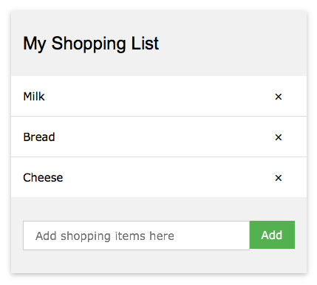
SPA Example: Shopping List
A single-page AngularJS application that manages a shopping list.
Add new items to the list.
Don’t allow duplicate items.
Remove items from the list.

Slide 32
SPA Example: Shopping List, cont’d
angular.module("myShoppingList", [])
.controller("myCtrl", function($scope)
{
// Initial list of items.
$scope.products = ["Milk", "Bread", "Cheese"];
$scope.addItem = function()
{
$scope.errortext = "";
if (!$scope.addMe) return; // add item is empty
// Add the item to the list if it's not already there.
if ($scope.products.indexOf($scope.addMe) == -1) {
$scope.products.push($scope.addMe);
}
else {
$scope.errortext =
"The item is already in your shopping list.";
}
}
ShoppingList.js

Slide 33
SPA Example: Shopping List, cont’d
$scope.removeItem = function(x)
{
$scope.errortext = "";
$scope.products.splice(x, 1);
}
});
ShoppingList.js

Slide 34
SPA Example: Shopping List, cont’d
ShoppingSPA.html
<head>
<link rel="stylesheet" href="https://www.w3schools.com/w3css/4/w3.css">
<script src="https://ajax.googleapis.com/ ... /angular.min.js"></script>
<script src="ShoppingList.js"></script>
</head>
<body>
<div ng-app="myShoppingList"
ng-cloak ng-controller="myCtrl"
class="w3-card-2 w3-margin"
style="max-width:400px;">
<header class="w3-container w3-light-grey w3-padding-16">
<h3>My Shopping List</h3>
</header>
...
</div>
</body>

Slide 35
SPA Example: Shopping List, cont’d
ShoppingSPA.html
<body>
<div ng-app="myShoppingList" ... >
...
<ul class="w3-ul">
<li ng-repeat="p in products"
class="w3-padding-16">
{{p}}
<span ng-click="removeItem($index)"
style="cursor:pointer;"
class="w3-right w3-margin-right">
×
</span>
</li>
</ul>
...
</div>
</body>
Shopping list

Slide 36
SPA Example: Shopping List, cont’d
<body>
<div ng-app="myShoppingList" ... >
...
<div class="w3-container w3-light-grey w3-padding-16">
<div class="w3-row w3-margin-top">
<div class="w3-col s10">
<input placeholder="Add shopping items here"
ng-model="addMe"
class="w3-input w3-border w3-padding">
</div>
<div class="w3-col s2">
<button ng-click="addItem()"
class="w3-btn w3-padding w3-green">
Add
</button>
</div>
</div>
<p class="w3-text-red">{{errortext}}</p>
</div>
</div>
</body>
ShoppingSPA.html
Text input for
item to add.
Green
add button.
Error message.

Slide 37
Mobile-Centric Thinking
Unique characteristics of a mobile user interface:
Small screen size (smart phone)
Touch screen
Gestures
iOS, Android, and Windows Phone have distinct design conventions.
Recommendation: Spend at least 6 weeks using each OS before starting a design.

Slide 38
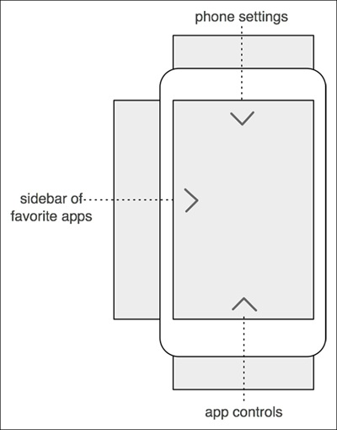
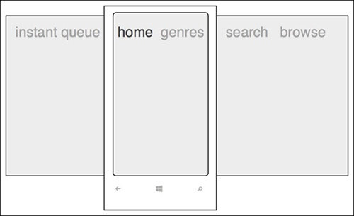
Designing with Small Screens
The screen is a window onto larger content that can’t all fit at once.
Mobile Design Pattern Gallery, 2nd ed.
by Theresa Neil
O’Reilly, 2014

Slide 39
Navigation Types
Persistent
Simple on-screen menu structures.
Used for primary navigation from one major category to another within an app.
Transient
Must be explicitly revealed with a tap or gesture.
Conserve space with a small screen size.

Slide 40
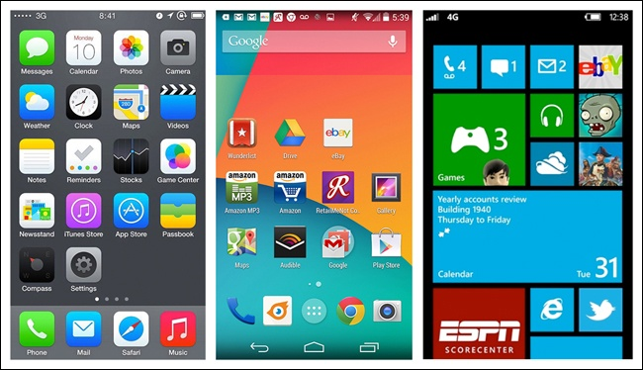
Persistent Navigation: Springboard
Combine the grid and menu page design patterns.
iOS
Android
Windows
Mobile Design Pattern Gallery, 2nd ed.
by Theresa Neil
O’Reilly, 2014

Slide 41
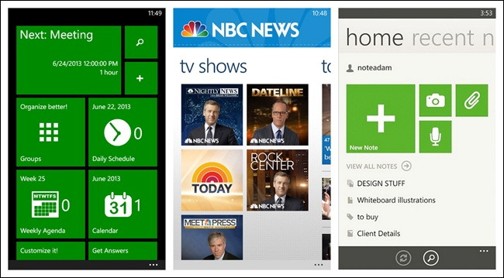
Persistent Navigation: Springboard, cont’d
Tiled menu page (Windows Phone):
CalendarPro
NBC News
Evernote
Mobile Design Pattern Gallery, 2nd ed.
by Theresa Neil
O’Reilly, 2014

Slide 42
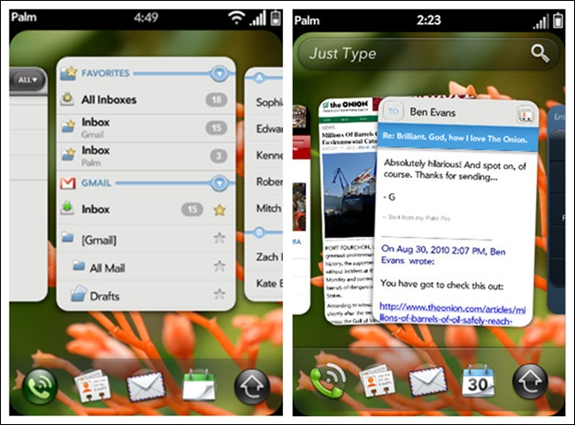
Persistent Navigation: Cards
Card deck metaphor
Stacking, shuffling, discarding, flipping, etc.
Palm webOS
Mobile Design Pattern Gallery, 2nd ed.
by Theresa Neil
O’Reilly, 2014

Slide 43
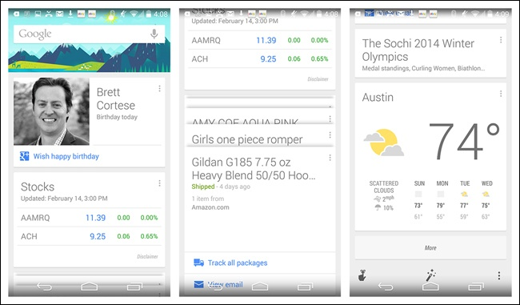
Persistent Navigation: Cards, cont’d
Cards can be used for primary navigation.
Google Now for Android
Mobile Design Pattern Gallery, 2nd ed.
by Theresa Neil
O’Reilly, 2014

Slide 44
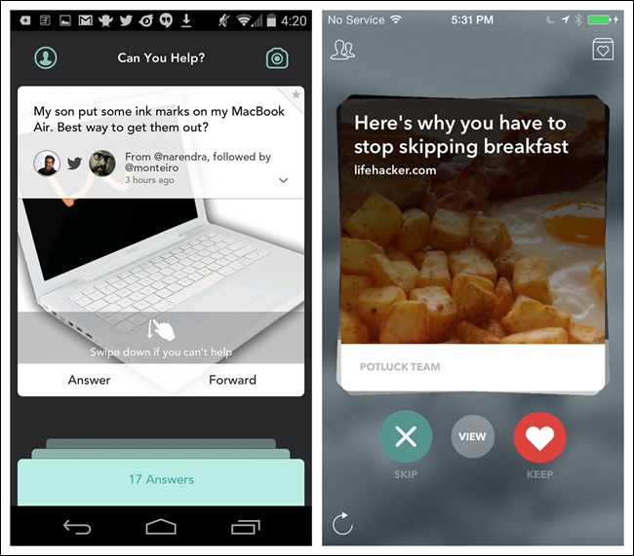
Persistent Navigation: Cards, cont’d
Swipe to move or remove cards.
Jelly
for iOS
Potluck
for iOS
Mobile Design Pattern Gallery, 2nd ed.
by Theresa Neil
O’Reilly, 2014

Slide 45
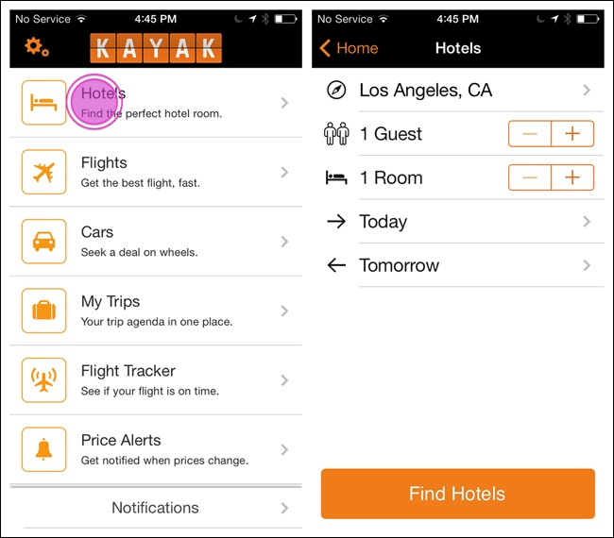
Persistent Navigation: List Menu
Can be hierarchical.
Kayak
for iOS
Mobile Design Pattern Gallery, 2nd ed.
by Theresa Neil
O’Reilly, 2014

Slide 46
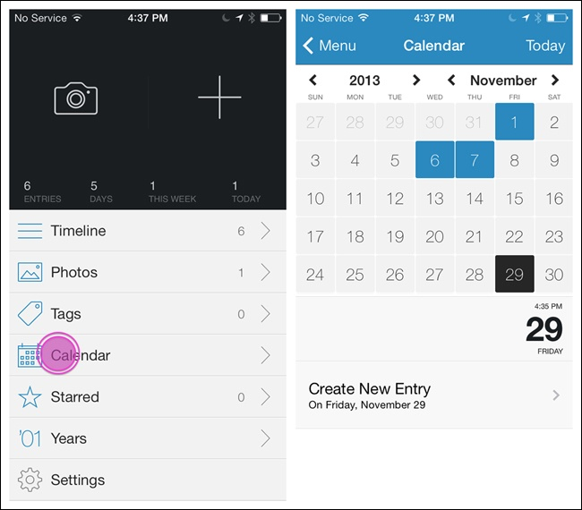
Persistent Navigation: List Menu, cont’d
Day One
for iOS
Mobile Design Pattern Gallery, 2nd ed.
by Theresa Neil
O’Reilly, 2014

Slide 47
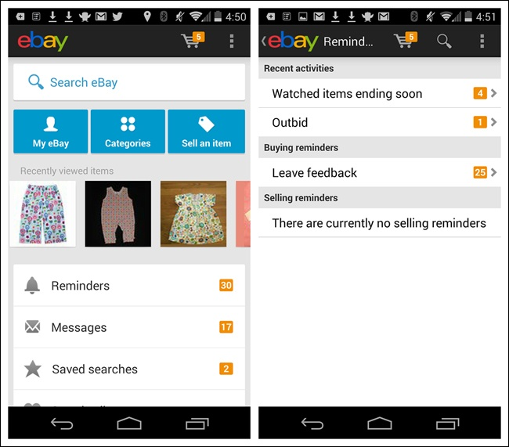
Persistent Navigation: List Menu, cont’d
Android: The “up” button is the “back” button.
Conveys hierarchy.
eBay
for Android
Mobile Design Pattern Gallery, 2nd ed.
by Theresa Neil
O’Reilly, 2014

Slide 48
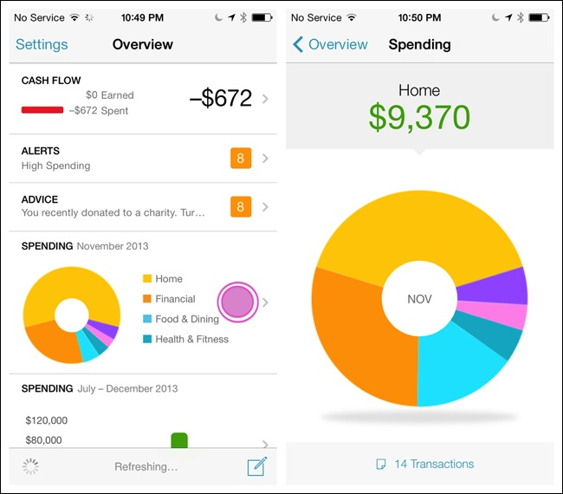
Persistent Navigation: Dashboard
A quick glance gives a snapshot of the most relevant information.
Similar to a list menu.
Mint for iOS
Mobile Design Pattern Gallery, 2nd ed.
by Theresa Neil
O’Reilly, 2014

Slide 49
Persistent Navigation: Gallery
Display live visual content.
News stories, recipes, photos, etc.
Arranged in a grid, carousel, or slideshow.
Non-hierarchical
Frequently updated.

Slide 50
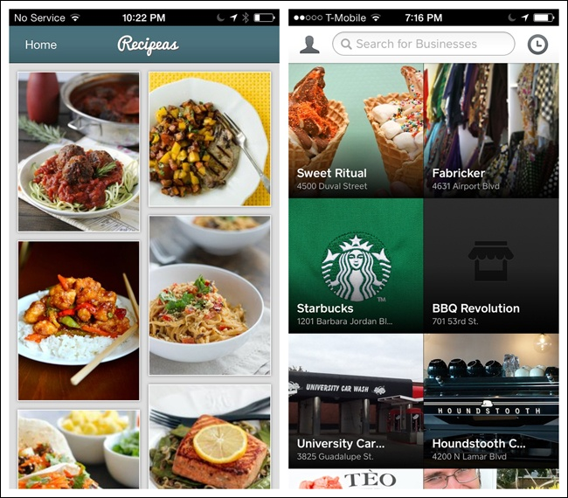
Persistent Navigation: Gallery, cont’d
Recipeas
for iOS
Square Wallet
for iOS
Mobile Design Pattern Gallery, 2nd ed.
by Theresa Neil
O’Reilly, 2014

Slide 51
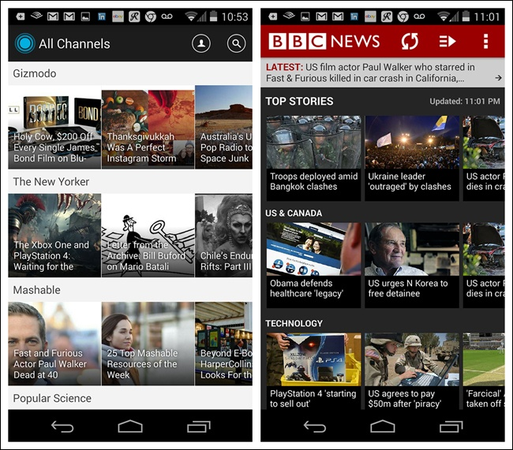
Persistent Navigation: Gallery, cont’d
Which is easier to read?
LinkedIn Pulse
for Android
BBC News
for Android
Mobile Design Pattern Gallery, 2nd ed.
by Theresa Neil
O’Reilly, 2014

Slide 52
Persistent Navigation: iOS Tab Menu
Tab bar to navigate “flat apps”.
Limited to five menu items.
“More” option as the fifth item.
“Call to action”: A highlighted menu item.
Tool bar
Presents tools or actions for a specific screen.
Mobile Design Pattern Gallery, 2nd ed.
by Theresa Neil
O’Reilly, 2014

Slide 53
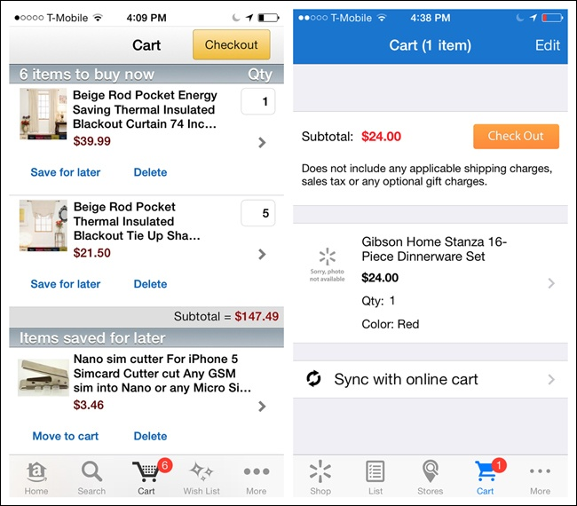
Persistent Navigation: iOS Tab Menu, cont’d
Amazon
for iOS
Walmart
for iOS
Mobile Design Pattern Gallery, 2nd ed.
by Theresa Neil
O’Reilly, 2014

Slide 54
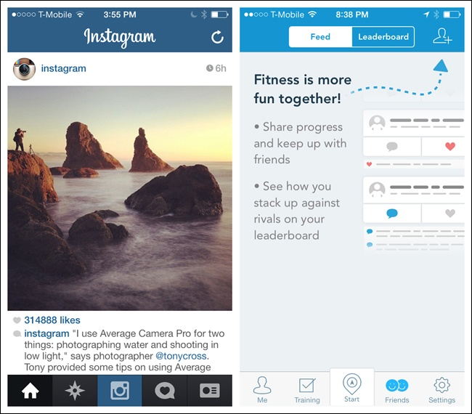
Persistent Navigation: iOS Tab Menu, cont’d
Calls to action
Instagram
for iOS
RunKeeper
for iOS
Mobile Design Pattern Gallery, 2nd ed.
by Theresa Neil
O’Reilly, 2014

Slide 55
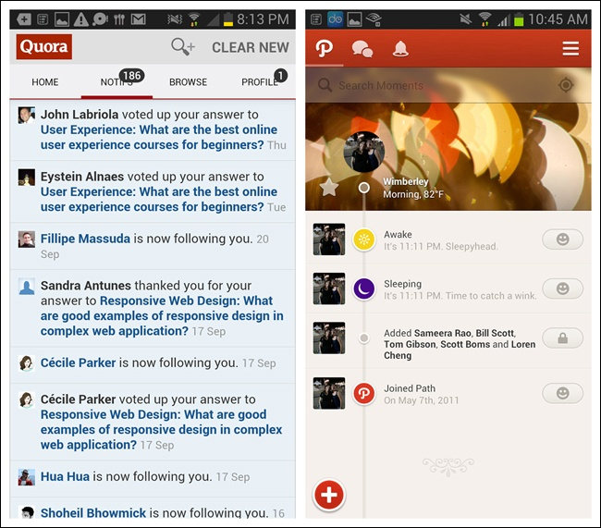
Persistent Navigation: Android Tab Menu
Fixed tabs for primary navigation
Quora
for Android
Path
for Android
Mobile Design Pattern Gallery, 2nd ed.
by Theresa Neil
O’Reilly, 2014

Slide 56
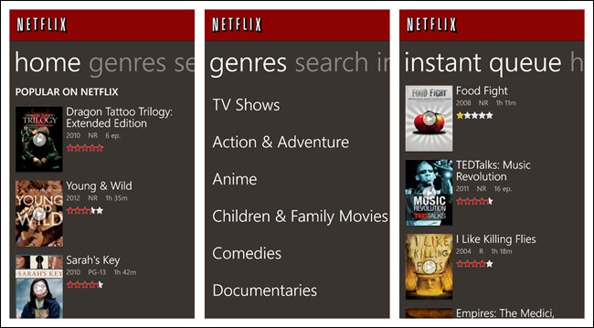
Persistent Navigation: Windows Tab Menu
App tabs pivot control
Mobile Design Pattern Gallery, 2nd ed.
by Theresa Neil
O’Reilly, 2014

Slide 57
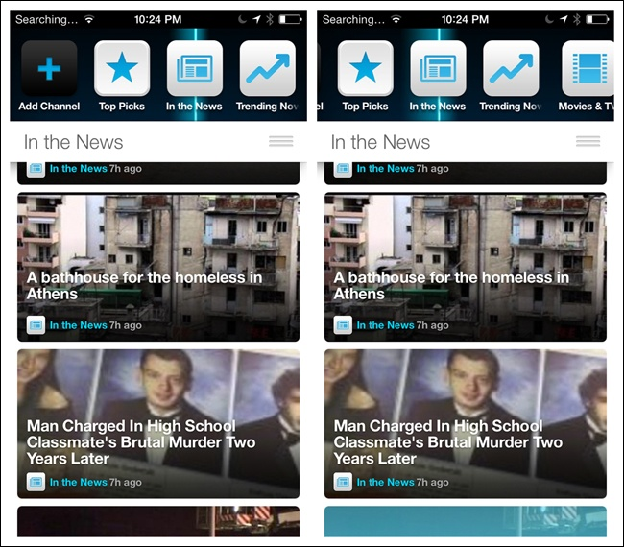
Persistent Navigation: Configurable Tabs
Users can add, delete, and rearrange tabs.
Frequency
for iOS
Mobile Design Pattern Gallery, 2nd ed.
by Theresa Neil
O’Reilly, 2014

Slide 58
Transient Navigation
Navigation menus remain hidden until the user reveals them.
Menus disappear after the user makes a selection.

Slide 59
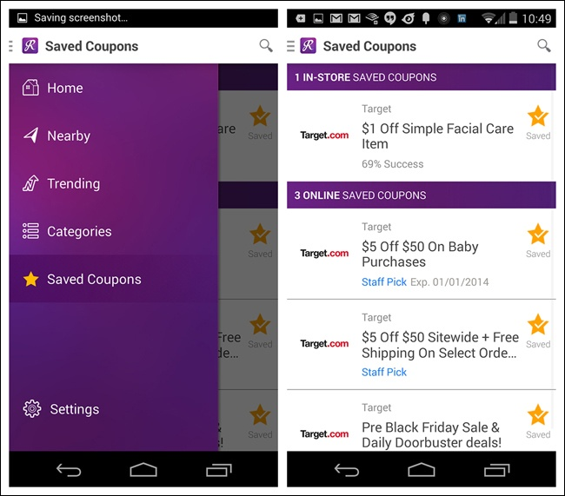
Transient Navigation: Overlay Side Drawer
A swipe or tap reveals a drawer that covers the original screen content.
RetailMeNot
for Android
Mobile Design Pattern Gallery, 2nd ed.
by Theresa Neil
O’Reilly, 2014

Slide 60
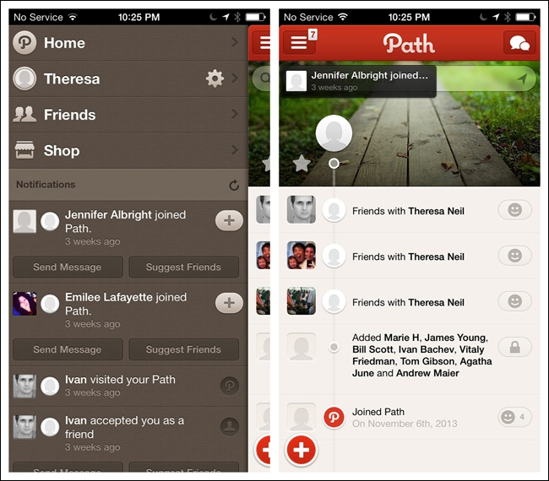
Transient Navigation: Inlay Side Drawer
A swipe or tap opens a drawer that pushes the original content partially off-screen.
Path
for iOS
Mobile Design Pattern Gallery, 2nd ed.
by Theresa Neil
O’Reilly, 2014

Slide 61
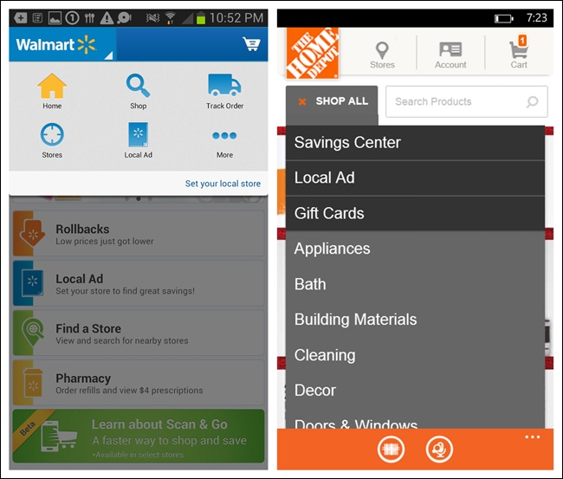
Transient Navigation: Toggle Menu
Tap to reveal the menu.
Walmart
for Android
Home Depot
for Windows Phone
Mobile Design Pattern Gallery, 2nd ed.
by Theresa Neil
O’Reilly, 2014

Slide 62
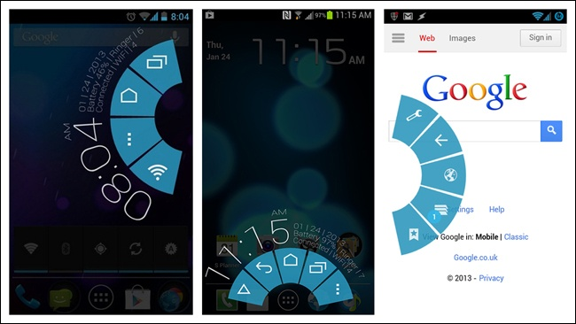
Transient Navigation: Pie Menu
Probably should be avoided.
Paranoid Android OS
Mobile Design Pattern Gallery, 2nd ed.
by Theresa Neil
O’Reilly, 2014

Slide 63
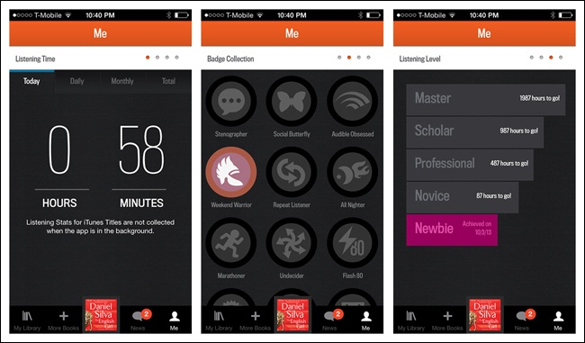
Transient Navigation: Page Swiping
Use page indicators to indicate navigation.
Audible for iOS
Mobile Design Pattern Gallery, 2nd ed.
by Theresa Neil
O’Reilly, 2014

Slide 64
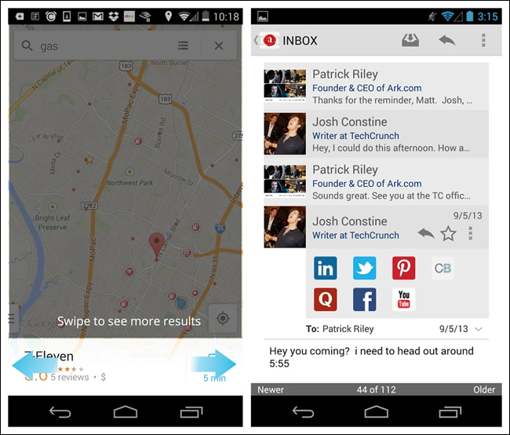
Transient Navigation: Page Swiping, cont’d
Android page indicators
Google Maps
for Android
Ark Mail
for Android
Mobile Design Pattern Gallery, 2nd ed.
by Theresa Neil
O’Reilly, 2014

Slide 65
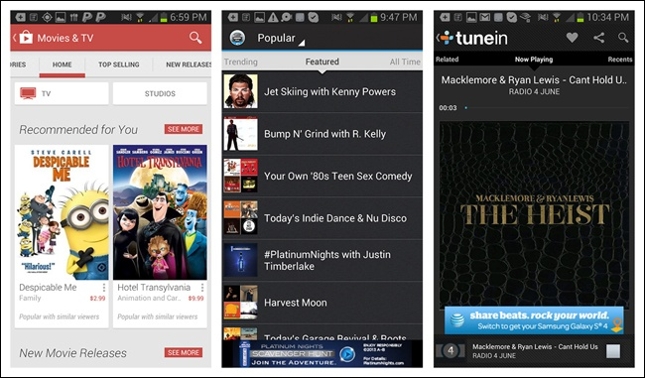
Transient Navigation: Android Scrolling Tabs
Useful to display multiple views in a module.
Often an affordance to swipe horizontally.
Google Play
Songza
TuneIn
Mobile Design Pattern Gallery, 2nd ed.
by Theresa Neil
O’Reilly, 2014

Slide 66
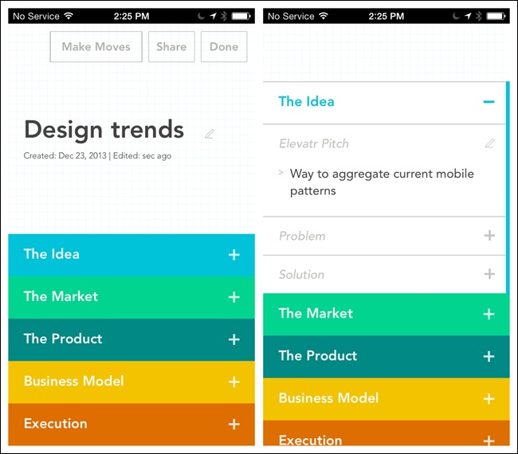
Transient Navigation: Accordion
See more information on the same screen.
Elevator
for iOS
Mobile Design Pattern Gallery, 2nd ed.
by Theresa Neil
O’Reilly, 2014

Slide 67
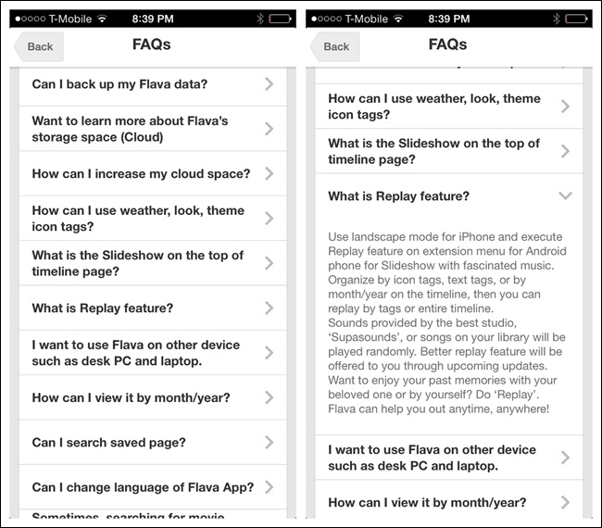
Transient Navigation: Accordion, cont’d
Flava
for iOS
Mobile Design Pattern Gallery, 2nd ed.
by Theresa Neil
O’Reilly, 2014

Slide 68
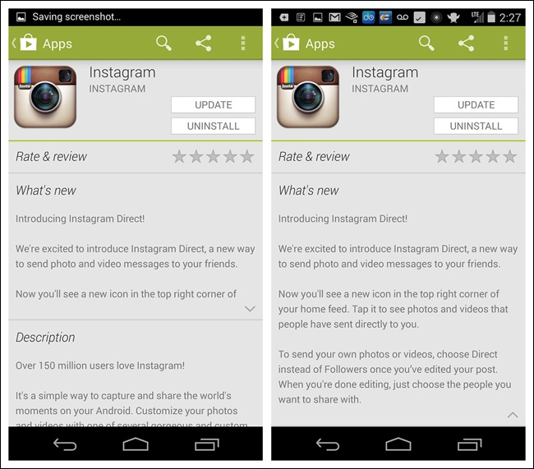
Transient Navigation: Accordion, cont’d
Play Store
for Android
Mobile Design Pattern Gallery, 2nd ed.
by Theresa Neil
O’Reilly, 2014

