Slide 1
CMPE 280 Web UI Design and Development April 16 Class Meeting
Department of Computer Engineering San Jose State University Spring 2020 Instructor: Ron Mak
www.cs.sjsu.edu/~mak

Slide 2
Project Oral Presentations
PowerPoint slides and live demo
At most 20 minutes each.
What to present
What is your data? What does it contain?
What does your information dashboard show?
What are the KPIs and why are they important?
What decisions will be prompted by your dashboard?
Use your website to present the story about your data.
Questions and answers.
The rest of the class will
evaluate each presentation
by filling out a Canvas survey.

Slide 3
Presentation Schedule
Tuesday, Apr. 28
WELL
GoBully
Front Enders
Thursday, Apr. 30
The Impact
Akali
Backup
Tuesday, May 5
Seekers
Immortal
Minions
Thursday, May 7
Simpsons
Formation
BruteForce
Think Tanks

Slide 4
Render the Home Page with Express

Slide 5
MVC Architecture Request-Response Flow

Slide 6
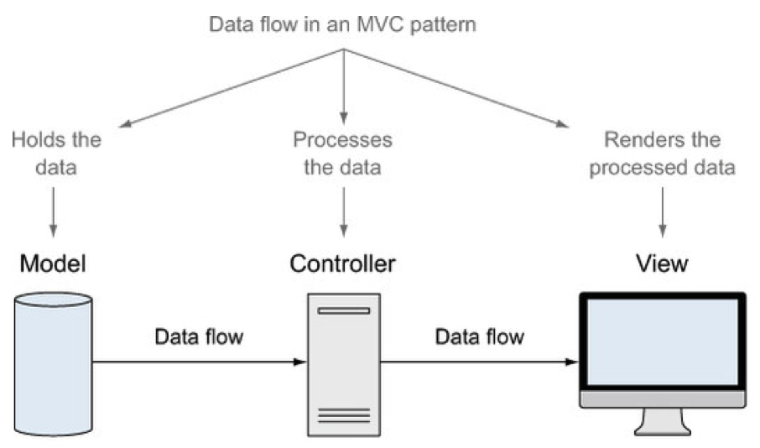
MVC Architecture Data Flow

Slide 7
The MEAN Full Stack Architecture
Full stack: All the components of a web app.
client side
server side
database server
The MEAN stack
MongoDB
Express
AngularJS (different from Angular 2)
Node.js

Slide 8
AngularJS
A JavaScript framework for working with data directly on the client side.
Traditional web app:
App logic and data processing on the server.
HTML page views and user interactions on the client.
AngularJS:
Move some or all app logic and data processing to the browser.
The server’s primary purpose is to access the database.

Slide 9
AngularJS, cont’d
jQuery:
Provides interactivity to a web page
Takes effect after the HTML has been sent to the browser and the Document Object Model (DOM) has completely loaded.
AngularJS:
Comes in earlier and helps put together the HTML based on the provided data.
Two-way data binding

Slide 10
AngularJS Two-Way Data Binding
Live view of the data.
The view is bound to the model.
Immediately update the HTML if the data changes.
Immediately update the data if the HTML changes.

Slide 11
AngularJS Two-Way Data Binding, cont’d
Traditional:
Two-way data binding:
Getting MEAN with Mongo,
Express, Angular, and Node
by Simon Holmes
Manning Publications, 2015

Slide 12
JavaScript is the Common Language
JSON is the common data format.
Getting MEAN with Mongo,
Express, Angular, and Node
by Simon Holmes
Manning Publications, 2015

Slide 13
Single-Page Application (SPA)
AngularJS is designed to support SPA functionality.
Everything runs inside the browser.
application logic
data processing
template delivery
user navigation
Never do a full page reload.
But slower first page load. Why?

Slide 14
Single-Page Application (SPA), cont’d
Greatly reduces the amount of resources needed on the server.
Each user’s browser does the hard work.
The server basically only serves static pages and data upon request.
Better user experience.
Fewer calls to the server.
Reduced network latency.

Slide 15
Hybrid Applications
Example: A blogging application:
Blogging interface for users: Not ideal for an SPA.
Admin interface: Ideal for an SPA.
Getting MEAN with Mongo,
Express, Angular, and Node
by Simon Holmes
Manning Publications, 2015

Slide 16
Hybrid Applications, cont’d
Deliver HTML and content
directly from the server.
An SPA to write and
manage the blogs.
Getting MEAN with Mongo,
Express, Angular, and Node
by Simon Holmes
Manning Publications, 2015

Slide 17
Application Design Options
Getting MEAN with Mongo,
Express, Angular, and Node
by Simon Holmes
Manning Publications, 2015

Slide 18
AngularJS App Development: Step 1
Getting MEAN with Mongo,
Express, Angular, and Node
by Simon Holmes
Manning Publications, 2015

Slide 19
AngularJS App Development: Step 2
Getting MEAN with Mongo,
Express, Angular, and Node
by Simon Holmes
Manning Publications, 2015

Slide 20
AngularJS App Development: Step 3
Getting MEAN with Mongo,
Express, Angular, and Node
by Simon Holmes
Manning Publications, 2015

Slide 21
AngularJS App Development: Step 4
Getting MEAN with Mongo,
Express, Angular, and Node
by Simon Holmes
Manning Publications, 2015

Slide 22
AngularJS App Development: Step 5

Slide 23
AngularJS App Development: Step 6

Slide 24
AngularJS App Development: Step 7

Slide 25
Network Architectures

Slide 26
Network Architectures, cont’d
Scale out MEAN apps with server clusters.

Slide 27
The AngularJS Framework
AngularJS is a JavaScript framework.
It’s a library written in JavaScript.
Include it in your HTML file.
Local installation:
Download from https://angularjs.org
Be sure you get AngularJS and not Angular.
From Google:
<script src="public/angular/angular.min.js"></script>
<script src="https://ajax.googleapis.com/ajax/libs/angularjs/1.6.6/angular.min.js">
</script>

Slide 28
AngularJS Tutorial
See https://www.w3schools.com/angular/default.asp

Slide 29
AngularJS Extends HTML
AngularJS extends HTML with ng-directives.
The ng-app directive defines an AngularJS application.
The ng-model directive binds the values of HTML controls (input, select, textarea) to application data.
The ng-bind directive binds application data to the HTML view.

Slide 30
AngularJS Extends HTML, cont’d
DataBinding1.html
<!DOCTYPE html>
<html ng-app>
<head>
<script src="public/angular/angular.min.js"></script>
<meta charset="utf-8">
<title>Angular binding test</title>
</head>
<body>
<input type="text" ng-model="name"
placeholder="Enter your name here"/>
<h1>Hello <span ng-bind="name"></span></h1>
</body>
</html>
ng-app: Define an AngularJS application.
ng-model: Bind the value of the input field
to the application variable name.
ng-bind: Bind the value of the HTML span field
to the application variable name.
Demo

Slide 31
Expressions
Enclose AngularJS expressions with {{ and }} to insert the results into the HTML page:
Expression.html
<body>
<div ng-app>
<h1>Expression value: {{ 3 + 5 }}</h1>
</div>
</body>
Demo

Slide 32
Module and Controller
Use the Angular function angular.module to create a module.
A module is a container for different parts of an application, such as application controllers.
Add a controller to the application.
Refer to it with the ng-controller directive.
Controllers always belong to a module.

Slide 33
Module and Controller, cont’d
Controller.html
<body>
<script>
var app = angular.module('myApp', []);
app.controller('myCtrl', function($scope)
{
$scope.firstName = "John";
$scope.lastName = "Doe";
});
</script>
<div ng-app="myApp" ng-controller="myCtrl">
First Name: <input type="text" ng-model="firstName"><br>
Last Name: <input type="text" ng-model="lastName"><br>
<br>
Full Name: <strong>{{firstName + " " + lastName}}</strong>
</div>
</body>
ng-app makes the
div the owner of
the AngularJS app.
Use the [] in the module definition to specify dependent modules.
Demo

Slide 34
Scope
Angular has root scope.
Contains everything in the application.
Implicitly created with the ng-app directive.
Root scope can have child scopes.
Directive ng-controller implicitly creates one.
Adding the controller moved the model out of the root scope and into the controller’s child scope.
Scope ties together the view, model, and controller as they all use the same scope.

Slide 35
Scope, cont’d
When you make a controller in AngularJS, you pass the $scope object as an argument.
If you add properties to the $scope object in the controller, the view (HTML) gets access to these properties.
In the view, do not use the prefix $scope, just refer to a property name, like {{carname}}.

Slide 36
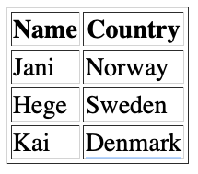
Repeating Elements
Repeating.html
<body>
<div ng-app="" ng-init="names=[
{name:'Jani',country:'Norway'},
{name:'Hege',country:'Sweden'},
{name:'Kai',country:'Denmark'}]">
<h1>Looping with objects</h1>
<table border='1'>
<tr>
<th>Name</th>
<th>Country</th>
</tr>
<tr ng-repeat="x in names">
<td> {{ x.name }} </td>
<td> {{ x.country }} </td>
</tr>
</table>
</div>
</body>
Ideal for iterating over
database query results.

Slide 37
Data Binding
DataBinding2.html
<body>
<div ng-app="" ng-init="quantity=1;price=5">
<h1>Cost Calculator</h1>
<h2>
Quantity: <input type="number" ng-model="quantity">
Price: $ <input type="number" ng-model="price">
</h2>
<h2>
Total: ${{quantity * price}}
</h2>
</div>
</body>

Slide 38
Two-Way Data Binding
Change the value inside the input field, and the AngularJS property will also change its value.
DataBinding3.html
<body>
<div ng-app="myApp" ng-controller="myCtrl">
Name: <input ng-model="name">
<h1>You entered: {{name}}</h1>
</div>
<script>
var app = angular.module('myApp', []);
app.controller('myCtrl', function($scope)
{
$scope.name = "John Doe";
});
</script>
</body>
Change the name inside the input field,
and the name in the h1 header
changes accordingly.

Slide 39
Input Validation
InputValidation.html
<body>
<form ng-app="" name="myForm">
Email:
<input type="email" name="myAddress" ng-model="text">
<span ng-show="myForm.myAddress.$error.email">
Not a valid e-mail address
</span>
</form>
</body>
The span displays only if the expression in the ng-show attribute returns true.
Only if there is an error in the email address.

Slide 40
CSS Classes
Directive ng-model provides CSS classes for HTML elements that depend on their status.
CSSclasses.html
<head>
<script src="https://ajax.googleapis.com/.../angular.min.js">
</script>
<style>
input.ng-invalid {
background-color: salmon;
}
</style>
</head>
<body>
<form ng-app="" name="myForm">
Enter your name:
<input name="myName" ng-model="myText" required>
</form>
</body>

Slide 41
Model-View-Controller
AngularJS applications are controlled by controllers.
The model and the view are immediately synchronized.
Therefore, the controller can concentrate on the model data.
Data binding allows the view to reflect any changes the controller makes to the model.

Slide 42
Model-View-Controller, cont’d
<body>
<div ng-app="myApp" ng-controller="myCtrl">
<h2>Click on the name to change it.</h2>
<h1 ng-click="changeName()">{{firstname}}</h1>
</div>
<script>
var app = angular.module('myApp', []);
app.controller('myCtrl', function($scope)
{
$scope.firstname = "John";
$scope.changeName = function()
{
$scope.firstname = "Nelly";
}
});
</script>
</body>
MVC.html
The controller changes
the model (the person’s
first name). Data binding
automatically updates
the view.

Slide 43
Controllers in External Files
Follow the MVC architectural guidelines and move the controller code to a separate file.
PersonController.js
angular.module('myApp', [])
.controller('personCtrl', function($scope)
{
$scope.firstName = "John",
$scope.lastName = "Doe",
$scope.fullName = function()
{
return $scope.firstName + " " + $scope.lastName;
};
});

Slide 44
Controllers in External Files, cont’d
Person.html
<head>
<script src="https://ajax.googleapis.com/.../angular.min.js">
</script>
<script src="PersonController.js"></script>
</head>
<body>
<div ng-app="myApp" ng-controller="personCtrl">
<h2>
First name: <input type="text" ng-model="firstName"><br>
Last name: <input type="text" ng-model="lastName"><br>
</h2>
<h1>
Full name: {{fullName()}}
</h1>
</div>
</body>

