Slide 1
CMPE 280 Web UI Design and Development March 19 Class Meeting
Department of Computer Engineering San Jose State University Spring 2020 Instructor: Ron Mak
www.cs.sjsu.edu/~mak

Slide 2
Software as a Service (SAAS)
Software available in the cloud that provides a service for other software or directly to users.
Often web-based applications that supply data.
Popular and successful SAAS use industry-standard APIs.

Slide 3
Review: Routes
A route is a mapping from an incoming HTTP request to the appropriate controller code.
Associates a URI plus an HTTP method (get or post) with a particular controller action.
HTTP method also called HTTP verb
Most widely used HTTP methods in web apps are GET, POST, PUT, and DELETE.
Defined by the HTTP standard.

Slide 4
REST
Representational State Transfer
First developed by Roy Fielding in his Ph.D. dissertation in 2000.
Entities manipulated by a web app are resources.
Design routes such that any HTTP request contains all the information necessary to identify both a resource and the action to perform on it.
“Expose RESTful APIs”

Slide 5
Database Actions and HTTP Verbs
Mapping between database CRUD actions and HTTP verbs:
A web browser is only able to issue GET and POST requests.
Therefore, Express “fakes” the PUT and DELETE requests with framework logic.
Database action | HTTP verb
Create | POST
Read (show) | GET
Update | PUT
Delete | DELETE

Slide 6
Default RESTful Actions
Express uses REST, which expands the read database action (HTTP GET) into four RESTful actions:
RESTful action | HTTP verb | Description
index | GET | List all documents.
show | GET | Show one document.
new | GET | Show a form to create a new document.
edit | GET | Show a form to edit an existing document.
create | POST | Create a new document.
update | PUT | Update an existing document.
destroy | DELETE | Delete a document.

Slide 7
RESTful App Example
Think of a web app primarily as a collection of resources accessible via RESTful APIs.
Example:
Controller action | Method and URI | Operation on resource
index | GET /userlist | Read (index) all users
show | GET /userlist/:username | Read (show) a user
new | GET /newuser | Display form to create a new user
edit | GET /edituser/:username | Display form to edit a user
create | POST /adduser | Create a new user from form data
update | PUT /userlist/:username | Update a user from form data
destroy | DELETE /deleteuser/:username | Delete a user
Engineering Software as a Service
by Armando Fox & David Patterson
self-published, 2014-2016

Slide 8
RESTful App Example, cont’d
Controller action | Method and URI | Operation on resource
index | GET /userlist | Read (index) all users
show | GET /userlist/:username | Read (show) a user
new | GET /newuser | Display form to create a new user
edit | GET /edituser/:username | Display form to edit a user
create | POST /adduser | Create a new user from form data
update | PUT /userlist/:username | Update a user from form data
destroy | DELETE /deleteuser/:username | Delete a user
routes/index.js
router.get('/userlist', ctrlMain.get_userlist);
router.get('/userlist/:username', ctrlMain.get_showuser);
router.get('/newuser', ctrlMain.get_newuser);
router.get('/edituser/:username', ctrlMain.get_edituser);
router.post('/adduser', ctrlMain.post_adduser);
router.post('/userlist/:username', ctrlMain.post_updateuser);
router.post('/deleteuser/:username', ctrlMain.post_deleteuser);

Slide 9
Introduction to Information Dashboards
A form of communication.
Present information on a computer screen to help monitor what’s going on.
Part of business intelligence (BI).
Not about cute gauges (skeuomorphs) or fancy artwork.
Images of car dashboard gauges, traffic lights, etc.
It’s about informed design.
Too many examples of poorly designed dashboards!

Slide 10
What is a Dashboard?
A visual display …
… of the most important information needed to achieve one or more objectives …
… that has been consolidated on a single computer screen …
… so that it can be monitored at a glance.

Slide 11
Visual Display
A visual display of the most important information needed to achieve one or more objectives
that has been consolidated on a single computer screen so that it can be monitored at a glance.
Combination of text and graphics.
Emphasis on graphics.
Graphical presentations can communicate more effectively and comprehensively than text alone.
If designed expertly.
To design well, you must understand concepts of visual perception.

Slide 12
Information to Achieve Objectives
A visual display of the most important information needed to achieve one or more objectives
that has been consolidated on a single computer screen so that it can be monitored at a glance.
A dashboard should achieve at least one objective.
Access a collection of facts from diverse sources that are not otherwise related.
Use whatever information needed to achieve the objective(s).
Can be a set of KPIs or any other facts.
KPI = Key Performance Indicator

Slide 13
Fits on a Single Computer Screen
A visual display of the most important information needed to achieve one or more objectives
that has been consolidated on a single computer screen so that it can be monitored at a glance.
Seen all at once, at a glance.
It’s not a dashboard if scrolling is required.
Have the most important information readily and easily available.
The viewer can quickly absorb what’s needed to know.
The information need not necessarily be updated in real time.
Sometimes only a snapshot is needed.

Slide 14
Monitor Information at a Glance
A visual display of the most important information needed to achieve one or more objectives
that has been consolidated on a single computer screen so that it can be monitored at a glance.
A dashboard provides an overview.
Quickly point out that something deserves attention and may require action.
Not required to provide all the details.
The viewer should be able to navigate to the details.
Primary job: Tell the viewer at a glance that he or she needs to act.

Slide 15
Dashboards are Customized
A dashboard is
a type of display
a form of presentation
Not a multi-chart display for user interaction.
No adding or removing charts, filtering data, etc.
The screen should look the same from day to day without alteration.
Except for changes in the data.
Why?

Slide 16
Example: Well Designed Dashboard
http://startuplifeblog.com/tag/stephen-few/

Slide 17
Example: Well Designed Dashboard, cont’d

Slide 18
What a Dashboard is Not
Not a display for data exploration and analysis.
Make the viewer aware of something that must be explored or analyzed.
Navigate to a different screen to explore or analyze.
Not a portal.
The purpose of a dashboard is to monitor important information.
The purpose of a portal is to enable a user to access often needed information to accomplish certain tasks.

Slide 19
What a Dashboard is Not, cont’d
Not a report to look up specific facts.
Looking up facts is not performance monitoring.
Looking up facts requires controls for accessing and filtering data.
A dashboard displays a defined set of information.

Slide 20
Situational Awareness
To do your job well, you must have an awareness of what’s going on.
Require a set of facts that present an overview of the current situation.
The facts must be readily available and easy and efficient to perceive.

Slide 21
Dashboard Solutions
Dashboards offer a unique solution to the problem of information overload.
Dashboards are cognitive tools that improve your “span of control” over a lot of information.
Dashboards are becoming an increasingly common form of business communication.
We must become experts on dashboard creation.

Slide 22
Not More Than a Single Screen
Limited working memory.
Lose context after scrolling or navigating.
A primary benefit of a dashboard is to show everything needed all at once.
Can lead to “Aha!” insights.
Don’t fragment the data onto separate screens or require the viewer to scroll.

Slide 23
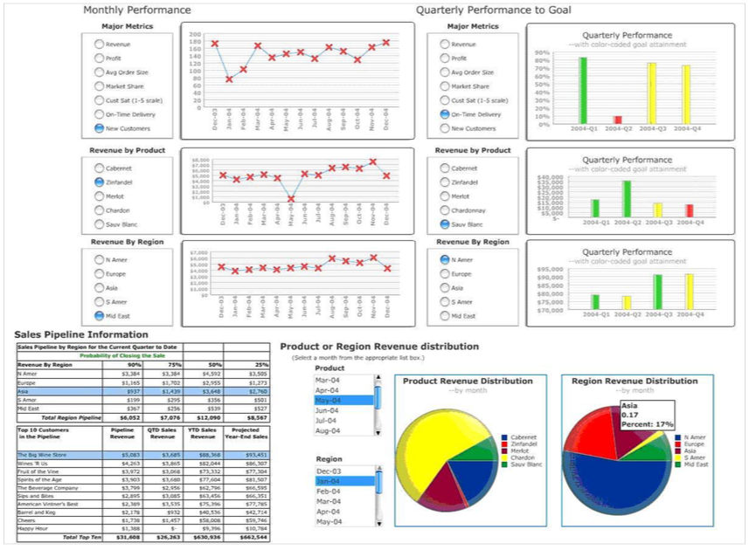
Not More Than a Single Screen, cont’d
Too much on a
single screen!
https://www.perceptualedge.com/articles/Whitepapers/Common_Pitfalls.pdf

Slide 24
Not More Than a Single Screen, cont’d
Requires
scrolling!
Information Dashboard Design, 2nd ed.
by Stephen Few
Analytics Press, 2013

Slide 25
Inadequate Context for Data
Supply the right context for data in order to enlighten and inspire action.
Example: The following display shows data but without context.
Compared to what?
Are the numbers good or bad?
Information Dashboard Design, 2nd ed.
by Stephen Few
Analytics Press, 2013

Slide 26
Inadequate Context for Data, cont’d
An improvement:
Prominently display primary information.
Don’t let the context get in the way of quickly scanning for the key data points.
Information Dashboard Design, 2nd ed.
by Stephen Few
Analytics Press, 2013

Slide 27
Excessive Detail or Precision
Present only high-level information.
Too much detail or precision slows scanning.
Every unnecessary piece of information results in time wasted as the view needs to filter out what’s important.

Slide 28
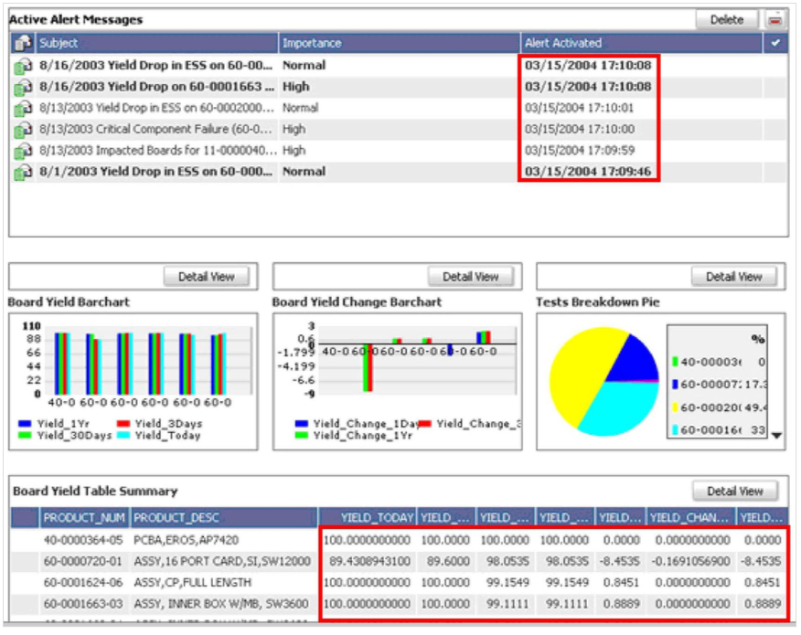
Excessive Detail or Precision, cont’d
https://www.perceptualedge.com/articles/Whitepapers/Common_Pitfalls.pdf

Slide 29
Express Measures Indirectly
What is being measured? What are the units?
A measure is deficient if it isn’t the one that most clearly and efficiently communicates the message that the viewer needs.
The data may be accurate but not the best choice to convey the intended message.

Slide 30
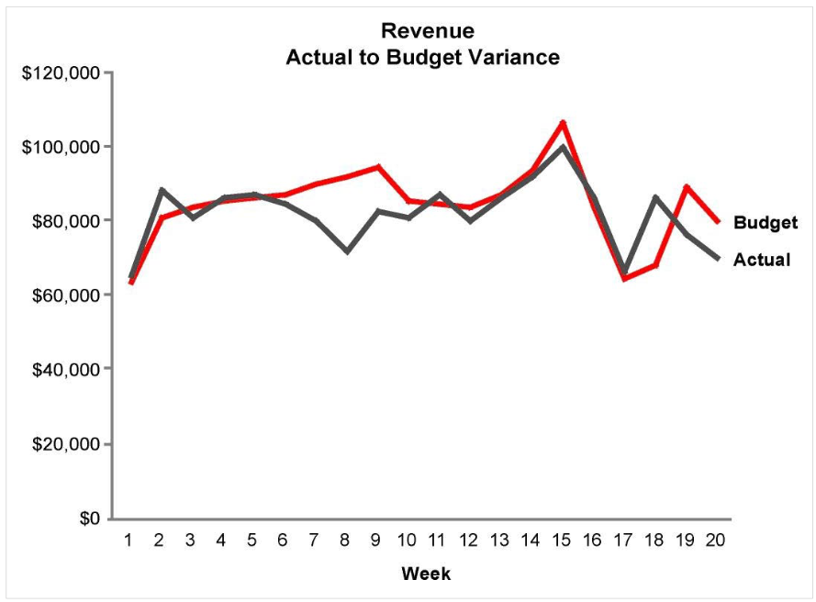
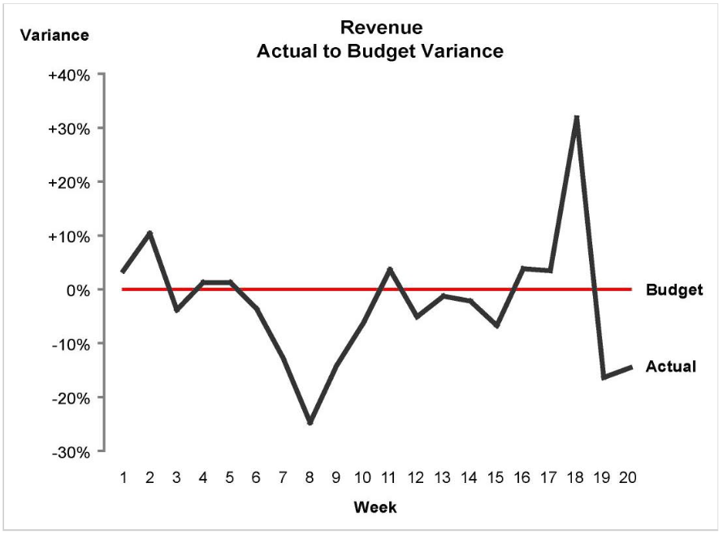
Express Measures Indirectly, cont’d
https://www.perceptualedge.com/articles/Whitepapers/Common_Pitfalls.pdf

Slide 31
Inappropriate Display Media
Choosing inappropriate display media is one of the most common design mistakes.
Examples:
Using a graph when a table of numbers is better.
Using a pie chart when a bar chart is better.

Slide 32
Inappropriate Display Media, cont’d
https://www.mrexcel.com/tech-tv/excel-pie-chart-secrets/

Slide 33
Inappropriate Display Media, cont’d
Information Dashboard Design, 2nd ed.
by Stephen Few
Analytics Press, 2013

Slide 34
Inappropriate Display Media, cont’d
Information Dashboard Design, 2nd ed.
by Stephen Few
Analytics Press, 2013

Slide 35
Inappropriate Display Media, cont’d
What’s the purpose
of the U.S. map?
Information Dashboard Design, 2nd ed.
by Stephen Few
Analytics Press, 2013

Slide 36
Meaningless Variety in Display Media
Arbitrary variety will aggravate viewers.
Don’t force users to work harder than necessary.
Viewers will not get “bored” by consistent media.
Consistent media enables viewers to use the same perceptual strategy to interpret all the data.
Saves time and energy.

Slide 37
Meaningless Variety in Display Media, cont’d
https://www.perceptualedge.com/articles/Whitepapers/Common_Pitfalls.pdf

Slide 38
Poorly Designed Display Media
Be wary of pie charts.
Avoid overuse of skeuomorphs.
Avoid 3-D bar charts.
http://www.synergy.com/wordpress_650164087/industry/klass/

Slide 39
Poorly Designed Display Media, cont’d
https://www.datapine.com/blog/common-data-visualization-mistakes/

Slide 40
Poorly Designed Display Media, cont’d
https://www.pinterest.com/pin/380132024776029784/

Slide 41
Encoding Data Inaccurately
Don’t display data inaccurately or misleadingly.
Why is this bar chart misleading?
http://123coolpictures.com/inferential+statistics+graph

Slide 42
Arranging Data Poorly
Don’t simply make the dashboard look good.
Arrange the information appropriately.
The most important information should be prominent.
Information that needs attention should stand out.
Data that should be compared should be arranged and visually designed to encourage comparisons.

Slide 43
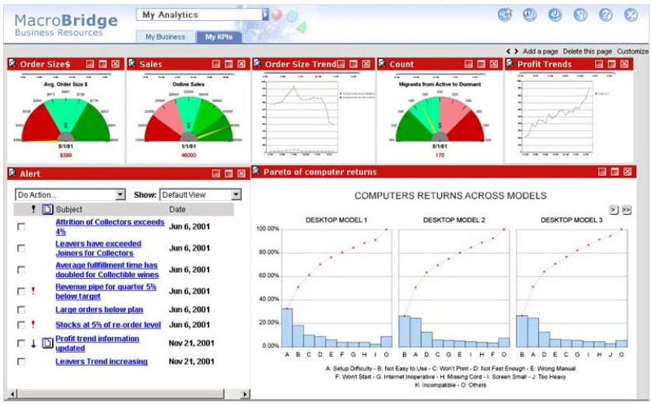
Arranging Data Poorly, cont’d
Wasted
screen space.
Should be
next to the
order size gauge.
Can we compare
the two line graphs?
Is this the most
important data?
https://www.perceptualedge.com/articles/Whitepapers/Common_Pitfalls.pdf

Slide 44
Highlighting Important Information Poorly
A dashboard should draw our eyes immediately to the most important information.
If everything is visually prominent, nothing will stand out.
If everything shouts for attention, nothing will be heard.

Slide 45
Highlighting Important Information Poorly, cont’d
What’s most
important?
Information Dashboard Design, 2nd ed.
by Stephen Few
Analytics Press, 2013

Slide 46
Cluttering with Visual Effects
An abundance of useless embellishments is a common dashboard problem.
Fancy artwork soon becomes weary.
Viewers must get past the decorations to obtain the information.

Slide 47
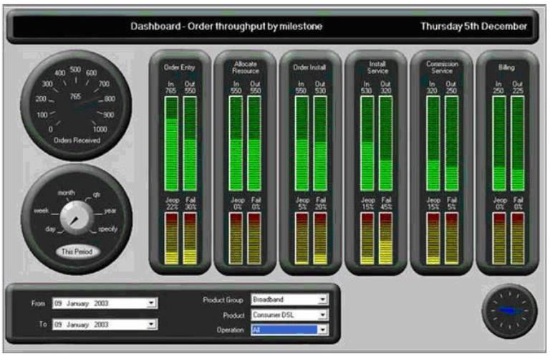
Cluttering with Visual Effects, cont’d
Skeuomorphs
https://www.perceptualedge.com/articles/Whitepapers/Common_Pitfalls.pdf

Slide 48
Cluttering with Visual Effects, cont’d
Information Dashboard Design, 2nd ed.
by Stephen Few
Analytics Press, 2013

Slide 49
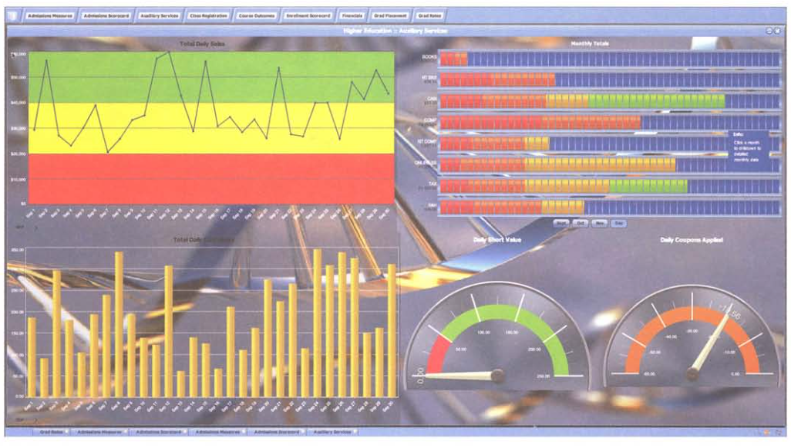
Cluttering with Visual Effects, cont’d
Information Dashboard Design, 2nd ed.
by Stephen Few
Analytics Press, 2013

