Slide 1
CMPE 280 Web UI Design and Development March 12 Class Meeting
Department of Computer Engineering San Jose State University Spring 2020 Instructor: Ron Mak
www.cs.sjsu.edu/~mak

Slide 2
NoSQL
“Not only SQL”
A mechanism to store and retrieve data that uses a model other than the tabular relations used in relational databases.
Big Data and real-time web applications.
Existed since the early 1960s but the term “NoSQL” became popular with Web 2.0 companies such as Google, Facebook, and Amazon.

Slide 3
NoSQL Benefits
Simpler design.
Object-oriented programming that is easier to use and more flexible.
Data structures are more flexible than relational tables.
More scalable and better performance than relational databases for certain applications.
Good for large volumes of rapidly changing data.

Slide 4
NoSQL Benefits, cont’d
More suitable for agile development.
Agile sprints, quick schema iteration, and frequent code pushes.
Finer control over data availability.
Geographically distributed scale-out architecture instead of an expensive, monolithic architecture.
scale-out: Add more nodes to a distributed system to expand it horizontally rather than vertically.
scale-up: Expand a system vertically by adding more memory, processors, disk space, etc.

Slide 5
NoSQL Disadvantages
Many NoSQL databases compromise consistency in favor of availability, partition tolerance, and speed.
More on this later.
Low-level query languages instead of SQL.
Often an API callable from various languages.

Slide 6
Types of NoSQL Databases
Key-value stores
Graph stores
Wide-column stores
Document databases

Slide 7
Types of NoSQL Databases, cont’d
https://www.dotnettricks.com/learn/mongodb/what-is-mongodb-and-why-to-use-it

Slide 8
Types of NoSQL Databases: Key-Value Stores
The simplest NoSQL databases.
Store a single item in the database as an attribute name (or “key”), together with its value.
Like a giant hash table.
Some key-value stores allow each value to have a type, such as integer, which adds functionality.
Store session information, user profiles, shopping cart data, etc.

Slide 9
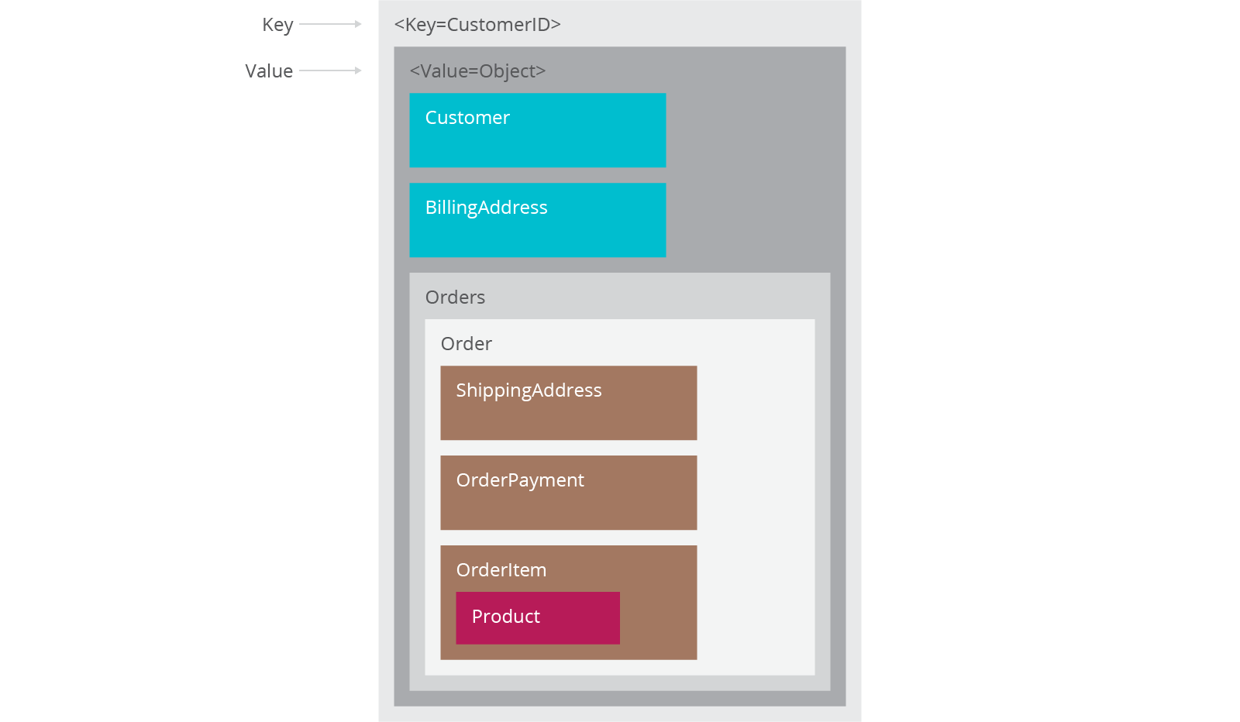
Key-Value Stores, cont’d
Key-value store
https://www.thoughtworks.com/insights/blog/nosql-databases-overview

Slide 10
Types of NoSQL Databases: Graph Stores
Store information about connected data, such as social networks, spatial data, routing information for goods and money, recommendation engines, etc.

Slide 11
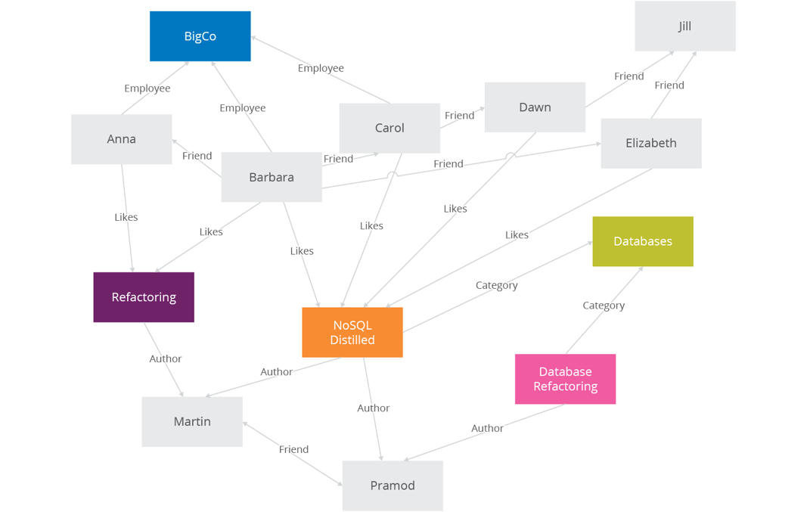
Graph Stores, cont’d
Graph store
https://www.thoughtworks.com/insights/blog/nosql-databases-overview

Slide 12
Types of NoSQL Databases: Wide-Column Stores
Optimized for queries over large datasets.
Store columns of data together, instead of rows.
The number of columns and the format of the data in a column can vary from row to row.
Useful for content management systems, blogging platforms, etc.

Slide 13
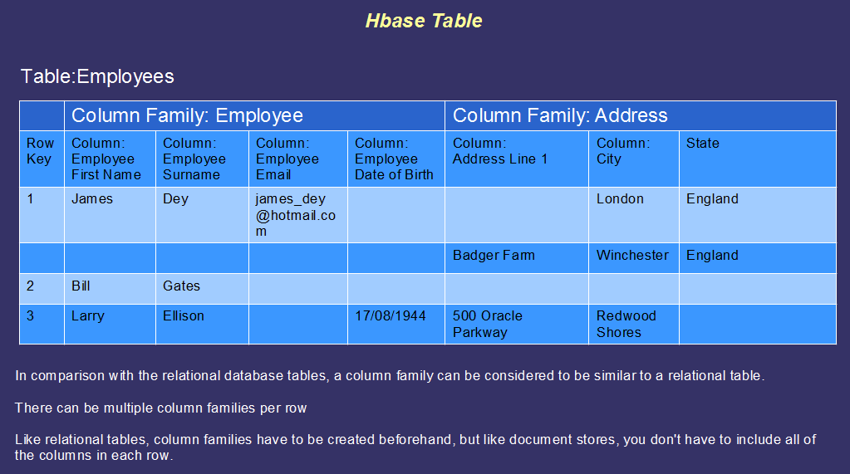
Wide-Column Stores, cont’d
Wide-column store
https://bigdatalondon.files.wordpress.com/2015/06/hbase-table2.png

Slide 14
Types of NoSQL Databases: Document Databases
Document: Each key is paired with a complex data structure.
Documents can contain many different key-value pairs, or key-array pairs, or even nested documents.
Useful for content management systems, blogging platforms, web analytics, real-time analytics, ecommerce-applications, etc.
Example: MongoDB

Slide 15
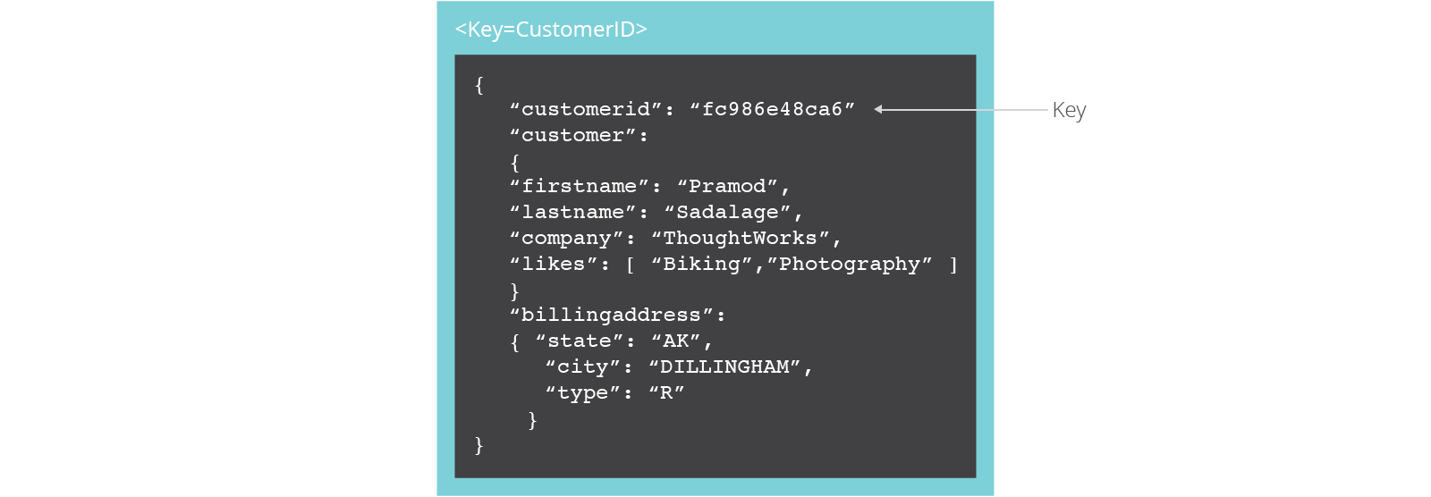
Document Databases, cont’d
Document database
https://www.thoughtworks.com/insights/blog/nosql-databases-overview

Slide 16
Structured vs. Semi-Structured Data
Structured data
Stored in tables of a relational database.
A schema describes data formats and relationships.
Semi-structured data
Data does not reside in a relational database.
Data may contain tags to separate semantic elements and enforce hierarchies of records and fields within the data (self-describing structure).
Examples: XML and JSON

Slide 17
The Document Model
Semi-structured data.
Typically JSON (JavaScript Object Notation).
The document’s internal structure provides the metadata to use for query optimization.
Type information is embedded in the data.
Each instance of data is different from others.
https://lennilobel.wordpress.com/2015/06/01/relational-databases-vs-nosql-document-databases/

Slide 18
The Document Model, cont’d
Query on any field within a document.
Most natural and productive.
Maps directly to the objects of an object-oriented language.

Slide 19
NoSQL Agile Development
Unlike relational databases, NoSQL does not require schemas to be defined in advance.
No database downtime to update a schema.
NoSQL can effectively address data that’s completely unstructured or unknown in advance.
Insert data without a predefined schema.
Apply validation rules within the database.
Enforce governance across data.
Maintain the agility benefits of a dynamic schema.

Slide 20
Scalability
Scale-up
Relational databases scale vertically.
Increase the database server’s capabilities in order to increase performance.
Scale-out
Scale horizontally to support rapidly growing applications by adding more servers.
NoSQL databases support auto-sharding.

Slide 21
Scalability, cont’d
https://interviewbubble.com/what-is-the-difference-between-scaling-horizontally-vs-scaling-vertically-scale-up-vs-scale-out/

Slide 22
Auto-Sharding
NoSQL databases natively and automatically spread data across an arbitrary number of servers.
Applications do not need to be aware of the composition of the server pool.
Data and query load are automatically balanced across servers.
When a server goes down, it can be quickly and transparently replaced without application disruption.

Slide 23
Auto-Sharding, cont’d
https://www.digitalocean.com/community/tutorials/understanding-database-sharding

Slide 24
Cloud Computing
Auto-sharding works well with cloud computing.
Example: Amazon Web Services
Provides virtually unlimited capacity on demand.
Takes care of all the necessary infrastructure administration tasks.
Developers no longer need to construct complex, expensive platforms to support their applications.

Slide 25
NoSQL Data Replication
Automatic database replication maintains availability in the event of outages or planned maintenance events.
Automated failover and recovery.
Distribute the database across multiple geographic regions to withstand regional failures and enable data localization.
No requirement for separate applications or expensive add-ons to implement replication.

Slide 26
NoSQL Data Caching
Integrated caching capabilities.
Keep frequently-used data in system memory as much as possible.
No need for a separate caching layer.
Available fully managed, integrated in-memory database management layer.
Support workloads that demand the highest throughput and lowest latency.

Slide 27
CAP Theorem
Consistency
All nodes of a distributed system see the same data at the same time.
Availability
A guarantee that every request gets a response whether the request succeeded or failed.
Partition tolerance
The system continues to operate despite arbitrary network partitioning (splitting) due to device failures.
Relational databases have ACID properties for transactions:
Atomicity
Consistency
Isolation
Durability

Slide 28
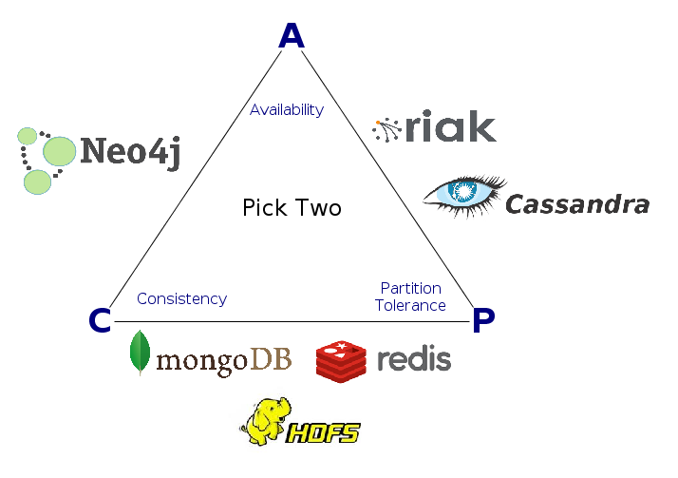
CAP Theorem, cont’d
Consistency, availability, partition tolerance: You can only choose two out of three.
Different NoSQL databases emphasize different pairs of CAP.
http://datasciencepedia.com/cap-theorem-big-data/

Slide 29
SQL vs. NoSQL
 | SQL | NoSQL
Types | SQL database | Key-value, graph, wide-column, document
Development history | Early 1970s | Late 2000s
Data model | Relational | Various
Schemas | Fixed | Dynamic
Scaling | Vertical | Horizontal
Development model | Mix of closed- and open-source | Open-source
Transaction support | Yes | At certain levels (e.g., document vs. database) depending on the application
Data manipulation | Via SQL language | Via object-oriented API
Consistency | Can be strong | Depends on the database product

Slide 30
MongoDB
From “humongous”
Scalable
High performance
Open-source
Document-oriented
Schema-free

Slide 31
MongoDB Features
Horizontal scaling
Indexing
Replication/failover support
Documents are stored in BSON (binary JSON)
Binary serialization of JSON-like objects.
Import or query any valid JSON object.
Query syntax based on JavaScript.

Slide 32
MongoDB Documents and Collections
Documents are analogous to records (rows) of a relational database.
Collections are analogous to relational tables.
A MongoDB query returns a cursor instead of records.

Slide 33
MongoDB Cursor
A query returns a cursor.
Use the cursor to iterate through a result set.
Better performance.
More efficient than loading all the objects into memory.

Slide 34
MongoDB Consistency
The document model (and the graph model) can be consistent or eventually consistent.
Eventually consistent: Database changes are propagated to all nodes “eventually”.
Typically within milliseconds
Stale reads: Updated data not immediately returned.
MongoDB consistency is tunable.
By default, all data is consistent.
All reads and writes access the primary data copy.
Read operations possible on the secondary copies.

Slide 35
Eventually Consistent Data
Advantages
Fast data inserts.
Disadvantages
Updates and deletes are more complex.
There can be periods of time during which not all copies of the data are synchronized.

Slide 36
MongoDB Demo
Install MongoDB: https://docs.mongodb.com/master/administration/install-community/
Create the database data directory:
Start the MongoDB server:
Start the MongoDB interactive shell:
mkdir –p ~/data/db
mongod --dbpath=data/db
mongo
connecting to: mongodb://127.0.0.1:27017/?compressors=disabled&gssapiServiceName=mongodb
Implicit session: session { "id" : UUID("4bbb2da1-fdab-4453-8894-11e27c4018fc") }
MongoDB server version: 4.2.3
>

Slide 37
MongoDB Demo, cont’d
Create the school database:
Insert a document into the teacher collection:
Who’s in there now?
> use school
switched to db school
> db.teacher.insert( {id: 7003, last: "Rogers", first: "Tom"} )
WriteResult({ "nInserted" : 1 })
> db.teacher.find()
{ "_id" : ObjectId("582a7630f22e3c2f12d899ac"),
"id" : 7003, "last" : "Rogers", "first" : "Tom" }

Slide 38
MongoDB Demo, cont’d
Insert the rest of the teachers as an array of documents:
> db.teacher.insert([
... { id: 7008, last: "Thompson", first: "Art" },
... { id: 7012, last: "Lane", first: "John" },
... { id: 7051, last: "Flynn", first: "Mabel" }
... ])

Slide 39
MongoDB Demo, cont’d
Find all of them and pretty print:
> db.teacher.find().pretty()
{
"_id" : ObjectId("582a7630f22e3c2f12d899ac"),
"id" : 7003,
"last" : "Rogers",
"first" : "Tom"
}
{
"_id" : ObjectId("582a7808f22e3c2f12d899ad"),
"id" : 7008,
"last" : "Thompson",
"first" : "Art"
}
{
"_id" : ObjectId("582a7808f22e3c2f12d899ae"),
"id" : 7012,
"last" : "Lane",
"first" : "John"
}
{
"_id" : ObjectId("582a7808f22e3c2f12d899af"),
"id" : 7051,
"last" : "Flynn",
"first" : "Mabel"
}

