Slide 1
SEO FUNDAMENTALS Robert Nicholson
Search Engine Optimization has become critical for all types of businesses. The field evolves rapidly, as search engine companies change their rules and algorithms, and competitors change their strategies.
Despite the rapid changes, there are fundamental techniques which, if applied consistently, will deliver dramatic results for most businesses.
This lecture will cover the fundamental principles of SEO, along with practical direct actions you can take to improve your position in search results.

Slide 2
SEO Fundamentals
Search Engine Optimization is the practice of tuning a “web presence” to acquire traffic through placement in organic search results.
SEO is not a precise science, and the “rules” constantly evolve due to changing search engine algorithms.
The goal of this talk is to understand the underlying ideas of SEO.
I will talk mostly about Google, but other search engines use similar principles.

Slide 3
SEO Versus PPC Advertising

Slide 4
SEO versus PPC Advertising
Pay-Per-Click (PPC) advertising is another way to get good placement in search results
You can pay for advertising in the search results; each time a user clicks your link, you are charged a fee
PPC can become very expensive, and when you stop paying, your traffic stops (unlike SEO, which has lasting value)
PPC can be a good SEO research tool.

Slide 5
Who Needs SEO
Appliance Repair - perfect fit – people search when they need it
Mexican Restaurant - some benefit - but relies more on “brand awareness”
Brain Surgeon - little or no benefit - a referral based business
Levitating Salad Bowls - no benefit - nobody is searching ?

Slide 6
SEO is Important for Web Developers
Technical and structural choices can make SEO easier or harder
Web Developers are often expected to be “one man shops”
Entrepreneurial Web Developers need to understand the requirements for a successful web business.

Slide 7
The Big Secret of SEO
Search Engine companies want to show the best sites first
Users want to visit (and share) good sites
If you are designing your site for search engines, you’re missing the point.
Build the best site you can, and search engines (and users) will support you.

Slide 8
The Three Rs
Right keywords - what are people searching for, and what do you want to tell them?
Relevant content – deliver the information users want, in a way that search engines understand
Reputation – your site’s visibility on the web, based on the number and quality of links to your site. (Previously Rank referring to Google Page Rank.)

Slide 9
The Right Keywords
Know what people are searching for: - WordTracker.com - MOZ Keyword Explorer - Ahrefs Keyword Explorer - Google Trends (formerly Google Insights) - Google Keyword Planner - (Search for keyword research tools)
Understand your business priorities
Image & messages
Markets
Most profitable products / services

Slide 10
Tools: WordTracker.com

Slide 11
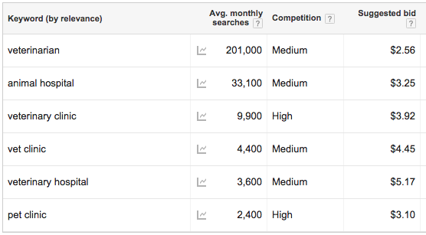
Tools: Google Keyword Planner

Slide 12
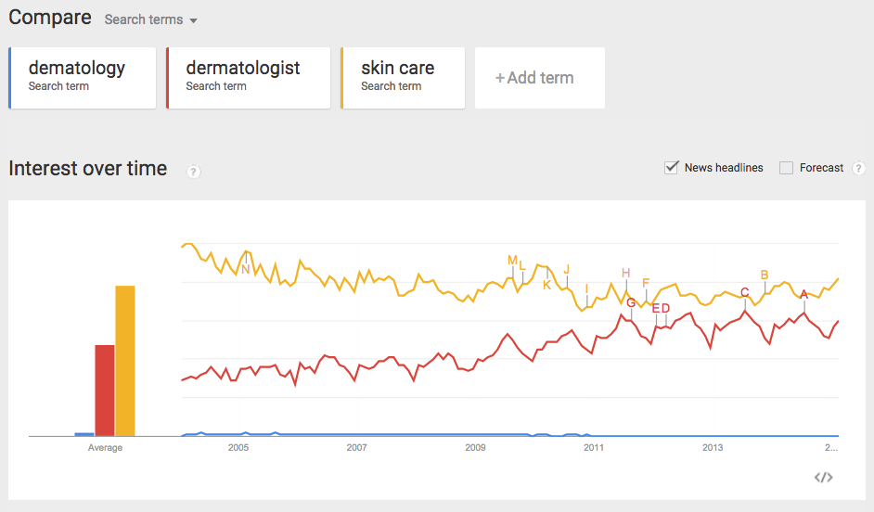
Tools: Google Trends

Slide 13
The Right Keyword Opportunities
Opportunity: Understand the Purchase Cycle
Exploring and Learning
“Types of TV sets”
Comparison and Evaluation
“LCD LED Plasma TVs compared”
Find and Purchase
“cheap Sony LED TV”
Each should be targeted separately with different keywords and different content.

Slide 14
Relevant Content
Focused, content-rich pages for specific targets
Incorporate keywords (and variants) in:
Page filenames (URLs): keywords.html
Page titles (first 60 characters): <title>
Headings and Subheads: <h1>, <h2>, <h3>
Lead paragraph(s)
Image captions and alt tags
Unique page descriptions: <meta name="Description" … (may also show up in search results)
Forget the keyword meta tag!

Slide 15
Making Content More Useful
Semantic Tagging
Allows search engines to intelligently respond to queries using your information
Google Rich Snippets (Google Search Console)
Schema.org: Supported by Google and Bing
Schemas for local businesses, products, etc
Open Graph tags for social networks
Supports Facebook Sharing

Slide 16
Build Reputation
The fundamental premise of Google: if a site is “good,” other sites will link to it
More credit for links from high reputation, relevant pages
Links from pages with high authority (news sites, government sites, educational institutions)
Google “PageRank” (PR) was a rough metric of site reputation. Logarithmic scale: 1-10
Moz.com Open Site Explorer “Authority”: 1-100

Slide 17
Link Sources
Professional associations
Conferences
Chamber of Commerce
Educational institutions (.edu)
Partners, suppliers
Satisfied clients
Rating and review sites
Local business directories
Industry-specific directories
News stories
Don’t Pay for Links

Slide 18
Online Forums
Find the top-ranking relevant forums
Learn the rules!
Participate and make yourself a valued “member” (this takes time)
Include links to your site, when you can, in legitimate responses to posts
Bonus: people actually follow forum links

Slide 19
Press Releases and News Coverage
Online Press Release services have little or no value
Traditional PR with a good publicist can land you coverage from REAL news sites
Be SURE to get a link in your news story! News links add lots of “Reputation”
Be sure your site has relevant content ready for searches BEFORE you launch your PR!

Slide 20
Trading Content for Links
Provide good quality, original content in exchange for links
Example: CopyrightSafeguard.com
Guest blogging: Six Copyright-for-Artists Facts You Need to Know
http://artprintissues.com/2014/12/six-copyright-artists-facts-need-know/
Guest article: How Does Copyright Law Protect My Work?
http://www.lawyerratingz.com/article/7/How+Does+Copyright+Law+Protect+my+Work?
Interview: Talking Internet Copyright with Bob Nicholson
http://twoartsygals.podomatic.com/entry/2015-01-28T17_55_06-08_00
Do this with high Rank websites
Save your best content for your own site!

Slide 21
Things to Avoid
Paid links
Link Exchanges
Article Syndication
Comment Spamming
Nofollow links (add no Rank)
Links TO or FROM “bad neighborhoods”

Slide 22
Links to Your Competitors
Find links to your competitors with free or paid “back link checkers”
backlinkwatch.com
moz.com
Check each site that links to your competitors; request a link to your site if appropriate
Besides specific links, look for ideas for types of sites that might link to yours

Slide 23
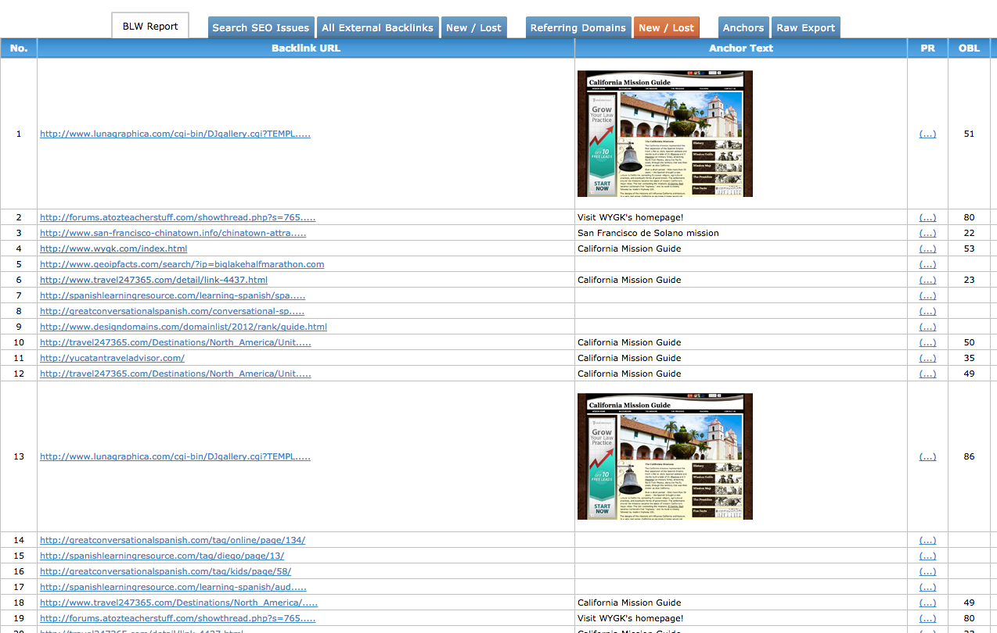
Tools: Backlinkwatch.com

Slide 24
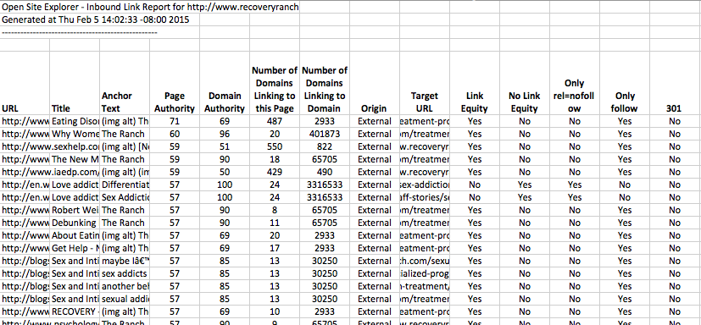
Tools: Moz.com

Slide 25
Helping Relevance With Links
Relevant link anchor text
Good link:
VOIP Phone Comparison
Not-so-good links:
For VOIP Phone Comparison Click Here
VOIP Phone Comparison at myVOIP.com
Google Bombing (classic case example):
Was George W Bush a miserable failure?

Slide 26
Additional Factors
Search engine results clicks
Social “Likes” and “Shares”
Download Speed
Valid html
Mobile Friendliness
Semantic tags
Domain longevity
Update frequency
Link frequency

Slide 27
LOCAL Factors
Local business directories
Google Pages for Business (with pictures)
Positive ratings and reviews on Google, Yelp
Address, City and State prominent on page
City and State in Title
Semantic Tags

Slide 28
Analytical & Tracking Tools
Google Analytics – traffic statistics and analysis. Where visitors come from (geography and referrals), pages they view, time on site, browser & system stats, etc.
Google Search Console (Webmaster Tools) – organic search keywords and data, site issues, crawl data
Submit your sitemap
Bing Webmaster Tools – similar to GSC.

Slide 29
SEO Tool Suites
keyword research, competitive site analysis, backlink checker, site explorer, campaign manager
Majestic SEO
Moz Pro*
Raven Tools
Advanced Web Ranking
SEMrush
* Tools I currently use
SEO PowerSuite
Ahrefs*
Rage Software
Whitespark
BuzzStream

Slide 30
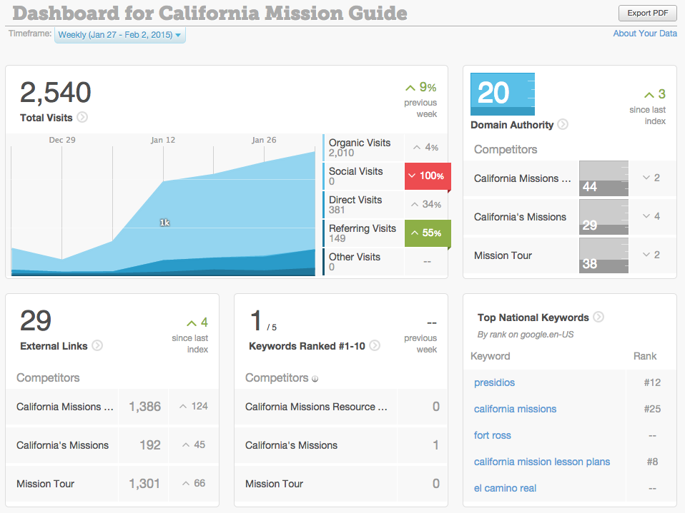
Tools: Moz Pro Dashboard

Slide 31
Conclusion
SEO is essential to web success
SEO requires an ongoing effort
Budget time
Track efforts and results (tools or spreadsheets)
SEO requires knowledge, skill, and tools
The “rules” will continue to change
Focus on creating a great site with lots of high quality content

Slide 32
Questions?

