Slide 1
CMPE 280 Web UI Design and Development February 13 Class Meeting
Department of Computer Engineering San Jose State University Spring 2020 Instructor: Ron Mak
www.cs.sjsu.edu/~mak

Slide 2
Checkbox Values
<body>
<form action="">
<fieldset>
<legend>Select one or more colors</legend>
<p>
<input type="checkbox" id="cbred" value="Red" />
<label for="cbred">Red</label>
<input type="checkbox" id="cbgreen" value="Green" />
<label for="cbgreen">Green</label>
<input type="checkbox" id="cbblue" value="Blue" />
<label for="cbblue">Blue</label>
<input type="button" value="Show colors"
onclick="showColors()" />
</p>
</fieldset>
</form>
<div id="outputDiv">
<p>Output will appear here.</p>
</div>
js/checkbox.html

Slide 3
Checkbox Values, cont’d
<head>
...
<script type="text/javascript">
function showColors()
{
var cbred = document.getElementById("cbred");
var cbgreen = document.getElementById("cbgreen");
var cbblue = document.getElementById("cbblue");
var output = "<p><strong>You chose:";
if (cbred.checked) output += " Red";
if (cbgreen.checked) output += " Green";
if (cbblue.checked) output += " Blue";
output += "</strong></p>";
document.getElementById("outputDiv").innerHTML = output;
}
</script>
</head>
js/checkbox.html
Demo

Slide 4
Radio Button Values
<body>
<form action="">
<fieldset>
<legend>Select a color</legend>
<p>
<input type="radio" name="colors" id="cbred" value="Red" />
<label for="cbred">Red</label>
<input type="radio" name="colors" id="cbgreen" value="Green" />
<label for="cbgreen">Green</label>
<input type="radio" name="colors" id="cbblue" value="Blue" />
<label for="cbblue">Blue</label>
<input type="button" value="Show color"
onclick="showColor()" />
</p>
</fieldset>
</form>
<div id="outputDiv">
<p>Output will appear here.</p>
</div>
</body>
js/radio.html

Slide 5
Radio Button Values, cont’d
<head>
...
<script type="text/javascript">
function showColor()
{
var colors = document.getElementsByName("colors");
var output = "<p><strong>You chose:";
for (i = 0; i < colors.length; i++) {
if (colors[i].checked) {
output += " " + colors[i].value;
}
}
output += "</strong></p>";
document.getElementById("outputDiv").innerHTML = output;
}
</script>
</head>
js/radio.html
Demo

Slide 6
Select Menu Value
js/backgroundcolor3.html
<body>
<form action="">
<fieldset>
<legend>Select a color</legend>
<p>
<select id="colorChooser">
<option value="red">Red</option>
<option value="green">Green</option>
<option value="blue">Blue</option>
</select>
<input type="button" value="Change color"
onclick="changeBGColor()" />
</p>
</fieldset>
</form>
</body>

Slide 7
Select Menu Value, cont’d
js/backgroundcolor3.html
<head>
...
<script type="text/javascript">
function changeBGColor()
{
var color = document.getElementById("colorChooser").value;
document.body.style.backgroundColor = color;
}
</script>
</head>
Demo

Slide 8
Multiple Selection Values
<body>
<form action="">
<fieldset>
<legend>Select one or more colors</legend>
<p>
<select id="colorChooser"
size = "3" multiple="multiple">
<option value="red">Red</option>
<option value="green">Green</option>
<option value="blue">Blue</option>
</select>
<input type="button" value="Show colors"
onclick="showColors()" />
</p>
</fieldset>
</form>
<div id="outputDiv">
<p>Output will appear here.</p>
</div>
</body>
js/multisel.html

Slide 9
Multiple Selection Values, cont’d
<head>
...
<script type="text/javascript">
function showColors()
{
var chooser = document.getElementById("colorChooser");
var output = "<p><strong>You chose:";
for (i = 0; i < chooser.length; i++) {
if (chooser[i].selected) {
output += " " + chooser[i].value;
}
}
output += "</strong></p>";
document.getElementById("outputDiv").innerHTML = output;
}
</script>
</head>
js/multisel.html
Demo

Slide 10
Input Validation
A key use of JavaScript code is input validation.
On the client side, validate user input in form fields before the values are submitted to the server side.
The result is much more responsive and interactive web pages.

Slide 11
Input Validation, cont’d
Inefficient:
The user enters form data at the browser and presses the Submit button.
The form data flows across the Internet as an HTTP request to the web server.
Server-side code running in the web server checks the user input and discovers errors.
The server-side code generates a new HTML page containing error messages as the HTTP response.
The user’s browser renders the new HTML page containing the error messages for the user to see.

Slide 12
Input Validation, cont’d
Too much network traffic!
The user experiences a delay between submitting the form and getting error messages.
Poor user experience (UX).
A better idea
Get the browser to validate the user input before sending the form data to the web server.
If there are errors, they’re caught by the browser, saving the time and expense of a round trip to the web server and back.

Slide 13
HTML Form with Input Validation
<form action = "/some_url" method="post"
onsubmit="return validate()">
<fieldset>
<legend>User input</legend>
<label>Name:</label>
<input type = "text"
value = ""
id = "name" />
<label>Phone number:</label>
<input type = "text"
value = "(nnn) nnn-nnnn"
id = "phone" />
<label>Email address:</label>
<input type = "text"
id = "email" />
<input type = "submit" />
</fieldset>
</form>

Slide 14
JavaScript Validation Function
<script type = "text/javascript">
function validate()
{
name = document.getElementById("name").value;
phone = document.getElementById("phone").value;
email = document.getElementById("email").value;
errors = "";
if (name == "") {
errors += "Missing name.\n";
}
phoneRE = /^\(\d{3}\) *\d{3}-\d{4}$/;
if (!phone.match(phoneRE)) {
errors += "Invalid phone number. " +
"Example: (999) 999-9999\n";
}
emailRE = /^.+@.+\..{2,4}$/;
if (!email.match(emailRE)) {
errors += "Invalid email address. " +
"Should be xxxxx@xxxxx.xxx\n";
}
...
...
if (errors != "") {
alert(errors);
return false;
}
else return true;
}
</script>

Slide 15
Validate Non-Empty Text
HTML:
JavaScript:
<label>Name</label>
<input type = "text"
value = ""
id = "name" />
name = document.getElementById("name").value;
if (name == "") {
errors += "Missing name.\n";
}

Slide 16
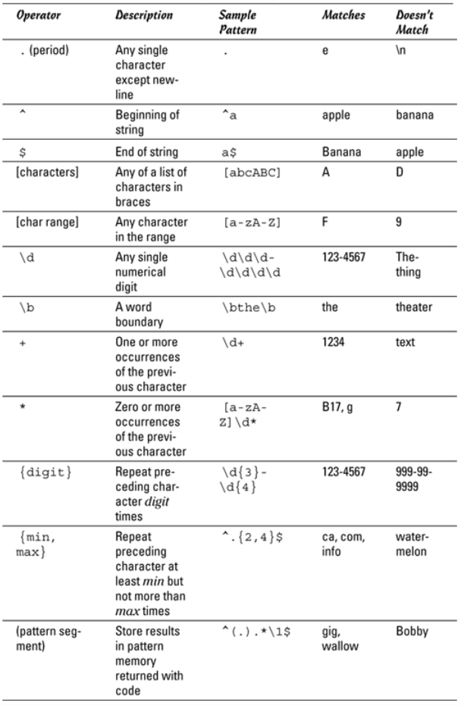
JavaScript Regular Expressions

Slide 17
Validate Phone Number
HTML:
JavaScript:
<label>Phone number</label>
<input type = "text"
value = "(nnn) nnn-nnnn"
id = "phone" />
validatation/validate1.html
phone = document.getElementById("phone").value;
phoneRE = /^\(\d{3}\) *\d{3}-\d{4}$/;
if (!phone.match(phoneRE)) {
errors += "Invalid phone number. " +
"Example: (999) 999-9999\n";
}
JavaScript quotes
regular expressions
with the forward /.
validatation/validate1.html

Slide 18
Validate Phone Number, cont’d
left paren
right paren
hyphen
/^\(\d{3}\) *\d{3}-\d{4}$/
start of
string
three digits
three digits
four digits
end of
string
any number
of blanks
(including none)
What is the purpose of specifying both the start of the string (^) and the end of the string ($)?
The entire string must match (nothing before or after).

Slide 19
Validate Email Address
HTML:
JavaScript:
<label>Email address</label>
<input type = "text"
value = "xxxxx@xxxxx.xxx"
id = "email" />
validatation/validate1.html
email = document.getElementById("email").value;
emailRE = /^.+@.+\..{2,4}$/;
if (!email.match(emailRE)){
errors += "Invalid email address. " +
"Should be xxxxx@xxxxx.xxx\n";
}
validatation/validate1.html

Slide 20
Validate Email Address, cont’d
start of
string
end of
string
@ sign
dot
/^.+@.+\..{2,4}$/
at least one
character
at least one
character
2, 3, or 4
characters
Demo

Slide 21
JavaScript Regular Expressions, cont’d
Use parentheses in a regular expression to group and store a pattern.
Example: /(Bora){2}/ matches BoraBora
Use \1, \2, etc. to recall the first, second, etc. match of a stored pattern.
Example: /^(.)(.).*\1\2$/ matches any string that begins and ends with the same two characters, such as BoraBoraBo
What can /^<(.+)>.*<\/\1>$/ match?

Slide 22
Input Validation with HTML5 and CSS3
CSS pseudo-classes:
:required
:invalid
validatation/validate2.css
input:required {
border: 1px solid blue;
}
input:invalid {
color: white;
background-color: red;
}

Slide 23
Input Validation with HTML5 and CSS3, cont’d
<label>Name:</label>
<input type = "text"
value = ""
id = "name"
required />
<label>Phone number:</label>
<input type = "text"
placeholder = "(999) 999-999"
pattern = "^\(\d{3}\) *\d{3}-\d{4}$"
id = "phone"
required />
<label>Email address:</label>
<input type = "text"
placeholder = "xxxxx@xxxxx.xxx"
pattern = "^.+@.+\..{2,4}$"
id = "email" />
validation/validate2.html
No JavaScript required!
HTML quotes
regular expressions
like any other string.
Demo

Slide 24
New HTML5 Input Types
HTML5 has new input types.
Automatic built-in input validation.
Special effects with some browsers.
date
time
datetime
datetime-local
week
month
color
number
range
search
email
tel
url
NOTE:
Different browsers implement
these input types differently
(Chrome does best).

Slide 25
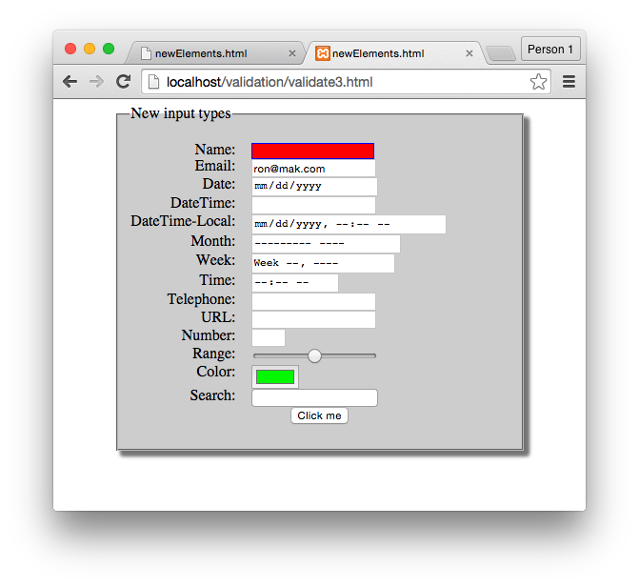
New HTML5 Input Types, cont’d
Chrome browser:
<p>
<label for = "range">Range:</label>
<input type = "range"
id = "range"
min = "0"
max = "256"
value = "128" />
</p>
validatation/validate3.html

Slide 26
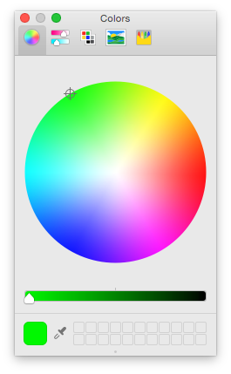
New HTML5 Input Types, cont’d
Chrome browser:
<p>
<label for="color">Color:</label>
<input type="color"
id = "color" />
</p>
validate/validate3.html
Demo

Slide 27
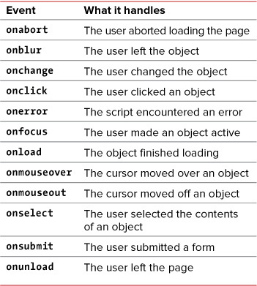
JavaScript Event Handlers

Slide 28
The HTML5 Canvas Object
HTML5 introduces the drawing canvas.
Universally supported by modern browsers.
The <canvas> tag provides a graphics context.
A rich set of drawing operations.
Execute using JavaScript.
Replaces the need for Flash or Java.
Used by many game developers.

Slide 29
Simple Canvas Demo
<canvas id = "canvas"
width = "200"
height = "200">
<p>Your browser does not support the canvas tag.</p>
</canvas>
canvas/simple.html
function draw()
{
var canvas = document.getElementById("canvas");
var con = canvas.getContext('2d');
con.strokeStyle = "black";
con.strokeRect(0, 0, 200, 200);
con.fillStyle = "red";
con.fillRect(40, 140, 150, 50);
}
Demo

Slide 30
Canvas Basics
Two main canvas drawing operations:
stroke: draw a line
fill: fill in a shape
Specify strokestyle and fillstyle.
Basic shapes: lines, rectangles, arcs, text
Create paths to draw complex shapes.
Draw images.
Alter pixels.

Slide 31
Ways to Specify Colors
By name: red, silver, gray, etc.
RGB with integers 0-255 or percentages: rgb(10, 250, 100) or rgb(100%, 100%, 0%)
RGBA with alpha transparency.
HSL and HSLA
RGB with six-digit hex values: #FF0000 is red, #FFFF00 is yellow.
RGB with three-digit hex values: #F00 is red, #FF0 is yellow.

Slide 32
Gradients
Fill a shape with a gradient.
Linear gradient or radial gradient.
Color stop: Specifies a color to add to a gradient and a position along the gradient.
Position 0 through 1
0 = beginning of the gradient
1 = end of the gradient

Slide 33
Gradients, cont’d
<canvas id = "linear"
height = "200"
width = "200">
<p>Canvas not supported!</p>
</canvas>
<canvas id = "radial"
height = "200"
width = "200">
<p>Canvas not supported!</p>
</canvas>
canvas/gradients.html

Slide 34
Gradients, cont’d
function draw()
{
var linear = document.getElementById("linear");
var radial = document.getElementById("radial");
// Linear gradient
var con = linear.getContext("2d");
lGrad = con.createLinearGradient(0, 0, 100, 200);
lGrad.addColorStop(0, "#FF0000"); // red
lGrad.addColorStop(0.5, "#00FF00"); // green
lGrad.addColorStop(1, "#0000FF"); // blue
con.fillStyle = lGrad;
con.fillRect(0, 0, 200, 200);
...
}
canvas/gradients.html

Slide 35
Gradients, cont’d
function draw()
{
...
// Radial gradient
con = radial.getContext("2d");
rGrad = con.createRadialGradient(50, 50, 0, 100, 100, 125);
rGrad.addColorStop(0, "#FF0000"); // red
rGrad.addColorStop(0.5, "#00FF00"); // green
rGrad.addColorStop(1, "#0000FF"); // blue
con.fillStyle = rGrad;
con.fillRect(0, 0, 200, 200);
}
canvas/gradients.html

Slide 36
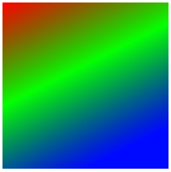
Gradients, cont’d
createLinearGradient(0, 0, 100, 200)
starting position
ending position
radius of
inner circle
radius of
outer circle
createRadialGradient(50, 50, 0, 100, 100, 125)
center position
of inner circle
center position
of outer circle

Slide 37
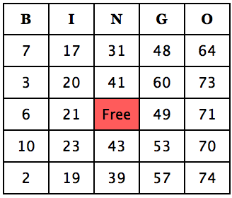
JavaScript Bingo Program
Demonstrate the coordination of HTML, CSS, and JavaScript.
Adapted from JavaScript, 9th edition by Tom Negrino and Dori Smith Peachpit Press, 2015 ISBN 978-0-321-99670-1
How would you implement
this Bingo card?
Demo

Slide 38
bingo.html
The card is an HTML table.
Each cell has an id and is initially blank.
<table>
<tr>
<th>B</th>
<th>I</th>
<th>N</th>
<th>G</th>
<th>O</th>
</tr>
<tr>
<td id="square0">&nbsp;</td>
<td id="square5">&nbsp;</td>
<td id="square10">&nbsp;</td>
<td id="square14">&nbsp;</td>
<td id="square19">&nbsp;</td>
</tr>
<tr>
<td id="square1">&nbsp;</td>
<td id="square6">&nbsp;</td>
<td id="square11">&nbsp;</td>
<td id="square15">&nbsp;</td>
<td id="square20">&nbsp;</td>
</tr>
<tr>
<td id="square2">&nbsp;</td>
<td id="square7">&nbsp;</td>
<td id="free">Free</td>
<td id="square16">&nbsp;</td>
<td id="square21">&nbsp;</td>
</tr>
<tr>
<td id="square3">&nbsp;</td>
<td id="square8">&nbsp;</td>
<td id="square12">&nbsp;</td>
<td id="square17">&nbsp;</td>
<td id="square22">&nbsp;</td>
</tr>
<tr>
<td id="square4">&nbsp;</td>
<td id="square9">&nbsp;</td>
<td id="square13">&nbsp;</td>
<td id="square18">&nbsp;</td>
<td id="square23">&nbsp;</td>
</tr>
</table>

Slide 39
bingo.js
window.onload = initAll;
function initAll()
{
document.getElementById("reload").onclick = anotherCard;
newCard();
}
function newCard()
{
for (var i = 0; i < 24; i++) {
setSquare(i);
}
}

Slide 40
bingo.js, cont’d
Note that on a Bingo card, the numbers are distributed randomly as follows:
Column B: 1 – 15
Column I: 16 – 30
Column N: 31 – 45
Column G: 46 – 60
Column O: 61 – 75
There are no repeated numbers on a card.

Slide 41
bingo.js, cont’d
var colPlace = new Array(0, 0, 0, 0, 0, // B
1, 1, 1, 1, 1, // I
2, 2, 2, 2, // N
3, 3, 3, 3, 3, // G
4, 4, 4, 4, 4); // O
var usedNums = new Array(76);
function setSquare(thisSquare)
{
var currSquare = "square" + thisSquare;
var colBasis = colPlace[thisSquare]*15;
var newNum;
do {
newNum = colBasis + getNewNum() + 1;
} while (usedNums[newNum]);
usedNums[newNum] = true;
document.getElementById(currSquare).innerHTML = newNum;
document.getElementById(currSquare).className = "";
document.getElementById(currSquare).onmousedown = toggleColor;
}

Slide 42
bingo.js, cont’d
function getNewNum()
{
return Math.floor(Math.random()*15);
}
function anotherCard()
{
for (var i = 1; i < usedNums.length; i++) {
usedNums[i] = false;
}
newCard();
return false;
}

Slide 43
bingo.js
function toggleColor(evt)
{
if (evt.target) {
var thisSquare = evt.target;
}
else {
var thisSquare = window.event.srcElement;
}
if (thisSquare.className == "") {
thisSquare.className = "pickedBG";
}
else {
thisSquare.className = "";
}
}
most browsers
Windows Internet Explorer
Dynamically
change the
cell’s class.

Slide 44
bingo.css
body {
background-color: white;
color: black;
font-size: 20px;
font-family: "Lucida Grande", Verdana, Arial, Helvetica, sans-serif;
}
h1, th {
font-family: Georgia, "Times New Roman", Times, serif;
}
h1 {
font-size: 28px;
}

Slide 45
bingo.css, cont’d
table {
border-collapse: collapse;
}
th, td {
padding: 10px;
border: 2px black solid;
text-align: center;
width: 20%;
}
#free, .pickedBG {
background-color: LightCoral;
}

