Slide 1
CMPE 226 Database Systems April 11 Class Meeting
Department of Computer Engineering San Jose State University Spring 2017 Instructor: Ron Mak
www.cs.sjsu.edu/~mak

Slide 2
Final Project
Put your emphasis on data management.
How you manage the data that are you are using.
Data models:
Operational tables
Analytical tables
Data operations:
Queries and updates of the operational tables.
How the analytical tables are loaded.
Queries of the analytical tables for data analysis.
You can use actual
downloaded data
or data created by
data generation tools.

Slide 3
Final Project, cont’d
User application that invokes the data operations.
Web-based or desktop-based.
PHP, Java, etc.
Fancy GUI or data visualization not necessary.
How well did you use the technologies you learned during the semester?
RDBM, DW, XML, data virtualization (CIS), NoSQL
Not all technologies have to be used.

Slide 4
Final Project, cont’d
Written report
What is the application?
What data did you use, and where did you get it?
Overview of your data models (in words).
ER diagram
Relational schemas
Star schemas
Operational and analytical queries
Example user actions and screen shots of results.

Slide 5
Detailed vs. Aggregated Fact Tables
In a detailed fact table, each row contains data about a single fact.
In an aggregated fact table, each row contains a summary of multiple facts.
Such as a sum (aggregation) of all sales of a product in a particular store during a single day.

Slide 6
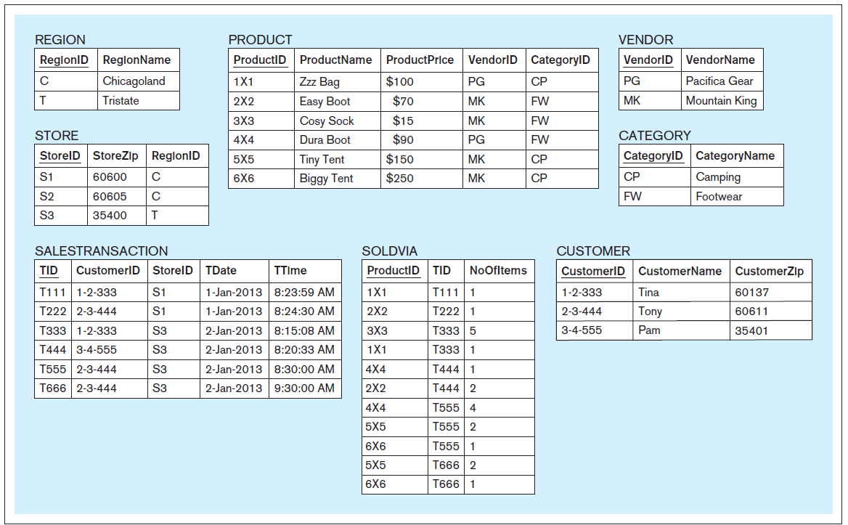
Detailed Fact Table Example
Database Systems
by Jukić, Vrbsky, & Nestorov
Pearson 2014
ISBN 978-0-13-257567-6

Slide 7
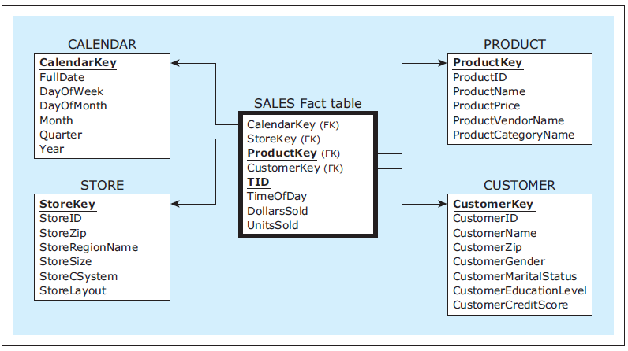
Detailed Fact Table Example, cont’d
Detailed fact table
Database Systems
by Jukić, Vrbsky, & Nestorov
Pearson 2014
ISBN 978-0-13-257567-6

Slide 8
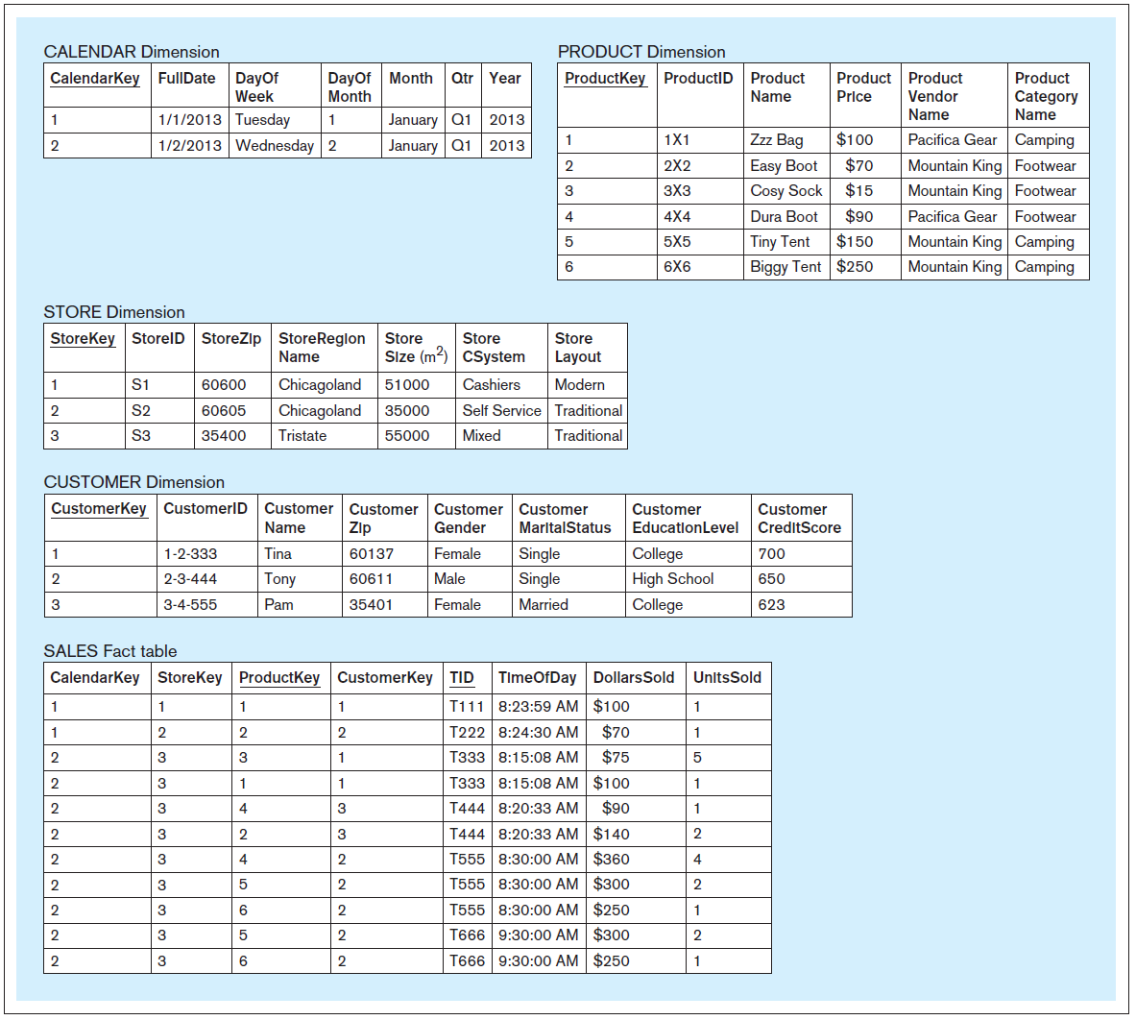
Detailed Fact Table Example, cont’d
Database Systems
by Jukić, Vrbsky, & Nestorov
Pearson 2014
ISBN 978-0-13-257567-6
Each fact table record
contains data about
one sales fact.

Slide 9
Line-Item Detailed Fact Table
Each row is a single line item of a particular transaction.
Database Systems
by Jukić, Vrbsky, & Nestorov
Pearson 2014
ISBN 978-0-13-257567-6

Slide 10
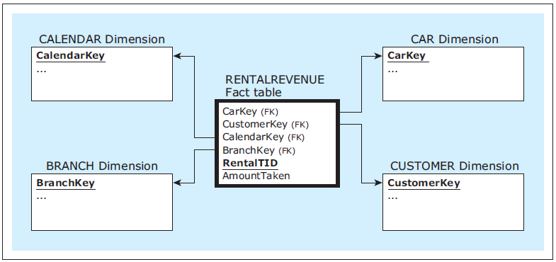
Transaction-Level Detailed Fact Table
Each row is a single transaction.
Database Systems
by Jukić, Vrbsky, & Nestorov
Pearson 2014
ISBN 978-0-13-257567-6

Slide 11
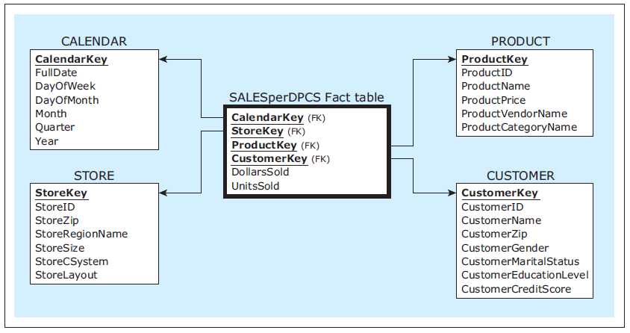
Aggregated Fact Table Example
Aggregated fact table DPCS:
Total amount sold
in dollars and units
on a particular day
for a particular product
for a particular customer
for a particular store.
Database Systems
by Jukić, Vrbsky, & Nestorov
Pearson 2014
ISBN 978-0-13-257567-6

Slide 12
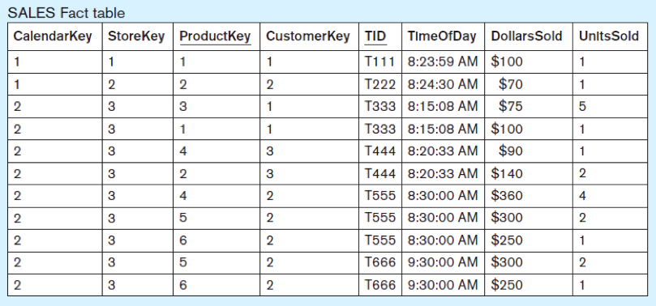
Aggregated Fact Table Example, cont’d
Database Systems
by Jukić, Vrbsky, & Nestorov
Pearson 2014
ISBN 978-0-13-257567-6

Slide 13
Aggregated Fact Table Example, cont’d
Database Systems
by Jukić, Vrbsky, & Nestorov
Pearson 2014
ISBN 978-0-13-257567-6

Slide 14
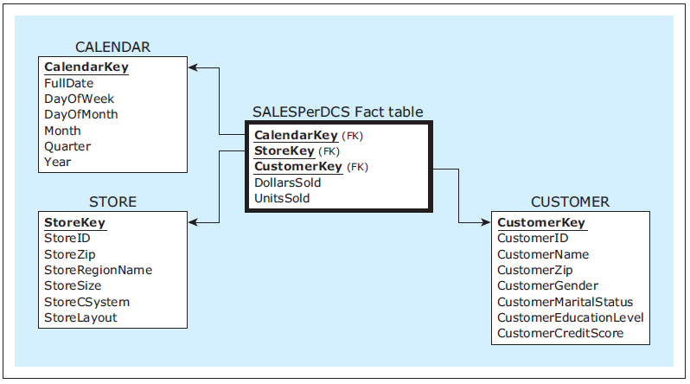
Aggregated Fact Table Example, cont’d
Aggregated fact table DCS:
Total amount sold
in dollars and units
on a particular day
for a particular customer
for a particular store
for all products.
Database Systems
by Jukić, Vrbsky, & Nestorov
Pearson 2014
ISBN 978-0-13-257567-6

Slide 15
Aggregated Fact Table Example, cont’d
Database Systems
by Jukić, Vrbsky, & Nestorov
Pearson 2014
ISBN 978-0-13-257567-6

Slide 16
Aggregated Fact Table Example, cont’d
Database Systems
by Jukić, Vrbsky, & Nestorov
Pearson 2014
ISBN 978-0-13-257567-6

Slide 17
Aggregated Fact Table Example, cont’d
Database Systems
by Jukić, Vrbsky, & Nestorov
Pearson 2014
ISBN 978-0-13-257567-6

Slide 18
Granularity of the Fact Table
Fine level of granularity: Detailed fact table.
Courser level of granularity: Aggregated fact table.
Finer granularity: More analysis power.
Courser granularity: Faster queries.

Slide 19
Granularity of the Fact Table, cont’d
Granularity can also depend on how the data is collected and loaded into the fact table.
Example: Load only daily sales.
But then you lose the ability to analyze sales by the hour.
A solution: Keep both fine-grained and aggregated tables and have them share the dimension tables.

Slide 20
Granularity of the Fact Table, cont’d
Good DW design involves deciding which aggregates are worth storing as tables.
The base fact tables contain data at the finest level of granularity required for analysis.
Facts can be pre-summarized in aggregate tables at granularity levels that are determined to be optimal for certain analysis procedures.

Slide 21
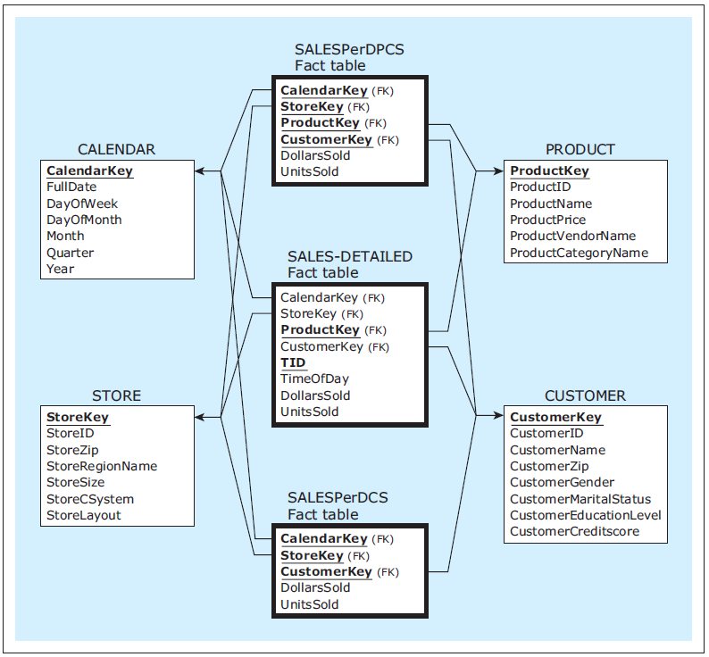
Granularity of the Fact Table, cont’d
Database Systems
by Jukić, Vrbsky, & Nestorov
Pearson 2014
ISBN 978-0-13-257567-6

Slide 22
Slowly Changing Dimensions
In a typical dimension of a star schema, either:
The values of a dimension’s attributes do not change or change extremely rarely.
Examples: store address, customer gender
OR: The values of a dimension’s attributes change occasionally and sporadically over time.
Example: customer address
Three approaches to handling slowly changing dimensions: Type 1, Type 2, and Type 3.

Slide 23
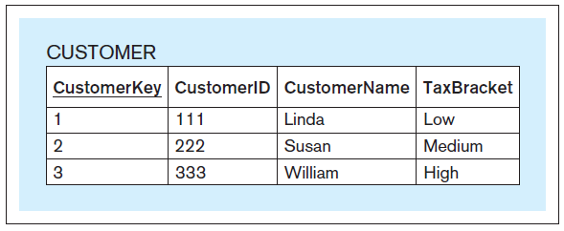
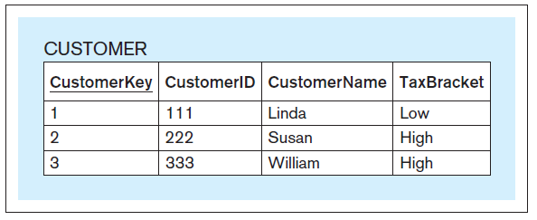
Slowly Changing Dimensions: Type 1
Simply change the value in the dimension table’s record.
Often used to correct errors.
Database Systems
by Jukić, Vrbsky, & Nestorov
Pearson 2014
ISBN 978-0-13-257567-6

Slide 24
Slowly Changing Dimensions: Type 2
Preserve history by creating an additional row with the new value.
Often used with timestamps.
Database Systems
by Jukić, Vrbsky, & Nestorov
Pearson 2014
ISBN 978-0-13-257567-6
Now you see why this
analytical table uses
separate a CustomerKey
rather than the CustomerID.

Slide 25
Slowly Changing Dimensions: Type 3
Create “previous” and “current” columns.
Only a fixed number of changes is possible.
Record only a limited history.
Database Systems
by Jukić, Vrbsky, & Nestorov
Pearson 2014
ISBN 978-0-13-257567-6

Slide 26
Snowflakes
Dimension tables can be unnormalized.
Fewer tables = faster joins = faster queries.
Update anomalies are not a concern.
Dimension tables are slowly changing.
Updates happen rarely if at all.
An undesirable snowflake results from unnecessarily normalizing dimension tables.

Slide 27
Snowflakes, cont’d
Unnormalized dimension tables.
Database Systems
by Jukić, Vrbsky, & Nestorov
Pearson 2014
ISBN 978-0-13-257567-6

Slide 28
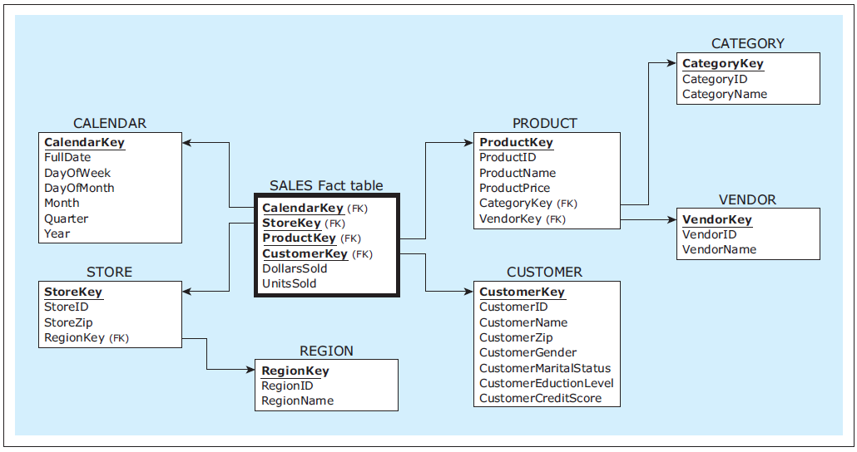
Snowflakes, cont’d
X
X
Avoid creating a snowflake!
Database Systems
by Jukić, Vrbsky, & Nestorov
Pearson 2014
ISBN 978-0-13-257567-6

Slide 29
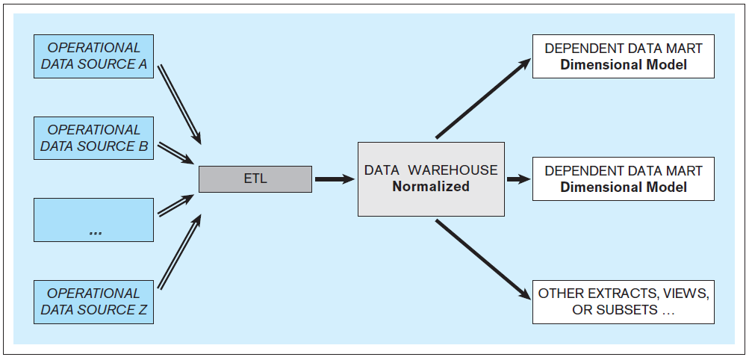
DW Architecture: Bill Inmon Approach
Normalized Data Warehouse
Database Systems
by Jukić, Vrbsky, & Nestorov
Pearson 2014
ISBN 978-0-13-257567-6

Slide 30
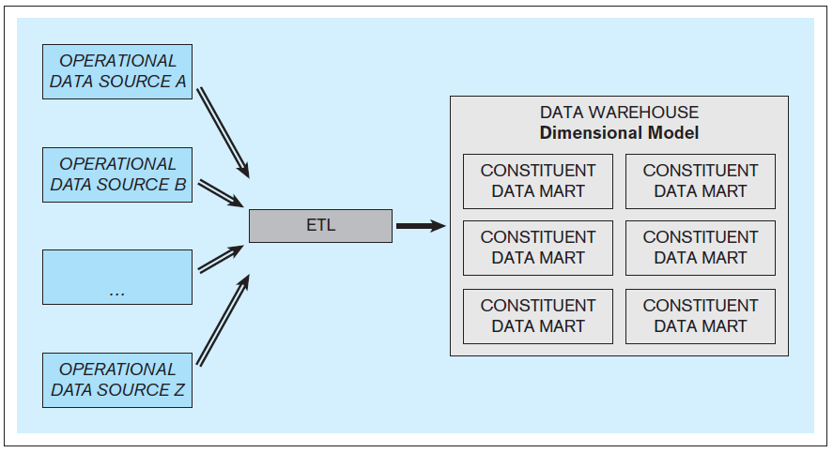
DW Architecture: Ralph Kimball Approach
Dimensionally Modeled Data Warehouse
Database Systems
by Jukić, Vrbsky, & Nestorov
Pearson 2014
ISBN 978-0-13-257567-6

Slide 31
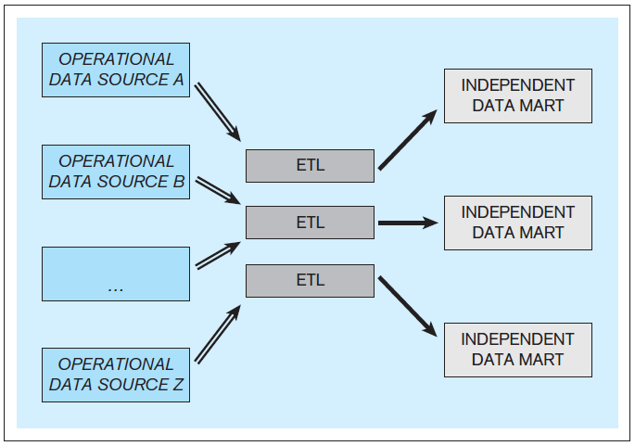
DW Architecture: Independent Data Marts
Inferior – Do not use!
Database Systems
by Jukić, Vrbsky, & Nestorov
Pearson 2014
ISBN 978-0-13-257567-6

Slide 32
Online Transaction Processing (OLTP)
Online: The computer responds immediately or very quickly.
online ≠ Internet
OLTP
online transaction processing
operational database = OLTP system
Update and query operational data.
Present data
Generate reports

Slide 33
Online Analytical Processing (OLAP)
Query data from data warehouses and/or data marts to analyze and present data.
OLAP tools support decision making.
OLAP tools are read only.
OLAP operations
drill up and drill down
slice and dice
pivot

Slide 34
OLAP Drill Up and Drill Down
Drill through dimension hierarchies.
Examples:
Location: country → state → region → city → store
Time: year → quarter → month → week → day → hour
Drill up
AKA roll up
Make the data granularity coarser.
Aggregate the data.
Drill down
Make the data granularity finer.

Slide 35
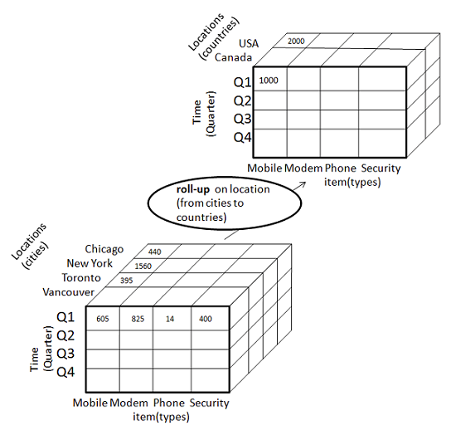
OLAP Drill Up and Drill Down, cont’d
http://www.tutorialspoint.com/dwh/dwh_olap.htm

Slide 36
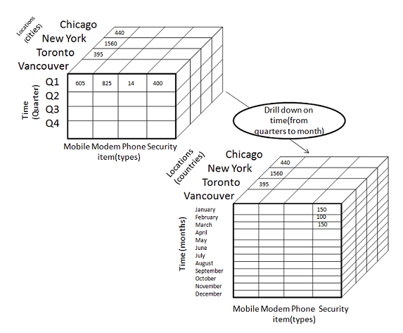
OLAP Drill Up and Drill Down, cont’d
http://www.tutorialspoint.com/dwh/dwh_olap.htm

Slide 37
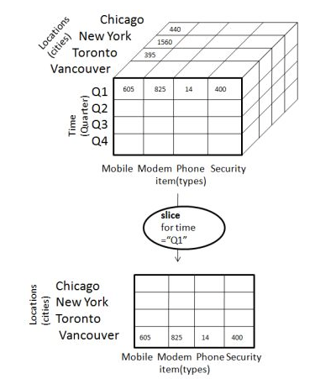
Slice and Dice
Slice: Select one value of a dimension attribute.
http://www.tutorialspoint.com/dwh/dwh_olap.htm

Slide 38
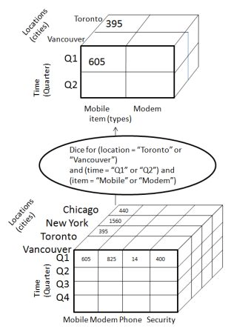
Slice and Dice
Dice: Select attribute values from two or more dimensions.
http://www.tutorialspoint.com/dwh/dwh_olap.htm

Slide 39
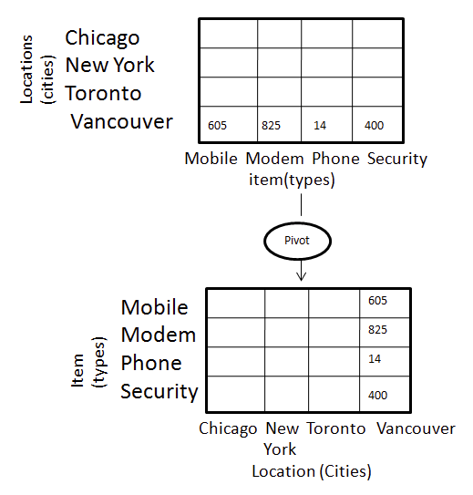
Pivot
Pivot: Reorganize query results by rotation.
http://www.tutorialspoint.com/dwh/dwh_olap.htm

Slide 40
Conformed Dimensions
When multiple star schemas share a common set of dimensions, the dimensions are called conformed dimensions.
Conformed dimensions enable analyses to span multiple star schemas, where the schemas share a common view of the world.
For example, all the schemas must share a common view of what a customer is.
Drill across: A OLAP operation that spans multiple star schemas.

Slide 41
OLAP/BI Tools
Users can query fact and dimension tables by using simple point-and-click query-building applications.
Based on user actions, the tool generates and executes the SQL code on the data warehouse or data mart.
SQL code to drill up or down, slice or dice, or pivot.
Example OLAP/BI tools
IBM Cognos, Oracle BI, TIBCO Spotfire, Tableau

Slide 42
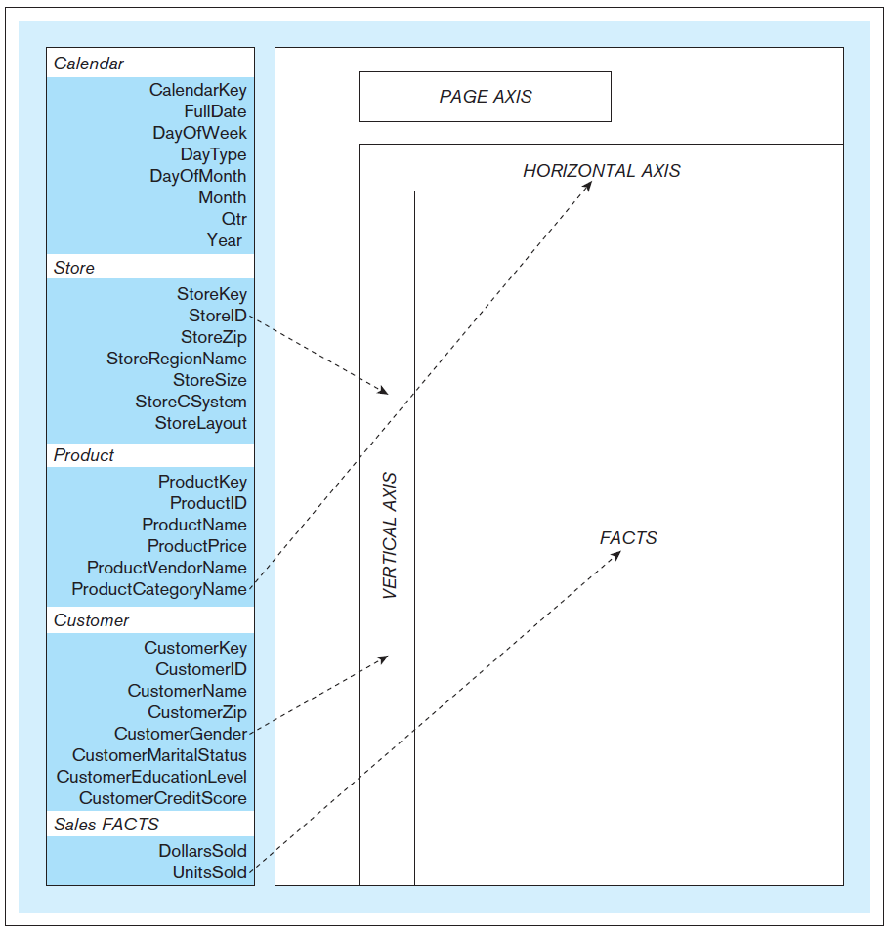
OLAP/BI Tools, cont’d
Typical OLAP
tool layout
Database Systems
by Jukić, Vrbsky, & Nestorov
Pearson 2014
ISBN 978-0-13-257567-6

Slide 43
OLAP/BI Tool Demos
RadarSoft: http://olaponline.radar-soft.com/Demos/HtmlOLAPGrid.aspx
Telerik: http://demos.telerik.com/aspnet-ajax/pivotgrid/examples/olap/defaultcs.aspx
See also: http://www.softwareadvice.com/bi/?more=true#more

Slide 44
Assignment #7
Team assignment.
Perform OLAP operations on your dimensional model from Assignment #6.
For each of the following operations, write and execute SQL queries using your sample data:
drill up
drill down
slice
dice

Slide 45
Assignment #7, cont’d
For each OLAP operation, show the query, and “before” and “after” query output.
Example: Do a query that shows quarterly results. Then for a drill down, do a query that shows monthly results. For a drill up, do a query that aggregates and shows yearly results.
Submit a zip file into Canvas containing:
Dump of your dimensional model.
SQL queries and text files containing the results.
Due Tuesday, April 18.

