Slide 1


CMPE 142
Operating Systems
May 7 Class Meeting
Department of Computer Engineering
San Jose State University
Spring 2021
Instructor: Ron Mak
www.cs.sjsu.edu/~mak

Slide 2
Distributed File System (DFS)
Multiple users share files and storage resources.
  The World Wide Web is today’s predominant distributed system.
A distributed file system manages
a set of dispersed storage devices.
  Multiplicity and autonomy of clients and servers.
  Appear as a conventional, centralized file system with no distinction between local and remote files.
  Performance includes the overhead of network access and communication.

Slide 3
DFS Structure
Service
  Software entity running on one or more machines.
  Provide a particular type of function to clients.

Slide 4
DFS Structure, cont’d
Server
  Service software running on a single machine.
Client
  Process that invokes a service using
  a set of operations that forms its client interface.
  A client interface for a file service is formed by
  a set of primitive file operations (create, delete,
  read, write).
  The client interface of a DFS should be transparent.
  Don’t distinguish between local and remote files.

Slide 5
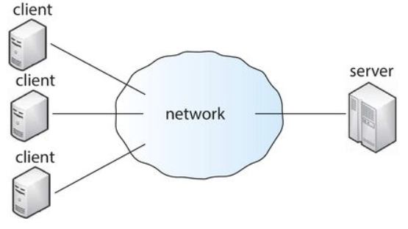
Client-Server DFS Model
Clients are connected to the server through a network and can request access to files in the DFS by contacting the server through a well-known protocol.
  Example protocol: Network File System (NFS)
Operating System Concepts, 10th edition
by Abraham Silberschatz, Greg Gagne, and Peter B. Galvin
Wiley, 2018, ISBN 978-1119456339

Slide 6
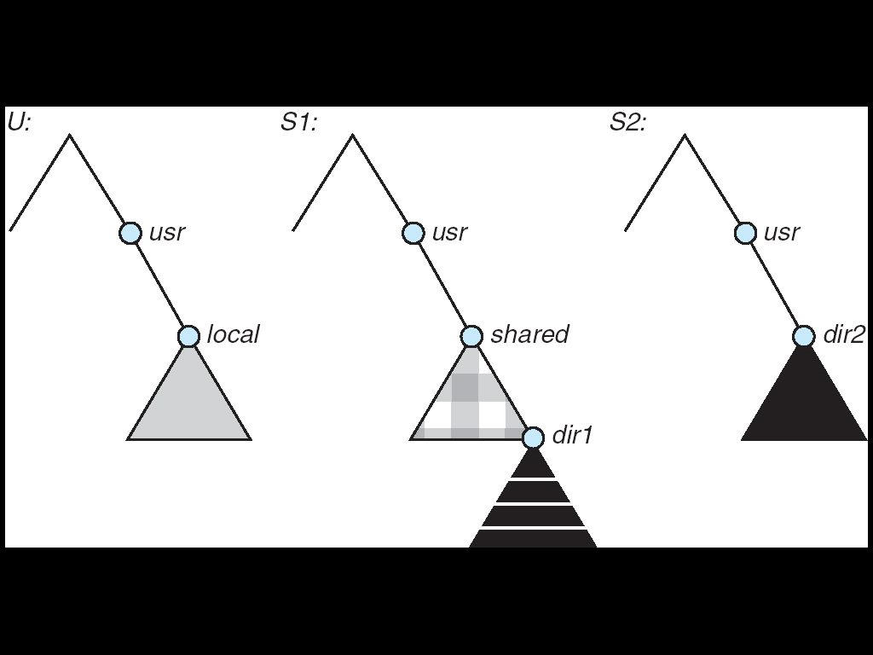
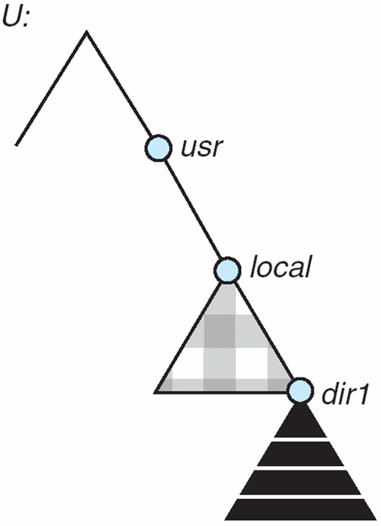
Reminder: NFS Mounting
(a)
(b)
A local file system U and two remote file systems S1 and S2.
The result of mounting the remote /usr/shared from S1 onto /usr/local
Operating System Concepts, 10th edition
by Abraham Silberschatz, Greg Gagne, and Peter B. Galvin
Wiley, 2018, ISBN 978-1119456339

Slide 7
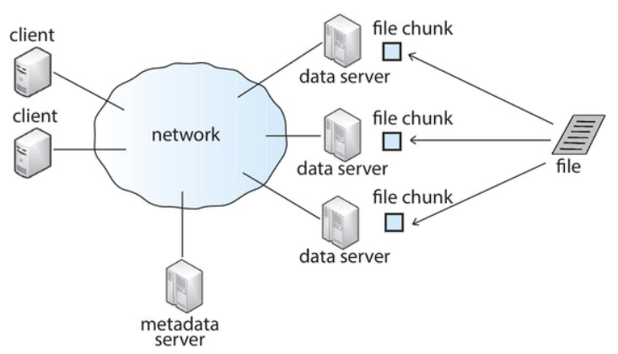
Cluster-Based DFS Model
Clients are connected via a network to a master metadata server and several data servers that house “chunks” (portions) of files.
  Examples: The Google File System (GFS) and the Hadoop Distributed File System (HDFS).
Operating System Concepts, 10th edition
by Abraham Silberschatz, Greg Gagne, and Peter B. Galvin
Wiley, 2018, ISBN 978-1119456339

Slide 8
Naming and Transparency
Naming
  Mapping between logical and physical objects.
Multilevel mapping
  textual name ➔ numerical identifier ➔ disk blocks
  Abstraction of a file that hides the details of
  how and where on the disk the file is actually stored.

Slide 9
Naming and Transparency, cont’d
A transparent DFS hides the location
in the network where the file is stored.
For a file being replicated in several sites,
the mapping returns a set of the locations
of the file’s replicas.
Both the existence of multiple copies and
their location are hidden from a client.

Slide 10
Naming and Transparency, cont’d
Location transparency
  A file name does not reveal
  the file’s physical storage location.
Location independence
  A file name does not need to be changed
  when the file’s physical storage location changes.

Slide 11
Naming and Transparency, cont’d
File migration (file mobility)
  Automatically change a file’s location.
  Examples:
    The Hadoop Distributed File System (HDFS)
    Amazon’s S3 (Simple Storage Service)
    cloud storage facility

Slide 12
Three Naming Schemes
Files are named by combination
of their host name and local name.
  Guarantees a unique system-wide name.
  Neither location transparent nor location independent.
Mount remote directories to local directories.
  Give the appearance of a coherent directory tree.
  Automount feature to mount on demand.
A single global name structure spans all files
in the system.
  A difficult goal to maintain due to special files.

Slide 13
Remote File Access
Remote-service mechanism
  A server on the network handles
  all remote file access requests.
Retain recently accessed disk blocks in a cache.
  Reduce network traffic.
  Repeated accesses to the same information
  can be handled locally.
  If needed data is not already cached,
  a copy of data is brought from the server to the user.
    Accesses are performed on the cached copy.

Slide 14
Remote File Access, cont’d
Identify files with one master copy
residing at the server.
  Copies of (parts of) the file
  are scattered in different caches.
Cache-consistency problem
  Keep the cached copies consistent
  with the master file.
Network virtual memory
  Demand-paged virtual memory
  with a remote backing store.
  NFS-mounted swap space.

Slide 15
Cache Update Policy: Write-Through
Write data through to disk as soon as
the data is placed on any cache.
Reliable, but poor performance.

Slide 16
Cache Update Policy: Delayed Write
Modifications are written to the cache
and then written through to the server later.
  AKA write-back caching
Write accesses complete quickly.
  Some cached data may be overwritten
  before being written back, and so
  only the last update needs to be written.
Poor reliability
  Unwritten data will be lost whenever
  a user machine crashes.

Slide 17
Cache Update Policy: Delayed Write, cont’d
Variation: Scan the cache at regular intervals.
  Flush blocks that have been modified
  since the last scan.
Variation: Write-on-close
  Write data back to the server when the file is closed.
  Best for files that are open for long periods
  and are frequently modified.

Slide 18
Caching Consistency
Is the locally cached copy of the data
consistent with the master copy?

Slide 19
Caching Consistency, cont’d
Client-initiated
  The client initiates a validity check to check whether the local data is consistent with the master copy.
  Frequency options:
    before each access
    at file open
    at fixed intervals
Server-initiated
  The server reacts when it detects
  a potential inconsistency.

Slide 20
Protection
An operating system must protect users and processes from each other’s activities.
  Mechanisms to control the access by programs, processes, or users to the computer system resources.
Each resource object has a unique name
and can be accessed through
a well-defined set of operations.
  Ensure that each object is accessed correctly and only by those processes that are allowed to do so.

Slide 21
Principle of Least Authority (POLA)
A guiding principle of protection.
Give programs, users and systems
just enough privileges to perform their tasks.
Limit damage if an entity has a bug or gets abused.
“Need to know”
  At any time, a process should be able to access
  only those resources that it currently requires
  to complete its task.

Slide 22
Protection Granularity
Rough-grained privilege management
is easier and simpler.
  Principle of least authority done in large chunks.
  Example: Traditional UNIX processes either have abilities of the associated user or of the root user.
Fine-grained management is more complex
and more overhead, but more protective.
  Examples:
    File access control lists (ACLs)
    Role-based access control (RBAC)

Slide 23
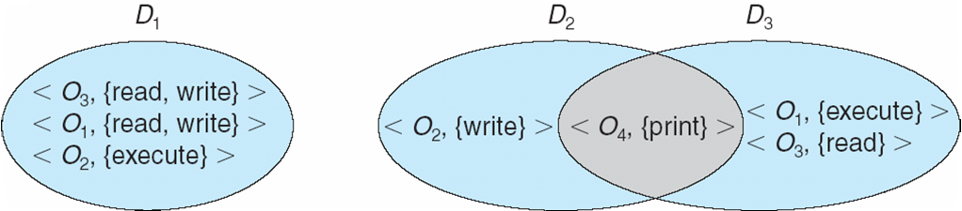
Protection Domains
A domain is a set of resource objects
and their allowable operations.
  A set of access rights as <object-name, rights-set> pairs
  Example: <file F, {read, write}>
Users, processes, and program procedures
can be in domains.
Operating System Concepts, 10th edition
by Abraham Silberschatz, Greg Gagne, and Peter B. Galvin
Wiley, 2018, ISBN 978-1119456339

Slide 24
UNIX Domains
In UNIX, a process’s domain is defined
by its UID (user ID) and GID (group ID).
A (UID, GID) combination determines:
  A complete list of all the
  accessible resource objects.
  Whether they can be read, written, or executed.

Slide 25
UNIX Domains, cont’d
Two processes with the same (UID, GID) combination have access to the
same set of objects.
Processes with different (UID, GID) combinations will have access
to different but possibly overlapping
sets of objects.

Slide 26
UNIX Domain Switching
A system call causes a domain switch
from the user’s domain to that of the kernel.
When a process executes a file
with the SETUID or SETGID bit on,
it acquires the UID or GID of the file owner.
  Get a different set of access rights.
  The UID and GID are reset
  when the execution completes.

Slide 27
UNIX Domain Switching, cont’d
Domain switch accomplished via passwords.
  The su command temporarily switches
  to another user’s domain when
  the other domain’s password is provided.
Domain switching via commands
  The sudo command prefix executes
  a specified command in another domain.

Slide 28
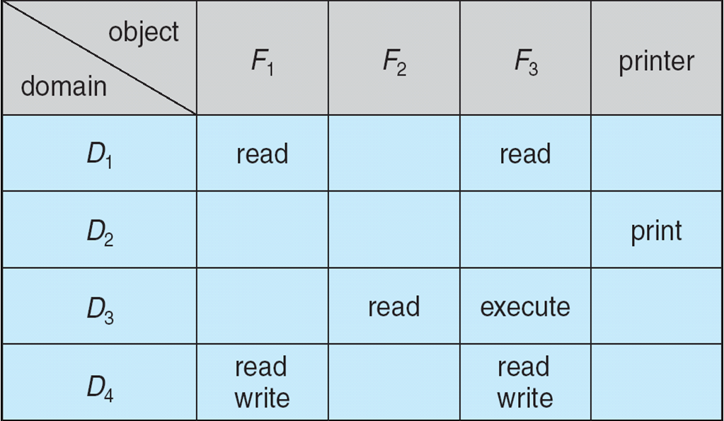
The Access Matrix
Rows represent domains
Columns represent objects
Access(i, j) is the set of operations that a process executing in Domain_{i} can invoke on Object_{j}
Operating System Concepts, 10th edition
by Abraham Silberschatz, Greg Gagne, and Peter B. Galvin
Wiley, 2018, ISBN 978-1119456339

Slide 29
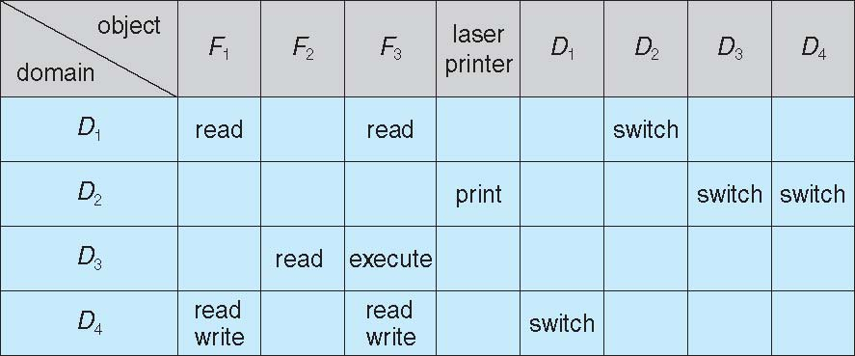
The Access Matrix, cont’d
Domains are also objects.
  Allow switching operations between domains.
The access matrix is generally very sparse.
  Can be implemented in other more efficient ways.
Operating System Concepts, 10th edition
by Abraham Silberschatz, Greg Gagne, and Peter B. Galvin
Wiley, 2018, ISBN 978-1119456339

Slide 30
The Access Matrix, cont’d
Separate mechanism from policy.
Mechanism
  The OS provides access matrix + rules.
  The OS ensures that the matrix is only manipulated by authorized agents and that rules are strictly enforced.
Policy
  User dictates policy.
  Who can access what object and in what mode.

Slide 31
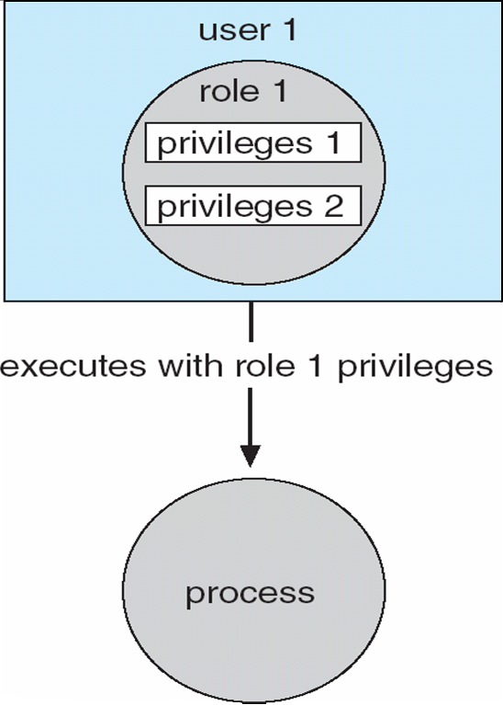
Role-Based Access Control (RBAC)
Implements the principle of least authority.
Users are assigned roles
that grant access to
privileges and programs
  Enable a role via a password
  to gain its privileges.
Operating System Concepts, 10th edition
by Abraham Silberschatz, Greg Gagne, and Peter B. Galvin
Wiley, 2018, ISBN 978-1119456339

Slide 32
Program-Level Protection
Programming languages can have
built-in protection mechanisms.
Allow the high-level description of policies
for the allocation and use of resources.
Provide software for protection enforcement
when automatic hardware-supported checking
is unavailable.

Slide 33
Break

Slide 34
Security
Protection mechanisms protect against
internal problems.
Security measures protect against
external threats.

Slide 35
Security Violations
Breach of confidentiality
  Unauthorized reading of data.
Breach of integrity
  Unauthorized modification of data.
Breach of availability
  Unauthorized destruction of data.

Slide 36
Security Violations, cont’d
Theft of service
  Unauthorized use of resources.
Denial of service (DOS)
  Prevention of legitimate use.

Slide 37
Security Violation Methods
Masquerading (breach authentication)
  Pretend to be an authorized user
  to escalate privileges.
Replay attack
  With or without message modification.
Session hijacking
  Intercept an already-established session
  to bypass authentication.

Slide 38
Security Violation Methods
Man-in-the-middle attack
  An intruder sits in data flow to masquerade
  as the sender in order to fool the receiver,
  and vice versa.

Slide 39
The Bad Guys
“Script kiddies”
  Young “hackers” who run malicious scripts
  that are shared among the hacker communities.
  Break-ins and stolen data are trophies for bragging.
  Can be thwarted by “honey pots”
    Fake data at a site designed to lure hackers.
Corporate thieves
  Steal confidential data from competitors.
Hostile (or friendly) governments
  Snooping and monitoring
  Spying

Slide 40
Layers of Security
It is impossible to have absolute security.
Make the cost to the perpetrator
sufficiently high to deter most intruders.
Security is as strong as the
weakest link in the chain.
But can too much security be a problem?

Slide 41
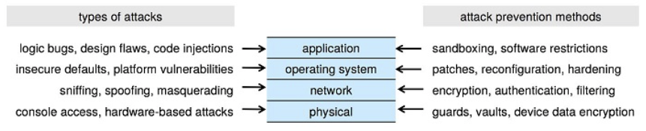
Layers of Security, cont’d
Operating System Concepts, 10th edition
by Abraham Silberschatz, Greg Gagne, and Peter B. Galvin
Wiley, 2018, ISBN 978-1119456339

Slide 42
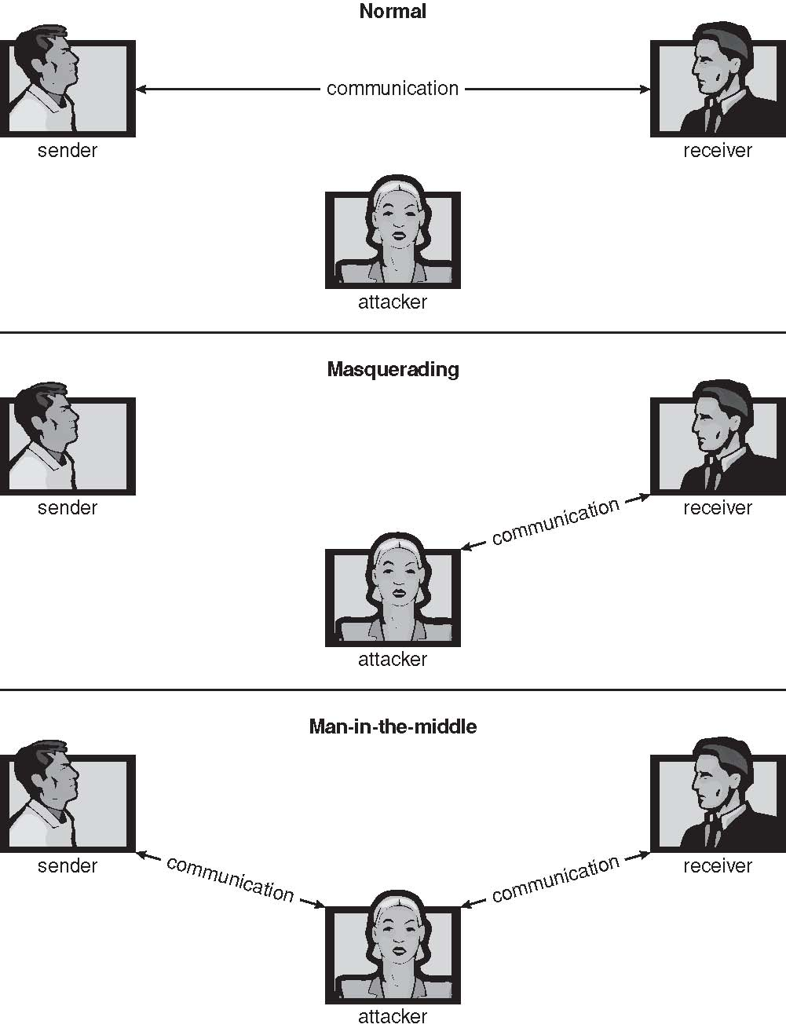
Man (or Woman) in the Middle Attack
Operating Systems Concepts, 9th edition
Silberschatz, Galvin, and Gagne
(c) 2013 John Wiley & Sons. All rights reserved. 978-1-118-06333-0

Slide 43
Trojan Horse Attack
A program written by one user can execute
in another user’s environment.
  The program gains the other user’s access rights.
  The program misuses those rights.
A long UNIX path names exposes
each directory on the path.
A path that includes “.” when used in another user’s directory can give a program access to the other user’s home directory.

Slide 44
Trojan Horse Attack, cont’d
Examples:
  spyware
  pop-up browser windows
  browser plug-ins
  covert channels
Up to 80% of spam is delivered
by spyware-infected systems.

Slide 45
Trap Door Attack
Specific user identifier or password that
circumvents normal security procedures.

Slide 46
Logic Bomb
A program initiates a security incident
under certain circumstances.
Developed by a disgruntled programmer.
  Must enter a password daily
  to prevent the bomb from going off.
If the programmer is fired, the bomb explodes.
Must hire the programmer back as an expensive consultant to “solve” the problem.

Slide 47
Stack and Buffer Overflow
Exploit a bug in a program to gain
unauthorized user or privilege escalation.
  Overflow either the stack or memory buffers.
  Fail to check bounds on inputs or arguments.
Write past the arguments on the stack
into the return address on stack.
  When routine returns from a function call,
  it returns to a hacked address.

Slide 48
Viruses
A malicious code fragment
embedded in a legitimate program.
Self-replicating, designed to
infect other computers.
Very specific to CPU architecture,
operating system, applications.
Usually borne via email or as a macro.

Slide 49
Categories of Viruses
Parasitic file
Boot
Macro
Source code
Polymorphic
  Avoids having a virus signature
Encrypted
  Encrypted to avoid detection.
  Decrypts to execute.

Slide 50
Categories of Viruses, cont’d
Stealth
  Modifies parts of the system
  that can be used to detect it.
Tunneling
  Installs in the interrupt-handler chain
  or in device drivers.
Multipartite
  Infect multiple parts of a system.
Armored
  Hard for antivirus researchers to detect.

Slide 51
Ransomware
A virus that encrypts important data on a user’s computer system.
  The villain demands payment (often in bitcoins)
  for the decryption key.
Threaten to post stolen private data on the web.
  The villain demands payment (often in bitcoins)
  or the data will be made public.

Slide 52
Keystroke Logger Virus
A virus that intercepts keystrokes.
Records passwords, etc.
Sends confidential information
to a malicious recipient.

Slide 53
Port Scanning
Automated attempt to connect
to a range of ports on one IP address
or on a range of IP addresses.

Slide 54
Denial of Service
Overload the targeted computer to prevent it
from doing any useful work.
A distributed denial-of-service (DDOS)
comes from multiple sites at once.
  “Ping” of death.
Consider traffic to a web site.
  How can you tell the difference between
  being a target and being really popular?
  Accidental: Students writing bad fork() code.

Slide 55
Design Principles for Security
The system design should be public.
The default should be no access.
Check for current authority.
Give each process the least authority possible.
The protection mechanism should be
simple, uniform, and built into the
lowest layers of the system.
The scheme chosen must be
psychologically acceptable.

Slide 56
User Authentication: Passwords
Passwords are often easy to guess.
A classic research study compiled a list
of likely passwords.
  first and last names
  street and city names
  words from a moderate-sized dictionary
  license plate numbers
  short strings of random numbers
  Discovered that over 86% of passwords
  then in use were in their list.

Slide 57
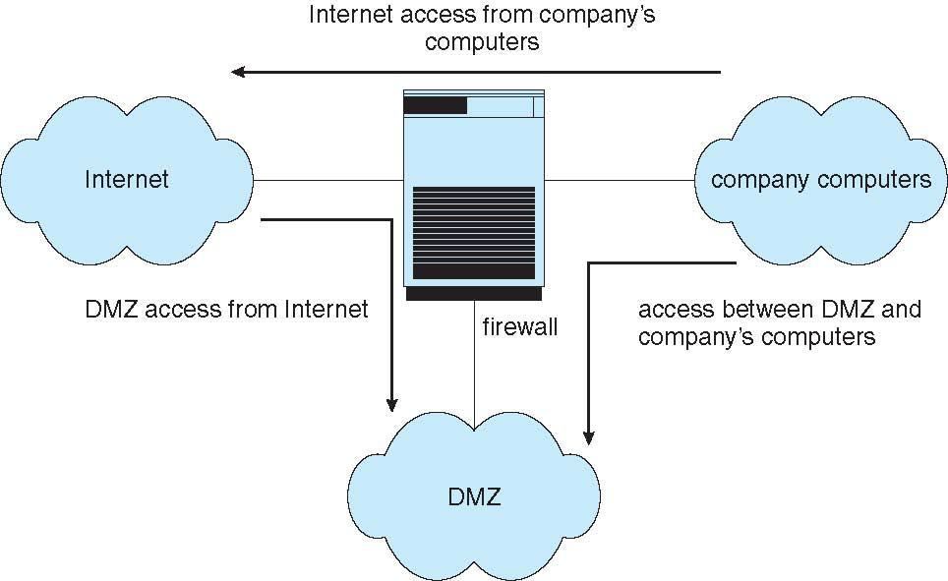
Security Firewalls
Operating System Concepts, 10th edition
by Abraham Silberschatz, Greg Gagne, and Peter B. Galvin
Wiley, 2018, ISBN 978-1119456339

Slide 58



Nontechnical Security Lecture
Presented to high
school teachers
July 15, 2015.
Sending data such as email messages
to each other via the Internet …
… is like sending postcards
via the U.S. mail system.
Anyone can read the
message along the way!
We plan to manufacture 7 million widgets next quarter.
Jill
John

Slide 59

Security, cont’d
We plan to manufacture 7 million widgets next quarter.
Jill
John
Bart
How can we keep the nefarious Bart
from reading confidential messages that
Jill and John are sending each other?

Slide 60
The Shared Secret
Jill needs to send a message containing the confidential data 7 to John.
John and Jill can agree ahead of time to a shared secret – the number 12.
Then Jill can encrypt the data by adding 12
to the confidential data 7.
John decrypts the data by subtracting 12.
19
John
Shared
secret 12
Jill
Shared
secret 12

Slide 61
The Shared Secret, cont’d
19
John
Shared
secret 12
Jill
Shared
secret 12
Bart
Because Bart doesn’t know the shared secret 12,
he won’t be able to decrypt the message and obtain the confidential data 7.

Slide 62
The Shared Secret, cont’d
19
John
Shared
secret 12
Jill
Shared
secret 12
But this shared secret solution has problems.
  Jill and John must arrange beforehand
  to share the secret 12.
  What if Jill doesn’t already know John?
  What if Jill wants to send the confidential data
  to all her vice presidents at the same time?
How can Jill and her recipients share a secret?

Slide 63
Public Key Cryptography, cont’d
How can Jill and her recipients share a secret number in order to encrypt the confidential data?
A security scheme called public key cryptography was invented just for this purpose.
In this simplified introduction, let’s pretend that multiplication is a one-way operation.
  Once you’ve multiplied two numbers, say 4x5=20,
  you can’t recover the original numbers by dividing.
  In other words, you can’t do 20÷4=5 or 20÷5=4

Slide 64
Public Key Cryptography, cont’d
Jill chooses a private key.
  Let’s suppose Jill chooses 10.
Each person to whom Jill wants to send confidential data also chooses a private key.
  Let’s suppose John chooses 8.
Private
key 10
Jill
John
Private
key 8

Slide 65
Public Key Cryptography, cont’d
Private
key 10
Jill
John
Private
key 8
Public
key 5
Bart
Now Jill announces a public key.
  Let’s suppose the public key is 5.
Everyone can see the public key.
  Including the nefarious Bart.

Slide 66
Public Key Cryptography, cont’d
Jill’s
public-private
key 50
John’s
public-private
key 40
Private
key 10
Jill
John
Private
key 8
Public
key 5
Now Jill can create her public-private key.
  She multiplies her private key by the public key: 10x5=50.
John creates his public-private key.
  He multiplies his private key by the public key: 8x5=40.

Slide 67
Public Key Cryptography, cont’d
Jill’s
public-private
key 50
John’s
public-private
key 40
Private
key 10
Jill
John
Private
key 8
Public
key 5
Remember that we’re pretending that multiplication is a one-way operation.
We cannot discover Jill’s private key 10 by dividing her public-private key 50 by the public key 5.
We cannot discover John’s private key 8 by dividing his public-private key 40 by the public key 5.

Slide 68
Public Key Cryptography, cont’d
Jill’s
public-private
key 50
John’s
public-private
key 40
Private
key 10
Jill
John
Private
key 8
Public
key 5
What is the goal of all this?
  To create a shared secret between Jill and John.
Jill multiplies John’s public-private key by her private key: 40x10=400
John multiplies Jill’s public-private key by his private key: 50x8=400

Slide 69
Public Key Cryptography, cont’d
Shared
secret 400
Jill’s
public-private
key 50
John’s
public-private
key 40
Shared
secret 400
Private
key 10
Jill
John
Private
key 8
Public
key 5
Now Jill and John have a shared secret 400.
Jill can encrypt the confidential data 7
by adding the shared secret 400.
John can decrypt the confidential data 7
by subtracting the shared secret 400.

Slide 70
Public Key Cryptography, cont’d
407
John
Shared
secret 400
Jill
Shared
secret 400
Bart
Bart can’t decrypt the 407 because he doesn’t know the shared secret 400.

Slide 71
Public Key Cryptography, cont’d
Public key encryption works
with multiple recipients.
Jill needs to send confidential data
to both John and his
twin brother Mark.
Each picks a private key.
Mark
Private
key 2
Private
key 10
Jill
John
Private
key 8

Slide 72
Public Key Cryptography, cont’d
Jill announces the public key 5, and everyone generates his or her public-private key.
  Jill: 10x5=50
  John: 8x5=40
  Mark: 2x5=10
Mark’s
public-private
key 10
Mark
Private
key 2
Public
key 5
Jill’s
public-private
key 50
John’s
public-private
key 40
Private
key 10
Jill
John
Private
key 8

Slide 73
Public Key Cryptography, cont’d
Jill will have a shared secret with each recipient.
  Jill and John will share 400 between them, as before.
  Jill and Mark will have a different shared secret.
    Jill: Multiply Mark’s
    public-private key by
    her private key:
    10x10=100.
    Mark: Multiply Jill’s
    public-private key by
    his private key:
    50x2=100
Mark’s
public-private
key 10
Shared secret
with Jill: 100
Mark
Private
key 2
Public
key 5
Jill’s
public-private
key 50
John’s
public-private
key 40
Shared secret
with Jill: 400
Shared secret
with John: 400
Private
key 10
Jill
John
Private
key 8
Shared secret
with Mark: 100

Slide 74
Public Key Cryptography, cont’d
Jill sends to each recipient.
  Bart can’t decrypt the messages to recover the confidential data 7 because he doesn’t know
  the shared secrets.
Shared secret
with Jill: 100
Mark
107
Shared secret
with John: 400
407
Shared secret
with Jill: 400
Jill
John
Shared secret
with Mark: 100
Bart

Slide 75
Cryptography in the Real World
Of course, in the real world, we can’t use simple operations like multiplication and addition to generate keys and to encrypt data.
  Multiplication and addition are
  not one-way operations.
Real-world encryption uses very large
prime numbers and modulo arithmetic.
  Not even today’s most powerful supercomputer
  can undo such operations.
  Worry: Can quantum computers in the future?

Slide 76
When is Cryptography Used?
Public key cryptography is a key exchange protocol first published by Whitfield Diffie
and Martin Hellman in 1976.
  It was actually invented earlier in 1970 by the
  British government, but it was classified.
Whenever you visit a secure website, you are using the Diffie-Hellman protocol or a variant.
  A secure website has a URL that
  starts with https: instead of http:

Slide 77
Computer Security as a Career
Cybersecurity is a hot field.
  Computers are used everywhere.
  Big data.
  Privacy issues.
Operate in a dark, shadowy world.
  SRI anecdote.

