Slide 1
CMPE 135 Object-Oriented Analysis and Design April 13 Class Meeting
Department of Computer Engineering San Jose State University Spring 2021 Instructor: Ron Mak
www.cs.sjsu.edu/~mak

Slide 2
Design Patterns
Strategy Pattern
Observer Pattern
Decorator Pattern
Factory Method
Adapter

Slide 3
Adapters
How can you plug your laptop with its American power cord into a British wall outlet?
adaptee
interface
the client
target
interface
These examples and their images are from
Head First Design Patterns
by Eric & Elizabeth Freeman
O’Reilly, 2004

Slide 4
Object-Oriented Adapters

Slide 5
Object-Oriented Adapters, cont’d
The adapter acts as the middleman.
Your existing system (as the client) wants to make requests to the vendor code.
The adapter converts the requests into requests that make sense to the vendor classes.
the adaptee
the client
target
interface
adaptee
interface

Slide 6
It’s those Ducks, Again
target interface
class Duck
{
public:
virtual void quack() = 0;
virtual void fly() = 0;
}
MallardDuck is a subclass.
class MallardDuck : public Duck
{
public:
void quack()
{
cout << "Quack";
}
void fly()
{
cout << "I’m flying";
}
}

Slide 7
Turkeys
The latest fowl:
adaptee interface
class Turkey
{
public:
virtual void gobble() = 0;
virtual void fly() = 0;
}
class WildTurkey : public Turkey
{
public:
void gobble()
{
cout << "Gobble gobble" << endl;
}
void fly()
{
cout << "I’m flying a short distance" << endl;
}
}

Slide 8
Turkeys, cont’d
If we’re short of Duck objects, how can we use Turkey objects in their place?
Turkey objects have a different interface.
We need to create an adapter.

Slide 9
Turkey Adapter
Adapt a turkey to be a duck.
class TurkeyAdapter : public Duck
{
private:
Turkey *turkey;
public:
TurkeyAdapter(Turkey *turkey)
{
this->turkey = turkey;
}
void quack()
{
turkey->gobble();
}
void fly()
{
for (int i = 0; i < 5; i++)
{
turkey->fly();
}
}
}
target interface
adaptee interface

Slide 10
Adapter Test Drive
int main()
{
MallardDuck *duck = new MallardDuck();
WildTurkey *turkey = new WildTurkey();
Duck *turkeyAdapter = new TurkeyAdapter(turkey);
cout << "The turkey says ..." << endl;
turkey->gobble();
turkey->fly();
cout << endl << "The duck says ..." << endl;
testDuck(duck);
cout << endl << "The turkey says ..." << endl;
testDuck(turkeyAdapter);
return 0;
}
static void testDuck(Duck *duck)
{
duck->quack();
duck->fly();
}
Adapt a turkey to be a duck.
class TurkeyAdapter : public Duck
{
private:
Turkey *turkey;
public:
TurkeyAdapter(Turkey *turkey)
{
this->turkey = turkey;
}
void quack()
{
turkey->gobble();
}
void fly()
{
for (int i = 0; i < 5; i++)
{
turkey->fly();
}
}
}

Slide 11
Adapter Test Drive, cont’d

Slide 12
The Adapter Pattern Explained
duck
turkey
turkey interface
duck interface

Slide 13
How the Client Uses the Adapter
duck asks to quack
The client makes a request to the adapter by calling a method on it using the target interface.
The adapter translates the request into calls on the adaptee using the adaptee interface.
The client receives the results of the call without knowing that an adapter did the translation.
The client and adaptee are decoupled – neither knows about the other.
quack ➔ gobble
duck
turkey

Slide 14
Adapter Design Pattern Defined
The Adapter Design Pattern converts the interface of a class into another interface that the clients expect.
Adapter lets classes work together that couldn’t otherwise because of incompatible interfaces.

Slide 15
Adapter Design Pattern Class Diagram
duck
turkey

Slide 16
Design Patterns
Strategy
Observer
Decorator
Factory Method
Adapter
Façade

Slide 17
The Façade Pattern
The Adapter Pattern converts the interface of a class to one that the client expects.
Wrap the object that has the incompatible interface with an object that implements the target interface.
The Façade Pattern provides a simpler interface that hides a more complex interface.
Hide the complexity of one or more classes behind a clean, well-designed façade.
These examples and their images are from
Head First Design Patterns
by Eric & Elizabeth Freeman
O’Reilly, 2004

Slide 18
Example: Home Theater

Slide 19
Watch a Movie the Hard Way
Turn on the popcorn popper
Start the popper popping
Dim the lights
Put the screen down
Turn the projector on
Set the projector input to DVD
Put the projector on wide-screen mode
Turn the sound amplifier on
Set the amplifier to DVD input
Set the amplifier to surround sound
Set the amplifier volume to medium (5)
Turn the DVD player on
Start the DVD player playing

Slide 20
Watch a Movie the Hard Way, cont’d

Slide 21
More Complexities
When the movie is over, how do you turn everything off?
Wouldn’t you have to do all this over again, in reverse?
Wouldn’t it be as complex to listen to a CD or the radio?
If you decide to upgrade your system, you’re probably going to have to learn a slightly different procedure.

Slide 22
Simplify with the Façade Pattern
Simplify a complex system by implementing a Façade class that provides a more reasonable interface.
If necessary, you can still go behind the façade to access the underlying complex system.

Slide 23
Simplify with the Façade Pattern, cont’d

Slide 24
Adapter vs. Façade Patterns
They differ in intent.
The Adapter Pattern alters an interface to match one that the client expects.
The Façade Pattern provides a simplified interface to a complex subsystem.
The Façade Pattern decouples a client from a subsystem of components.

Slide 25
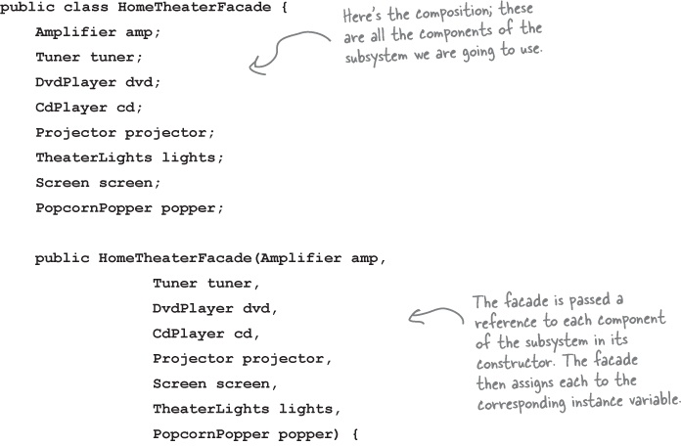
The Home Theater Façade

Slide 26
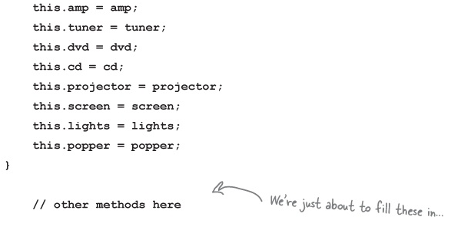
The Home Theater Façade, cont’d

Slide 27
Implementation

Slide 28
Watch a Movie the Easy Way

Slide 29
Watch a Movie the Easy Way, cont’d

Slide 30
Façade Design Pattern Defined
The Façade Design Pattern provides a unified interface to a set of interfaces in a subsystem.
Façade defines a higher-level interface that makes the subsystem easier to use.
It allows us to avoid tight coupling between clients and subsystems.

Slide 31
Façade Design Pattern Defined

Slide 32
Principle of Least Knowledge
AKA Law of Demeter.
From any member function of an object, you may only call functions that belong to:
The object itself
Objects passed in as a parameter to the function
Any object the function creates or instantiates
Any components of the object
The member function should not call a member function of an object returned from another call.

Slide 33
Principle of Least Knowledge, cont’d

Slide 34
Principle of Least Knowledge, cont’d

Slide 35
Principle of Least Knowledge, cont’d
The Façade Design Pattern
supports the Principle of
Least Knowledge.

