Slide 1
CMPE 135: Object-Oriented Analysis and Design March 23 Class Meeting
Department of Computer Engineering San Jose State University Spring 2021 Instructor: Ron Mak
www.cs.sjsu.edu/~mak

Slide 2
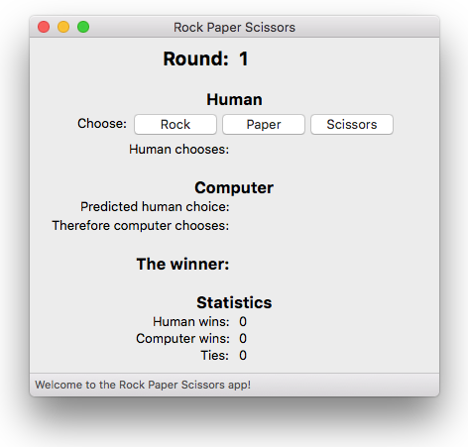
wx-RPS: MacOS X

Slide 3
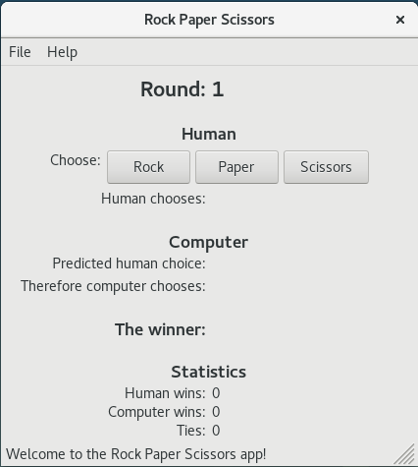
wx-RPS: Linux

Slide 4
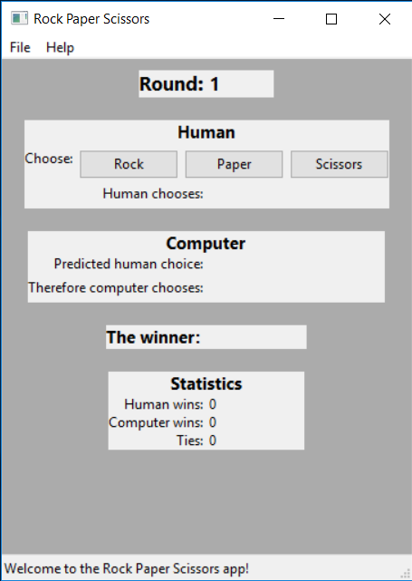
wx-RPS: Windows 10
Why does the app look
so ugly on Windows?

Slide 5
Tutorials
My tutorials: http://www.cs.sjsu.edu/~mak/tutorials/index.html
Install Ubuntu
Configure Ubuntu
Install wxWidgets
Compile all the sample and demo programs.
The top-level makefile in directories samples and demos compiles all the samples and demos.
Each program directory contains a makefile.
Use these makefiles as models for your makefile.
Install the latest
stable version 3.0.5.

Slide 6
Install wxWidgets on Mac OS X
An alternative to the tutorial’s instructions.
On the command line:
This will install wxWidgets in /usr/local/Cellar/wxmac/3.0.5.1_1
See: http://web.eng.fiu.edu/watsonh/eel3160/WxMac.pdf
A major downside of installing this way is that brew does not install the samples and demos.
brew install wxmac

Slide 7
wxWidgets Apps in MacOS Eclipse
Create a C++ project in Eclipse and open the Properties dialog box.
In the left panel, select C/C++ Build ➔ Settings

Slide 8
wxWidgets Apps in MacOS Eclipse, cont’d
GCC C++ Compiler
Dialect:
Includes: Include paths
Preprocessor: Defined symbols (-D)
Miscellaneous: Other flags
If you don’t want to use Eclipse,
each sample and demo directory
has a makefile to build on the
command line. Use these makefiles
as models for your makefile.
C++11
/usr/local/Cellar/wxmac/3.0.5.1_1/lib/wx/include/osx_cocoa-unicode-3.0
/usr/local/Cellar/wxmac/3.0.5.1_1/include/wx-3.0
Adjust the paths to match your installation.
__WXOSX_COCOA__
WXUSINGDLL
_FILE_OFFSET_BITS=64
Double underscores!
-c -mmacosx-version-min=10.14 -fmessage-length=0 -fvisibility=hidden -fvisibility-inlines-hidden

Slide 9
wxWidgets Apps in MacOS Eclipse, cont’d
MacOS X C++ Linker
Libraries (-l)
Library search path (-L)
Miscellaneous: Linker flags (one long line)
wx_osx_cocoau_adv-3.0
wx_osx_cocoau_core-3.0
wx_baseu-3.0
png
z
jpeg
lzma
pthread
iconv
Adjust the path to match your installation.
/usr/local/Cellar/wxmac/3.0.5.1_1/lib
-mmacosx-version-min=10.14 -framework IOKit -framework Carbon -framework Cocoa
-framework AudioToolbox -framework System -framework OpenGL -framework Security

Slide 10
Install wxWidgets on Ubuntu
Download the source code from https://github.com/wxWidgets/wxWidgets/releases/download/v3.0.5/wxWidgets-3.0.5.tar.bz2
Unzip into a subdirectory named wxWidgets-3.0.5 in your home directory.
Follow instructions in docs/gtk/install.txt.
When you’re done, go into directories buildgtk/samples and buildgtk/demos and run make in each to build all the sample programs and demos.

Slide 11
wxWidgets Apps in Ubuntu Eclipse
GCC C++ Compiler
Dialect:
Includes: Include paths
Preprocessor: Defined symbols (-D)
Miscellaneous: Other flags
If you don’t want to use Eclipse,
each sample and demo directory
has a makefile to build on the
command line. Use these makefiles
as models for your makefile.
C++11
/home/ron/wxWidgets-3.0.5/include/
/home/ron/wxWidgets-3.0.5/buildgtk/lib/wx/include/gtk3-unicide-3.0e-3.0
Adjust the paths to match your installation.
__WXGTK__
Double underscores!
-c -fmessage-length=0

Slide 12
wxWidgets Apps in Ubuntu Eclipse, cont’d
GCC C++ Linker
Libraries (-l)
Library search path (-L)
Miscellaneous: Linker flags
wx_gtk3u_core-3.0
wx_gtk3u_adv-3.0
wx_baseu-3.0
wxtiff-3.0
wxjpeg-3.0
/home/ron/wxWidgets-3.0.5/buildgtk/lib
Adjust the paths to match your installation.
-Wl,-rpath,/home/ron/wxWidgets-3.0.5/gtk-build/lib

Slide 13
Inversion of Control
Your code is not in control.
The application framework (e.g., wxWidgets) is in control.
You write callback functions that you register with the framework.
Common callbacks are event handlers.
For example, button event handlers that you register with button components.
The application framework decides when to call your registered callback function in response to an event.
For example, the user clicks a button, and the application framework calls your button event handler.

Slide 14
Hello World Demo
Two key classes:
class HelloWorldApp: public wxApp
Your application class.
A subclass of wxApp.
class HelloWorldFrame: public wxFrame
Your main window class.
A subclass of wxFrame.

Slide 15
Hello World Demo, cont’d
You will override OnInit(), which is called by the wxWidgets framework when your application starts.
HelloWorldApp.h
#include <iostream>
#include <wx/wx.h>
using namespace std;
class HelloWorldApp: public wxApp
{
public:
virtual bool OnInit() override;
};

Slide 16
Hello World Demo, cont’d
HelloWorldApp.cpp
#include <wx/wx.h>
#include "HelloWorldApp.h"
#include "HelloWorldFrame.h"
using namespace std;
bool HelloWorldApp::OnInit()
{
cout << "OnInit: Initializing Hello World app!" << endl;
if (!wxApp::OnInit()) return false;
HelloWorldFrame *frame = new HelloWorldFrame("Hello World",
wxPoint(50, 50),
wxSize(450, 340) );
frame->Show(true);
return true;
}
// Create a new application object.
wxIMPLEMENT_APP(HelloWorldApp);
The main() is generated by
the wxIMPLEMENT_APP macro.

Slide 17
Hello World Demo, cont’d
HelloWorldFrame.h
#include <wx/wx.h>
class HelloWorldFrame: public wxFrame
{
public:
HelloWorldFrame(const wxString& title,
const wxPoint& pos, const wxSize& size);
private:
void OnHello(wxCommandEvent& event);
void OnBonjour(wxCommandEvent& event);
void OnGutenTag(wxCommandEvent& event);
void OnExit(wxCommandEvent& event);
void OnAbout(wxCommandEvent& event);
wxDECLARE_EVENT_TABLE();
};
enum
{
ID_Hello = 1,
ID_Bonjour = 2,
ID_GutenTag = 3
};
The declaration of the event table
is generated by macro
wxDECLARE_EVENT_TABLE.

Slide 18
Hello World Demo, cont’d
HelloWorldFrame.cpp
#include <iostream>
#include <wx/wx.h>
#include "HelloWorldFrame.h"
using namespace std;
wxBEGIN_EVENT_TABLE(HelloWorldFrame, wxFrame)
EVT_MENU(ID_Hello, HelloWorldFrame::OnHello)
EVT_MENU(ID_Bonjour, HelloWorldFrame::OnBonjour)
EVT_MENU(ID_GutenTag, HelloWorldFrame::OnGutenTag)
EVT_MENU(wxID_ABOUT, HelloWorldFrame::OnAbout)
EVT_MENU(wxID_EXIT, HelloWorldFrame::OnExit)
wxBEGIN_EVENT_TABLE()
The event table is generated by macros
wxBEGIN_EVENT_TABLE and
wxBEGIN_EVENT_TABLE.

Slide 19
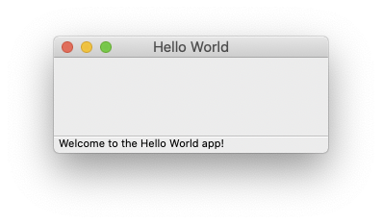
Hello World Demo, cont’d
HelloWorldFrame::HelloWorldFrame(const wxString& title,
const wxPoint& pos, const wxSize& size)
: wxFrame(NULL, wxID_ANY, title, pos, size)
{
wxMenu *menuFile = new wxMenu;
menuFile->Append(ID_Hello, "&Hello...\tCtrl-H",
"Status string: Hello!");
menuFile->AppendSeparator();
menuFile->Append(ID_Bonjour, "&Bonjour...\tCtrl-B",
"Status string: Bonjour!");
menuFile->Append(ID_GutenTag, "&Guten Tag...\tCtrl-G",
"Status string: Guten Tag!");
menuFile->Append(wxID_EXIT, "E&xit...\tCtrl-X",
"Status string: Quit Wx-helloworld");
wxMenu *menuHelp = new wxMenu;
menuHelp->Append(wxID_ABOUT);
wxMenuBar *menuBar = new wxMenuBar;
menuBar->Append(menuFile, "&File");
menuBar->Append(menuHelp, "&Help");
SetMenuBar(menuBar);
CreateStatusBar();
SetStatusText("Welcome to the Hello World app!");
}
HelloWorldFrame.cpp

Slide 20
Hello World Demo, cont’d
void HelloWorldFrame::OnAbout(wxCommandEvent& event)
{
wxMessageBox("This is a wxWidgets' Hello world sample",
"About Hello World", wxOK | wxICON_INFORMATION);
}
void HelloWorldFrame::OnExit(wxCommandEvent& event)
{
cout << "OnExit: Exiting Hello World app!" << endl;
Close(true);
}
HelloWorldFrame.cpp

Slide 21
Hello World Demo, cont’d
void HelloWorldFrame::OnHello(wxCommandEvent& event)
{
wxMessageBox("Hello, world!",
"OnHello", wxOK | wxICON_INFORMATION);
}
void HelloWorldFrame::OnBonjour(wxCommandEvent& event)
{
wxMessageBox("Bonjour, monde!",
"OnBonjour", wxOK | wxICON_INFORMATION);
}
void HelloWorldFrame::OnGutenTag(wxCommandEvent& event)
{
wxMessageBox("Guten Tag, Welt!",
"OnGutenTag", wxOK | wxICON_INFORMATION);
}
HelloWorldFrame.cpp

Slide 22
Menu Bar Bug on Mac OS
On Mac OS, when a wxWidgets app first opens, the menu bar menus don’t drop down when you click on their labels.
This problem doesn’t seem to appear in the Linux and Windows platforms.
Solution:
Click in another window to take the focus there.
Click back in the wxWidgets app to return the focus.
The drop-down menus will now work.

Slide 23
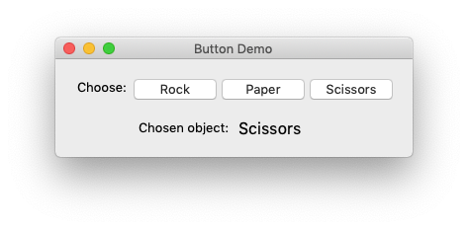
Button Demo

Slide 24
class ButtonDemo : public wxApp
{
public:
virtual bool OnInit() override;
};
ButtonDemo.h
ButtonDemo.cpp
wxIMPLEMENT_APP(ButtonDemo);
bool ButtonDemo::OnInit()
{
if (!wxApp::OnInit()) return false;
DemoFrame *frame = new DemoFrame("Button Demo");
frame->Show(true);
return true;
}

Slide 25
Button Demo, cont’d
class DemoFrame : public wxFrame
{
public:
DemoFrame(const wxString& title);
virtual ~DemoFrame();
void on_about(wxCommandEvent& event);
void on_quit(wxCommandEvent& event);
private:
wxDECLARE_EVENT_TABLE();
ButtonPanel *button_panel;
void init();
void init_sizer();
void init_menu_bar();
};
DemoFrame.h
// IDs for the menu commands.
enum
{
RPS_About = wxID_ABOUT,
RPS_Quit = wxID_EXIT
};

Slide 26
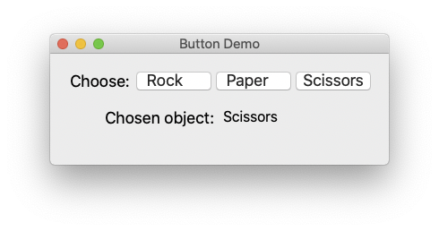
Button Demo, cont’d
DemoFrame.cpp
void DemoFrame::init()
{
init_menu_bar();
init_sizer();
wxSize size = GetBestSize();
SetMinClientSize(size);
}
void DemoFrame::init_sizer()
{
wxSizer *frame_sizer = new wxBoxSizer(wxVERTICAL);
frame_sizer->AddSpacer(20);
frame_sizer->Add(button_panel, 0, wxALIGN_CENTER, 0);
SetSizerAndFit(frame_sizer);
}
A “sizer” is a layout manager for components.

Slide 27
Button Demo, cont’d
void DemoFrame::init_menu_bar()
{
wxMenu *fileMenu = new wxMenu;
fileMenu->Append(RPS_Quit, "E&xit\tAlt-X", "Quit program");
wxMenu *helpMenu = new wxMenu;
helpMenu->Append(RPS_About, "&About\tF1", "Show about dialog");
wxMenuBar *menuBar = new wxMenuBar();
menuBar->Append(fileMenu, "&File");
menuBar->Append(helpMenu, "&Help");
SetMenuBar(menuBar);
}
void DemoFrame::on_about(wxCommandEvent& WXUNUSED(event))
{
wxMessageBox(wxString::Format(
"This is a button demo\n"
"built with %s\n"
"and running under %s.",
wxVERSION_STRING,
wxGetOsDescription()
),
"About the button demo",
wxOK | wxICON_INFORMATION,
this);
}
DemoFrame.cpp
// The event table.
wxBEGIN_EVENT_TABLE(DemoFrame, wxFrame)
EVT_MENU(RPS_About, DemoFrame::on_about)
EVT_MENU(RPS_Quit, DemoFrame::on_quit)
wxEND_EVENT_TABLE()

Slide 28
Button Demo, cont’d
ButtonPanel.h
class ButtonPanel : public wxPanel
{
public:
ButtonPanel(wxFrame *parent) : wxPanel(parent, wxID_ANY)
{
init();
}
// Event handlers void on_rock(wxCommandEvent& event);
void on_paper(wxCommandEvent& event);
void on_scissors(wxCommandEvent& event);
private:
wxStaticText *button_chosen_name;
void init();
void update_button_choice_text(const Choice choice);
};

Slide 29
Button Demo, cont’d
ButtonPanel.cpp
void ButtonPanel::init()
{
wxSizer *main_panel_sizer = new wxBoxSizer(wxVERTICAL);
wxPanel *button_panel = new wxPanel(this, wxID_ANY);
wxSizer *button_sizer = new wxBoxSizer(wxHORIZONTAL);
wxStaticText *choose_text = new wxStaticText(button_panel, wxID_ANY,
"Choose:");
wxButton *rock_button = new wxButton(button_panel, wxID_ANY,
choice_to_wxString(ROCK));
wxButton *paper_button = new wxButton(button_panel, wxID_ANY,
choice_to_wxString(PAPER));
wxButton *scissors_button = new wxButton(button_panel, wxID_ANY,
choice_to_wxString(SCISSORS));
...

Slide 30
Button Demo, cont’d
ButtonPanel.cpp
...
rock_button->Bind (wxEVT_BUTTON, &ButtonPanel::on_rock, this);
paper_button->Bind (wxEVT_BUTTON, &ButtonPanel::on_paper, this);
scissors_button->Bind(wxEVT_BUTTON, &ButtonPanel::on_scissors, this);
button_sizer->Add(choose_text, 0, 0, 0);
button_sizer->AddSpacer(5);
button_sizer->Add(rock_button, 0, 0, 0);
button_sizer->AddSpacer(5);
button_sizer->Add(paper_button, 0, 0, 0);
button_sizer->AddSpacer(5);
button_sizer->Add(scissors_button, 0, 0, 0);
button_panel->SetSizer(button_sizer);
...
Bind an event handler to each button.
Lay out the
button panel.

Slide 31
Button Demo, cont’d
ButtonPanel.cpp
...
wxPanel *choice_panel = new wxPanel(this, wxID_ANY);
wxSizer *choice_sizer = new wxGridSizer(2, 0, 5);
wxStaticText *chosen_object_label =
new wxStaticText(choice_panel, wxID_ANY, "Chosen object:");
chosen_button_name = new wxStaticText(choice_panel, wxID_ANY, "");
chosen_button_name->SetFont(chosen_button_name->GetFont().Larger());
choice_sizer->Add(chosen_object_label, 0, wxALIGN_RIGHT, 0);
choice_sizer->Add(chosen_button_name, 0, 0, 0);
choice_panel->SetSizer(choice_sizer);
...
Lay out the
choice panel.

Slide 32
Button Demo, cont’d
ButtonPanel.cpp
...
main_panel_sizer->Add(button_panel, 0, wxALIGN_CENTER, 0);
main_panel_sizer->AddSpacer(20);
main_panel_sizer->Add(choice_panel, 0, wxALIGN_CENTER, 0);
main_panel_sizer->AddSpacer(20);
SetSizer(main_panel_sizer);
}
Lay out the
main panel.

Slide 33
Button Demo, cont’d
ButtonPanel.cpp
void ButtonPanel::on_rock(wxCommandEvent& event)
{
update_button_choice_text(ROCK);
}
void ButtonPanel::on_paper(wxCommandEvent& event)
{
update_button_choice_text(PAPER);
}
void ButtonPanel::on_scissors(wxCommandEvent& event)
{
update_button_choice_text(SCISSORS);
}
void ButtonPanel::update_button_choice_text(const Choice choice)
{
chosen_button_name->SetLabelText(choice_to_wxString(choice));
}

Slide 34
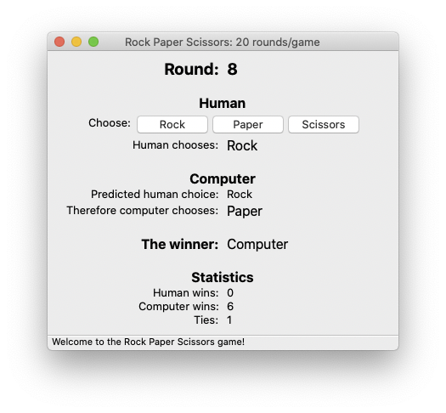
Assignment #5. GUI-Based RPS Game
Develop a GUI-based version of your Rock-Paper-Scissors game.
Sample GUI:

Slide 35
Assignment #5, cont’d
Features
Display which round
A way for the user to enter a choice for each round.
The computer’s prediction of the human’s choice for the round.
The computer’s choice for the round.
Who the winner is (or is it a tie) of the round.
The number of human and computer wins, and the number of ties.

Slide 36
Assignment #5, cont’d
Menu commands
About
Exit
Start a new game
The default is 20 rounds per game.
Provide a way for the human player to change that number before the start of the next game.

Slide 37
Assignment #5, cont’d
Considerations
How to use inversion of control?
What the logic for each round?
What triggers each round’s control flow?
Due Wednesday, April 14
Semester project presentations and demos Thursday, May 13.
They must be GUI-based using wxWidgets.
Projects are due Monday, May 17.

