Slide 1
CMPE 135: Object-Oriented Analysis and Design March 18 Class Meeting
Department of Computer Engineering San Jose State University Spring 2021 Instructor: Ron Mak
www.cs.sjsu.edu/~mak

Slide 2
Midterm: Question #41
Describe in at most 50 words how you can use delegation in your Rock Paper Scissors game program.
One way is to create a MoveAlgorithm class which knows the different algorithms for making the computer’s move. Then the game logic can delegate to the MoveAlgorithm object how to choose the computer’s next move.

Slide 3
Midterm: Question #42
Describe in at most 50 words how you can use polymorphism in your Rock Paper Scissors game program.
You can make MoveAlgorithm a superclass for subclasses that implement the different move algorithms. The superclass would have an abstract choose() function that the subclasses implement. Polymorphism allows the correct choose() function to be called, depending on which subclass object is being used.

Slide 4
Midterm: Question #43
In the SimUDuck application, the abstract base class Duck has member functions perform_quack() and perform_fly(). Describe in at most 50 words why the class wasn't designed to simply let the subclasses override these two functions.
We want “has a” relationships between the Duck class and the Quack and Fly classes. At run time, we initialize a Duck subclass object with the appropriate Quack and Fly subclass objects in order to delegate behaviors to thoseß objects.

Slide 5
Midterm: Question #44
Rich's Music Emporium now wants to sell all types of musical instruments, not only string instruments. Describe in at most 50 words what high-level changes will be needed for the music inventory program.
The key is storing each instrument’s attributes in a hash map. We would need to add new enumerated types to represent new attributes and their values. But the basic inventory and search functions should remain the same.

Slide 6
Midterm: Question #45
You are designing an application that involves the inventory of books in a bookcase. Explain in at most 50 words why you would use aggregation or composition between classes Bookcase and Book, and why you would use aggregation or composition between classes Bookcase and Shelf.
A Book object most likely can be in a context other than being contained by a Bookcase object, so Bookcase should aggregate Book. But a Shelf object is in integral part of a Bookcase object, so Bookcase should compose Shelf.

Slide 7
Midterm: Question #46
Explain in at most 50 words how the getter and setter member functions of a class can support encapsulation.
One way to encapsulate change in the internal implementation of a class is to make those parts private. Then provide only public getter and setter functions. The private parts are hidden, and any changes to them won’t affect other classes.

Slide 8
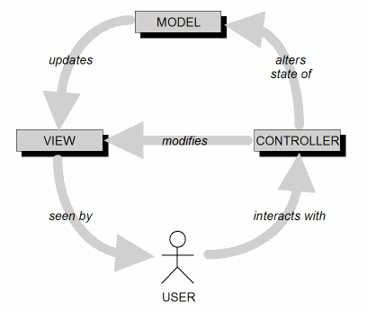
Model-View-Controller Architecture (MVC)
MVC is an ideal architecture for GUI applications.
Design goal: Identify which application components are model, view, or controller.
A user cannot directly modify the model.

Slide 9
MVC Implementation: Loose Coupling
Keep the implementations of the three object types separate.
Each type of objects does not depend on how the other types are implemented.
Your application is
easier to develop and maintain
faster to develop
more robust (resilient to runtime errors)

Slide 10
MVC Model Objects
Represent the persistent information maintained by your application.
The information can be kept in a database.

Slide 11
MVC View Objects
View objects represent user interface components.
Input components such as text fields and checkboxes.
In each use case, users interact with at least one view object.
A view object collects information from users in a form that the model and controller objects can use.

Slide 12
MVC Controller Objects
Coordinate the model and view objects.
Often have no physical counterpart in the real world.
Collect information from view objects for dispatch to model objects.
This is how user-entered data can update the model.

Slide 13
Software Frameworks
A software framework consists of a set of cooperating classes.
These classes implement the essential mechanisms for a particular problem domain.
Example: wxWidgets is a C++ software framework for multi-platform GUI programming.
A framework imposes a structure on the design and development of applications.
It has classes and API that implement the structure.
It is more than simply a library.

Slide 14
Software Frameworks, cont’d
A programmer builds an application by:
Subclassing framework classes.
Adding new classes that provide custom functionality.
Inversion of control
The framework controls the execution flow.
The programmer registers callback functions, mostly as event handlers, with the framework.
The framework invokes the callback functions at the appropriate times, such as in response to events.

Slide 15
Building and Installing wxWidgets
Go to https://www.wxwidgets.org to download for your platform.
Use the stable version 3.0.5
It’s a bit tricky to build and install.
Mac: Fairly straightforward. I use Eclipse.
Linux: I failed to build the dynamic libraries, so I built the static libraries instead.
Windows: I successfully built for Microsoft Visual C++.
I strongly recommend using “Windows Subsystem for Linux” to install Ubuntu, and then build Linux wxWidgets.

Slide 16
wxWidgets Samples and Demos
The download includes the source code for many sample programs and several demos.
The build scripts also build all these programs.
Each has a makefile to build individually.
Use the sample programs to learn how to code and use each widget.

Slide 17
wxWidgets Documentation
Online tutorials: https://www.wxwidgets.org/docs/tutorials/
Online reference: https://docs.wxwidgets.org/3.0/
Tutorial to build on MacOS
https://docs.wxwidgets.org/trunk/plat_osx_install.html
https://wiki.wxwidgets.org/Compiling_wxWidgets_using_the_command-line_%28Terminal%29
Use Homebrew?: https://formulae.brew.sh/formula/wxmac
Tutorial to build on Ubuntu: https://www.binarytides.com/install-wxwidgets-ubuntu/

Slide 18
Tutorials
My tutorials: http://www.cs.sjsu.edu/~mak/tutorials/index.html
Install Ubuntu
Configure Ubuntu
Install wxWidgets

Slide 19
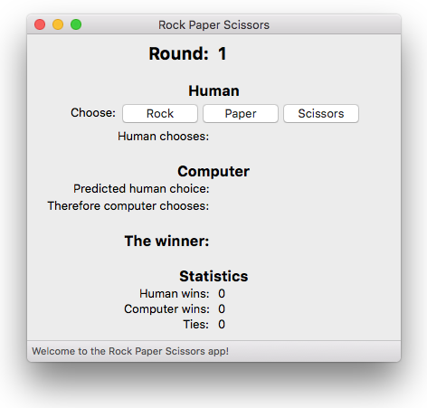
wx-RPS: Mac OS X

Slide 20
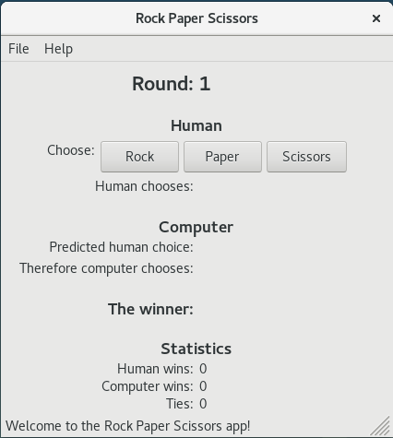
wx-RPS: Linux

Slide 21
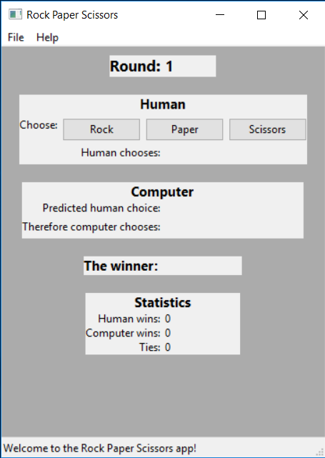
wx-RPS: Windows 10
Why does the app look
so ugly on Windows?

