Slide 1
CMPE 135 Object-Oriented Analysis and Design February 11 Class Meeting
Department of Computer Engineering San Jose State University Spring 2021 Instructor: Ron Mak
www.cs.sjsu.edu/~mak

Slide 2
The Current Situation
We developed a guitar inventory program for Rick’s Guitar Shop.
But then it became Rick’s Music when he added mandolins.
We attempted to use classic object-oriented techniques to accommodate the new requirements.
Abstract Instrument and InstrumentSpec base classes.
Concrete Guitar, GuitarSpec, Mandolin, and Mandolin spec subclasses.

Slide 3
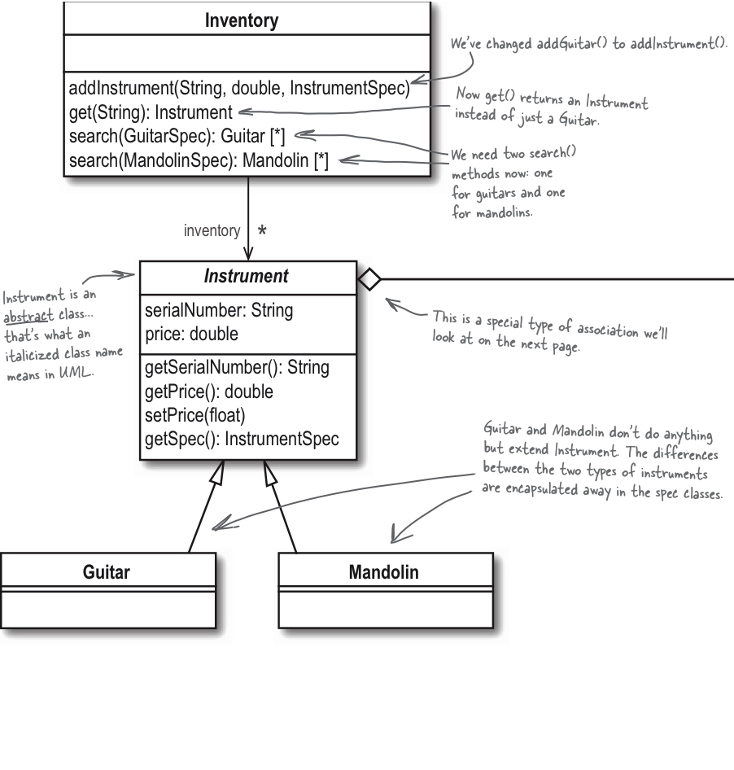
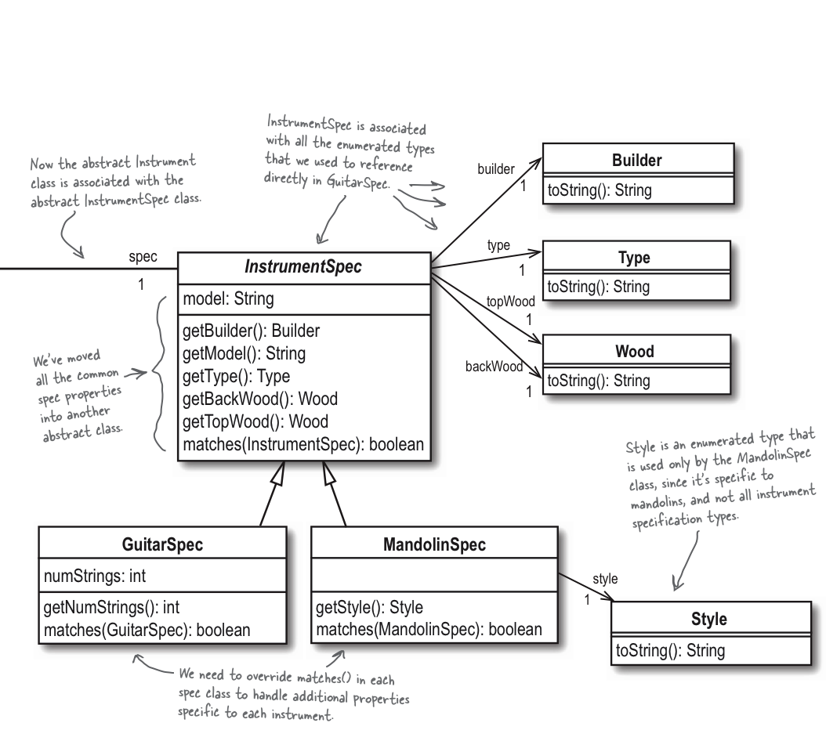
Design for Rick’s Music
Head First Object-Oriented
Analysis & Design
by Brett D. McLaughlin, et al.
O’Reilly, 2006.

Slide 4
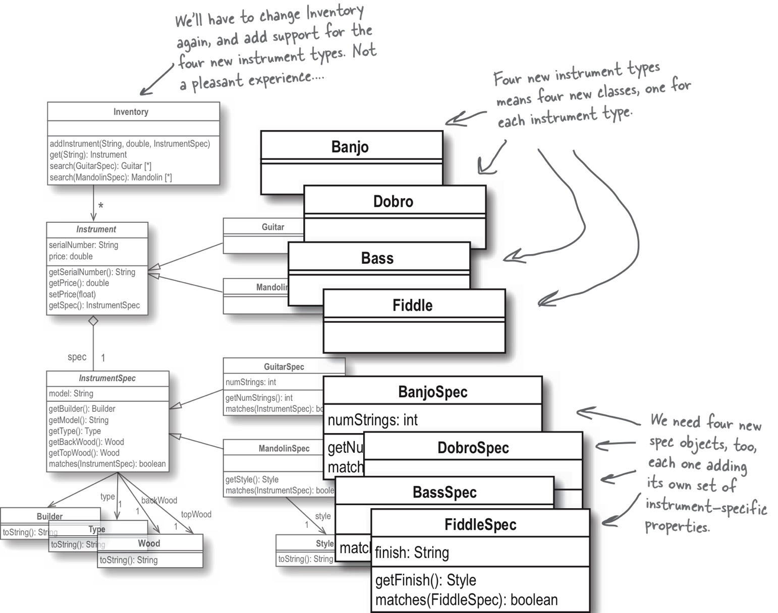
Rick Wants More Instruments!
YIKES!
Our design doesn’t
scale very well ...
Head First Object-Oriented
Analysis & Design
by Brett D. McLaughlin, et al.
O’Reilly, 2006.

Slide 5
Our Design Doesn’t Scale Very Well
For each new instrument:
We need to add a subclass of Instrument.
We need to add a subclass of InstrumentSpec.
We need to add a new overloaded function to Inventory::search() for the new instrument.
We need to add a new type test and add a new type cast in the Inventory::add_instrument() function.

Slide 6
Our Design Doesn’t Scale Very Well, cont’d
For each new instrument, cont’d:
We need to add a new type test and add a new type cast in the Inventory::add_instrument() function.
if (typeid(spec) == typeid(GuitarSpec))
{
instrument = new Guitar(serial_number, price,
dynamic_cast<GuitarSpec *>(spec));
}
else if (typeid(spec) == typeid(MandolinSpec))
{
instrument = new Mandolin(serial_number, price,
dyhnamic_cast<MandolinSpec *>(spec));
}

Slide 7
Time to Revisit Our Design!
Having all those Instrument and InstrumentSpec subclasses may not be such a good idea after all.

Slide 8
Time to Revisit Our Design! cont’d
What changes among different kinds of instruments?
attribute sets
matching algorithm
What doesn’t change?
kind of instrument
serial number
price
Different kinds of instruments
have different sets of attributes.
Examples:
Guitars have the number of strings attribute,
and mandolins have the style attribute.
What should we do
with stuff that varies?
Every instrument has these.
An instrument’s kind, serial number,
and price don’t change.

Slide 9
Encapsulation to the Rescue?
If we can encapsulate the varying sets of instrument attributes in one place, we can get rid of all the Instrument and InstrumentSpec subclasses.
Then both the Instrument and InstrumentSpec classes can become concrete classes (instead of being abstract).
How can we achieve this?

Slide 10
Encapsulation Using a Hash Map
Idea: Encapsulate the varying attributes in a hash map.
Pairs of attribute name and attribute value
Each kind of instrument can have a different set of name:value pairs in the hash map.
Examples:
Guitar
Builder: Gibson
Model: “Les Paul”
Type: electric
String count: 6
Top wood: maple
Back wood: maple
Mandolin
Builder: Gibson
Model: “F-5G”
Type: acoustic
Style: A
Top wood: maple
Back wood: maple
Banjo
Builder: Gibson
Model: “SRB-3 Wreath”
Type: acoustic
String count: 5
Back wood: maple

Slide 11
Encapsulation Using a Hash Map, cont’d
The hash map can use the following keys:
This enum class contains keys for all the attributes across all the kinds of instruments.
We may need to add new enum values when we add more kinds of instruments.
Attributes.h
enum class Key
{
BUILDER, MODEL, STRING_COUNT, STYLE, TYPE, TOP_WOOD, BACK_WOOD
};

Slide 12
Encapsulation Using a Hash Map, cont’d
What about the values in the hash map?
When the key is Key::BUILDER, the value is one of
When the key is Key::STYLE, the value is one of
When the key is Key::TYPE, the value is one of
enum class Builder
{
FENDER, MARTIN, GIBSON, COLLINGS, OLSON, RYAN, PRS, ANY,
};
Builder.h
enum class Style
{
A, F,
};
Style.h
enum class Type
{
ACOUSTIC, ELECTRIC
};
Type.h

Slide 13
Encapsulation Using a Hash Map, cont’d
When the key is Key::TOP_WOOD or Key::BACK_WOOD, the value is one of
When the key is Key::STRING_COUNT, the value is an integer (the number of strings).
When the key is Key::MODEL, the value is a string.
Wood.h
enum class Wood
{
INDIAN_ROSEWOOD, BRAZILIAN_ROSEWOOD, MAHOGANY, MAPLE,
COCOBOLO, CEDAR, ADIRONDACK, ALDER, SITKA
};

Slide 14
Encapsulation Using a Hash Map, cont’d
How can we store values of different datatypes into the hash map?
One possible solution:
union Value
{
Builder builder;
Kind kind;
Style style;
Type type;
Wood wood;
int string_count;
string model;
};

Slide 15
Using Boost
A better solution is to use the Boost C++ library.
Download from https://www.boost.org/
For our program, we only need the Boost header files.
You don’t need to build the library.

Slide 16
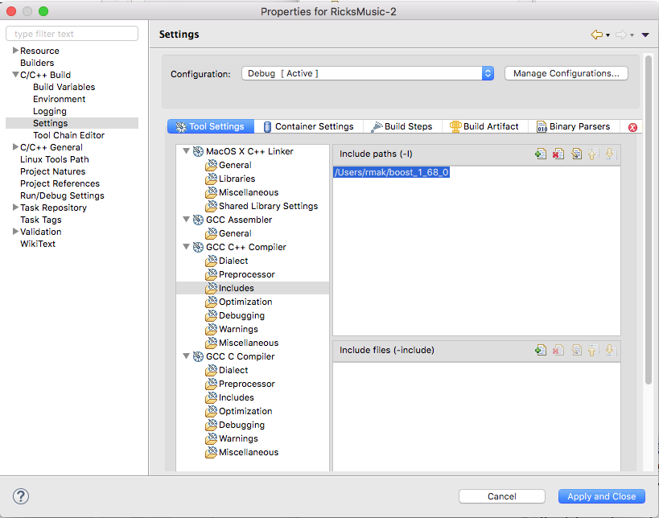
Using Boost
Tell Eclipse where you put the header files.
On the Mac and Linux, put them in the standard header file directory /usr/local/include/boost and then you won’t need to tell Eclipse.
On the command line, use the -I
option to specify the directory path

Slide 17
The boost::any Class
A variable of type boost::any can hold a value of any scalar datatype, string, or a pointer.
To assign a value:
To retrieve a value, you must do a type cast with boost::any_cast<type>
#include <boost/any.hpp>
...
boost::any value;
value = Builder::FENDER;
Builder b;
b = boost::any_cast<Builder>(value);

Slide 18
The Kind Enumeration Class
Kind.h
#include <boost/any.hpp>
enum class Kind
{
GUITAR, BANJO, DOBRO, FIDDLE, BASS, MANDOLIN,
};
inline Kind to_kind(boost::any value)
{
return boost::any_cast<Kind>(value);
}
inline bool equal_kinds(boost::any value1, boost::any value2)
{
return to_kind(value1) == to_kind(value2);
}
Return a Kind value.
Compare two Kind values.

Slide 19
The Builder Enumeration Class
Builder.h
#include <boost/any.hpp>
enum class Builder
{
FENDER, MARTIN, GIBSON, COLLINGS, OLSON, RYAN, PRS, ANY,
};
inline Builder to_builder(boost::any value)
{
return boost::any_cast<Builder>(value);
}
inline bool equal_builders(boost::any value1, boost::any value2)
{
return to_builder(value1) == to_builder(value2);
}
Return a Builder value.
Compare two Builder values.

Slide 20
The Builder Enumeration Class, cont’d
Similarly define enum classes Model, Strings, Type, and Wood and their helper functions.

Slide 21
The Attributes Map
The attribute keys:
Add more keys as needed for new kinds of instruments.
The attributes map:
The boost::any value can be any value of type Builder, Style, Wood, Model, int, string, etc.
Attributes.h
enum class Key
{
BUILDER, MODEL, STRING_COUNT, STYLE, TYPE, TOP_WOOD, BACK_WOOD
};
Attributes.h
typedef map<Key, boost::any> AttributesMap;

Slide 22
Class Attributes
Attributes.h
class Attributes
{
public:
AttributesMap get_attributes() { return attributes; } boost::any get_value(Key key) { return attributes[key]; } void set(Key key, boost::any value) { attributes[key] = value; }
bool matches(Attributes *other); void print();
private:
AttributesMap attributes; // the attributes map
bool has_key(Key key); bool equals(Attributes *other, const Key key);
};
ostream& operator <<(ostream& ostr, const Key attr);

Slide 23
Class Attributes, cont’d
Attributes.cpp
bool Attributes::matches(Attributes *other)
{
AttributesMap::iterator it;
for (it = attributes.begin(); it != attributes.end(); it++)
{
Key key = it->first;
// Are the corresponding attribute values equal?
if (! (other->has_key(key) && equals(other, key)) ) return false;
}
return true; // the values all match
}
bool Attributes::has_key(Key key)
{
return attributes.find(key) != attributes.end();
}
Iterate over the map’s entries.
The first component of an entry is the key.

Slide 24
Class Attributes, cont’d
Attributes.cpp
bool Attributes::equals(Attributes *other, const Key key)
{
boost::any this_value = get_value(key);
boost::any other_value = other->get_value(key);
switch (key)
{
case Key::BUILDER: return equal_builders(this_value, other_value);
case Key::MODEL: return equal_models(this_value, other_value);
case Key::STRING_COUNT: return equal_string_count(this_value, other_value);
case Key::STYLE: return equal_styles(this_value, other_value);
case Key::TYPE: return equal_types(this_value, other_value);
case Key::TOP_WOOD: return equal_woods(this_value, other_value);
case Key::BACK_WOOD: return equal_woods(this_value, other_value);
default: return false;
}
}
inline bool equal_builders(boost::any value1, boost::any value2)
{
return to_builder(value1) == to_builder(value2);
}
Builder.h

Slide 25
Class InstrumentSpec
InstrumentSpec.h
class InstrumentSpec
{
public:
InstrumentSpec(Attributes *attributes) : attributes(attributes) {}
Attributes *get_attributes() const { return attributes; } bool matches(InstrumentSpec *other_spec);
private:
Attributes *attributes;
};
inline bool InstrumentSpec::matches(InstrumentSpec *other_spec)
{
return attributes->matches(other_spec->get_attributes());
}
Delegate matching to class Attributes

Slide 26
Class Instrument
Instrument.h
class Instrument
{
public:
Instrument(Kind kind, string serial_number, double price,
InstrumentSpec *spec)
: kind(kind), serial_number(serial_number), price(price), spec(spec)
{}
string get_serial_number() const { return serial_number; }
double get_price() const { return price; }
void set_price(float new_price) { price = new_price; }
InstrumentSpec *get_spec() const { return spec; }
void print_match();
private:
Kind kind;
string serial_number;
double price;
InstrumentSpec *spec;
};
Every instrument has
this set of attributes,
so they don’t vary.
Encapsulate the varying set of attributes

Slide 27
Class Inventory
Inventory.h
class Inventory
{
public:
void add_instrument(Kind kind, string serial_number, double price,
InstrumentSpec *spec);
Instrument *get(string serial_number);
vector<Instrument *> search(InstrumentSpec *search_spec);
private:
vector<Instrument *> inventory;
};

Slide 28
Class Inventory, cont’d
Inventory.cpp
vector<Instrument *> Inventory::search(InstrumentSpec *target_spec)
{
vector<Instrument *> matching_instruments;
// Loop over the instruments in the inventory.
for (Instrument *instrument : inventory)
{
InstrumentSpec *instrument_spec = instrument->get_spec();
// Does the instrument's specification match?
if (target_spec->matches(instrument_spec))
{
matching_instruments.push_back(instrument);
}
}
return matching_instruments;
}
Delegate to class InstrumentSpec

Slide 29
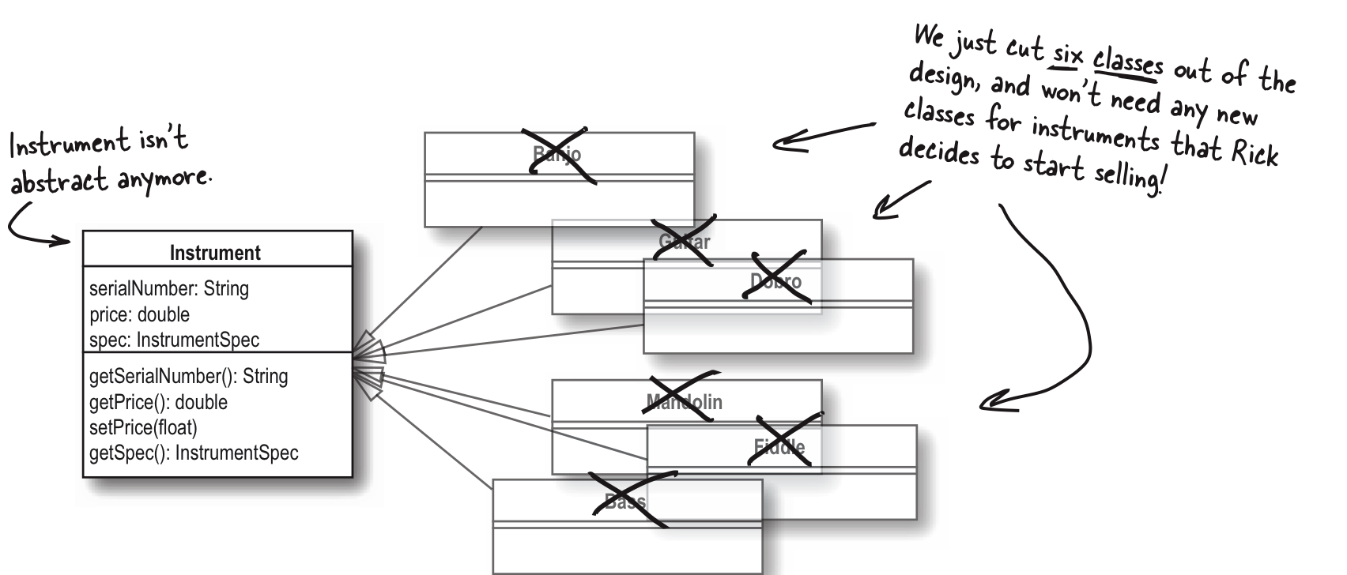
Improved Design
kind
Kind
Kind
Head First Object-Oriented
Analysis & Design
by Brett D. McLaughlin, et al.
O’Reilly, 2006.

Slide 30
Improved Design, cont’d
get_attributes(): Attributes
attributes
attribute keys
attribute values
Head First Object-Oriented
Analysis & Design
by Brett D. McLaughlin, et al.
O’Reilly, 2006.

Slide 31
Encapsulation
We have encapsulated the varying attributes.
Class Attributes
Add more keys as needed.
Attribute classes Builder, Style, Model, etc.
Add more classes as needed.
The other classes don’t have to change.
We’ve also encapsulated
our use of the Boost library.
Attributes.h
enum class Key
{
BUILDER, MODEL, STRING_COUNT, STYLE, TYPE, TOP_WOOD, BACK_WOOD
};

Slide 32
Test the New Version
int main()
{
Inventory *inventory = new Inventory();
initialize_inventory(inventory);
Attributes *attributes = new Attributes();
attributes->set(Key::BUILDER, Builder::GIBSON);
attributes->set(Key::BACK_WOOD, Wood::MAPLE);
InstrumentSpec *target_spec = new InstrumentSpec(attributes);
vector<Instrument *> matching_instruments = inventory->search(target_spec);
if (matching_instruments.size() > 0)
{
cout << "Erin, you might like these instruments:" << endl << endl;
vector<Instrument *>::iterator it_instrument;
for (Instrument *instrument : matching_instruments)
{
instrument->print_match();
}
}
else
{
cout << "Sorry, we have nothing that matches." << endl;
}
}
FindInstrumentTester.cpp
Search target with
attributes to match.

Slide 33
Test the New Version, cont’d
FindInstrumentTester.cpp
void initialize_inventory(Inventory *inventory)
{
Attributes *attributes = new Attributes();
attributes->set(Key::BUILDER, Builder::COLLINGS);
attributes->set(Key::MODEL, string("CJ"));
attributes->set(Key::TYPE, Type::ACOUSTIC);
attributes->set(Key::STRING_COUNT, 6);
attributes->set(Key::TOP_WOOD, Wood::INDIAN_ROSEWOOD);
attributes->set(Key::BACK_WOOD, Wood::SITKA);
inventory->add_instrument(Kind::GUITAR, "11277", 3999.95,
new InstrumentSpec(attributes));
attributes = new Attributes();
attributes->set(Key::BUILDER, Builder::MARTIN);
attributes->set(Key::MODEL, string("D-18"));
attributes->set(Key::TYPE, Type::ACOUSTIC);
attributes->set(Key::STRING_COUNT, 6);
attributes->set(Key::TOP_WOOD, Wood::MAHOGANY);
attributes->set(Key::BACK_WOOD, Wood::ADIRONDACK);
inventory->add_instrument(Kind::GUITAR, "122784", 5495.95,
new InstrumentSpec(attributes));
...
}

Slide 34
Wildcard Attributes?
What if a user doesn’t care about certain attributes?
Does our design support wildcards during attribute matching?
FindInstrumentTester.cpp
Attributes *attributes = new Attributes();
attributes->set(Key::BUILDER, Builder::GIBSON);
attributes->set(Key::BACK_WOOD, Wood::MAPLE);
InstrumentSpec *target_spec = new InstrumentSpec(attributes);

Slide 35
Conclusions
It takes a journey to achieve good design.
iterative improvements
wrong paths
backtracking
Developing great software can be a messy business!
Be willing to fix your own bad design decisions.

