Slide 1
PRETZEL TIME
Code & Design Review
Michael Lee, Danny McLane,
Anthony Minaise, Randy Gamarra
Team CMPE 131

Slide 2
What is Pretzel Time?
Movie forum website based on everyday people’s opinion
No critic, professional review
Allows flexibility with what to comment or post about
Limit each post based on if movie already posted about
Limit comments on user basis

Slide 3
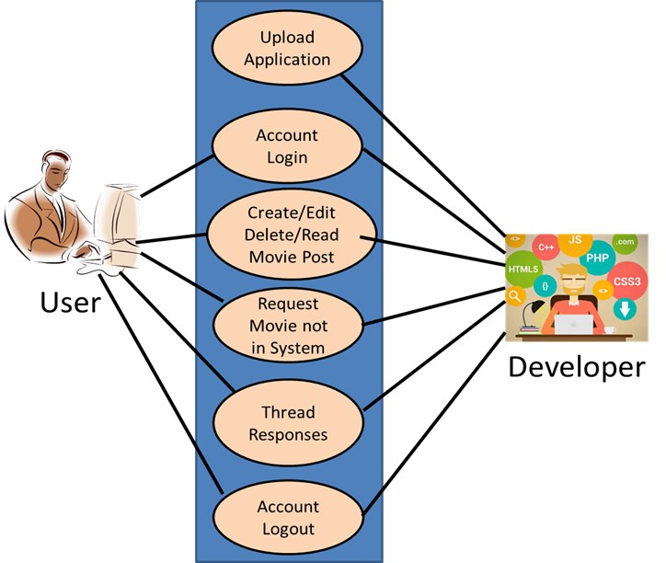
MVC Diagram
Model Objects
Developer
User
Messages
View Objects
Display
Options (login, create, edit, read, delete post, etc.)
text
Controller Objects
Account login
Movie post
Thread response
Account logout

Slide 4
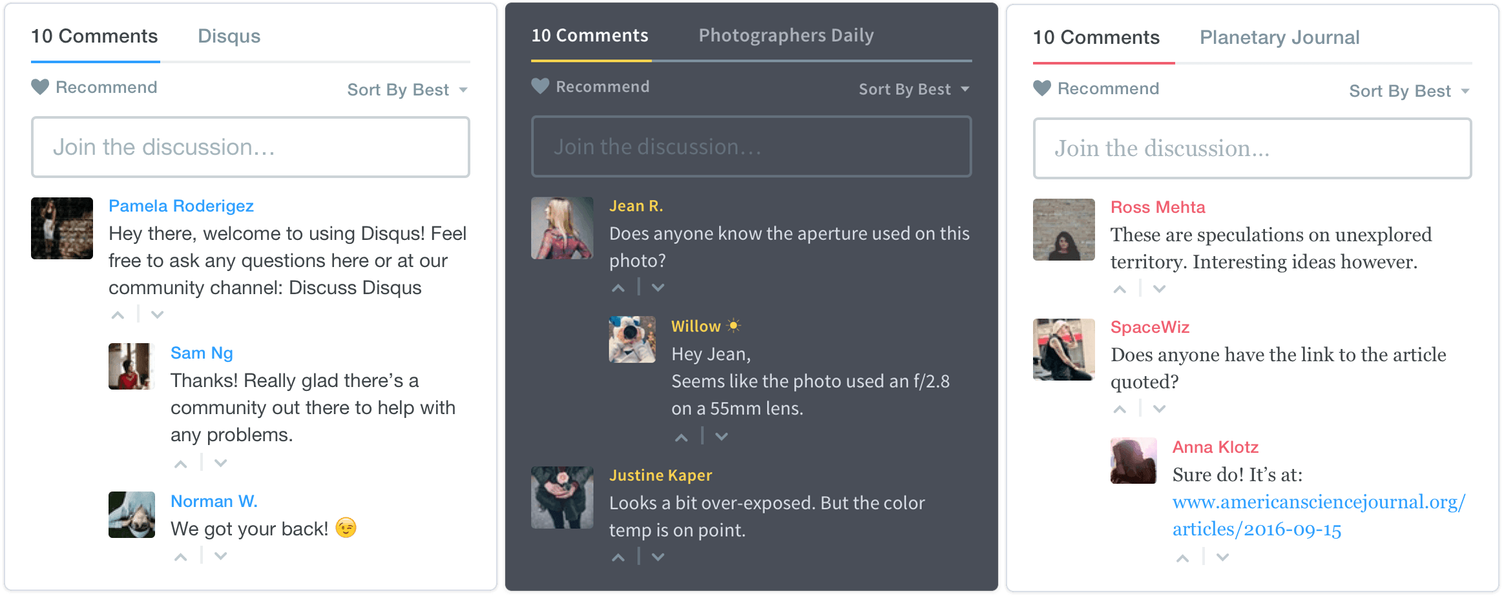
Posting / Commenting Tool - Disqus
Disqus is a networked community platform used by hundreds of thousands of sites all over the web. With Disqus, your website gains a feature-rich comment system complete with social network integration, advanced administration and moderation options, and other extensive community functions. Most importantly, by utilizing Disqus, you are instantly plugging into our web-wide community network, connecting millions of global users to your small blog or large media hub.

