Slide 1


CS 153: Concepts of Compiler Design
October 15 Class Meeting
Department of Computer Science
San Jose State University
Fall 2026
Instructor: Ron Mak
www.cs.sjsu.edu/~mak

Slide 2
Code Templates
Syntax diagrams
  Specify the source language grammar
  Help us write the parsers
Code templates
  Specify what object code to generate
  Help us write the code emitters

Slide 3
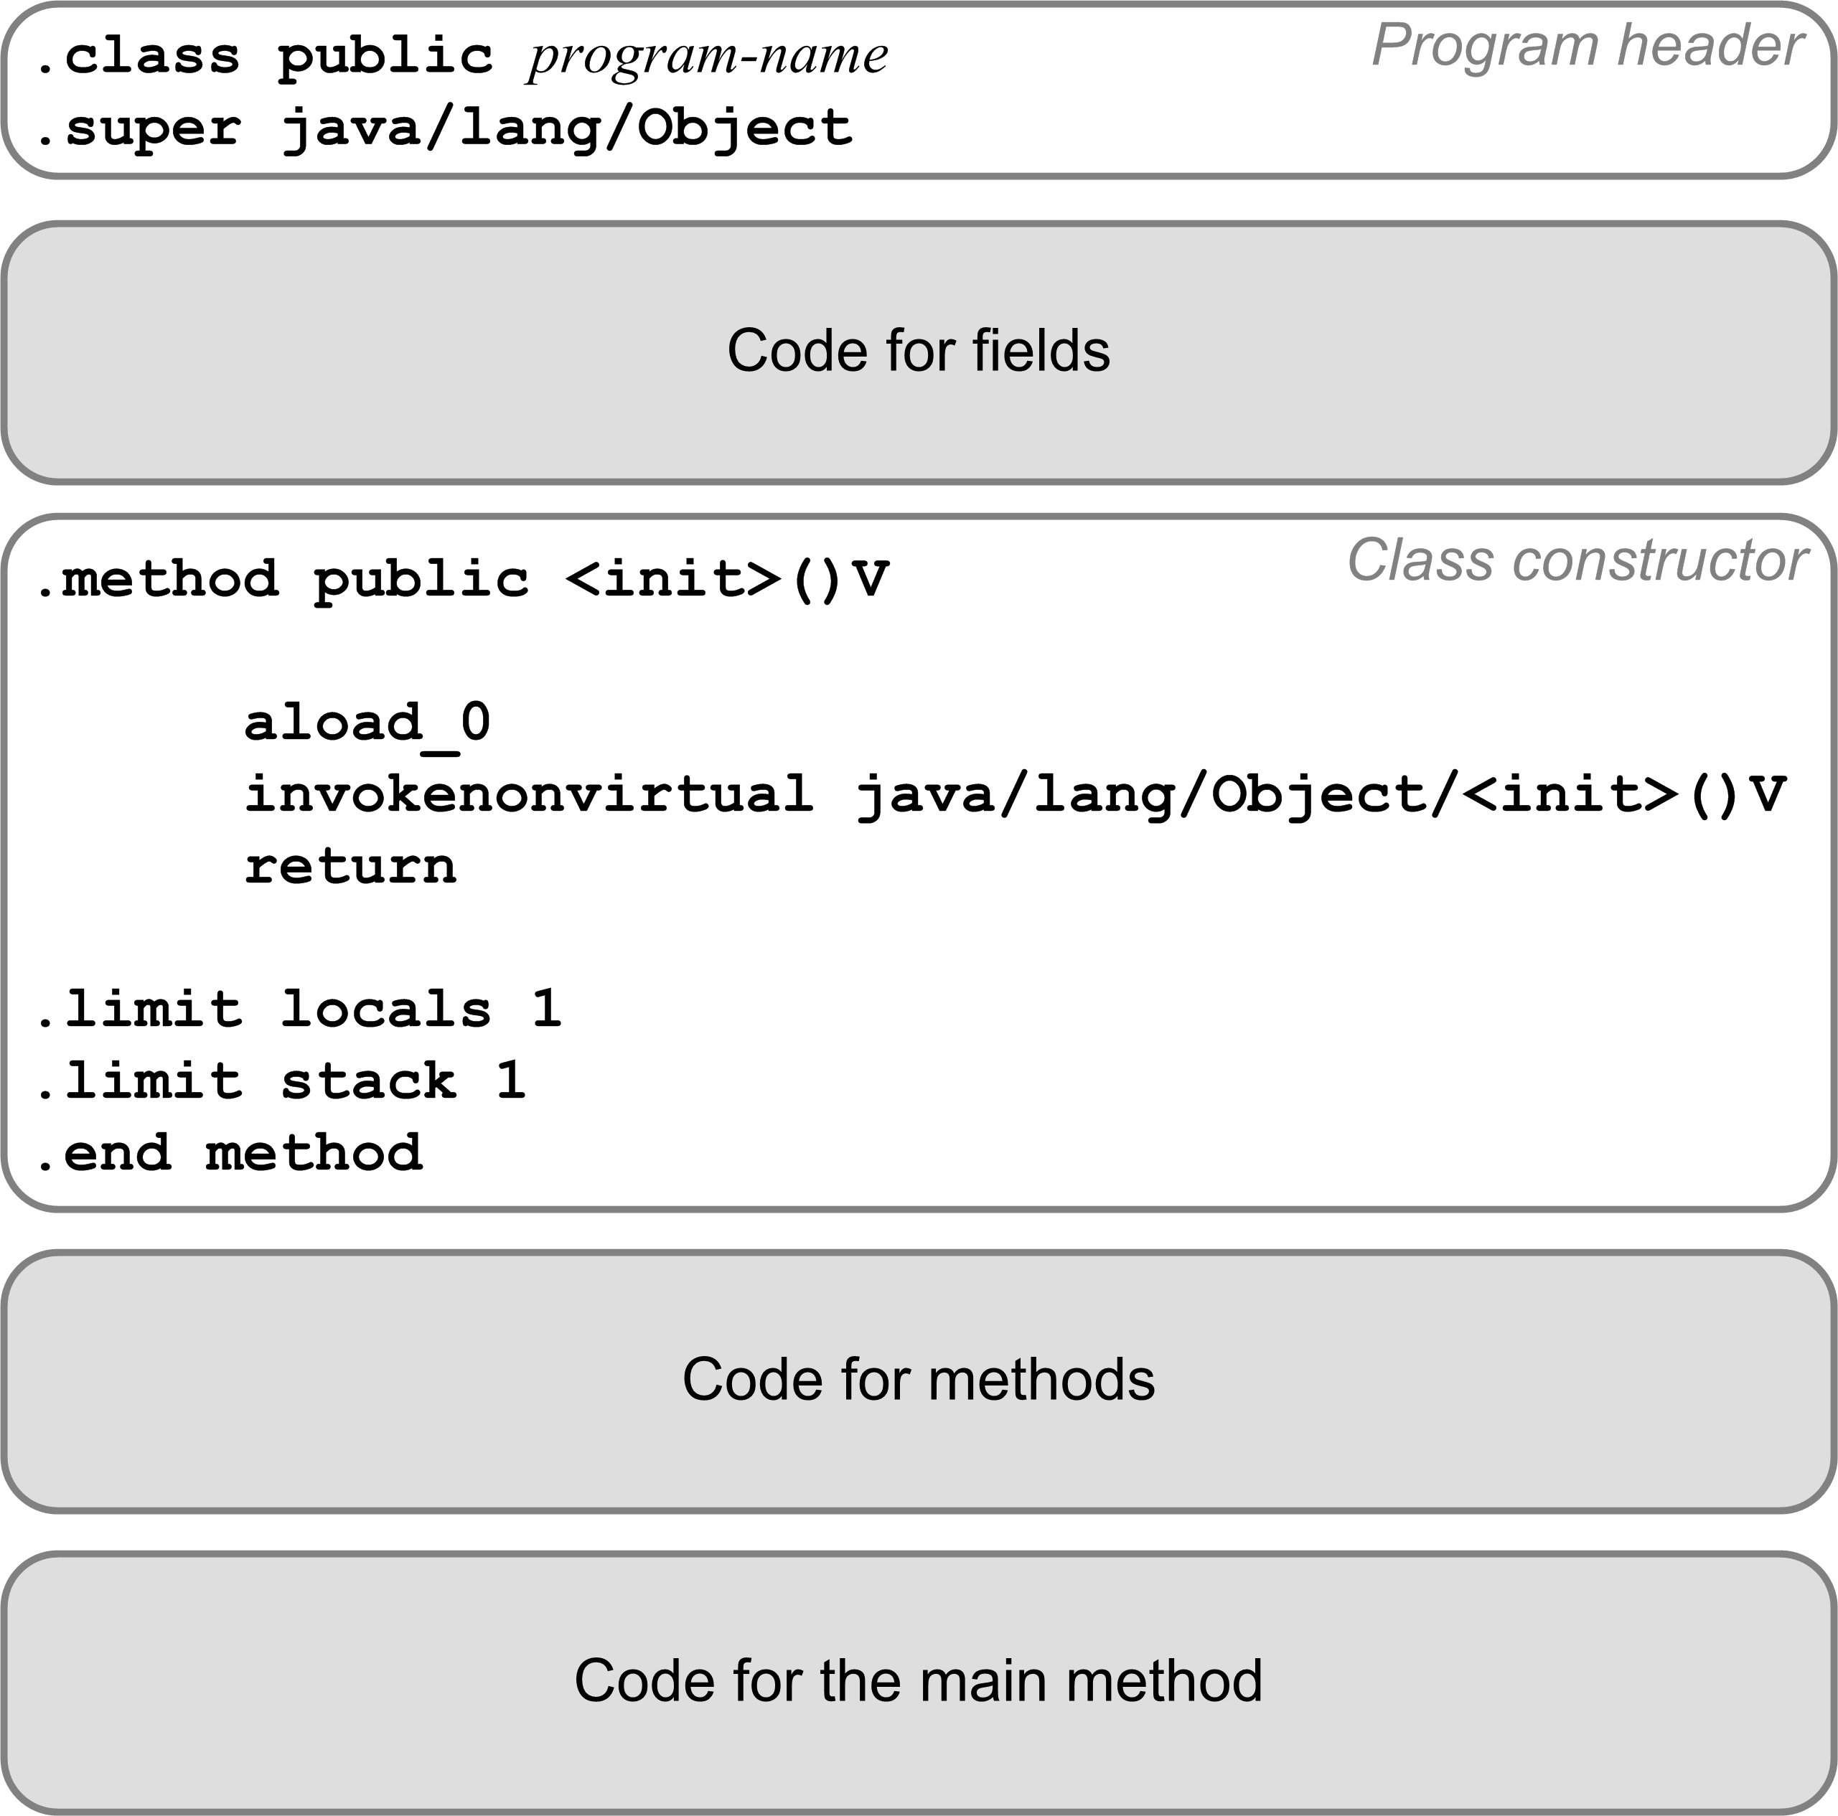
Code Template for a Pascal Program
Translate a Pascal program into a
public class.
Program variables become class fields.
Must have a
default constructor.
Each procedure or function becomes a private static method.
The main program code becomes the public static
main method.

Slide 4
Compilation Strategy
Compile a Pascal program
as if it were a public Java class.
  The Pascal program name becomes
  the Java class name.
The main compound statement becomes the
main method of the Java class.
Compile each program variable
as if it were a field of the Java class.
  Fields do have names in a Jasmin program.

Slide 5
Compilation Strategy, cont’d
Compile each Pascal procedure or function
as if it were a private static method
of the Java class.
Local variables and formal parameters
of the method do not have names in a
Jasmin program.
  Jasmin instructions refer to local variables and parameters by their slot numbers of the local variables array.

Slide 6
Jasmin Datatype Descriptors
Java Scalar type | Jasmin Type Descriptor
int | I
float | F
boolean | Z
double | D
char | C
Java Class | Jasmin Type Descriptor
java.lang.String | Ljava/lang/String;
java.util.HashMap | Ljava/util/HashMap;
Newton | LNewton;
Java Array type | Jasmin Type Descriptor
java.lang.String[] | [Ljava/lang/String;
Newton[][] | [[LNewton;
int[][][] | [[[I
You can choose to compile a Pascal real as either a Jasmin float (F) or double (D).
  public static double func(int k, long m,
  float x, String[][] s)
  .method public static func(IJF[[Ljava/lang/String;)D

Slide 7
Jasmin Assembly Code Generation
Our compiler will follow the same pattern for Jasmin assembly code generation as our converter did to convert Pascal programs to Java.
Code templates will be our guide to code generation.
Yet another set of visit methods!

Slide 8
Program Fields

Slide 9
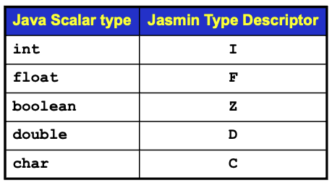
Program Fields, cont’d
For example:
PROGRAM test;
VAR
i, j, k : integer;
x, y : real;
p, q : boolean;
ch : char;
index : 1..10;
Pascal program variables
Compiles to:
.field private static ch C
.field private static i I
.field private static index I
.field private static j I
.field private static k I
.field private static p Z
.field private static q Z
.field private static x F
.field private static y F

Slide 10
Code Template for the Main Method, cont’d

Slide 11
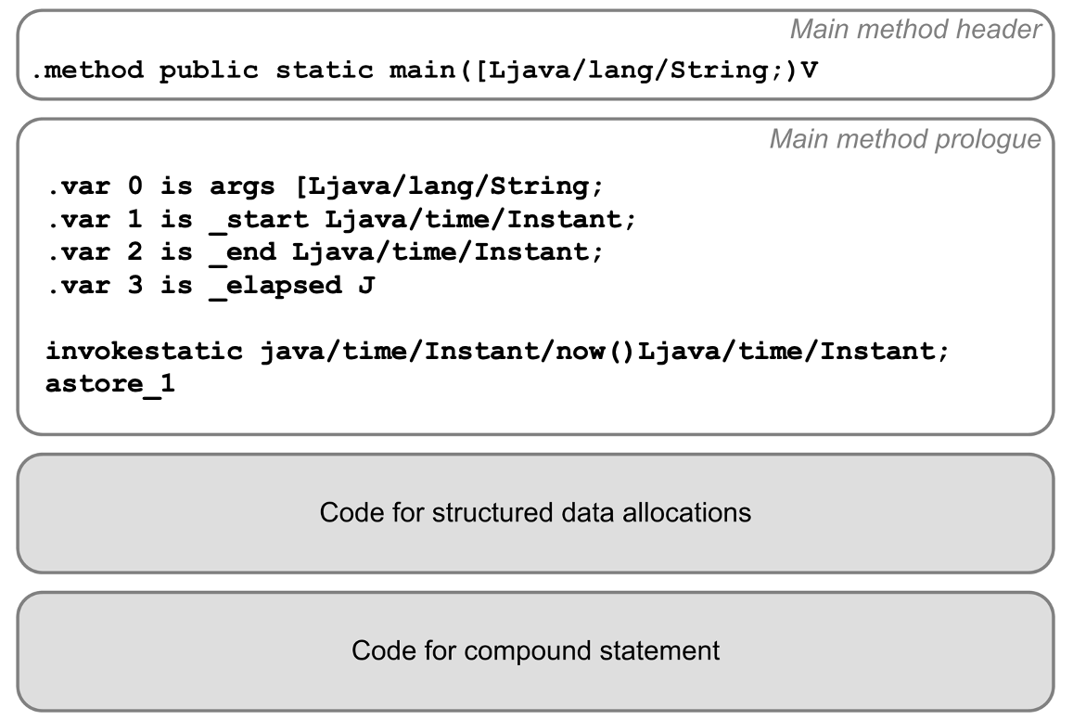
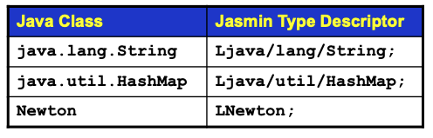
Code Template for the Main Method, cont’d
The main method prologue initializes the runtime timer.
Main method epilogue

Slide 12
Code Template for the Main Method, cont’d
The main method epilogue prints the elapsed run time.
Main program epilogue
invokestatic java/time/Instant/now()Ljava/time/Instant;
astore_2
aload_1
aload_2
invokestatic java/time/Duration/between(Ljava/time/temporal/Temporal;Ljava/time/temporal/Temporal;)Ljava/time/Duration;
invokevirtual java/time/Duration/toMillis()J
lstore_3
getstatic java/lang/System/out Ljava/io/PrintStream;
ldc "\n[%,d milliseconds execution time.]\n"
iconst_1
anewarray java/lang/Object
dup
iconst_0
lload_3
invokestatic java/lang/Long/valueOf(J)Ljava/lang/Long;
aastore
invokevirtual java/io/PrintStream/printf(Ljava/lang/String;[Ljava/lang/Object;)Ljava/io/PrintStream;
pop
return
.limit locals 6
.limit stack 7
.end method

Slide 13
Loading a Program Variable’s Value
To load (push) a program variable’s value
onto the operand stack:
getstatic program-name/variable-name type-descriptor
Examples:
getstatic Test/count I
getstatic Test/radius F

Slide 14
Storing a Program Variable’s Value
To store (pop) a value from the operand stack
into a program variable:
putstatic program-name/variable-name type-descriptor
Examples:
putstatic Test/count I
putstatic Test/radius F

Slide 15
Code for Procedures and Functions

Slide 16
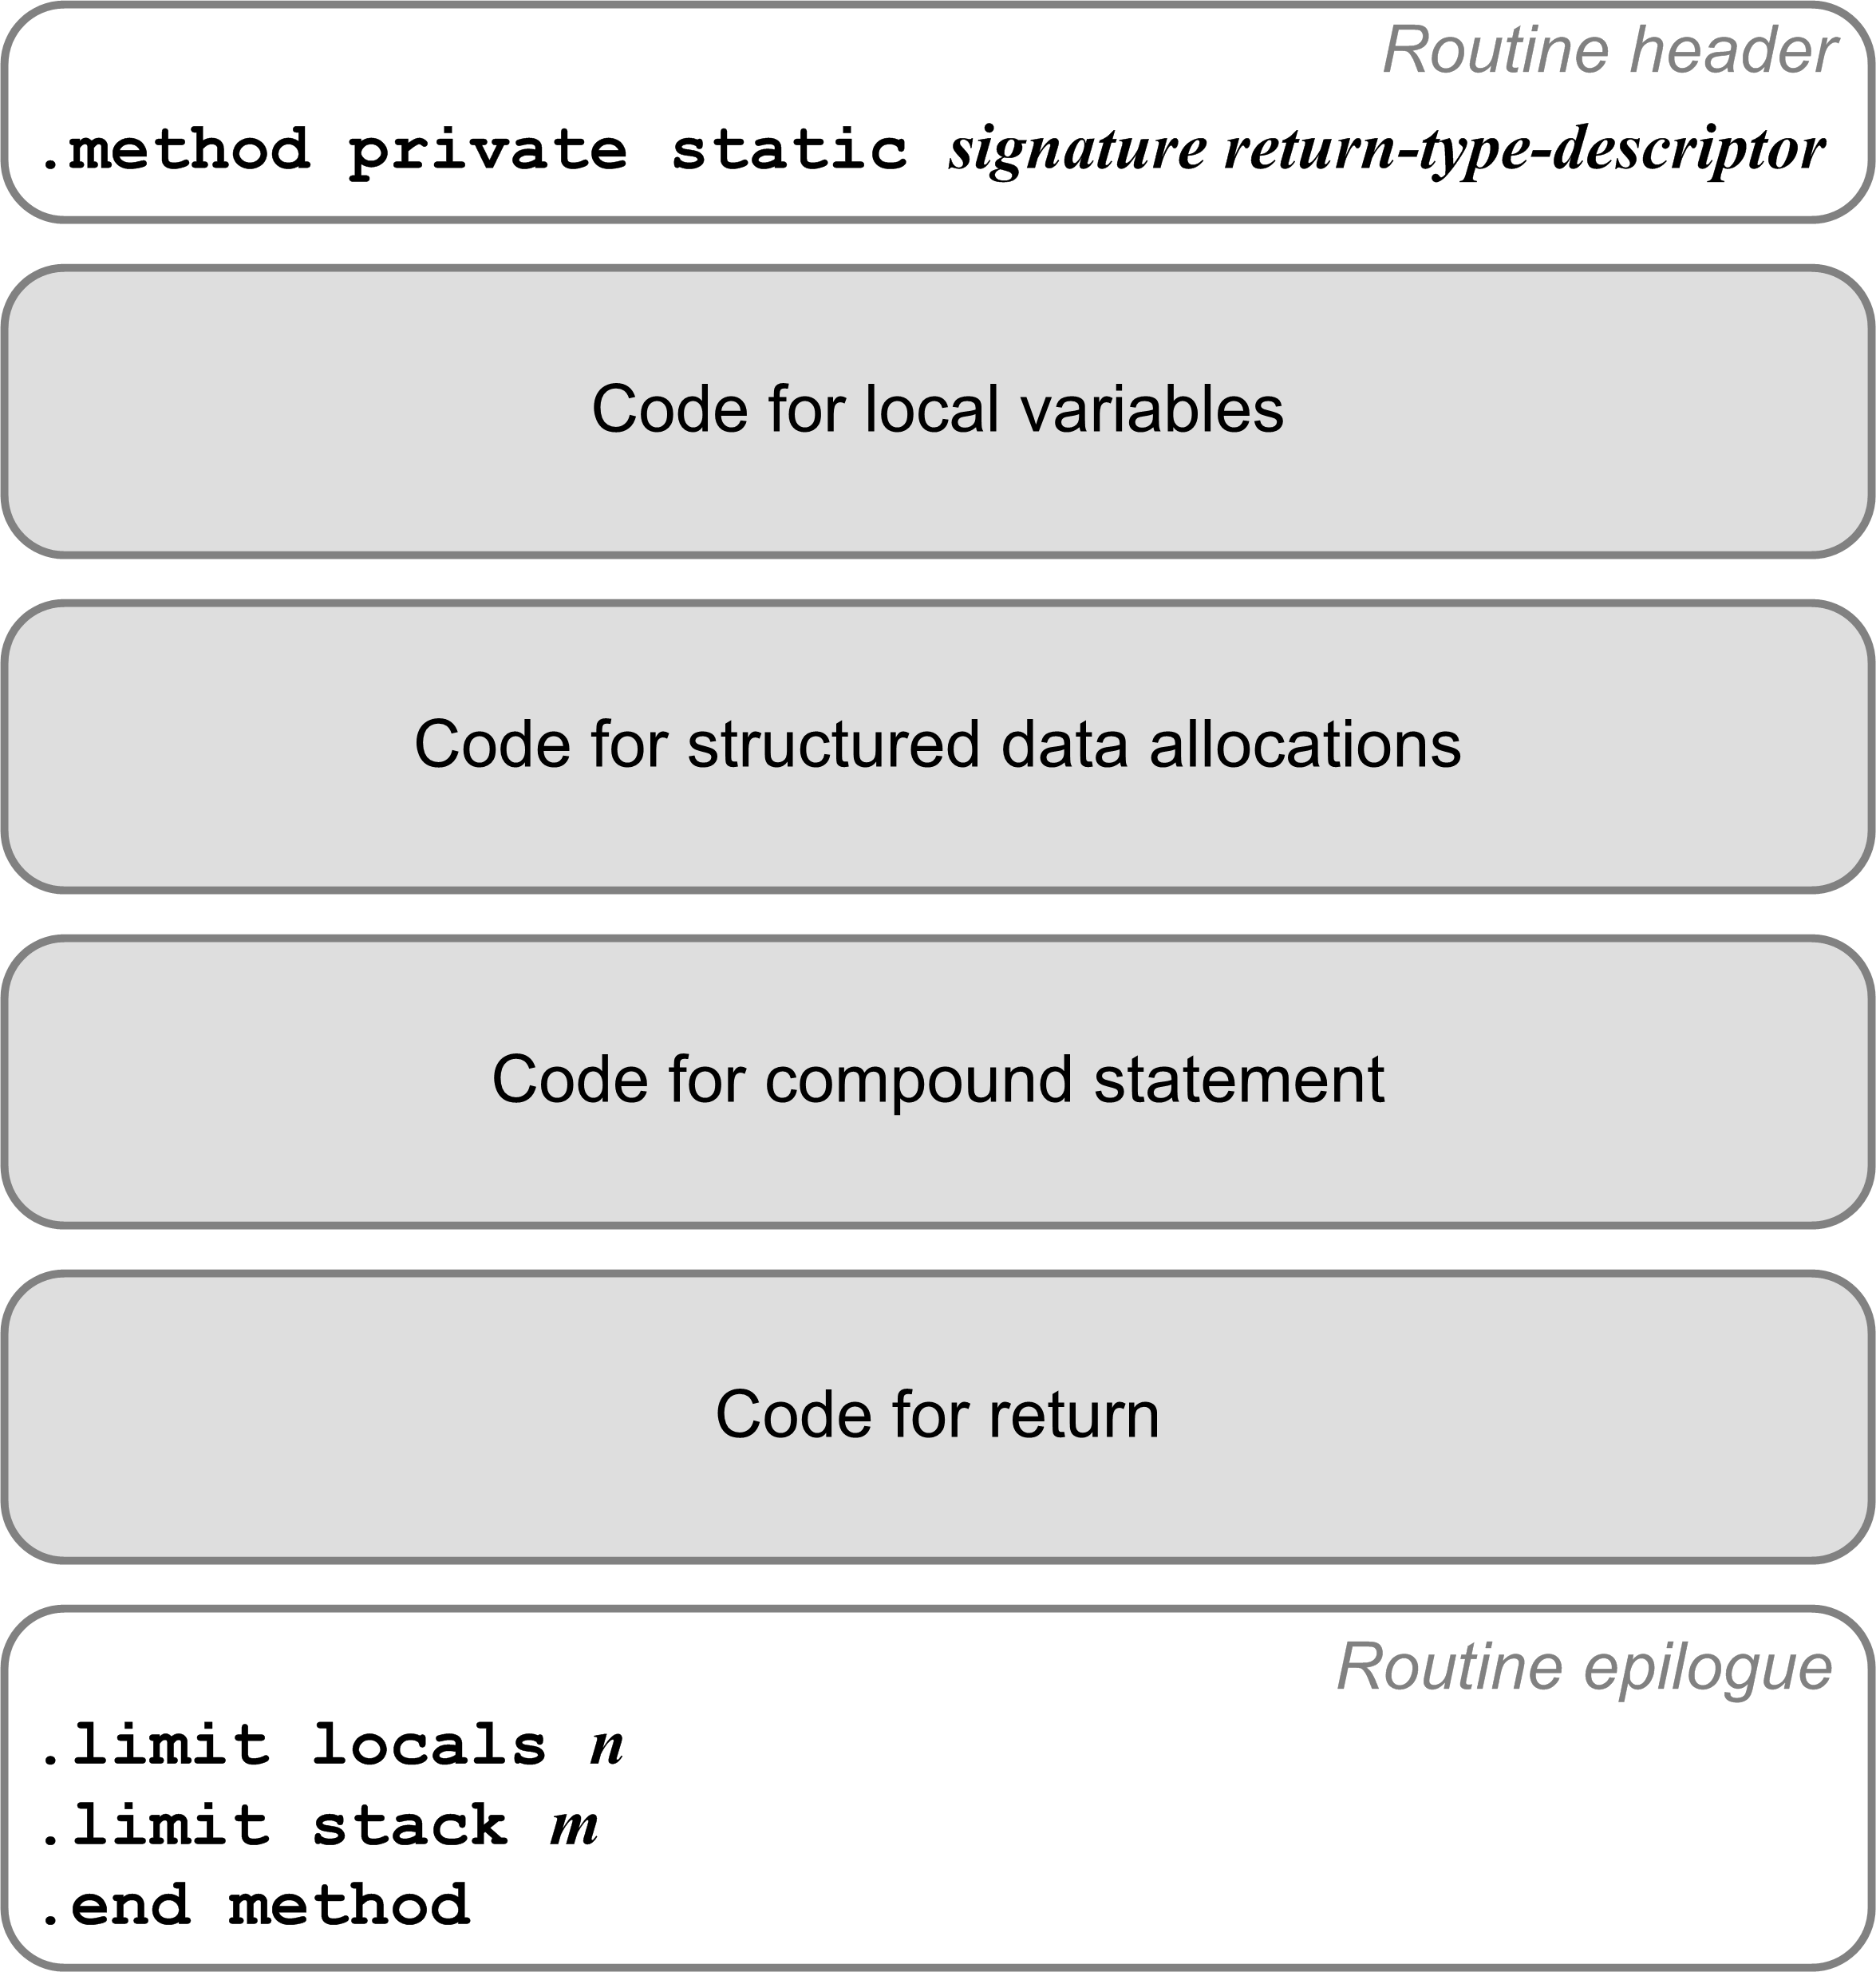
Code for Procedures and Functions
Each a private static method.
Method signature:
  Routine’s name
  Type descriptors of the formal parameters and return value.
Example:
TYPE
arr = ARRAY [1..5] OF real;
FUNCTION func(i, j : integer;
x, y : real;
p : boolean;
ch : char;
vector : arr;
length : integer)
: real;
Compiles to:
.method private static func(IIFFZC[FI)F

Slide 17
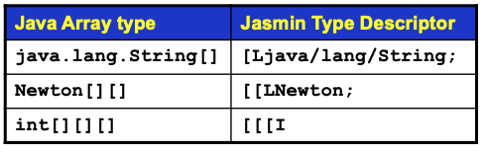
Compiling Local Variables
TYPE
arr = ARRAY [1..5] OF real;
FUNCTION func(i, j : integer;
x, y : real;
p : boolean;
ch : char;
VAR vector : arr;
length : integer)
: real;
VAR
n : integer;
z : real;
w : arr;
Compiles to:
.method private static func(IIFFZC[FI)F
.var 0 is i I
.var 1 is j I
.var 2 is x F
.var 3 is y F
.var 4 is p Z
.var 5 is ch C
.var 6 is vector [F
.var 7 is length I
.var 8 is n I
.var 9 is z F
.var 10 is w [F
.var 11 is func F
Add a local variables array slot number
to each variable’s symbol table entry.

Slide 18
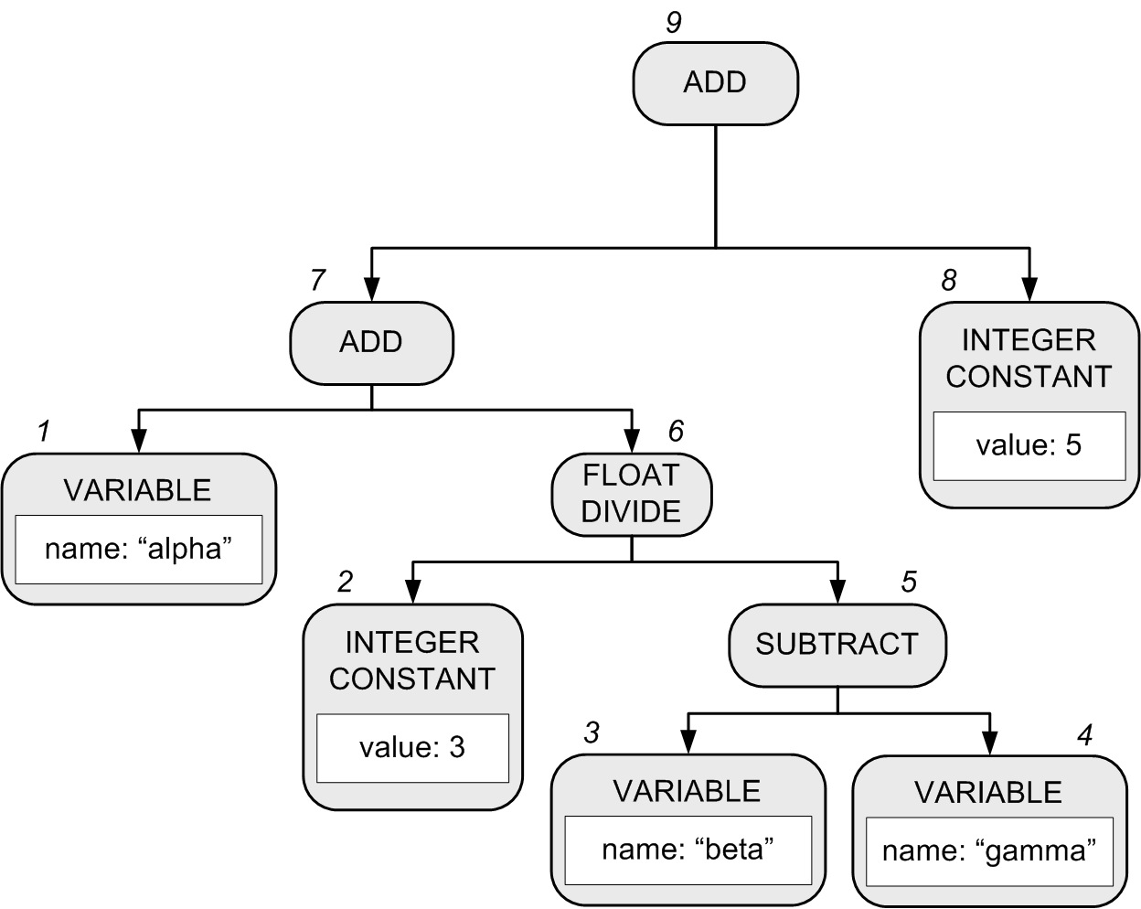
Generating Code for Expressions
alpha + 3/(beta - gamma) + 5
Recall that in our Pascal interpreter, the expression executor visits the nodes of the expression parse tree in order to execute the expression.
  Pascal’s operator precedence rules are encoded in the structure of the parse tree.
Notes:
START HERE.

Slide 19
Generating Code for Expressions
A compiler’s expression code generator also must visit the tree nodes to generate code for the expression.
  Yet another set of visit methods, in backend class Compiler.
  Assume that alpha, beta, and gamma are local real variables
  alpha ➔ local variable slot #0
  beta ➔ local variable slot #1
  gamma ➔ local variable slot #2
1 fload_0
2 ldc 3.0
3 fload_1
4 fload_2
5 fsub
6 fdiv
7 fadd
8 ldc 5.0
9 fadd
alpha + 3/(beta - gamma) + 5

Slide 20
Classes Containing Visit Methods
Semantic checking (front end)
  frontend.Semantics
Conversion (backend language convertor)
  backend.converter.Converter
Execution (backend interpreter)
  backend.interpreter.Executor
Compiler (backend compiler)
  backend.compiler.Compiler
The visit methods all visit
the same parse tree!
Pass 2
Pass 3
Pass 3
Pass 3

Slide 21
Compare Integer Values
Jasmin has a set of instructions each of which
pop off the top two integer values from the operand stack, compare them, and then branch if the comparison is true.
Instruction | Action
if_icmpeq label | Branch to label if [TOS-1] == [TOS]
if_icmpne label | Branch to label if [TOS-1] != [TOS]
if_icmpgt label | Branch to label if [TOS-1] > [TOS]
if_icmpge label | Branch to label if [TOS-1] >= [TOS]
if_icmplt label | Branch to label if [TOS-1] < [TOS]
if_icmple label | Branch to label if [TOS-1] <= [TOS]

Slide 22
Compare Integer Values, cont’d
Instruction | Action
if_icmpeq label | Branch to label if [TOS-1] == [TOS]
if_icmpne label | Branch to label if [TOS-1] != [TOS]
if_icmpgt label | Branch to label if [TOS-1] > [TOS]
if_icmpge label | Branch to label if [TOS-1] >= [TOS]
if_icmplt label | Branch to label if [TOS-1] < [TOS]
if_icmple label | Branch to label if [TOS-1] <= [TOS]
The two values are popped off
the operand stack.
  [TOS] is the value at the top of the stack.
  [TOS-1] is the value just under the one
  at the top of the stack.

Slide 23
Compare Integer Values, cont’d
You can also pop off only the single integer value at the top of the operand stack, compare it to 0, and then branch if the comparison is true.
The top value is popped off the stack.
Instruction | Action
ifeq label | Branch to label if [TOS] == 0
ifne label | Branch to label if [TOS] != 0
ifgt label | Branch to label if [TOS] > 0
ifge label | Branch to label if [TOS] >= 0
iflt label | Branch to label if [TOS] < 0
ifle label | Branch to label if [TOS] <= 0

Slide 24
Compare Values of Other Datatypes
Instructions lcmp, fcmp, and dcmp compare two long, float, or double values at the top of the operand stack.
  Each pops off the top two values, compares them, and then pushes the integer value -1, 0, or 1 back onto the operand stack.
    If [TOS-1] < [TOS], push -1.
    If [TOS-1] == [TOS], push 0.
    If [TOS-1] > [TOS], push 1.
Then use instructions iflt, ifeq, or ifgt
to test for the -1, 0, or 1.

Slide 25
Assignment Statement Code Template
The code template for an assignment statement to a local variable <variable> := <expression>
code for
<expression>
xstore n
Where x is i, l, f, or d depending on the datatype of the computed value of <expression>.
You can generate a shortcut store instruction such as istore_3 (3 is a slot number) whenever possible.

Slide 26
Load and Store Tips
Write special code emitters for loading (pushing) values onto the operand stack.
If loading constants:
  Determine whether you can emit a shortcut instruction.

Slide 27
Load and Store Tips, cont’d
To load (push) a variable’s value:
  Determine whether it’s a program variable
  (emit a getstatic instruction with the field name and data type descriptor) or a local variable (emit an appropriate load instruction with the slot number).
  Determine whether you can emit a
  shortcut instruction for a local variable.
Similarly, write special code emitters to store (pop) a value off the operand stack into a program variable or into a local variable’s slot.

Slide 28
What Would James Gosling Do?
What Jasmin code should you generate for this Pascal program?
CodeTest.pas
PROGRAM CodeTest;
FUNCTION test : real;
VAR
alpha, beta, gamma : real;
thirty, forty, fifty : integer;
BEGIN
alpha := 0;
beta := 10;
gamma := 20;
thirty := 30;
forty := 40;
fifty := 50;
IF forty = fifty
THEN test := alpha + 3/(beta - gamma) + 5
ELSE test := alpha + thirty/(beta - gamma) + fifty;
END;
BEGIN
writeln(test())
END.

Slide 29
What Would James Gosling Do, cont’d
What Jasmin code should you generate?
CodeTest.java
public class CodeGen
{
private static double test()
{
double alpha = 0; //* slot #0
double beta = 10; //* slot #2
double gamma = 20; //* slot #4
int thirty = 30; //* slot #6
int forty = 40; //* slot #7
int fifty = 50; //* slot #8
if (forty == fifty)
{
return alpha + 3/(beta - gamma) + 5;
}
else
{
return alpha + thirty/(beta - gamma) + fifty;
}
}
}

Slide 30
What Would James Gosling Do, cont’d
If you have a construct in your source language and you don’t know what Jasmin code to generate for it:
  Write the equivalent construct in Java.
  Compile the Java into a .class file.
  Run the jasper disassembler to get an idea
  of what code you should generate.

Slide 31
What Would James Gosling Do, cont’d
CodeTest.pas
PROGRAM CodeTest;
FUNCTION test : real;
VAR
alpha, beta, gamma : real;
thirty, forty, fifty : integer;
BEGIN
alpha := 0;
beta := 10;
gamma := 20;
thirty := 30;
forty := 40;
fifty := 50;
IF forty = fifty
THEN test := alpha + 3/(beta - gamma) + 5
ELSE test := alpha + thirty/(beta - gamma) + fifty;
END;
BEGIN
writeln(test())
END.
CodeTest.java
public class CodeTest
{
private static double test()
{
double alpha = 0; //* slot #0
double beta = 10; //* slot #2
double gamma = 20; //* slot #4
int thirty = 30; //* slot #6
int forty = 40; //* slot #7
int fifty = 50; //* slot #8
if (forty == fifty)
{
return alpha + 3/(beta - gamma) + 5;
}
else
{
return alpha + thirty/(beta - gamma) + fifty;
}
}
public static void main(String args[])
{
System.out.println(test());
}
}

Slide 32
Jasper
Use the Jasper disassembler:
https://github.com/kohsuke/jasper
It claims to disassemble .class files into Jasmin files suitable for the Jasmin assembler.
  Jasper is a Java program.
Google “Java byte code viewer”
for other disassemblers.
  Java comes with javap, but its output cannot be assembled by the Jasmin assembler.

Slide 33
Jasper, cont’d
.method private static test()D
.limit stack 8
.limit locals 9
.var 0 is alpha D from LABEL0x2 to LABEL0x3c
.var 2 is beta D from LABEL0x6 to LABEL0x3c
.var 4 is gamma D from LABEL0xb to LABEL0x3c
.var 6 is thirty I from LABEL0xf to LABEL0x3c
.var 7 is forty I from LABEL0x13 to LABEL0x3c
.var 8 is fifty I from LABEL0x17 to LABEL0x3c
.line 5
dconst_0
dstore_0
.line 6
LABEL0x2:
ldc2_w 10.0
dstore_2
.line 7
LABEL0x6:
ldc2_w 20.0
dstore 4
.line 8
LABEL0xb:
bipush 30
istore 6
.line 9
LABEL0xf:
bipush 40
istore 7
.line 10
LABEL0x13:
bipush 50
istore 8
private static double test()
{
double alpha = 0; //* slot #0
double beta = 10; //* slot #2
double gamma = 20; //* slot #4
int thirty = 30; //* slot #6
int forty = 40; //* slot #7
int fifty = 50; //* slot #8
if (forty == fifty)
{
return alpha + 3/(beta - gamma) + 5;
}
else
{
return alpha + thirty/(beta - gamma) + fifty;
}
}

Slide 34
Jasper, cont’d
.line 12
LABEL0x17:
iload 7
iload 8
if_icmpne LABEL0x2d
.line 14
dload_0
ldc2_w 3.0
dload_2
dload 4
dsub
ddiv
dadd
ldc2_w 5.0
dadd
dreturn
.line 18
LABEL0x2d:
dload_0
iload 6
i2d
dload_2
dload 4
dsub
ddiv
dadd
iload 8
i2d
dadd
dreturn
LABEL0x3c:
.end method
private static double test()
{
double alpha = 0; //* slot #0
double beta = 10; //* slot #2
double gamma = 20; //* slot #4
int thirty = 30; //* slot #6
int forty = 40; //* slot #7
int fifty = 50; //* slot #8
if (forty == fifty)
{
return alpha + 3/(beta - gamma) + 5;
}
else
{
return alpha + thirty/(beta - gamma) + fifty;
}
}

