Slide 1


CS 153: Concepts of Compiler Design
October 13 Class Meeting
Department of Computer Science
San Jose State University
Fall 2026
Instructor: Ron Mak
www.cs.sjsu.edu/~mak

Slide 2
Rest of the Semester
Backend compiler.
Generate low-level Jasmin assembly language code for the Java Virtual Machine (JVM).
  Learn the architecture and instruction set of the JVM.
  Code generation skills can apply to other machine architectures.
Work on your team compiler project.

Slide 3
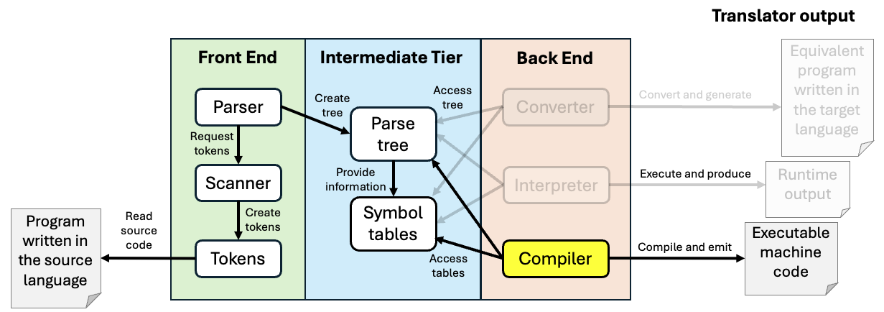
Onward to the Compiler!
You’ve built a large skillset with ANTLR 4, the Pascal-to-Java program converter and the Pascal interpreter with an interactive debugger.
  Apply those skills to developing a compiler.

Slide 4
Target Machines
A compiler’s backend code generator produces
object code for a target machine.
Target machine: Java Virtual Machine (JVM)
Object language: Jasmin assembly language
  The Jasmin assembler translates assembly language programs into binary .class files.
  The JVM loads and executes .class files.
Skills learned from generating Jasmin transfer to generating other assembly languages and for other machine architectures.

Slide 5
Target Machines, cont’d
Instead of using javac to compile a source program written in Java into a .class file ...
Use your compiler to compile a source program written in your chosen language into a Jasmin
object program.
Then use the Jasmin assembler
to create the .class file.

Slide 6
Target Machines, cont’d
No matter what language the source program was originally written in, once it’s been compiled into a .class file, the JVM will be able to load and execute it.
The JVM runs on a wide variety
of hardware platforms.

Slide 7
Why Assembly Language?
Why not generate binary (machine) code?
  Binary code is hard to debug when you’re still figuring out what object code to generate.
  There are already tools (i.e., assemblers) that are very good at producing binary code in the correct formats for loaders.
Jasmin assembly code is human readable.
  Much easier to debug code generation errors.
  Disassembly tools are available to convert .class binary files to Jasmin.
    Compare your object code to the Java compiler’s.

Slide 8
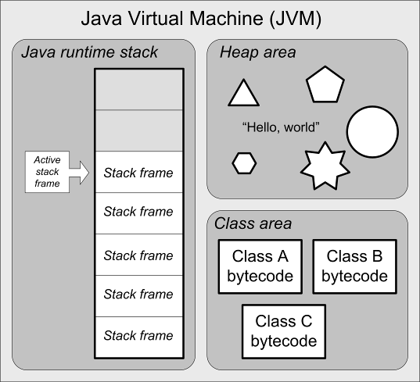
Java Virtual Machine (JVM) Architecture
Java runtime stack
  stack frames
Heap area
  dynamically allocated objects
  automatic garbage collection
Class area
  code for methods
  constants pool
Native method stacks
  support native methods, e.g., written in C
  (not shown)

Slide 9
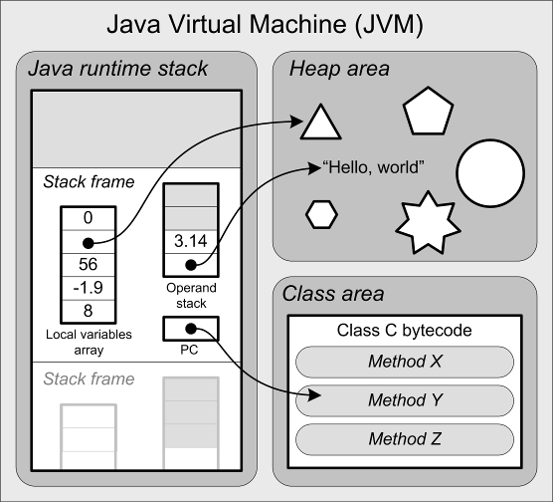
Java Virtual Machine Architecture, cont’d
The runtime stack contains stack frames.
Each stack frame contains:
  local variables array
  operand stack
  program counter (PC)
What is missing in the JVM
that we had in our
Pascal interpreter?

Slide 10
Stack Frame Contents
Operand stack
  For doing computations.
Local variables array
  Equivalent to the
  memory map in our
  interpreter’s stack frame.
Program counter (PC)
  Keeps track of the currently executing instruction.
  Automatically managed, so we don’t have to worry about this.

Slide 11
The JVM’s Java Runtime Stack
Each method invocation pushes a stack frame.
The stack frame currently on top of the runtime stack is the active stack frame.
  It’s the local stack frame.
A stack frame is popped
off when the method
returns, possibly leaving
behind a return value
on top of the caller’s
operand stack.

Slide 12
JVM Instructions
Load and store values
Arithmetic operations
Type conversions
Object creation and management
Runtime stack management (push/pop values)
Branching
Method call and return
Throwing exceptions
Concurrency

Slide 13
Jasmin Assembler
Download from:
  http://jasmin.sourceforge.net/
  jasmin.jar
Site also includes:
  User Guide
  Instruction set
  Sample programs

Slide 14
Example Jasmin Program
hello.j
.class public HelloWorld
.super java/lang/Object
.method public static main([Ljava/lang/String;)V
.limit stack 2
.limit locals 1
getstatic java/lang/System/out Ljava/io/PrintStream;
ldc " Hello, world!"
invokevirtual java/io/PrintStream/println(Ljava/lang/String;)V
return
.end method
jasmin.sh
#!/bin/bash
java -jar /Users/rmak/Java/jasmin-2.4/jasmin.jar $1
Assemble:
  jasmin hello.j
Execute:
  java HelloWorld
Demo

Slide 15
Jasmin Assembly Instructions
A Jasmin instruction consists of a mnemonic optionally followed by arguments.
  Example:
  ldc 2 ; Push the constant 2 onto the operand stack
Reference: The Java Virtual Machine Instruction Set
https://docs.oracle.com/javase/specs/jvms/se7/html/jvms-6.html

Slide 16
Jasmin Assembly Instructions, cont’d
Some instructions require operands
on the operand stack.
  Examples:
  iadd ; Pop the two integer values on top of the
  ; operand stack, add them, and push the result
  ; back onto the operand stack
if_icmpeq L004 ; Pop the two integer values on top of
; operand stack, compare them, and then
; branch to label L004 if they're equal

Slide 17
Jasmin Assembly Instructions, cont’d
The JVM (and Jasmin) supports
five basic datatypes:
  int
  long
  float
  double
  reference
Examples:
Long and double values each
requires two consecutive entries
in the local variables array and
two elements on the operand stack.
The first letter of the instruction mnemonic indicates the type of operand.
Letter | Type
a | reference
b | byte or boolean
c | char
d | double
f | float
i | int
l | long
s | short
isub ; integer subtraction
dmul ; double multiplication
Byte, boolean, char, and
short are treated as ints
on the operand stack and
in the local variables array.

Slide 18
Loading Constants onto the Operand Stack
Use the instructions ldc and ldc2_w
(load constant and load double-word constant)
to push constant values onto the operand stack of the active stack frame (the one currently
on top of the runtime stack).
  Examples:
ldc 2
ldc "Hello, world”
ldc 1.0
ldc2_w 1234567890L
ldc2_w 2.7182818284D
aconst_null ; push null
2-word long integer
2-word double

Slide 19
Shortcuts for Loading Constants
Special shortcut instructions for loading certain
small values of constant x:
iconst_m1 ; Push int -1
iconst_x ; Push int x, x = 0, 1, 2, 3, 4, or 5
lconst_x ; Push long x, x = 0 or 1
fconst_x ; Push float x, x = 0, 1, or 2
dconst_x ; Push double x, x = 0 or 1
bipush x ; Push byte x, -128 <= x <= 127
sipush x ; Push short x, -32,768 <= x <= 32,767
Shortcut instructions take up less memory
and can execute faster.
  Smaller operand, or no separate operand at all.

Slide 20
Two-Level Memory Hierarchy
The JVM and the Jasmin instruction set support a two-level memory hierarchy.
Program level: Memory for the fields of a class.
  Jasmin instructions refer to the fields by fully-qualified name: classname/fieldname
  Example:
    Pascal program Test.pas has a global (program level) integer variable named index.
    Equivalent to a Java class Test with static integer field index.
    To push the value of index
    onto the operand stack:
  Example:
getstatic Test/index I
getstatic java/lang/System/out Ljava/io/PrintStream;

Slide 21
Two-Level Memory Hierarchy, cont’d
Local level: Local variables declared in a
Pascal procedure or function (Java method).
  Jasmin instructions refer to local variables not by their names but by their slot numbers (indexes into the local variables array).
  Slot numbers for a method’s parameters are assigned automatically by Jasmin starting with slot #0.
  Slot numbers for a method’s local variables are assigned by you.
    Typically, consecutive slot numbers starting with the next slot number after the last slot number for a parameter.
  Store slot numbers in symbol table entries.

Slide 22
Local Variables and Parameters
Local variables do not
have names in Jasmin.
Refer to a local variable
by its slot number
in the local variables array
of the active stack frame.
  Example: Push the local
  integer value in slot #5 onto the operand stack:
  iload 5 ; Push the int value in slot #5

Slide 23
Local Variables and Parameters, cont’d
Since each long and double value requires
two consecutive slots, refer to the value using the lower slot number.
  Example:
  lstore 3 ; Pop the long value
  ; from the top two stack elements
  ; and store it into slots #3 and #4

Slide 24
Local Variables and Parameters, cont’d
Do not confuse constant values
with slot numbers!
  It depends on the instruction.
  Examples:
  bipush 14 ; push the constant value 14
  iload 14 ; push the value in slot #14

Slide 25
Local Variables and Parameters, cont’d
The values of a function’s parameters are implicitly assigned to slots starting with #0.
  Example Java method:
  k ➔ local slot #0
  m ➔ local slot #1
  x ➔ local slot #3
  s ➔ local slot #4
  Jasmin function signature:
  public static double func(int k, long m,
  float x, String[][] s)
What happened to slot #2?
  .method public static func(IJF[[Ljava/lang/String;)D

Slide 26
Load and Store Instructions
In general:
iload n ; push the int value in local slot #n
lload n ; push the long value in local slot #n
fload n ; push the float value in local slot #n
dload n ; push the double value in local slot #n
aload n ; push the reference in local slot #n
Shortcut examples
(for certain small values of slot number n):
iload_0 ; push the int value in local slot #0
lload_2 ; push the long value in local slot #2
fload_1 ; push the float value in local slot #1
dload_3 ; push the double value in local slot #3
aload_2 ; push the reference in local slot #2
Store instructions are similar.

Slide 27
Arithmetic Instructions
Addition
iadd ladd fadd dadd
Subtraction
isub lsub fsub dsub
Multiplication
imul lmul fmul dmul
Division and remaindering
idiv ldiv fdiv ddiv
Negation
ineg lneg fneg dneg
Operands are on top of
the operand stack.
Pop off the operands and replace them with the result value.
Negation has only one operand, the others each has two.
Int and float operands each takes a single stack element.
Long and double operands each takes two operand stack elements.

Slide 28
Other Instructions
Bitwise operations
  Left and right shifts
  And, or, exclusive or
Type conversions
  int ➔ float
Widening and narrowing
  int ➔ long
  double ➔ long
Stack manipulations
  Push and pop
  Swap and duplicate
Array operations
  Allocate array
  Index element
Object operations
Control instructions

Slide 29
Final Compiler Project Requirements
The minimum compiler project:
  At least two data types with type checking.
  Basic arithmetic operations.
  Operator precedence.
  Assignment statements.
  At least one conditional control statement (e.g., IF).
  At least one looping control statement.
  Functions with calls and returned values.
  Parameters passed by value.
  Basic error recovery.

Slide 30
Final Compiler Project Requirements, cont’d
Use ANTLR 4.
Three-tiered architecture with parse tree and symbol tables in the intermediate tier.
  It should be possible to integrate a program converter and an interpreter into your architecture.
Generate Jamin code that you assemble to .class files for execution on the JVM.
  Provide example source programs written in your chosen language.

Slide 31
Final Compiler Project Requirements, cont’d
Not acceptable: Taking the Pascal compiler and simply changing all the reserved words.
If you do a Pascal-like language, you should change the syntax of some statements (in meaningful ways) and add new statements.
Final compiler project due Monday, December 21

