Slide 1


CS 153: Concepts of Compiler Design
October 1 Class Meeting
Department of Computer Science
San Jose State University
Fall 2026
Instructor: Ron Mak
www.cs.sjsu.edu/~mak

Slide 2
The Pcl_X1 Interpreter
Translator Pcl_X1 can interpret Pascal programs (X for eXecution).
  It retains the ability to convert to Java.
  To run, precede the source file name with either
  -convert or -execute. Examples:
The backend executor code uses the same grammar, parser, parse tree, and symbol tables that we developed for the converter.
  We only need to develop the backend executor.
java -cp bin:$ANTLR_JAR Pcl_X1 -convert SquareRootProcedure.pas
java -cp bin:$ANTLR_JAR Pcl_X1 -execute SquareRootProcedure.pas

Slide 3
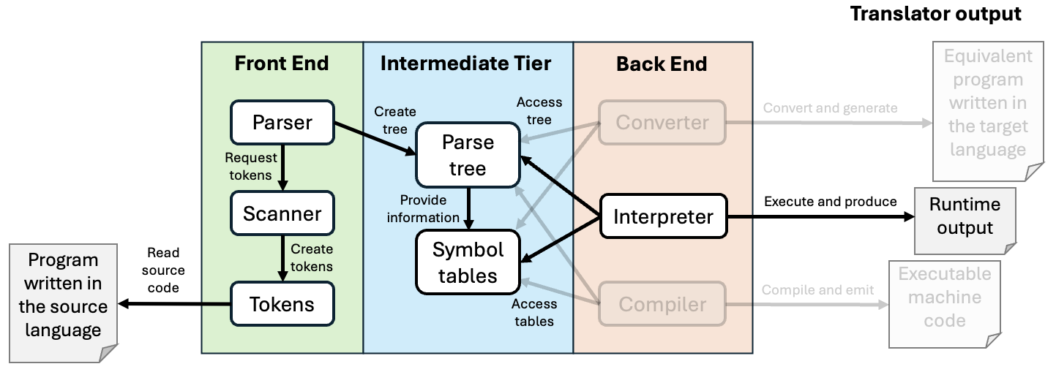
Shared Front End and Intermediate Tiers

Slide 4
Backend Interpreter Classes
The grammar file is Pcl_X1.
  Little changed from our previous version.
Class backend.interpreter.Executor is a subclass of Pcl_X1BaseVisitor<Object>.
  Contains the overridden visit methods for execution.
Classes Program, Statement, and Expression are each a subclass of Executor.
  Contain the implementations of the overridden visit methods.

Slide 5
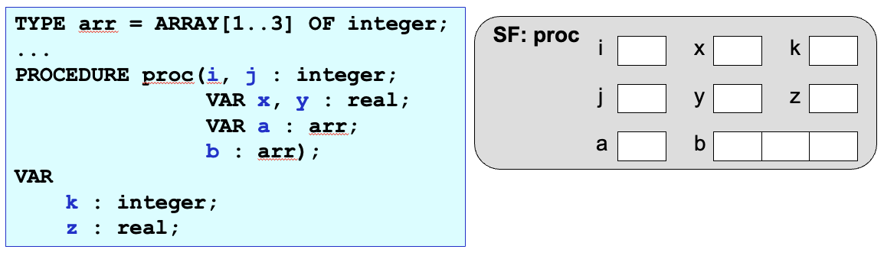
Classes MemoryMap and Cell
Class MemoryMap is a subclass of HashMap<String, Cell>
  The key is the name of the variable or parameter.
  The value is a Cell object as a memory cell to hold a runtime value.

Slide 6
Classes MemoryMap and Cell, cont’d
Cell.java
package backend.interpreter;
public class Cell
{
private Object value = null; // value contained in the memory cell
public Cell(Object value)
{
this.value = value;
}
/**
* Set a new value into the cell.
* @param newValue the new value.
*/
public void setValue(Object newValue) { value = newValue; }
/**
* Get the value in the cell.
* @return the value.
*/
public Object getValue() { return value; }
}

Slide 7
MemoryMap.java
public class MemoryMap extends HashMap<String, Cell>
{
public MemoryMap(Symtab symtab)
{
for (Map.Entry<String, SymtabEntry> symtabEntry : symtab.entrySet())
{
SymtabEntry entry = (SymtabEntry) symtabEntry.getValue();
Kind kind = entry.getKind();
switch (kind)
{
case VARIABLE:
case FUNCTION:
case VALUE_PARAMETER:
case RECORD_FIELD:
{
String name = entry.getName();
Typespec typespec = entry.getTypespec();
put(name, new Cell(allocateCellValue(typespec)));
break;
}
case REFERENCE_PARAMETER:
{
String name = entry.getName();
put(name, new Cell(null));
}
default: break;
}
}
}

Slide 8
Class MemoryMap, cont’d
MemoryMap.java
private Object allocateCellValue(Typespec typespec)
{
switch (typespec.getForm())
{
case ARRAY: return allocateArrayCells(typespec);
case RECORD: return allocateRecordMap(typespec);
default: return null; // uninitialized scalar value
}
}
private Object[] allocateArrayCells(Typespec typespec)
{
int elmtCount = typespec.getArrayElementCount();
Typespec elmtType = typespec.getArrayElementType();
Cell allocation[] = new Cell[elmtCount];
for (int i = 0; i < elmtCount; ++i)
{
allocation[i] = new Cell(allocateCellValue(elmtType));
}
return allocation;
}

Slide 9
Class MemoryMap, cont’d
MemoryMap.java
private MemoryMap allocateRecordMap(Typespec typespec)
{
Symtab symtab = (Symtab) typespec.getRecordSymtab();
MemoryMap memoryMap = new MemoryMap(symtab);
return memoryMap;
}
}
Implement and allocate a Pascal record as a memory map made from the record type’s symbol table.

Slide 10
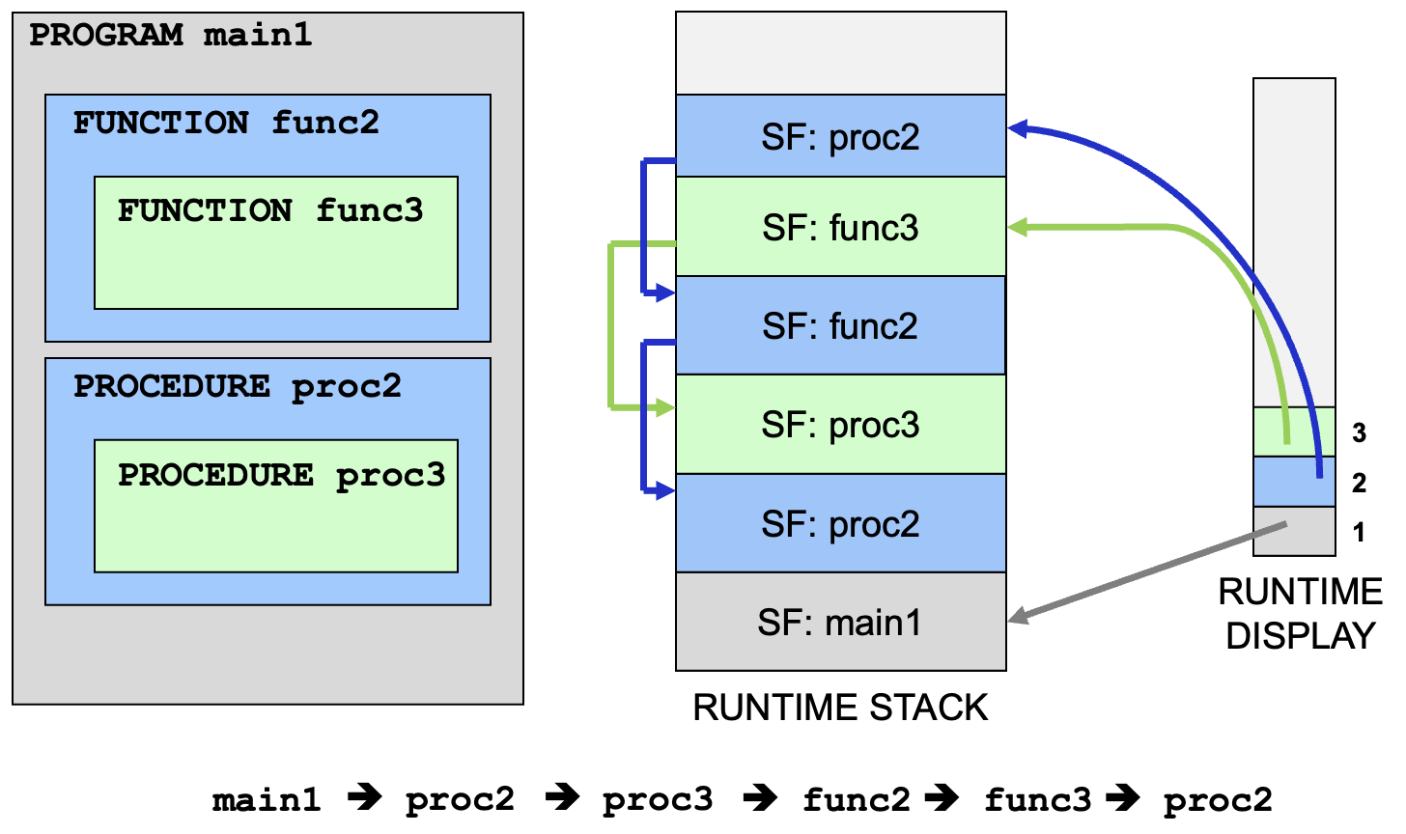
Class StackFrame

Slide 11
Class StackFrame, cont’d
StackFrame.java
public class StackFrame
{
private SymtabEntry routineEntry; // symtab entry of the routine's name
private StackFrame backlink; // backlink to the previous frame
private int nestingLevel; // scope nesting level of this frame
private MemoryMap memoryMap; // memory map of this stack frame
public Cell getCell(String name) { return memoryMap.getCell(name); }
public void replaceCell(String name, Cell cell)
{
memoryMap.replaceCell(name, cell);
}
public int getNestingLevel() { return nestingLevel; }
public StackFrame backlink() { return backlink; }
public StackFrame createBacklink(StackFrame frame)
{
backlink = frame;
return this;
}
}

Slide 12
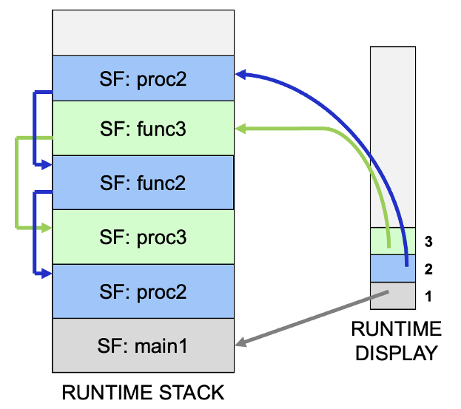
Class RuntimeStack
RuntimeStack.java
public class RuntimeStack extends ArrayList<StackFrame>
{
private RuntimeDisplay display; // runtime display
public RuntimeStack()
{
display = new RuntimeDisplay();
}
public StackFrame getTopmost(int nestingLevel)
{
return display.getStackFrame(nestingLevel);
}
public int currentNestingLevel()
{
int topIndex = size() - 1;
return topIndex >= 0 ? get(topIndex).getNestingLevel() : -1;
}
...

Slide 13
Class RuntimeStack, cont’d
RuntimeStack.java
public void push(StackFrame frame)
{
int nestingLevel = frame.getNestingLevel();
add(frame);
display.callUpdate(nestingLevel, frame);
}
public void pop()
{
display.returnUpdate(currentNestingLevel());
remove(size() - 1);
}
}

Slide 14
Class RuntimeDisplay
RuntimeDisplay.java
public class RuntimeDisplay extends ArrayList<StackFrame>
{
public RuntimeDisplay()
{
add(null); // dummy element 0 (never used)
}
/**
* Get the stack frame at a given nesting level.
* @param nestingLevel the nesting level.
* @return the stack frame.
*/
public StackFrame getStackFrame(int nestingLevel)
{
return get(nestingLevel);
}
...

Slide 15
Class RuntimeDisplay, cont’d
RuntimeDisplay.java
/**
* Update the display for a call to a routine at a given nesting level.
* @param nestingLevel the nesting level.
* @param frame the stack frame for the routine.
*/
public void callUpdate(int nestingLevel, StackFrame frame)
{
// Next higher nesting level: Append a new element at the top.
if (nestingLevel >= size()) add(frame);
// Existing nesting level: Set at the specified level.
else
{
StackFrame prevFrame = get(nestingLevel);
set(nestingLevel, frame.createBacklink(prevFrame));
}
}
...

Slide 16
Class RuntimeDisplay, cont’d
RuntimeDisplay.java
/**
* Update the display for a return from a routine at a given nesting level.
* @param nestingLevel the nesting level.
*/
public void returnUpdate(int nestingLevel)
{
int topIndex = size() - 1;
StackFrame frame = get(nestingLevel); // frame about to be popped off
StackFrame prevFrame = frame.backlink(); // previous frame it points to
// Point the element at that nesting level
// to the previous stack frame.
if (prevFrame != null) set(nestingLevel, prevFrame);
// The top element has become null, so remove it.
else if (nestingLevel == topIndex) remove(topIndex);
}
}

Slide 17
Ready to Execute Pascal Programs
Now we have all the infrastructure we need in the back end to execute Pascal programs.
Let’s time the execution of each program.
  Use Java’s System.currentTimeMillis()

Slide 18
Backend Class Program
Program.java
public class Program extends Executor
{
Object program(ProgramContext ctx)
{
long startTime = System.currentTimeMillis();
StackFrame programFrame = new StackFrame(programEntry);
runtimeStack.push(programFrame);
visit(ctx.block().compoundStatement());
long elapsedTime = System.currentTimeMillis() - startTime;
System.out.printf("\n%,20d statements executed." +
"\n%,20d runtime errors." +
"\n%,20d milliseconds execution time.\n",
executionCount, error.getCount(), elapsedTime);
return null;
}
}
Start time
Execute the code
Elapsed time

Slide 19
Backend Method AssignmentStatement()
Method assignmentStatement() delegates the work to a helper method assignValue() .
  The helper method will also be used in FOR statements and to assign actual argument values to formal parameters during a function or a procedure call.
Statements.java
Object assignmentStatement(AssignmentStatementContext ctx)
{
ExpressionContext exprCtx = ctx.expression();
Object value = visit(exprCtx);
assignValue(ctx.variable(), value, exprCtx.typespec);
return null;
}

Slide 20
Backend Helper Method assignValue()
Executor.java
/**
* Assign a value to a target variable's memory cell.
* @param variableCtx the VariableContext of the target.
* @param value the value to assign.
* @param valueType the datatype of the value.
* @return the target variable's memory cell.
*/
protected Cell assignValue(VariableContext variableCtx,
Object value, Typespec valueType)
{
Typespec targetType = variableCtx.typespec;
Cell targetCell = (Cell) visit(variableCtx);
assignValue(targetCell, targetType, value, valueType);
return targetCell;
}

Slide 21
Helper Method assignValue(), cont’d
Executor.java
/**
* Assign a value to a target variable's memory cell.
* @param targetCell the target variable's memory cell.
* @param targetType the datatype of the target variable.
* @param value the value to assign.
* @param valueType the datatype of the value.
*/
protected void assignValue(Cell targetCell, Typespec targetType,
Object value, Typespec valueType)
{
// Assign with any necessary type conversions.
if ( (targetType == Predefined.integerType)
&& (valueType == Predefined.charType))
{
int charValue = (Character) value;
targetCell.setValue(charValue);
}
...

Slide 22
Helper Method assignValue(), cont’d
Executor.java
...
else if (targetType == Predefined.realType)
{
double doubleValue =
(valueType == Predefined.integerType) ? (Integer) value
: (valueType == Predefined.charType) ? (Character) value
: (Double) value;
targetCell.setValue(doubleValue);
}
else
{
targetCell.setValue(value);
}
}

Slide 23
Backend Method ifStatement()
Statements.java
Object ifStatement(IfStatementContext ctx)
{
TrueStatementContext trueCtx = ctx.trueStatement();
FalseStatementContext falseCtx = ctx.falseStatement();
boolean value = (Boolean) visit(ctx.expression());
if (value) visit(trueCtx);
else if (falseCtx != null) visit(falseCtx);
return null;
}

Slide 24
Backend Method repeatStatement()
Statements.java
Object repeatStatement(RepeatStatementContext ctx)
{
StatementListContext listCtx = ctx.statementList();
boolean value;
do
{
visit(listCtx);
value = (Boolean) visit(ctx.expression());
} while (!value);
return null;
}

Slide 25
Backend Method whileStatement()
Statements.java
Object whileStatement(WhileStatementContext ctx)
{
StatementContext stmtCtx = ctx.statement();
boolean value = (Boolean) visit(ctx.expression());
while (value)
{
visit(stmtCtx);
value = (Boolean) visit(ctx.expression());
}
return null;
}

Slide 26
Backend Method forStatement()
Statements.java
Object forStatement(ForStatementContext ctx)
{
VariableContext controlCtx = ctx.variable();
ExpressionContext startExprCtx = ctx.expression().get(0);
ExpressionContext stopExprCtx = ctx.expression().get(1);
// Initial control value.
Object startValue = visit(startExprCtx);
assignValue(controlCtx, startValue, startExprCtx.typespec);
// Terminal control value.
boolean to = ctx.TO() != null;
Object stopValue = visit(stopExprCtx);
...
forStatement : FOR variable ':=' expression
( TO | DOWNTO ) expression DO statement ;

Slide 27
Method forStatement(), cont’d
Statements.java
// Integer control values.
if (controlCtx.typespec.baseType() == Predefined.integerType)
{
int control = (Integer) startValue;
int stop = (Integer) stopValue;
if (to)
{
while (control <= stop)
{
visit(ctx.statement());
Object nextValue = ++control;
assignValue(controlCtx, nextValue, Predefined.integerType);
}
}
else // downto
{
while (control >= stop)
{
visit(ctx.statement());
Object nextValue = --control;
assignValue(controlCtx, nextValue, Predefined.integerType);
}
}
}

Slide 28
Method forStatement(), cont’d
Statements.java
// Character control values.
else
{
char control = (Character) startValue;
char stop = (Character) stopValue;
if (to)
{
while (control <= stop)
{
visit(ctx.statement());
Object nextValue = ++control;
assignValue(controlCtx, nextValue, Predefined.charType);
}
}
else // downto
{
while (control >= stop)
{
visit(ctx.statement());
Object nextValue = --control;
assignValue(controlCtx, nextValue, Predefined.charType);
}
}
}
return null;
}

Slide 29
Backend Method caseStatement()
The first time a particular CASE statement is executed, first create a hashmap for it.
  Key: Value of a case constant
  Value: The parse tree node of the corresponding statement.
  Store the hashmap as a local field in the CASE statement’s parse tree node.
caseStatement
locals [ HashMap<Integer, StatementContext> jumpTable = null
]
: CASE expression OF caseBranchList END ;

Slide 30
Backend Method caseStatement()
Statements.java
Object caseStatement(CaseStatementContext ctx)
{
ExpressionContext exprCtx = ctx.expression();
CaseBranchListContext branchListCtx = ctx.caseBranchList();
// First time: Create the jump table.
if (ctx.jumpTable == null)
{
ctx.jumpTable = createJumpTable(branchListCtx);
}
Object value = visit(exprCtx);
int intValue =
(exprCtx.typespec == Predefined.integerType) ? (Integer) value
: (Character) value;
// From the jump table obtain the statement corresponding to the value.
StatementContext stmtCtx = ctx.jumpTable.get(intValue);
if (stmtCtx != null) visit(stmtCtx);
return null;
}

Slide 31
Method caseStatement(), cont’d
Statements.java
private HashMap<Integer, StatementContext> createJumpTable(
CaseBranchListContext branchListCtx)
{
HashMap<Integer, StatementContext> table = new HashMap<>();
// Loop over the CASE branches.
for (CaseBranchContext branchCtx : branchListCtx.caseBranch())
{
CaseConstantListContext constListCtx = branchCtx.caseConstantList();
StatementContext stmtCtx = branchCtx.statement();
if (constListCtx != null)
{
// Loop over the CASE constants of each CASE branch.
for (CaseConstantContext caseConstCtx : constListCtx.caseConstant())
{
table.put(caseConstCtx.value, stmtCtx);
}
}
}
return table;
}

Slide 32
Method procedureCallStatement()
Statements.java
Object procedureCallStatement(ProcedureCallStatementContext ctx)
{
SymtabEntry routineEntry = ctx.procedureName().entry;
ArgumentListContext argListCtx = ctx.argumentList();
StackFrame newFrame = new StackFrame(routineEntry);
// Execute any actual parameters and initialize
// the formal parameters in the routine's new stack frame.
if (argListCtx != null)
{
ArrayList<SymtabEntry> parameters = routineEntry.getRoutineParameters();
executeCallArguments(argListCtx, parameters, newFrame);
}
...

Slide 33
Method procedureCallStatement(), cont’d
Statements.java
...
// Push the routine's stack frame onto the runtime stack
// and execute the procedure.
runtimeStack.push(newFrame);
// Execute the routine.
CompoundStatementContext stmtCtx =
(CompoundStatementContext) routineEntry.getExecutable();
visit(stmtCtx);
// Pop off the routine's stack frame.
runtimeStack.pop();
return null;
}

Slide 34
Method factorFunctionCall()
Expressions.java
Object factorFunctionCall(FactorFunctionCallContext ctx)
{
FunctionCallContext callCtx = ctx.functionCall();
SymtabEntry routineEntry = callCtx.functionName().entry;
ArgumentListContext argListCtx = callCtx.argumentList();
StackFrame newFrame = new StackFrame(routineEntry);
// Execute any call arguments and initialize
// the parameters in the routine's new stack frame.
if (argListCtx != null)
{
ArrayList<SymtabEntry> parms = routineEntry.getRoutineParameters();
executeCallArguments(argListCtx, parms, newFrame);
}
// Push the routine's stack frame onto the runtime stack
// and execute the procedure.
runtimeStack.push(newFrame);
...

Slide 35
Method factorFunctionCall(), cont’d
Expressions.java
...
// Execute the routine.
CompoundStatementContext stmtCtx =
(CompoundStatementContext) routineEntry.getExecutable();
visit(stmtCtx);
// Get the function value from its associated variable.
String functionName = routineEntry.getName();
Cell valueCell = newFrame.getCell(functionName);
Object functionValue = valueCell.getValue();
// Pop off the routine's stack frame.
runtimeStack.pop();
return functionValue;
}
Demo

Slide 36
Total Control During Execution
The interpreter has total control over the execution of a source program.
  Unlike the converter, which generates a separate Java program that then executes independently.
Because it has total control, an interpreter can easily incorporate an interactive symbolic debugger to allow manual control.
  Symbolic means that the debugger can refer to the source program’s statements by their line numbers and refer to variables by their names.
  Create a separate debugger command language.

