Slide 1


CS 153: Concepts of Compiler Design
September 24 Class Meeting
Department of Computer Science
San Jose State University
Fall 2026
Instructor: Ron Mak
www.cs.sjsu.edu/~mak

Slide 2
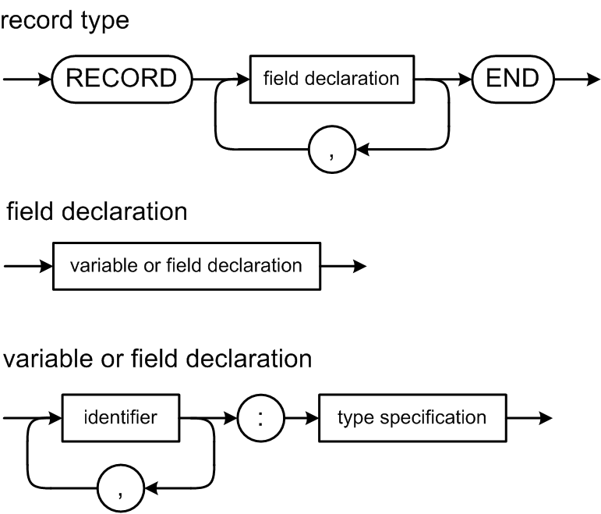
Pascal Record Type Definitions
A record field can be any type.
  Including another record type (nested records).

Slide 3
Named Record Type Definitions
Examples of named record definitions:
TYPE
rec1 = RECORD
i : integer;
r : real;
b1, b2 : boolean;
c : char
END;
rec2 = RECORD
ten : integer;
r : rec1;
a1, a2, a3 : ARRAY [range3] OF range2;
END;
Classic Pascal is not object-oriented. A record type contains only fields, not procedures or functions.

Slide 4
Unnamed Record Types
Like the other types, a record type can be unnamed.
VAR
rec : RECORD
alpha : integer;
beta : real;
gamma : char;
END;
BEGIN
rec.alpha := 5;
rec.beta := 3.14;
rec.gamma := 'g';
END.

Slide 5
Pascal Record Example
PROGRAM RecordTest1;
TYPE
String2 = PACKED ARRAY [0..1 ] OF char;
String5 = PACKED ARRAY [0..4 ] OF char;
String8 = PACKED ARRAY [0..7 ] OF char;
String16 = PACKED ARRAY [0..15] OF char;
AddressRec = RECORD
street : String16;
city : String16;
state : String2;
zip : String5;
END;
PersonRec = RECORD
firstName : String16;
lastName : String16;
age : integer;
address : AddressRec;
phones : ARRAY [0..1]
OF String8;
END;
VAR
john : PersonRec;
mary : PersonRec;
BEGIN
john.firstName := 'John';
john.lastName := 'Doe';
john.age := 24;
john.address.street := '1680 25th Street';
john.address.city := 'San Pablo';
john.address.state := 'CALIFORNIA';
john.address.zip := '94806';
john.phones[0] := '111-1111';
john.phones[1] := '222-2222';
mary.firstName := 'Mary';
mary.lastName := 'Jane';
mary.age := 22;
mary.address.street := '4899 Bela Drive ';
mary.address.city := 'San Jose';
mary.address.state := 'CALIFORNIA';
mary.address.zip := '95129';
mary.phones[0] := '333-3333';
mary.phones[1] := '444-4444';
END.

Slide 6
Type Check Record Fields
A record field can be any type, including arrays and other record types.
Type check a field reference such as
  Is the variable a record variable?
  Is the field one of the record type’s fields.
  Does the data type of the field match the record type’s definition?
  Assignment compatible?
john.address.street := '1680 25th Street';

Slide 7
Converting Pascal Records to Java
Each Pascal record type will become a nested Java class.
  The nested class will have public fields but no methods.
Conversion not yet completed in Pcl_P6.

Slide 8
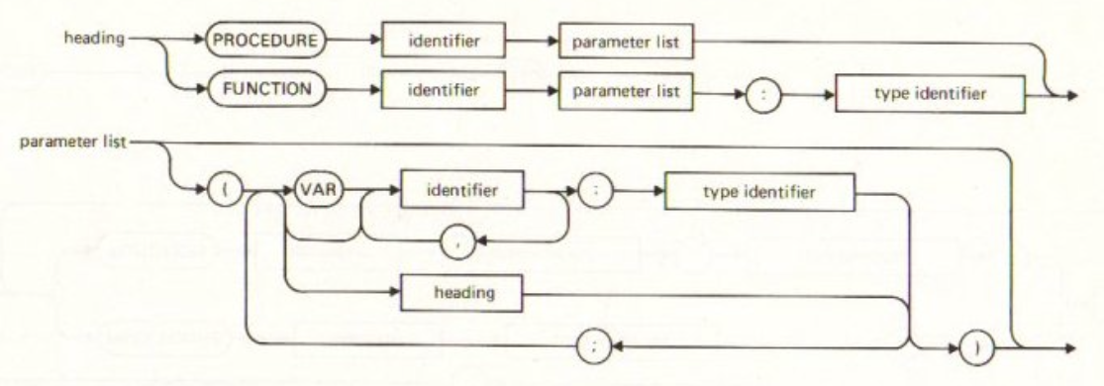
Pascal Functions and Procedures
A Pascal procedure is a function that doesn’t return a value.

Slide 9
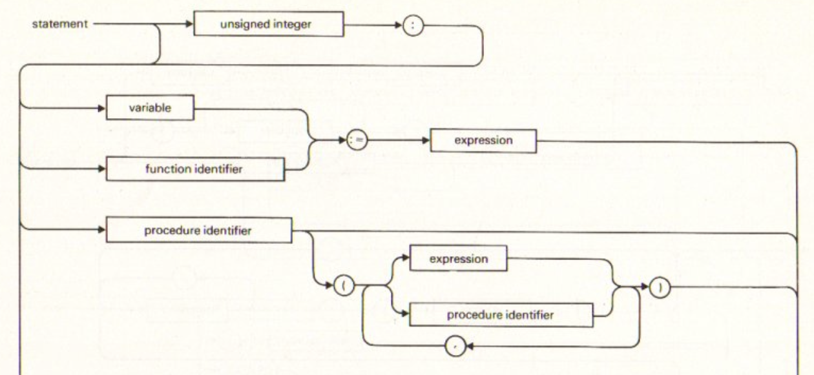
Pascal Functions and Procedures, cont’d
A procedure call is a statement.
Each function has a local associated variable with the same name as the function. The last value assigned to that variable during a call becomes the return value of the call.

Slide 10
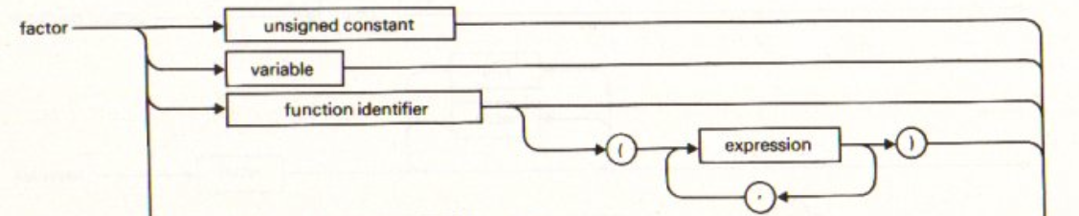
Pascal Functions and Procedures, cont’d
A function call is a factor.

Slide 11
Type Check Calls
Is the identifier the name of a procedure or function?
  Is the procedure call a statement?
  Is the function call a factor of an expression?
Type check the data type of the function.
Type check the arguments of the call.
Ensure the correct number of arguments.

Slide 12
Scopes and Symbol Tables
Our last remaining symbol table hack: that there is only one symbol table.
There needs to be a symbol table for
each scope in a program, one for
  Predefined names, such as int, real, char, boolean, string, etc.
  Global program names, including for constants, types, variables, procedures, and functions.
  Local names inside procedures and functions
  Field names of each record type.

Slide 13
Scope and the Symbol Table Stack
Global scope
  Nesting level 0:
  At the bottom of the symbol table stack.
  All predefined global identifiers such as
  integer, real, boolean, char.
Program scope
  Nesting level 1:
  One up from the bottom of the stack.
  All identifiers declared at the “top level”
  of a program (not in a procedure or function).

Slide 14
The Symbol Table Stack
It is important to know which symbol table each name belongs in.
  The local entry field of each context (parse tree) node must reference the correct symbol table entry.
  It’s possible for multiple variables in different scopes to have the same name but different data types.
During the pass 2 parse tree walk to create and populate symbol tables, the symbols are managed on the symbol table stack.

Slide 15
The Symbol Table Stack, cont’d
As you semantically analyze the source program from top to bottom during pass 2’s tree walk:
  First create the global symbol table at the stack bottom.
  Upon entering each new scope, create a new local symbol table
  for the scope and push it onto the symbol table stack.
Enter local names of the scope into the local symbol table at the top of the stack.
  Look up already declared local names in the local symbol table
  Look up already declared nonlocal names in symbol tables below the top one.
  Pop off the local symbol table upon leaving the scope.
The symbol table stack has no role during pass 3.

Slide 16
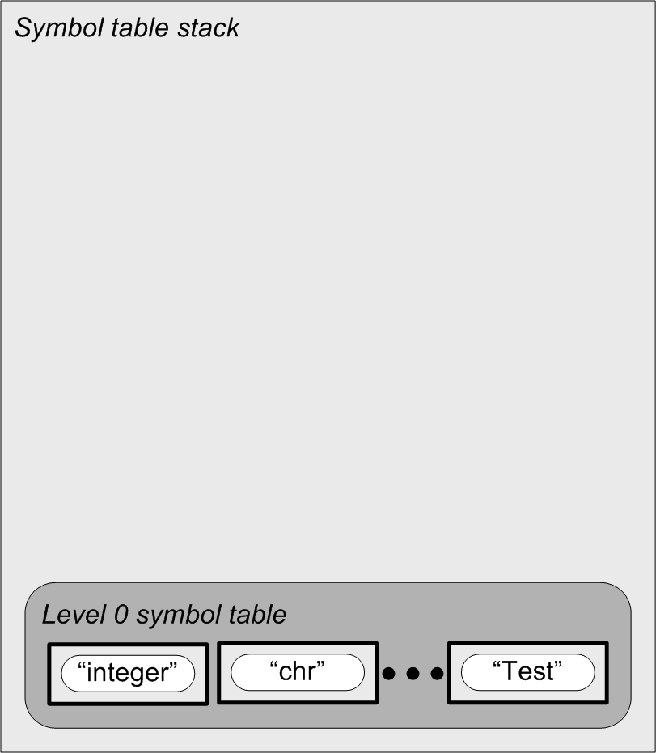
Nested Scopes and the Symbol Table Stack
PROGRAM Test;
VAR i, j, k, n : integer;
PROCEDURE p(j : real);
VAR k : char;
FUNCTION f(x : real) : real;
VAR i:real;
BEGIN {f}
f := i + j + n + x;
END {f};
BEGIN {p}
k := chr(i + trunc(f(n)));
END {p};
BEGIN {test}
p(j + k + n)
END {test}.
During pass 2, you’re walking the parse tree to analyze the program from top to bottom in order to build the symbol tables.
Note that the program name
Test is defined in the global
scope at level 0.

Slide 17
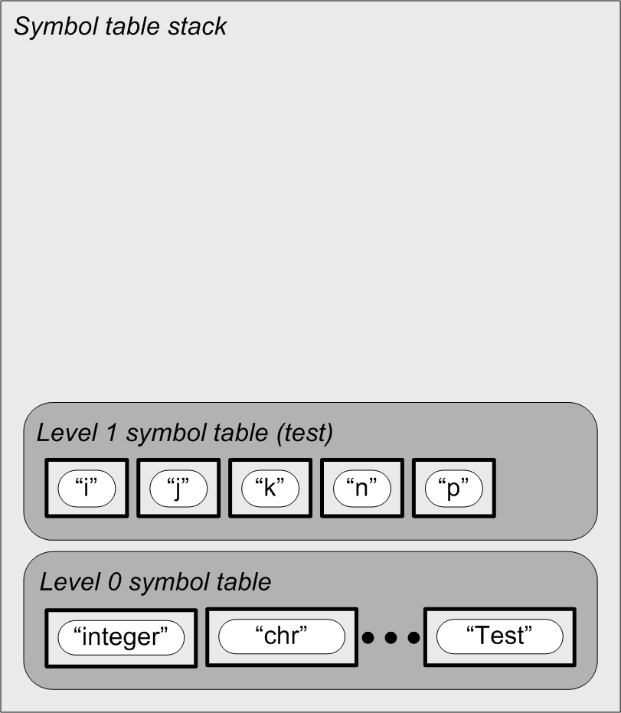
Nested Scopes and the Symbol Table Stack
PROGRAM Test;
VAR i, j, k, n : integer;
PROCEDURE p(j : real);
VAR k : char;
FUNCTION f(x : real) : real;
VAR i:real;
BEGIN {f}
f := i + j + n + x;
END {f};
BEGIN {p}
k := chr(i + trunc(f(n)));
END {p};
BEGIN {test}
p(j + k + n)
END {test}.
During pass 2, you’re walking the parse tree to analyze the program from top to bottom in order to build the symbol tables.

Slide 18
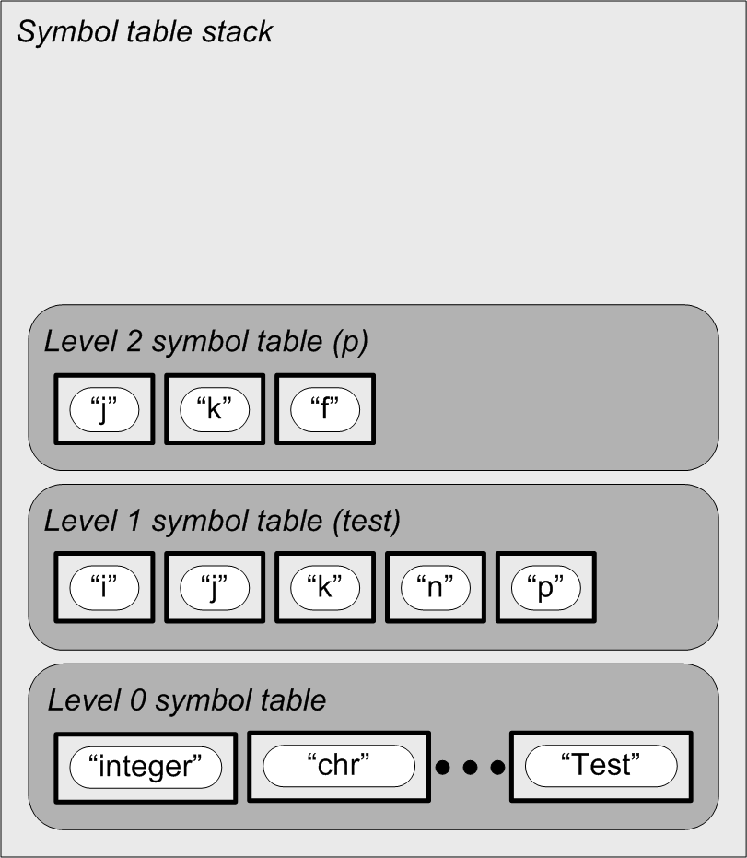
Nested Scopes and the Symbol Table Stack
PROGRAM Test;
VAR i, j, k, n : integer;
PROCEDURE p(j : real);
VAR k : char;
FUNCTION f(x : real) : real;
VAR i:real;
BEGIN {f}
f := i + j + n + x;
END {f};
BEGIN {p}
k := chr(i + trunc(f(n)));
END {p};
BEGIN {test}
p(j + k + n)
END {test}.
During pass 2, you’re walking the parse tree to analyze the program from top to bottom in order to build the symbol tables.

Slide 19
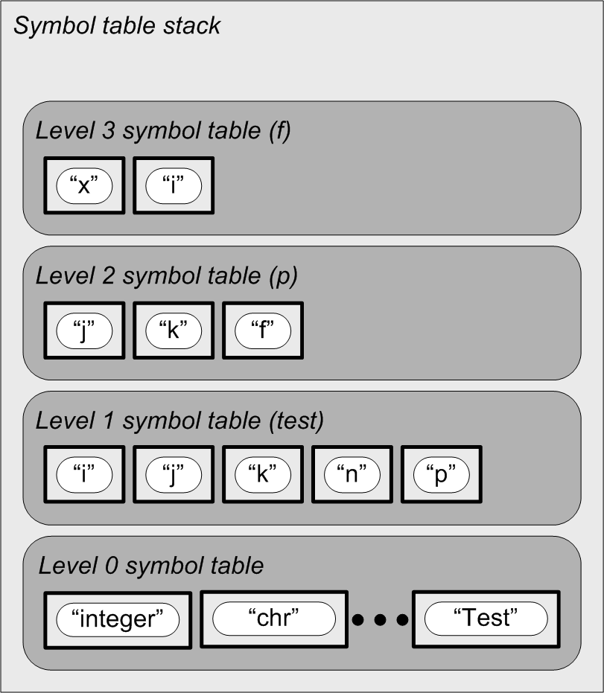
Nested Scopes and the Symbol Table Stack
PROGRAM Test;
VAR i, j, k, n : integer;
PROCEDURE p(j : real);
VAR k : char;
FUNCTION f(x : real) : real;
VAR i:real;
BEGIN {f}
f := i + j + n + x;
END {f};
BEGIN {p}
k := chr(i + trunc(f(n)));
END {p};
BEGIN {test}
p(j + k + n)
END {test}.
During pass 2, you’re walking the parse tree to analyze the program from top to bottom in order to build the symbol tables.

Slide 20
Nested Scopes and the Symbol Table Stack
PROGRAM Test;
VAR i, j, k, n : integer;
PROCEDURE p(j : real);
VAR k : char;
FUNCTION f(x : real) : real;
VAR i:real;
BEGIN {f}
f := i + j + n + x;
END {f};
BEGIN {p}
k := chr(i + trunc(f(n)));
END {p};
BEGIN {test}
p(j + k + n)
END {test}.

Slide 21
Nested Scopes and the Symbol Table Stack
PROGRAM Test;
VAR i, j, k, n : integer;
PROCEDURE p(j : real);
VAR k : char;
FUNCTION f(x : real) : real;
VAR i:real;
BEGIN {f}
f := i + j + n + x;
END {f};
BEGIN {p}
k := chr(i + trunc(f(n)));
END {p};
BEGIN {test}
p(j + k + n)
END {test}.

Slide 22
Nested Scopes and the Symbol Table Stack
PROGRAM Test;
VAR i, j, k, n : integer;
PROCEDURE p(j : real);
VAR k : char;
FUNCTION f(x : real) : real;
VAR i:real;
BEGIN {f}
f := i + j + n + x;
END {f};
BEGIN {p}
k := chr(i + trunc(f(n)));
END {p};
BEGIN {test}
p(j + k + n)
END {test}.

Slide 23
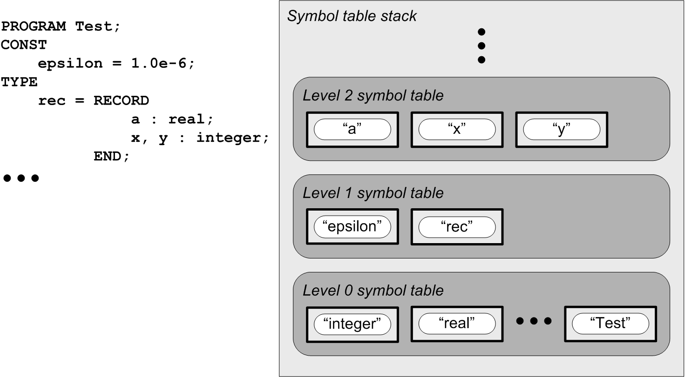
The Scope of Record Fields
Each record type has a symbol table:
Tree walk is here!
Program symbol table
Global symbol table
Note that the program name
Test is defined in the global
scope at level 0.

