Slide 1


CS 153: Concepts of Compiler Design
September 22 Class Meeting
Department of Computer Science
San Jose State University
Fall 2026
Instructor: Ron Mak
www.cs.sjsu.edu/~mak

Slide 2
Statements and Expressions
Now we can parse Pascal declarations and enter the appropriate information into the symbol table.
We’re ready to use ANTLR 4 to parse statements and expressions and, in the backend tier, convert them to equivalent Java.
  Start with compound, assignment, and REPEAT statements.
Jump from Pcl_P2 to Pcl_P5.
  Skip over intermediate steps that are in my book.

Slide 3
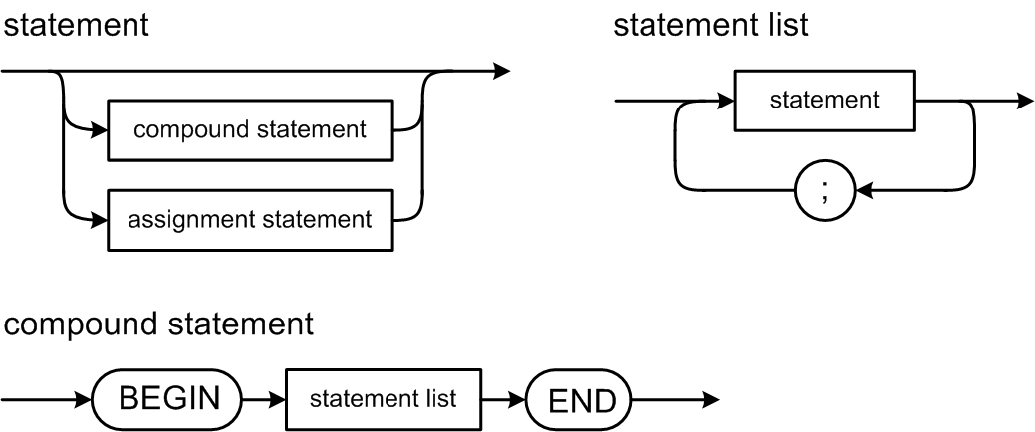
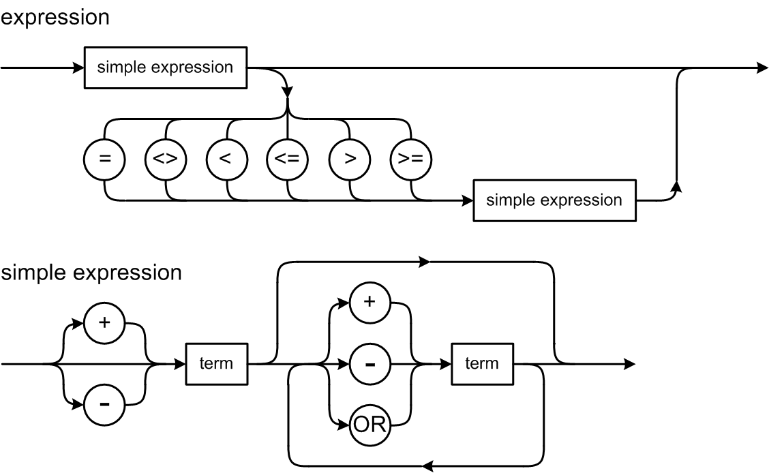
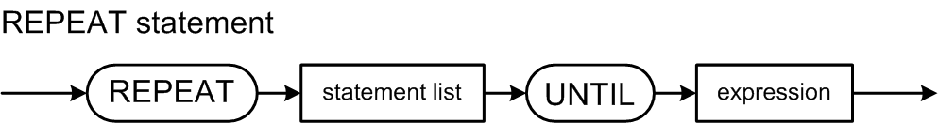
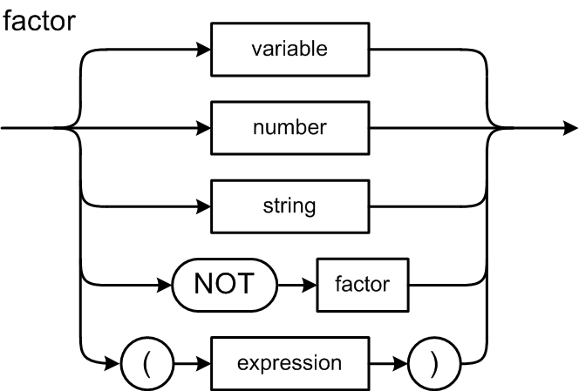
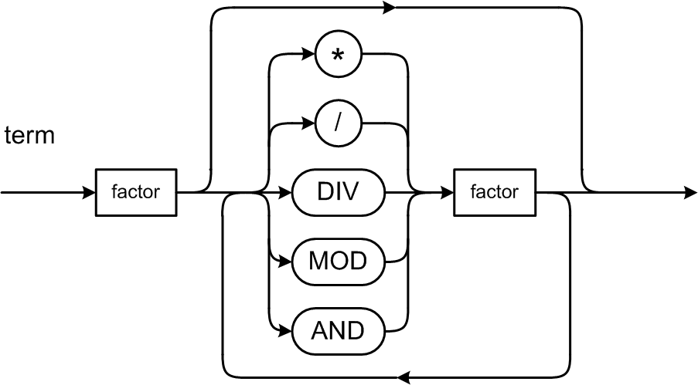
Pascal Syntax Diagrams

Slide 4
ANTLR 4 Grammar File
Pcl_P5.g4
compoundStatement : BEGIN statementList END ;
statementList : statement ( ';' statement )* ;
statement : compoundStatement
| assignmentStatement
| repeatStatement
| writeStatement
| writelnStatement
| emptyStatement
;
assignmentStatement : variable ':=' expression ;
repeatStatement : REPEAT statementList UNTIL expression ;

Slide 5
ANTLR 4 Grammar File, cont’d
Pcl_P5.g4
expression locals [ Typespec_P4 typespec = null ]
: simpleExpression (relOp simpleExpression)? ;
simpleExpression locals [ Typespec_P4 typespec = null ]
: sign? term (addOp term)* ;
term locals [ Typespec_P4 typespec = null ]
: factor (mulOp factor)* ;
relOp : '=' | '<>' | '<' | '<=' | '>' | '>=' ;
addOp : '+' | '-' | OR ;
mulOp : '*' | '/' | DIV | MOD | AND ;
factor locals [ Typespec_P5 typespec = null ]
: variable # factorVariable
| constantIdentifier # factorConstantIdentifier
| integerConstant # factorIntegerConstant
| realConstant # factorRealConstant
| characterConstant # factorCharacterConstant
| stringConstant # factorStringConstant
| booleanConstant # factorBooleanConstant
| NOT factor # factorNot
| '(' expression ')' # factorParens
;
If you label one alternative of a rule, you must label all of the rule’s alternatives. But you don’t have to use all of them.

Slide 6
ANTLR 4 Grammar File, cont’d
Pcl_P5.g4
variable locals [ Typespec_P4 typespec = null,
SymtabEntry entry = null
]
: identifier modifier* ;
modifier : '[' indexList ']' ;
indexList : index ( ',' index )* ;
index : expression ;
constant locals [ Typespec_P5 typespec = null,
Object value = null
]
: sign? constantIdentifier # constantSignedIdentifier
| sign? integerConstant # constantSignedInteger
| sign? realConstant # constantSignedReal
| characterConstant # constantCharacter
| stringConstant # constantString
| booleanConstant # constantBoolean
;

Slide 7
Type Checking
Along with creating the symbol table, another important semantic operation during Pass 2 is type checking statements and expressions.
Are the data types of the operands in an expression compatible with each other?
  Can you assign that value to this variable?
  Example: OK to add or multiply an integer operand and a real operand.
  Example: Not OK to multiply a string by an integer.
  Example: The expression in the UNTIL part of a REPEAT statement must be boolean.

Slide 8
Class intermediate.type.TypeChecker
TypeChecker.java
public class TypeChecker
{
public static boolean areBothInteger(Typespec_P5 typespec1,
Typespec_P5 typespec2)
{
return typespec1.isInteger() && typespec2.isInteger();
}
public static boolean isAtLeastOneReal(Typespec_P5 typespec1,
Typespec_P5 typespec2)
{
return (typespec1.isReal() && typespec2.isReal())
|| (typespec1.isReal() && typespec2.isInteger())
|| (typespec1.isInteger() && typespec2.isReal());
}
public static boolean areBothChar(Typespec_P5 typespec1,
Typespec_P5 typespec2)
{
return typespec1.isChar() && typespec2.isChar();
}
...

Slide 9
Class TypeChecker, cont’d
TypeChecker.java
...
public static boolean areBothBoolean(Typespec_P5 typespec1,
Typespec_P5 typespec2)
{
return typespec1.isBoolean() && typespec2.isBoolean();
}
public static boolean areBothString(Typespec_P5 typespec1,
Typespec_P5 typespec2)
{
return typespec1.isString() && typespec2.isString();
}
...

Slide 10
Class TypeChecker, cont’d
TypeChecker.java
...
public static boolean assignmentCompatible(Typespec_P5 targetTypespec,
Typespec_P5 valueTypespec)
{
if ( (targetTypespec == null)
|| (valueTypespec == null)) return false;
targetTypespec = targetTypespec.baseType();
valueTypespec = valueTypespec.baseType();
if (targetTypespec == valueTypespec) return true;
else if ( targetTypespec.isReal()
&& valueTypespec.isInteger()) return true;
else return false;
}
...

Slide 11
Class TypeChecker, cont’d
TypeChecker.java
...
public static boolean comparisonCompatible(Typespec_P5 typespec1,
Typespec_P5 typespec2)
{
if ((typespec1 == null) || (typespec2 == null)) return false;
typespec1 = typespec1.baseType();
typespec2 = typespec2.baseType();
if ( isAtLeastOneReal(typespec1, typespec2)
|| sameScalarOrEnumerated(typespec1, typespec2)) return true;
else return false;
}
private static boolean sameScalarOrEnumerated(Typespec_P5 typespec1,
Typespec_P5 typespec2)
{
Form form = typespec1.getForm();
return (typespec1 == typespec2)
&& ((form == SCALAR) || (form == ENUMERATED));
}
}

Slide 12
Class Semantics_P5
Semantics_P5.java
public class Semantics_P5 extends Pcl_P5BaseVisitor<Object>
{
public static SymtabEntry programEntry;
protected static Symtab symtab;
protected static SemanticErrorHandler error;
protected static Program_P5 programDeclarations;
protected static ConstantDefinitions_P5 constantDefinitions;
protected static TypeDefinitions_P5 typeDefinitions;
protected static VariableDeclarations_P5 variableDeclarations;
protected static Statements_P5 statements;
protected static Expressions_P5 expressions;
static
{
symtab = new Symtab();
error = new SemanticErrorHandler();
programDeclarations = new Program_P5();
constantDefinitions = new ConstantDefinitions_P5();
...
Predefined.initialize(symtab);
}
...
@Override
public Object visitProgramHeader(ProgramHeaderContext ctx)
{
programEntry = (SymtabEntry) programDeclarations.programHeader(ctx);
return null;
}

Slide 13
Class Semantics_P5, cont’d
Semantics_P5.java
...
@Override
public Object visitAssignmentStatement(AssignmentStatementContext ctx)
{
return statements.assignmentStatement(ctx);
}
@Override
public Object visitRepeatStatement(RepeatStatementContext ctx)
{
return statements.repeatStatement(ctx);
}
@Override
public Object visitExpression(ExpressionContext ctx)
{
return expressions.expression(ctx);
}
@Override
public Object visitSimpleExpression(SimpleExpressionContext ctx)
{
return expressions.simpleExpression(ctx);
}

Slide 14
Class Semantics_P5, cont’d
Semantics_P5.java
...
@Override
public Object visitTerm(TermContext ctx)
{
return expressions.term(ctx);
}
@Override
public Object visitVariable(VariableContext ctx)
{
return expressions.variable(ctx);
}
@Override
public Object visitFactorNot(FactorNotContext ctx)
{
return expressions.factorNot(ctx);
}
@Override
public Object visitFactorParens(FactorParensContext ctx)
{
return expressions.factorParens(ctx);
}
}
factor locals [ Typespec_P5 typespec = null ]
: variable # factorVariable
| constantIdentifier # factorConstantIdentifier
| integerConstant # factorIntegerConstant
| realConstant # factorRealConstant
| characterConstant # factorCharacterConstant
| stringConstant # factorStringConstant
| booleanConstant # factorBooleanConstant
| NOT factor # factorNot
| '(' expression ')' # factorParens
;
Rules variable, factorNot, and factorParens need “special treatment” beyond the overridden visit methods we had already provided earlier for the other rules.

Slide 15
Type Check Assignment Statement
intermediate.semantics.Statement_P5
public class Statements_P5 extends Semantics_P5
{
Object assignmentStatement(AssignmentStatementContext ctx)
{
VariableContext variableCtx = ctx.variable();
ExpressionContext exprCtx = ctx.expression();
Typespec_P5 variableTypespec = (Typespec_P5) visit(variableCtx);
Typespec_P5 exprTypespec = (Typespec_P5) visit(exprCtx);
if (!assignmentCompatible(variableTypespec, exprTypespec))
{
error.flag(INCOMPATIBLE_ASSIGNMENT, exprCtx);
}
return null;
}
...
Each overridden semantic visit method generally returns either a Typespec object or null.
assignmentStatement : variable ':=' expression ;

Slide 16
Type Check REPEAT Statement
intermediate.semantics.Statement_P5
Object repeatStatement(RepeatStatementContext ctx)
{
ExpressionContext exprCtx = ctx.expression();
Typespec_P5 exprTypespec = (Typespec_P5) visit(exprCtx);
if (!exprTypespec.isBoolean())
{
error.flag(TYPE_MUST_BE_BOOLEAN, exprCtx);
}
visit(ctx.statementList());
return null;
}
}
repeatStatement : REPEAT statementList UNTIL expression ;

Slide 17
Type Check Expression
Very tricky to get expression type checking right.
  Too many combinations of operands that are wrong.
  Hard to flag all possible errors precisely.
  Trial and error.
If there is a type error, be sure to set the type specification of the expression to a default type, such as integer.
  Otherwise, there can be a subsequent null pointer exception.

Slide 18
Type Check Expression, cont’d
intermediate.semantics.Expressions_P5
public class Expressions_P5 extends Semantics_P5
{
Typespec_P5 expression(ExpressionContext ctx)
{
SimpleExpressionContext simpleExprCtx1 = ctx.simpleExpression(0);
// First simple expression.
Typespec_P5 simpleTypespec1 = (Typespec_P5) visit(simpleExprCtx1);
ctx.typespec = simpleTypespec1;
RelOpContext relOpCtx = ctx.relOp();
// Second simple expression?
if (relOpCtx != null)
{
SimpleExpressionContext simpleExprCtx2 = ctx.simpleExpression(1);
Typespec_P5 simpleTypespec2 = (Typespec_P5) visit(simpleExprCtx2);
if (!comparisonCompatible(simpleTypespec1, simpleTypespec2))
{
error.flag(INCOMPATIBLE_COMPARISON, ctx);
}
ctx.typespec = Predefined.booleanType;
}
return ctx.typespec;
}
Compare two simple expressions.
Must be comparison compatible.

Slide 19
Type Check Simple Expression
intermediate.semantics.Expressions_P5
Typespec_P5 simpleExpression(SimpleExpressionContext ctx)
{
int count = ctx.term().size();
SignContext signCtx = ctx.sign();
Boolean hasSign = signCtx != null;
// First term.
TermContext termCtx1 = ctx.term(0);
Typespec_P5 termTypespec1 = (Typespec_P5) visit(termCtx1);
ctx.typespec = termTypespec1;
// Loop over any subsequent terms.
for (int i = 1; i < count; i++)
{
String op = ctx.addOp().get(i-1).getText().toLowerCase();
TermContext termCtx2 = ctx.term(i);
Typespec_P5 termTypespec2 = (Typespec_P5) visit(termCtx2);
...
}
return ctx.typespec;
}
simpleExpression locals [ Typespec_P5 typespec = null ]
: sign? term (addOp term)* ;

Slide 20
Type Check Simple Expression, cont’d
intermediate.semantics.Expressions_P5
if (op.equals("or"))
{
if (!termTypespec1.isBoolean())
{
error.flag(TYPE_MUST_BE_BOOLEAN, termCtx1);
}
if (!termTypespec2.isBoolean())
{
error.flag(TYPE_MUST_BE_BOOLEAN, termCtx2);
}
if (hasSign)
{
error.flag(INVALID_SIGN, signCtx);
}
ctx.typespec = Predefined.booleanType;
}

Slide 21
Type Check Simple Expression, cont’d
intermediate.semantics.Expressions_P5
else if (areBothInteger(termTypespec1, termTypespec2))
{
ctx.typespec = Predefined.integerType;
}
else if (isAtLeastOneReal(termTypespec1, termTypespec2))
{
ctx.typespec = Predefined.realType;
}
else if (areBothString(termTypespec1, termTypespec2))
{
if (!op.equals("+"))
{
error.flag(TYPE_MUST_BE_NUMERIC, termCtx1);
ctx.typespec = Predefined.integerType;
}
else if (hasSign)
{
error.flag(INVALID_SIGN, signCtx);
ctx.typespec = Predefined.stringType;
}
}

Slide 22
Type Check Simple Expression, cont’d
intermediate.semantics.Expressions_P5
else
{
if (!termTypespec1.isNumeric())
{
error.flag(TYPE_MUST_BE_NUMERIC, termCtx1);
}
if (!termTypespec2.isNumeric())
{
error.flag(TYPE_MUST_BE_NUMERIC, termCtx2);
}
ctx.typespec = Predefined.integerType;
}
}

Slide 23
Type Check Term
intermediate.semantics.Expressions_P5
Typespec_P5 term(TermContext ctx)
{
int count = ctx.factor().size();
// First factor.
FactorContext factorCtx1 = ctx.factor(0);
Typespec_P5 factorTypespec1 = (Typespec_P5) visit(factorCtx1);
ctx.typespec = factorTypespec1;
// Loop over any subsequent factors.
for (int i = 1; i < count; i++)
{
String op = ctx.mulOp(i-1).getText().toLowerCase();
FactorContext factorCtx2 = ctx.factor(i);
Typespec_P5 factorTypespec2 = (Typespec_P5) visit(factorCtx2);
...
}
return ctx.typespec;
}
term locals [ Typespec_P5 typespec = null ]
: factor (mulOp factor)* ;

Slide 24
Type Check Term, cont’d
intermediate.semantics.Expressions_P5
if (op.equals("and"))
{
if (!factorTypespec1.isBoolean())
{
error.flag(TYPE_MUST_BE_BOOLEAN, factorCtx1);
}
if (!factorTypespec2.isBoolean())
{
error.flag(TYPE_MUST_BE_BOOLEAN, factorCtx2);
}
ctx.typespec = Predefined.booleanType;
}

Slide 25
Type Check Term, cont’d
intermediate.semantics.Expressions_P5
else if (op.equals("*"))
{
if (areBothInteger(factorTypespec1, factorTypespec2))
{
ctx.typespec = Predefined.integerType;
}
else if (isAtLeastOneReal(factorTypespec1, factorTypespec2))
{
ctx.typespec = Predefined.realType;
}
else
{
if (!factorTypespec1.isNumeric())
{
error.flag(TYPE_MUST_BE_NUMERIC, factorCtx1);
}
if (!factorTypespec2.isNumeric())
{
error.flag(TYPE_MUST_BE_NUMERIC, factorCtx2);
}
ctx.typespec = Predefined.integerType;
}
}

Slide 26
Type Check Term, cont’d
intermediate.semantics.Expressions_P5
else if (op.equals("/"))
{
if ( areBothInteger(factorTypespec1, factorTypespec2)
|| isAtLeastOneReal(factorTypespec1, factorTypespec2))
{
ctx.typespec = Predefined.realType;
}
else
{
if (!factorTypespec1.isNumeric())
{
error.flag(TYPE_MUST_BE_NUMERIC, factorCtx1);
}
if (!factorTypespec2.isNumeric())
{
error.flag(TYPE_MUST_BE_NUMERIC, factorCtx2);
}
ctx.typespec = Predefined.realType;
}
}

Slide 27
Type Check Term, cont’d
intermediate.semantics.Expressions_P5
else if (op.equals("div") || op.equals("mod"))
{
if (!factorTypespec1.isInteger())
{
error.flag(TYPE_MUST_BE_INTEGER, factorCtx1);
}
if (!factorTypespec2.isInteger())
{
error.flag(TYPE_MUST_BE_INTEGER, factorCtx2);
}
ctx.typespec = Predefined.integerType;
}

Slide 28
NOT Factor and Parenthesized Expression
intermediate.semantics.Expression_P5
Typespec_P5 factorNot(FactorNotContext ctx)
{
FactorContext factorCtx = ctx.factor();
ctx.typespec = (Typespec_P5) visit(factorCtx);
if (factorCtx.typespec != Predefined.booleanType)
{
error.flag(TYPE_MUST_BE_BOOLEAN, factorCtx);
}
return ctx.typespec;
}
Typespec_P5 factorParens(FactorParensContext ctx)
{
ExpressionContext exprCtx = ctx.expression();
ctx.typespec = (Typespec_P5) visit(exprCtx);
return ctx.typespec;
}
factor locals [ Typespec_P5 typespec = null ]
: variable # factorVariable
| constantIdentifier # factorConstantIdentifier
| integerConstant # factorIntegerConstant
| realConstant # factorRealConstant
| characterConstant # factorCharacterConstant
| stringConstant # factorStringConstant
| booleanConstant # factorBooleanConstant
| NOT factor # factorNot
| '(' expression ')' # factorParens
;

Slide 29
Type Check Term, cont’d
A variable can have subscripts.
  Must check if it’s an array type.
  Does each subscript have the right type?
  Does the number of subscripts exceed the number of array dimensions?
Later: A variable can have a record field.

Slide 30
Type Check Variable
Typespec_P5 variable(VariableContext ctx)
{
IdentifierContext idCtx = ctx.identifier();
String variableName = idCtx.getText().toLowerCase();
SymtabEntry variableEntry = symtab.lookup(variableName);
if (variableEntry != null)
{
ctx.entry = idCtx.entry = variableEntry;
idCtx.typespec = variableEntry.getTypespec();
ctx.typespec = modifiedVariableTypespec(ctx, idCtx.typespec);
int lineNumber = ctx.getStart().getLine();
variableEntry.appendLineNumber(lineNumber);
Kind kind = variableEntry.getKind();
switch (kind)
{
case TYPE:
case PROGRAM:
case PROGRAM_PARAMETER:
case PROCEDURE:
case UNDEFINED:
error.flag(INVALID_VARIABLE, ctx);
break;
default: break;
}
}
else
{
error.flag(UNDECLARED_IDENTIFIER, ctx);
ctx.typespec = Predefined.integerType;
}
return ctx.typespec;
}
variable locals [ Typespec_P5 typespec = null,
SymtabEntry entry = null
]
: identifier modifier* ;
modifier : '[' indexList ']' ;
indexList : index ( ',' index )* ;
index : expression ;
intermediate.semantics.Expressions_P5

Slide 31
Type Check Variables, cont’d
private Typespec_P5 modifiedVariableTypespec(VariableContext varCtx,
Typespec_P5 typespec)
{
// Loop over the modifiers.
for (ModifierContext modCtx : varCtx.modifier())
{
// Subscripts.
if (modCtx.indexList() != null)
{
IndexListContext indexListCtx = modCtx.indexList();
// Loop over the subscripts.
for (IndexContext indexCtx : indexListCtx.index())
{
if (typespec.getForm() == ARRAY)
{
Typespec_P5 indexTypespec = typespec.getArrayIndexType();
ExpressionContext exprCtx = indexCtx.expression();
Typespec_P5 exprTypespec = (Typespec_P5) visit(exprCtx);
if (indexTypespec.baseType() != exprTypespec.baseType())
{
error.flag(TYPE_MISMATCH, exprCtx);
}
// Datatype of the next dimension.
typespec = typespec.getArrayElementType();
}
else
{
error.flag(TOO_MANY_SUBSCRIPTS, indexCtx);
}
}
}
}
return typespec;
}
variable locals [ Typespec_P5 typespec = null,
SymtabEntry entry = null
]
: identifier modifier* ;
modifier : '[' indexList ']' ;
indexList : index ( ',' index )* ;
index : expression ;
intermediate.semantics.Expressions_P5

Slide 32
Converting Statements and Expressions
Now we’re ready to start converting Pascal statements and expressions to Java!

Slide 33
Class backend.converter.Converter_P5
Converter_P5.java
public class Converter_P5 extends Pcl_P5BaseVisitor<Object>
{
...
@Override
public Object visitProgram(ProgramContext ctx)
{
programName = programEntry.getName();
code = new JavaEmitter(programName, "java");
return program.program(ctx);
}
@Override
public Object visitConstantDefinition(ConstantDefinitionContext ctx)
{
return constantDefinitions.constantDefinition(ctx);
}
@Override
public Object visitConstantSignedIdentifier(ConstantSignedIdentifierContext ctx)
{
return constantDefinitions.constantSignedIdentifier(ctx);
}
...

Slide 34
Converter_P5, cont’d
Converter_P5.java
...
@Override
public Object visitTypeDefinition(TypeDefinitionContext ctx)
{
return typeDefinitions.typeDefinition(ctx);
}
@Override
public Object visitEnumeratedType(EnumeratedTypeContext ctx)
{
return typeDefinitions.enumeratedType(ctx);
}
...
@Override
public Object visitAssignmentStatement(AssignmentStatementContext ctx)
{
return statements.assignmentStatement(ctx);
}
@Override
public Object visitRepeatStatement(RepeatStatementContext ctx)
{
return statements.repeatStatement(ctx);
}
...
}

Slide 35
Compound Statement and Statement List
public class Statements_P5 extends Converter_P5
{
Object compoundStatement(CompoundStatementContext ctx)
{
code.emitStart("{");
code.indent();
visit(ctx.statementList());
code.dedent();
code.emitLine("}");
return null;
}
Object statementList(StatementListContext ctx)
{
for (StatementContext stmtCtx : ctx.statement())
{
if (stmtCtx.emptyStatement() == null)
{
visit(stmtCtx);
}
}
return null;
}
backend.converter.Statements_P5

Slide 36
Convert Assignment Statement
backend.converter.Statements_P5
Object assignmentStatement(AssignmentStatementContext ctx)
{
String lhs = (String) visit(ctx.variable());
String expr = (String) visit(ctx.expression());
code.emitStart(lhs + " = " + expr);
code.emitEnd(";");
return null;
}
assignmentStatement : variable ':=' expression ;

Slide 37
Convert REPEAT Statement
backend.converter.Statements_P5
Object repeatStatement(RepeatStatementContext ctx)
{
boolean needBraces = ctx.statementList().statement().size() > 1;
code.emitStart("do");
if (needBraces) code.emitLine("{");
code.indent();
visit(ctx.statementList());
code.dedent();
if (needBraces) code.emitLine("}");
code.emitStart("while (!(");
code.emit((String) visit(ctx.expression()));
code.emitEnd("));");
return null;
}
repeatStatement : REPEAT statementList UNTIL expression ;

Slide 38
Convert Expression
backend.converter.Expressions_P5
public class Expressions_P5 extends Converter_P5
{
String expression(ExpressionContext ctx)
{
SimpleExpressionContext simpleCtx1 = ctx.simpleExpression(0);
RelOpContext relOpCtx = ctx.relOp();
String simpleText1 = (String) visit(simpleCtx1);
String text = simpleText1;
// Second simple expression?
if (relOpCtx != null)
{
...
}
return text;
}

Slide 39
Convert Expression, cont’d
backend.converter.Expressions_P5
// Second simple expression?
if (relOpCtx != null)
{
String op = relOpCtx.getText();
if (op.equals("=")) op = "==";
else if (op.equals("<>")) op = "!=";
SimpleExpressionContext simpleCtx2 = ctx.simpleExpression(1);
String simpleText2 = (String) visit(simpleCtx2);
// Java uses the compareTo method for strings.
if (simpleCtx1.typespec == Predefined.stringType)
{
text = "(" + simpleText1 + ")."
+ "compareTo(" + simpleText2 + ") "
+ op + " 0";
}
else
{
text = simpleText1 + " " + op + " " + simpleText2;
}
}

Slide 40
Convert Simple Expression
String simpleExpression(SimpleExpressionContext ctx)
{
int count = ctx.term().size();
String text = "";
if ((ctx.sign() != null) && (ctx.sign().getText().equals("-")))
{
text += "-";
}
// Loop over the terms.
for (int i = 0; i < count; i++)
{
TermContext termCtx = ctx.term(i);
text += (String) visit(termCtx);
if (i < count-1)
{
String addOp = ctx.addOp(i).getText().toLowerCase();
if (addOp.equals("or")) addOp = "||";
text += " " + addOp + " ";
}
}
return text;
}
backend.converter.Expressions_P5

Slide 41
Convert Term
backend.converter.Expressions_P5
String term(TermContext ctx)
{
int count = ctx.factor().size();
String text = "";
// Loop over the factors.
for (int i = 0; i < count; i++)
{
FactorContext factorCtx = ctx.factor(i);
text += (String) visit(factorCtx);
if (i < count-1)
{
String mulOp = ctx.mulOp(i).getText().toLowerCase();
if (mulOp.equals("and")) mulOp = " && ";
else if (mulOp.equals("div")) mulOp = "/";
else if (mulOp.equals("mod")) mulOp = "%";
text += mulOp;
}
}
return text;
}

Slide 42
Convert Variable
String variable(VariableContext ctx)
{
IdentifierContext idCtx = ctx.identifier();
SymtabEntry variableEntry = idCtx.entry;
String variableName = variableEntry.getName();
Typespec_P5 typespec = idCtx.typespec;
if ( (typespec != Predefined.booleanType)
&& (variableEntry.getKind() == ENUMERATED_CONSTANT))
{
String typeIdName = typespec.getIdentifier().getName();
variableName = typeIdName + "." + variableName;
}
// Loop over any subscript and field modifiers.
for (ModifierContext modCtx : ctx.modifier())
{
...
}
return variableName;
}
backend.converter.Expressions_P5

Slide 43
Convert Variable, cont’d
// Loop over any subscript and field modifiers.
for (ModifierContext modCtx : ctx.modifier())
{
// Subscripts.
if (modCtx.indexList() != null)
{
for (IndexContext indexCtx : modCtx.indexList().index())
{
Typespec_P5 indexType = typespec.getArrayIndexType();
int minIndex = 0;
if (indexType.getForm() == SUBRANGE)
{
minIndex = (Integer) indexType.getSubrangeMinValue();
}
ExpressionContext exprCtx = indexCtx.expression();
String expr = (String) visit(exprCtx);
String subscript =
(minIndex == 0) ? expr
: (minIndex < 0) ? "(" + expr + ")+" + (-minIndex)
: "(" + expr + ")-" + minIndex ;
variableName += "[" + subscript + "]";
typespec = typespec.getArrayElementType();
}
}
}
Map Pascal subscript ranges to 0-based Java.
backend.converter.Expressions_P5

Slide 44
NOT Factor and Parenthesized Expression
backend.converter.Expressions_P5
String factorNot(FactorNotContext ctx)
{
return "!(" + (String) visit(ctx.factor()) + ")";
}
String factorParens(FactorParensContext ctx)
{
return "(" + (String) visit(ctx.expression()) + ")";
}
Demo

