Slide 1


CS 153: Concepts of Compiler Design
September 17 Class Meeting
Department of Computer Science
San Jose State University
Fall 2026
Instructor: Ron Mak
www.cs.sjsu.edu/~mak

Slide 2
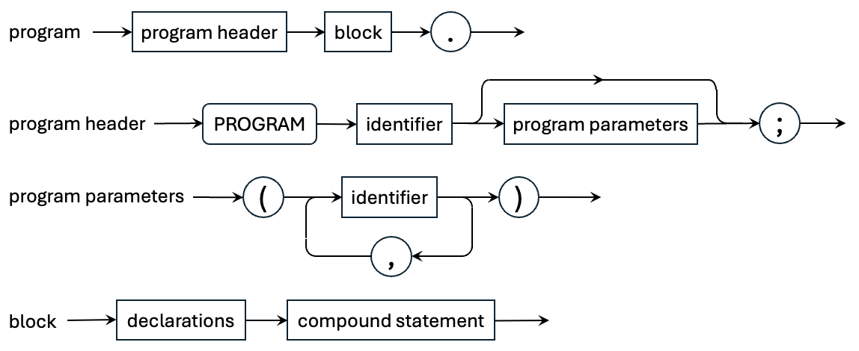
A Pascal Program

Slide 3
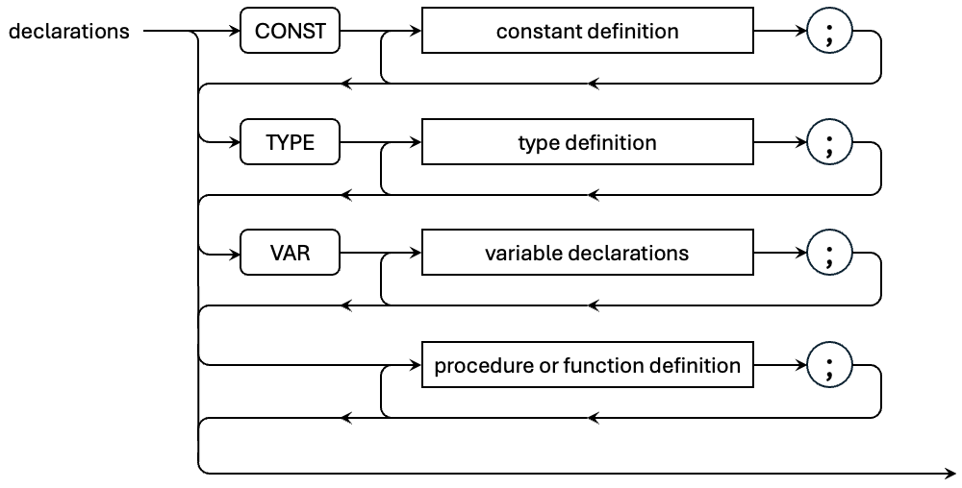
Pascal Declarations, cont’d
All the parts are optional, but they must come in this order. Note that variables are declared and the others are defined. Collectively, refer to all as declarations.

Slide 4
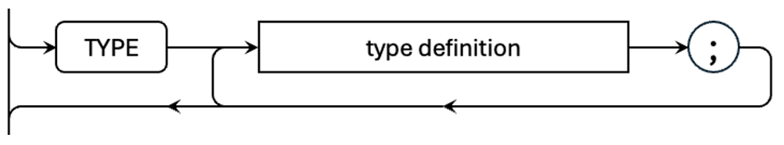
Define New Types
Pascal allows you to define new types.
  Built from the predefined types, structured types, and previously defined types.
Type definitions of a programming language are often the most challenging to parse.
  Syntax is often difficult.
  Recursive definitions.
  Diverse information to keep track of.
  Many new items to enter into the symbol table.

Slide 5
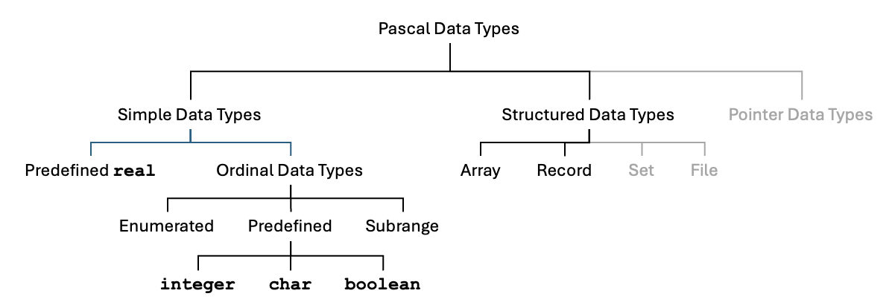
Pascal Data Types

Slide 6
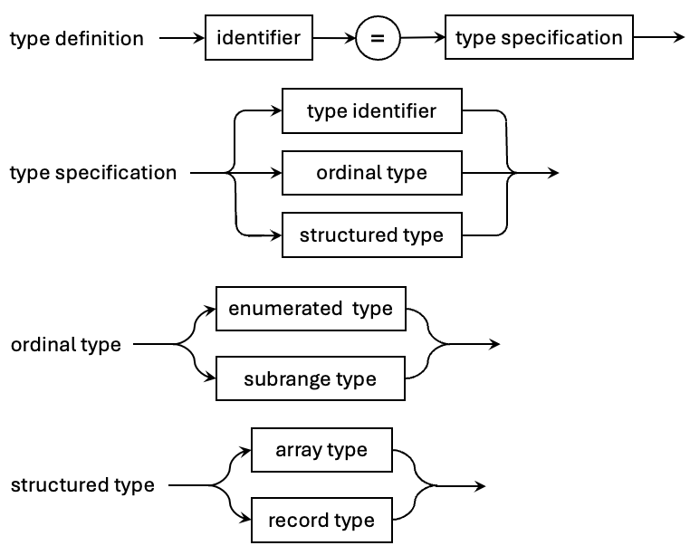
Pascal Type Definition Grammar
Pcl_P2.g4
typeDefinition : identifier '=' typeSpecification ;
typeSpecification locals [ Typespec_P2 typespec = null ]
: typeIdentifier
| ordinalType
| structuredType
;
typeIdentifier : identifier ;
ordinalType locals [ Typespec_P2 typespec = null ]
: enumeratedType
| subrangeType
;
structuredType locals [ Typespec_P2 typespec = null ]
: arrayType
| recordType
;

Slide 7
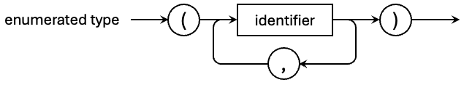
Pascal Enumerated Types
Pcl_P2.g4
enumeratedType locals [ Typespec_P2 typespec = null ]
: '(' identifier ( ',' identifier )* ')' ;
TestEnumerated.pas
PROGRAM TestEnumerated;
TYPE
greek = (ALPHA, BETA, GAMMA);
days = (SUN, MON, TUE, WED, THU, FRI, SAT);
...

Slide 8
Named vs. Unnamed Types
A Pascal type can be named or unnamed.
  A type defined in the TYPE section is named.
  A type specification used elsewhere is unnamed.
PROGRAM TestEnumerated;
TYPE
greek = (ALPHA, BETA, GAMMA);
days = (SUN, MON, TUE, WED, THU, FRI, SAT);
VAR
g : greek;
d : days;
r : (IV, V, VI);
BEGIN
END.
Named enumerated types.
Unnamed enumerated type.

Slide 9
Typespec_P2 Support for Enumerated Types
Typespec_P2.java
public class Typespec_P2
{
public enum Form
{
SCALAR, ENUMERATED, SUBRANGE, STRING, ARRAY, RECORD, UNKNOWN;
public String toString() { return super.toString().toLowerCase(); }
}
private interface TypeInfo {}
private class EnumeratedInfo implements TypeInfo
{
private ArrayList<SymtabEntry> constants;
}
private class SubrangeInfo implements TypeInfo ...
private class ArrayInfo implements TypeInfo ...
...

Slide 10
Typespec_P2, cont’d
Typespec_P2.java
public Typespec_P2(Form form)
{
this.form = form;
this.identifier = null;
switch (form)
{
case ENUMERATED:
info = new EnumeratedInfo();
((EnumeratedInfo) info).constants =
new ArrayList<SymtabEntry>();
break;
case SUBRANGE: ...
case ARRAY: ...
}
}

Slide 11
Method Overrides in Semantics_P2
Semantics_P2.java
public class Semantics_P2 extends Pcl_P2BaseVisitor<Object>
{
@Override
public Object visitTypeDefinition(TypeDefinitionContext ctx)
{
return typeDefinitions.typeDefinition(ctx);
}
@Override
public Object visitTypeSpecification(TypeSpecificationContext ctx)
{
return typeDefinitions.typeSpecification(ctx);
}
@Override
public Object visitTypeIdentifier(TypeIdentifierContext ctx)
{
return typeDefinitions.typeIdentifier(ctx);
}
...

Slide 12
Semantics_P2, cont’d
Semantics_P2.java
...
@Override
public Object visitEnumeratedType(EnumeratedTypeContext ctx) …
{
return typeDefinitions.enumeratedType(ctx);
}
@Override
public Object visitSubrangeType(SubrangeTypeContext ctx)
{
return typeDefinitions.subrangeType(ctx);
}
@Override
public Object visitArrayType(ArrayTypeContext ctx)
{
return typeDefinitions.arrayType(ctx);
}
...

Slide 13
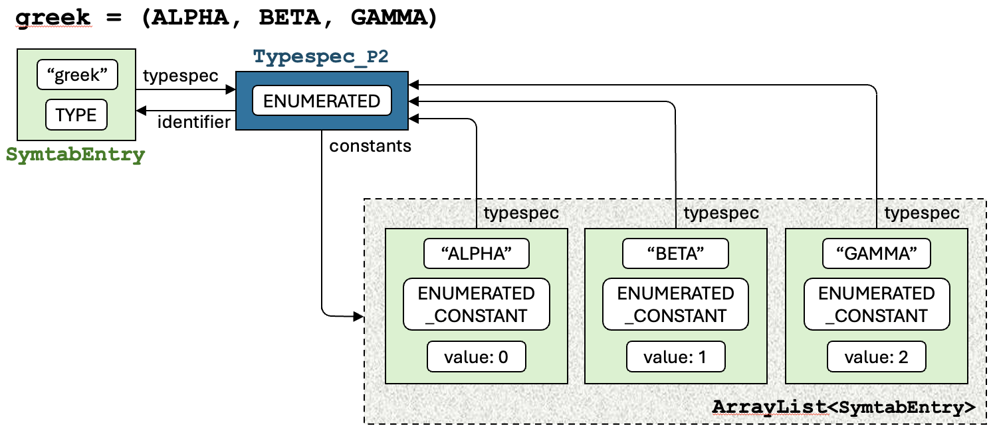
Enumerated Types in the Symbol Table
Type information is also entered
into the symbol table.
The SymtabEntry and Typespec_P2 objects are cross-linked.

Slide 14
intermediate.semantics.TypeDefinitions_P2
typeDefinition : identifier '=' typeSpecification ;
public class TypeDefinitions_P2 extends Semantics_P2
{
Typespec_P2 typeDefinition(TypeDefinitionContext ctx)
{
IdentifierContext typeIdCtx = ctx.identifier();
String typeName = typeIdCtx.getText();
SymtabEntry typeEntry = symtab.lookup(typeName);
TypeSpecificationContext typespecCtx = ctx.typeSpecification();
Typespec_P2 typespec = null;
if (typeEntry == null)
{
typespec = (Typespec_P2) visit(typespecCtx);
typeEntry = symtab.enter(typeName, TYPE);
typeEntry.setTypespec(typespec);
if (typespec.getIdentifier() == null)
{
typespec.setIdentifier(typeEntry);
}
}
else ...
TypeDefinitions_P2.java

Slide 15
TypeDefinitions_P2, cont’d
TypeDefinitions_P2.java
...
else
{
error.flag(REDECLARED_IDENTIFIER, typeIdCtx);
typespec = Predefined.undefinedType;
}
typeIdCtx.entry = typeEntry;
typeIdCtx.typespec = typespecCtx.typespec = typespec;
typeEntry.appendLineNumber(ctx.getStart().getLine());
return typespec;
}

Slide 16
TypeDefinitions_P2, cont’d
enumeratedType locals [ Typespec_P2 typespec = null ]
: '(' identifier ( ',' identifier )* ')' ;
TypeDefinitions_P2.java
Typespec_P2 enumeratedType(EnumeratedTypeContext ctx)
{
Typespec_P2 enumTypespec = new Typespec_P2(ENUMERATED);
ArrayList<SymtabEntry> constants = new ArrayList<>();
int value = -1;
for (IdentifierContext constIdCtx : ctx.identifier())
{
...
}
enumTypespec.setEnumeratedConstants(constants);
ctx.typespec = enumTypespec;
return enumTypespec;
}

Slide 17
TypeDefinitions_P2, cont’d
TypeDefinitions_P2.java
for (IdentifierContext constIdCtx : ctx.identifier())
{
String constantName = constIdCtx.getText();
SymtabEntry constantEntry = symtab.lookup(constantName);
if (constantEntry == null)
{
constantEntry = symtab.enter(constantName, ENUMERATED_CONSTANT);
constantEntry.setTypespec(enumTypespec);
constantEntry.setValue(++value);
constants.add(constantEntry);
}
else
{
error.flag(REDECLARED_IDENTIFIER, constIdCtx);
}
constIdCtx.entry = constantEntry;
constIdCtx.typespec = enumTypespec;
constantEntry.appendLineNumber(ctx.getStart().getLine());
}

Slide 18
Enumerated Type Conversion
TestEnumerated.pas
PROGRAM TestEnumerated;
TYPE
greek = (ALPHA, BETA, GAMMA);
days = (SUN, MON, TUE, WED, THU, FRI, SAT);
VAR
g : greek;
d : days;
r : (IV, V, VI);
BEGIN
END.
TestEnumerated.java
public class TestEnumerated
{
private static enum greek {ALPHA, BETA, GAMMA};
private static enum days {SUN, MON, TUE, WED, THU, FRI, SAT};
private static greek g;
private static days d;
private static int r;
public static void main(String[] args)
{
System.out.println("Done!");
}
}

Slide 19
New Method Overrides in Converter_P2
Converter_P2.java
@Override
public Object visitTypeDefinition(TypeDefinitionContext ctx)
{
return typeDefinitions.typeDefinition(ctx);
}
@Override
public Object visitEnumeratedType(EnumeratedTypeContext ctx)
{
return typeDefinitions.enumeratedType(ctx);
}

Slide 20
backend.converter.TypeDefinitions_P2
TypeDefinitions_P2.java
public class TypeDefinitions_P2 extends Converter_P2
{
boolean first = true;
Object typeDefinition(TypeDefinitionContext ctx)
{
IdentifierContext typeIdCtx = ctx.identifier();
Typespec_P2 typespec = typeIdCtx.typespec;
Form form = typespec.getForm();
if (form == ENUMERATED)
{
String typeName = typeIdCtx.entry.getName();
TypeSpecificationContext typespecCtx = ctx.typeSpecification();
...
code.emitStart();
code.emit("private static enum " + typeName);
visit(typespecCtx);
}
return null;
}
typeDefinition : identifier '=' typeSpecification ;

Slide 21
TypeDefinitions_P2, cont’d
enumeratedType locals [ Typespec_P2 typespec = null ]
: '(' identifier ( ',' identifier )* ')' ;
TypeDefinitions_P2.java
Object enumeratedType(EnumeratedTypeContext ctx)
{
String separator = " {";
for (IdentifierContext constIdCtx : ctx.identifier())
{
String name = constIdCtx.entry.getName();
code.emit(separator + name);
separator = ", ";
}
code.emitEnd("};");
return null;
}

Slide 22

Pascal Subrange Types
Pcl_P2.g4
subrangeType locals [ Typespec_P2 typespec = null ]
: constant '..' constant ;

Slide 23
Pascal Subrange Types, cont’d
PROGRAM TestSubrange;
CONST
MINUSFIVE = -5;
TEN = 10;
TYPE
days = (SUN, MON, TUE, WED, THU, FRI, SAT);
weekdays = MON..FRI;
sr1 = 5..25;
sr2 = MINUSFIVE..TEN;
sr3 = -TEN..-3;
VAR
k : sr1;
w : weekdays;
n : 45..50;
grade : 'A'..'F';
midweek : TUE..THU;
BEGIN
END.

Slide 24
Typespec_P2 Support for Subrange Types
Typespec_P2.java
private class SubrangeInfo implements TypeInfo
{
private Typespec_P2 baseType;
private Object minValue;
private Object maxValue;
}
...
public Typespec_P2(Form form)
{
this.form = form;
this.identifier = null;
switch (form)
{
case ENUMERATED: ...
case SUBRANGE:
info = new SubrangeInfo();
((SubrangeInfo) info).minValue = 0;
((SubrangeInfo) info).maxValue = 0;
((SubrangeInfo) info).baseType = null;
break;
case ARRAY: ...

Slide 25
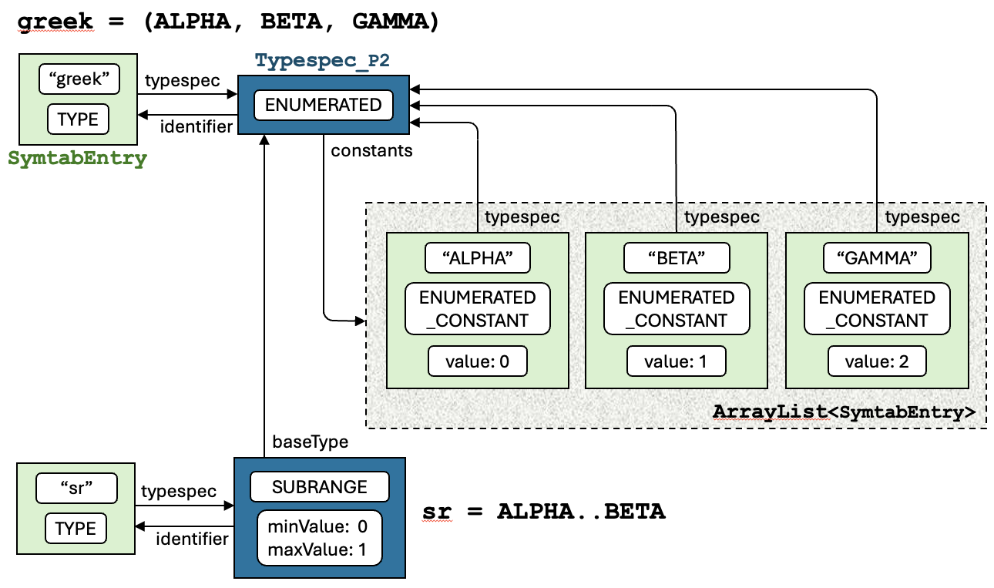
Subrange Types in the Symbol Table

Slide 26
intermediate.semantics.TypeDefinitions_P2
subrangeType locals [ Typespec_P2 typespec = null ]
: constant '..' constant ;
TypeDefinitions_P2.java
Typespec_P2 subrangeType(SubrangeTypeContext ctx)
{
Typespec_P2 subrangeTypespec = new Typespec_P2(SUBRANGE);
ConstantContext minCtx = ctx.constant().get(0);
ConstantContext maxCtx = ctx.constant().get(1);
Typespec_P2 minTypespec = (Typespec_P2) visit(minCtx);
Typespec_P2 maxTypespec = (Typespec_P2) visit(maxCtx);
int minValue = 0;
int maxValue = 0;
boolean badMin = false;
boolean badMax = false;
if (!minTypespec.isOrdinal()) badMin = true;
if (!maxTypespec.isOrdinal()) badMax = true;
if (minTypespec != maxTypespec) badMax = true;

Slide 27
intermediate.semantics.TypeDefinitions_P2
TypeDefinitions_P2.java
if (!(badMin || badMax))
{
if ( (minTypespec == Predefined.integerType)
|| (minTypespec.getForm() == ENUMERATED))
{
minValue = (Integer) minCtx.value;
maxValue = (Integer) maxCtx.value;
}
else
{
minValue = (Character) minCtx.value;
maxValue = (Character) maxCtx.value;
}
}
if (minValue > maxValue)
{
error.flag(INVALID_SUBRANGE, ctx);
badMin = badMax = true;
}
else if (badMin || badMax)
{
error.flag(INVALID_SUBRANGE_CONSTANT,
badMin ? minCtx : maxCtx);
}

Slide 28
intermediate.semantics.TypeDefinitions_P2
TypeDefinitions_P2.java
if (badMin || badMax)
{
maxTypespec = minTypespec = Predefined.integerType;
}
subrangeTypespec.setSubrangeBaseType(minTypespec);
subrangeTypespec.setSubrangeMinValue(minCtx.value);
subrangeTypespec.setSubrangeMaxValue(maxCtx.value);
ctx.typespec = subrangeTypespec;
return subrangeTypespec;
}
Why?

Slide 29
Subrange Type Conversion
TestSubrange.pas
PROGRAM TestSubrange;
CONST
MINUSFIVE = -5;
TEN = 10;
TYPE
days = (SUN, MON, TUE, WED, THU, FRI, SAT);
weekdays = MON..FRI;
sr1 = 5..25;
sr2 = MINUSFIVE..TEN;
sr3 = -TEN..-3;
VAR
k : sr1;
w : weekdays;
n : 45..50;
grade : 'A'..'F';
midweek : TUE..THU;
BEGIN
END.
TestSubrange.java
public class TestSubrange
{
private static final int MINUSFIVE = -5;
private static final int TEN = 10;
private static enum days {SUN, MON, TUE, WED, THU, FRI, SAT};
private static int k;
private static days w;
private static int n;
private static char grade;
private static days midweek;
public static void main(String[] args)
{
System.out.println("Done!");
}
}

Slide 30
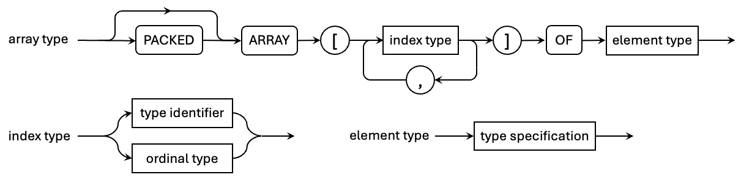
Pascal Array Types
Pcl_P2.g4
arrayType locals [ Typespec_P2 typespec = null ]
: PACKED? ARRAY '[' dimensionList ']' OF elmtType ;
dimensionList : indexType ( ',' indexType )* ;
indexType : typeIdentifier | ordinalType ;
elmtType : typeSpecification;

Slide 31
Pascal Array Types
PROGRAM TestArrays;
CONST
MINUSFIVE = -5;
TEN = 10;
TYPE
greek = (ALPHA, BETA, GAMMA);
days = (MON, TUE, WED, THU, FRI, SAT, SUN);
weekdays = MON..FRI;
sr1 = 5..25;
sr2 = MINUSFIVE..TEN;
sr3 = -TEN..-3;
ar1 = ARRAY [1..TEN] OF integer;
ar2 = ARRAY [sr1] OF real;
ar3 = ARRAY [WED..SAT] of boolean;
ar4 = ARRAY [(SMALL, MEDIUM, LARGE)] OF greek;
char32 = ARRAY [1..32] OF char;
ar5 = ARRAY [sr1] OF ARRAY [sr2] OF weekdays;
ar6 = ARRAY [sr1, sr2, sr3] OF weekdays;
VAR
a1a, a1b : ar1;
a2 : ar2;
a3 : ar3;
a4 : ar4;
a5 : ar5;
a6 : ar6;
chs : char32;
ua1 : ARRAY ['a'..'z'] OF (JAN, FEB, MAR, APR);
ua2 : ARRAY [sr1] OF ARRAY [8..12] OF JAN..APR;
ua3 : ARRAY [boolean, sr1, (RED, WHITE, BLUE)] OF greek;
BEGIN
END.
1-D named arrays
2-D named array
3-D named array
1-D unnamed array of unnamed enumeration0
2-D unnamed array of unnamed subrange
3-D unnamed array

Slide 32
intermediate.semantics.TypeDefinitions_P2
arrayType locals [ Typespec_P2 typespec = null ]
: PACKED? ARRAY '[' dimensionList ']' OF elmtType ;
elmtType : typeSpecification;
TypeDefinitions_P2.java
Typespec_P2 arrayType(ArrayTypeContext ctx)
{
DimensionListContext dimListCtx = ctx.dimensionList();
int dimensionsCount = dimListCtx.indexType().size();
if (ctx.PACKED() != null)
{
return packedArray(ctx, dimensionsCount);
}
Typespec_P2 arrayTypespec = new Typespec_P2(ARRAY);
ctx.typespec = arrayTypespec;
for (int i = 0; i < dimensionsCount; i++)
{
...
}
Typespec_P2 elmtTypespec = (Typespec_P2) visit(ctx.elmtType());
arrayTypespec.setArrayElementType(elmtTypespec);
return ctx.typespec;
}
String type

Slide 33
intermediate.semantics.TypeDefinitions_P2
TypeDefinitions_P2.java
for (int i = 0; i < dimensionsCount; i++)
{
IndexTypeContext indexCtx = dimListCtx.indexType().get(i);
Typespec_P2 indexTypespec = (Typespec_P2) visit(indexCtx);
if (!indexTypespec.isOrdinal())
{
error.flag(INVALID_INDEX_TYPE, indexCtx);
indexTypespec = Predefined.booleanType;
}
arrayTypespec.setArrayIndexType(indexTypespec);
arrayTypespec.setArrayElementCount(elementCount(indexTypespec));
if (i < dimensionsCount-1)
{
Typespec_P2 elmtTypespec = new Typespec_P2(ARRAY);
arrayTypespec.setArrayElementType(elmtTypespec);
arrayTypespec = elmtTypespec;
}
}
Dimensions other than the last.
dimensionList : indexType ( ',' indexType )* ;
indexType : typeIdentifier | ordinalType ;

Slide 34
Array Type Conversion
public class TestArrays
{
private static final int MINUSFIVE = -5;
private static final int TEN = 10;
private static enum greek {ALPHA, BETA, GAMMA};
private static enum days {MON, TUE, WED, THU, FRI, SAT, SUN};
private static int a1a[] = new int[10], a1b[] = new int[10];
private static double a2[] = new double[21];
private static boolean a3[] = new boolean[4];
private static greek a4[] = new greek[3];
private static days a5[][] = new days[21][16];
private static days a6[][][] = new days[21][16][8];
private static char chs[] = new char[32];
private static int ua1[] = new int[26];
private static int ua2[][] = new int[21][5];
private static greek ua3[][][] = new greek[2][21][3];
public static void main(String[] args)
{
System.out.println("Done!");
}
}
PROGRAM TestArrays;
CONST
MINUSFIVE = -5;
TEN = 10;
TYPE
greek = (ALPHA, BETA, GAMMA);
days = (MON, TUE, WED, THU, FRI, SAT, SUN);
weekdays = MON..FRI;
sr1 = 5..25;
sr2 = MINUSFIVE..TEN;
sr3 = -TEN..-3;
ar1 = ARRAY [1..TEN] OF integer;
ar2 = ARRAY [sr1] OF real;
ar3 = ARRAY [WED..SAT] of boolean;
ar4 = ARRAY [(SMALL, MEDIUM, LARGE)] OF greek;
char32 = ARRAY [1..32] OF char;
ar5 = ARRAY [sr1] OF ARRAY [sr2] OF weekdays;
ar6 = ARRAY [sr1, sr2, sr3] OF weekdays;
VAR
a1a, a1b : ar1;
a2 : ar2;
a3 : ar3;
a4 : ar4;
a5 : ar5;
a6 : ar6;
chs : char32;
ua1 : ARRAY ['a'..'z'] OF (JAN, FEB, MAR, APR);
ua2 : ARRAY [sr1] OF ARRAY [8..12] OF JAN..APR;
ua3 : ARRAY [boolean, sr1, (RED, WHITE, BLUE)] OF greek;
BEGIN
END.
TestArrays.java
TestArrays.pas

Slide 35
Pascal Strings
A Pascal string type is a “packed array” of characters.
  If it’s not packed, it’s just an array of characters.
  For convenience, we created a predefined type named string.

Slide 36
String Type Conversion
TestStrings.pas
PROGRAM TestStrings;
TYPE
days = (MON, TUE, WED, THU, FRI, SAT, SUN);
weekdays = MON..FRI;
sr1 = 5..25;
string32 = PACKED ARRAY [1..32] OF char;
char32 = ARRAY [1..32] OF char;
VAR
str : string32;
chars : char32;
msg : ARRAY [sr1] OF string32;
ustr : ARRAY [sr1, weekdays] OF PACKED ARRAY [THU..SUN] OF char;
carr : ARRAY [sr1, weekdays] OF ARRAY [THU..SUN] OF char;
BEGIN
END.
TestStrings.java
public class TestStrings
{
private static enum days {MON, TUE, WED, THU, FRI, SAT, SUN};
private static String str;
private static char chars[] = new char[32];
private static String msg[] = new String[21];
private static String ustr[][] = new String[21][5];
private static char carr[][][] = new char[21][5][4];
public static void main(String[] args)
{
System.out.println("Done!");
}
}

Slide 37
Pascal Strings, cont’d
TypeDefinitions_P2.java
private Typespec_P2 packedArray(ArrayTypeContext ctx,
int dimensionsCount)
{
ElmtTypeContext elmtTypeCtx = ctx.elmtType();
Typespec_P2 elmtTypespec = (Typespec_P2) visit(elmtTypeCtx);
if ( (elmtTypespec == Predefined.charType)
&& (dimensionsCount == 1))
{
return Predefined.stringType;
}
else
{
error.flag(INVALID_PACKED_ARRAY, elmtTypeCtx);
ctx.typespec = Predefined.undefinedType;
return Predefined.undefinedType;
}
}

Slide 38
backend.converter.VariableDeclarations_P2
variableDeclarations : variableIdentifierList ':' typeSpecification ;
variableIdentifierList : identifier ( ',' identifier )* ;
public class VariableDeclarations_P2 extends Converter_P2
{
boolean first = true;
Object variableDeclarations(VariableDeclarationsContext ctx)
{
VariableIdentifierListContext varListCtx = ctx.variableIdentifierList();
TypeSpecificationContext typespecCtx = ctx.typeSpecification();
Typespec_P2 typespec = typespecCtx.typespec;
Form typeForm = typespec.getForm();
String typeName = javaTypeName(typespec);
...
code.emitStart();
code.emit("private static " + typeName);
String separator = " ";
for (IdentifierContext idCtx : varListCtx.identifier())
{
...;
}
code.emitEnd(";");
return null;
}
VariableDeclarations_P2.java

Slide 39
VariableDeclarations_P2, cont’d
variableDeclarations : variableIdentifierList ':' typeSpecification ;
variableIdentifierList : identifier ( ',' identifier )* ;
VariableDeclarations_P2.java
String separator = " ";
for (IdentifierContext idCtx : varListCtx.identifier())
{
String variableName = idCtx.entry.getName().toLowerCase();
code.emit(separator + variableName);
if (typeForm == ARRAY) array(typespecCtx);
separator = ", ";
}

Slide 40
VariableDeclarations_P2, cont’d
VariableDeclarations_P2.java
private void array(TypeSpecificationContext typespecCtx)
{
String brackets = "";
Typespec_P2 typespec = typespecCtx.typespec;
String typeName = javaTypeName(typespec);
while (typespec.getForm() == ARRAY)
{
brackets += "[]";
typespec = typespec.getArrayElementType();
}
code.emit(brackets);
code.emit(" = new " + typeName);
typespec = typespecCtx.typespec;
while (typespec.getForm() == ARRAY)
{
int elmtCount = typespec.getArrayElementCount();
code.emit("[" + elmtCount + "]");
typespec = typespec.getArrayElementType();
}
}
Loop to emit [] for each dimension.
Loop to emit [size] for each dimension.
private static days a6[][][] = new days[21][16][8];

Slide 41
Name Mapping
private String javaTypeName(Typespec_P2 pascalType)
{
Form form = pascalType.getForm();
SymtabEntry typeEntry = pascalType.getIdentifier();
String pascalTypeName = typeEntry != null ? typeEntry.getName() : null;
String javaTypeName = null;
switch (form)
{
case SCALAR:
return typeNameTable.get(pascalTypeName);
case ENUMERATED:
return pascalTypeName != null ? pascalTypeName : "int";
case SUBRANGE:
Typespec_P2 baseType = pascalType.baseType();
pascalTypeName = baseType.getIdentifier().getName();
javaTypeName = typeNameTable.get(pascalTypeName);
return javaTypeName != null ? javaTypeName : pascalTypeName;
case STRING:
return "String";
case ARRAY:
Typespec_P2 elmtType = pascalType.getArrayBaseType();
if (elmtType.getIdentifier() != null)
{
if (elmtType.getForm() == STRING) return "String";
pascalTypeName = elmtType.getIdentifier().getName();
javaTypeName = typeNameTable.get(pascalTypeName);
return javaTypeName != null ? javaTypeName : pascalTypeName;
}
else return "int";
default: return "*unknown*";
}
}
Map Pascal names to Java names.
VariableDeclarations_P2.java

Slide 42
Pascal Multidimensional Arrays
Pascal is flexible about how to define multidimensional arrays.
  They are implemented as arrays of arrays.
  These are all equivalent:
  Therefore, all must enter the same type information into the symbol table.
multi = ARRAY [1..3] OF ARRAY ['a'..'z'] OF ARRAY [boolean] OF real
multi = ARRAY [1..3, 'a'..'z'] OF ARRAY [boolean] OF real
multi = ARRAY [1..3] OF ARRAY ['a'..'z', boolean] OF real
multi = ARRAY [1..3, 'a'..'z', boolean] OF real

Slide 43
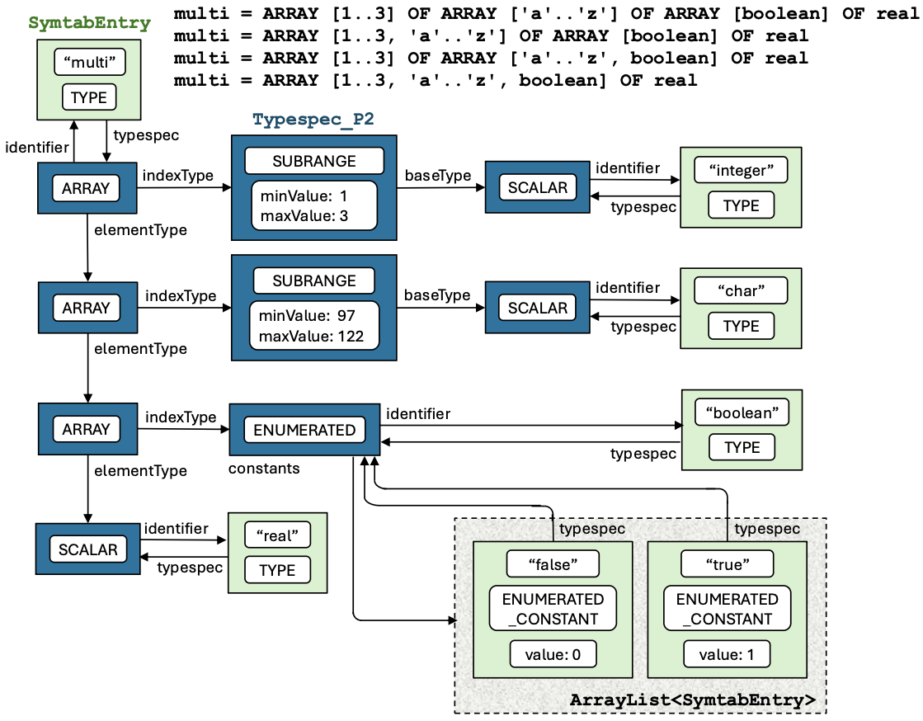
Pascal Multidimensional Arrays, cont’d

Slide 44
Assignment #4
Classic Pascal had built-in set data type.
  Read about it here in Chapter 8 (syntax diagrams in Appendix D):
  http://pascal.hansotten.com/uploads/books/Pascal_User_Manual_and_Report_Fourth_Edition.pdf
  Implement named and unnamed set type definitions.
Create a new hashtable data type for Pascal.
  Example definitions:
TYPE
roster = hashtable [0..999] OF string;
VAR
dictionary : hashtable [string] OF string;

