Slide 1


CS 153: Concepts of Compiler Design
September 15 Class Meeting
Department of Computer Science
San Jose State University
Fall 2026
Instructor: Ron Mak
www.cs.sjsu.edu/~mak

Slide 2
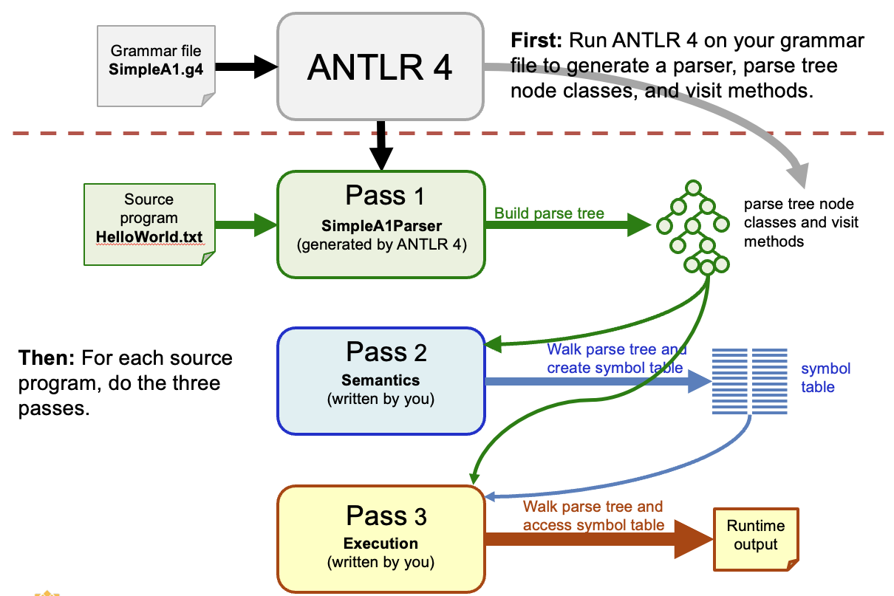
Where are We Now?
Translators: converter, interpreter, compiler
Parsers, scanners, tokens
Three-tiered translator architecture
Translations in three passes
ANTLR 4 grammar file
ANTLR 4 generates parser, context (parse tree node) classes, base visitor method implementations
Pass 2: Walk the parse tree to build the symbol table with one set of visitor method overrides.
Pass 3: Walk the parse tree to execute statements and expressions with another set of visitor method overrides.

Slide 3
We’re Ready for Pascal!
We’ll use a subset of Pascal named “Pcl” as our example source language.
  It will have most of the features of “classic” Pascal.
Work on a Pcl ➔ Java converter for now.
  Afterwards, a Pcl ➔ Java interpreter.
  Interpreters require more work than we’ve already done with the SimpleA3 interpreter.
We’ll create converters Pcl_P1, Pcl_P2, etc.
  The “_P” stands for “program converter”.
  Incremental development as usual.

Slide 4
Typical Pascal Program
PROGRAM CircleAreas;
CONST
PI = 3.1415926535;
TYPE
radius = 1..15;
VAR
r : radius;
a : real;
FUNCTION area(r : radius) : real;
BEGIN
area := PI*r*r;
END;
PROCEDURE print(rdius : radius; ar : real);
BEGIN
writeln(rdius:4, ar:16:8);
END;
BEGIN
writeln('Radius Area');
FOR r := 1 TO 10 DO BEGIN
a := area(r);
print(r, a);
END;
END.
program header
constant definitions
Each procedure and function can have local constant definitions, type definitions, and variable declarations.
Pascal allows a procedure or a function to have local (nested) procedures and functions, unlike Java.
type definitions
variable declarations
function definition
procedure definition
main
CircleAreas.pas

Slide 5
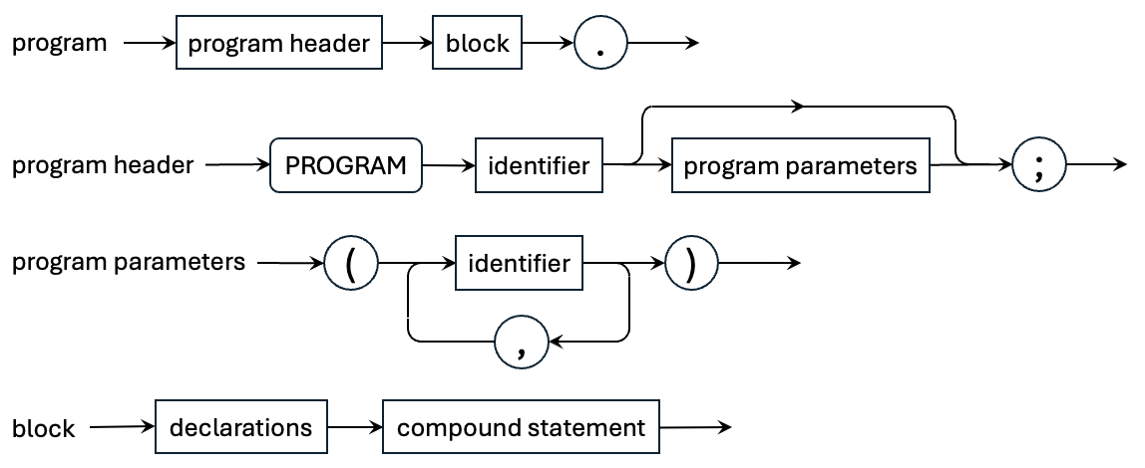
A Pascal Program

Slide 6
Pascal Declarations
Pascal declarations include:
  label declarations (we won’t use these)
  constant definitions
  type definitions
  variable declarations
  procedure and function definitions
Each is optional, but they must be in this order.

Slide 7
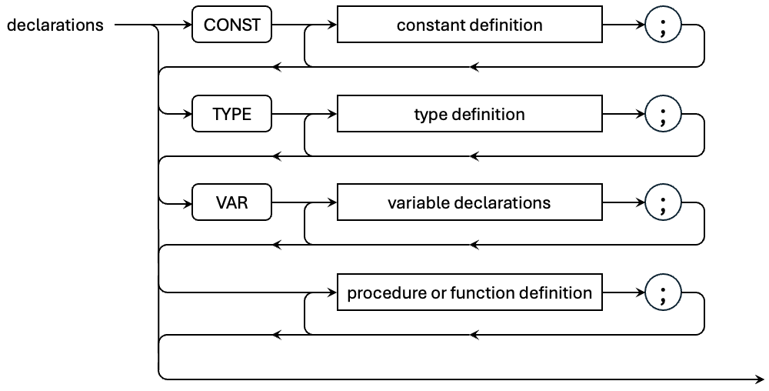
Pascal Declarations, cont’d
All the parts are optional, but they must come in this order. Note that variables are declared and the others are defined. Collectively, refer to all as declarations.

Slide 8
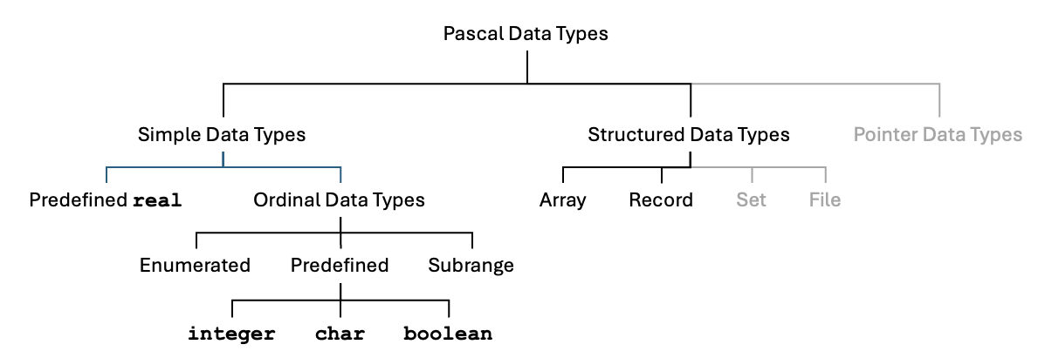
Pascal Data Types

Slide 9
Class intermediate.type.Typespec
Typespec.java
package intermediate.type;
...
public class Typespec_P1
{
public enum Form
{
SCALAR, ENUMERATED, SUBRANGE, STRING, ARRAY, RECORD, UNKNOWN;
public String toString() { return super.toString().toLowerCase(); }
}
private interface TypeInfo {}
private class EnumeratedInfo implements TypeInfo
{
private ArrayList<SymtabEntry> constants;
}
private class SubrangeInfo implements TypeInfo {}
private class ArrayInfo implements TypeInfo {}
private class RecordInfo implements TypeInfo {}
...

Slide 10
Class intermediate.type.Typespec, cont’d
Typespec.java
...
private Form form;
private SymtabEntry identifier;
private TypeInfo info;
public Typespec_P1(Form form)
{
this.form = form;
this.identifier = null;
switch (form)
{
case ENUMERATED:
info = new EnumeratedInfo();
((EnumeratedInfo) info).constants =
new ArrayList<SymtabEntry>();
break;
default:
info = null;
break;
}
}
...

Slide 11
Class intermediate.type.Typespec, cont’d
public boolean isNumeric()
{
return (this == Predefined.integerType)
|| (this == Predefined.realType);
}
public boolean isOrdinal()
{
return (this == Predefined.integerType)
|| (this == Predefined.charType)
|| (this == Predefined.booleanType)
|| (form == Form.ENUMERATED)
|| (form == Form.SUBRANGE);
}
public ArrayList<SymtabEntry> getEnumeratedConstants()
{
return ((EnumeratedInfo) info).constants;
}
public void setEnumeratedConstants(ArrayList<SymtabEntry> constants)
{
((EnumeratedInfo) info).constants = constants;
}
}
Typespec.java

Slide 12
Pascal’s Predefined Types
Add Pascal’s predefined types to the symbol table so that variables can have those types.
  integer
  real
  boolean
  char
  string
Pascal has fixed-length strings that are arrays of characters. For convenience, we’ll treat it as a predefined type.

Slide 13
Class intermediate.symtab.Predefined
Predefined.java
package intermediate.symtab;
...
public class Predefined
{
private static Symtab symtab;
public static Typespec_P1 integerType;
public static Typespec_P1 realType;
public static Typespec_P1 booleanType;
public static Typespec_P1 charType;
public static Typespec_P1 stringType;
public static Typespec_P1 undefinedType;
public static void initialize(Symtab symtab)
{
Predefined.symtab = symtab;
initializeTypes();
initializeConstants();
}
...

Slide 14
intermediate.symtab.Predefined, cont’d
Predefined.java
private static void initializeTypes()
{
SymtabEntry integerEntry = symtab.enter("integer", TYPE);
integerType = new Typespec_P1(SCALAR);
integerType.setIdentifier(integerEntry);
integerEntry.setTypespec(integerType);
SymtabEntry realEntry = symtab.enter("real", TYPE);
realType = new Typespec_P1(SCALAR);
realType.setIdentifier(realEntry);
realEntry.setTypespec(realType);
SymtabEntry charEntry = symtab.enter("char", TYPE);
charType = new Typespec_P1(SCALAR);
charType.setIdentifier(charEntry);
charEntry.setTypespec(charType);
SymtabEntry booleanEntry = symtab.enter("boolean", TYPE);
booleanType = new Typespec_P1(ENUMERATED);
booleanType.setIdentifier(booleanEntry);
booleanEntry.setTypespec(booleanType);
SymtabEntry stringEntry = symtab.enter("string", TYPE);
stringType = new Typespec_P1(STRING);
stringType.setIdentifier(stringEntry);
stringEntry.setTypespec(stringType);
undefinedType = new Typespec_P1(UNKNOWN);
}

Slide 15
intermediate.symtab.Predefined, cont’d
Predefined.java
private static void initializeConstants()
{
SymtabEntry falseEntry =
symtab.enter("false", ENUMERATED_CONSTANT);
falseEntry.setTypespec(booleanType);
falseEntry.setValue(0);
SymtabEntry trueEntry =
symtab.enter("true", ENUMERATED_CONSTANT);
trueEntry.setTypespec(booleanType);
trueEntry.setValue(1);
ArrayList<SymtabEntry> constants =
booleanType.getEnumeratedConstants();
constants.add(falseEntry);
constants.add(trueEntry);
}
}

Slide 16
Rules for Declarations in Pcl_P1.g4
Pcl_P1.g4
grammar Pcl_P1 ;
...
program : programHeader block '.' ;
programHeader : PROGRAM identifier programParameters? ';' ;
programParameters : '(' identifier ( ',' identifier )* ')' ;
block : declarations compoundStatement ;
compoundStatement : BEGIN END ;
declarations : ( constantsPart ';' )? ( typesPart ';' )?
( variablesPart ';' )? ( procedureAndFunctionsPart ';')? ;
constantsPart : CONST constantDefinitionsList ;
constantDefinitionsList : constantDefinition ( ';' constantDefinition )* ;
typesPart : /* empty */ ;
variablesPart : VAR variableDeclarationsList ;
variableDeclarationsList : variableDeclarations
( ';' variableDeclarations )* ;
procedureAndFunctionsPart : /* empty */ ;
...

Slide 17

Pascal Constant Definitions
PROGRAM TestConstDefs;
CONST
ONE = 1;
MINUSONE = -ONE;
MINUSTWO = -2;
THOUSAND = 1e3;
PI = 3.14159265;
AVOGADRO = 6.0221408e+23;
HATOMSIZE = 0.105835442134E-9;
LETTERX = 'x';
GREETING = 'Hello, world';
FRIDAY = 'It''s Friday!';
QUOTED = 'A "quoted" word';
BEGIN
END.
TestConstDefs.pas
Classic Pascal only allows a constant value
after the = sign.
  No constant expressions.

Slide 18
Constant Definitions in Pcl_P1.g4
Pcl_P1.g4
constantDefinition : identifier '=' constant ;
constant locals [ Typespec_P1 typespec = null,
Object value = null
]
: sign? ( constantIdentifier | unsignedConstant )
| characterConstant
| stringConstant
| booleanConstant
;
sign : '-' | '+’ ;
constantIdentifier locals [ Typespec_P1 typespec = null,
Object value = null
]
: identifier ;

Slide 19
Constant Definitions in Pcl_P1.g4, cont’d
Pcl_P1.g4
identifier locals [ SymtabEntry entry = null,
Typespec_P1 typespec = null,
Object value = null
]
: IDENTIFIER ;
unsignedConstant locals [ Typespec_P1 typespec = null,
Object value = null
]
: integerConstant
| realConstant
;
integerConstant locals [ Typespec_P1 typespec = null,
Object value = null
]
: INTEGER ;
realConstant locals [ Typespec_P1 typespec = null,
Object value = null
]
: REAL;

Slide 20
Constant Definitions in Pcl_P1.g4, cont’d
Pcl_P1.g4
characterConstant locals [ Typespec_P1 typespec = null,
Object value = null
]
: CHARACTER ;
stringConstant locals [ Typespec_P1 typespec = null,
Object value = null
]
: STRING ;
booleanConstant locals [ Typespec_P1 typespec = null,
Object value = null
]
: TRUE | FALSE ;

Slide 21
Class intermediate.semantics.Semantics_P1
Subclass of Pcl_P1BaseVisitor<Object>
  Contains the visitor method overrides for Pass 2 semantic operations.
Each visitor method override dispatches to a similarly named method in a subclass.
  public class ProgramDeclarations_P1 extends Semantics_P1
  public class ConstantDefinitions_P1 extends Semantics_P1
  public class TypeSpecification_P1 extends Semantics_P1
  public class VariableDeclarations_P1 extends Semantics_P1
This way class Semantics_P1 doesn’t become huge and unmanageable.

Slide 22
Class intermediate.semantics.Semantics_P1, cont’d
Semantics_P1.java
public class Semantics_P1 extends Pcl_P1BaseVisitor<Object>
{
...
protected static ProgramDeclarations_P1 programDeclarations;
protected static ConstantDefinitions_P1 constantDefinitions;
protected static TypeSpecification_P1 typeSpecification;
protected static VariableDeclarations_P1 variableDeclarations;
static
{
symtab = new Symtab();
error = new SemanticErrorHandler();
programDeclarations = new ProgramDeclarations_P1();
constantDefinitions = new ConstantDefinitions_P1();
typeSpecification = new TypeSpecification_P1();
variableDeclarations = new VariableDeclarations_P1();
Predefined.initialize(symtab);
}

Slide 23
Class intermediate.semantics.Semantics_P1, cont’d
Semantics_P1.java
@Override
public Object visitProgram(ProgramContext ctx)
{
return programDeclarations.program(ctx);
}
@Override
public Object visitConstantDefinition(ConstantDefinitionContext ctx)
{
return constantDefinitions.constantDefinition(ctx);
}
@Override
public Object visitConstant(ConstantContext ctx)
{
return constantDefinitions.constant(ctx);
}
@Override
public Object visitVariableDeclarations(
VariableDeclarationsContext ctx)
{
return variableDeclarations.variableDeclarations(ctx);
}
}

Slide 24
Class ConstantDefinitions
ConstantDefinitions_P1.java
public class ConstantDefinitions_P1 extends Semantics_P1
{
Object constantDefinition(ConstantDefinitionContext ctx)
{
IdentifierContext idCtx = ctx.identifier();
String constantName = idCtx.getText();
SymtabEntry constantEntry = symtab.lookup(constantName);
if (constantEntry == null)
{
ConstantContext constCtx = ctx.constant();
Object constValue = visit(constCtx);
constantEntry = symtab.enter(constantName, CONSTANT);
constantEntry.setValue(constValue);
constantEntry.setTypespec(constCtx.typespec);
idCtx.entry = constantEntry;
idCtx.typespec = constCtx.typespec;
}
else
{
error.flag(REDECLARED_IDENTIFIER, idCtx);
}
constantEntry.appendLineNumber(ctx.getStart().getLine());
return null;
}

Slide 25
Class ConstantDefinitions, cont’d
Pcl_P1.g4
constant locals [ Typespec_P1 typespec = null,
Object value = null
]
: SIGN? ( constantIdentifier | unsignedConstant )
| characterConstant
| stringConstant
| booleanConstant
;
ConstantDefinitions_P1.java
Object constant(ConstantContext ctx)
{
SignContext signCtx = ctx.sign();
ConstantIdentifierContext constIdCtx = ctx.constantIdentifier();
UnsignedConstantContext unsignedConstCtx = ctx.unsignedConstant();
CharacterConstantContext charConstCtx = ctx.characterConstant();
StringConstantContext stringConstCtx = ctx.stringConstant();
BooleanConstantContext booleanConstCtx = ctx.booleanConstant();
if (constIdCtx != null)
{
ctx.value = visit(constIdCtx);
ctx.typespec = constIdCtx.typespec
= constIdCtx.identifier().typespec;
}
One will not be null.

Slide 26
Class ConstantDefinitions, cont’d
ConstantDefinitions_P1.java
else if (unsignedConstCtx != null)
{
IntegerConstantContext integerConstCtx =
unsignedConstCtx.integerConstant();
RealConstantContext realConstCtx =
unsignedConstCtx.realConstant();
if (integerConstCtx != null)
{
ctx.value = visit(integerConstCtx);
ctx.typespec = integerConstCtx.typespec
= Predefined.integerType;
}
else
{
ctx.value = visit(realConstCtx);
ctx.typespec = realConstCtx.typespec
= Predefined.realType;
}
}

Slide 27
Class ConstantDefinitions, cont’d
ConstantDefinitions_P1.java
else if (charConstCtx != null)
{
ctx.value = visit(charConstCtx);
ctx.typespec = charConstCtx.typespec
= Predefined.charType;
}
else if (stringConstCtx != null)
{
ctx.value = visit(stringConstCtx);
ctx.typespec = stringConstCtx.typespec
= Predefined.stringType;
}
else // booleanConstCtx != null
{
ctx.value = visit(booleanConstCtx);
ctx.typespec = booleanConstCtx.typespec
= Predefined.booleanType;
}

Slide 28
Class ConstantDefinitions, cont’d
ConstantDefinitions_P1.java
if (signCtx != null)
{
Typespec_P1 typespec = ctx.typespec;
if (typespec == Predefined.integerType)
{
ctx.value = -(Integer) ctx.value;
}
else if (typespec == Predefined.realType)
{
ctx.value = -(Double) ctx.value;
}
else
{
error.flag(INVALID_SIGN, signCtx);
}
}
return ctx.value;
}

Slide 29
Class ConstantDefinitions, cont’d
ConstantDefinitions_P1.java
Object constantIdentifier(ConstantIdentifierContext ctx)
{
IdentifierContext idCtx = ctx.identifier();
String idName = idCtx.getText();
SymtabEntry idEntry = symtab.lookup(idName);
int lineNumber = idCtx.start.getLine();
if (idEntry != null)
{
Kind kind = idEntry.getKind();
if ( (kind == CONSTANT)
|| (kind == ENUMERATED_CONSTANT))
{
Typespec_P1 typespec = idEntry.getTypespec();
idCtx.typespec = typespec;
idCtx.value = idEntry.getValue();
}
else
{
error.flag(INVALID_CONSTANT, idCtx);
idCtx.typespec = Predefined.undefinedType;
idCtx.value = 0;
}
idEntry.appendLineNumber(lineNumber);
}
else ...
}
Must be an identifier that was previously defined to be a constant with a value.

Slide 30
Class ConstantDefinitions, cont’d
ConstantDefinitions_P1.java
Object constantIdentifier(ConstantIdentifierContext ctx)
{
...
else
{
error.flag(UNDECLARED_IDENTIFIER, idCtx);
SymtabEntry unknownEntry = symtab.enter(idName, CONSTANT);
unknownEntry.setValue(0);
unknownEntry.setTypespec(Predefined.undefinedType);
unknownEntry.appendLineNumber(lineNumber);
idCtx.typespec = Predefined.undefinedType;
idCtx.value = 0;
}
return idCtx.value;
}

Slide 31
Class ConstantDefinitions, cont’d
ConstantDefinitions_P1.java
Object integerConstant(IntegerConstantContext ctx)
{
ctx.value = Integer.parseInt(ctx.getText());
ctx.typespec = Predefined.integerType;
return ctx.value;
}
Object realConstant(RealConstantContext ctx)
{
...
return ctx.value;
}
Object booleanConstant(BooleanConstantContext ctx)
{
...
return ctx.value;
}

Slide 32
Class ConstantDefinitions, cont’d
ConstantDefinitions_P1.java
Object characterConstant(CharacterConstantContext ctx)
{
String str = ctx.getText();
str = str.substring(1, str.length() - 1)
.replace("''''", "'\''")
.replace("\"", "\\\"");
ctx.value = str.charAt(0);
ctx.typespec = Predefined.charType;
return ctx.value;
}
Object stringConstant(StringConstantContext ctx)
{
String str = ctx.getText();
ctx.value = str.substring(1, str.length() - 1)
.replace("''", "'")
.replace("\"", "\\\"");
ctx.typespec = Predefined.stringType;
return ctx.value;
}
Demo

Slide 33
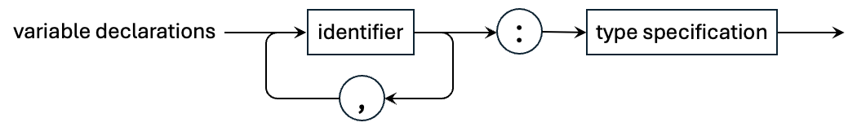
Pascal Variable Declarations
PROGRAM TestVarDecls;
VAR
i, j, k : integer;
x, y, Alpha, bEtA : real;
zeta777 : real;
ch : char;
p, q : Boolean;
BEGIN
END.
TestVarDecls.pas
Pcl_P1.g4
variableDeclarations : variableIdentifierList ':' typeSpecification ;
variableIdentifierList : identifier ( ',' identifier )* ;

Slide 34
Class VariableDeclarations_P1
VariableDeclarations_P1.java
public class VariableDeclarations_P1 extends Semantics_P1
{
Typespec_P1 variableDeclarations(VariableDeclarationsContext ctx)
{
TypeSpecificationContext typespecCtx = ctx.typeSpecification();
Typespec_P1 typespec = (Typespec_P1) visit(typespecCtx);
VariableIdentifierListContext varListCtx =
ctx.variableIdentifierList();
typespecCtx.typespec = typespec;
...

Slide 35
Class VariableDeclarations_P1, cont’d
VariableDeclarations_P1.java
for (IdentifierContext idCtx : varListCtx.identifier())
{
int lineNumber = idCtx.getStart().getLine();
String variableName = idCtx.getText();
SymtabEntry variableEntry = symtab.lookup(variableName);
if (variableEntry == null)
{
variableEntry = symtab.enter(variableName, VARIABLE);
variableEntry.setTypespec(typespec);
idCtx.entry = variableEntry;
idCtx.typespec = typespec;
}
else
{
error.flag(REDECLARED_IDENTIFIER, idCtx);
}
variableEntry.appendLineNumber(lineNumber);
}
return typespec;
}
}
Demo

Slide 36
Class backend.converter.Converter_P1
Subclass of Pcl_P1BaseVisitor<Object>
  Contains the visitor method overrides for Pass 3 conversion operations.
Each visitor method override dispatches to a similarly named method in a subclass.
  public class ProgramDeclarations_P1 extends Semantics_P1
  public class ConstantDefinitions_P1 extends Converter_P1
  public class VariableDeclarations_P1 extends Semantics_P1
This way class Converter_P1 doesn’t become huge and unmanageable.

Slide 37
Class backend.converter.JavaEmitter
Methods that emit well-formatted Java code that was converted from Pascal.
  The Java object file will have the same name as the Pascal source file with .pas replaced by .java
JavaEmitter.java

Slide 38
TestConstDefs
PROGRAM TestConstDefs;
CONST
ONE = 1;
MINUSONE = -ONE;
MINUSTWO = -2;
THOUSAND = 1e3;
PI = 3.14159265;
AVOGADRO = 6.0221408e+23;
HATOMSIZE = 0.105835442134E-9;
LETTERX = 'x';
GREETING = 'Hello, world';
FRIDAY = 'It''s Friday!';
QUOTED = 'A "quoted" word';
BEGIN
END.
TestConstDefs.java
public class TestConstDefs
{
private static final int ONE = 1;
private static final int MINUSONE = -1;
private static final int MINUSTWO = -2;
private static final double THOUSAND = 1000.0;
private static final double PI = 3.14159265;
private static final double AVOGADRO = 6.0221408E23;
private static final double HATOMSIZE = 1.05835442134E-10;
private static final char LETTERX = 'x';
private static final String GREETING = "Hello, world";
private static final String FRIDAY = "It's Friday!";
private static final String QUOTED = "A \"quoted\" word";
public static void main(String[] args)
{
System.out.println("Done!");
}
}
TestConstDefs.pas

Slide 39
TestVarDecls
PROGRAM TestVarDecls;
VAR
i, j, k : integer;
x, y, Alpha, bEtA : real;
zeta777 : real;
ch : char;
p, q : Boolean;
BEGIN
END.
TestVarDecls.java
public class TestVarDecls
{
private static int i, j, k;
private static double x, y, alpha, beta;
private static double zeta777;
private static char ch;
private static boolean p, q;
public static void main(String[] args)
{
System.out.println("Done!");
}
}
TestVarDecls.pas

Slide 40
Class Converter_P1
Converter_P1.java
public class Converter_P1 extends Pcl_P1BaseVisitor<Object>
{
protected static JavaEmitter code;
protected static String programName;
protected static Hashtable<String, String> typeNameTable;
protected static ProgramDeclarations_P1 programDeclarations;
protected static ConstantDefinitions_P1 constantDefinitions;
protected static VariableDeclarations_P1 variableDeclarations;
static
{
programDeclarations = new ProgramDeclarations_P1();
constantDefinitions = new ConstantDefinitions_P1();
variableDeclarations = new VariableDeclarations_P1();
typeNameTable = new Hashtable<>();
typeNameTable.put("integer", "int");
typeNameTable.put("real", "double");
typeNameTable.put("boolean", "boolean");
typeNameTable.put("char", "char");
typeNameTable.put("string", "String");
}
...

Slide 41
Class Converter_P1, cont’d
Converter_P1.java
@Override
public Object visitProgram(ProgramContext ctx)
{
programName = Semantics_P1.programEntry.getName();
code = new JavaEmitter(programName, "java");
return programDeclarations.program(ctx);
}
@Override
public Object visitConstantDefinition(ConstantDefinitionContext ctx)
{
return constantDefinitions.constantDefinition(ctx);
}
@Override
public Object visitVariableDeclarations(VariableDeclarationsContext ctx)
{
return variableDeclarations.variableDeclarations(ctx);
}
}

Slide 42
Class ProgramDeclarations_P1
public class ProgramDeclarations_P1 extends Converter_P1
{
Object program(ProgramContext ctx)
{
code.emitLine("public class " + programName);
code.emitLine("{");
code.indent();
visitChildren(ctx);
code.emitLine();
code.emitLine("public static void main(String[] args)");
code.emitLine("{");
code.indent();
code.emitLine("System.out.println(\"Done!\");");
code.dedent();
code.emitLine("}");
code.dedent();
code.emitLine("}");
code.close();
return null;
}
}
ProgramDeclarations_P1.java

Slide 43
Class ConstantDefinitions_P1
ConstantDefinitions_P1.java
public class ConstantDefinitions_P1 extends Converter_P1
{
Object constantDefinition(ConstantDefinitionContext ctx)
{
ConstantContext constantCtx = ctx.constant();
IdentifierContext idCtx = ctx.identifier();
String constantName = idCtx.entry.getName().toUpperCase();
Typespec_P1 typespec = constantCtx.typespec;
String pascalTypeName = typespec.getIdentifier().getName();
String javaTypeName = typeNameTable.get(pascalTypeName);
String str = toJavaString(constantCtx.value,
constantCtx.typespec);
code.emitStart();
code.emit("private static final ");
code.emitEnd(javaTypeName + " " + constantName
+ " = " + str + ";");
return null;
}
...

Slide 44
Class ConstantDefinitions_P1, cont’d
ConstantDefinitions_P1.java
private String toJavaString(Object value, Typespec_P1 typespec)
{
if (typespec == Predefined.charType)
{
return "'" + (Character) value + "'";
}
else if (typespec == Predefined.stringType)
{
return "\"" + (String) value + "\"";
}
else
{
return value.toString();
}
}
}

Slide 45
Class VariableDeclarations_P1
VariableDeclarations_P1.java
public class VariableDeclarations_P1 extends Converter_P1
{
Object variableDeclarations(VariableDeclarationsContext ctx)
{
VariableIdentifierListContext varListCtx = ctx.variableIdentifierList();
TypeSpecificationContext typespecCtx = ctx.typeSpecification();
Typespec_P1 typespec = typespecCtx.typespec;
String typeName = javaTypeName(typespec);
String separator = " ";
code.emitStart();
code.emit("private static " + typeName);
for (IdentifierContext idCtx : varListCtx.identifier())
{
String variableName = idCtx.entry.getName().toLowerCase();
code.emit(separator + variableName);
separator = ", ";
}
code.emitEnd(";");
return null;
}

Slide 46
Class VariableDeclarations_P1, cont’d
VariableDeclarations_P1.java
private String javaTypeName(Typespec_P1 pascalType)
{
SymtabEntry typeEntry = pascalType.getIdentifier();
String pascalTypeName = typeEntry != null ? typeEntry.getName()
: null;
return typeNameTable.get(pascalTypeName);
}
}

