Slide 1


CS 153: Concepts of Compiler Design
September 8 Class Meeting
Department of Computer Science
San Jose State University
Fall 2026
Instructor: Ron Mak
www.cs.sjsu.edu/~mak

Slide 2
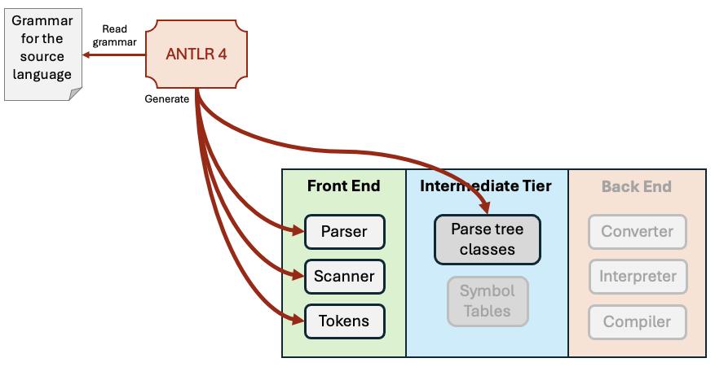
ANTLR 4 Operations
ANTLR 4 does not create symbol tables.
  We still must write code for that.

Slide 3
Multiple Passes
Pass | Operations
1 | Syntax analysis: In the front end, the parser requests tokens from the scanner, performs syntax checking, and builds the parse tree in the intermediate tier.
2 | Semantic analysis: Perform operations based on the meanings of the parse tree nodes. The analysis includes populating symbol tables with information about names contained in the tree nodes and performing type checking to verify datatype compatibilities of the operands in expressions.
3 | Output generation: The backend components independently operate by accessing only the parse tree and symbol tables in the intermediate tier.

Slide 4
Grammar file SimpleA1.g4
ANTLR 4
First: Run ANTLR 4 on your grammar file to generate a parser, parse tree node classes, and visit methods.
Source program
HelloWorld.txt
Pass 1
Build parse tree
parse tree node classes and visit methods
SimpleA1Parser
(generated by ANTLR 4)
Then: For each source program, do the three passes.
Pass 2
Walk parse tree and create symbol table
Semantics
(written by you)
symbol table
Pass 3
Walk parse tree and access symbol table
Runtime output
Execution
(written by you)

Slide 5
ANTLR 4 Grammar File
A grammar file for a source programming language to be read by ANTLR 4 is a text file that consists of
  A header
  Production rules
  Token definitions
Name the grammar file after the name of the source language and use the suffix .g4.
  Example: Pascal.g4

Slide 6
Example ANTLR 4 Grammar File
SimpleA1.g4
grammar SimpleA1;
@header
{
package intermediate.antlr4;
}
program : programHeader block '.' ;
programHeader : PROGRAM identifier ';' ;
...
identifier : IDENTIFIER ;
statement : compoundStatement
| assignmentStatement
| repeatStatement
| ...
;
compoundStatement : BEGIN statementList END ;
assignmentStatement : variable ':=' expression ;
...
PROGRAM : 'PROGRAM' ;
IDENTIFIER : LETTER ( LETTER | DIGIT )*;
INTEGER : DIGITS ;
REAL : DIGITS '.' DIGITS
| DIGITS ('e' | 'E') ('+' | '-')? DIGITS
| DIGITS '.' DIGITS ('e' | 'E') ('+' | '-')? DIGITS
;
LETTER : [a-zA-Z] ;
DIGIT : [0-9];
DIGITS : DIGIT+ ;
...
Put the generated parser code into package intermediate.antlr4.
header
production rules
token definitions

Slide 7
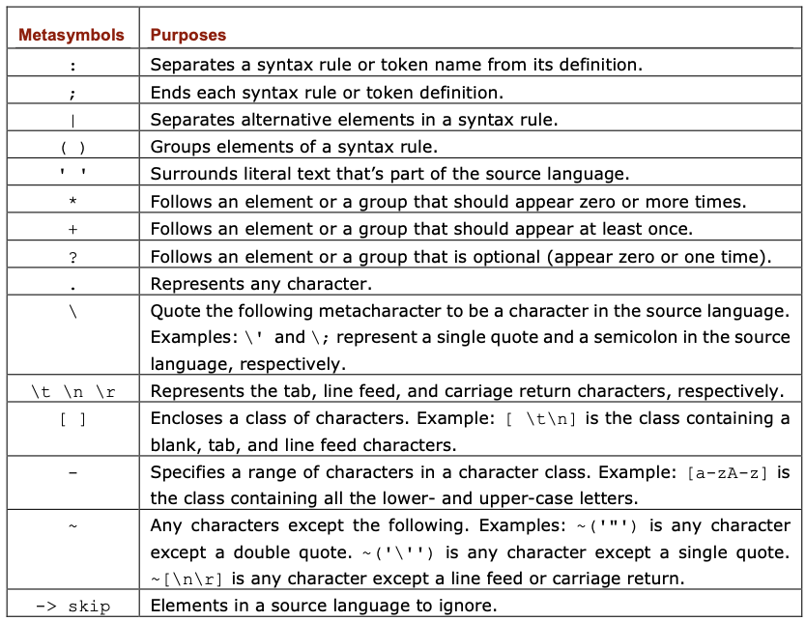
Grammar File Metasymbols
ANTLR 4 grammar files use metasymbols similar to regular expressions.

Slide 8
Pascal Token Definitions
Token names start with a capital letter.
  My convention is to use all caps for the names.
SimpleANTLR1.g4
PROGRAM : 'PROGRAM' ;
BEGIN : 'BEGIN' ;
END : 'END' ;
DIV : 'DIV' ;
MOD : 'MOD' ;
AND : 'AND' ;
OR : 'OR' ;
NOT : 'NOT' ;
REPEAT : 'REPEAT' ;
UNTIL : 'UNTIL' ;
WRITE : 'write' ;
WRITELN : 'writeln' ;
Pascal reserved word tokens

Slide 9
Pascal Token Definitions, cont’d
SimpleA1.g4
IDENTIFIER : LETTER ( LETTER | DIGIT )*;
INTEGER : DIGITS ;
REAL : DIGITS '.' DIGITS
| DIGITS ('e' | 'E') ('+' | '-')? DIGITS
| DIGITS '.' DIGITS ('e' | 'E') ('+' | '-')? DIGITS
;
LETTER : [a-zA-Z] ;
DIGIT : [0-9];
DIGITS : DIGIT+ ;
WHITESPACE : [ \n\r\t]+ -> skip ;
COMMENT : '{' COMMENT_CHAR* '}' -> skip ;

Slide 10
Pascal Token Definitions, cont’d
Fragments help to simplify token definitions.
  They can only be used by token definitions
  and other fragments.
  They are not tokens themselves.
SimpleA1.g4
QUOTE : '\'' ;
CHARACTER : QUOTE CHARACTER_CHAR QUOTE ;
STRING : QUOTE STRING_CHAR* QUOTE ;
fragment CHARACTER_CHAR : ~('\'') // any non-quote character
;
fragment STRING_CHAR : QUOTE QUOTE // two consecutive quotes
| CHARACTER_CHAR
;
fragment COMMENT_CHAR : ~'}' ; // any character except }

Slide 11
Pascal Production Rules
Start production each rule name with
a lower-case letter.
SimpleA1.g4
statement : compoundStatement
| assignmentStatement
| repeatStatement
| writeStatement
| writelnStatement
| emptyStatement
;
emptyStatement : /* empty */ ;
compoundStatement : BEGIN statementList END ;
statementList : statement ( ';' statement )* ;
assignmentStatement : variable ':=' expression ;
repeatStatement : REPEAT statementList UNTIL expression ;

Slide 12
Pascal Production Rules, cont’d
SimpleA1.g4
expression : simpleExpression (relOp simpleExpression)? ;
simpleExpression : sign? term (addOp term)* ;
term : factor (mulOp factor)* ;
factor : variable
| unsignedConstant
| characterConstant
| stringConstant
| NOT factor
| '(' expression ')'
;
relOp : '=' | '<>' | '<' | '<=' | '>' | '>=' ;
addOp : '+' | '-' | OR ;
mulOp : '*' | '/' | DIV | MOD | AND ;
variable : identifier ;
identifier : IDENTIFIER ;

Slide 13
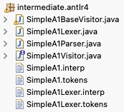
ANTLR 4 Generates a Parser
Given a grammar file, ANTLR 4 will generate
  A parser for the source language
  Context classes (node classes) for parse trees
  A visit method for each context class
Terminal window command for grammar SimpleA1:
ANTLR-demo1: antlr4 -o intermediate/antlr4 SimpleA1.g4
Generated files:

Slide 14
The ANTLR 4 Testing Tool
ANTLR-demo1: javac intermediate/antlr4/*.java
ANTLR-demo1: grun intermediate.antlr4.SimpleA1 program -tokens HelloWorld.txt
[@0,0:6='PROGRAM',<'PROGRAM'>,1:0]
[@1,8:17='HelloWorld',<IDENTIFIER>,1:8]
[@2,18:18=';',<';'>,1:18]
[@3,21:25='BEGIN',<'BEGIN'>,3:0]
[@4,31:31='i',<IDENTIFIER>,4:4]
[@5,33:34=':=',<':='>,4:6]
[@6,36:36='0',<INTEGER>,4:9]
[@7,37:37=';',<';'>,4:10]
[@8,48:53='REPEAT',<'REPEAT'>,6:4]
[@9,63:63='i',<IDENTIFIER>,7:8]
[@10,65:66=':=',<':='>,7:10]
[@11,68:68='i',<IDENTIFIER>,7:13]
[@12,70:70='+',<'+'>,7:15]
[@13,72:72='1',<INTEGER>,7:17]
[@14,73:73=';',<';'>,7:18]
...
Compile the generated Java code
[@9,63:63='i',<IDENTIFIER>,7:8]
Tenth token (@9) in character positions 63 through 63 of the source file;
text is i; it’s an IDENTIFIER; at source line 7 starting in position 8 of the line.

Slide 15
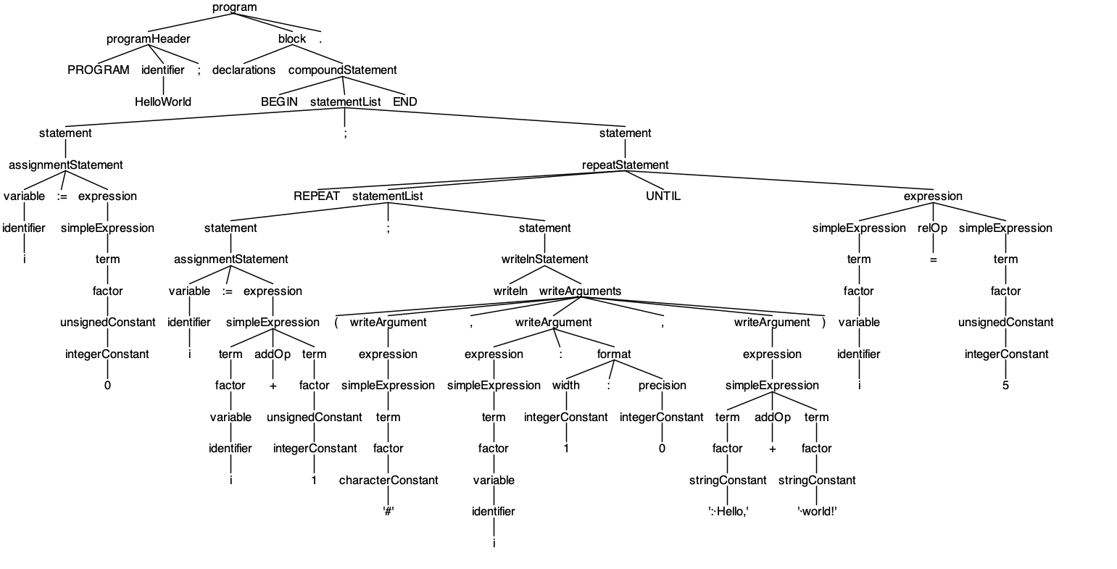
The ANTLR 4 Testing Tool, cont’d
ANTLR-demo1: grun intermediate.antlr4.SimpleA1 program -gui HelloWorld.txt
Production rule names are the context object (tree node) names.
Each and every token in the source program appears as a leaf node.

Slide 16
Generated Context Classes
Context classes (parse tree node classes)
public static class ProgramContext extends ParserRuleContext
public static class ProgramHeaderContext extends ParserRuleContext
public static class BlockContext extends ParserRuleContext
public static class DeclarationsContext extends ParserRuleContext
public static class IdentifierContext extends ParserRuleContext
public static class StatementContext extends ParserRuleContext
public static class EmptyStatementContext extends ParserRuleContext
public static class CompoundStatementContext extends ParserRuleContext
public static class StatementListContext extends ParserRuleContext
public static class AssignmentStatementContext extends ParserRuleContext
public static class RepeatStatementContext extends ParserRuleContext
public static class WriteStatementContext extends ParserRuleContext
public static class WritelnStatementContext extends ParserRuleContext
public static class ExpressionContext extends ParserRuleContext
public static class SimpleExpressionContext extends ParserRuleContext
public static class TermContext extends ParserRuleContext
public static class FactorContext extends ParserRuleContext
public static class RelOpContext extends ParserRuleContext
public static class AddOpContext extends ParserRuleContext
public static class MulOpContext extends ParserRuleContext
public static class VariableContext extends ParserRuleContext
public static class UnsignedConstantContext extends ParserRuleContext
public static class IntegerConstantContext extends ParserRuleContext
public static class RealConstantContext extends ParserRuleContext
public static class CharacterConstantContext extends ParserRuleContext
public static class StringConstantContext extends ParserRuleContext
...
intermediate.antlr4.SimpleA1Parser.java

Slide 17
A Visit Method for Each Context Class
public interface SimpleA1Visitor<T> extends ParseTreeVisitor<T> {
T visitProgram(SimpleA1Parser.ProgramContext ctx);
T visitProgramHeader(SimpleA1Parser.ProgramHeaderContext ctx);
T visitBlock(SimpleA1Parser.BlockContext ctx);
T visitDeclarations(SimpleA1Parser.DeclarationsContext ctx);
T visitIdentifier(SimpleA1Parser.IdentifierContext ctx);
T visitStatement(SimpleA1Parser.StatementContext ctx);
T visitEmptyStatement(SimpleA1Parser.EmptyStatementContext ctx);
T visitCompoundStatement(SimpleA1Parser.CompoundStatementContext ctx);
T visitStatementList(SimpleA1Parser.StatementListContext ctx);
T visitAssignmentStatement(SimpleA1Parser.AssignmentStatementContext ctx);
T visitRepeatStatement(SimpleA1Parser.RepeatStatementContext ctx);
T visitWriteStatement(SimpleA1Parser.WriteStatementContext ctx);
T visitWritelnStatement(SimpleA1Parser.WritelnStatementContext ctx);
T visitExpression(SimpleA1Parser.ExpressionContext ctx);
T visitSimpleExpression(SimpleA1Parser.SimpleExpressionContext ctx);
T visitTerm(SimpleA1Parser.TermContext ctx);
T visitFactor(SimpleA1Parser.FactorContext ctx);
T visitRelOp(SimpleA1Parser.RelOpContext ctx);
T visitAddOp(SimpleA1Parser.AddOpContext ctx);
T visitMulOp(SimpleA1Parser.MulOpContext ctx);
T visitVariable(SimpleA1Parser.VariableContext ctx);
T visitUnsignedConstant(SimpleA1Parser.UnsignedConstantContext ctx);
T visitIntegerConstant(SimpleA1Parser.IntegerConstantContext ctx);
T visitRealConstant(SimpleA1Parser.RealConstantContext ctx);
T visitCharacterConstant(SimpleA1Parser.CharacterConstantContext ctx);
T visitStringConstant(SimpleA1Parser.StringConstantContext ctx);
...
}
intermediate.antlr4.SimpleA1Visitor.java

Slide 18
Visit Methods Base Implementations
public class SimpleA1BaseVisitor<T> extends AbstractParseTreeVisitor<T>
implements SimpleA1Visitor<T> {
@Override public T visitProgram(SimpleA1Parser.ProgramContext ctx)
{ return visitChildren(ctx); }
@Override public T visitProgramHeader(SimpleA1Parser.ProgramHeaderContext ctx)
{ return visitChildren(ctx); }
@Override public T visitBlock(SimpleA1Parser.BlockContext ctx)
{ return visitChildren(ctx); }
@Override public T visitDeclarations(SimpleA1Parser.DeclarationsContext ctx)
{ return visitChildren(ctx); }
@Override public T visitIdentifier(SimpleA1Parser.IdentifierContext ctx)
{ return visitChildren(ctx); }
@Override public T visitStatement(SimpleA1Parser.StatementContext ctx)
{ return visitChildren(ctx); }
@Override public T visitEmptyStatement(SimpleA1Parser.EmptyStatementContext ctx)
{ return visitChildren(ctx); }
@Override public T visitCompoundStatement(SimpleA1Parser.CompoundStatementContext ctx)
{ return visitChildren(ctx); }
@Override public T visitStatementList(SimpleA1Parser.StatementListContext ctx)
{ return visitChildren(ctx); }
@Override public T visitAssignmentStatement(SimpleA1Parser.AssignmentStatementContext ctx)
{ return visitChildren(ctx); }
...
}
By default, each visit method for a parse tree node simply visits the node’s children.

Slide 19
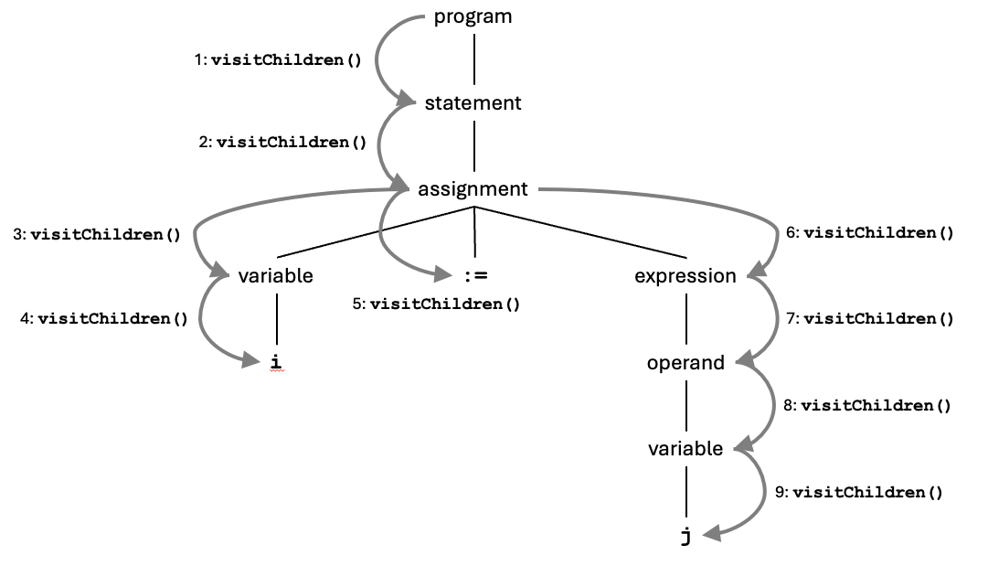
Visit Methods Base Implementations
Therefore, the base visit methods simply run down the branches of the parse tree.
  To do something useful during a visit, we need to override the base implementation of its visit method.

Slide 20
Create the Symbol Table
Pass 1: The ANTLR-generated parser parses source file SquareRootTable.txt and builds the parse tree that represents the source program using its generated tree node classes.
Pass 2: Perform the semantic operation of walking the parse tree to populate the symbol table from the tree nodes for variables.
  Override the following base visit methods:
    visitProgramHeader
    visitAssignmentStatement
    visitIdentifier
For now, each of our overrides of semantic visit methods returns null.

Slide 21
Override Visit Methods for Semantics (Pass 2)
Grammar: programHeader : PROGRAM identifier ';' ;
public class Semantics extends SimpleA1BaseVisitor<Object>
{
private Symtab symtab = new Symtab();
private SemanticErrorHandler error = new SemanticErrorHandler();
private SymtabEntry programEntry;
public Symtab getSymtab() { return symtab; }
public int getErrorCount() { return error.getCount(); }
@Override
public Object visitProgramHeader(ProgramHeaderContext ctx)
{
int lineNumber = ctx.start.getLine();
IdentifierContext idCtx = ctx.identifier();
String programName = idCtx.getText();
programEntry = symtab.enter(programName, PROGRAM);
programEntry.appendLineNumber(lineNumber);
return null;
}
...
}
identifier child node
Semantics.java

Slide 22
Override Visit Methods, cont’d
Grammar: assignmentStatement : variable ':=' expression ;
@Override
public Object visitAssignmentStatement(AssignmentStatementContext ctx)
{
int lineNumber = ctx.start.getLine();
VariableContext variableCtx = ctx.variable();
ExpressionContext expressionCtx = ctx.expression();
// Enter the variable name into the symbol table
// if it isn't already in there.
String variableName = variableCtx.getText();
SymtabEntry variableEntry =
symtab.lookup(variableName.toLowerCase());
if (variableEntry == null)
{
variableEntry = symtab.enter(variableName, VARIABLE);
}
variableEntry.appendLineNumber(lineNumber);
visit(expressionCtx);
return null;
}
variable child node
root node of expression subtree
visit the expression subtree
Semantics.java

Slide 23
Override Visit Methods, cont’d
Semantics.java
@Override
public Object visitIdentifier(IdentifierContext ctx)
{
int lineNumber = ctx.start.getLine();
String idName = ctx.getText();
SymtabEntry idEntry = symtab.lookup(idName);
if (idEntry != null)
{
idEntry.appendLineNumber(lineNumber);
}
else
{
error.flag(UNDECLARED_IDENTIFIER, ctx);
}
return null;
}

Slide 24
Method main() in Class SimpleA1
SyntaxErrorHandler syntaxErrorHandler = new SyntaxErrorHandler();
System.out.printf("\nPASS 1 Syntax:\n");
// Create a lexer which scans the character stream
// to create a token stream.
SimpleA1Lexer lexer = new SimpleA1Lexer(chars);
lexer.removeErrorListeners();
lexer.addErrorListener(syntaxErrorHandler);
CommonTokenStream tokens = new CommonTokenStream(lexer);
// Create a parser which parses the token stream
// to create a parse tree.
SimpleA1Parser parser = new SimpleA1Parser(tokens);
parser.removeErrorListeners();
parser.addErrorListener(syntaxErrorHandler);
// Build the parse tree.
ParseTree tree = parser.program();
Replace the syntax error handler
Replace the syntax error handler

Slide 25
Method main() in Class SimpleA1, cont’d
System.out.printf("\nPASS 2 Semantics:\n");
Semantics pass2 = new Semantics();
pass2.visit(tree);
errorCount = pass2.getErrorCount();
if (errorCount > 0)
{
System.out.printf("\nThere were %d semantic errors.\n",
errorCount);
}
else
{
System.out.println("There were no semantic errors.");
}
Symtab symtab = pass2.getSymtab();
CrossReferencer xref = new CrossReferencer();
xref.print(symtab);
Walk the tree to create the symbol table.

Slide 26
Method main() in Class SimpleA1, cont’d
PASS 1 Syntax:
There were no syntax errors.
PASS 2 Semantics:
There were no semantic errors.
===== CROSS-REFERENCE TABLE =====
Identifier Line numbers
---------- ------------
diff 027 029
i 008 010 011 011 012 019 021 032 032 033
number 021 022 026
prev 023 027 028
root 022 023 026 026 026 027 028 031
row 015 017 021 036 036 037
squareroottable 001

Slide 27
Semantic Error Handler
SemanticErrorHandler.java
package intermediate.semantics;
import org.antlr.v4.runtime.ParserRuleContext;
public class SemanticErrorHandler
{
public enum Code
{
UNDECLARED_IDENTIFIER ("Undeclared identifier"),
;
private String message;
Code(String message) { this.message = message; }
}
private int count = 0;
public int getCount() { return count; }
public void flag(Code code, int lineNumber, String text) ...
...
}
Many more to come!

Slide 28
Semantic Error Handler, cont’d
SemanticErrorHandler.java
public void flag(Code code, int lineNumber, String text)
{
if (count == 0)
{
System.out.println("\n===== SEMANTIC ERRORS =====\n");
System.out.printf("%-4s %-40s %s\n",
"Line", "Message", "Found near");
System.out.printf("%-4s %-40s %s\n",
"----", "-------", "----------");
}
count++;
System.out.printf("%03d %-40s \"%s\"\n",
lineNumber, code.message, text);
}
public void flag(Code code, ParserRuleContext ctx)
{
flag(code, ctx.getStart().getLine(), ctx.getText());
}
source line number of the context object
text of the context object

Slide 29
Syntax Error Handler
ANTLR 4 has a built-in syntax error handler.
  It prints an error message whenever a generated parser detects a syntax error in a source program.
We can replace the built-in syntax error handler with our own so that syntax error messages are formatted similarly to semantic error messages printed by our class SemanticErrorHandler.
  Our class SyntaxErrorHandler must follow ANTLR’s API to allow the generated parser to call it.

Slide 30
Syntax Error Handler, cont’d
package frontend;
import org.antlr.v4.runtime.BaseErrorListener;
import org.antlr.v4.runtime.RecognitionException;
import org.antlr.v4.runtime.Recognizer;
public class SyntaxErrorHandler extends BaseErrorListener
{
private static int count = 0;
public int getCount() { return count; };
@Override
public void syntaxError(Recognizer<?, ?> recognizer,
Object offendingSymbol,
int line, int charPositionInLine,
String msg,
RecognitionException ex)
{
if (count == 0)
{
System.out.println("\n===== SYNTAX ERRORS =====\n");
System.out.printf("%-4s %-35s\n", "Line", "Message");
System.out.printf("%-4s %-35s\n", "----", "-------");
}
count++;
System.out.printf("%03d %-35s\n", line, msg);
}
}
SyntaxErrorHandler.java

Slide 31
Order is Important in the Grammar File!
What’s wrong with the second ordering?
Original ordering:
IDENTIFIER : LETTER ( LETTER | DIGIT )*;
INTEGER : DIGITS ;
REAL : DIGITS '.' DIGITS
| DIGITS ('e' | 'E') ('+' | '-')? DIGITS
| DIGITS '.' DIGITS ('e' | 'E') ('+' | '-')? DIGITS
;
LETTER : [a-zA-Z] ;
DIGIT : [0-9];
DIGITS : DIGIT+ ;
SimpleA1.g4
Second ordering:
LETTER : [a-zA-Z] ;
DIGIT : [0-9];
DIGITS : DIGIT+ ;
IDENTIFIER : LETTER ( LETTER | DIGIT )*;
INTEGER : DIGITS ;
REAL : DIGITS '.' DIGITS
| DIGITS ('e' | 'E') ('+' | '-')? DIGITS
| DIGITS '.' DIGITS ('e' | 'E') ('+' | '-')? DIGITS
;

Slide 32
Order is Important, cont’d
identifier : IDENTIFIER ;
factor : variable
| unsignedConstant
| characterConstant
| stringConstant
| NOT factor
| '(' expression ')'
;
variable : identifier ;
unsignedConstant : integerConstant | realConstant ;
integerConstant : INTEGER ;
realConstant : REAL;
001 PROGRAM HelloWorld;
002
003 BEGIN
004 i := 0;
005
006 REPEAT
007 i := i + 1;
008 writeln('#', i:1:0, ': Hello,' + ' world!')
009 UNTIL i = 5
010 END.
PASS 1 Syntax:
===== SYNTAX ERRORS =====
Line Message
---- -------
004 no viable alternative at input 'i'
007 no viable alternative at input 'i'
008 mismatched input 'i' expecting {'(', '-', '+', 'NOT', IDENTIFIER, INTEGER, REAL, CHARACTER, STRING}
008 mismatched input '1' expecting {'-', '+', INTEGER}
008 mismatched input '0' expecting INTEGER
009 mismatched input 'i' expecting {'(', '-', '+', 'NOT', IDENTIFIER, INTEGER, REAL, CHARACTER, STRING}
009 mismatched input '5' expecting {'(', '-', '+', 'NOT', IDENTIFIER, INTEGER, REAL, CHARACTER, STRING}
There were 7 syntax errors.
...
LETTER : [a-zA-Z] ;
DIGIT : [0-9];
DIGITS : DIGIT+ ;
IDENTIFIER : LETTER ( LETTER | DIGIT )*;
INTEGER : DIGITS ;
REAL : DIGITS '.' DIGITS
| DIGITS ('e' | 'E') ('+' | '-')? DIGITS
| DIGITS '.' DIGITS ('e' | 'E') ('+' | '-')? DIGITS
;

