Slide 1


CS 153: Concepts of Compiler Design
September 3 Class Meeting
Department of Computer Science
San Jose State University
Fall 2026
Instructor: Ron Mak
www.cs.sjsu.edu/~mak

Slide 2
Assignment #2
Execute WHILE, IF, FOR, and CASE statements.

Slide 3
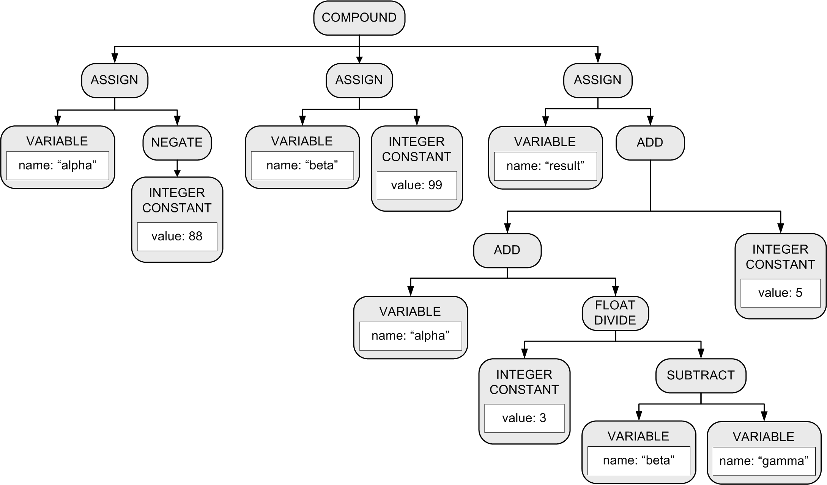
The Parse Tree Implements Precedence
result := alpha + 3/(beta – gamma) + 5

Slide 4
Quiz #1
Use the lockdown browser.
10 minutes.

Slide 5
Top-Down Recursive Descent Parsing
The term is very descriptive of
how the parser works.
Start by parsing the topmost
source language construct.
  Example: The program
Separate parse methods for the various language constructs.
  Examples: parseProgram(), parseAssignmentStatement(), parseExpression(), etc.

Slide 6
Top-Down Recursive Descent Parsing, cont’d
Drill down (descend) by parsing
the sub-constructs.
  Parse methods call lower-level parse methods.
  statement → assignment statement → expression
  → variable → etc.
Use recursion on the way down.
  statement →WHILE statement → statement → etc.

Slide 7
Top-Down Recursive Descent Parsing, cont’d
This is the technique for hand-coded parsers.
  Very easy to understand and write.
  The source language’s grammar is encoded in the
  structure of the parser methods.
  Close correspondence between the parser code
  and the syntax diagrams.
Disadvantages
  Can be tedious coding.
  Ad hoc error handling.
  Big and slow!

Slide 8
Top-Down Recursive Descent Parsing, cont’d
Bottom-up parsers can be smaller and faster.
  Error handling can still be tricky.
  To be covered later this semester.

Slide 9
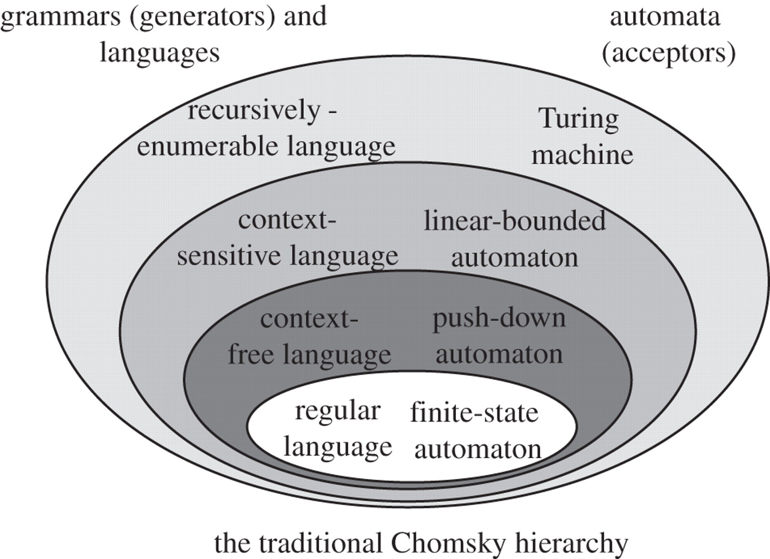
Chomsky Hierarchy of Languages
Define statements and expressions
Parsers
Define tokens
Scanners
http://rstb.royalsocietypublishing.org/content/367/1598/1933

Slide 10
Can We Build a Better Scanner?
Our scanner in the front end is relatively
easy to understand and follow.
  Separate token methods for each token type:
  word(), number(), specialSymbol(), etc.
However, it’s big and slow.
  Creates lots of token objects.
  Makes lots of method calls.
Write a more compact and faster scanner.
  However, it will be harder for us
  to debug and trace its execution.

Slide 11
Deterministic Finite Automata (DFA)
Pascal identifier
  Regular expression: <letter> ( <letter> | <digit> )*
  Implement the regular expression with a
  finite automaton (AKA finite state machine):
letter
1
letter
2
[other]
3
digit

Slide 12
Deterministic Finite Automata (DFA)
This automaton is a deterministic finite automaton (DFA).
  At each state, the next input character
  uniquely determines which transition
  to take to the next state.
start state
letter
accepting state
1
letter
2
[other]
3
transition
digit

Slide 13
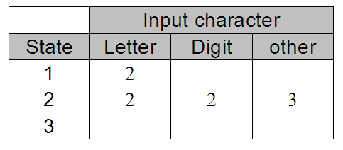
State-Transition Matrix
letter
1
letter
2
[other]
3
digit
Represent the behavior of a DFA by a
state-transition matrix:

Slide 14
DFA for a Pascal Constant
E
digit
digit
digit
digit
.
+
0
+
3
digit
4
6
digit
7
E
9
10
digit
11
[other]
12
-
-
digit
[other]
[other]
5
8
Example Pascal numbers:
0 123 -456 +123.456 0.123 -123.0 123.45E12 123e-12 0.00123E+14
In real numbers, there must be at least one digit before and after a decimal point.
Note that this diagram allows only an upper-case E for an exponent.
What changes are required to also allow a lower-case e?

Slide 15
DFA for a Pascal Identifier or Number
private static final int matrix[][] = {
/* letter digit + - . E other */
/* 0 */ { 1, 4, 3, 3, ERR, 1, ERR },
/* 1 */ { 1, 1, -2, -2, -2, 1, -2 },
/* 2 */ { ERR, ERR, ERR, ERR, ERR, ERR, ERR },
/* 3 */ { ERR, 4, ERR, ERR, ERR, ERR, ERR },
/* 4 */ { -5, 4, -5, -5, 6, 9, -5 },
/* 5 */ { ERR, ERR, ERR, ERR, ERR, ERR, ERR },
/* 6 */ { ERR, 7, ERR, ERR, ERR, ERR, ERR },
/* 7 */ { -8, 7, -8, -8, -8, 9, -8 },
/* 8 */ { ERR, ERR, ERR, ERR, ERR, ERR, ERR },
/* 9 */ { ERR, 11, 10, 10, ERR, ERR, ERR },
/* 10 */ { ERR, 11, ERR, ERR, ERR, ERR, ERR },
/* 11 */ { -12, 11, -12, -12, -12, -12, -12 },
/* 12 */ { ERR, ERR, ERR, ERR, ERR, ERR, ERR },
};
Negative numbers
in the matrix are the
accepting states.
letter
0
letter
1
[other]
2
digit
+
-
digit
E
digit
digit
digit
digit
.
+
3
4
6
digit
7
E
9
10
digit
11
[other]
12
digit
-
[other]
[other]
Notice how the
letter E is handled!
5
8

Slide 16
A Simple DFA Scanner
public class SimpleDFAScanner
{
// Input characters.
private static final int LETTER = 0;
private static final int DIGIT = 1;
private static final int PLUS = 2;
private static final int MINUS = 3;
private static final int DOT = 4;
private static final int E = 5;
private static final int OTHER = 6;
private static final int ERR = -99999; // error state
private static final int matrix[][] = { ... };
private char ch; // current input character
private int state; // current state
...
}
SimpleDFAScanner.java

Slide 17
A Simple DFA Scanner, cont’d
SimpleDFAScanner.java
int typeOf(char ch)
{
return (ch == 'E') ? E
: Character.isLetter(ch) ? LETTER
: Character.isDigit(ch) ? DIGIT
: (ch == '+') ? PLUS
: (ch == '-') ? MINUS
: (ch == '.') ? DOT
: OTHER;
}

Slide 18
A Simple DFA Scanner, cont’d
private String nextToken()
throws IOException
{
while (Character.isWhitespace(ch)) nextChar();
if (ch == 0) return null; // EOF?
state = 0; // start state
StringBuilder buffer = new StringBuilder();
while (state >= 0) { // not accepting state
state = matrix[state][typeOf(ch)]; // transit
if ((state >= 0) || (state == ERR)) {
buffer.append(ch); // build token string
nextChar();
}
}
return buffer.toString();
}
SimpleDFAScanner.java
This is the
heart of the
scanner.
Table-driven scanners
can be very fast!

Slide 19
A Simple DFA Scanner, cont’d
private void scan()
throws IOException
{
nextChar();
while (ch != 0) { // EOF?
String token = nextToken();
if (token != null) {
System.out.print("=====> \"" + token + "\" ");
String tokenType =
(state == -2) ? "IDENTIFIER"
: (state == -5) ? "INTEGER"
: (state == -8) ? "REAL (fraction only)"
: (state == -12) ? "REAL"
: "*** ERROR ***";
System.out.println(tokenType);
}
}
}
SimpleDFAScanner.java
How do we know which token we just got?
Demo

Slide 20
A Simple DFA Scanner, cont’d
This table is
very sparse.
  Lots of ERR entries.
What would happen
if we added the
reserved words and
all the special symbols?
  Is there a better way to implement a sparse matrix?
private static final int matrix[][] = {
/* letter digit + - . E other */
/* 0 */ { 1, 4, 3, 3, ERR, 1, ERR },
/* 1 */ { 1, 1, -2, -2, -2, 1, -2 },
/* 2 */ { ERR, ERR, ERR, ERR, ERR, ERR, ERR },
/* 3 */ { ERR, 4, ERR, ERR, ERR, ERR, ERR },
/* 4 */ { -5, 4, -5, -5, 6, 9, -5 },
/* 5 */ { ERR, ERR, ERR, ERR, ERR, ERR, ERR },
/* 6 */ { ERR, 7, ERR, ERR, ERR, ERR, ERR },
/* 7 */ { -8, 7, -8, -8, -8, 9, -8 },
/* 8 */ { ERR, ERR, ERR, ERR, ERR, ERR, ERR },
/* 9 */ { ERR, 11, 10, 10, ERR, ERR, ERR },
/* 10 */ { ERR, 11, ERR, ERR, ERR, ERR, ERR },
/* 11 */ { -12, 11, -12, -12, -12, -12, -12 },
/* 12 */ { ERR, ERR, ERR, ERR, ERR, ERR, ERR },
};

Slide 21
Scanner and Parser Rules of Thumb
Scanner
  At any point in the source file,
  extract the longest possible token.
  Example:
    <= is a single less-than-or-equals token
    Not a less-than token followed by an equals token
Parser
  At any point in the source file,
  parse the longest possible statement.
  Example:
  IF i = 3 THEN IF j = 2 THEN t := 500 ELSE f := -500
“maximum munch”

Slide 22
Syntax and Semantics
Syntax refers to the rules of the grammar
of a source language.
The rules prescribe the proper form
of its programs.
The parser “knows” the grammar.
  Rules can be described by syntax diagrams.
Syntax checking
  Does this sequence of tokens follow
  the syntax rules?
  Performed by the frontend parser.

Slide 23
Syntax and Semantics, cont’d
Semantics refers to the meaning of syntactically correct token sequences of the source language.
Example: Certain sequences of tokens constitute an IF statement according to the language’s grammar.

Slide 24
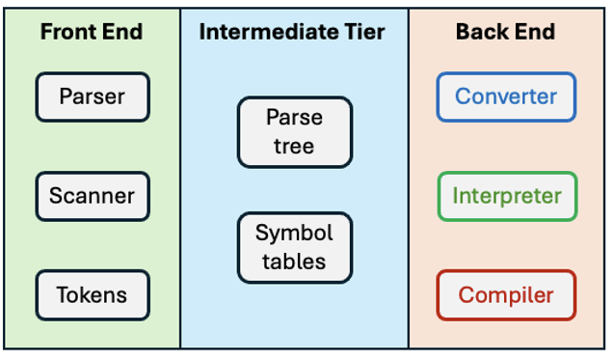
Syntax and Semantics, cont’d
Semantic actions in the front end and in the intermediate tier based on the meanings of statements and expressions:
  Building proper parse trees.
  Building symbol tables.
  Type checking
  (which we’ll do later).
The parse trees implement operator precedence in their structures.

Slide 25
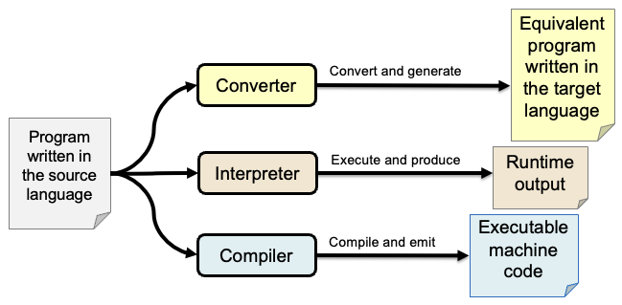
Syntax and Semantics, cont’d
Semantic actions in the back end:
  Interpreter: The executor runs the program and performs actions according to the meanings
  of the statements and expressions.
  Converter and compiler: The code generator
  emits object code that reflects the meanings
  of the statements and expressions.

Slide 26
Grammars and Languages
A grammar defines a language.
Grammar: The set of all the syntax rules
  Expressed by syntax diagrams
  Expressed by traditional Back-Naur Form (BNF)
Language: The set of all the legal strings of tokens according to the grammar.
Legal string of tokens: A syntactically correct statement according to the grammar.

Slide 27
Grammars and Languages
A statement is in the language
(it’s syntactically correct) if it can be
derived by the grammar.
Each grammar rule can produce
a token string in the language.
  AKA production rule
The sequence of productions required to arrive at a syntactically correct token string is the derivation of the string.
Syntax only.
No semantics!

Slide 28
Grammars and Languages, cont’d
Example: A very simplified expression grammar expressed in BNF:
What strings (expressions) can we derive
from this grammar?
<expr> ::= <digit>
| <expr> <op> <expr>
| ( <expr> )
<digit> ::= 0|1|2|3|4|5|6|7|8|9
<op> ::= + | *

Slide 29
Derivations and Productions
Is (1 + 2)*3 valid in our expression language?
DERIVATION
GRAMMAR RULE
<expr> ➔ <expr> <op> <expr>
<expr> ::= <expr> <op> <expr>
➔ <expr> <op> <digit>
<expr> ::= <digit>
➔ <expr> <op> 3
<digit> ::= 3
➔ <expr>*3
<op> ::= *
➔ ( <expr> )*3
<expr> ::= ( <expr> )
➔ ( <expr> <op> <expr> )*3
<expr> ::= <expr> <op> <expr>
➔ ( <expr> <op> <digit> )*3
<expr> ::= <digit>
➔ ( <exp> <op> 2 )*3
<digit> ::= 2
➔ ( <expr> + 2 )*3
<op> ::= +
➔ ( <digit> + 2 )*3
<expr> ::= <digit>
➔ ( 1 + 2 )*3
<digit> ::= 1
Yes! The expression is valid.
<expr> ::= <digit>
| <expr> <op> <expr>
| ( <expr> )
<digit> ::= 0|1|2|3|4|5|6|7|8|9
<op> ::= + | *

Slide 30
Compiler Development Tools
ANTLR 4 is a very popular modern tool for developing programming language translators such as compilers.
  Professional compiler writers generally don’t start from scratch.
  Compiler development tools are also known as “compiler compilers”.
Traditional tools include yacc and lex.
  Included with UNIX and Linux distributions.
Read Chapter 4 of my new book to learn how to install and run ANTLR 4.

Slide 31
What Does ANTLR 4 Do for Us?
Given a grammar file containing production rules and token definitions for a programming language, ANTLR 4 will:
  Generate a lexer (scanner) that recognizes tokens.
  Generate a parser from the production rules.
  Generate visit methods for the parse tree nodes.
Given a source program, the ANTLR-generated parser will:
  Perform syntax checking of the source program’s statements and expressions.
  Built a parse tree representing the source program.

Slide 32
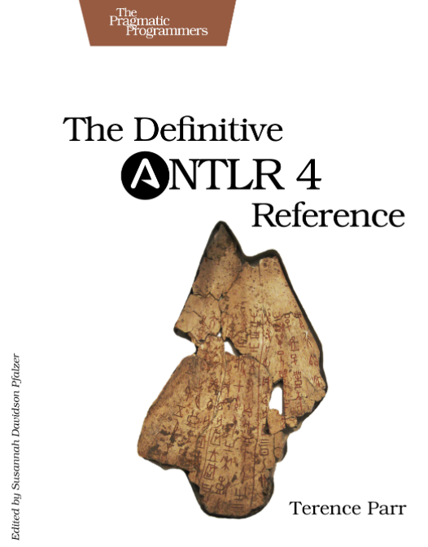
ANTLR 4 Reference Manual
Buy from Amazon (paperback):
https://www.amazon.com/Definitive-ANTLR-4-Reference/dp/1934356999/ref=sr_1_1?s=books&ie=UTF8&qid=1508372536&sr=1-1&keywords=antlr4
Buy from The Pragmatic Bookshelf (eBook):
https://pragprog.com/titles/tpantlr2/the-definitive-antlr-4-reference/

Slide 33
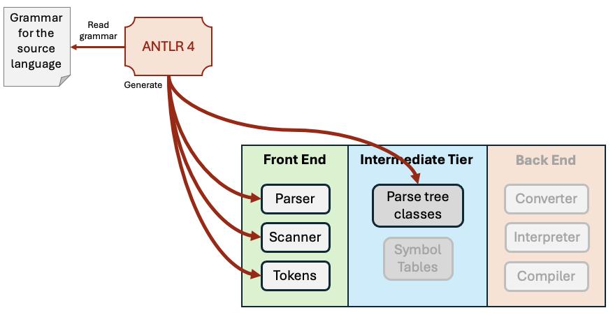
ANTLR 4 Operations
ANTLR 4 does not create symbol tables.
  We still must write code for that.

Slide 34
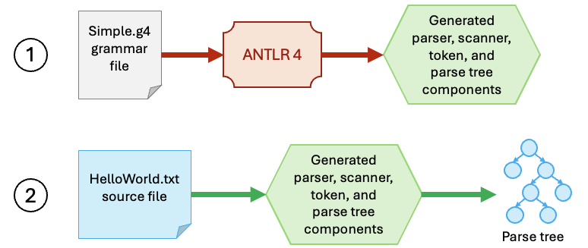
Translation Workflow
Step 1: Use ANTLR 4 to generate a parser, lexer, and parse tree visit methods.
Step 2: Use the generated parser on a source program to generate a parse tree for the statements and expressions.

Slide 35
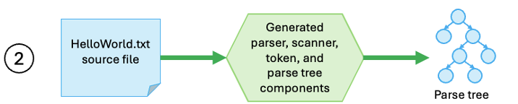
Multiple Passes
Step 2 occurs in three passes.
  It’s just a coincidence that the architecture has three tiers and there are three operational passes.
  Different translators can have different numbers of architectural tiers and operational passes.
Pass | Operations
1 | Syntax analysis: In the front end, the parser requests tokens from the scanner, performs syntax checking, and builds the parse tree in the intermediate tier.
2 | Semantic analysis: Perform operations based on the meanings of the parse tree nodes. The analysis includes populating symbol tables with information about names contained in the tree nodes and performing type checking to verify datatype compatibilities of the operands in expressions.
3 | Output generation: The backend components independently operate by accessing only the parse tree and symbol tables in the intermediate tier.

