Slide 1


CS 153: Concepts of Compiler Design
September 1 Class Meeting
Department of Computer Science
San Jose State University
Fall 2026
Instructor: Ron Mak
www.cs.sjsu.edu/~mak

Slide 2
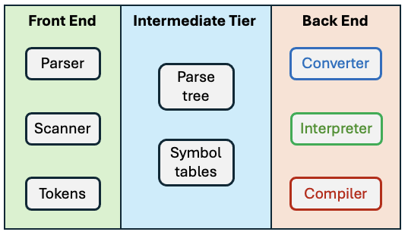
Recall: A Software Architecture
A three-tier architecture:

Slide 3

Recall: Symbol Table
Contain important
information about names
in the parse tree.
Information about a name
includes its datatype and whether it’s the name of a variable or a function.
Makes it much more efficient for the backend components to access information about the names if the information is all in one place and isn’t scattered throughout the parse tree.

Slide 4
The Symbol Table: Basic Concepts
Purpose
  To store information about identifier tokens during early phases of the translation process (i.e., parsing and scanning)
What information to store?
  Anything that’s useful!
  For an identifier:
    name
    data type
    kind (variable name, type name, function name, etc.)

Slide 5
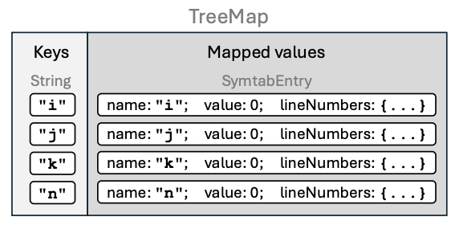
The Symbol Table: Conceptual Design
Goal: The symbol table
should be source language
independent.
Each entry in the symbol table has
  a name
  attributes

Slide 6
The Symbol Table: Basic Operations
Enter new information.
Look up existing information.
Update existing information.
The parser performs these operations whenever it gets an identifier token
from the scanner.

Slide 7
What Needs a Symbol Table?
A Pascal program
  Identifier names of global constants, types, variables, procedures, and functions.
A Pascal procedure or function
  Identifier names of local constants, types, variables, procedures, and functions.
  Identifier names for formal parameters.
A Pascal record type
  Identifiers for field names.

Slide 8
Symbol Table Hack #1
For now, we will store the runtime value of a variable in its symbol table entry.
  So that we can continue to make progress.
Later, we will discover that this hack will fail miserably when we execute calls to recursive functions.
  Why?

Slide 9
Symbol Table Hack #2
We will assume that a variable has been “declared” after the first time it appears as the target of an assignment statement.
  We haven’t yet started to parse variable declarations such as
  Enter the name into the symbol table only if it isn’t already in there.
Therefore, a variable in an expression is undeclared if it isn’t already in the symbol table.
k := k + 1;
VAR
i, j, k : integer
k := k + 1;

Slide 10
Symbol Table Hack #3
For now, there is only one symbol table.
Later, when we have records, procedures, and functions, each one will have its own symbol table.
  We will have to manage multiple symbol tables when we parse a more complete Pascal program.

Slide 11
Class SymtabEntry
SymtabEntry.java
public class SymtabEntry
{
private String name;
private Double value;
private ArrayList<Integer> lineNumbers;
public SymtabEntry(String name)
{
this.name = name;
this.value = 0.0;
lineNumbers = new ArrayList<>();
}
...
public ArrayList<Integer> getLineNumbers()
{
return lineNumbers;
}
public void appendLineNumber(int lineNumber)
{
lineNumbers.add(lineNumber);
}
}
Symbol Table Hack #1
Runtime values stored in the symbol table.
Line numbers are where the identifier appears in the source program, to be displayed in the cross-reference listing.

Slide 12
Symbol Table
Symtab.java
public class Symtab extends TreeMap<String, SymtabEntry>
{
private static final long serialVersionUID = 0L;
/**
* Make an entry.
* @param name the entry's name.
*/
public SymtabEntry enter(String name)
{
SymtabEntry entry = new SymtabEntry(name);
put(name, entry);
return entry;
}
/**
* Look up an entry.
* @param name the entry's name.
* @return the entry or null if it's not in the symbol table.
*/
public SymtabEntry lookup(String name) { return get(name); }
}
Make Symtab a subclass of class TreeMap to store the entries in alphabetical order.

Slide 13
Method Parser.parseProgram()
Parser.java
public Node parseProgram()
{
Node programNode = new Node(Node.NodeType.PROGRAM);
...
if (currentToken.type == IDENTIFIER)
{
String programName = currentToken.text;
SymtabEntry programEntry = symtab.enter(programName);
programNode.text = programName;
int lineNumber = currentToken.lineNumber;
programEntry.appendLineNumber(lineNumber);
// Consume program name.
currentToken = scanner.nextToken();
}
else syntaxError("Expecting program name");
...
PROGRAM HelloWorld;
BEGIN
i := 0;
REPEAT
i := i + 1;
write('#'); write(i);
writeln(': Hello, world!');
UNTIL i = 5;
END.

Slide 14
Method Parser.parseAssignmentStatement()
Parser.java
private Node parseAssignmentStatement()
{
...
Node lhsNode = new Node(VARIABLE);
String variableName = currentToken.text;
SymtabEntry variableEntry =
symtab.lookup(variableName.toLowerCase());
if (variableEntry == null)
{
variableEntry = symtab.enter(variableName.toLowerCase());
}
int lineNumber = currentToken.lineNumber;
variableEntry.appendLineNumber(lineNumber);
...
Symbol Table Hack #2
“Declare” a variable the first time it’s an assignment target.
PROGRAM HelloWorld;
BEGIN
i := 0;
REPEAT
i := i + 1;
write('#'); write(i);
writeln(': Hello, world!');
UNTIL i = 5;
END.

Slide 15
Method Parser.parseVariable()
Parser.java
private Node parseVariable()
{
// The current token should now be an identifier.
// Has the variable been "declared"?
String variableName = currentToken.text;
SymtabEntry variableEntry = symtab.lookup(variableName.toLowerCase());
if (variableEntry == null) semanticError("Undeclared identifier");
int lineNumber = currentToken.lineNumber;
variableEntry.appendLineNumber(lineNumber);
...
}
Symbol Table Hack #2
A variable is “undeclared” if it’s not already in the symbol table.
PROGRAM HelloWorld;
BEGIN
i := 0;
REPEAT
i := i + 1;
write('#'); write(i);
writeln(': Hello, world!');
UNTIL i = 5;
END.

Slide 16
Source Program Listing
Class Listing in package frontend prints the source program with line numbers.
001 PROGRAM HelloWorld;
002
003 BEGIN
004 i := 0;
005
006 REPEAT
007 i := i + 1;
008 write('#'); write(i);
009 writeln(': Hello, world!');
010 UNTIL i = 5;
011 END.

Slide 17
Class Simple
Simple.java
public static void main(String args[])
{
...
try
{
Listing listing = new Listing(sourceFileName);
listing.print();
}
catch(IOException ex)
{
System.out.printf("ERROR: %s\n", ex.getMessage());
System.exit(-1);
}
...
}

Slide 18
Cross-Reference Table
Class CrossReferencer in package intermediate.utility generates a cross-reference table after the parser is done.
001 PROGRAM HelloWorld;
002
003 BEGIN
004 i := 0;
005
006 REPEAT
007 i := i + 1;
008 write('#'); write(i);
009 writeln(': Hello, world!');
010 UNTIL i = 5;
011 END.
===== CROSS-REFERENCE TABLE =====
Identifier Line numbers
---------- ------------
HelloWorld 001
i 004 007 007 008 010

Slide 19
Class Simple, cont’d
private static void testParser(Scanner scanner, Symtab symtab)
{
// Create the parser and parse the program.
Parser parser = new Parser(scanner, symtab);
Node programNode = parser.parseProgram();
printSymbolTable(symtab);
...
}
private static void executeProgram(Scanner scanner, Symtab symtab)
{
// Create the parser and parse the program.
Parser parser = new Parser(scanner, symtab);
Node programNode = parser.parseProgram();
printSymbolTable(symtab);
...
}
private static void printSymbolTable(Symtab symtab)
{
CrossReferencer xref = new CrossReferencer();
xref.print(symtab);
System.out.println();
}
Simple.java

Slide 20
Simple Interpreter
Now that we have a basic parse tree and a rudimentary symbol table, we can start the backend tier.
Recall the the backend components only work with the intermediate tier components.

Slide 21
Back End Components
Equivalent program written in the target language
Converter
Convert and generate
Program written in the source language
Interpreter
Execute and produce
Runtime output
Executable machine code
Compiler
Compile and emit

Slide 22
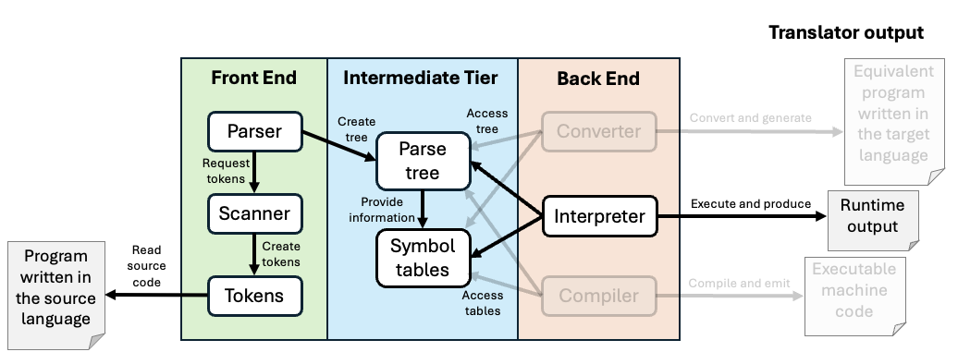
Translator Control Flow

Slide 23
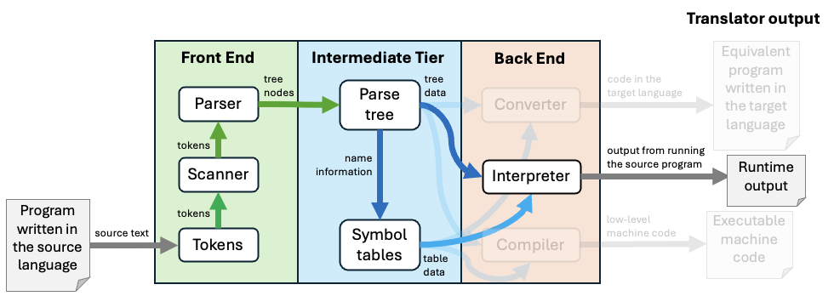
Translator Data Flow

Slide 24
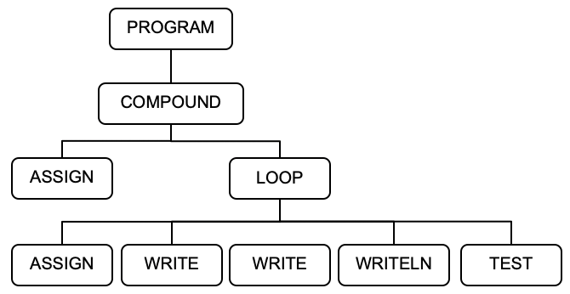
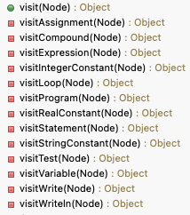
Visiting Parse Tree Nodes During Run Time
Class Executor in the backend package contains numerous visit methods for the
types of tree nodes:
We write visit*() methods because we'll soon see that the ANTLR compiler development tool generates visit*() methods for us.
This is based on the visitor design pattern.

Slide 25
What is “Run Time”?
Run time is when the interpreter is executing the source program (e.g., the Pascal program).
  This can be confusing because
  the interpreter itself is running.
  Adjective: runtime or run-time
During run time, the execution of the source program is under the control of the interpreter.
  The executor in the interpreter’s back end relies solely on the parse tree and the symbol table in the intermediate tier (which were built by the parser in the front end).

Slide 26
Use of the Parse Tree at Run Time
The parse tree represents the statements
of the source program.
During run time, the executor “visits” (accesses)
the nodes of the tree.
  The executor performs certain operations
  depending on the type of node that it’s visiting.
  During a node visit, the executor can also visit
  the children of the node.

Slide 27
Use of the Symbol Table at Run Time
Each VARIABLE parse tree node contains a link to the variable’s symbol table entry.
Therefore, during the visit of an ASSIGN node, the value of the right-hand-side expression can be stored into the left-hand-side variable’s symbol table entry.
  The value of the RHS expression is obtained by visiting the nodes of the expression subtree.
  If there is a VARIABLE node in the expression subtree, the value of the variable is obtained
  from its symbol table entry.
Symbol Table Hack #1

Slide 28
Example Runs
These source files are named *.txt because they’re not complete Pascal programs.
  They are missing variable declarations, so all variables are type real.
HelloWorld.txt
Temperature.txt
SquareRootTable.txt
java -cp bin Simple -execute HelloWorld.txt
java -cp bin Simple -execute Temperature.txt
java -cp bin Simple -execute SquareRootTable.txt

Slide 29
Visiting Parse Tree Nodes, cont’d
To test the backend executor, main() starts things off with a visit of the PROGRAM node:
Simple.java
private static void executeProgram(Parser parser, Symtab symtab)
{
Node programNode = parser.parseProgram(); // build the parse tree
int errorCount = parser.errorCount();
printSymbolTable(symtab);
// If no errors, execute the program using the parse tree.
if (errorCount == 0)
{
Executor executor = new Executor(symtab);
executor.visit(programNode);
}
else
{
System.out.println();
System.out.println("There were " + errorCount + " errors.");
}
}
package backend

Slide 30
Visiting Parse Tree Nodes, cont’d
Executor.java
public Object visit(Node node)
{
switch (node.type)
{
case PROGRAM : return visitProgram(node);
case COMPOUND :
case ASSIGN :
case LOOP :
case WRITE :
case WRITELN : return visitStatement(node);
case TEST: return visitTest(node);
default : return visitExpression(node);
}
}
package backend

Slide 31
Visiting Parse Tree Nodes, cont’d
Each visit method returns a value.
Most visit methods return null.
But each visit method for expression nodes
returns a value that the visit calculated.
The return type is Object to enable returning a value of any scalar type or a String value.

Slide 32
Visiting Parse Tree Nodes, cont’d
private Object visitProgram(Node programNode)
{
Node compoundNode = programNode.children.get(0);
return visit(compoundNode);
}
Executor.java
private Object visitCompound(Node compoundNode)
{
for (Node statementNode : compoundNode.children) visit(statementNode);
return null;
}
Executor.java

Slide 33
Visiting Parse Tree Nodes, cont’d
private Object visitStatement(Node statementNode)
{
lineNumber = statementNode.lineNumber;
switch (statementNode.type)
{
case COMPOUND : return visitCompound(statementNode);
case ASSIGN : return visitAssignment(statementNode);
case LOOP : return visitLoop(statementNode);
case WRITE : return visitWrite(statementNode);
case WRITELN : return visitWriteln(statementNode);
default : return null;
}
}
Executor.java

Slide 34
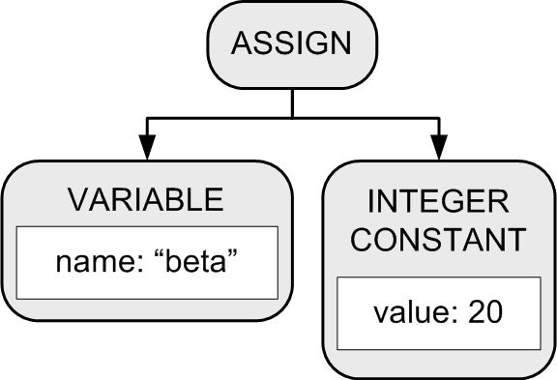
Visiting Parse Tree Nodes, cont’d
Executor.java
private Object visitAssignment(Node assignNode)
{
Node lhs = assignNode.children.get(0);
Node rhs = assignNode.children.get(1);
// Evaluate the right-hand-side expression;
Double value = (Double) visit(rhs);
// Store the value into the variable's symbol table entry.
SymtabEntry variableEntry = lhsNode.entry;
variableEntry.setValue(value);
return null;
}
Symbol Table Hack #1
Runtime values stored in the symbol table.

Slide 35
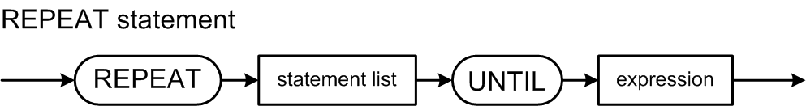
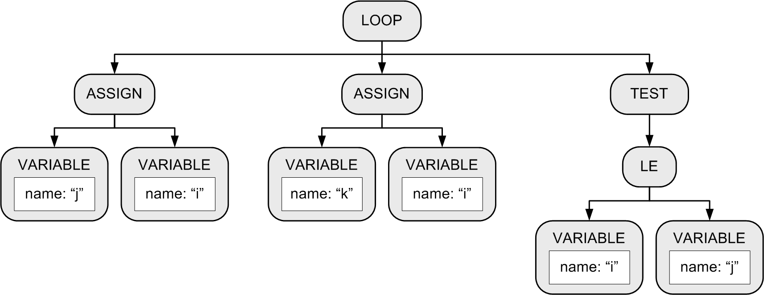
REPEAT Statement
Example:
Keep looping until the boolean expression becomes true.
  Execute the loop at least once.
  REPEAT
  j := i;
  k := i
  UNTIL i <= j
Use LOOP and TEST nodes for
source language independence.
Exit the loop
when the test
expression
evaluates to
true.

Slide 36
REPEAT Statement, cont’d
Executor.java
private Object visitLoop(Node loopNode)
{
boolean b = false;
do
{
for (Node node : loopNode.children)
{
Object value = visit(node); // statement or test
// Evaluate the test condition. Stop looping if true.
b = (node.type == TEST) && ((boolean) value);
if (b) break;
}
} while (!b);
return null;
}
private Object visitTest(Node testNode)
{
return (Boolean) visit(testNode.children.get(0));
}
Repeatedly execute the LOOP node’s children (at least once).
Exit the loop
when the test
expression
evaluates to
true.

Slide 37
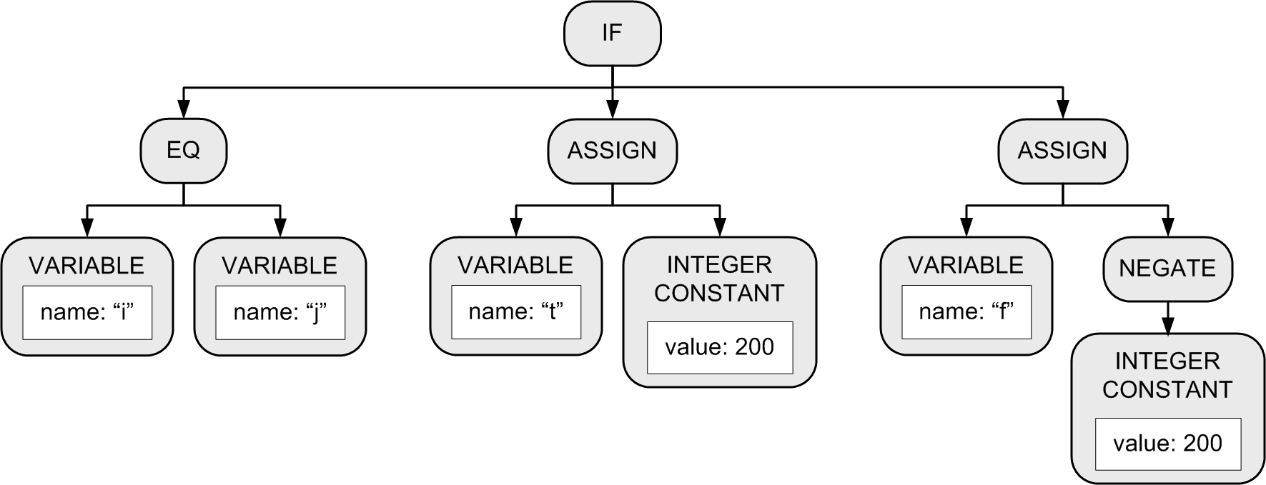
Executing an IF Parse Tree
Evaluate the first child’s expression subtree.
If the expression value is true ...
  Execute the second child’s statement subtree.
If the expression value is false …
  If there is a third child statement subtree, then execute it.
  If there isn’t a third child subtree, then we’re done with this tree.

Slide 38
Evaluating Expressions
Visit the nodes.
Perform the appropriate operation on the child nodes according to the type of node.

Slide 39
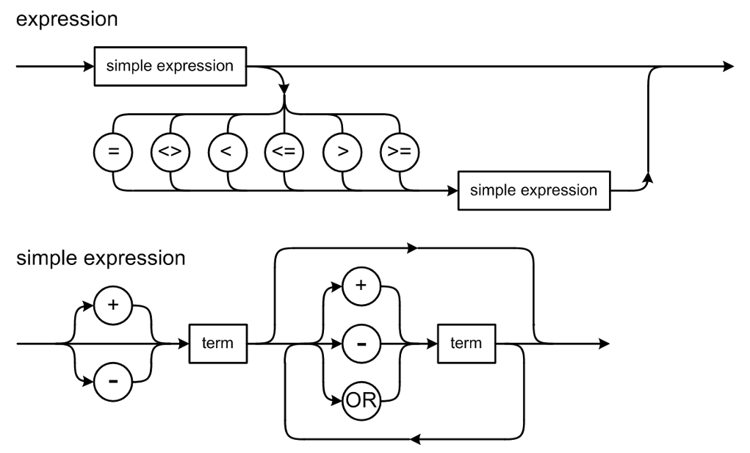
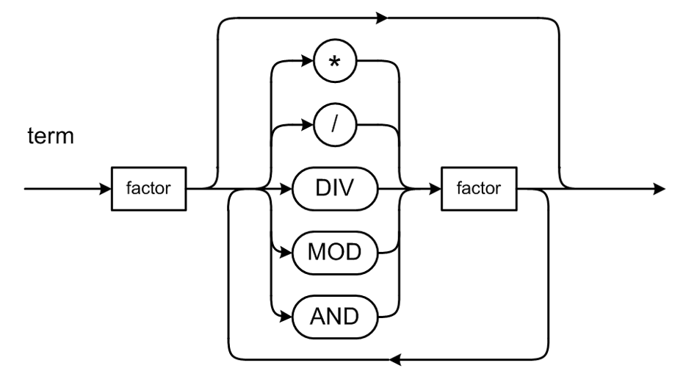
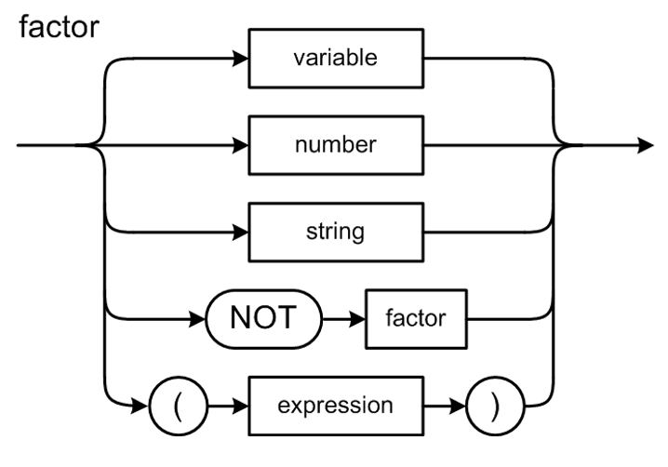
Evaluating Expressions, cont’d
Return the result of the operation.
  visitExpression()
  visitVariable()
  visitIntegerConstant()
  visitRealConstant()
  visitStringConstant()
Note how factor is recursive:
  NOT factor
  ( expression )

Slide 40
Class Executor
Executor.java
public class Executor
{
...
private static HashSet<Node.NodeType> singleOperands;
private static HashSet<Node.NodeType> relationals;
static
{
singleOperands = new HashSet<Node.NodeType>();
relationals = new HashSet<Node.NodeType>();
singleOperands.add(VARIABLE);
singleOperands.add(INTEGER_CONSTANT);
singleOperands.add(REAL_CONSTANT);
singleOperands.add(STRING_CONSTANT);
relationals.add(EQ);
relationals.add(LT);
}
...
package backend

Slide 41
Method Executor.visitExpression()
Executor.java
private Object visitExpression(Node expressionNode)
{
// Single-operand expressions.
if (singleOperands.contains(expressionNode.type))
{
switch (expressionNode.type)
{
case VARIABLE :
return visitVariable(expressionNode);
case INTEGER_CONSTANT :
return visitIntegerConstant(expressionNode);
case REAL_CONSTANT :
return visitRealConstant(expressionNode);
case STRING_CONSTANT :
return visitStringConstant(expressionNode);
default: return null;
}
}
// Binary expressions.
double value1 = (Double) visit(expressionNode.children.get(0));
double value2 = (Double) visit(expressionNode.children.get(1));
...

Slide 42
Executor.visitExpression(), cont’d
Executor.java
...
// Relational expressions.
if (relationals.contains(expressionNode.type))
{
boolean value = false;
switch (expressionNode.type)
{
case EQ : value = value1 == value2; break;
case LT : value = value1 < value2; break;
default : break;
}
return value;
}
...

Slide 43
Executor.visitExpression(), cont’d
Executor.java
...
double value = 0.0;
// Arithmetic expressions.
switch (expressionNode.type)
{
case ADD : value = value1 + value2; break;
case SUBTRACT : value = value1 - value2; break;
case MULTIPLY : value = value1 * value2; break;
case DIVIDE :
{
if (value2 != 0.0) value = value1/value2;
else
{
runtimeError(expressionNode, "Division by zero");
return 0.0;
}
break;
}
default : break;
}
return Double.valueOf(value);
}

Slide 44
Evaluating Expressions, cont'd
Executor.java
private Object visitVariable(Node variableNode)
{
// Obtain the variable's value from its symbol table entry.
SymtabEntry variableEntry = variableNode.entry;
Double value = variableEntry.getValue();
return value;
}
private Object visitIntegerConstant(Node integerConstantNode)
{
long value = (Long) integerConstantNode.value;
return (double) value;
}

Slide 45
Quiz on Thursday, Sept. 3
A quick 10-minute multiple-choice quiz on the lectures through today.
  Closed-book, requires lockdown browser.
  Let’s make sure we’re all good on the subject material before it gets harder.
  The quizzes will become part of your total midterm score.

