Slide 1


CS 153: Concepts of Compiler Design
August 27 Class Meeting
Department of Computer Science
San Jose State University
Fall 2026
Instructor: Ron Mak
www.cs.sjsu.edu/~mak

Slide 2
ISA
Tejas Chakkuwar

Slide 3
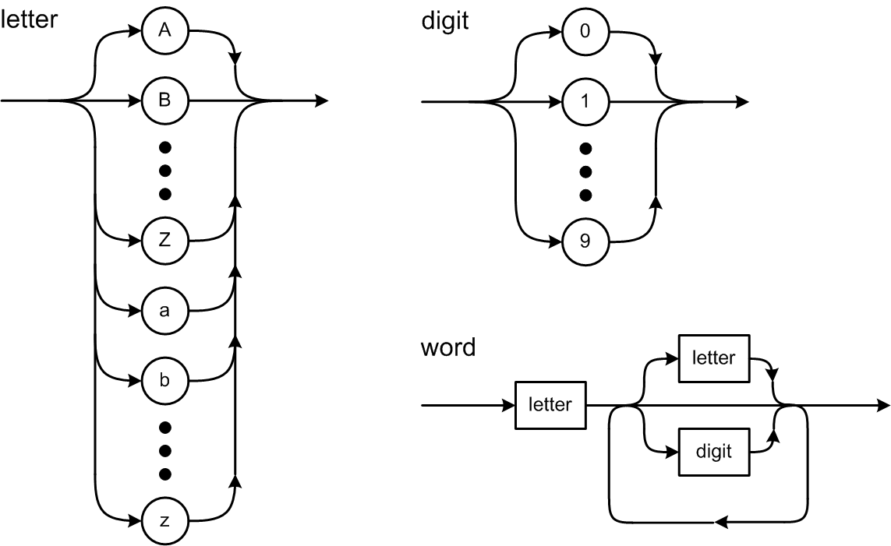
Syntax Diagrams

Slide 4
Consume Characters and Tokens
To consume the current input character, use it (such as by appending it to the text of the current token) and then read the next character.
To consume the current token, process it
and then extract the next token.
What happens if you
forget to consume
the current input character
or the current token?

Slide 5
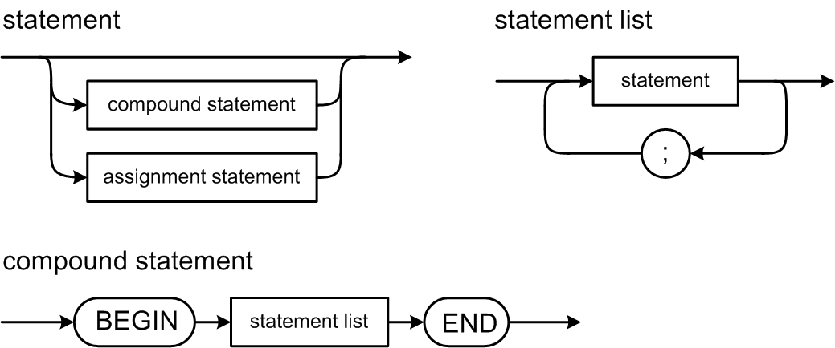
Pascal Statement Syntax Diagrams

Slide 6
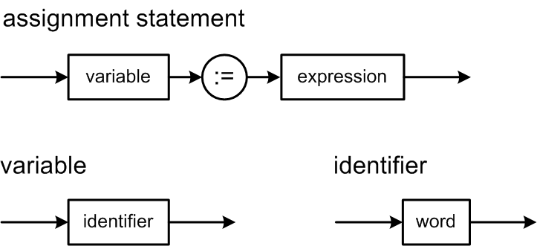
Pascal Statement Syntax Diagrams, cont'd
For now,
greatly simplified!

Slide 7
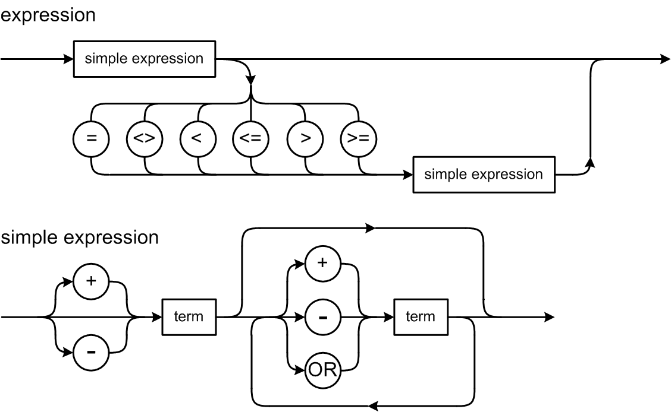
Pascal Expression Syntax Diagrams

Slide 8
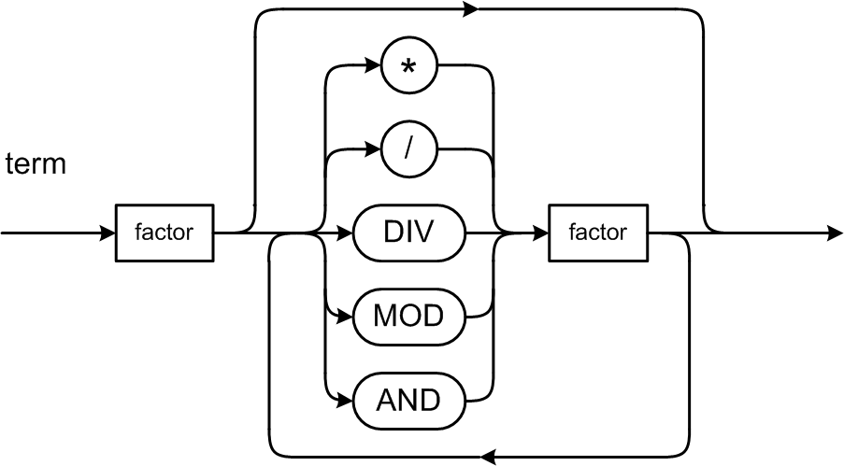
Expression Syntax Diagrams, cont’d

Slide 9
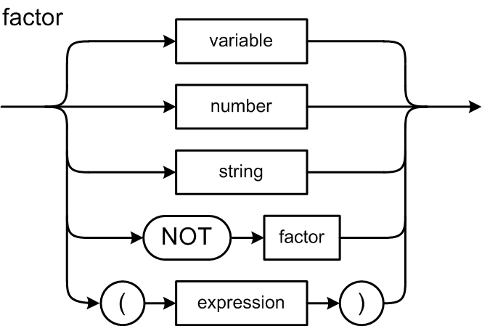
Expression Syntax Diagrams, cont’d

Slide 10
Pascal’s Operator Precedence Rules
Level | Operators
1 (factor: highest) | NOT
2 (term) | multiplicative: * / DIV MOD AND
3 (simple expression) | additive: + - OR
4 (expression: lowest) | relational: = <> < <= > >=
If there are no parentheses:
  Higher level operators execute before the lower level ones.
  Operators at the same level execute from left to right.
Because the factor syntax diagram defines parenthesized expressions, parenthesized expressions always execute first, from the most deeply nested outwards.

Slide 11
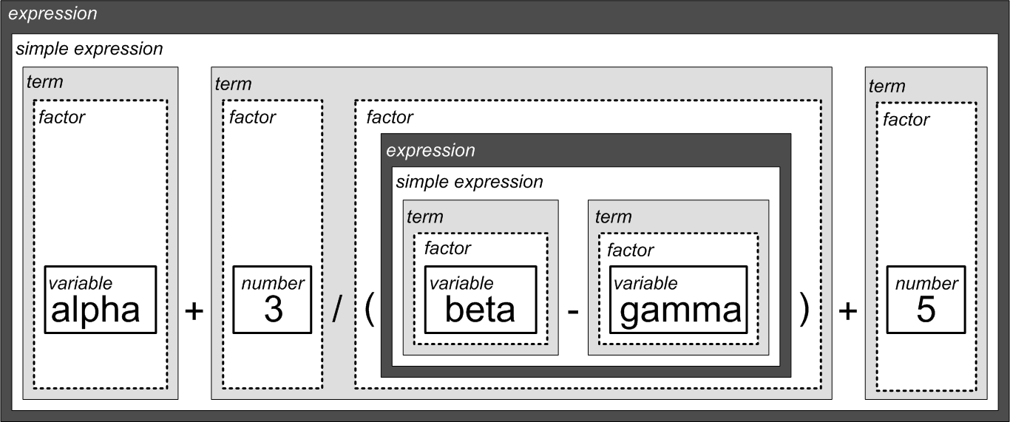
Example Decomposition
alpha + 3/(beta – gamma) + 5

Slide 12
Pascal Control Statements
Looping statements
  REPEAT UNTIL
  WHILE DO
  FOR TO
  FOR DOWNTO
Conditional statements
  IF THEN
  IF THEN ELSE
  CASE OF

Slide 13
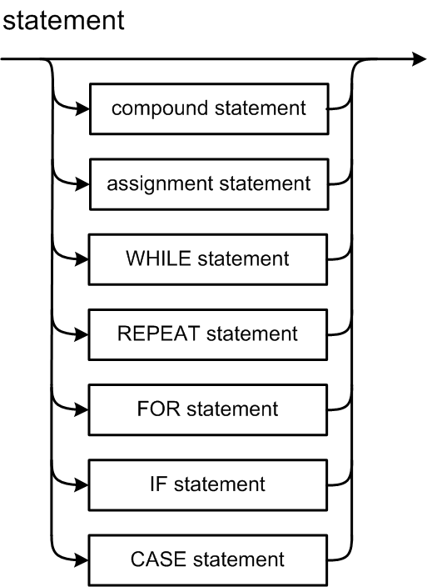
Statement Syntax Diagram

Slide 14
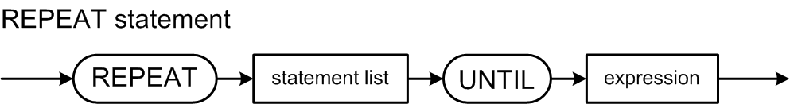
REPEAT Statement Syntax Diagram
See: http://primepuzzle.com/tp2/syntax-diagrams.html
REPEAT
i := i + 1;
write('#'); write(i);
writeln(': Hello, world!');
UNTIL i = 5;

Slide 15
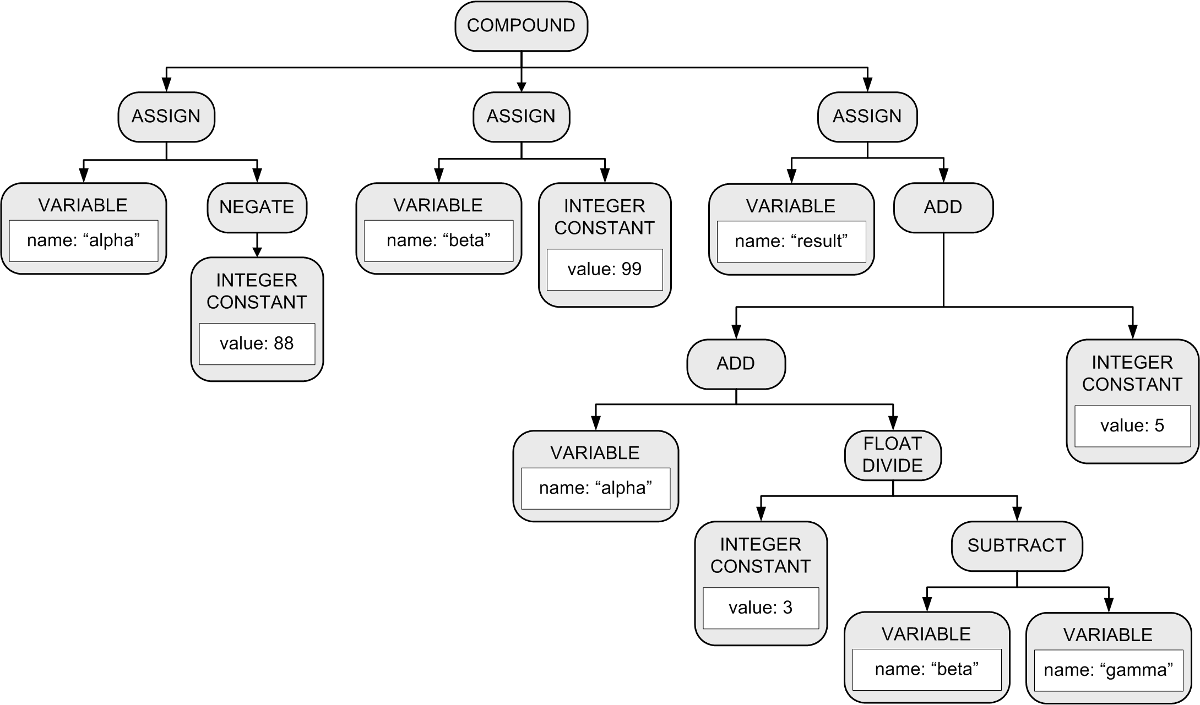
Parse Tree: Conceptual Design
This tree is more accurately called an abstract syntax tree (AST) because tokens such as parentheses and := and semicolons are not included.
BEGIN
alpha := -88;
beta := 99;
result := alpha + 3/(beta – gamma) + 5
END

Slide 16
Parse Tree: Basic Tree Operations
Create a new node.
Create a copy of a node.
Set and get the root node of a parse tree.
Set and get an attribute value of a node.
Add a child node to a node.
Get the list of a node’s child nodes.
Get a node’s parent node.

Slide 17
Test the Simple Parser
Parser.java
  parseProgram()
  parseStatement()
  parseAssignmentStatement()
  parseCompoundStatement()
  parseRepeatStatement()
  parseWriteStatement()
  parseWritelnStatement()
  parseExpression()
  parseSimpleExpression()
  parseTerm()
  parseFactor()
  parseVariable()
  parseIntegerConstant()
  parseRealConstant()
  parseStringConstant()
package frontend
Many individual parser
member functions!

Slide 18
Building a Parse Tree
Each parse*() member function builds a new subtree and returns the subtree’s root node.
The caller of the parse*() function adopts
the new subtree’s root node as a child of the subtree that the caller itself is building.
  The caller then returns the root node
  of the subtree that it built to its caller.
  This process continues until the entire source has been parsed and we have the entire parse tree.

Slide 19

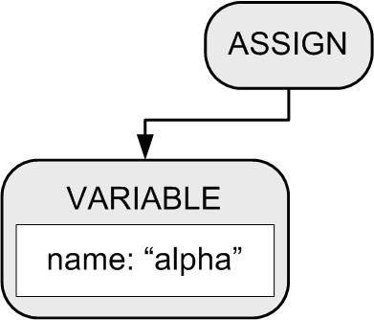
Building a Parse Tree
Example:
BEGIN
alpha := 10;
beta := 20
END
Function parseCompoundStatement()
method creates a COMPOUND node.
2. Function parseAssignmentStatement()
creates an ASSIGN node and a VARIABLE node, which the ASSIGN node adopts as its first child.

Slide 20
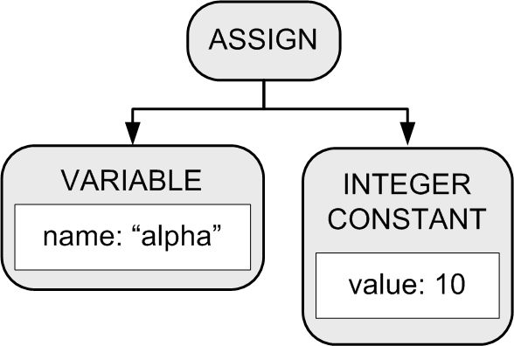
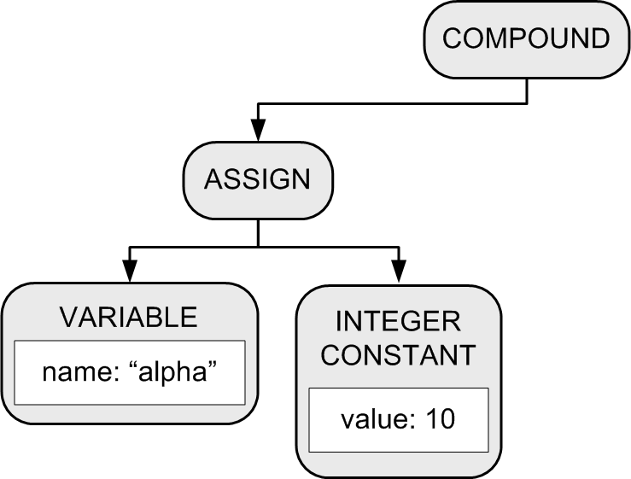
Building a Parse Tree
3. Function parseExpression()
creates an INTEGER CONSTANT
node which the ASSIGN node
adopts as its second child.
BEGIN
alpha := 10;
beta := 20
END
4. The COMPOUND node
adopts the ASSIGN node
as its first child.

Slide 21
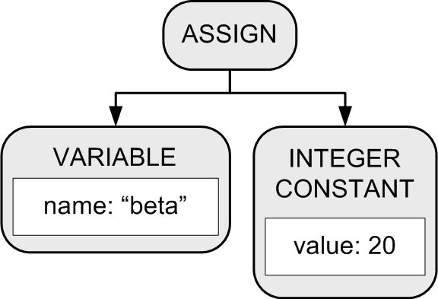
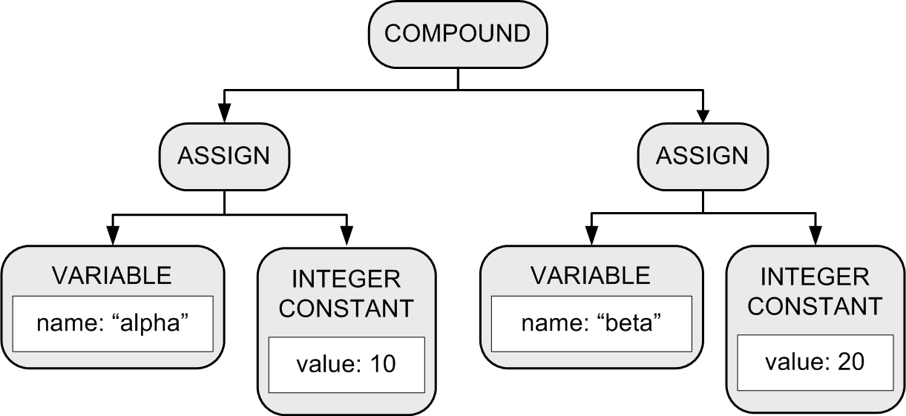
Building a Parse Tree
Another set of calls to functions parseAssignmentStatement() and parseExpression() builds another assignment statement subtree.
6. The COMPOUND node
adopts the subtree
as its second child.
BEGIN
alpha := 10;
beta := 20
END

Slide 22
Class Token
Token.java
public class Token
{
public enum TokenType
{
PROGRAM, BEGIN, END, REPEAT, UNTIL, WRITE, WRITELN,
PERIOD, COLON, COLON_EQUALS, SEMICOLON,
PLUS, MINUS, STAR, SLASH, LPAREN, RPAREN,
EQUALS, LESS_THAN,
IDENTIFIER, INTEGER, REAL, STRING, END_OF_FILE, ERROR
}
private static HashMap<String, TokenType> reservedWords;
static
{
reservedWords = new HashMap<String, TokenType>();
reservedWords.put("PROGRAM", TokenType.PROGRAM);
reservedWords.put("BEGIN", TokenType.BEGIN);
reservedWords.put("END", TokenType.END);
reservedWords.put("REPEAT", TokenType.REPEAT);
reservedWords.put("UNTIL", TokenType.UNTIL);
reservedWords.put("WRITE", TokenType.WRITE);
reservedWords.put("WRITELN", TokenType.WRITELN);
}

Slide 23
Class Token, cont’d
Token.java
public static Token word(char firstChar, Source source)
{
Token token = new Token(firstChar);
token.lineNumber = source.lineNumber();
// Loop to get the rest of the characters of the word token.
// Append letters and digits to the token.
for (char ch = source.nextChar();
Character.isLetterOrDigit(ch);
ch = source.nextChar())
{
token.text += ch;
}
// Is it a reserved word or an identifier?
token.type = reservedWords.get(token.text.toUpperCase());
if (token.type == null) token.type = TokenType.IDENTIFIER;
return token;
}

Slide 24
Class Scanner
Scanner.java
public Token nextToken()
{
char ch = source.currentChar();
// Skip blanks and other whitespace characters.
while (Character.isWhitespace(ch)) ch = source.nextChar();
if (Character.isLetter(ch)) return Token.word(ch, source);
else if (Character.isDigit(ch)) return Token.number(ch, source);
else if (ch == '\'') return Token.string(ch, source);
else return Token.specialSymbol(ch, source);
}

Slide 25
Class Node
Node.java
public class Node
{
public enum NodeType
{
PROGRAM, COMPOUND, ASSIGN, LOOP, TEST, WRITE, WRITELN,
ADD, SUBTRACT, MULTIPLY, DIVIDE, EQ, LT,
VARIABLE, INTEGER_CONSTANT, REAL_CONSTANT, STRING_CONSTANT
}
public NodeType type;
public int lineNumber;
public String text;
public SymtabEntry entry;
public Object value;
public ArrayList<Node> children;

Slide 26
Class Node, cont’d
Node.java
public Node(NodeType type)
{
this.type = type;
this.lineNumber = 0;
this.text = null;
this.value = null;
this.children = new ArrayList<>();
}
public void adopt(Node child)
{
children.add(child);
}
public ArrayList<Node> getChildren() { return children; }

Slide 27
Class Node, cont’d
Node.java
public String display()
{
String str = type.name() + " ";
if (type == PROGRAM) str += text;
else if (type == VARIABLE) str += text;
else if (type == INTEGER_CONSTANT) str += (long) value;
else if (type == REAL_CONSTANT) str += value;
else if (type == STRING_CONSTANT) str += "'" + (String) value + "'";
if (lineNumber > 0) str = lineNumber + ": " + str;
return str;
}

Slide 28
Class SymtabEntry
SymtabEntry.java
public class SymtabEntry
{
private String name;
private Double value;
/**
* Constructor.
* @param name the entry's name.
*/
public SymtabEntry(String name)
{
this.name = name;
this.value = 0.0;
}

Slide 29
Symbol Table Hack #1
For now, we will store the runtime value of a variable in its symbol table entry.
  So that we can continue to make progress.
Later, we will discover that this hack will fail miserably when we execute calls to recursive functions.
  Why?

Slide 30
Symbol Table
Symtab.java
public class Symtab
{
private HashMap<String, SymtabEntry> contents = new HashMap<>();
/**
* Make an entry.
* @param name the entry's name.
*/
public SymtabEntry enter(String name)
{
SymtabEntry entry = new SymtabEntry(name);
contents.put(name, entry);
return entry;
}
/**
* Look up an entry.
* @param name the entry's name.
* @return the entry or null if it's not in the symbol table.
*/
public SymtabEntry lookup(String name) { return contents.get(name); }
}

Slide 31
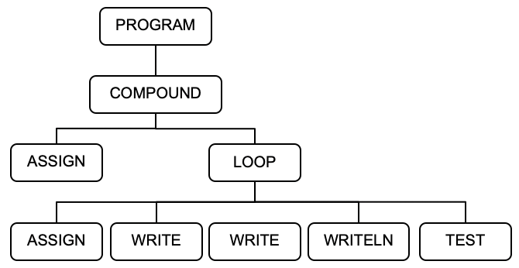
Method Parser.parseProgram()
Parser.java
public Node parseProgram()
{
Node programNode = new Node(Node.NodeType.PROGRAM);
// First token!
currentToken = scanner.nextToken();
if (currentToken.type == Token.TokenType.PROGRAM)
{
// Consume PROGRAM.
currentToken = scanner.nextToken();
}
else syntaxError("Expecting PROGRAM");
if (currentToken.type == IDENTIFIER)
{
String programName = currentToken.text;
symtab.enter(programName);
programNode.text = programName;
// Consume program name.
currentToken = scanner.nextToken();
}
else syntaxError("Expecting program name");
PROGRAM HelloWorld;
BEGIN
i := 0;
REPEAT
i := i + 1;
write('#'); write(i);
writeln(': Hello, world!');
UNTIL i = 5;
END.

Slide 32
Method Parser.parseProgram(), cont’d
Parser.java
if (currentToken.type == SEMICOLON)
{
// Consume ;
currentToken = scanner.nextToken();
}
else syntaxError("Missing ;");
if (currentToken.type != BEGIN) syntaxError("Expecting BEGIN");
// The PROGRAM node adopts the COMPOUND tree.
programNode.adopt(parseCompoundStatement());
if (currentToken.type != PERIOD) syntaxError("Expecting .");
return programNode;
}
PROGRAM HelloWorld;
BEGIN
i := 0;
REPEAT
i := i + 1;
write('#'); write(i);
writeln(': Hello, world!');
UNTIL i = 5;
END.

Slide 33
Syntax Error Handling
Syntax error handling in the front end is a three-step process:
  Detect the error.
  Flag the error.
  Recover from the error.
Good syntax error handling is important!
  A hallmark of a compiler excellence.

Slide 34
Options for Error Recovery
Stop after the first error.
  No error recovery at all.
  Easiest for the compiler writer,
  annoying for the programmer.
  Worse case: The compiler crashes or hangs.
Become hopelessly lost.
  Attempt to continue parsing
  the rest of the source program.
  Spew out lots of irrelevant and
  meaningless error messages.
  No error recovery here, either …
    … but the compiler writer doesn’t admit it!

Slide 35
Options for Error Recovery, cont’d
Skip tokens after the erroneous token until …
  The parser finds a token it recognizes, and
  It can safely resume syntax checking the rest of the source program.
For now, we’ve implemented
very simple syntax error handling.
  Will our parser get lost attempting to recover?
  Will our parser go into an infinite loop or crash?

Slide 36
Method Parser.syntaxError()
private static HashSet<Token.TokenType> statementFollowers;
static
{
// Tokens that can immediately follow a statement.
statementFollowers.add(SEMICOLON);
statementFollowers.add(END);
statementFollowers.add(UNTIL);
statementFollowers.add(END_OF_FILE);
}
private void syntaxError(String message)
{
System.out.println("SYNTAX ERROR at line " + lineNumber
+ ": " + message + " at '" + currentToken.text + "'");
errorCount++;
// Recover by skipping the rest of the statement.
// Skip to a statement follower token.
while (! statementFollowers.contains(currentToken.type))
{
currentToken = scanner.nextToken();
}
}

Slide 37
Method Parser.parseStatement()
Parser.java
private Node parseStatement()
{
Node stmtNode = null;
int savedLineNumber = currentToken.lineNumber;
lineNumber = savedLineNumber;
switch (currentToken.type)
{
case IDENTIFIER : stmtNode = parseAssignmentStatement(); break;
case BEGIN : stmtNode = parseCompoundStatement(); break;
case REPEAT : stmtNode = parseRepeatStatement(); break;
case WRITE : stmtNode = parseWriteStatement(); break;
case WRITELN : stmtNode = parseWritelnStatement(); break;
case SEMICOLON : stmtNode = null; break; // empty statement
default : syntaxError("Unexpected token");
}
if (stmtNode != null) stmtNode.lineNumber = savedLineNumber;
return stmtNode;
}

Slide 38
Method Parser.parseAssignmentStatement()
Parser.java
private Node parseAssignmentStatement()
{
// The current token should now be the left-hand-side variable name.
Node assignmentNode = new Node(ASSIGN);
// The assignment node adopts the variable node as its first child.
Node lhsNode = new Node(VARIABLE);
String variableName = currentToken.text;
SymtabEntry variableEntry = symtab.enter(variableName.toLowerCase());
lhsNode.text = variableName;
lhsNode.entry = variableEntry;
assignmentNode.adopt(lhsNode);
// Consume the LHS variable.
currentToken = scanner.nextToken();
PROGRAM HelloWorld;
BEGIN
i := 0;
REPEAT
i := i + 1;
write('#'); write(i);
writeln(': Hello, world!');
UNTIL i = 5;
END.

Slide 39
Parser.parseAssignmentStatement(), cont’d
Parser.java
if (currentToken.type == COLON_EQUALS)
{
// Consume :=
currentToken = scanner.nextToken();
}
else syntaxError("Missing :=");
// The assignment node adopts the expression node
// as its second child.
Node rhsNode = parseExpression();
assignmentNode.adopt(rhsNode);
return assignmentNode;
}
PROGRAM HelloWorld;
BEGIN
i := 0;
REPEAT
i := i + 1;
write('#'); write(i);
writeln(': Hello, world!');
UNTIL i = 5;
END.

Slide 40
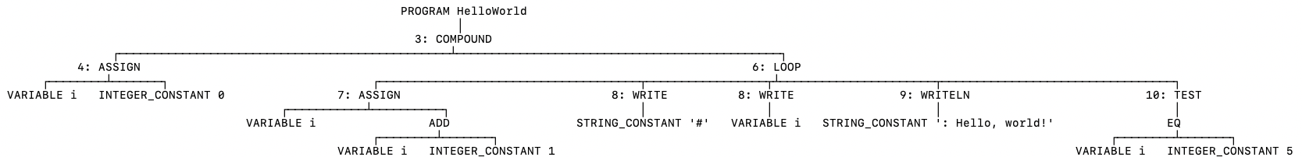
REPEAT Parse Tree
HelloWorld.txt
PROGRAM HelloWorld;
BEGIN
i := 0;
REPEAT
i := i + 1;
write('#'); write(i);
writeln(': Hello, world!')
UNTIL i = 5
END.
var ppt = new PrettyPrintTree<Node>(Node::getChildren,
Node::display);
ppt.setColor(Color.NONE);
ppt.display(programNode);
Simple.java

Slide 41
Cool Facts about the LOOP Subtree
It's language-independent.
  It can handle any kind of looping statement.
The TEST node can be any one of the children.
  It can be the first, last, or intermediate child.
  There can be more than one TEST node.
  At run time, exit the loop when the test is true.

Slide 42
Method Parser.parseRepeatStatement()
Parser.java
private Node parseRepeatStatement()
{
// The current token should now be REPEAT.
// Create a LOOP node.
Node loopNode = new Node(LOOP);
// Consume REPEAT
currentToken = scanner.nextToken();
parseStatementList(loopNode, UNTIL);

Slide 43
Parser.parseRepeatStatement(), cont’d
Parser.java
if (currentToken.type == UNTIL)
{
// Create a TEST node.
// It adopts the test expression node.
Node testNode = new Node(TEST);
lineNumber = currentToken.lineNumber;
testNode.lineNumber = lineNumber;
// Consume UNTIL.
currentToken = scanner.nextToken();
testNode.adopt(parseExpression());
// The LOOP node adopts the TEST node
// as its final child.
loopNode.adopt(testNode);
}
else syntaxError("Expecting UNTIL");
return loopNode;
}

Slide 44
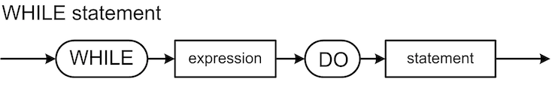
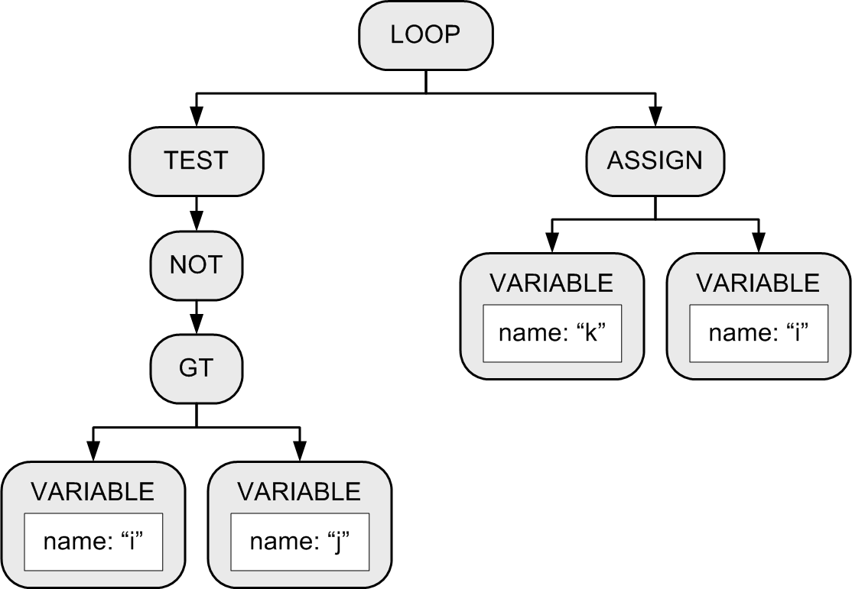
Parse Tree for the WHILE Statement
The statement
can be a
compound
statement.
while i > j do k := i
Why?

Slide 45
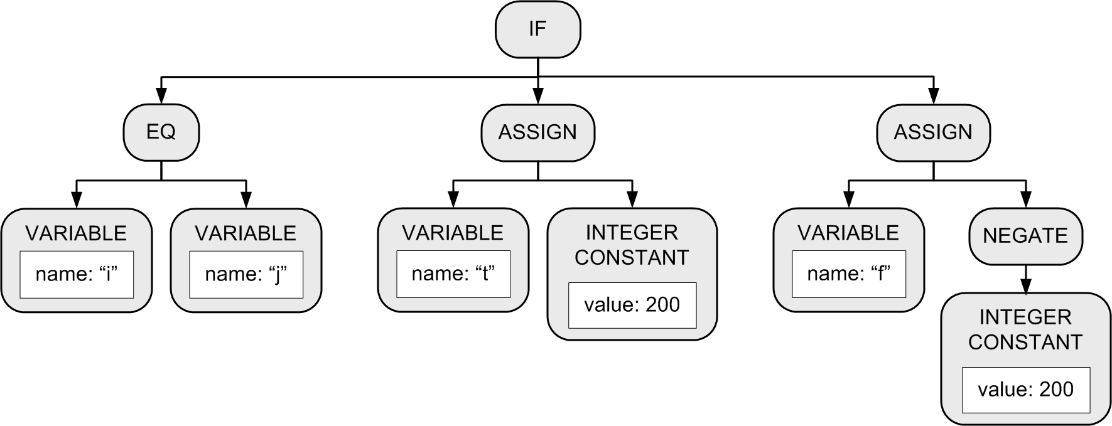
IF Statement
Each statement
can be a
compound
statement.
Example:
  IF (i = j) THEN t := 200
  ELSE f := -200;
Third child only if
there is an ELSE.

Slide 46
The “Dangling” ELSE
Consider:
Which THEN does the ELSE pair with?
  Is it:
  IF i = 3 THEN IF j = 2 THEN t := 500 ELSE f := -500
  Or is it:
  IF i = 3 THEN IF j = 2 THEN t := 500 ELSE f := -500
IF i = 3 THEN IF j = 2 THEN t := 500 ELSE f := -500

Slide 47
The “Dangling” ELSE, cont’d
According to Pascal syntax,
the nested IF statement is
the THEN statement of the outer IF statement
IF i = 3 THEN IF j = 2 THEN t := 500 ELSE f := -500
Therefore, the ELSE pairs with the closest
(i.e., the second) THEN.

Slide 48
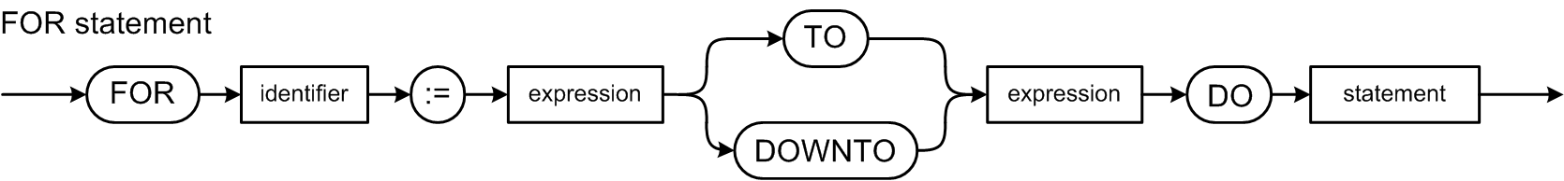
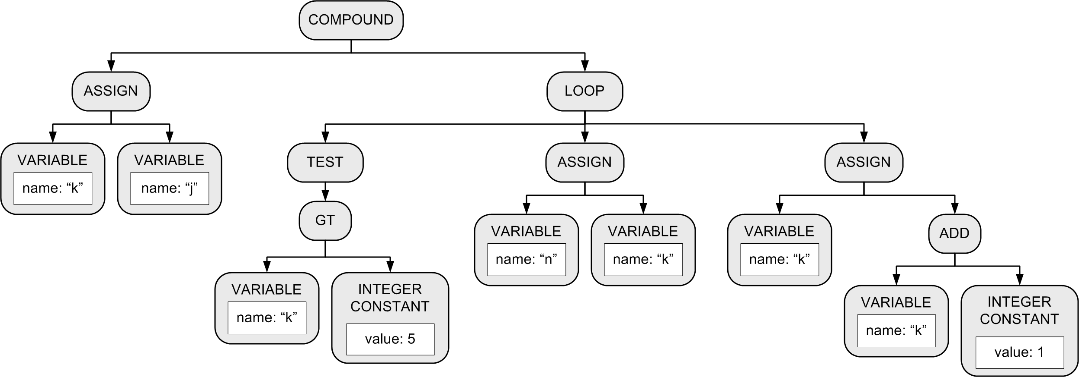
FOR Statement
The DO statement can be a compound statement.
Example:
FOR k := j TO 5 DO n := k
Increment/decrement
the control variable:
Node type ADD for TO
and SUBTRACT for
DOWNTO
Initial assignment
Node type GT
for TO and LT
for DOWNTO
DO statement

Slide 49
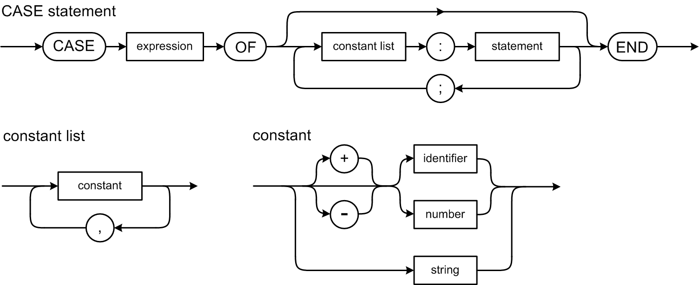
CASE Statement
Example:
  CASE i+1 OF
  1: j := i;
  4: j := 4*i;
  5, 2, 3: j := 523*i;
  END
Note that Pascal’s
CASE statement
does not use
BREAK statements.

Slide 50
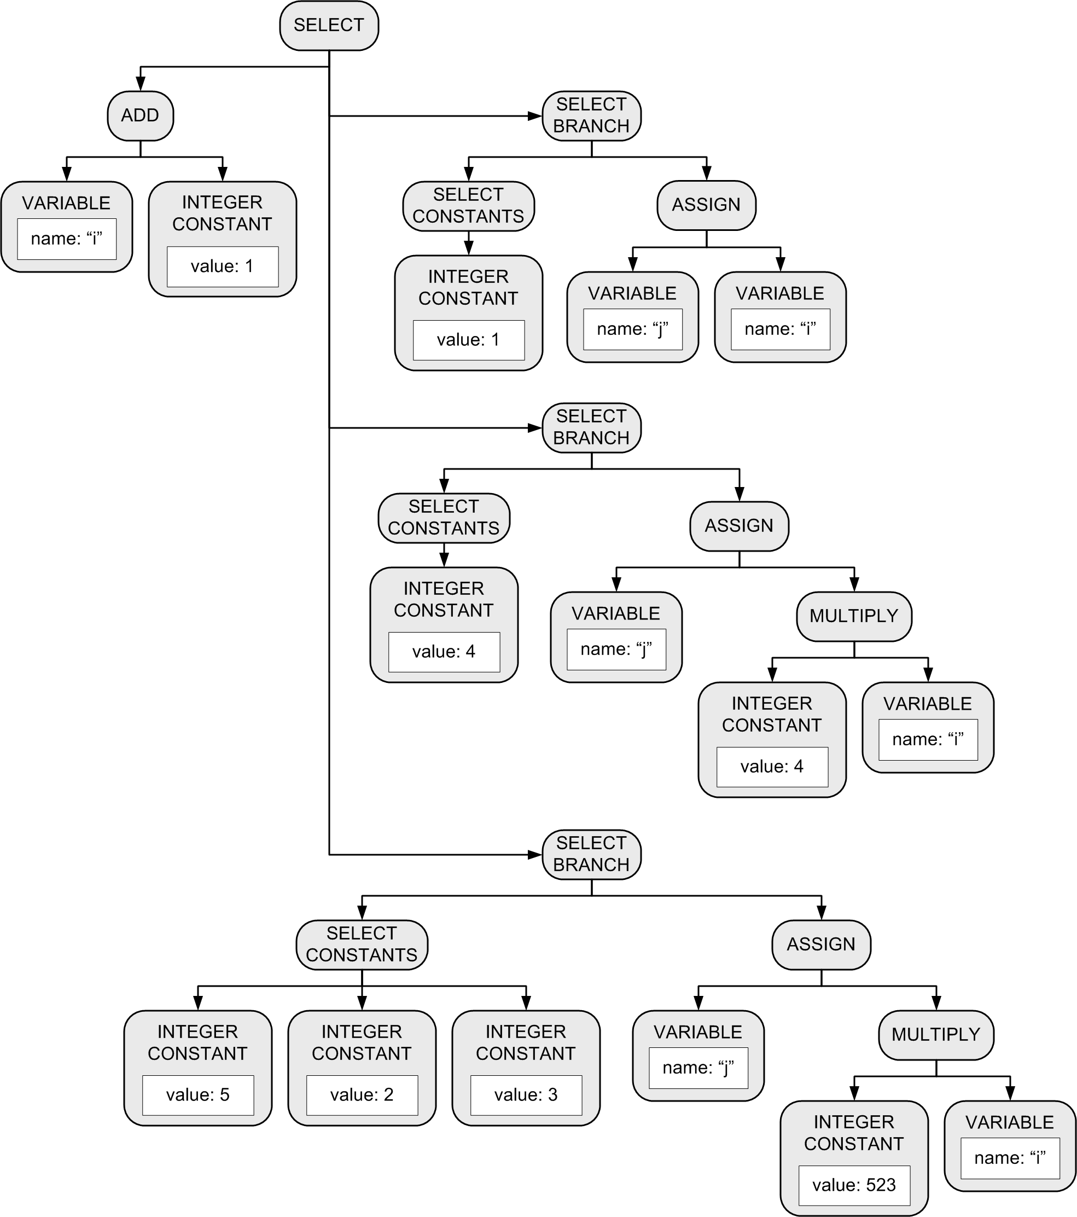
CASE Statement, cont’d
Example:
CASE i+1 OF
1: j := i;
4: j := 4*i;
5, 2, 3: j := 523*i;
END
The first child of the SELECT node is the expression subtree.
Subsequent children are subtrees for each SELECT branch.

