Slide 1


CS 153: Concepts of Compiler Design
August 25 Class Meeting
Department of Computer Science
San Jose State University
Fall 2026
Instructor: Ron Mak
www.cs.sjsu.edu/~mak

Slide 2
Software Engineering
Translators are large, complex programs!
To succeed, we must:
  Apply good software design principles.
  Use a good software architecture that breaks
  the work into manageable pieces.
  Develop incrementally.
  Develop iteratively: design — code — test

Slide 3
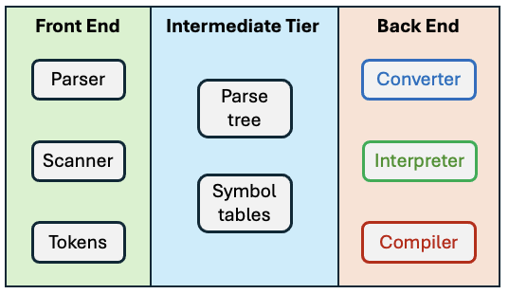
A Software Architecture
A three-tier architecture:

Slide 4

Front End Components: Parser
Directs the frontend
operations of a translator.
Incorporates the grammar
of the source language.
Performs syntax checking of a source program written in the language.
Repeatedly requests tokens from the scanner.
Builds a parse tree in the intermediate tier as it analyzes a source program,

Slide 5
Front End Components: Tokens
Tokens are the elements of
a programming language.
  Examples: identifiers, reserved
  words, numbers, and special
  symbols such as + - :=
Each token object represents a token recognized by the scanner in the source program.
The scanner relies on the token definitions in the source language’s grammar to determine how to create a token object.

Slide 6
Front End Components: Scanner
Incorporates the token
definitions in the source
language’s grammar.
Upon each request by the
parser, the scanner recognizes the next token (the token that immediately follows the one that the scanner last recognized) in the source program and returns a token object to the parser.

Slide 7
Intermediate Tier Components: Parse Tree
Built by the parser as it
analyzes a source program.
Represents the statements
and expressions of the
source program.
Makes it much more efficient for the backend components to access information about the statements and expressions without needing to reanalyze the source code.

Slide 8
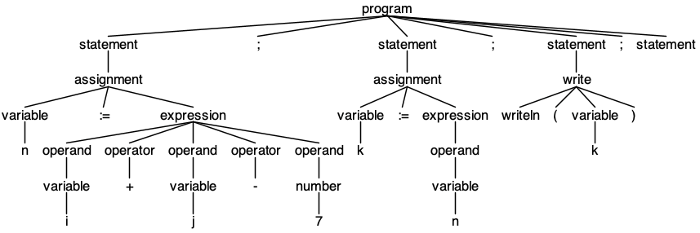
Example Parse Tree
n := i + j - 7;
k := n;
writeln(k);

Slide 9
Intermediate Tier Components: Symbol Table
Contain important
information about names
in the parse tree.
Information about a name
includes its datatype and whether it’s the name of a variable or a function.
Makes it much more efficient for the backend components to access information about the names if the information is all in one place and isn’t scattered throughout the parse tree.

Slide 10
Back End Components
Equivalent program written in the target language
Converter
Convert and generate
Program written in the source language
Interpreter
Execute and produce
Runtime output
Executable machine code
Compiler
Compile and emit

Slide 11
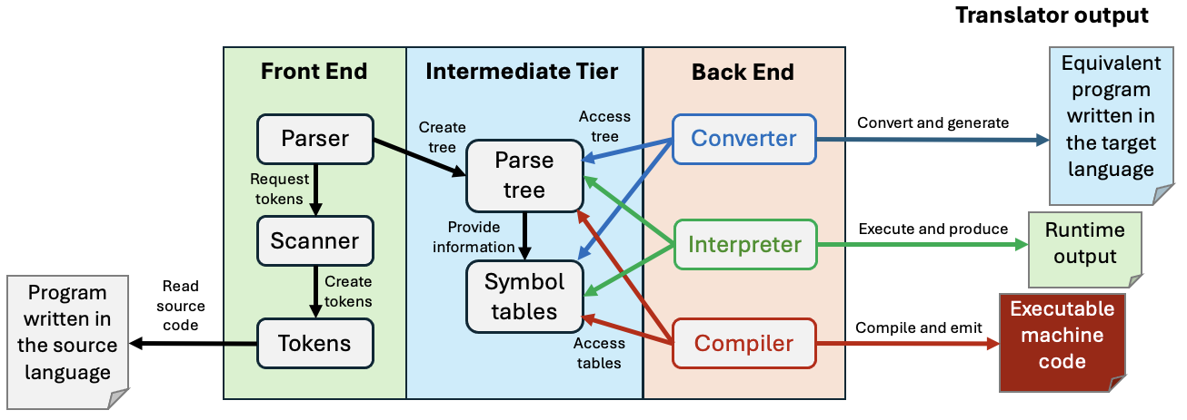
Translator Control Flow

Slide 12
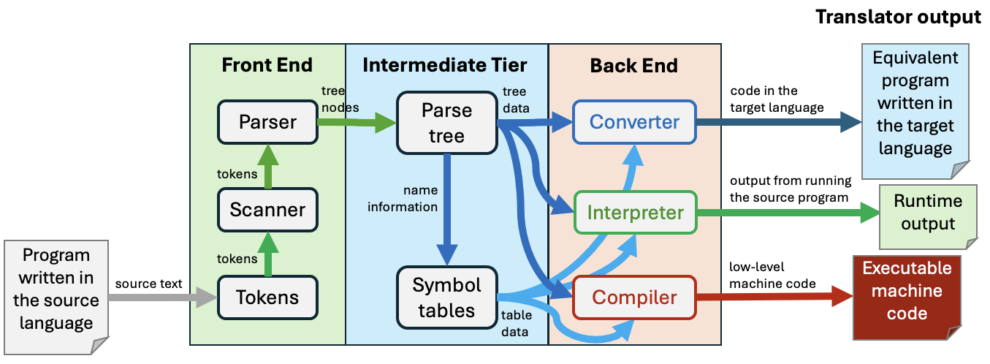
Translator Data Flow

Slide 13
Take roll

Slide 14
Pascal Tokens
Identifiers, numbers, and strings
  alpha 123 -123.45e12 'Hello, world!'
Reserved words
  PROGRAM BEGIN END WHILE FOR
  REPEAT UNTIL IF THEN ELSE CASE
Special symbols
  . , : ; := + - * / ( )
  = < <= <> >= > { }
Miscellaneous
  END_OF_FILE, ERROR
More tokens
to come!

Slide 15
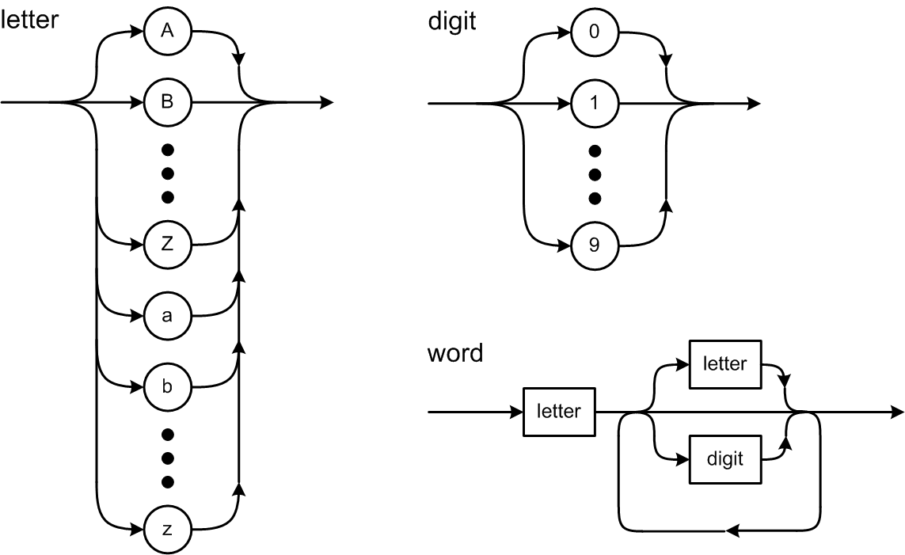
Syntax Diagrams

Slide 16
The Scanner Extracts Tokens
It’s the scanner’s job to extract tokens
from the input source file.
Whenever the parser wants the next token,
it asks the scanner to extract and return it.

Slide 17
How to Scan for Tokens
Suppose the source line contains
IF (index >= 10) THEN
The scanner skips over the leading blanks.
The current character is I, so the next token must be a word.
The word token is extracted by reading source characters up to but not including the first character that is not valid for a word, which in this case is a blank. The blank becomes the current character. The scanner determines that the word is a reserved word.

Slide 18
How to Scan for Tokens, cont’d
The scanner skips over any blanks between tokens. The current character is (. The next token must be a special symbol.
After extracting the special symbol token, the current character is i. The next token must be a word.
After extracting the word token, the current character is a blank. The scanner determines that the word is an identifier.

Slide 19
How to Scan for Tokens, cont’d
Skip the blank. The current character is >.
Extract the special symbol token. The current character is a blank.
Skip the blank. The current character is 1, so the next token must be a number.
After extracting the number token, the current character is ).

Slide 20
How to Scan for Tokens, cont’d
Extract the special symbol token. The current character is a blank.
Skip the blank. The current character is T, so the next token must be a word.
Extract the word token and determine that it’s a reserved word.
The current character is \n, so the scanner is done with this line.

Slide 21
Basic Scanning Algorithm
Skip any blanks until the current character is nonblank.
  In Pascal, a comment and the end-of-line character
  each should be treated as a blank.
The current (nonblank) character determines what the next token is and becomes that token’s first character.
Extract the rest of the next token by copying successive characters up to but not including the first character that does not belong to that token.

Slide 22
Basic Scanning Algorithm, cont’d
Extracting a token consumes all the source characters that constitute the token.
  After extracting a token, the current character is the
  next character after the last character of that token.

Slide 23
Test the Scanner
Simple.java
  main()
  testScanner()
Source.java
  currentChar()
  nextChar()
Scanner.java
  nextToken()
package frontend
Keep track of the current input character
and read the next character upon demand.
The scanner extracts the first character
of the next token. That first character
determines what type of token is next.

Slide 24
Test the Scanner, cont’d
Token.java
  reservedWords table
  word()
    identifier
    reserved word
  number()
    integer
    real
  string()
  specialSymbol()
Distinguishes reserved words
from identifiers.
Each of these static Token methods
is called by the scanner to create a
token of the appropriate type and
to extract the remaining characters
of the token.
package frontend
Demo

Slide 25
Current Character vs. Next Character
Suppose the source line contains ABCDE
and we’ve already read the first character.
currentChar() | A
nextChar() | B
nextChar() | C
nextChar() | D
currentChar() | D
currentChar() | D
nextChar() | E
nextChar() | eol

Slide 26
Consume Characters and Tokens
To consume the current input character, use it (such as by appending it to the text of the current token) and then read the next character.
To consume the current token, process it
and then extract the next token.
What happens if you
forget to consume
the current input character
or the current token?

Slide 27
Reminder: By Tomorrow
Form teams.
Submit your team information into Canvas
(one submission per team)
  team name
  team members and email addresses
  cc all team members in an email to ron.mak@sjsu.edu

