Slide 1
CMPE 202 Software Systems Engineering April 30 Class Meeting
Engineering Extended Studies San Jose State University Spring 2024 Instructor: Ron Mak
www.cs.sjsu.edu/~mak

Slide 2
Today
The State Design Pattern
Different behaviors under different states
Break
Introduction to multithreaded programming
Critical regions
Mutexes
Condition variables

Slide 3
Oral presentations on Tuesday, May 7
What is your application?
What is its architecture?
You can use slides, such as PowerPoint.
Show high-level UML diagrams.
Point out your use of good design principles
Examples: cohesive classes, loose coupling, coding to the interface, delegation, etc.
Point out code modeled by design patterns.
Which patterns?
How did your code benefit from the patterns?
Live demo of the application.
Maximum 20 minutes per presentation.
Students in the class will help grade each oral presentation via a Canvas survey.

Slide 4
Oral Presentation: Five Survey Questions
Overview of application.
Good choice?
How well explained?
Overview of software architecture and GUI.
How well explained?
Screenshots?
Diagrams?
Use of good design principles.
Use of design patterns.
Overall presentation and demo.
You can use PowerPoint slides or other means of presentation.
Teams should not fill out the survey for themselves.
Survey results will count for at least 25% of the overall project grade.

Slide 5
Team Project Written Reports
Short written report.
Not more than 15 pages.
Basically, a write-up of your oral presentation.
Add more details, such as UML diagrams.
Emphasize how your project uses good design techniques.
design principles
design patterns

Slide 6
Object State and Behavior
Recall that at run time, the values of an object’s member variables uniquely determine its state.
The state changes whenever the values change.
The object makes state transitions.
An object’s member functions determine an object’s behavior.
An object’s state can influence how an object behaves.
The State Design Pattern provides a model for managing an object’s states, the state transitions, and the different behaviors in each state.

Slide 7
An Analogy: Object State and Behavior
Your car is a complex object that can be in any one of several states.
It can be turned off, idling, moving, stopped, etc.
Your car behaves differently, depending on the state it is in.
When it’s in the moving state, it can be going forward.

Slide 8
An Analogy, cont’d
In each state, you can perform actions that correctly cause your car to make a reasonable transition to another state.
When it’s in the idling state, you can transition it to the moving state by stepping on the accelerator.
When it’s moving, you can make it stop by stepping on the brake.

Slide 9
An Analogy, cont’d
Your car must also handle unreasonable or useless actions.
If your car is stopped, stepping on the brake has no effect, and it stays in the stopped state.
If an older car is already moving forward, turning the key in the ignition will cause a horrible grinding noise, and it stays in the moving forward state.

Slide 10
The State Design Pattern
The State Design Pattern provides a model for a software application that must manage an object’s runtime states and behaviors.
The application must handle all the actions, reasonable or not, that can cause the object to transition from one state to another.
We may have an object in our application whose current state is critical to monitor.
The application’s overall operation heavily depends on that object’s current state and how it behaves.
A useful design tactic is to explicitly name the states to make it easier to refer to each one.

Slide 11
Example: An Automatic Ticket Machine
An automatic ticket machine at a sports stadium can be in any one of several named states at any moment:
READY: The machine is ready to accept a customer’s credit card.
VALIDATING: The machine is validating a customer’s credit card.
TICKET_SOLD: The machine has sold a ticket to a customer.
SOLD_OUT: The game is sold out, and the machine cannot sell any more tickets.

Slide 12
An Automatic Ticket Machine, cont’d
Member variables whose values determine the current state of the machine:
count: The number of tickets left in the machine
card_inserted: Whether or not a customer’s credit card is inserted (true or false)
card_validity: The validity of the credit card (YES, NO, or UNKNOWN)
Customer actions can change the values of the member variables and thereby cause state transitions.
The machine itself can cause a state transition.

Slide 13
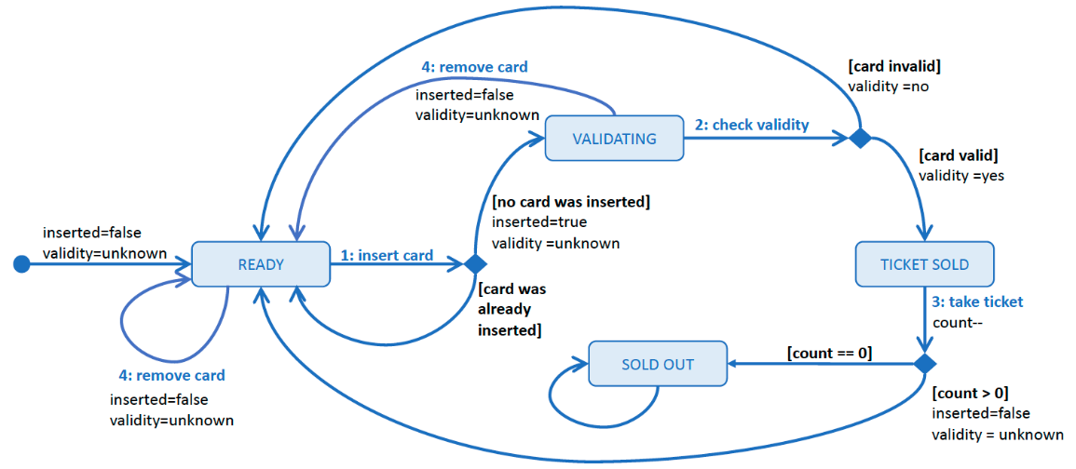
An Automatic Ticket Machine, cont’d
A UML state diagram showing the four states and the state transitions of an automatic ticket machine. The machine keeps track of the number of tickets it has, whether there is a credit card inserted, and the validity status of the card. Customer and machine actions (numbered; e.g., 1: insert card) or certain conditions (in square brackets; e.g., [card invalid]) can cause transitions from one state to another. This figure only shows the actions that cause transitions.

Slide 14
An Automatic Ticket Machine, cont’d
Ticket machine simulation:
Assume only 3 tickets are left.
User inputs trigger actions to be performed by the customer or by the machine:
User input | Action | By whom
1 | Insert a credit card. | customer
2 | Validate the credit card. | machine
3 | Take the ticket. | customer
4 | Remove the credit card. | customer
0 | Terminate the program.

Slide 15
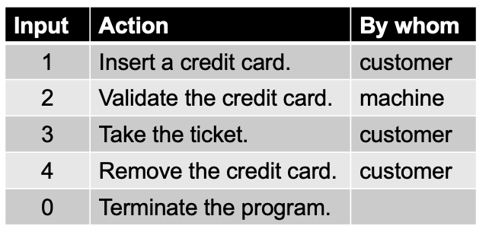
An Automatic Ticket Machine, cont’d
We successfully purchase a ticket, and the machine returns to the READY state.
1: insert card, 2: check card validity
3: take ticket, 4: remove card, 0: quit
[READY 3 false unknown] Command? 1
Validating your credit card.
1: insert card, 2: check card validity
3: take ticket, 4: remove card, 0: quit
[VALIDATING 3 true unknown] Command? 2
Your credit card is validated. Take your ticket.
1: insert card, 2: check card validity
3: take ticket, 4: remove card, 0: quit
[TICKET_SOLD 3 true yes] Command? 3
Remove your credit card. Enjoy the game!
1: insert card, 2: check card validity
3: take ticket, 4: remove card, 0: quit
[READY 2 true yes] Command? 4
You've removed your credit card.
1: insert card, 2: check card validity
3: take ticket, 4: remove card, 0: quit
[READY 2 false unknown] Command? 0
Done!
The output [READY 2 true yes]
shows the current state, the number of tickets left, whether the credit card was inserted, and whether the credit card is valid (yes or no).

Slide 16
An Automatic Ticket Machine, cont’d
We change our mind and remove a card while its validity is being checked. The machine returns to the READY state.
1: insert card, 2: check card validity
3: take ticket, 4: remove card, 0: quit
[READY 3 false unknown] Command? 1
Validating your credit card.
1: insert card, 2: check card validity
3: take ticket, 4: remove card, 0: quit
[VALIDATING 3 true unknown] Command? 4
You removed your credit card before it was validated. No sale.
1: insert card, 2: check card validity
3: take ticket, 4: remove card, 0: quit
[READY 3 false unknown] Command?

Slide 17
An Automatic Ticket Machine, cont’d
The machine fails to validate the credit card and rejects it. After we remove the credit card, the machine returns to the READY state.
1: insert card, 2: check card validity
3: take ticket, 4: remove card, 0: quit
[READY 2 false unknown] Command? 1
Validating your credit card.
1: insert card, 2: check card validity
3: take ticket, 4: remove card, 0: quit
[VALIDATING 2 true unknown] Command? 2
*** Credit card rejected. ***
Remove your card.
1: insert card, 2: check card validity
3: take ticket, 4: remove card, 0: quit
[READY 2 true no] Command? 4

Slide 18
An Automatic Ticket Machine, cont’d
We try to take a ticket while the machine is still checking our credit card’s validity.
This is an unreasonable action, and the machine remains in its current VALIDATING state.
1: insert card, 2: check card validity
3: take ticket, 4: remove card, 0: quit
[READY 3 false unknown] Command? 1
Validating your credit card.
1: insert card, 2: check card validity
3: take ticket, 4: remove card, 0: quit
[VALIDATING 3 true unknown] Command? 3
Still checking your credit card's validity.
1: insert card, 2: check card validity
3: take ticket, 4: remove card, 0: quit
[VALIDATING 3 true unknown] Command?

Slide 19
An Automatic Ticket Machine, cont’d
We attempt to purchase a ticket when the machine is sold out. The machine remains in the SOLD_OUT state.
1: insert card, 2: check card validity
3: take ticket, 4: remove card, 0: quit
[SOLD_OUT 0 false unknown] Command? 1
*** Game sold out. ***
Remove your credit card.
1: insert card, 2: check card validity
3: take ticket, 4: remove card, 0: quit
[SOLD_OUT 0 true unknown] Command? 4
You've removed your credit card.

Slide 20
Desired Design Features
DF 1: It is always clear at runtime what is the application’s current state.
DF 2: The code for each state, including its behaviors and transitions, should be well encapsulated.
DF 3: The code for each state should handle all the actions for that state, whether reasonable or not.
DF 4: It should be possible to add, remove, or modify states with minimal code changes.
DF 5: There should be minimal dependencies among the states other than the transitions.

Slide 21
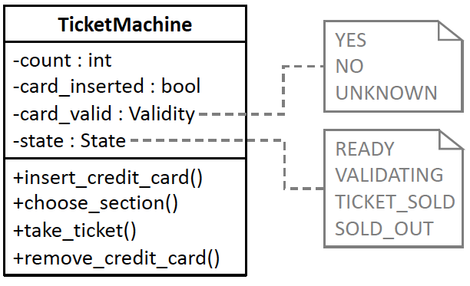
Before Using the State DP
Class TicketMachine is the heart of the first version of our ticket machine application. Its member variables keep track of the number of tickets, whether a credit card is inserted, the validity of the credit card, and the name of the current state. The public member functions implement the customer and machine actions.
13.1/Enums.h
13.1/TicketMachine.h
13.1/TicketMachine.cpp
13.1/tester.cpp

Slide 22
Before Using the State DP, cont’d
Action function 1: insert_credit_card()
Ticket machine state | Machine behaviors in each state
READY | If no card is already inserted, Write “Validating your credit card.” Set card_inserted to true. Set card_validity to unknown. Transition to the VALIDATING state. Else if the already inserted card is invalid, Write “Credit card rejected.” Write “Remove your card.” Else, Write “Remove the already-inserted card.”
VALIDATING | If the already inserted card is invalid, Write “Credit card rejected.” Write “Remove your card.” Transition to the READY state. Else, Write “You’ve already inserted your card.” Write “Checking its validation.”
TICKET_SOLD | Write “Take the ticket you’ve already bought.” Set card_inserted to true. Set card_validity to unknown.
SOLD_OUT | Write “Game sold out.” Write “Remove your card.” Set card_inserted to true. Set card_validity to unknown.

Slide 23
Before Using the State DP, cont’d
Action function 2: check_validity()
Ticket machine state | Machine behaviors in each state
READY | If no card is inserted, Write “First insert your credit card.” Else if the card is valid, Write “Remove the already-inserted credit card.” Else, Write “Credit card rejected.” Write “Remove your card.”
VALIDATING | If the card’s validity is unknown, Randomly set card_validity to either yes or no. If the card is valid, Write “Your credit card is validated.” Write “Take your ticket.” Transition to the TICKET_SOLD state. Else, Write “Credit card rejected.” Write “Remove your card.” Transition to the READY state.
TICKET_SOLD | Write “Take the ticket you’ve already bought.”
SOLD_OUT | Write “Game sold out.” If a card is inserted Write “Remove your card.”

Slide 24
Before Using the State DP, cont’d
Ticket machine state | Machine behaviors in each state
READY | If no card is inserted, Write “First insert your credit card.” Else if the card’s validity is unknown, Write “Still checking your card’s validity.” Else if the card is valid, Write “Take the ticket you’ve already bought.” Write “Remove your credit card.” Else, Write “*** Credit card rejected. ***” Write “Remove your credit card.”
VALIDATING | If the card’s validity is unknown, Write “Still checking your card’s validity.” Else if the card is valid, Write “Your card is already validated.” Write “Take your ticket.” Else, Write “*** Credit card rejected. ***” Write “Remove your card.”
TICKET_SOLD | Write “Remove your credit card.” Write “Enjoy the game!” Decrement the ticket count. If the ticket count > 0, Transition to the READY state. Else, Transition to the SOLD_OUT state.
SOLD_OUT | Write “Game sold out.” If a card is inserted, Write “Remove your card.”
Action function 3: take_ticket()

Slide 25
Before Using the State DP, cont’d
Action function 4: remove_credit_card()
Ticket machine state | Machine behaviors in each state
READY | If a card is inserted, Write “You’ve removed your credit card.” Else, Write “No credit card inserted.” Set card_inserted to false. Set card_validity to unknown.
VALIDATING | If no card is inserted, Write “No credit card inserted.” Else if the card is invalid, Write “*** Credit card rejected. ***” Write “Remove your card.” Else, Write “You removed your credit card. No sale.” Set card_inserted to false. Set card_validity to unknown. Transition to the READY state.
TICKET_SOLD | Write “First take your ticket.”
SOLD_OUT | If card is inserted, Write “You’ve removed your credit card.” Set card_inserted to false. Set card_validity to unknown. Else, Write “No credit card inserted.”

Slide 26
Problem with “Before”
The design is focused on actions, not states.
Multiple responsibilities. Class TicketMachine not only has to keep track of the machine’s state but it is also responsible for all the actions that occur in all the states.
All the application logic is concentrated in this one class.
The states’ behaviors are scattered among the class’s member functions.
Poor encapsulation. The states and their behaviors are not well encapsulated.
Inflexible code. If we need to modify, add, or remove ticket machine states and their actions, we will need to change the TicketMachine class.

Slide 27
The State Design Pattern
The State Design Pattern
“Allow an object to alter its behavior when its internal state changes. The object will appear to change its class.” [GoF 305]

Slide 28
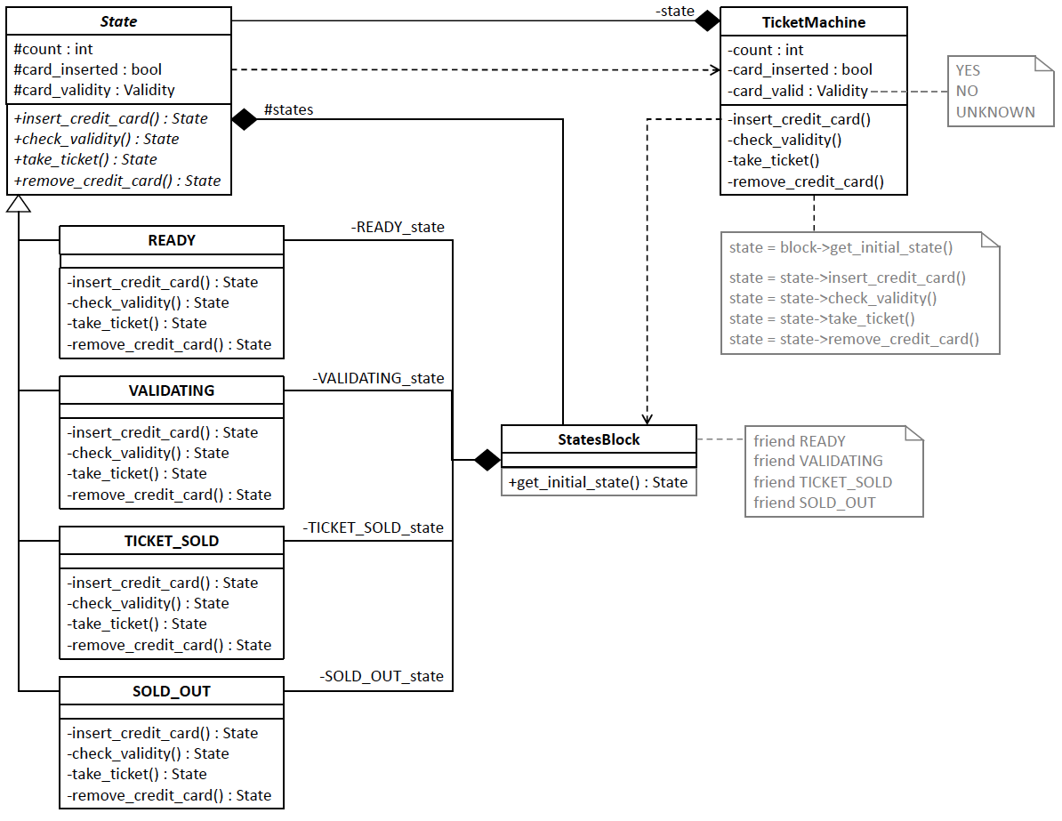
After Using the State DP
13.2/Enums.h
13.2/State.h
13.2/READY.cpp
13.2/VALIDATING.cpp
13.2/TICKET_SOLD.cpp
13.2/SOLD_OUT.cpp
13.2/StatesBlock.h
13.2/TicketMachine.h
13.2/TicketMachine.cpp
13.2/tester.cpp
The subclasses of superclass State encapsulate handling the customer and machine actions for each state of the ticket machine. Each action member function of the subclasses returns a State object that is the next state for the ticket machine to transition to. By aggregating the subclasses in class StatesBlock, the subclasses are loosely coupled with each other, and class TicketMachine is loosely coupled with the State subclasses. Each action member function of class TicketMachine defers to the corresponding member function of the current State object pointed to by the private state member variable.

Slide 29
Benefits of “After”
Encapsulated customer actions: Each State subclass encapsulates all the customer actions when the ticket machine is in the corresponding state. It will be possible to modify the behavior of a state or to remove or add states without changing the other State subclasses or class TicketMachine. This is the Encapsulate What Varies Principle.
Single responsibility classes: Class TicketMachine only has the responsibility to keep track of the values of its current state and the other member variables. It no longer is responsible for the customer actions of each state. This is the Single Responsibility Principle.
Loosely coupled classes: The State subclasses are loosely coupled with each other and class TicketMachine is loosely coupled with the State subclasses. Following the Principle of Least Knowledge, class TicketMachine has no dependencies on any of the State subclasses.

Slide 30
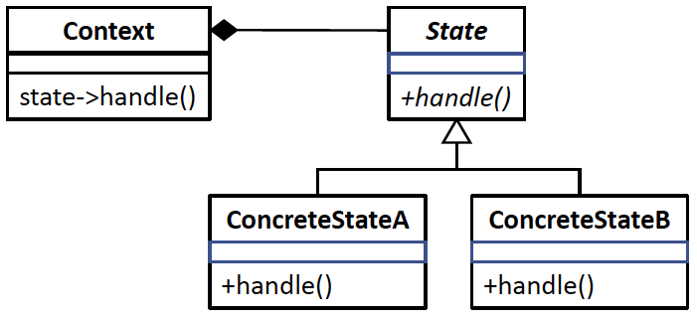
State DP Generic Model
The generic model of the State Design Pattern. Instead of the Context class aggregating the State subclasses as shown earlier, this figure shows the State subclasses encapsulated in the StatesBlock class, which allows the State subclasses to be loosely coupled with each other and the TicketMachine class to be loosely coupled with the State subclasses. Also in the previous figure, each of the customer action member functions returns the State object the ticket machine will transition to.
Design pattern | Applied by the example application
Class Context | Class TicketMachine (using class StatesBlock)
Superclass State | Superclass State
Subclasses ConcreteStateA, ConcreteStateB, etc. | Subclasses READY, VALIDATING, TICKET_SOLD, and SOLD_OUT
Member function handle() | Member functions insert_credit_card(), check_validity(), take_ticket(), and remove_credit_card()

Slide 31
Break

Slide 32
Intro to Multithreaded Programming
Knowing how to design and develop multithreaded applications allows us to take advantage of a computer’s ability to handle multiple threads of execution.
A properly designed multithreaded program can take better advantage of today’s multicore computers.
A thread is a path the computer takes through the code as it executes your program.
Multithreading means the computer is running multiple paths simultaneously.

Slide 33
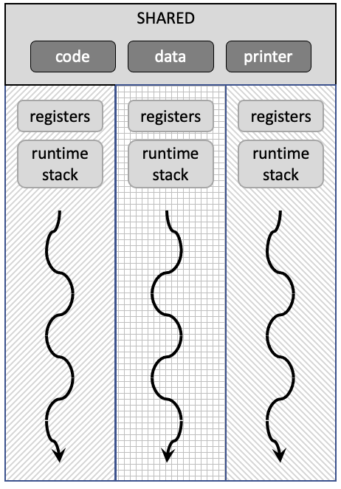
Conceptual View of Multithreading
An application’s code, data, and external resources are shared among the threads.
Each thread has its own runtime stack and a copy of the machine registers.

Slide 34
Simultaneous: Concurrency vs. Parallelism
Example: Planning for a dinner party.
Concurrent work by yourself:
Switch among simultaneous tasks of cleaning, cooking, setting the table, etc.
You can physically do only one task at a time.
Coordinate use of resources (mops, stove, pots and pans, etc.).
Parallel work with friends:
Friends do multiple tasks simultaneously.
Must coordinate use of resources.

Slide 35
Critical Regions and Mutual Exclusion
A multithreaded program must protect a shared resource so that multiple threads don’t step on each other.
Examples: data in memory, a printer, etc.
The critical region of a thread is its code that accesses a share resource.
Mutual exclusion allows only one thread at a time to be in its critical region.

Slide 36
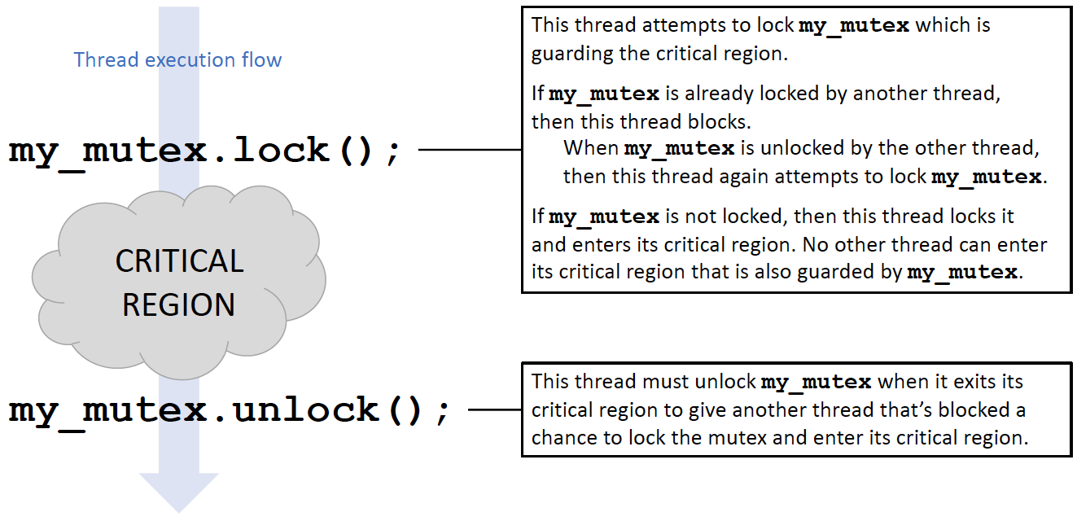
Mutex
A mutex is an object that enforces mutual exclusion.

Slide 37
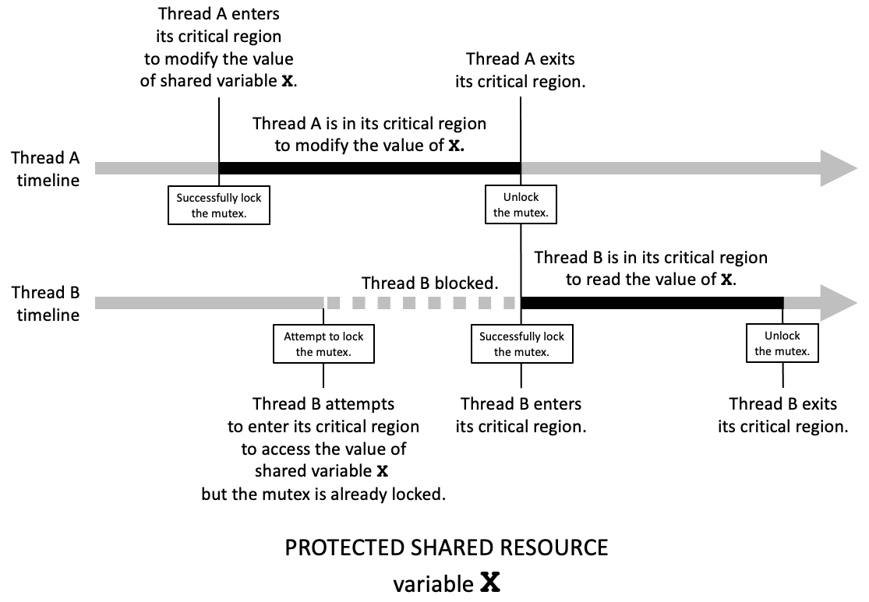
Locking and Unlocking a Mutex
The critical regions of threads A and B modify the same shared resource, variable X. A mutex object guards the critical regions. A thread that successfully locks the mutex can enter its critical region. Attempting to lock a mutex that’s already locked causes the thread to block. The thread that’s exiting its critical region must unlock the mutex to allow another thread to lock it.

Slide 38
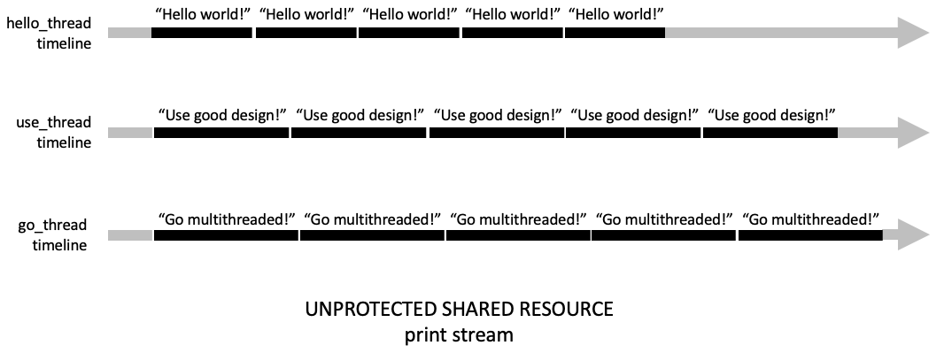
Multithreaded Printing
Multiple threads print simultaneously.
Shared resource: the output stream.
Without mutual exclusion:

Slide 39
Multithreaded Printing, cont’d
#include <iostream>
#include <string>
#include <thread>
using namespace std;
const int COUNT = 5;
void print(string text);
int main(void)
{
thread hello_thread(print, "Hello, world!\n");
thread use_thread(print, "Use good design!\n");
thread go_thread(print, "Go multithreaded\n");
hello_thread.join();
use_thread.join();
go_thread.join();
cout << endl << "Program done." << endl;
return 0;
}
void print(string text)
{
for (int i = 0; i < COUNT; i++)
{
for (const char &ch : text) cout << ch;
}
}
16.1/printing.cpp
Output:
Spawn threads
HelloUGo multithreadeds, world!
Hello, worle
G goo mod design!
Used!
He ugood llo, wordesiltithreagn!
Use gldo!
Helded
olo, worlddG!
Hel dlo o, wormulld!
tithreaded
Go multithreesign!
Use good desaded
Go mign!
Use good design!
ultithreaded
Program done.
Wait for threads to complete.
Function that each thread executes.

Slide 40
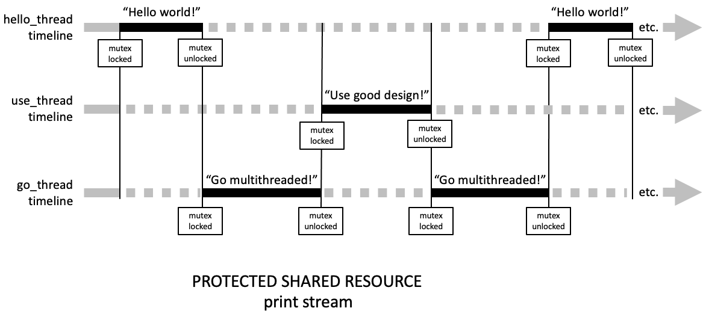
Multithreaded Printing, cont’d
With a mutex guarding the critical regions of the threads, only one thread at a time can print to the print stream, which is the shared resource. When a thread wants to enter its critical region, it attempts to lock the mutex. If it succeeds, it can enter its critical region and print. If it doesn’t, it blocks until another thread unlocks the mutex. Then, the thread can attempt to lock the mutex again. A thread must unlock the mutex before it exits its critical region. When the mutex is unlocked, the runtime system determines which blocked thread can unlock it.

Slide 41
Multithreaded Printing, cont’d
16.2/printing-MT.cpp
Output:
void print(string text)
{
for (int i = 0; i < COUNT; i++)
{
print_mutex.lock();
{
for (const char &ch : text) cout << ch;
}
print_mutex.unlock();
}
}
Hello, world!
Hello, world!
Hello, world!
Hello, world!
Go multithreaded!
Hello, world!
Use good design!
Use good design!
Use good design!
Use good design!
Use good design!
Go multithreaded!
Go multithreaded!
Go multithreaded!
Go multithreaded!
Program done.

Slide 42
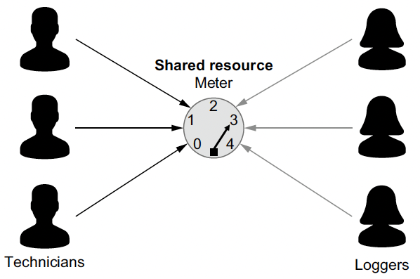
The Classic Reader Writer Problem
Multiple technicians (the writers) each makes several attempts to set the meter’s value.
Meanwhile, several loggers (the readers) attempt to read and log the meter’s current setting.
Three technicians simultaneously attempt to set the meter’s value; meanwhile, three loggers attempt to read and log the meter’s current setting. Therefore, the meter is the shared resource. Only one technician should be setting the meter at a time, and no logger should read the meter while a technician is setting it. However, unless a technician is setting the meter, multiple loggers can be reading it at the same time.

Slide 43
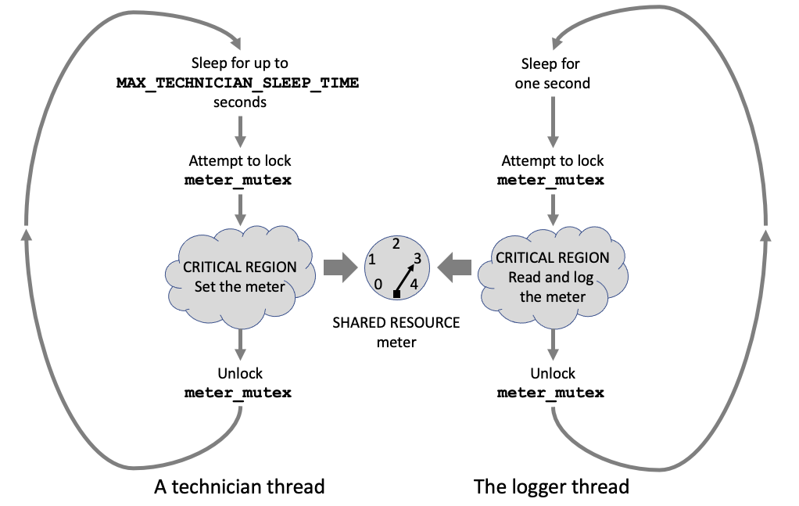
The Classic Reader Writer Problem, cont’d
The technician threads and the logger thread each loop and attempt to enter their critical regions to access the meter, which is the shared resource. The mutex prevents more than one technician thread at a time from setting the meter. The same mutex prevents a logger from reading and logging the meter’s value while a technician thread is setting the meter.

Slide 44
void Meter::set_meter(const int thread_id)
{
for (int turn = 1; turn <= TECHNICIAN_TURNS; turn++)
{
{
unique_lock<shared_mutex> writing_lock(meter_mutex);
{
printf("TECH #%d @%02d:", thread_id,
elapsed_seconds());
int level = rand()%MAX_SETTING_LEVEL + 1;
setting = level;
for (int n = 1; n <= level; n++)
{
this_thread::sleep_for(chrono::seconds(1));
printf("%2d", n);
cout.flush();
}
cout << endl;
if (turn == TECHNICIAN_TURNS)
{
printf("TECH #%d @%02d: done!\n",
thread_id, elapsed_seconds());
active_technicians_count--;
}
}
if (turn < TECHNICIAN_TURNS)
{
int sleep_time =
rand()%( MAX_TECHNICIAN_SLEEP_TIME
- MIN_TECHNICIAN_SLEEP_TIME + 1)
+ MIN_TECHNICIAN_SLEEP_TIME;
this_thread::sleep_for(chrono::seconds(sleep_time));
}
}
}
Unique lock
When a shared_mutex object is locked using a unique_lock object, no other thread can lock the same mutex using either a unique_lock or a shared_lock object.
A unique lock automatically unlocks when it goes out of scope.
16.3/Meter.cpp

Slide 45
void Meter::log_meter(const int thread_id)
{
while (true)
{
int setting_read;
int time_started;
{
shared_lock<shared_mutex> reading_lock(meter_mutex);
{
setting_read = setting;
time_started = elapsed_seconds();
this_thread::sleep_for(
chrono::seconds(LOGGING_TIME));
this_thread::sleep_for(
chrono::seconds(rand()%MAX_LOGGER_SLEEP_TIME + 1));
{
lock_guard<mutex> printing_lock(print_mutex);
{
printf("%*sLOGGER #%d @%02d: logging %d\n",
LOGGER_PRINT_MARGIN, " ",
thread_id, time_started,
setting_read);
}
}
if (active_technicians_count == 0) break;
}
}
this_thread::sleep_for(
chrono::seconds(rand()%MAX_LOGGER_SLEEP_TIME + 1));
}
}
Shared lock
When a shared_mutex object is locked using a shared_lock object, other threads can also lock the same mutex using a shared_lock object, but no other thread can lock the mutex using a unique_lock object.
A shared lock automatically unlocks when it goes out of scope.
16.3/Meter.cpp

Slide 46
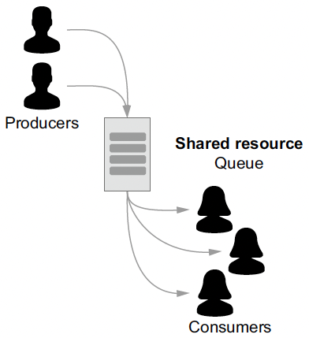
The Classic Producer-Consumer Problem
Some multithreaded applications require greater synchronization among their threads.
Mutexes and locks alone may not be sufficient.
Example: The producer–consumer application has multiple producer threads and consumer threads.
Simultaneously, the producer threads enter values into a data container such as a queue, and the consumer threads remove values from the queue.
The queue is the shared resource, and it has limited capacity.

Slide 47
Producer-Consumer Problem, cont’d
Critical regions
Producer: Its code that enters values into the queue.
Consumer: Its code that removes values from the queue.
We need a mutex to guard the critical regions.
Queue state
Assume that function data.size() returns the number of values currently in the shared queue and that constant CAPACITY is the limited capacity of the queue.

Slide 48
Producer-Consumer Problem, cont’d
Synchronization is needed!
data.size() == CAPACITY: If the queue is currently full, the producer threads must wait until the queue is no longer full before entering values.
data.size() == 0: If the queue is currently empty, the consumer threads must wait until the queue is no longer empty before removing values.
data.size() == 1: If the queue just became not empty, that is, a producer thread entered a value into the queue that was empty, that producer thread must notify all the consumer threads that were waiting for the queue to become not empty.
data.size() == CAPACITY–1: If the queue just became not full, that is, a consumer thread removed a value from the queue that was full, that consumer thread must notify all the producer threads that were waiting for the queue to become not full.

Slide 49
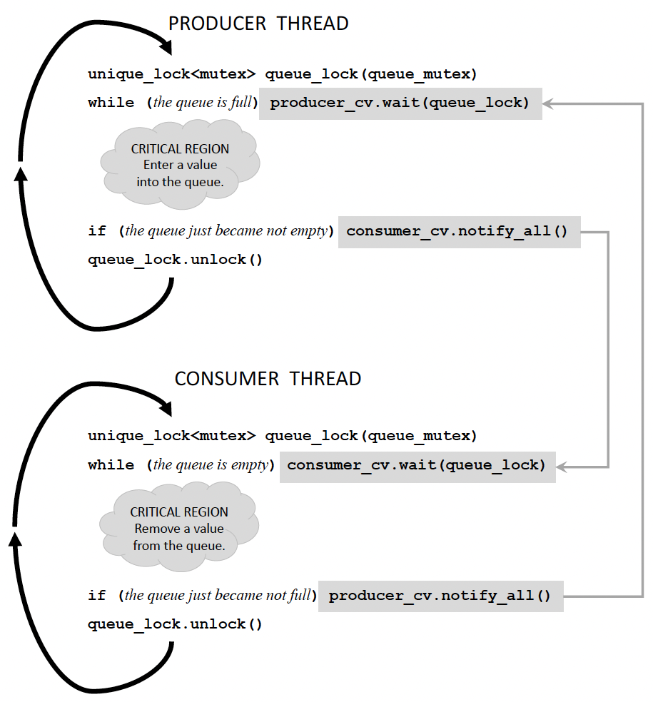
Condition Variables for Synchronization
The producer and consumer threads each creates a local unique lock object queue_lock from queue_mutex to guard its critical region.
The two condition variables, producer_cv and consumer_cv, work together to synchronize the producer and consumer threads.
The producer threads loop to enter values into the shared queue, and the consumer threads loop to remove values from the shared queue.
A producer thread cannot enter a value into the queue when the queue is full. A consumer thread cannot remove a value from an empty queue.

Slide 50
void Producer::produce(const int thread_id)
{
condition_variable& consumer_cv = consumer->get_cv();
for (int i = 0; i < producer_times; i++)
{
this_thread::sleep_for(
chrono::seconds(rand()%producer_rate));
{
unique_lock<mutex> queue_lock(shared_queue.get_mutex());
{
while (shared_queue.is_full())
{
producer_cv.wait(queue_lock);
}
data_value++;
shared_queue.enter(data_value.load());
print_spaces(thread_id);
printf("%4d (%1d) \n",
data_value.load(), shared_queue.size());
if (shared_queue.just_became_not_empty())
{
consumer_cv.notify_all();
}
}
}
}
active_producers_count--;
print_spaces(thread_id);
printf(" Done!\n");
if (active_producers_count.load() == 0)
{
consumer_cv.notify_all();
}
}
The producer attempts to enter data into the queue.
Attempt to lock the mutex.
Wait until the queue is no longer full.
Enter data into the queue.
Notify waiting consumers that the queue is no longer empty.
All the producers are done. Notify any waiting consumers.

Slide 51
void Consumer::consume(const int thread_id)
{
condition_variable& producer_cv = producer->get_cv();
while (true)
{
this_thread::sleep_for(
chrono::seconds(rand()%consumer_rate));
{
unique_lock<mutex> queue_lock(shared_queue.get_mutex());
{
while ( shared_queue.is_empty()
&& (producer->get_active_count() > 0))
{
consumer_cv.wait(queue_lock);
}
if (shared_queue.is_empty()) break;
int value = shared_queue.remove();
print_spaces(thread_id);
printf("%4d (%1d) \n",
-value, shared_queue.size());
if (shared_queue.just_became_not_full())
{
producer_cv.notify_all();
}
}
}
}
active_consumers_count--;
print_spaces(thread_id);
printf(" Done!\n");
}
The consumer attempts to remove data from the queue.
Attempt to lock the mutex.
Wait until the queue is no longer empty.
Remove data from the queue.
Notify waiting producers that the queue is no longer full.

Slide 52
Final Notes on Multithreading
It’s a major challenge to design and develop a multithreaded application.
Because the runtime system usually determines the order that threads are created and executed, timing issues can cause random and irreproducible behaviors from one run of the application to another.
Debugging then becomes a nightmare.
A deadlock can occur when all the threads are blocked, and the entire application hangs.

Slide 53
Final Notes on Multithreading, cont’d
Increasing the number of threads does not mean that an application’s execution time approaches zero!
Mutexes and condition variables have performance costs themselves.
The costs of context switching can overwhelm the benefit of having more threads.
Designing a multithreaded application can be a delicate balancing act if the goal is to increase performance without increasing complexity.

