Slide 1
CMPE 152: Compiler Design May 4 Class Meeting
Department of Computer Engineering San Jose State University Spring 2021 Instructor: Ron Mak
www.cs.sjsu.edu/~mak

Slide 2
Project Presentation Schedule
Thursday, May 6
CODENT
HZWZ
Programmers for Fun
The Compiler Whispers
WSRY
Tuesday, May 11
Devs United
JTTG
Team 300
To the Moon
Thursday, May 13
Elbrus-64
No Name 4
TTCP
Hakuna Matata
XXX
Two teams can trade dates
if both teams agree.
Final compiler project
due Monday, May 17

Slide 3
What to Present in at Most 15 Minutes
What is your source language?
Show us a sample program or two with parse trees.
Show us highlights of your grammar.
Grammar of a few interesting statements.
Excerpt from your .g4 file and syntax diagrams.
What Jasmin object code will you generate?
Show code templates for a few statements.
Show actual Jasmin code if you have any.
Optional: Compile and run a program.
Screen share (any of these):
PowerPoint slides
Example programs
Diagrams
Jasmin object code
Demos
Take some questions at
the end from the class.

Slide 4
Surveys
The rest of the class will rate each presentation (Excellent, Good, OK, Poor) on the following:
Choice of source language
Sample programs and parse trees
Grammar
Proposed (or actual) Jasmin object code generation
Overall presentation
Do not rate your own team!

Slide 5
Compiler Design Theory
A very brief introduction to the theory upon which compiler design (especially parsing and scanning) is based.
Often taught at the start of a compiler design course, but I chose to start by jumping right into writing a parser and a scanner.
So now you’re getting this material at the very end of the course.

Slide 6
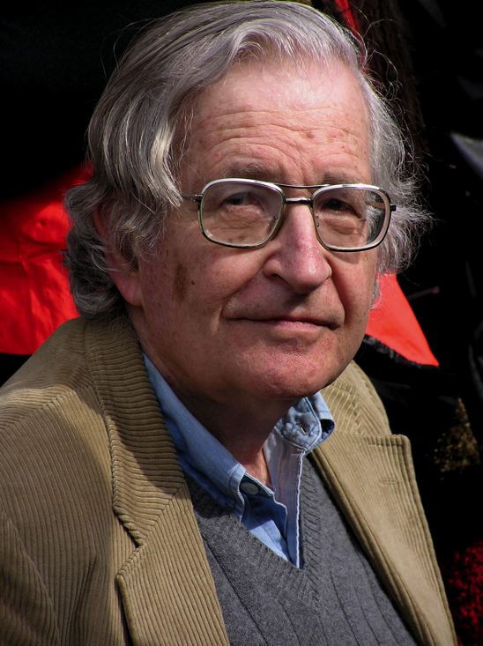
Noam Chomsky
American, born 1928
Linguist and political activist
Created mathematical models for the description of languages (1956).
Pioneered the study of programming languages.
Why are programming languages easy for a computer to understand but human languages are very difficult?

Slide 7
Formal Languages
The study of languages in a very formal way, hence the term formal languages.
Which sentences belong to a language, and which ones don’t?
What operations can we perform on sentences from a language and have the result be in the language?

Slide 8
The Language Game
Our study of formal languages starts out like a game.
As with any other game, it has rules.
The rules determine what sentences belong to the language.
The goal of the game is simple:
Given an arbitrary sentence, determine if it belongs to the language.

Slide 9
Example: The English Language
The rules of the English language are its grammar rules.
The grammar rules determine whether or not a given sentence belongs to the English language. Is the sentence “proper English”?
Which are proper English sentences?
The dog chased the cat.
My hearing ran the water.
Table fourteen chair happy.

Slide 10
Some Basic Terms
English is much too complex a language.
Let’s instead start with some basic terms.
Let Σ represent a nonempty set of symbols called an alphabet.
We can construct finite strings of symbols from the alphabet.
sigma

Slide 11
String Examples
Let alphabet Σ = {a, b}.
Then abab and aaabbba are strings on Σ.
If we write it means that the string named w has the value abaaa.
w = abaaa
By convention, we use lowercase letters a, b, c, …
for elements in Σ and u, v, w, ... for string names.

Slide 12
Some Basic Terms, cont’d
If string w = a₁a₂…a_{n} and string v = b₁b₂...b_{m} then wv = a₁a₂…a_{n}b₁b₂...b_{m} is the concatenation of strings w and v.
String w^{R} = a_{n}... a₂a₁ is the reverse of string w.
|w| is the length of string w.
The number of symbols in the string.
λ is the empty string.
|λ| = 0
λw = wλ

Slide 13
Substrings
A substring of string w is any string of consecutive symbols of w.
If w = vu, then the substring v is a prefix of w, and the substring u is a suffix of w.
Example: If w = abbab, then
All prefixes: {λ, a, ab, abb, abba, abbab}
All suffixes: {λ, b, ab, bab, bbab, abbab}
If u and v are strings, then |uv| = |u| + |v|.

Slide 14
More Basic Terms
If w is a string, then w^{n} is the string obtained by repeating w n times.
Special case: w⁰ = λ for all w.
If Σ is an alphabet, then Σ* is the set of strings obtained by concatenating zero or more symbols from Σ.
Σ* always contains λ
Σ⁺ = Σ* - {λ} is the set of all nonempty strings
Even though Σ is finite, Σ* and Σ⁺ are infinite since there is no limit on the string lengths.
The * operator is known
as the Kleene star.

Slide 15
We Have Languages!
Recall that a language has rules that determine whether a given string is a sentence in the language.
We often refer to strings in a language as sentences.
Therefore, any subset of Σ* is a language.
The rules are those that determine membership in the subset.

Slide 16
Example Languages
Let Σ* = {λ, a, b, aa, ab, ba, bb, aaa, aab, …}
The subset {a, aa, aab} is a language on Σ.
The membership rule is trivial since we explicitly listed the members of the subset.
It is a finite language because it contains a finite number of sentences.

Slide 17
Example Languages, cont’d
Let Σ* = {λ, a, b, aa, ab, ba, bb, aaa, aab, …}
The subset is a language on Σ.
The strings aabb and aaaabbbb are sentences in L.
The string abb is not a sentence in L.
This is an infinite language.
Most interesting languages are infinite.
L = {a^{n}b^{n} : n ≥ 0}

Slide 18
Languages are Sets
We can calculate the union, intersection, and difference of two languages.
The complement of language L is
The reverse of a language is the set of all string reversals:
L^{R} = {w^{R} : w in L}

Slide 19
Languages are Sets, cont’d
The concatenation of two languages L₁ and L₂:
L^{n} is L concatenated with itself n times.
L⁰ = {λ} and L¹ = L
Star closure
Positive closure
L₁L₂ = {xy : x in L₁, y in L₂}
Infinite sets!

Slide 20
Example Languages, cont’d
Let
Then
n and m are unrelated.
The string aabbaaabbb is in L².
The reverse

Slide 21
Rules of a Language
The rules of a language must enable us to decide, in a finite amount of time, whether a given string is a sentence of the language.
Two kinds of rules:
Rules that tell us whether or not a string is a sentence of the language.
Rules that tell us how to generate all the sentences of the language.

Slide 22
Example Languages, cont’d
Let L₁ = {aa, b}
Then
L₁* = {λ plus any string composed of factors of aa and b}
= {λ plus all strings of a’s and b’s where the a’s are in even groups

Slide 23
Example Languages, cont’d
Let L₂ = {a, ab}
Then
Is the string abaab a sentence of L₂*?
Yes. We can factor the string as (ab)(a)(ab) and each factor is in L₂.
This factoring is unique.
L₂* = {λ plus any string composed of factors of a and ab}
= {λ plus all strings of a’s and b’s except those that start with b
and those that contain any double b}

Slide 24
Example Languages, cont’d
Let L₃ = {aa, aaa}
Then
Is the string a⁷ = aaaaaaa a sentence of L₃*?
Yes. We can factor the string as (aa)(aa)(aaa) or (aa)(aaa)(aa) or (aaa)(aa)(aa).
This factoring is not unique.
L₃* = {λ plus any string composed of more than one a}

Slide 25
Grammars
The grammar of a language is the set of rules that determine whether or not a sentence is in the language.
Example: From English grammar:
If <article> is “a” or “the”, <noun> is “boy” or “dog”, and <verb> is “runs” or “walks”, then proper sentences are “a boy runs” and “the dog walks”.
<sentence> → <noun phrase> <predicate>
<noun phrase> → <article> <noun>
<predicate> → <verb>

Slide 26
Grammars, cont’d
A grammar G is defined as the quadruple where:
V is a finite set of objects called variables
T is a finite set of objects called terminal symbols
S in V is a special symbol called the start variable
P is a finite set of production rules
G = (V, T, S, P)

Slide 27
Production Rules
The production rules specify how the grammar transforms one string to another.
They define a language associated with the grammar.
All production rules are of the form where and
x → y

Slide 28
Derivations
If we apply to the string the production rule we obtain the new string
We say that w derives z, or z is derived from w and write
w = uxv
x → y
z = uyv

Slide 29
Derivations, cont’d
We can derive successive strings by applying production rules of the grammar in any order.
We can use a production rule whenever it is applicable, and we can apply it as often as we desire.
If then w₁ derives w_{n}, and we can write
*

Slide 30
Language Generation by a Grammar
By applying the production rules in a different order, a grammar can generate many strings.
The set of all such terminal strings is the language generated by the grammar.
AKA the language defined by the grammar.
Let G = (V, T, S, P) be a grammar. Then the set is the language generated by G.
*

Slide 31
Sentential Forms
If , then the sequence is a derivation of the sentence w.
The strings S, w₁, w₂, …, w_{n} are sentential forms of the derivation.
Sentential forms can contain both variables and terminals.

Slide 32
Grammar Examples
Let grammar with P given by
Then so we can write
Therefore, the string aabb is in the language
sentential forms
*
L(G) = {a^{n}b^{n} : n ≥ 0}

Slide 33
Grammar Examples, cont’d
Find a grammar that generates the language
The language is similar to the previous example but with an extra b. We add the production rule
Therefore, G = ({S, A}, {a, b}, S, P) with the production rules
L = {a^{n}b^{n+1} : n ≥ 0}
S → Ab
S → Ab
A → aAb
A → λ
Or:
S → Ab
A → aAb | λ

Slide 34
Equivalent Grammars
Two grammars are equivalent if they both generate the same language:
It is not always easy to discover whether or not two grammars are equivalent.
L(G₁) = L(G₂)

