Slide 1


CMPE 152: Compiler Design
April 27 Class Meeting
Department of Computer Engineering
San Jose State University
Spring 2021
Instructor: Ron Mak
www.cs.sjsu.edu/~mak

Slide 2
Runtime Memory Management
In the “Pascal Virtual Machine” all local data is kept on the runtime stack.
  All memory for the parameters and variables declared locally by a routine is allocated in the routine’s stack frame.
PROGRAM main1
FUNCTION func2
FUNCTION func3
PROCEDURE proc2
PROCEDURE proc3
SF: proc2
SF: func3
AR: proc3
SF: func2
SF: proc3
3
SF: proc2
2
1
SF: main1
RUNTIME
DISPLAY
RUNTIME STACK
main1
➔ proc2
➔ proc3
➔ func2
➔ func3
➔ proc2
  The memory is later automatically deallocated when the stack frame is popped off the stack.

Slide 3
Runtime Memory Management, cont’d
What about dynamically allocated data?
Memory for dynamically allocated data
is kept in the “heap”.

Slide 4
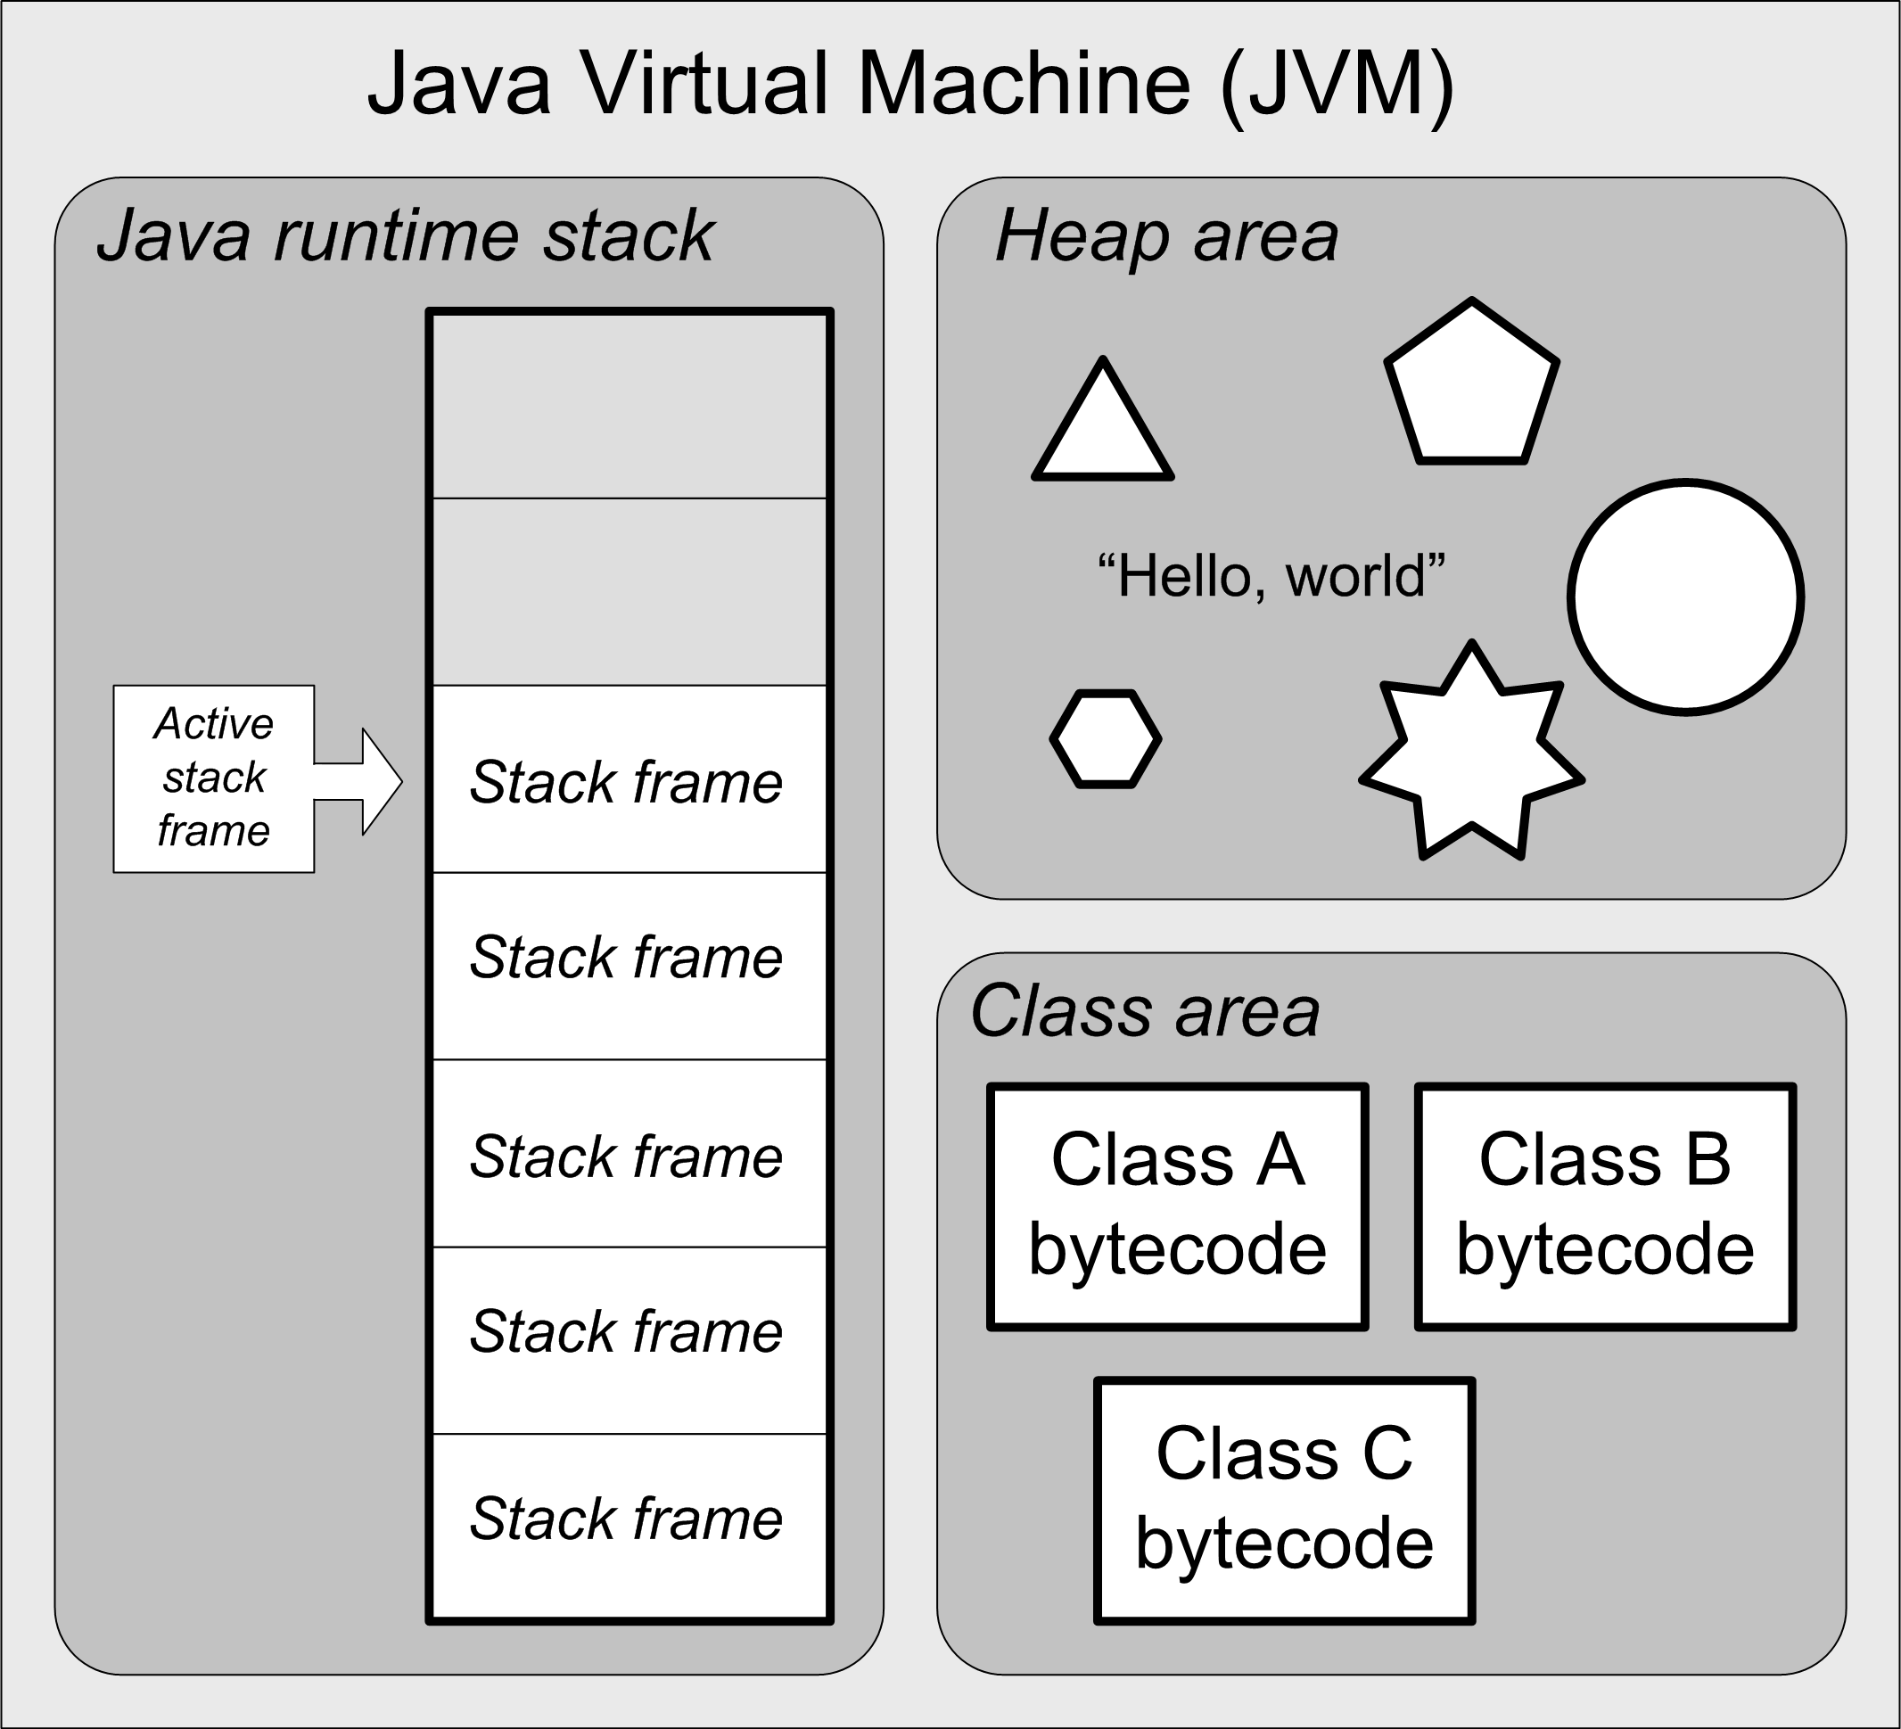
Recall the JVM Architecture ...

Slide 5
Runtime Memory Management, cont’d
Runtime memory can be divided into four partitions:
  Static memory
    executable code
    statically-allocated data
  Runtime stack
    activation records that contain locally-scoped data
  Heap
    dynamically-allocated data
    such as Java objects
  Free memory
Heap
Heap limit
Free memory
Top of stack
Runtime stack
Statically-allocated data
Executable code
Avoid: Heap-stack collision
(Out of memory error)

Slide 6
Runtime Heap Management
Handled by language-specific runtime routines.
Pascal, C, and C++
  Call new or malloc to allocate memory.
  Call delete or free to de-allocate.
Java
  Call new to allocate memory.
  Automatic garbage collection.
New C++ “smart pointers”
do automatic deletes.

Slide 7
Runtime Heap Management, cont’d
Keep track of all allocated blocks of memory
and all free blocks.
Free blocks are “holes” caused by freeing some of the dynamically allocated objects.

Slide 8
Runtime Heap Management, cont’d
When a new object needs to be allocated dynamically, where in the heap should you
put it?
  You can allocate it at the end of the heap,
  and thereby expand the size of the heap.
  You can find a hole within the heap
  that’s big enough for the object.

Slide 9
Runtime Heap Management, cont’d
What’s the optimal memory allocation strategy?
  Find the first hole that the object will fit in.
  Find the smallest possible hole
  that the object will fit in.
  Randomly pick any hole that’s big enough.

Slide 10
Runtime Heap Management, cont’d
Should you periodically compact the heap
to get rid of holes and thereby
reduce the size of the heap?
If an allocated object moves due to compaction,
how do you update references (pointers)
to the object?

Slide 11
Garbage Collection
Return the memory occupied by an object
to unallocated status …
  … when there are no longer any references to the object (“garbage”) and therefore it is inaccessible.
  That memory becomes a freed block (a “hole”).
Invented by computer scientist John McCarthy in 1959 to automatically manage runtime memory for his language Lisp.

Slide 12
Garbage Collection Algorithms
Reference counts
Mark and sweep
Stop and copy
Generational
... plus others

Slide 13
Automatic Garbage Collection
Automatic garbage collection is great
for us programmers, because we don’t
have to think about it and write code
to free unused objects.
But it can slow runtime performance unpredictably.
  Don’t write mission-critical real-time applications
  in a language that has automatic garbage collection, unless you can programmatically turn GC off when necessary.

Slide 14
Garbage Collection: Reference Counts
Include a counter with each block
of allocated memory.
  Increment the counter each time
  a pointer is set to point to the block.
  Decrement the counter whenever a pointer
  to the block is set to null (or to point elsewhere).
  Deallocate the block when the counter reaches 0.
Problem: Cyclic graphs
  The reference counts
  never become 0.

Slide 15
Garbage Collection: Mark and Sweep
A type of tracing garbage collection.
  Trace which objects are reachable by a chain of references from pointers within stack frames.
Periodically make a pass over the heap to
mark all reachable objects.
  Various marking algorithms.
  This can happen concurrently with program execution.
Make a second pass to sweep (deallocate) objects that are not marked.

Slide 16
Garbage Collection: Stop and Copy
Partition the heap into two halves.
  Allocate memory only in one half at a time.
When an allocation fails to find a sufficiently large block of free memory …
  Stop
  Copy all allocated blocks to the other half of the heap,
  thereby compacting it.
  Update all references to objects in the allocated blocks.
    How do you update pointer values?

Slide 17
Generational Garbage Collection: Theory
Most objects are short-lived.
Long-lived objects are likely to last
until the program terminates.

Slide 18
Generational Garbage Collection: Practice
Partition the heap into a new generation area and an old generation area.
  Allocate new objects in the new generation area.
  Keep track of how long an object lives.
  Once an object lives past a predetermined threshold of time, migrate it to the old generation area.
The old generation area stays fairly compacted.
The new generation area needs compacting infrequently.

Slide 19
Aggressive Heap Management
Aggressive heap management means doing garbage collection frequently, even when
it’s not necessary.
  There’s still adequate free space remaining
  in the heap area.
Keep the heap as small as possible.
  Improve reference locality.
  Optimize the use of physical memory
  when multiple programs are running.
  Reduce virtual memory paging.

Slide 20
Aggressive Heap Management: Tradeoff
GC operations slow program performance.
But paging to disk can be
orders of magnitude slower.

Slide 21
Garbage Collection Research
Entire books have been written about
garbage collection.
It’s still an area with opportunities for research.
You can become famous by inventing
a better GC algorithm!
Maybe some form of adaptive GC
using machine learning?
  Train the GC algorithm on the types of programs
  that you typically run.

