Slide 1


CMPE 152: Compiler Design
April 22 Class Meeting
Department of Computer Engineering
San Jose State University
Spring 2021
Instructor: Ron Mak
www.cs.sjsu.edu/~mak

Slide 2
Static Scoping
Pascal uses
static (lexical) scoping.
Scopes are determined
at compile time by
how the routines are
nested in the source
program.
At runtime, variables are bound to their values as determined by the lexical scopes.
The runtime display helps do the bindings.
PROGRAM main1
FUNCTION func2
FUNCTION func3
PROCEDURE proc2
PROCEDURE proc3
SF: proc2
SF: func3
AR: proc3
SF: func2
SF: proc3
3
SF: proc2
2
1
SF: main1
RUNTIME
DISPLAY
RUNTIME STACK
main1
➔ proc2
➔ proc3
➔ func2
➔ func3
➔ proc2

Slide 3
Static Scoping in C++
What value is returned by calling function g()?
What is the binding
of this x with
static scoping?
int x = 0;
int f() { return x ; }
int g() { int x = 1; return f(); }

Slide 4
Dynamic Scoping
With dynamic scoping, runtime binding of variables to their values is determined
at run time by the call chain.
To determine a variable’s binding,
search the call chain backwards
starting with the currently active routine.
The variable is bound to the value
of the first declared variable found
with the same name.

Slide 5
Hypothetical Dynamic Scoping in C++
What value is returned by calling function g()?
  Call chain: main → g → f
What is the binding
of this x with
dynamic scoping?
  int x = 0;
  int f() { return x ; }
  int g() { int x = 1; return f(); }
How would you implement
runtime dynamic scoping?

Slide 6
Backend Architecture
Namespace backend
  backend::interpreter
  backend::debugger
  backend::converter
  backend::compiler

Slide 7
Backend Compiler Helper Classes
Label
  Generate statement labels in the form Lindex
  where index is a counter.
  The first generated label is L001.
Directive
  An enumeration class of assembler directives: .class, .method, .field, .var, .limit, etc.

Slide 8
Backend Compiler Helper Classes, cont’d
LocalVariables
  Maintain use of the local variables array in the
  stack frame of a procedure or function.
  Reserve slots for use by the local variables and parameters.
  Search for unused slots to reserve.
  Release slots that are no longer used.
  Count how many slots are used so that an accurate .limit locals directive can be emitted.

Slide 9
Backend Compiler Helper Classes, cont’d
LocalStack
  Maintain use of the operand stack in the
  stack frame of a procedure or function.
  As Jasmin code is being emitted, keep track of the size of the stack when that code is later executed.
  Member functions increase() and decrease() monitor the stack size.
  Return the maximum size of the stack so that an accurate .limit stack directive can be emitted.

Slide 10
Backend Compiler Helper Classes, cont’d
CodeGenerator
  LocalVariables and LocalStack fields.
  Emit Jasmin instructions, labels, and directives.
  Emit comments and blank lines.
  Overloaded emit() and emitDirective() functions.
  Emit code sequences to load and store variable values and constants. Check for:
    Local vs. program variables
    Regular vs. shortcut instructions
  Emit code for array elements and record fields.

Slide 11
Backend Compiler Helper Classes, cont’d
CodeGenerator, cont’d
  Miscellaneous code emitters:
    Type checking and casting
    Function return values
  Utilities
    Datatype names
    String conversion
    etc.

Slide 12
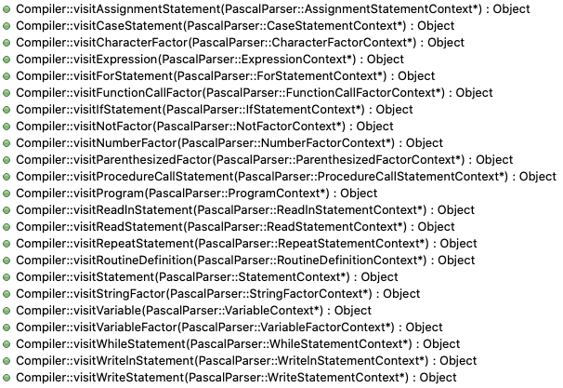
Visit Member Functions in Class Compiler
Most of the work is delegated
to helper classes:
ProgramGenerator
StructuredDataGenerator
StatementGenerator
ExpressionGenerator

Slide 13
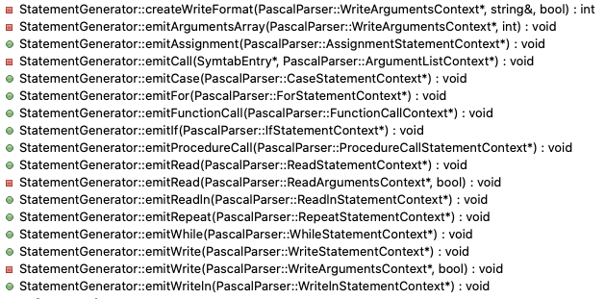
Class StatementGenerator

Slide 14
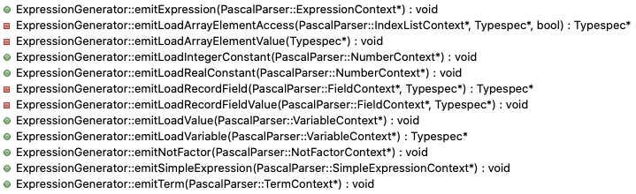
Class ExpressionGenerator

Slide 15
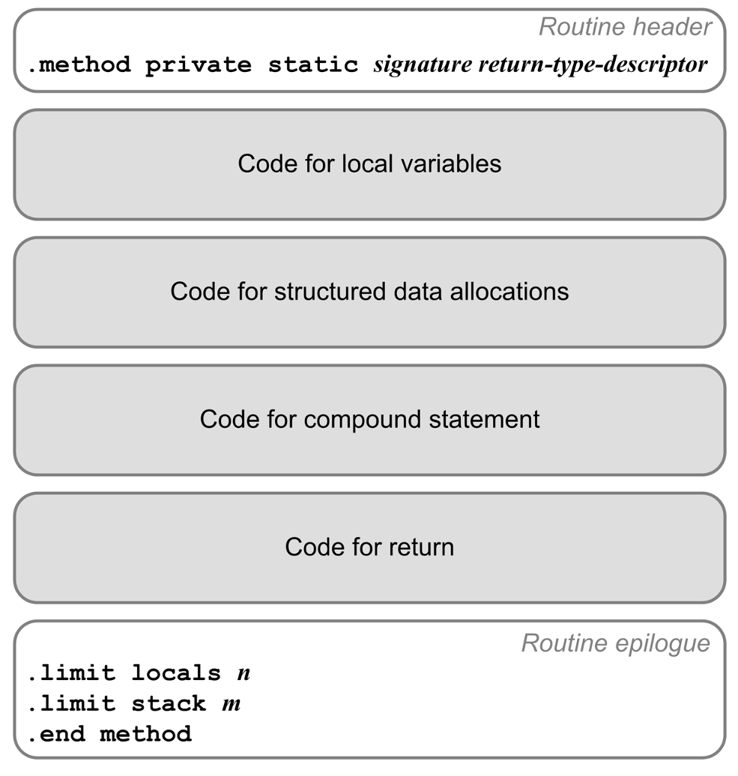

Class StructuredDataGenerator

Slide 16
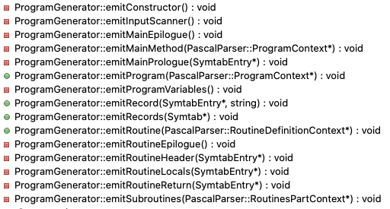
Class ProgramGenerator

Slide 17
Class ProgramGenerator, cont’d
void ProgramGenerator::emitProgram(PascalParser::ProgramContext *ctx)
{
programId = ctx->programHeader()->programIdentifier()->entry;
Symtab *programSymtab = programId->getRoutineSymtab();
localVariables = new LocalVariables(programLocalsCount);
emitRecords(programSymtab);
emitDirective(CLASS_PUBLIC, programName);
emitDirective(SUPER, "java/lang/Object");
emitProgramVariables();
emitInputScanner();
emitConstructor();
emitSubroutines(ctx->block()->declarations()->routinesPart());
emitMainMethod(ctx);
}

Slide 18
Class ProgramGenerator, cont’d
void ProgramGenerator::emitMainMethod(PascalParser::ProgramContext *ctx)
{
emitLine();
emitComment("MAIN");
emitDirective(METHOD_PUBLIC_STATIC,
"main([Ljava/lang/String;)V");
emitMainPrologue(programId);
// Emit code to allocate any arrays, records, and strings.
StructuredDataGenerator structureCode(this, compiler);
structureCode.emitData(programId);
// Emit code for the compound statement.
emitLine();
compiler->visit(ctx->block()->compoundStatement());
emitMainEpilogue();
}

Slide 19
Class ProgramGenerator, cont’d
void ProgramGenerator::emitMainEpilogue()
{
// Print the execution time.
emitLine();
emit(INVOKESTATIC, "java/time/Instant/now()Ljava/time/Instant;");
localStack->increase(1);
emit(ASTORE_2);
emit(ALOAD_1);
emit(ALOAD_2);
emit(INVOKESTATIC,
string("java/time/Duration/between(Ljava/time/temporal/Temporal;") +
string("Ljava/time/temporal/Temporal;)Ljava/time/Duration;"));
localStack->decrease(1);
emit(INVOKEVIRTUAL, "java/time/Duration/toMillis()J");
localStack->increase(1);
emit(LSTORE_3);
...

Slide 20
Class ProgramGenerator, cont’d
...
emit(GETSTATIC, "java/lang/System/out Ljava/io/PrintStream;");
emit(LDC, "\"\\n[%,d milliseconds execution time.]\\n\"");
emit(ICONST_1);
emit(ANEWARRAY, "java/lang/Object");
emit(DUP);
emit(ICONST_0);
emit(LLOAD_3);
emit(INVOKESTATIC, "java/lang/Long/valueOf(J)Ljava/lang/Long;");
emit(AASTORE);
emit(INVOKEVIRTUAL,
string("java/io/PrintStream/printf(Ljava/lang/String;") +
string("[Ljava/lang/Object;)Ljava/io/PrintStream;"));
localStack->decrease(2);
emit(POP);
emitLine();
emit(RETURN);
emitLine();
emitDirective(LIMIT_LOCALS, localVariables->count());
emitDirective(LIMIT_STACK, localStack->capacity());
emitDirective(END_METHOD);
close(); // the object file
}

Slide 21
Class ProgramGenerator, cont’d
void ProgramGenerator::emitRoutine(PascalParser::RoutineDefinitionContext *ctx)
{
SymtabEntry *routineId = ctx->procedureHead() != nullptr
? ctx->procedureHead()->routineIdentifier()->entry
: ctx->functionHead()->routineIdentifier()->entry;
Symtab *routineSymtab = routineId->getRoutineSymtab();
emitRoutineHeader(routineId);
emitRoutineLocals(routineId);
// Generate code to allocate any arrays, records, and strings.
StructuredDataGenerator structuredCode(this, compiler);
structuredCode.emitData(routineId);
localVariables = new LocalVariables(routineSymtab->getMaxSlotNumber());
// Emit code for the compound statement.
PascalParser::CompoundStatementContext *stmtCtx =
(PascalParser::CompoundStatementContext *) routineId->getExecutable();
compiler->visit(stmtCtx);
emitRoutineReturn(routineId);
emitRoutineEpilogue();
}

Slide 22
Class ProgramGenerator, cont’d
void ProgramGenerator::emitRoutineReturn(SymtabEntry *routineId)
{
emitLine();
// Function: Return the value in the implied function variable.
if (routineId->getKind() == FUNCTION)
{
Typespec *type = routineId->getType();
// Get the slot number of the function variable.
string varName = routineId->getName();
SymtabEntry *varId = routineId->getRoutineSymtab()->lookup(varName);
emitLoadLocal(type, varId->getSlotNumber());
emitReturnValue(type);
}
// Procedure: Just return.
else emit(RETURN);
}

Slide 23
Class ProgramGenerator, cont’d
void ProgramGenerator::emitRoutineEpilogue()
{
emitLine();
emitDirective(LIMIT_LOCALS, localVariables->count());
emitDirective(LIMIT_STACK, localStack->capacity());
emitDirective(END_METHOD);
}

