Slide 1


CMPE 152: Compiler Design
April 15 Class Meeting
Department of Computer Engineering
San Jose State University
Spring 2021
Instructor: Ron Mak
www.cs.sjsu.edu/~mak

Slide 2
A Free Compiler Book!
A compiler textbook first published in 1979:
http://www.eis.mdx.ac.uk/staffpages/r_bornat/books/compiling.pdf
A bit dated, but free to download.
  2.6 MB PDF.

Slide 3
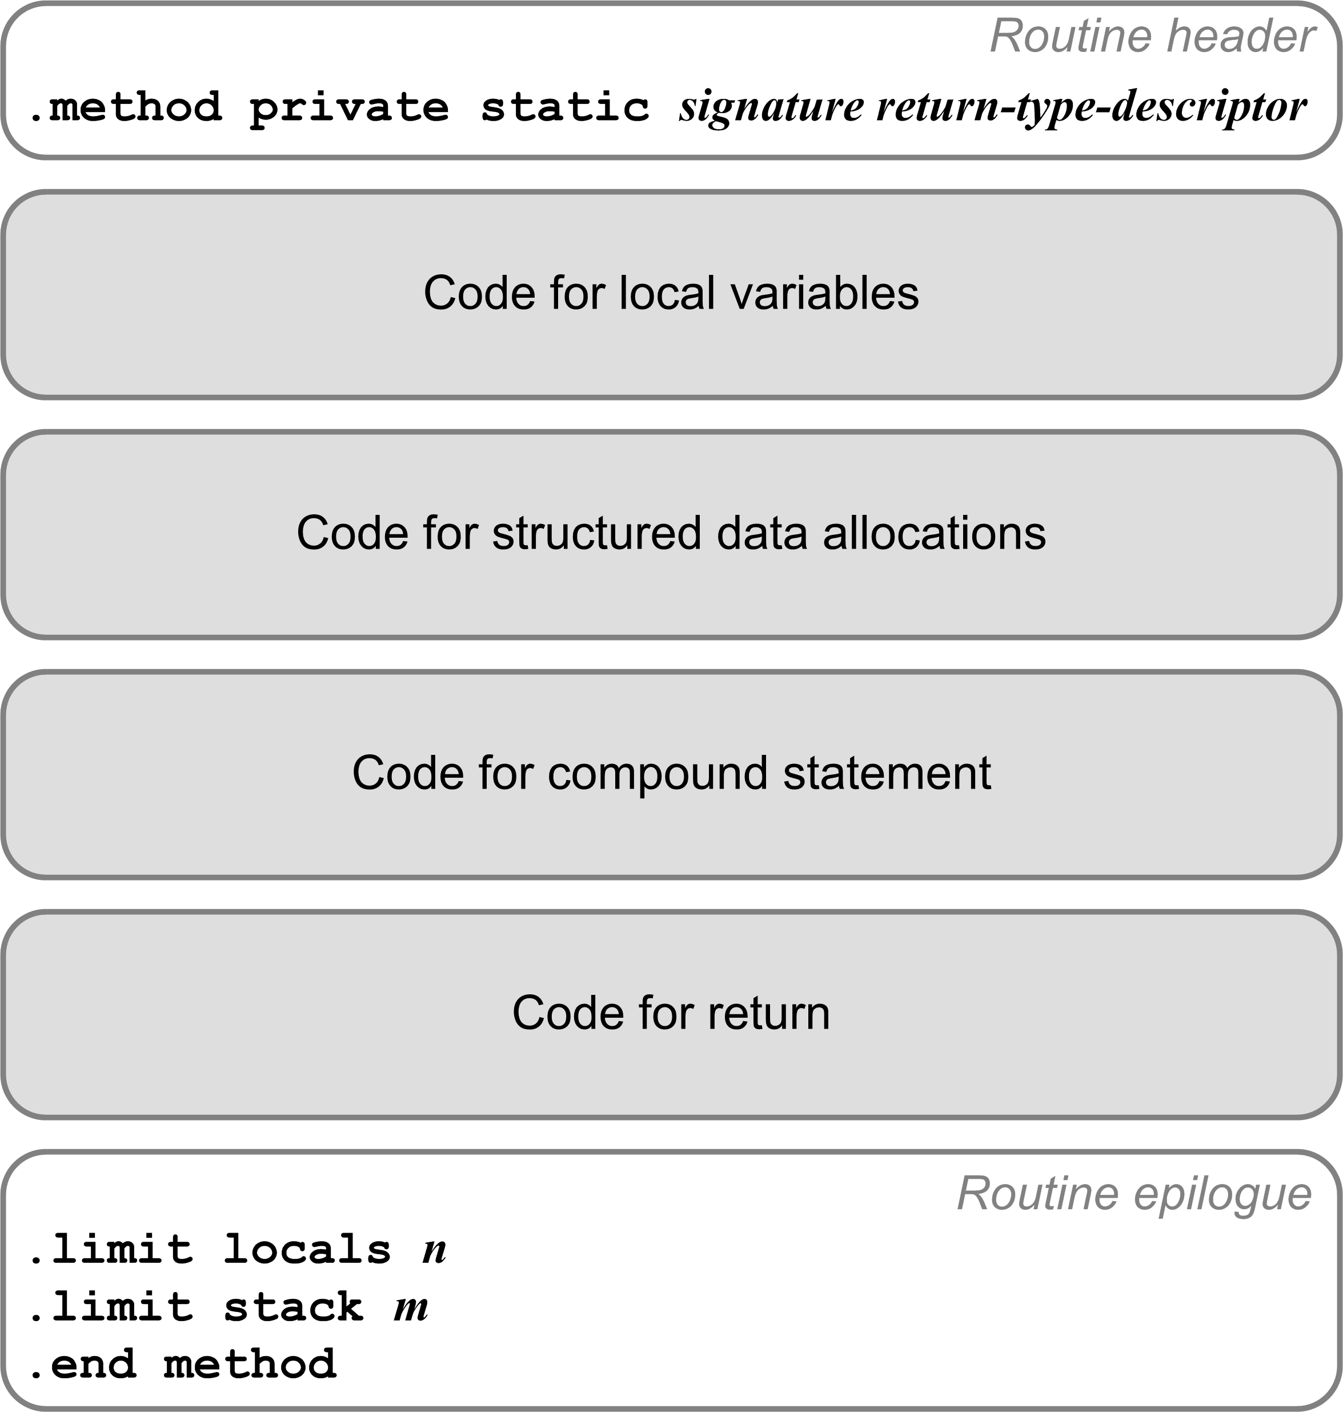
Records and Fields
Recall the code template for a Jasmin method.
Code to allocate records here!
Implement the value of each Pascal record variable as a static nested Java class that has only fields.
Notes:
start here

Slide 4
Records and Fields, cont’d
Pascal program:
PROGRAM TestRecord;
TYPE
PersonRec = RECORD
firstName : string;
lastName : string;
age : integer;
phones : ARRAY [0..1] OF string;
END;
VAR
john : PersonRec;
age : integer;
name : string;
BEGIN
john.age := 24;
age := john.age;
END.

Slide 5
Records and Fields, cont’d
Equivalent Java:
public class TestRecord
{
public static class personrec
{
String firstname;
String lastname;
int age;
String phones[];
}
private static personrec john;
private static int age;
private static String name;
public static void main(String[] args)
{
john = new personrec();
john.phones = new String[2];
john.age = 24;
age = john.age;
}
}
PROGRAM TestRecord;
TYPE
PersonRec = RECORD
firstName : string;
lastName : string;
age : integer;
phones : ARRAY [0..1] OF string;
END;
VAR
john : PersonRec;
age : integer;
name : string;
BEGIN
john.age := 24;
age := john.age;
END.

Slide 6
TestRecord$personrec.j
TYPE
PersonRec =
RECORD
firstName : string;
lastName : string;
age : integer;
phones :
ARRAY [0..1] OF string;
END;
.class public TestRecord$personrec
.super java/lang/Object
.field age I
.field firstname Ljava/lang/String;
.field lastname Ljava/lang/String;
.field phones [Ljava/lang/String;
;
; Class constructor
;
.method public <init>()V
.var 0 is this LTestRecord$personrec;
aload_0
invokespecial java/lang/Object/<init>()V
return
.limit locals 1
.limit stack 1
.end method
The Pascal record PersonRec compiles into a separate Jasmin class TestRecord$personrec.

Slide 7
TestRecord.j (Excerpt)
TYPE
PersonRec =
RECORD
firstName : string;
lastName : string;
age : integer;
phones :
ARRAY [0..1] OF string;
END;
VAR
john : PersonRec;
age : integer;
name : string;
BEGIN
john.age := 24;
age := john.age;
END.
new TestRecord$personrec
dup
invokespecial TestRecord$personrec/<init>()V
dup
putstatic TestRecord/john LTestRecord$personrec;
dup
iconst_2
anewarray java/lang/String
putfield TestRecord$personrec/phones [Ljava/lang/String;
pop
getstatic TestRecord/john LTestRecord$personrec;
bipush 24
putfield TestRecord$personrec/age I
getstatic TestRecord/john LTestRecord$personrec;
getfield TestRecord$personrec/age I
putstatic TestRecord/age I
Why?
Why?

Slide 8
Passing Parameters
Java (and therefore Jasmin) passes all arguments by value.
  It passes references to objects and arrays by value.
Therefore (at least for now), we will ignore the VAR in front of parameters in Pascal programs.
  Pass all scalars by value.
  Pass references to arrays and records by value.
Notes:
START HERE.

Slide 9
Java Parameter Passing
ReferenceParm.java
public class ReferenceParm
{
public int value;
public ReferenceParm(int v) { value = v; }
public static void func1(ReferenceParm parm)
{
parm.value = 111;
System.out.println("In func1: parm.value = " + parm.value);
}
public static void func2(ReferenceParm parm)
{
parm = new ReferenceParm(222);
System.out.println("In func2: parm.value = " + parm.value);
}
Pass parm by value.
Modify the object that parm points to.
Pass parm by value.
Modify what parm points to.

Slide 10
Java Parameter Passing, cont’d
ReferenceParm.java
public static void main(String args[])
{
ReferenceParm p = new ReferenceParm(0);
System.out.println("In main before call to func1: p.value = "
+ p.value);
System.out.println();
func1(p);
System.out.println("In main after call to func1: p.value = "
+ p.value);
System.out.println();
func2(p);
System.out.println("In main after call to func2: p.value = "
+ p.value);
}
}
In main before call to func1: p.value = 0
In func1: parm.value = 111
In main after call to func1: p.value = 111
In func2: parm.value = 222
In main after call to func2: p.value = 111
Didn’t change!

Slide 11
C++ Parameter Passing
ReferenceParm1.cpp
class ReferenceParm1
{
public:
int value;
ReferenceParm1(int v) : value(v) {}
};
void func1(ReferenceParm1 *parm)
{
parm->value = 111;
cout << "In func1: parm->value = " << parm->value << endl;
}
void func2(ReferenceParm1* &parm)
{
parm = new ReferenceParm1(222);
cout << "In func2: parm->value = " << parm->value << endl;
}
Pass parm by value.
Modify the object that parm points to.
Pass parm by reference.
Modify what parm points to.

Slide 12
C++ Parameter Passing, cont’d
ReferenceParm1.cpp
int main()
{
ReferenceParm1 *p = new ReferenceParm1(0);
cout << "In main before call to func1: p.value = " << p->value << endl;
cout << endl;
func1(p);
cout << "In main after call to func1: p.value = " << p->value << endl;
cout << endl;
func2(p);
cout << "In main after call to func2: p.value = " << p->value << endl;
return 0;
}
In main before call to func1: p.value = 0
In func1: parm->value = 111
In main after call to func1: p.value = 111
In func2: parm->value = 222
In main after call to func2: p.value = 222
Changed!

Slide 13
C++ Can Pass Scalars by Reference
ReferenceParm2.cpp
int i;
void func1(int parm)
{
parm = 111;
cout << "In func1: parm = " << parm << endl;
}
void func2(int& parm)
{
parm = 222;
cout << "In func2: parm = " << parm << endl;
cout << "In func2: i = " << i << endl;
}
int main()
{
i = 0;
cout << "In main before call to func1: i = " << i << endl;
cout << endl;
func1(i);
cout << "In main after call to func1: i = " << i << endl;
cout << endl;
func2(i);
cout << "In main after call to func2: i = " << i << endl;
}
In main before call to func1: i = 0
In func1: parm = 111
In main after call to func1: i = 0
In func2: parm = 222
In func2: i = 222
In main after call to func2: i = 222
Changed!

Slide 14
Java Hack to Pass Parameters by Reference?
Idea: To implement passing a scalar or reference (pointer) value by reference, we first wrap the value in an object and then pass a reference to the object (by value) to the function.
  Then the function can change the value
  that’s inside the wrapper.
  Upon return, unwrap
  the changed value!
Code to wrap arguments that are
supposed to be passed by reference.
Code to call the function.
Unwrap the arguments
access the changed values.

Slide 15
Java Hack, cont’d
IWrap.java
public class IWrap
{
public int wrapped;
IWrap(int w) { wrapped = w; }
}

Slide 16
Java Hack, cont’d
public class ReferenceHack
{
public static void func1(int parm)
{
parm = 111;
System.out.println("In func1: parm = " + parm);
}
public static void func2(IWrap parm)
{
parm.wrapped = 222;
System.out.println("In func2: parm.wrapped = "
+ parm.wrapped);
}

Slide 17
Java Hack, cont’d
public static void main(String args[])
{
int i = 0;
System.out.println("In main before call to func1: i = " + i);
System.out.println();
func1(i);
System.out.println("In main after call to func1: i = " + i);
System.out.println();
IWrap iw = new IWrap(i);
func2(iw);
i = iw.wrapped;
System.out.println("In main after call to func2: i = " + i);
}
}
Wrap
Unwrap
In main before call to func1: i = 0
In func1: parm = 111
In main after call to func1: i = 0
In func2: parm.wrapped = 222
In main after call to func2: i = 222
Changed!

Slide 18
The Java Hack Fails
public class ReferenceHack2
{
private static int i;
public static void func2(IWrap parm)
{
parm.wrapped = 222;
System.out.println("In func2: parm.wrapped = "
+ parm.wrapped);
System.out.println("In func2: i = " + i);
}
public static void main(String args[])
{
i = 0;
System.out.println("In main before call to func2: i = " + i);
IWrap iw = new IWrap(i);
func2(iw);
i = iw.wrapped;
System.out.println("In main after call to func2: i = " + i);
}
}
In main before call to func2: i = 0
In func2: parm.wrapped = 222
In func2: i = 0
In main after call to func2: i = 222
Wrong value!

Slide 19
Runtime Libraries
When compiling programs, compilers generally do not generate all the code.
Instead, for specialized statements
and expressions, it can generate calls
to runtime library routines.
The runtime library routines then perform the operations for an executing program.
  The routines can be written in a high-level language.
  For example: A source language can have constructs for doing regular expression operations, which can be performed by calls to library routines.

Slide 20
Runtime Library Example
Multiplier.java
public class Multiplier
{
public static int times(int factor1, int factor2)
{
return factor1*factor2;
}
}

Slide 21
Runtime Library Example, cont’d
LibraryTest.j
.field private static i I
.field private static j I
.method public static main([Ljava/lang/String;)V
.limit stack 6
.limit locals 2
.var 0 is args [Ljava/lang/String;
.var 1 is product I
iconst_5
putstatic LibraryTest/i I
bipush 7
putstatic LibraryTest/j I
getstatic LibraryTest/i I
getstatic LibraryTest/j I
invokestatic Multiplier/times(II)I
istore_1

Slide 22
Runtime Library Example, cont’d
getstatic java/lang/System/out Ljava/io/PrintStream;
ldc "%d times %d is %d\012"
iconst_3
anewarray java/lang/Object
dup
iconst_0
getstatic LibraryTest/i I
invokestatic java/lang/Integer/valueOf(I)Ljava/lang/Integer;
aastore
dup
iconst_1
getstatic LibraryTest/j I
invokestatic java/lang/Integer/valueOf(I)Ljava/lang/Integer;
aastore
dup
iconst_2
iload_1
invokestatic java/lang/Integer/valueOf(I)Ljava/lang/Integer;
aastore
invokevirtual java/io/PrintStream/printf(Ljava/lang/String;
[Ljava/lang/Object;)Ljava/io/PrintStream;
pop
return
.end method
LibraryTest.j
5 times 7 is 35
Demo

Slide 23
Final Compiler Project
The minimum compiler project:
  At least two data types with type checking.
  Basic arithmetic operations,
  Operator precedence.
  Assignment statements.
  At least one conditional control statement (e.g., IF).
  At least one looping control statement.
  Procedures or functions with calls and returns.
  Parameters passed by value.
  Basic error recovery (ANTLR parser’s recovery).

Slide 24
Final Compiler Project, cont’d
Create a .g4 grammar file for your language.
Use ANTLR to generate compiler code.
Write sample programs in your language.
Compile the sample programs to Jasmin assembly language.
Assemble and run your sample programs
on the Java Virtual Machine.
Final compiler project due Monday, May 17

Slide 25
Invent a New Language!
You can invent a new programming language.
  New language constructs,
  or new syntax for old constructs.
  Write sample programs in your language,
  compile them, and run them.
However, simply replacing Pascal’s keywords with cute substitutes is not a good project.
Another option: Choose an existing language such as Lua, Rust, or Go and write a compiler for a subset.

Slide 26
Project Presentations
Show what you have working
up to the day of your presentation.
  10 - 15 minutes per team.
  What is your source language?
  Is your language for a particular application domain?
  Show your grammar. Anything special?
  Show one or more sample programs
  written in your source language.
  If you can: Compile and run your sample programs.
  Discussion and Q&A from the rest of the class.

Slide 27
Project Presentations, cont’d
Thursday, May 6
  CODENT
  HZWZ
  Programmers for Fun
  The Compiler Whispers
  WSRY
Tuesday, May 11
  Devs United
  JTTG
  Team 300
  To the Moon
Thursday, May 13
  Elbrus-64
  No Name 4
  TTCP
  Hakuna Matata
  XXX
Two teams can trade dates
if both teams agree.

Slide 28
Project Demos, cont’d
During each presentation, the rest of the class will fill out a survey to evaluate your presentation.
  The presentation part of your project grade
  will be based significantly on the survey results.
  The survey questions will be posted
  before the presentations.

Slide 29
Example CMPE 152 Project
MicroGame dodge’em
  ANTLR grammar Microgame.g4
  Source program dodge'em.mgl

