Slide 1


CMPE 152: Compiler Design
April 13 Class Meeting
Department of Computer Engineering
San Jose State University
Spring 2021
Instructor: Ron Mak
www.cs.sjsu.edu/~mak

Slide 2
Pascal Arrays
If a Pascal program declares an array variable, the generated Jasmin code must allocate that array when the program starts.
PROGRAM Hilbert;
CONST
SIZE = 5;
TYPE
vector = ARRAY [1..SIZE] OF real;
matrix = ARRAY [1..SIZE, 1..SIZE] OF real;
VAR
ps : ARRAY [1..SIZE] OF integer; {global pivot index array}
H : matrix; {Hilbert matrix}
Hinv : matrix; {Hilbert matrix inverse}

Slide 3
Pascal Arrays, cont’d
If a Pascal procedure or function declares a
local array variable, then the Jasmin code must allocate that array each time the routine is called.
PROCEDURE decompose(n : integer; VAR A, LU : matrix);
VAR
scales : vector;

Slide 4
Code Generation for Arrays and Subscripts
Code to allocate memory for an array variable.
Code to allocate memory for each
non-scalar array element.
Code for a subscripted variable in an expression.
Code for a subscripted variable that is an assignment target.

Slide 5
Arrays and Subscripts, cont’d
Allocate memory for single-dimensional arrays:
  Instruction newarray for scalar elements.
  Instruction anewarray for non-scalar elements.
    The a is for address, i.e., a pointer to an object in the heap.
Allocate memory for multidimensional arrays:
  Instruction multianewarray.
    It’s an array of arrays, so the a is for the address of an array.

Slide 6
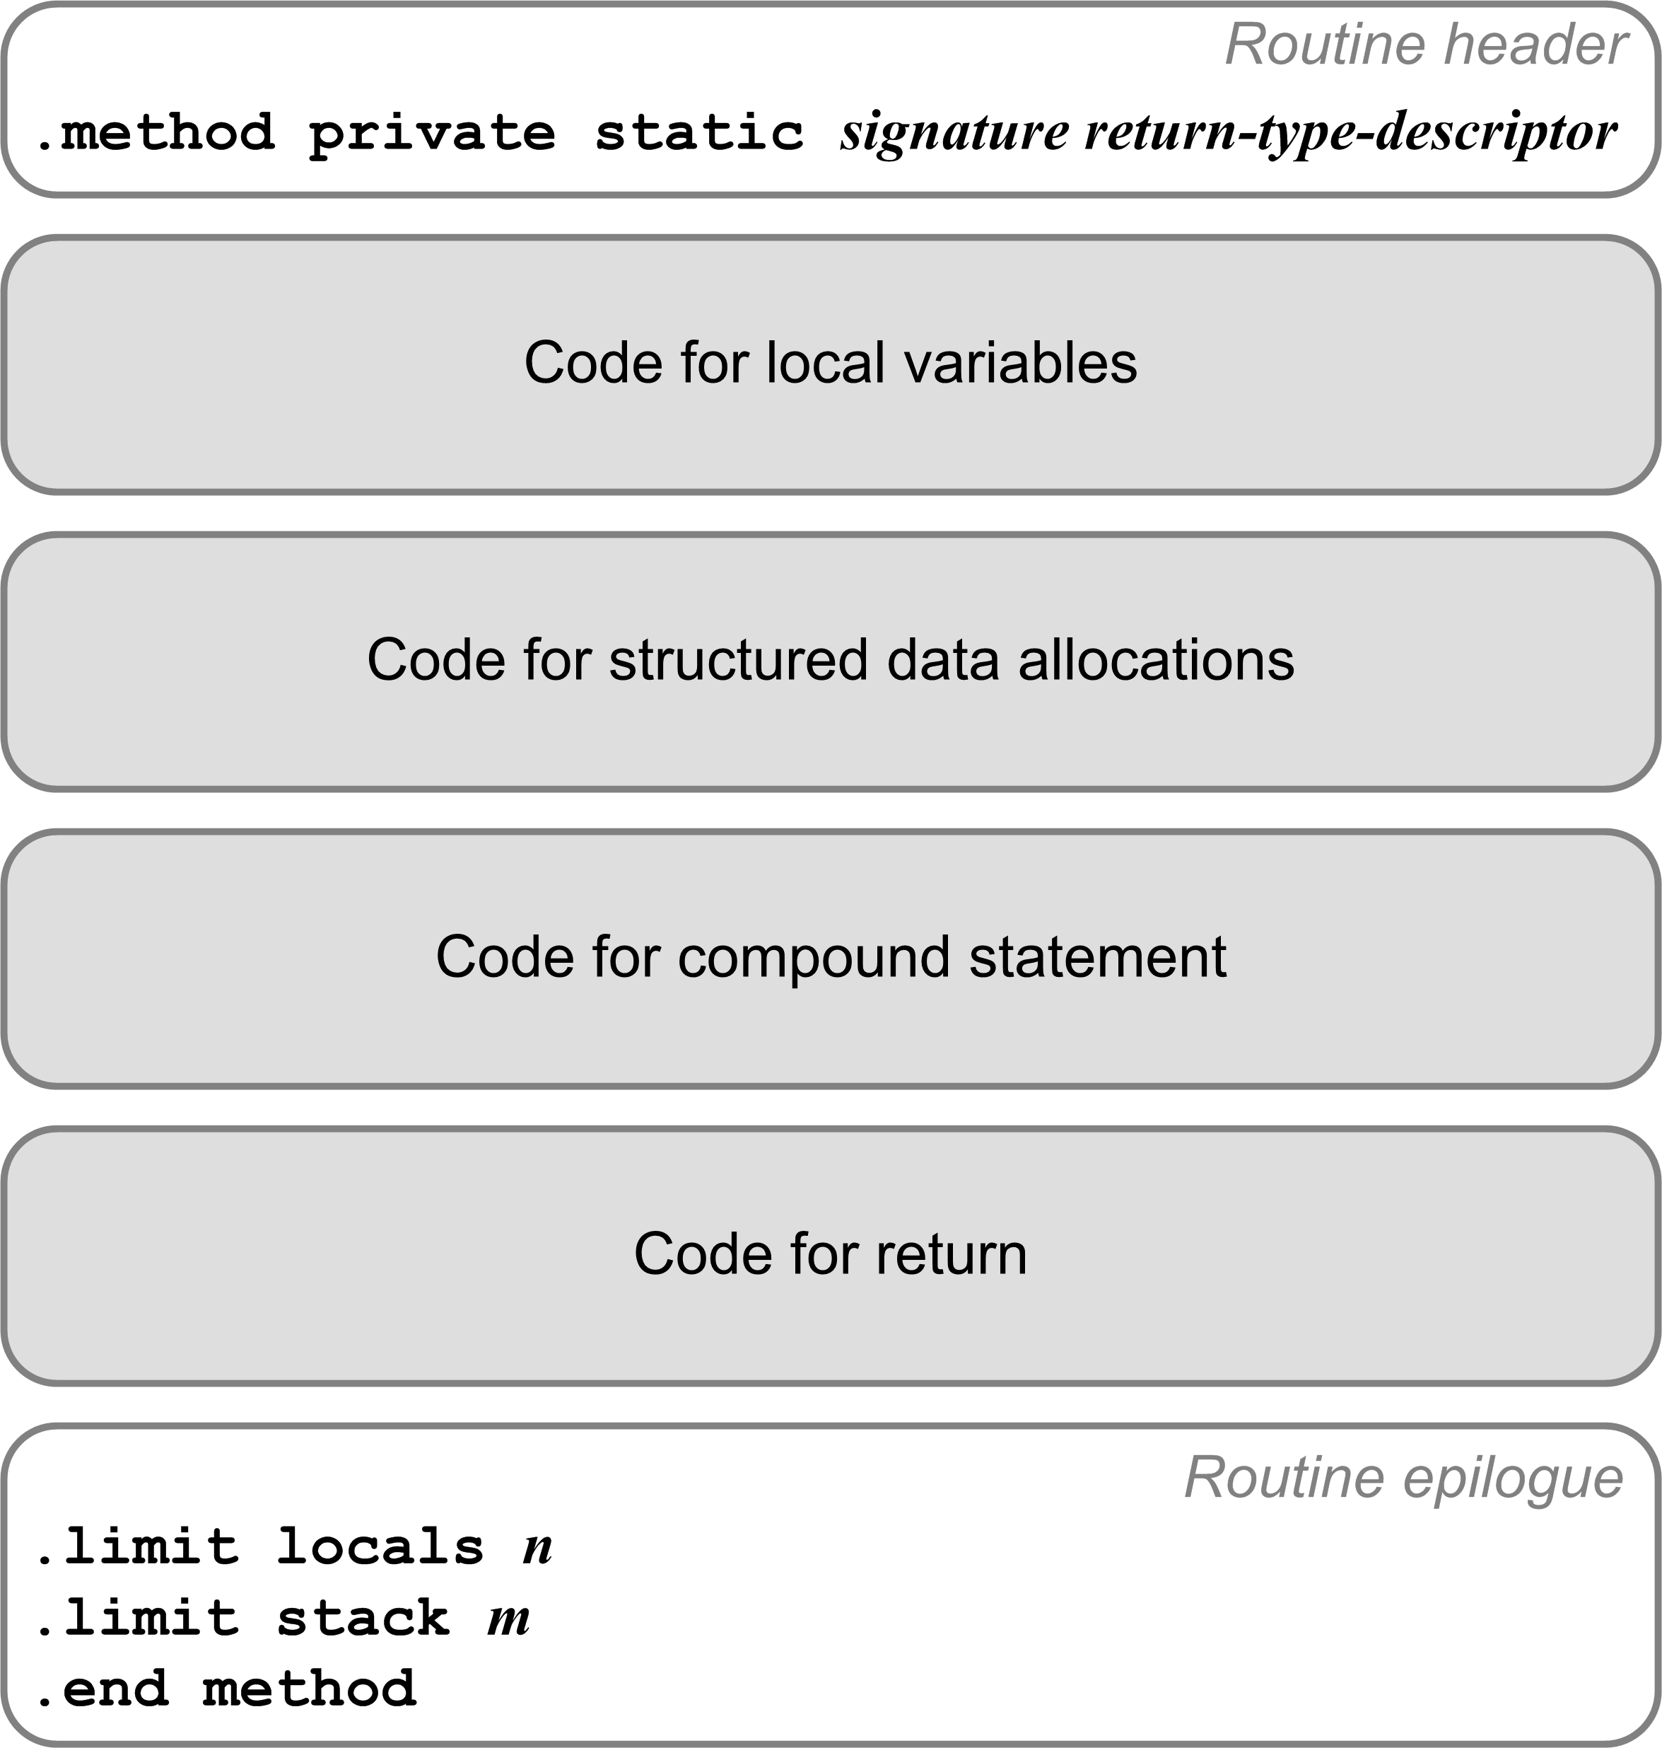
Allocating Memory for Arrays
Recall the code template for a Jasmin method.
Code to allocate arrays here!
Pascal automatically allocates memory for arrays declared in the main program or locally in a procedure or function.
  This is separate from dynamically allocated data
  using pointers and new.
Therefore, our generated Jasmin code must
implement this automatic runtime behavior.

Slide 7
Recall: System.out.printf()
Instruction aastore operands on the stack:
Array reference
Index value
Element value
(object reference)
System.out.printf(
"The square root of %4d is %8.4f\n",
n, root);
getstatic java/lang/System/out Ljava/io/PrintStream;
ldc "The square root of %4d is %8.4f\n"
iconst_2
anewarray java/lang/Object
dup
iconst_0
getstatic FormatTest/n I
invokestatic java/lang/Integer.valueOf(I)Ljava/lang/Integer;
aastore
dup
iconst_1
getstatic FormatTest/root F
invokestatic java/lang/Float.valueOf(F)Ljava/lang/Float;
aastore
invokevirtual java/io/PrintStream.printf(
Ljava/lang/String;[Ljava/lang/Object;)Ljava/io/PrintStream;
pop
Create an array of size 2 (two values to print)
and leave the array reference on the operand stack.
Store element 0:
The value of n as
an Integer object.
Why the dup instructions?
Store element 1:
The value of root
as a Float object.
This invokevirtual instruction should all be on one line.

Slide 8
Example: Allocate Memory for Scalar Arrays
PROGRAM ArrayTest;
TYPE
vector = ARRAY[0..9] OF integer;
matrix = ARRAY[0..4, 0..4] OF integer;
cube = ARRAY[0..1, 0..2, 0..3] OF integer;
VAR
i, j, k, n : integer;
a1 : vector;
a2 : matrix;
a3 : cube;
BEGIN
...
END.
bipush 10
newarray int
putstatic arraytest/a1 [I
iconst_5
iconst_5
multianewarray [[I 2
putstatic arraytest/a2 [[I
iconst_2
iconst_3
iconst_4
multianewarray [[[I 3
putstatic arraytest/a3 [[[I

Slide 9
Access an Array Element of a 2-D Array
PROGRAM ArrayTest;
TYPE
matrix = ARRAY[0..2, 0..3]
OF integer;
VAR
i, j, k : integer;
a2 : matrix;
BEGIN
...
i := 1;
j := 2;
k := a2[i, j];
...
END.
a2
0
1
2
3
1 | 2 | 3 | 4
0
5 | 6 |  | 8
1
7
2
9 | 10 | 11 | 12
k
7
getstatic arraytest/a2 [[I
getstatic arraytest/i I
aaload
getstatic arraytest/j I
iaload
putstatic arraytest/k I
1 | 2 | 3 | 4
5 | 6 | 7 | 8
9 | 10 | 11 | 12

Slide 10
Subscripted Variables in Expressions
PROGRAM ArrayTest;
TYPE
vector = ARRAY[0..9] OF integer;
matrix = ARRAY[0..4, 0..4] OF integer;
cube = ARRAY[0..1, 0..2, 0..3] OF integer;
VAR
i, j, k, n : integer;
a1 : vector;
a2 : matrix;
a3 : cube;
BEGIN
...
j := a1[i];
k := a2[i, j];
n := a3[i, j, k];
...
END.
getstatic arraytest/a1 [I
getstatic arraytest/i I
iaload
putstatic arraytest/j I
getstatic arraytest/a2 [[I
getstatic arraytest/i I
aaload
getstatic arraytest/j I
iaload
putstatic arraytest/k I
getstatic arraytest/a3 [[[I
getstatic arraytest/i I
aaload
getstatic arraytest/j I
aaload
getstatic arraytest/k I
iaload
putstatic arraytest/n I
iaload: push the scalar value of an array element.
aaload: push the address of an array element

Slide 11
Set an Array Element of a 2-D Array
PROGRAM ArrayTest;
TYPE
matrix = ARRAY[0..2, 0..3]
OF integer;
VAR
i, j, k : integer;
a2 : matrix;
BEGIN
...
i := 1;
j := 2;
k := 0;
a2[i, j] := k;
...
END.
a2
0
1
2
3
1 | 2 | 3 | 4
0
5 | 6 |  | 8
7
1
0
2
9 | 10 | 11 | 12
k
0
getstatic arraytest/a2 [[I
getstatic arraytest/i I
aaload
getstatic arraytest/j I
getstatic arraytest/k I
iastore
1 | 2 | 3 | 4
5 | 6 | 7 | 8
9 | 10 | 11 | 12
Instruction iastore operands on the stack:
Array reference
Index value
Element value
(scalar integer)

Slide 12
More Subscripted Variables
PROGRAM ArrayTest;
TYPE
vector = ARRAY[0..9] OF integer;
matrix = ARRAY[0..4, 0..4] OF integer;
cube = ARRAY[0..1, 0..2, 0..3] OF integer;
VAR
i, j, k, n : integer;
a1 : vector;
a2 : matrix;
a3 : cube;
BEGIN
...
a3[i][a1[j]][k] := a2[i][j] - a3[k, 2*n][k+1];
...
END.
getstatic arraytest/a3 [[[I
getstatic arraytest/i I
aaload
getstatic arraytest/a1 [I
getstatic arraytest/j I
iaload
aaload
getstatic arraytest/k I
getstatic arraytest/a2 [[I
getstatic arraytest/i I
aaload
getstatic arraytest/j I
iaload
getstatic arraytest/a3 [[[I
getstatic arraytest/k I
aaload
iconst_2
getstatic arraytest/n I
imul
aaload
getstatic arraytest/k I
iconst_1
iadd
iaload
isub
iastore
Instruction aaload pushes the
address of one dimension of an array.
Instruction iaload pushes the
integer value of an array element.
Instruction iastore operands on the stack:
Array reference
Index value
Element value
(scalar integer)
What’s on top of the
operand stack after
this instruction?

Slide 13
Allocate Memory for Non-Scalar Arrays
For a non-scalar array,
we must generate code to :
  Allocate memory for the array itself.
  Similar to a scalar array, except that each element
  will contain a reference to its data.
  Allocate memory for the data of each array element
  and initialize each element.

Slide 14
Allocate Memory for a 1-D String Array
a1
" "
PROGRAM AllocArrayTest2;
TYPE
string = ARRAY[1..5] OF char;
vector = ARRAY[0..9] OF string;
VAR
a1 : vector;
BEGIN
END.
" "
" "
" "
" "
" "
" "
" "
Each array element should contain a reference to a
string object.
" "
" "

Slide 15
Memory for a 1-D String Array, cont’d
PROGRAM AllocArrayTest2;
TYPE
string = ARRAY[1..5] OF char;
vector = ARRAY[0..9] OF string;
VAR
a1 : vector;
BEGIN
END.
a1
" "
" "
" "
bipush 10
anewarray java/lang/String
iconst_0
istore_1
L001:
iload_1
bipush 10
if_icmpge L002
dup
iload_1
new java/lang/String
dup
invokespecial java/lang/String/<init>V
aastore
iinc 1 1
goto L001
L002:
putstatic allocarraytest2/a1
[Ljava/lang/String;
" "
Allocate slot #1
as the temporary
variable i.
" "
" "
Like the Java code:
for (int i = 0; i < 10; ++i)
{
a1[i] = new String();
}
" "
What are we duplicating and why?
" "
" "
" "

Slide 16
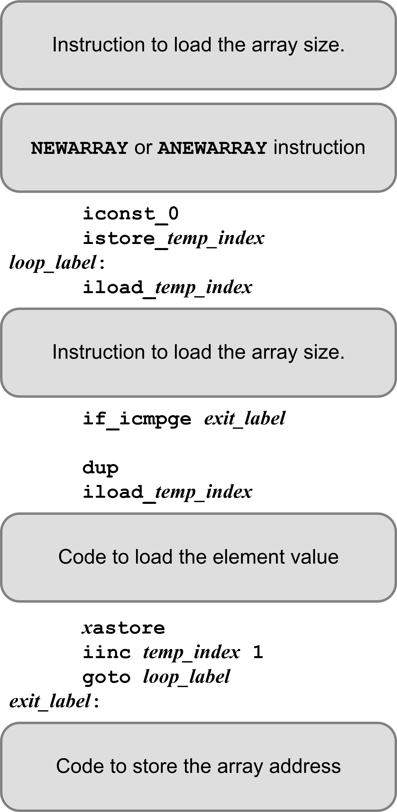
Code Template: 1-D Non-Scalar Array
bipush 10
anewarray java/lang/String
iconst_0
istore_1
L001:
iload_1
bipush 10
if_icmpge L002
dup
iload_1
new java/lang/String
dup
invokespecial java/lang/String/<init>()V
aastore
iinc 1 1
goto L001
L002:
putstatic allocarraytest2/a1 [Ljava/lang/String;

Slide 17
Allocate Memory for a 2-D String Array
a2
" "
" "
" "
" "
" "
" "
" "
" "
" "
" "
" "
" "
PROGRAM AllocArrayTest2;
TYPE
string = ARRAY[1..5] OF char;
matrix = ARRAY[0..2, 0..3] OF string;
VAR
a2 : matrix;
BEGIN
END.

Slide 18
Memory for a 2-D String Array, cont’d
PROGRAM AllocArrayTest2;
TYPE
string = ARRAY[1..5] OF char;
matrix = ARRAY[0..2, 0..3] OF string;
VAR
a2 : matrix;
BEGIN
END.
iconst_3
iconst_4
multianewarray [[Ljava/lang/String; 2
iconst_0
istore_1
L003:
iload_1
iconst_3
if_icmpge L004
dup
iload_1
aaload
iconst_0
istore_2
L005:
iload_2
iconst_4
if_icmpge L006
dup
iload_2
new java/lang/String
dup
invokespecial java/lang/String/<init>V
aastore
iinc 2 1
goto L005
L006:
pop
iinc 1 1
goto L003
L004:
putstatic allocarraytest2/a2 [[Ljava/lang/String;
" "
" "
Allocate slots #1
and #2 as the
temporary variables
i and j.
" "
a2
" "
ditto
ditto
Like the Java code:
for (int i = 0; i < 3; ++i)
{
for (int j = 0; j < 4; ++j)
{
a2[i][j] = new String();
}
}

Slide 19
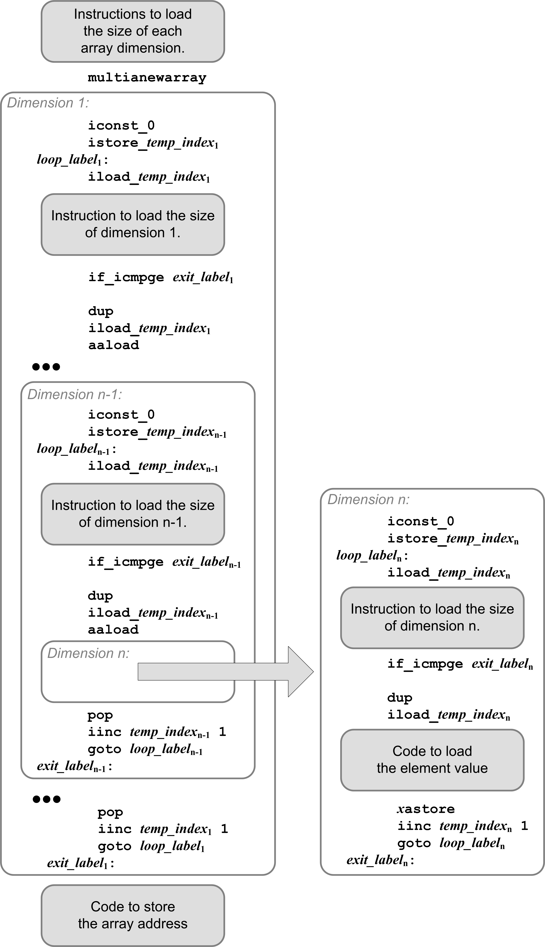
Code Template: n-D Non-Scalar Array
iconst_5
iconst_4
multianewarray [[Ljava/lang/String; 2
iconst_0
istore_1
L003:
iload_1
iconst_3
if_icmpge L004
dup
iload_1
aaload
iconst_0
istore_2
L005:
iload_2
iconst_4
if_icmpge L006
dup
iload_2
new java/lang/String
dup
invokespecial java/lang/String/<init>V
aastore
iinc 2 1
goto L005
L006:
pop
iinc 1 1
goto L003
L004:
putstatic allocarraytest2/a2 [[Ljava/lang/String;

Slide 20
Records and Fields
Recall the code template for a Jasmin method.
Code to allocate records here!
Implement the value of each Pascal record variable as a static nested Java class that has only fields.
Notes:
start here

Slide 21
Records and Fields, cont’d
Pascal program:
PROGRAM TestRecord;
TYPE
PersonRec = RECORD
firstName : string;
lastName : string;
age : integer;
phones : ARRAY [0..1] OF string;
END;
VAR
john : PersonRec;
age : integer;
name : string;
BEGIN
john.age := 24;
age := john.age;
END.

Slide 22
Records and Fields, cont’d
Equivalent Java:
public class TestRecord
{
public static class personrec
{
String firstname;
String lastname;
int age;
String phones[];
}
private static personrec john;
private static int age;
private static String name;
public static void main(String[] args)
{
john = new personrec();
john.phones = new String[2];
john.age = 24;
age = john.age;
}
}
PROGRAM TestRecord;
TYPE
PersonRec = RECORD
firstName : string;
lastName : string;
age : integer;
phones : ARRAY [0..1] OF string;
END;
VAR
john : PersonRec;
age : integer;
name : string;
BEGIN
john.age := 24;
age := john.age;
END.

Slide 23
TestRecord$personrec.j
TYPE
PersonRec =
RECORD
firstName : string;
lastName : string;
age : integer;
phones :
ARRAY [0..1] OF string;
END;
.class public TestRecord$personrec
.super java/lang/Object
.field age I
.field firstname Ljava/lang/String;
.field lastname Ljava/lang/String;
.field phones [Ljava/lang/String;
;
; Main class constructor
;
.method public <init>()V
.var 0 is this LTestRecord$personrec;
aload_0
invokespecial java/lang/Object/<init>()V
return
.limit locals 1
.limit stack 1
.end method
The Pascal record PersonRec compiles into a separate Jasmin class TestRecord$personrec.

Slide 24
TestRecord.j (Excerpt)
private static personrec john;
private static int age;
...
john = new personrec();
john.phones = new String[2];
john.age = 24;
age = john.age;
new TestRecord$personrec
dup
invokespecial TestRecord$personrec/<init>()V
dup
putstatic TestRecord/john LTestRecord$personrec;
dup
iconst_2
anewarray java/lang/String
putfield TestRecord$personrec/phones [Ljava/lang/String;
pop
getstatic TestRecord/john LTestRecord$personrec;
bipush 24
putfield TestRecord$personrec/age I
getstatic TestRecord/john LTestRecord$personrec;
getfield TestRecord$personrec/age I
putstatic TestRecord/age I
Why?
Why?

Slide 25
Passing Parameters
Java (and therefore Jasmin) passes all arguments by value.
  It passes references to objects and arrays by value.
Therefore (at least for now), we will ignore the VAR in front of parameters in Pascal programs.
  Pass all scalars by value.
  Pass references to arrays and records by value.
Notes:
START HERE.

Slide 26
Runtime Libraries
When compiling programs, compilers generally do not generate all the code.
Instead, for specialized statements and expressions, it can generate calls to runtime library routines.
The runtime library routines then perform the operations for an executing program.
  The routines can be written in a high-level language.
  For example: A source language can have constructs for doing regular expression operations, which can be performed by calls to library routines.

