Slide 1


CMPE 152: Compiler Design
April 8 Class Meeting
Department of Computer Engineering
San Jose State University
Spring 2021
Instructor: Ron Mak
www.cs.sjsu.edu/~mak

Slide 2
Pascal Procedures and Functions
Analogous to Java methods (functions).
Two major simplifications for our Pascal compiler:
  Standard Pascal is not object-oriented.
  Therefore, Pascal procedures and functions are more like the private static methods of a Java class.
Java does not have nested methods.
  The JVM does not easily implement nested methods.
  Therefore, we will compile only top level (level 1)
  Pascal procedures and functions.

Slide 3
Procedures and Functions, cont’d
A Pascal program:
The roughly equivalent Java class:
  Fields and methods are
  private static.
PROGRAM ADDER;
VAR
i, j, sum : integer;
FUNCTION add(n1, n2 : integer) : integer;
VAR
s : integer;
BEGIN
s := i + j + n1 + n2;
add := s;
END;
BEGIN
i := 10;
j := 20;
sum := add(i, j);
writeln('Sum = ', sum)
END.
public class Adder
{
private static int i, j, sum;
private static int add(int n1, int n2)
{
int s = i + j + n1 + n2;
return s;
}
public static void main(String args[])
{
i = 10;
j = 20;
sum = add(i, j);
System.out.println("Sum = " + sum);
}
}

Slide 4
Roughly Equivalent C++ Code
A Pascal program:
The roughly equivalent C++ code:
  As emitted by the converter.
  C++ has standalone (non-member) functions , so static isn’t needed.
PROGRAM ADDER;
VAR
i, j, sum : integer;
FUNCTION add(n1, n2 : integer) : integer;
VAR
s : integer;
BEGIN
s := i + j + n1 + n2;
add := s;
END;
BEGIN
i := 10;
j := 20;
sum := add(i, j);
writeln('Sum = ', sum)
END.
int i, j;
int sum;
int add(int n1, int n2)
{
int add;
int s;
s = i + j + n1 + n2;
add = s;
return add;
}
int main(int argc, char *args[])
{
i = 10;
j = 20;
sum = add(i, j);
printf("Sum = %d\n", sum);
}

Slide 5
Code for a Pascal Main Program
PROGRAM Adder;
VAR
i, j, sum : integer;
FUNCTION add(n1, n2 : integer) : integer;
VAR
s : integer;
BEGIN
s := i + j + n1 + n2;
add := s;
END;
BEGIN
i := 10;
j := 20;
sum := add(i, j);
writeln('Sum = ', sum)
END.
.class public Adder
.super java/lang/Object
.private field static i I
.private field static j I
.private field static sum I
.method public <init>()V
aload_0
invokenonvirtual java/lang/Object/<init>()V
return
.limit stack 1
.limit locals 1
.end method
...
Private static
class fields.
Void method.
No parameters.
Each Jasmin class must have a
constructor named <init>.
  The local variable in slot #0 contains the value of “this”.
  Each constructor must call the superclass constructor.

Slide 6
Code for a Pascal Function (Static Method)
PROGRAM Adder;
VAR
i, j, sum : integer;
FUNCTION add(n1, n2 : integer) : integer;
VAR
s : integer;
BEGIN
s := i + j + n1 + n2;
add := s;
END;
BEGIN
i := 10;
j := 20;
sum := add(i, j);
writeln('Sum = ', sum)
END.
.method private static add(II)I
.var 0 is n1 I
.var 1 is n2 I
.var 2 is s I
.var 3 is add I
getstatic Adder/i I
getstatic Adder/j I
iadd
iload_0
iadd
iload_1
iadd
istore_2
iload_2
istore_3
iload_3
ireturn
.limit locals 4
.limit stack 2
.end method
#3
#0
#1
#2

Slide 7
Code to Call a Function (Static Method)
PROGRAM ADDER;
VAR
i, j, sum : integer;
FUNCTION add(n1, n2 : integer) : integer;
VAR
s : integer;
BEGIN
s := i + j + n1 + n2;
add := s;
END;
BEGIN
i := 10;
j := 20;
sum := add(i, j);
writeln('Sum = ', sum)
END.
.method public static main([Ljava/lang/String;)V
bipush 10
putstatic Adder/i I
bipush 20
putstatic Adder/j I
getstatic Adder/i I
getstatic Adder/j I
invokestatic Adder/add(II)I
putstatic Adder/sum I
...
A function call leaves its
return value on top of the
operand stack of the caller.
Use putstatic with a fully qualified field
name and type signature to pop a value off the
operand stack and store it into a static field.
Use invokestatic with a fully-qualified
method name and a type signature
to call a static method.

Slide 8
Calling Member Functions
We’re trying to stay away from object-oriented programming in this class a much as possible.
  Code generation for object-oriented programming adds additional challenges we don’t have time for.
But there are some built-in Java classes
that we can’t easily avoid.
  Such as classes involved with I/O.
How do we call a member function
on an object?

Slide 9
Calling Member Functions, cont’d
public class Adder
{
public int add(int v1, int v2) { return v1 + v2; }
public static void main(String args[])
{
int i = 5, j = 7;
Adder adder = new Adder();
int sum = adder.add(i, j);
System.out.printf("The sum of %d and %d is %d\n", i, j, sum);
}
}
Adder.java
#0
#1
#2
#4
#3
.method public static main([Ljava/lang/String;)V
.limit stack 6
.limit locals 5
.var 0 is args [Ljava/lang/String;
.var 1 is i I
.var 2 is j I
.var 3 is adder LAdder;
.var 4 is sum I

Slide 10
Calling Member Functions, cont’d
public class Adder
{
public int add(int v1, int v2) { return v1 + v2; }
public static void main(String args[])
{
int i = 5, j = 7;
Adder adder = new Adder();
int sum = adder.add(i, j);
System.out.printf("The sum of %d and %d is %d\n", i, j, sum);
}
}
Adder.java
#0
#1
#2
#4
#3
iconst_5
istore_1
bipush 7
istore_2
new Adder
dup
invokespecial Adder/<init>()V
astore_3
Why dup?
Call the constructor.

Slide 11
Calling Member Functions, cont’d
public class Adder
{
public int add(int v1, int v2) { return v1 + v2; }
public static void main(String args[])
{
int i = 5, j = 7;
Adder adder = new Adder();
int sum = adder.add(i, j);
System.out.printf("The sum of %d and %d is %d\n", i, j, sum);
}
}
Adder.java
#0
#1
#2
#4
#3
aload_3
iload_1
iload_2
invokevirtual Adder/add(II)I
istore 4
object reference
first argument
second argument

Slide 12
invokestatic vs. invokevirtual
Use invokestatic to call a static
member function that belongs to a class.
  Example: The Java function java.lang.Integer.valueOf() takes an int argument and returns a java.lang.Integer object. Static function valueOf() is a class method of Integer.
int n;
Integer intObj = Integer.valueOf(n)
getstatic FormatTest/n I
invokestatic java/lang/Integer/valueOf(I)Ljava/lang/Integer;

Slide 13
invokestatic vs. invokevirtual, cont’d
Use invokevirtual to call a
member function on an object.
public class Adder
{
public int add(int v1, int v2) { return v1 + v2; }
public static void main(String args[])
{
int i = 5, j = 7;
Adder adder = new Adder();
int sum = adder.add(i, j);
System.out.printf("The sum of %d and %d is %d\n", i, j, sum);
}
}
#0
#1
#2
#4
#3
aload_3
iload_1
iload_2
invokevirtual Adder/add(II)I
istore 4
object reference
first argument
second argument

Slide 14
Code to Call System.out.println()
What does the call
require on the operand stack?
  A reference to the object
  System.out of datatype
  java.io.PrintStream .
  A reference to the java.lang.String object "Hello, world!"
System.out.println("Hello, world!")
Each call to invokevirtual
requires an object reference
and then any required
actual parameter values
on the operand stack.
object reference
type descriptor of object
getstatic java/lang/System/out Ljava/io/PrintStream;
ldc "Hello, world!"
invokevirtual java/io/PrintStream/println(Ljava/lang/String;)V
fully-qualified function
argument type descriptor
no return type (void)

Slide 15
System.out.printf()
Compile Pascal
as if it were the Java
writeln('The square root of ', n:4,
' is ', root:8:4);
System.out.printf(
"The square root of %4d is %8.4f\n",
n, root);

Slide 16
System.out.printf(), cont’d
The Java System.out.printf() method
has a variable-length parameter list.
The first parameter is the format string.
  Like C’s format strings for printf().
The code generator must construct the format string by converting the Pascal arguments.
  Pascal:
  Equivalent Java (same as C or C++):
('The square root of ', n:4, ' is ', root:8:4)
  ("The square root of %4d is %8.4f\n", n, root)

Slide 17
System.out.printf(), cont’d
The remaining parameters are the
values to be formatted, one for each
format specification in the format string.
Jasmin passes these remaining parameters as a one-dimensional array of objects.
Therefore, we must emit code to
create and initialize the array and
leave its reference on the operand stack.

Slide 18
System.out.printf(), cont’d
Instruction aastore operands on the stack:
  Array reference
  Index value
  Element value
  (object reference)
System.out.printf(
"The square root of %4d is %8.4f\n",
n, root);
getstatic java/lang/System/out Ljava/io/PrintStream;
ldc "The square root of %4d is %8.4f\n"
iconst_2
anewarray java/lang/Object
dup
iconst_0
getstatic FormatTest/n I
invokestatic java/lang/Integer.valueOf(I)Ljava/lang/Integer;
aastore
dup
iconst_1
getstatic FormatTest/root F
invokestatic java/lang/Float.valueOf(F)Ljava/lang/Float;
aastore
invokevirtual java/io/PrintStream.printf(
Ljava/lang/String;[Ljava/lang/Object;)Ljava/io/PrintStream;
pop
Create an array of size 2 (two values to print)
and leave the array reference on the operand stack.
Store element 0:
The value of n as
an Integer object.
Why the dup instructions?
Store element 1:
The value of root
as a Float object.
This invokevirtual instruction should all be on one line.

Slide 19
System.out.printf(), cont’d
To compile
Pascal’s
we had to convert the arguments to
which is extra work.
Tip: In your source language, include a print statement that looks like Java or C++.
  You can even have a reserved word PRINTF.
  Then you won’t have to do a conversion.
writeln('The square root of ', n:4,
' is ', root:8:4);
  ("The square root of %4d is %8.4f\n", n, root)
PRINTF("The square root of %4d is %8.4f\n", n, root)

Slide 20
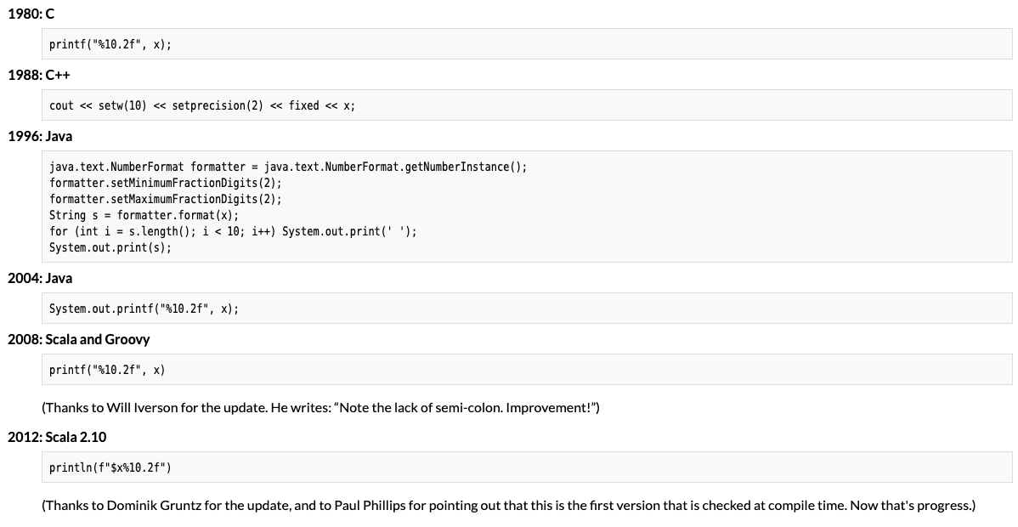
“The March of Progress”
https://www.horstmann.com/
Demo

Slide 21
Translation Recap
Pascal ➔ action (interpreter)
  Control the execution of the source program.
  Slow, but fast turnaround and debugging possible.
Pascal ➔ C++ (high-level language conversion)
  Let the C++ compiler do all the work!
  Convert legacy applications written in obsolete languages (FORTRAN IV, COBOL, Pascal, etc.)
Pascal ➔ assembly language (compiler)
  Slow turnaround but fast execution.
  Harder to debug the source program.

Slide 22
Assignment #6: Pascal Compiler
Generate Jasmin assembly object code!
In the backend class StatementGenerator, complete the following member functions:
  emitIf
  emitCase
  emitWhile
  emitFor
  emitProcedureCall
  emitFunctionCall
  emitCall

Slide 23
Assignment #6, cont’d
Use the provided test programs:
  TestWhile.pas
  TestFor.pas
  TestIf.pas
  TestCase.pas
  TestProcedure.pas
  Newton3.pas

Slide 24
Assignment #6, cont’d
You should be able to assemble and run
your generated Jasmin object code.
Produce runtime printed output,
including the elapsed time at the end.
  The boilerplate code to compute and print
  the elapsed run time is provided for you.
Due Friday, April 23

Slide 25
Final Compiler Project
The minimum compiler project:
  At least two data types with type checking.
  Basic arithmetic operations,
  Operator precedence.
  Assignment statements.
  At least one conditional control statement (e.g., IF).
  At least one looping control statement.
  Procedures or functions with calls and returns.
  Parameters passed by value.
  Basic error recovery (ANTLR parser’s recovery).

Slide 26
Final Compiler Project, cont’d
Create a .g4 grammar file for your language.
Use ANTLR to generate compiler code.
Write sample programs in your language.
Compile the sample programs to Jasmin assembly language.
Assemble and run your sample programs
on the Java Virtual Machine.
Final compiler project due Monday, May 17

