Slide 1
CMPE 152: Compiler Design April 6 Class Meeting
Department of Computer Engineering San Jose State University Spring 2021 Instructor: Ron Mak
www.cs.sjsu.edu/~mak

Slide 2
Discuss Assignment #5
Pascal-to-C++ converter

Slide 3
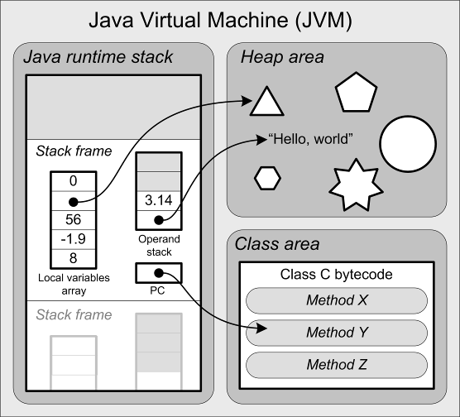
Reminder: JVM Architecture
The runtime stack contains stack frames.
Each stack frame contains:
local variables array
operand stack
program counter (PC)

Slide 4
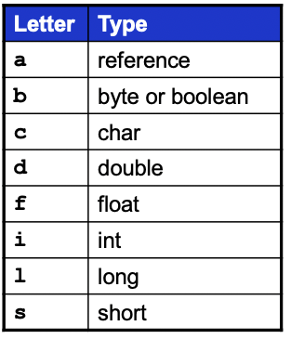
Assignment Statement Code Template
The code template for an assignment statement to a local variable <variable> := <expression>
code for <expression>
Leaves the computed value
at the top of the operand stack.
xstore n
Where x is i, l, f, or d depending on the datatype of the computed value of <expression>.
Byte, boolean, char, and short are treated as ints on the operand stack and in the local variables array.
You can generate a shortcut store instruction such as istore_3 (3 is a slot number) whenever possible.

Slide 5
Reminder: Compare Integer Values
Jasmin has a set of instructions each of which pops off the top two integer values from the operand stack, compare them, and then branch if the comparison is true.
Instruction | Action
if_icmpeq label | Branch to label if [TOS-1] == [TOS]
if_icmpne label | Branch to label if [TOS-1] != [TOS]
if_icmpgt label | Branch to label if [TOS-1] > [TOS]
if_icmpge label | Branch to label if [TOS-1] >= [TOS]
if_icmplt label | Branch to label if [TOS-1] < [TOS]
if_icmple label | Branch to label if [TOS-1] <= [TOS]
Notation
[TOS] is the value at the top of the stack.
[TOS-1] is the value just under the one at the top of the stack.

Slide 6
Reminder: Compare Integer Values, cont’d
You can also pop off only the single integer value at the top of the operand stack, compare it to 0, and then branch if the comparison is true.
The top value is popped off the stack.
Instruction | Action
ifeq label | Branch to label if [TOS] == 0
ifne label | Branch to label if [TOS] != 0
ifgt label | Branch to label if [TOS] > 0
ifge label | Branch to label if [TOS] >= 0
iflt label | Branch to label if [TOS] < 0
ifle label | Branch to label if [TOS] <= 0

Slide 7
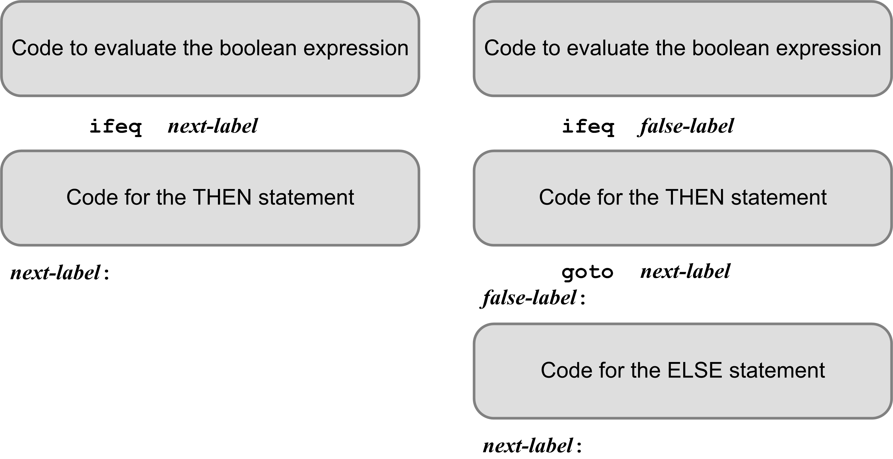
IF Statement Code Templates
The code that evaluates the boolean expression leaves either 0 (false) or 1 (true) on top of the operand stack.
ifeq branches if [TOS] is 0 (the expression is false)

Slide 8
Example: IF Statement
getstatic iftest/i I
getstatic iftest/j I
if_icmplt L002
iconst_0
goto L003
L002:
iconst_1
L003:
ifeq L001
sipush 300
putstatic iftest/t I
L001:
getstatic iftest/i I
getstatic iftest/j I
if_icmpeq L005
iconst_0
goto L006
L005:
iconst_1
L006:
ifeq L007
sipush 200
putstatic iftest/t I
goto L004
L007:
sipush 200
ineg
putstatic iftest/f I
L004:
PROGRAM IfTest;
VAR
i, j, t, f : integer;
BEGIN {IF statements}
...
IF i < j THEN t := 300;
IF i = j THEN t := 200
ELSE f := -200;
...
END.
Variables i, j, t, f
are program variables
and so the Jasmin code
uses their names.

Slide 9
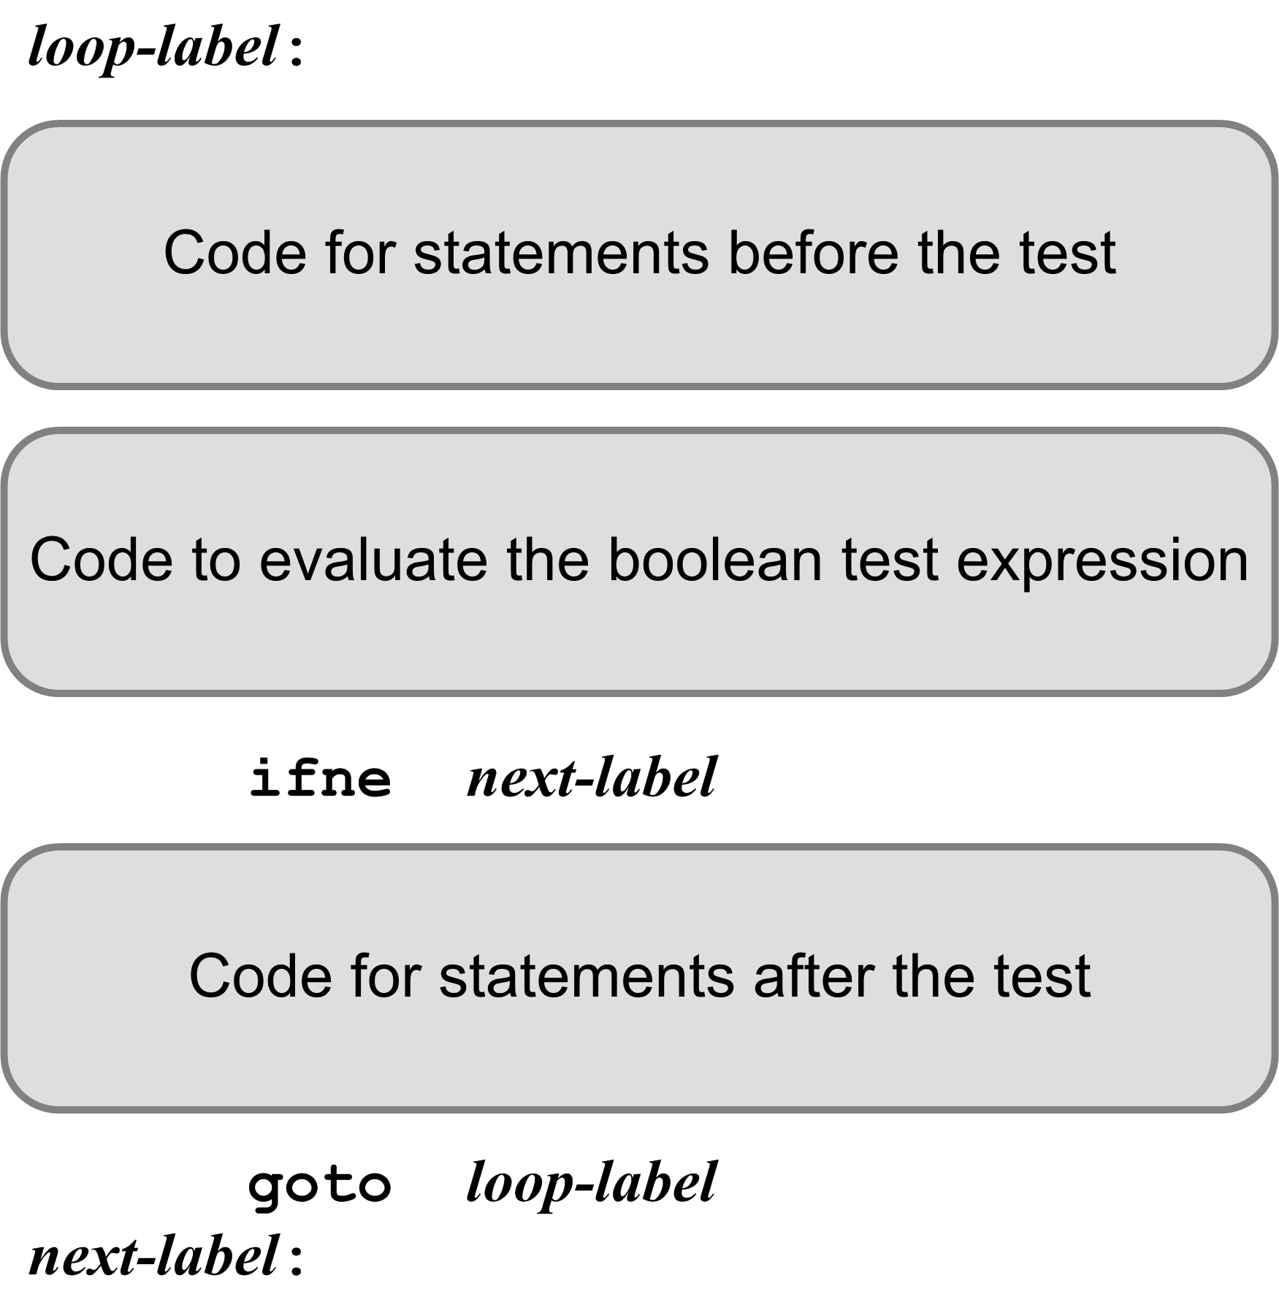
Looping Statement Code Template
The code that evaluates the boolean expression leaves either 0 (false) or 1 (true) on top of the operand stack.
ifne branches if [TOS] is not 0 (the expression value is true)
There may or may not be any code before or after the test.

Slide 10
Example: Newton’s Square Root Function
iconst_0
istore_1 ; i := 0
fload_0
fstore_2 ; root := x
L000:
fload_0 ; x
fload_2 ; root
fdiv ; /
fload_2 ; root
fadd ; +
fconst_2 ; 2.0
fdiv ; /
fstore_2 ; ==> root
iinc 1 1 ; i := i + 1;
iload_1 ; i
bipush 10 ; 10
if_icmpgt L001 ; if i > 10 goto L001
iconst_0 ; false goto L002 L001:
iconst_1 ; true
L002:
ifne L003 ; if true goto L003
goto L000
L003:
fload_2
fstore_3
fload_3
freturn ; return root
#3
#0
FUNCTION sqrt(x : real) : real;
VAR
i : integer;
root : real;
BEGIN
i := 0;
root := x;
REPEAT
root := (x/root + root)/2;
i := i + 1;
UNTIL i > 10;
sqrt := root;
END;
#1
#2

Slide 11
Example: FOR Statement
PROGRAM ForTest;
VAR
j, k, n : integer;
BEGIN {FOR statements}
...
FOR k := j TO 5 DO BEGIN
n := k;
END;
...
END.
getstatic fortest/j I
putstatic fortest/k I
L001:
getstatic fortest/k I
iconst_5
if_icmpgt L003
iconst_0
goto L004
L003:
iconst_1
L004:
ifne L002
getstatic fortest/k I
putstatic fortest/n I
getstatic fortest/k I
iconst_1
iadd
putstatic fortest/k I
goto L001
L002:
This is code
emitted for a
general > test.
It can be much
improved!
Remember that program variables
are translated into Jasmin static fields,
and so they have names, not slot numbers.
What is the value of k
after the loop is done?

Slide 12
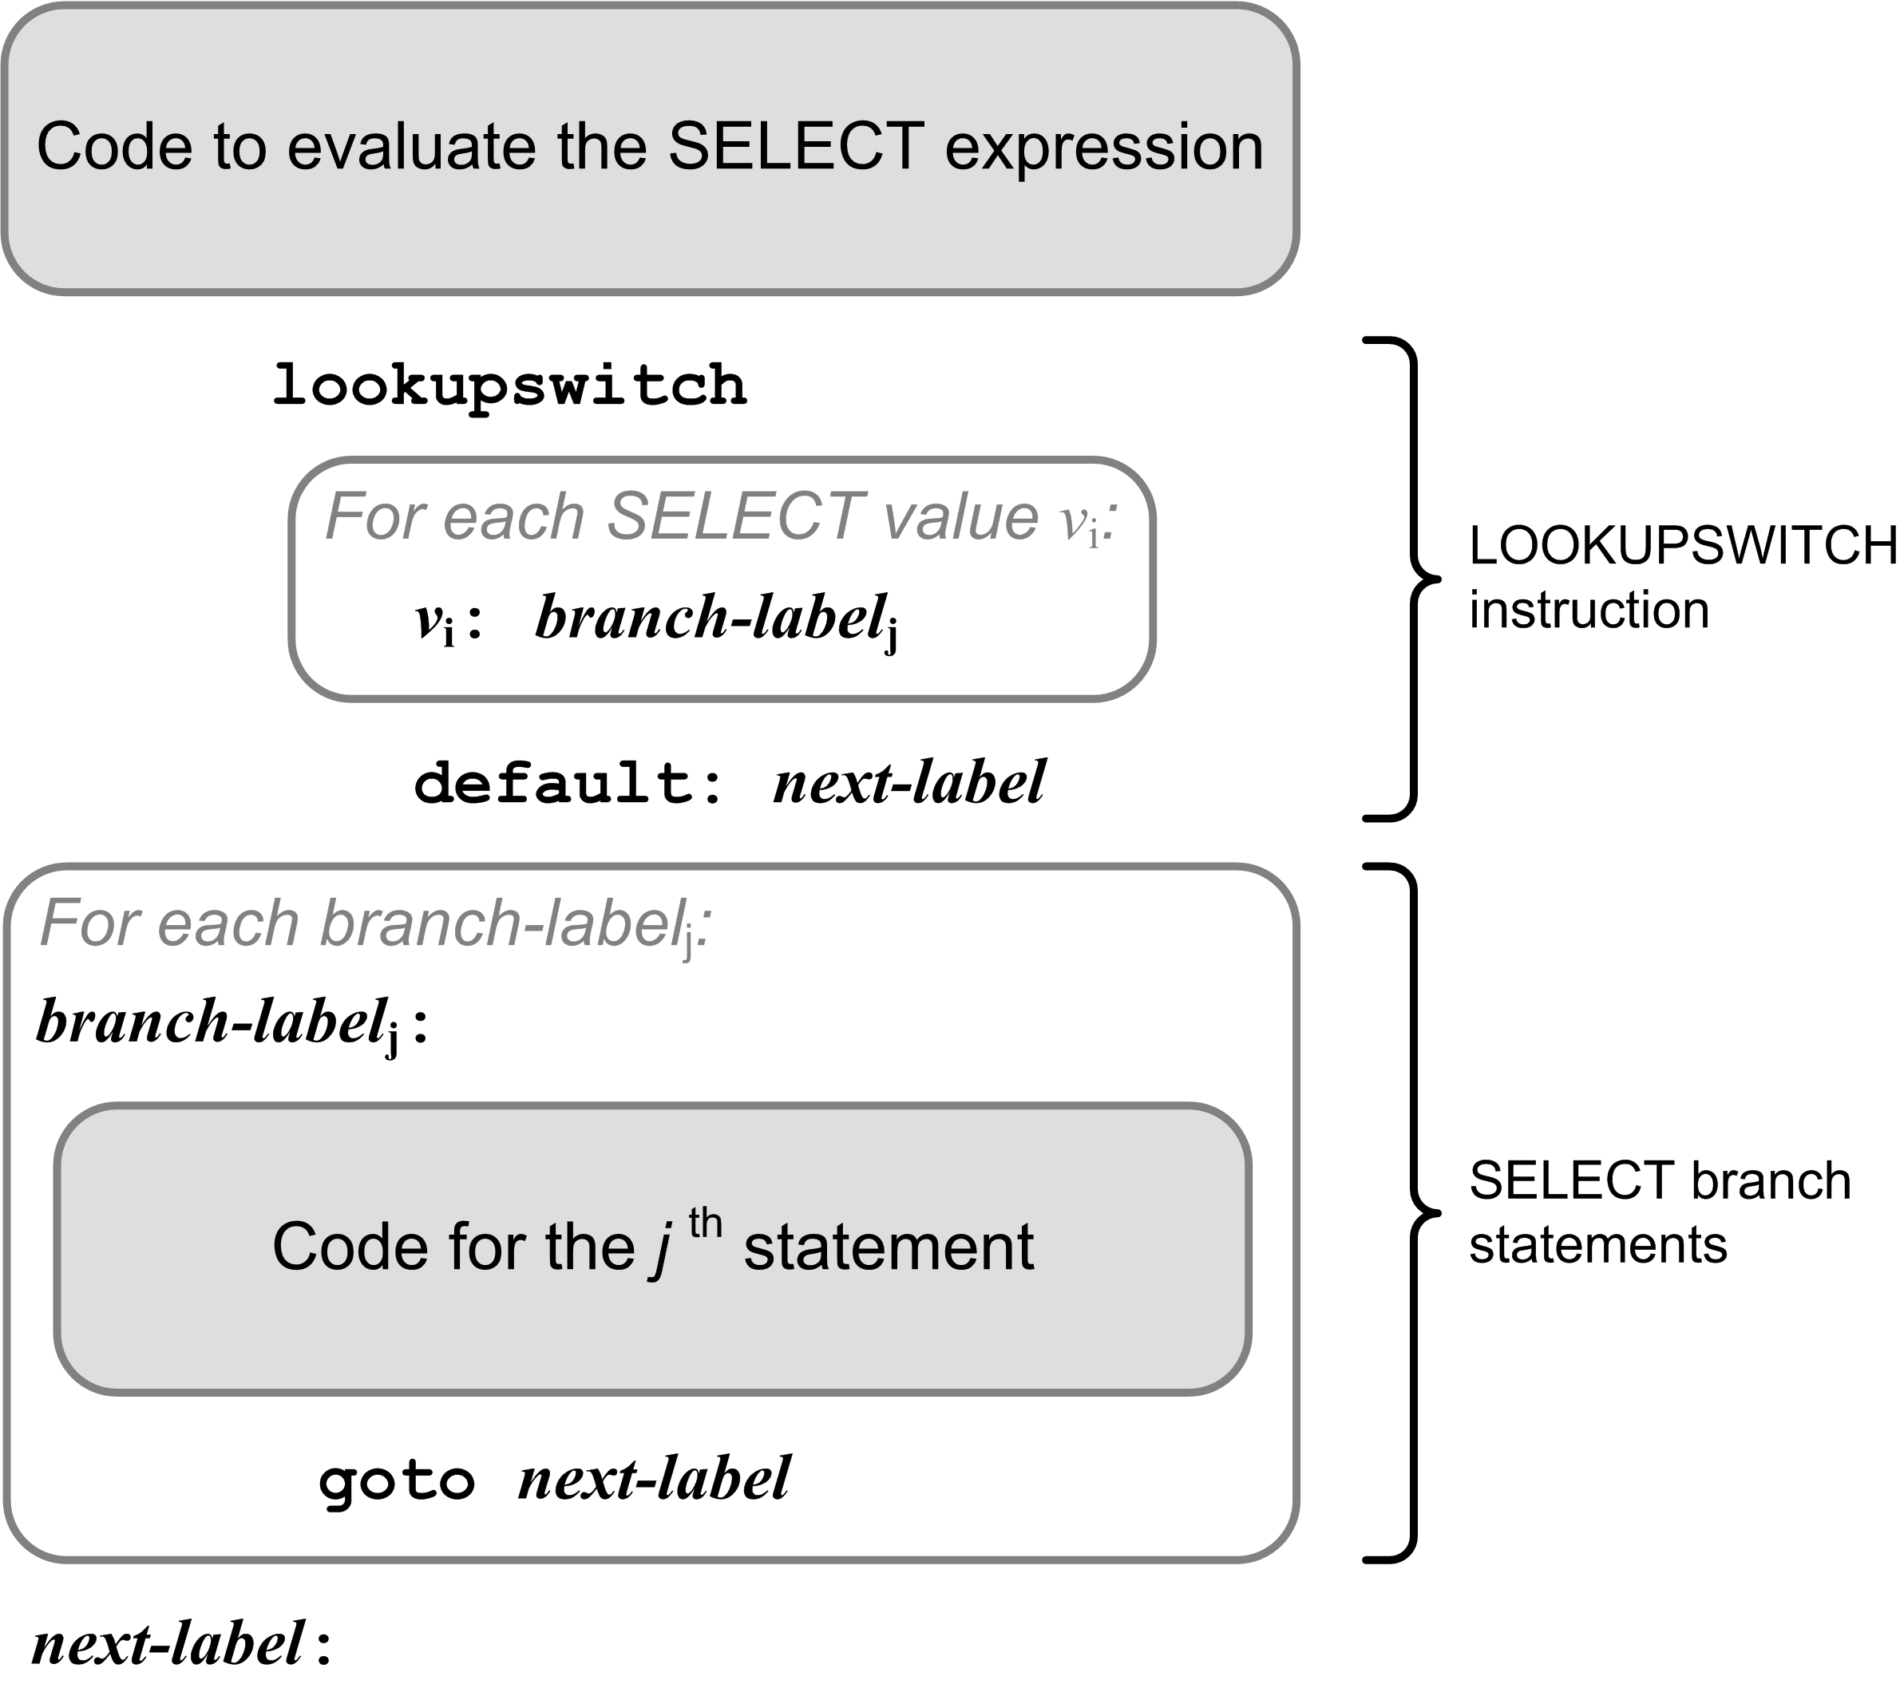
Select Template

Slide 13
Example: CASE Statement
#0
#1
iload_0 ; i
lookupswitch
100: L010
105: L010
200: L020
256: L020
282: L020
default: L099
L010:
sipush 1000
istore_1 ; j := 1000
goto L099
L020:
sipush 2000
istore_1 ; j := 2000
goto L099
L099:
VAR i, j : integer;
...
CASE i OF
100,105: j := 1000;
200,256,282: j := 2000;
END

Slide 14
Pascal Procedures and Functions
Analogous to Java methods (functions).
Two major simplifications for our Pascal compiler:
Standard Pascal is not object-oriented.
Therefore, Pascal procedures and functions are more like the private static methods of a Java class.
Java does not have nested methods.
The JVM does not easily implement nested methods.
Therefore, we will compile only top level (level 1) Pascal procedures and functions.

Slide 15
Procedures and Functions, cont’d
A Pascal program:
The roughly equivalent Java class:
Fields and methods are private static.
PROGRAM ADDER;
VAR
i, j, sum : integer;
FUNCTION add(n1, n2 : integer) : integer;
VAR
s : integer;
BEGIN
s := i + j + n1 + n2;
add := s;
END;
BEGIN
i := 10;
j := 20;
sum := add(i, j);
writeln('Sum = ', sum)
END.
public class Adder
{
private static int i, j, sum;
private static int add(int n1, int n2)
{
int s = i + j + n1 + n2;
return s;
}
public static void main(String args[])
{
i = 10;
j = 20;
sum = add(i, j);
System.out.println("Sum = " + sum);
}
}

Slide 16
Code for a Pascal Main Program
PROGRAM Adder;
VAR
i, j, sum : integer;
FUNCTION add(n1, n2 : integer) : integer;
VAR
s : integer;
BEGIN
s := i + j + n1 + n2;
add := s;
END;
BEGIN
i := 10;
j := 20;
sum := add(i, j);
writeln('Sum = ', sum)
END.
.class public Adder
.super java/lang/Object
.private field static i I
.private field static j I
.private field static sum I
.method public <init>()V
aload_0
invokenonvirtual java/lang/Object/<init>()V
return
.limit stack 1
.limit locals 1
.end method
...
Private static class fields.
Void method.
No parameters.
Each Jasmin class must have a constructor named <init>.
The local variable in slot #0 contains the value of “this”.
Each constructor must call the superclass constructor.
The superclass is Object.

Slide 17
Code for a Pascal Function (Static Method)
PROGRAM Adder;
VAR
i, j, sum : integer;
FUNCTION add(n1, n2 : integer) : integer;
VAR
s : integer;
BEGIN
s := i + j + n1 + n2;
add := s;
END;
BEGIN
i := 10;
j := 20;
sum := add(i, j);
writeln('Sum = ', sum)
END.
.method private static add(II)I
.var 0 is n1 I
.var 1 is n2 I
.var 2 is s I
.var 3 is add I
getstatic Adder/i I
getstatic Adder/j I
iadd
iload_0
iadd
iload_1
iadd
istore_2
iload_2
istore_3
iload_3
ireturn
.limit locals 4
.limit stack 2
.end method
#3
#0
#1
#2

Slide 18
Code to Call a Static Function
PROGRAM ADDER;
VAR
i, j, sum : integer;
FUNCTION add(n1, n2 : integer) : integer;
VAR
s : integer;
BEGIN
s := i + j + n1 + n2;
add := s;
END;
BEGIN
i := 10;
j := 20;
sum := add(i, j);
writeln('Sum = ', sum)
END.
.method public static main([Ljava/lang/String;)V
bipush 10
putstatic Adder/i I
bipush 20
putstatic Adder/j I
getstatic Adder/i I
getstatic Adder/j I
invokestatic Adder/add(II)I
putstatic Adder/sum I
...
A function call leaves its
return value at the top of the
operand stack of the caller.
Use putstatic with a fully qualified field name and type signature to pop a value off the operand stack and store it into a static field.
Use invokestatic with a fully-qualified method name and a type signature to call a static method.

