Slide 1


CMPE 152: Compiler Design
March 25 Class Meeting
Department of Computer Engineering
San Jose State University
Spring 2021
Instructor: Ron Mak
www.cs.sjsu.edu/~mak

Slide 2
Code Templates
Syntax diagrams
  Specify the source language grammar
  Help us write the parsers
Code templates
  Specify what object code to generate
  Help us write the code emitters

Slide 3
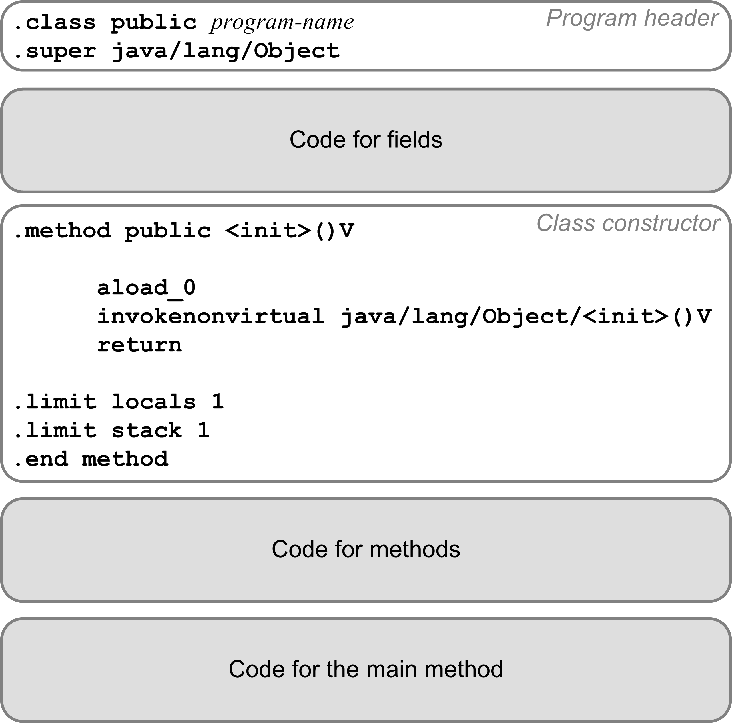
Code Template for a Pascal Program
Translate a Pascal program into a
public class.
Program variables become class fields.
Must have a
default constructor.
Each procedure or function becomes a private static method.
The main program code becomes the public static
main method.

Slide 4
Compilation Strategy
We’ll compile a Pascal program
as if it were a public Java class.
  The Pascal program name becomes
  the Java class name.
The main program becomes the
main method of the Java class.
We’ll compile each program variable
as if it were a field of the Java class.
  Fields do have names in a Jasmin program.
  Recall that local variables and parameters
  are referred to only by their slot numbers.

Slide 5
Compilation Strategy, cont’d
We’ll compile each Pascal procedure or function as if it were a private static method
of the Java class.
Local variables and formal parameters of the method do not have names in a Jasmin program.
  Jasmin instructions refer to local variables and parameters by their slot numbers of the local variables array.

Slide 6
Jasmin Datatype Descriptors
Java Scalar type | Jasmin Type Descriptor
int | I
long | J
float | F
double | D
boolean | Z
char | C
Java Class | Jasmin Type Descriptor
java.lang.String | Ljava/lang/String;
java.util.HashMap | Ljava/util/HashMap;
Newton | LNewton;
Java Array type | Jasmin Type Descriptor
java.lang.String[] | [Ljava/lang/String;
Newton[][] | [[LNewton;
int[][][] | [[[I

Slide 7
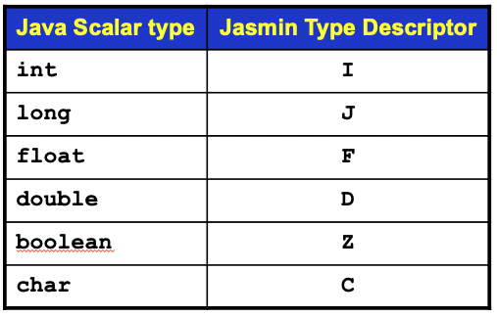
Local Variables
The values of a function’s parameters are implicitly assigned to slots starting with #0.
  Example:
  k ➔ local slot #0
  m ➔ local slot #1
  x ➔ local slot #3
  s ➔ local slot #4
  Jasmin function signature:
  public static double func(int k, long m,
  float x, String[][] s)
  .method public static func(IJF[[Ljava/lang/String;)D

Slide 8
Program Fields

Slide 9
Program Fields, cont’d
For example:
PROGRAM test;
VAR
i, j, k : integer;
x, y : real;
p, q : boolean;
ch : char;
index : 1..10;
Pascal program variables
Compiles to:
.field private static ch C
.field private static i I
.field private static index I
.field private static j I
.field private static k I
.field private static p Z
.field private static q Z
.field private static x F
.field private static y F

Slide 10
Code Template for the Main Method, cont’d

Slide 11
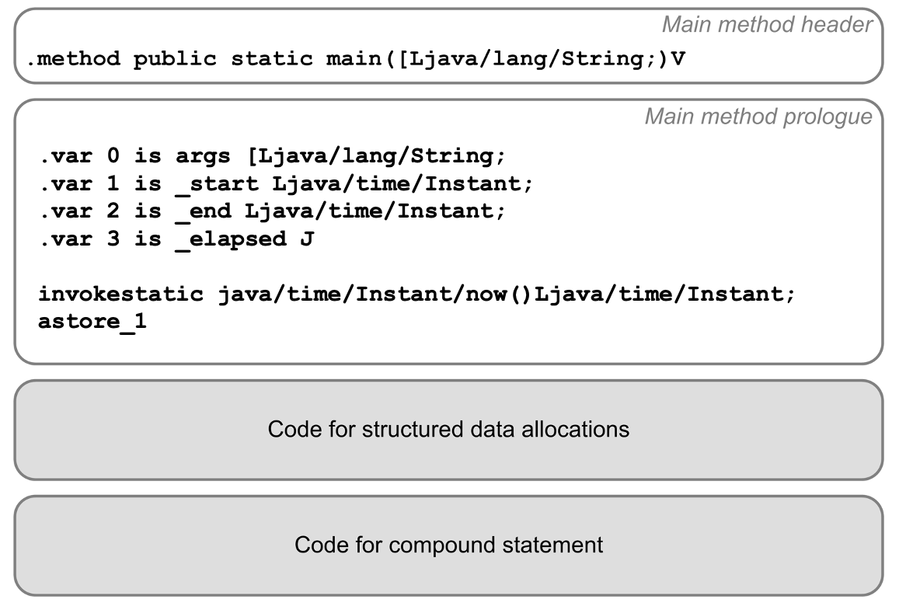
Code Template for the Main Method, cont’d
The main method prologue initializes the runtime timer.
Boilerplate code
Main method epilogue

Slide 12
Code Template for the Main Method, cont’d
The main method epilogue prints the elapsed run time.
Main program epilogue
invokestatic java/time/Instant/now()Ljava/time/Instant;
astore_2
aload_1
aload_2
invokestatic java/time/Duration/between(Ljava/time/temporal/Temporal;Ljava/time/temporal/Temporal;)Ljava/time/Duration;
invokevirtual java/time/Duration/toMillis()J
lstore_3
getstatic java/lang/System/out Ljava/io/PrintStream;
ldc "\n[%,d milliseconds execution time.]\n"
iconst_1
anewarray java/lang/Object
dup
iconst_0
lload_3
invokestatic java/lang/Long/valueOf(J)Ljava/lang/Long;
aastore
invokevirtual java/io/PrintStream/printf(Ljava/lang/String;[Ljava/lang/Object;)Ljava/io/PrintStream;
pop
return
.limit locals 6
.limit stack 7
.end method
Boilerplate code

Slide 13
Loading a Program Variable’s Value
To load (push) a program variable’s value
onto the operand stack:
getstatic program-name/variable-name type-descriptor
Examples:
getstatic Test/count I
getstatic Test/radius F

Slide 14
Storing a Program Variable’s Value
To store (pop) a value from the operand stack
into a program variable:
putstatic program-name/variable-name type-descriptor
Examples:
putstatic Test/count I
putstatic Test/radius F

Slide 15
Code for Procedures and Functions

Slide 16
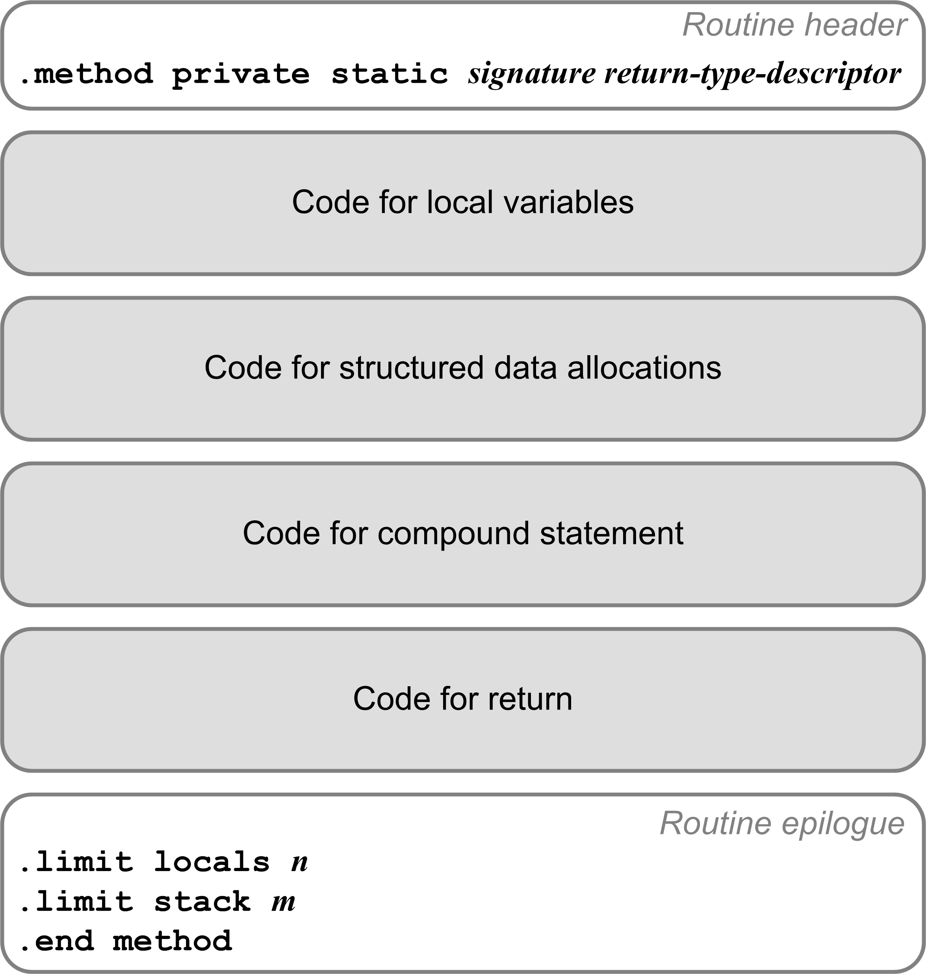
Code for Procedures and Functions
Each a private static method.
Method signature:
  Routine’s name
  Type descriptors of the formal parameters and return value.
Example:
TYPE
arr = ARRAY [1..5] OF real;
FUNCTION func(i, j : integer;
x, y : real;
p : boolean;
ch : char;
vector : arr;
length : integer)
: real;
Compiles to:
.method private static func(IIFFZC[FI)F

Slide 17
Compiling Local Variables
TYPE
arr = ARRAY [1..5] OF real;
FUNCTION func(i, j : integer;
x, y : real;
p : boolean;
ch : char;
vector : arr;
length : integer)
: real;
VAR
n : integer;
z : real;
w : arr;
Compiles to:
.method private static func(IIFFZC[FI)F
.var 5 is ch C
.var 0 is i I
.var 1 is j I
.var 7 is length I
.var 8 is n I
.var 4 is p Z
.var 6 is vector [F
.var 10 is w [F
.var 2 is x F
.var 3 is y F
.var 9 is z F
.var 11 is func F
Add a local variables array slot number
to each variable’s symbol table entry.

Slide 18
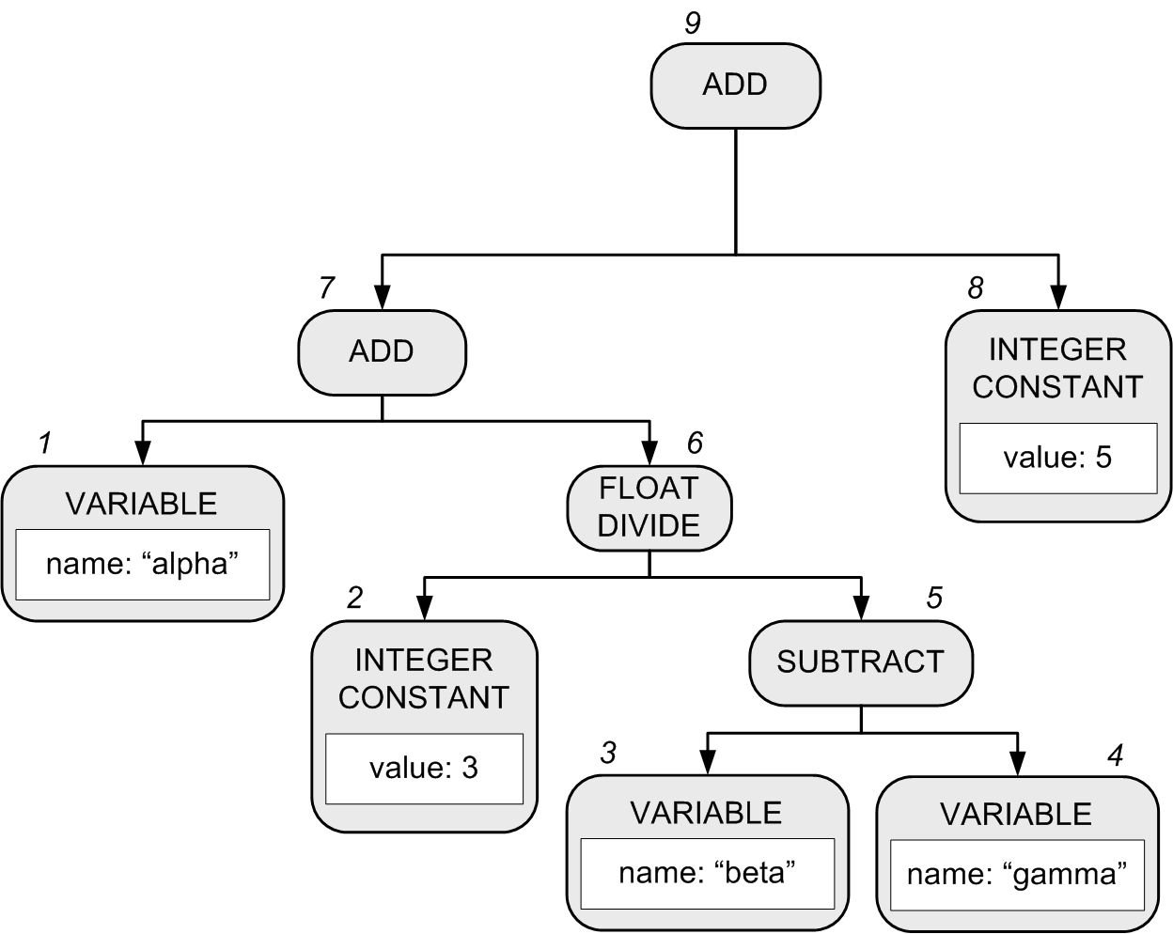
Generating Code for Expressions
alpha + 3/(beta - gamma) + 5
Recall that in our Pascal interpreter, the expression executor does a postorder traversal of the expression parse tree in order to execute the expression.
  Pascal’s operator precedence rules are encoded in the structure of the parse tree.
Notes:
START HERE.

Slide 19
Generating Code for Expressions
A compiler’s expression code generator also does a postorder traversal to generate code for the expression.
  Assume that alpha, beta, and gamma are local real variables
  alpha ➔ local variable slot #0
  beta ➔ local variable slot #1
  gamma ➔ local variable slot #2
  Generated code:
1 fload_0
2 ldc 3.0
3 fload_1
4 fload_2
5 fsub
6 fdiv
7 fadd
8 ldc 5.0
9 fadd
alpha + 3/(beta - gamma) + 5

Slide 20
Compare Integer Values
Jasmin has a set of instructions each of which
pops off the top two integer values from the operand stack, compare them, and then branch if the comparison is true.
Instruction | Action
if_icmpeq label | Branch to label if [TOS-1] == [TOS]
if_icmpne label | Branch to label if [TOS-1] != [TOS]
if_icmpgt label | Branch to label if [TOS-1] > [TOS]
if_icmpge label | Branch to label if [TOS-1] >= [TOS]
if_icmplt label | Branch to label if [TOS-1] < [TOS]
if_icmple label | Branch to label if [TOS-1] <= [TOS]
Notation
[TOS] is the value at the top of the stack.
[TOS-1] is the value just under the one
at the top of the stack.

Slide 21
Compare Integer Values, cont’d
You can also pop off only the single integer value at the top of the operand stack, compare it to 0, and then branch if the comparison is true.
The top value is popped off the stack.
Instruction | Action
ifeq label | Branch to label if [TOS] == 0
ifne label | Branch to label if [TOS] != 0
ifgt label | Branch to label if [TOS] > 0
ifge label | Branch to label if [TOS] >= 0
iflt label | Branch to label if [TOS] < 0
ifle label | Branch to label if [TOS] <= 0

Slide 22
Compare Values of Other Datatypes
Instructions lcmp, fcmp, and dcmp each
compares two long, float, or double values
at the top of the operand stack.
  Each pops off the top two values, compares them,
  and then pushes the integer value -1, 0, or 1 back
  onto the operand stack.
    If [TOS-1] < [TOS], push -1.
    If [TOS-1] == [TOS], push 0.
    If [TOS-1] > [TOS], push 1.
  Long and double values each uses two stack elements.
Then use instructions iflt, ifeq, or ifgt
to test for the -1, 0, or 1.

Slide 23
What Would James Gosling Do?
What Jasmin code should you generate?
Test.java
public class Test
{
private static float test()
{
float alpha = 0; //* slot #0
float beta = 10; //* slot #1
float gamma = 20; //* slot #2
int thirty = 30; //* slot #3
int forty = 40; //* slot #4
int fifty = 50; //* slot #5
if (forty == fifty)
{
return alpha + 3/(beta - gamma) + 5;
}
else
{
return alpha + thirty/(beta - gamma) + fifty;
}
}
}

Slide 24
What Would James Gosling Do, cont’d
If you have a construct in your source language and you don’t know what Jasmin code to generate for it:
  Write the equivalent construct in Java.
  Compile the Java into a .class file.
  Run the jasper disassembler to get an idea
  of what code you should generate.

Slide 25
Jasper
Use the Jasper disassembler: http://www.angelfire.com/tx4/cus/jasper/
It claims to disassemble .class files into Jasmin files suitable for the Jasmin assembler.
  Jasper is a Java program.
Google “Java byte code viewer”
for other disassemblers.
  Java comes with javap, but its output cannot be assembled by the Jasmin assembler.

Slide 26
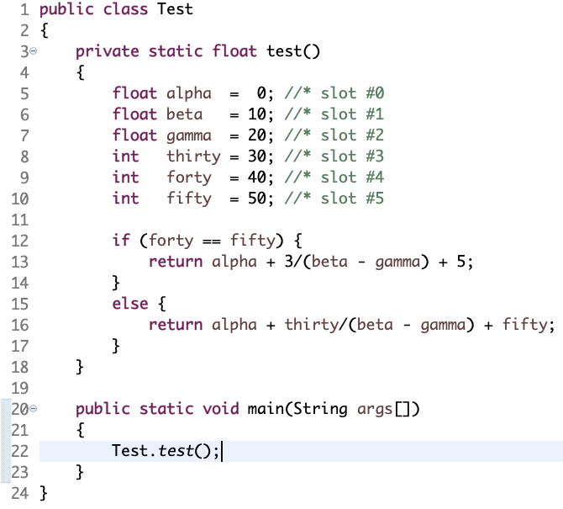
Jasper, cont’d
.method private static test()F
.limit stack 4
.limit locals 6
.var 0 is alpha F from LABEL0x2 to LABEL0x33
.var 1 is beta F from LABEL0x5 to LABEL0x33
.var 2 is gamma F from LABEL0x8 to LABEL0x33
.var 3 is thirty I from LABEL0xb to LABEL0x33
.var 4 is forty I from LABEL0xf to LABEL0x33
.var 5 is fifty I from LABEL0x13 to LABEL0x33
.line 5
fconst_0
fstore_0
.line 6
LABEL0x2:
ldc 10.0
fstore_1
.line 7
LABEL0x5:
ldc 20.0
fstore_2
.line 8
LABEL0x8:
bipush 30
istore_3
.line 9
LABEL0xb:
bipush 40
istore 4
.line 10
LABEL0xf:
bipush 50
istore 5
First:
javac Test.java
Then:
jasper Test.class

Slide 27
Jasper, cont’d
.line 12
LABEL0x13:
iload 4
iload 5
if_icmpne LABEL0x26
.line 13
fload_0
ldc 3.0
fload_1
fload_2
fsub
fdiv
fadd
ldc 5.0
fadd
freturn
.line 16
LABEL0x26:
fload_0
iload_3
i2f
fload_1
fload_2
fsub
fdiv
fadd
iload 5
i2f
fadd
freturn
LABEL0x33:
.end method
A useful alias (put in .bashrc):
alias jasper='java -cp ~/jasper/jasper.jar jasper/Jasper'

Slide 28
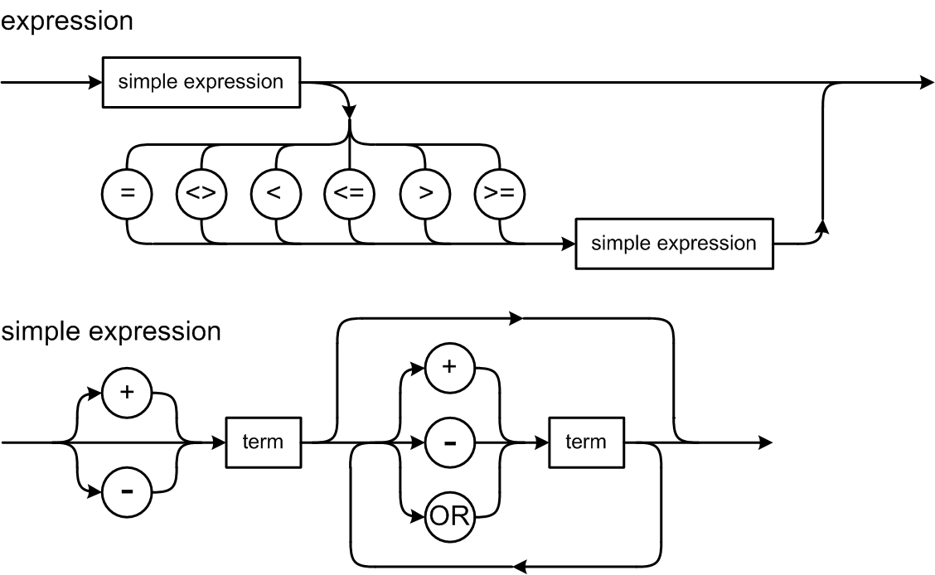
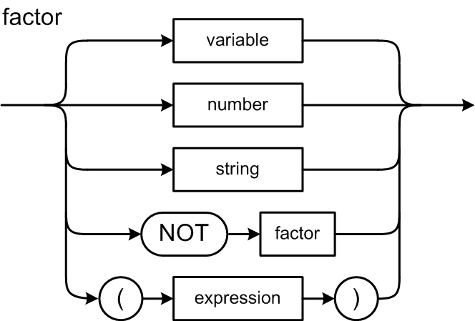
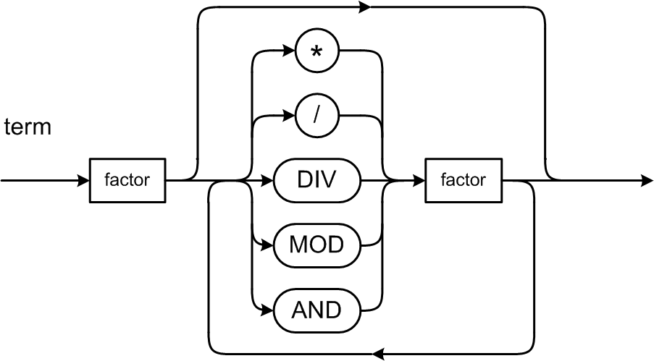
Expression Syntax Diagrams
What code should we generate for a relational expression?

Slide 29
Relational Expressions
Suppose i and j are local integer variables, and that:
  i ➔ slot #0
  j ➔ slot #1
0 represents false and
1 represents true.
For the expression i < j leave either 0 or 1
on top of the operand stack:
This is a hack that is
easy but inefficient.
iload_0 ; push the value of i (slot #0)
iload_1 ; push the value of j (slot #1)
if_icmplt L003 ; branch if i < j
iconst_0 ; push false
goto L004 ; go to next statement
L003:
iconst_1 ; push true
L004:
Your code generator
also needs to
emit labels.

Slide 30
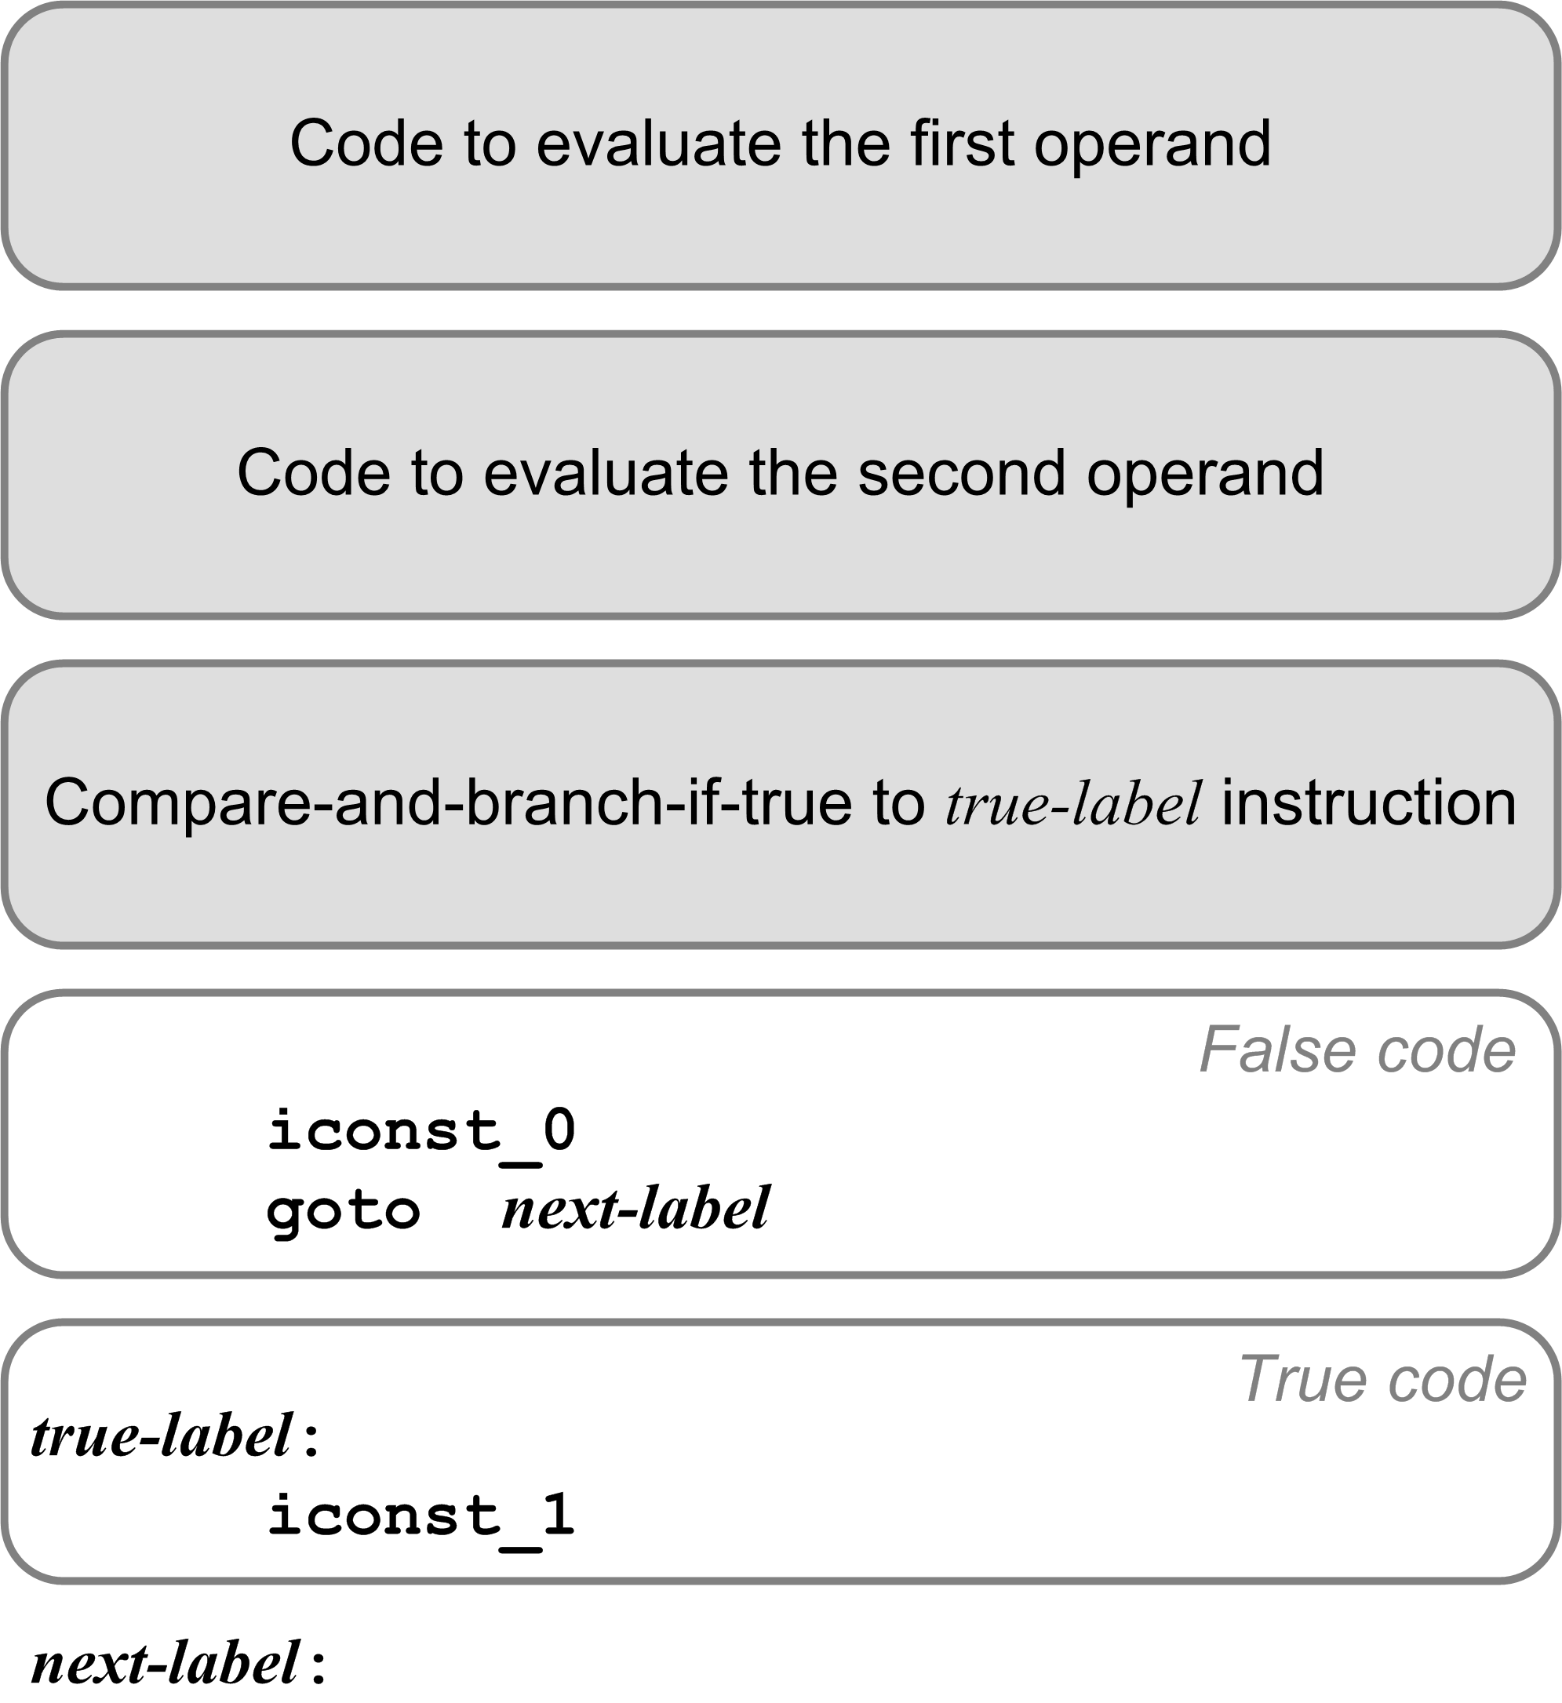
Relational Expression Code Template
iload_0
iload_1
if_icmplt L003
iconst_0
goto L004
L003:
iconst_1
L004:

Slide 31
Load and Store Tips
Write special code emitters for loading (pushing) values onto the operand stack.
If loading constants:
  Determine whether you can emit a shortcut instruction.

Slide 32
Load and Store Tips, cont’d
To load (push) a variable’s value:
  Determine whether it’s a program variable
  (emit a getstatic instruction with the field name and data type descriptor) or a local variable (emit an appropriate load instruction with the slot number).
  Determine whether you can emit a shortcut instruction for a local variable.
Similarly, write special code emitters to store (pop) a value off the operand stack into a program variable or into a local variable’s slot.

