Slide 1


CMPE 152: Compiler Design
March 23 Class Meeting
Department of Computer Engineering
San Jose State University
Spring 2021
Instructor: Ron Mak
www.cs.sjsu.edu/~mak

Slide 2
Midterm Solution: Question #1
Briefly explain the purpose of each set of visit functions:
  Front end: Perform semantic operations -- build the symbol table, do type checking, add additional information to the tree nodes, etc.
  Interpreter: Execute the source program by using the parse trees and the symbol table entries.
  Interactive debugger: Same as the interpreter with additional checks for debugger operations.
  Command interpreter: Execute the debug commands by by using the parse trees.
  Converter: Convert the source program to an equivalent program in a different language by using the parse trees and the symbol table entries.

Slide 3
Midterm Solution: Question #2
Explain the benefits the ANTLR-generated base visitor classes provide the compiler developer.
  The base visit functions each perform the default action of visiting the parse tree node’s children. Therefore, the developer only needs to override the visit functions that are necessary to perform custom operations at certain nodes. Otherwise, the default action automatically visits children.

Slide 4
Midterm Solution: Question #3
Explain how, during Pass 2, how the front end
  can determine whether a variable is being incorrectly redeclared in the same scope.
    If the front end finds the variable name is in the local symbol table (at the top of the symbol table stack), then the variable is being redecuared.
  can verify that a variable in an expression has been declared, either in the current scope or in an enclosing scope.
    The front end searches the symbol tables in the symbol table stack from top to bottom (i.e., it searches ever-wider enclosing outer scopes) until it finds the declaration. If it doesn’t find the declaration, the variable is undeclared.

Slide 5
Midterm Solution: Question #4
You want to extend the Pascal language by adding a new LOOP AGAIN statement.
  This can be done if the front end builds the same parse tree using LOOP and TEST nodes in the middle tier for any looping statement of the language. Each EXITIF statement results in a TEST node. A LOOP node can have multiple TEST node children.
  The back end would treat every LOOP tree the same way regardless of the source statement that generated the tree.

Slide 6
Review: Interpreter, Converter, Compiler
Same front end
  parser, scanner, tokens
  one set of visit functions for semantic operations
Same intermediate tier
  symbol tables, parse trees
Different back end operations
  different sets of visit functions

Slide 7
Interpreter, Converter, Compiler, cont’d
Interpreter: Use the symbol tables and parse trees to execute the source program.
  backend executor
Converter: Use the symbol tables and parse trees to generate an object program written in a different high-level language.
  backend code generator
Compiler: Use the symbol tables and parse trees to generate an object program written in a low-level language such as assembly language.
  backend code generator

Slide 8
Target Machines
A compiler’s backend code generator produces
object code for a target machine.
Target machine: Java Virtual Machine (JVM)
Object language: Jasmin assembly language
  The Jasmin assembler translates assembly language programs into binary .class files.
  The JVM loads and executes .class files.

Slide 9
Target Machines, cont’d
Instead of using javac to compile a source program written in Java into a .class file ...
Use your compiler to compile a source program written in your chosen language into a Jasmin
object program.
Then use the Jasmin assembler
to create the .class file.

Slide 10
Target Machines, cont’d
No matter what language the source program was originally written in, once it’s been compiled into a .class file, the JVM will be able to load and execute it.
The JVM runs on a wide variety
of hardware platforms.

Slide 11
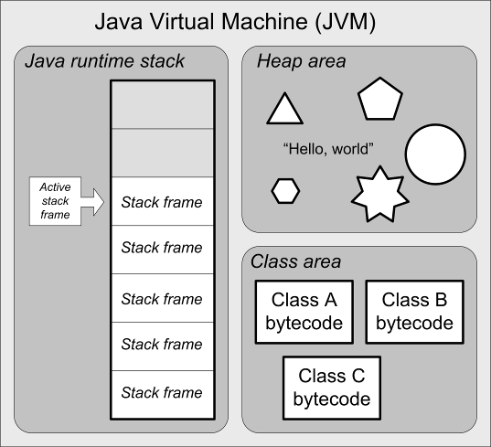
Java Virtual Machine (JVM) Architecture
Java stack
  runtime stack
Heap area
  dynamically allocated objects
  automatic garbage collection
Class area
  code for methods
  constants pool
Native method stacks
  support native methods, e.g., written in C
  (not shown)

Slide 12
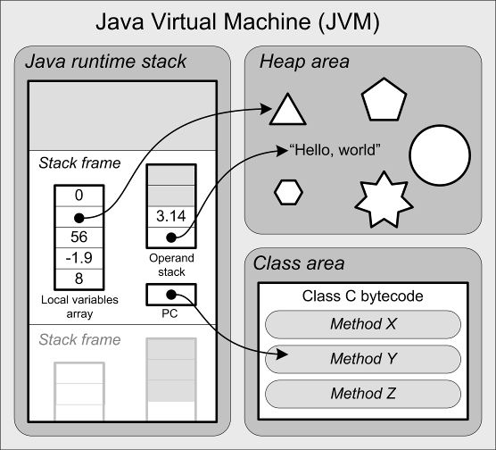
Java Virtual Machine Architecture, cont’d
The runtime stack contains stack frames.
Each stack frame contains:
  local variables array
  operand stack
  program counter (PC)
What is missing in the JVM
that we had in our
Pascal interpreter?

Slide 13
The JVM’s Java Runtime Stack
Each function or procedure call
pushes a stack frame.
The stack frame currently on top
of the runtime stack is the
active stack frame.
A stack frame is popped off when the function returns, possibly leaving behind a return value on top of the caller’s operand stack.

Slide 14
Stack Frame Contents
Operand stack
  For doing computations.
Local variables array
  Equivalent to the memory map in our
  Pascal interpreter’s stack frame.
Program counter (PC)
  Keeps track of the currently executing instruction.
  It’s automatically managed, so we don’t have to worry about this.

Slide 15
JVM Instructions
Load and store values
Arithmetic operations
Type conversions
Object creation and management
Runtime stack management (push/pop values)
Branching
Function call and return
Throwing exceptions
Concurrency

Slide 16
Jasmin Assembler
Download from:
  http://jasmin.sourceforge.net/
Site also includes:
  User Guide
  Instruction set
  Sample programs

Slide 17
Example Jasmin Program
.class public HelloWorld
.super java/lang/Object
.method public static main([Ljava/lang/String;)V
.limit stack 2
.limit locals 1
getstatic java/lang/System/out Ljava/io/PrintStream;
ldc " Hello, world!"
invokevirtual java/io/PrintStream/println(Ljava/lang/String;)V
return
.end method
hello.j
Assemble:
  jasmin hello.j
Execute:
  java HelloWorld
jasmin.sh
#!/bin/bash
java -jar /Users/rmak/jasmin-2.4/jasmin.jar $1
Demo

Slide 18
Jasmin Assembly Instructions
A Jasmin instruction consists of a mnemonic optionally followed by arguments.
  Example:
  ldc 2 ; Push the constant 2 onto the operand stack
Reference: The Java Virtual Machine Instruction Set
https://docs.oracle.com/javase/specs/jvms/se7/html/jvms-6.html

Slide 19
Jasmin Assembly Instructions, cont’d
Some instructions require operands
on the operand stack.
  Examples:
  iadd ; Pop the two integer values on top of the
  ; operand stack, add them, and push the result
  ; back onto the operand stack
if_icmpeq L004 ; Pop the two integer values on top of
; operand stack, compare them, and then
; branch to label L004 if they're equal

Slide 20
Jasmin Assembly Instructions, cont’d
The JVM (and Jasmin) supports
five basic datatypes:
  int
  long
  float
  double
  reference
Examples:
Long and double values each requires two consecutive entries
in the local variables array and
two elements on the operand stack.
Letter | Type
a | reference
b | byte or boolean
c | char
d | double
f | float
i | int
l | long
s | short
isub ; integer subtraction
fmul ; float multiplication
Byte, boolean, char, and
short are treated as ints
on the operand stack and
in the local variables array.

Slide 21
Loading Constants onto the Operand Stack
Use the instructions ldc and ldc2_w
(load constant and load double-word constant)
to push constant values onto the operand stack of the active stack frame (the one currently
on top of the runtime stack).
  Examples:
ldc 2
ldc "Hello, world”
ldc 1.0
ldc2_w 1234567890L
ldc2_w 2.7182818284D
aconst_null ; push null

Slide 22
Shortcuts for Loading Constants
Special shortcuts for loading certain
small values of constant x:
iconst_m1 ; Push int -1
iconst_x ; Push int x, x = 0, 1, 2, 3, 4, or 5
lconst_x ; Push long x, x = 0 or 1
fconst_x ; Push float x, x = 0, 1, or 2
dconst_x ; Push double x, x = 0 or 1
bipush x ; Push byte x, -128 <= x <= 127
sipush x ; Push short x, -32,768 <= x <= 32,767
Shortcut instructions take up less memory
and can execute faster.

Slide 23
Local Variables
Local variables do not have names in Jasmin.
  Fields of a class do have names, as we’ll see later.
Refer to a local variable by its slot number
in the local variables array of the active stack frame.
  Example:
  iload 5 ; Push the int value in local slot #5

Slide 24
Local Variables, cont’d
Since each long and double value requires
two consecutive slots, refer to the value using the lower slot number.
  Example:
  lstore 3 ; Pop the long value
  ; from the top two stack elements
  ; and store it into local slots #3 and #4

Slide 25
Local Variables, cont’d
Do not confuse constant values
with slot numbers!
  It depends on the instruction.
  Examples:
  bipush 14 ; push the constant value 14
  iload 14 ; push the value in local slot #14

Slide 26
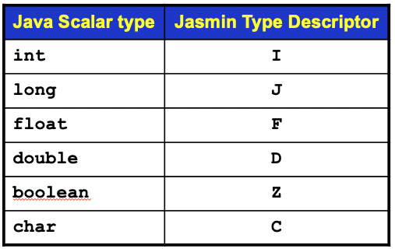
Local Variables, cont’d
The values of a function’s parameters are implicitly assigned to slots starting with #0.
  Example:
  k ➔ local slot #0
  m ➔ local slot #1
  x ➔ local slot #3
  s ➔ local slot #4
  Jasmin function signature:
  public static double func(int k, long m,
  float x, String[][] s)
What happened to slot #2?
  .method public static func(IJF[[Ljava/lang/String;)D

Slide 27
Load and Store Instructions
In general:
iload n ; push the int value in local slot #n
lload n ; push the long value in local slot #n
fload n ; push the float value in local slot #n
dload n ; push the double value in local slot #n
aload n ; push the reference in local slot #n
Shortcut examples
(for certain small values of slot number n):
iload_0 ; push the int value in local slot #0
lload_2 ; push the long value in local slot #2
fload_1 ; push the float value in local slot #1
dload_3 ; push the double value in local slot #3
aload_2 ; push the reference in local slot #2
Store instructions are similar.

Slide 28
Arithmetic Instructions
Addition
iadd ladd fadd dadd
Subtraction
isub lsub fsub dsub
Multiplication
imul lmul fmul dmul
Division and remaindering
idiv ldiv fdiv ddiv
Negation
ineg lneg fneg dneg
Operands are on top of
the operand stack.
Pop off the operands and replace them with the result value.
Negation has only one operand, the others each has two.
Int and float operands each takes a single operand stack element.
Long and double operands each takes two operand stack elements.

Slide 29
Other Instructions
Bitwise operations
  Left and right shifts
  And, or, exclusive or
Type conversions
  int ➔ float
Widening and narrowing
  int ➔ long
  double ➔ long
Stack manipulations
  Push and pop
  Swap and duplicate
Array operations
  Allocate array
  Index element
Object operations
Control instructions

Slide 30
Code Templates
Syntax diagrams
  Specify the source language grammar
  Help us write the parsers
Code templates
  Specify what object code to generate
  Help us write the code emitters

Slide 31
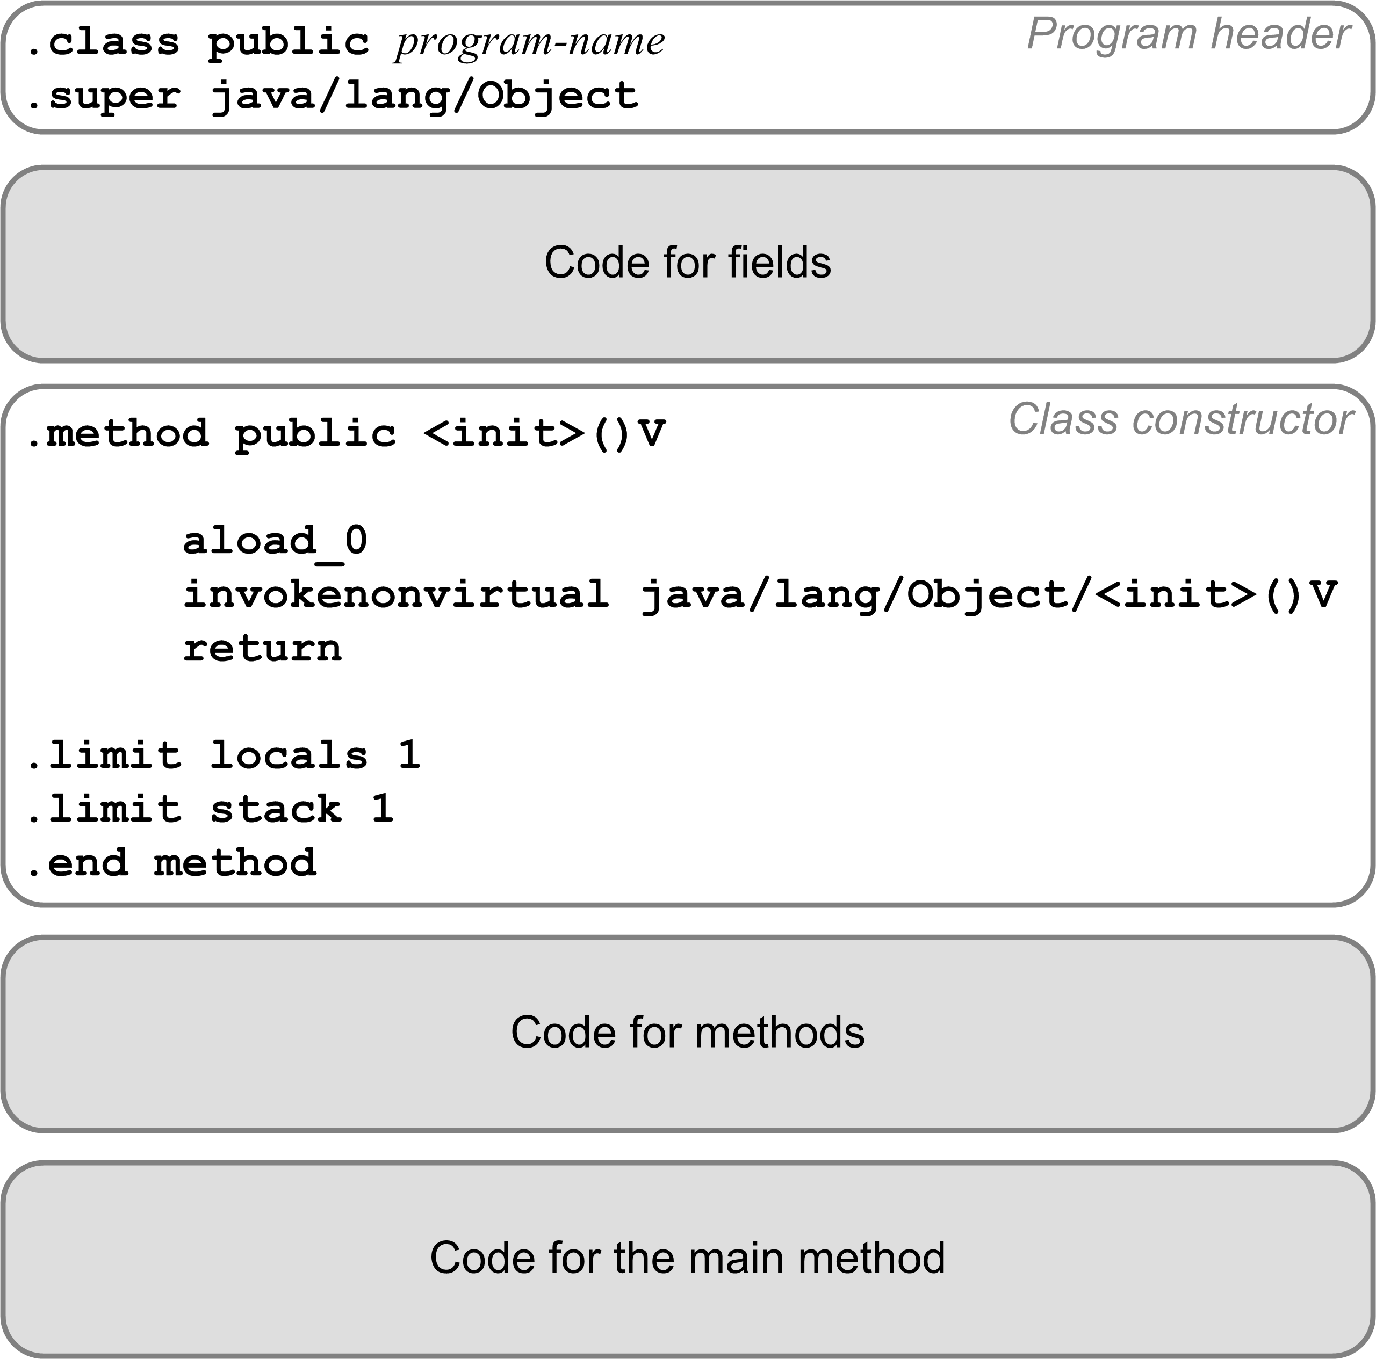
Code Template for a Pascal Program
Translate a Pascal program into a
public class.
Program variables become class fields.
Must have a
default constructor.
Each procedure or function becomes a private static method.
The main program code becomes the public static
main method.

Slide 32
Compilation Strategy
We’ll compile a Pascal program
as if it were a public Java class.
  The Pascal program name becomes
  the Java class name.
The main program becomes the
main method of the Java class.
We’ll compile each program variable
as if it were a field of the Java class.
  Fields do have names in a Jasmin program.
  Recall that local variables and parameters
  are referred to only by their slot numbers.

Slide 33
Compilation Strategy, cont’d
We’ll compile each Pascal procedure or function as if it were a private static method
of the Java class.
Local variables and formal parameters of the method do not have names in a Jasmin program.
  Jasmin instructions refer to local variables and parameters by their slot numbers of the local variables array.
  The first parameter is automatically assigned
  to slot #0.

Slide 34
Jasmin Datatype Descriptors
Java Scalar type | Jasmin Type Descriptor
int | I
long | J
float | F
double | D
boolean | Z
char | C
Java Class | Jasmin Type Descriptor
java.lang.String | Ljava/lang/String;
java.util.HashMap | Ljava/util/HashMap;
Newton | LNewton;
Java Array type | Jasmin Type Descriptor
java.lang.String[] | [Ljava/lang/String;
Newton[][] | [[LNewton;
int[][][] | [[[I

