Slide 1
CMPE 152: Compiler Design March 16 Class Meeting
Department of Computer Engineering San Jose State University Spring 2021 Instructor: Ron Mak
www.cs.sjsu.edu/~mak

Slide 2
Debugger Command Language
Define a simple debugger command language that the user can type at each breakpoint:
break
Set and display breakpoints using source line numbers.
unbreak
Remove breakpoints using source line numbers.
go
Resume execution of the program until the next breakpoint.
step
Execute the program one statement at a time.

Slide 3
Debugger Command Language
Debugger command language, cont’d
show
Display the current value of a variable.
watch
Monitor the values of variables.
unwatch
Stop monitoring the values of variables.
stack
Display the current contents of the runtime stack.
quit
Terminate the execution of the source program.
Demo

Slide 4
Parse the Debugger Commands
Use ANTLR to parse the debugger commands.
Create the Commander.g4 grammar file.
In addition to the generated lexer and parser for the source language, also generate the new classes CommanderLexer and CommanderParser.
At each breakpoint, after the user has typed a debugger command, CommanderLexer tokenizes the one-line command and CommanderParser builds a small parse tree.

Slide 5
Execute the Debugger Commands
Write class Commander containing visitor functions that perform debugger actions when visiting the nodes of the command parse tree.
Class Commander and class Debugger (the modified Executor class) live in the new namespace backend::debugger.
New runtime option: -debug

Slide 6
It’s all about Translation!
Interpreter
Translate a source program written in a high-level language to action (i.e., execute the program)
Converter
Translate a source program written in a high-level language to an equivalent program written in a different high-level language
Example: Convert a Pascal program to C++
Compiler
Translate a source program written in a high-level language to a low-level language (e.g., assembly)
Next!

Slide 7
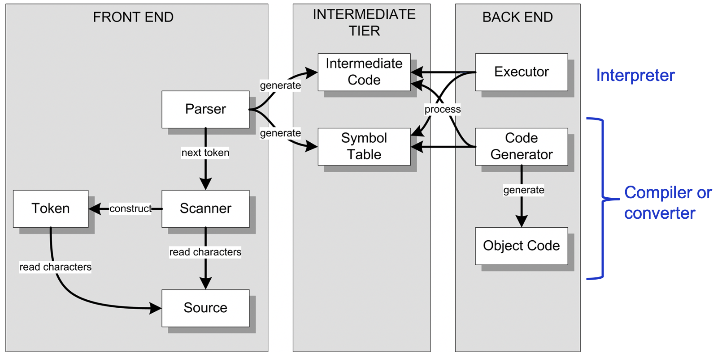
Backend Converter
Create a different set of visit functions than the set for the interpreter’s class Executor.
Keep the set of visit methods for class Semantics.

Slide 8
Conversion to a Different Language
Pascal source program ➔ parse tree
Perform the usual semantic checks.
Then parse tree ➔ C++ program
In the visit methods, instead of performing the action (i.e., executing a statement or evaluating an expression), emit the equivalent C++ statement or expression that will perform that action.

Slide 9
Convert Pascal’s REPEAT Statement
Pascal:
C++:
REPEAT
i := i + 1;
writeln('#', i:1, ': Hello, world!')
UNTIL i = 5
do
{
i = i + 1;
printf("#%1d: Hello, world!\n", i);
}
while (!(i == 5));

Slide 10
Convert Pascal’s REPEAT Statement, cont’d
Object Converter::visitRepeatStatement(PascalParser::RepeatStatementContext *ctx)
{
bool needBraces = ctx->statementList()->statement().size() > 1;
code.emit("do");
if (needBraces) code.emitLine("{");
code.indent();
visit(ctx->statementList());
code.dedent();
if (needBraces) code.emitLine("}");
code.emitStart("while (!(");
code.emit(visit(ctx->expression()).as<string>());
code.emitEnd("));");
return nullptr;
}
Converter.cpp

Slide 11
Convert Pascal’s Assignment Statement
Converter.cpp
Object Converter::visitAssignmentStatement(
PascalParser::AssignmentStatementContext *ctx)
{
string lhs = visit(ctx->lhs()->variable()).as<string>();
string expr = visit(ctx->rhs()->expression()).as<string>();
code.emit(lhs + " = " + expr);
code.emitEnd(";");
return nullptr;
}
Backend code generation methods.
Example:
void CodeGenerator::emit(const string code)
{
objectFile << code;
objectFile.flush();
length += code.length();
needLF = true;
}
CodeGenerator.cpp

Slide 12
Assignment #5: Converter
Complete the Pascal ➔ C++ converter:
WHILE statements
FOR statements
IF statements
CASE statements
procedure calls
function calls
Start with the test Pascal programs from previous assignments.
More Pascal programs to come!
Due Friday, April 9.

Slide 13
Midterm Review: Question 1
The parser builds data structures consisting of symbol table entry objects (STEO) and type specification objects (TSO).
How are these structures used at compile time?
STEO: Store information about locally-declared identifiers.
TSO: Represent type information.
Both: Assign types to variables.
Both: Do type checking in statements and expressions.

Slide 14
Midterm Review: Question 1, cont’d
How does the interpreter use these structures at run time?
STEO: Create the memory map for each Stack Frame that’s pushed onto the runtime stack.
STEO: Get the values of defined and enumeration constants.
TSO: Do runtime range checking for subranges.
TSO: Get the data types of array indexes and elements.

Slide 15
Midterm Review: Question 2
How does the symbol table stack …
… allow a variable declared in an enclosing scope to be redeclared in the local scope?
Push a new symbol table onto the symbol table stack for the local scope. Enter the variable’s name into the local table.
… prevent a variable already declared in the local scope from being redeclared in the local scope?
First check the local symbol table to see whether the variable’s name is already entered into the table.

Slide 16
Midterm Review: Question 2, cont’d
How does the symbol table stack …
… allow two record types defined in the same procedure to declare fields with the same names?
Push a separate symbol table for each record type onto the symbol table stack when the parser is parsing the record type specification. Pop it off when the parser is done parsing the specification.

Slide 17
Midterm Review: Question 3
Some programming languages use parentheses to enclose array subscripts and to enclose arguments to function calls. Suppose Pascal did the same. Consider the assignment statement: Describe how the Pascal parser could (or could not) determine whether it is parsing a call to function arr or an access to an element of array arr.
x := arr(i, 2*j)

Slide 18
Midterm Review: Question 3, cont’d
x := arr(i, 2*j)
By the time the parser is parsing the assignment statement, it would have already parsed the declaration of arr as either an array or a function. Therefore, when the parser encounters arr in the assignment statement, it looks in the symbol table to see how arr was declared.

Slide 19
Midterm Review: Question 4
Suppose Pascal has an exponentiation operator **, so that n**4 represents the mathematical expression n⁴. Exponentiation has a higher operator precedence level than the multiplicative operators. Therefore, n**i*j is evaluated as (n**i)*j. Furthermore, exponentiation is right-associative, so that n**i**j**k is evaluated as n**(i**(j**k)).

Slide 20
Midterm Review: Question 4
What modifications to the expression, simple expression, term, and factor grammar rules are required to accommodate the ** operator?
term : power ( mulOp power )* ;
power : factor ( '**' power )? ;
A combination of multiple-choice and short-answer questions.
Use a standard browser to access Canvas.
Open book, notes, laptop, internet.
No communication with anyone else during the exam.
Turn on your camera during the exam.
The exam will be recorded.

