Slide 1


CMPE 152: Compiler Design
March 4 Class Meeting
Department of Computer Engineering
San Jose State University
Spring 2021
Instructor: Ron Mak
www.cs.sjsu.edu/~mak

Slide 2
More Assignment #4 Tips
In the visit functions for expressions, method visitChildren() might not return an object with the datatype that you expect.
  Use visit() instead to make a direct visit.
  Example: In method visitSimpleExpression():
Method visitFactor() can return an integer number, a real number, or a string.
  Always return a string.
  Convert the string to a number to do arithmetic.
Object value = visit(ctx->term()->factor()->number());

Slide 3
Reminder: Syntax and Semantics
Syntax refers to the grammar rules of the
of a source language.
The rules prescribe the proper form
of its programs.
The parser “knows” the grammar.
  Rules can be described by syntax diagrams.
Syntax checking
  Does this sequence of tokens follow
  the syntax rules?
  Performed by the frontend parser.

Slide 4
Syntax and Semantics, cont’d
Semantics refers to the meaning of syntactically correct token sequences of the source language.
Example: Certain sequences of tokens constitute an IF statement according to the language’s grammar.
The semantics of the statement determine
  How the interpreter will execute the statement, or
  How the compiler or converter will generate object code for the statement.

Slide 5
Syntax and Semantics, cont’d
Semantic actions by the frontend parser based on the meanings of statements and expressions:
  Building proper parse trees.
  Building symbol tables.
  Type checking.
The parse trees encode type checking and
operator precedence in their structures.

Slide 6
Syntax and Semantics, cont’d
Semantic actions in the back end:
  Interpreter: The executor runs the program and performs actions according to the meanings of the statements and expressions.
  Compiler and converter: The code generator emits object code that reflects the meanings of the statements and expressions.

Slide 7
Multipass Compilers
A compiler can make multiple passes.
  A pass involves going through the source program, either in the original text form or as a parse tree.
  During each pass, the compiler performs operations that are relevant to that pass.
Pass 1 (frontend syntax)
  Read the original source program text.
  Verify that the source program is
  syntactically correct.
  Build the parse tree.
Done by ANTLR-generated code.

Slide 8
Multipass Compilers, cont’d
Pass 2 (frontend semantics)
  Visit the parse tree.
  Enter identifier and type information
  into the symbol table.
  Perform type checking.
  Add additional information to the parse tree nodes.
Pass 3 (backend semantics)
  Revisit the parse tree, now with additional information in the tree nodes.
  Execute the source program or generate code.

Slide 9
Declarations and the Symbol Table
Identifiers from Pascal declarations that
we will enter into a symbol table, names of:
  constants
  types
  enumeration values
  record fields
  variables
Information from parsing type specifications:
  simple types
  array types
  record types
Notes:
START HERE.

Slide 10
Type Specification Attributes
Each type specification has certain attributes
depending on its form.
Type form
Type specification attributes
Scalar
None
Enumeration
List of enumeration constant identifiers
Subrange
Base type
Minimum value
Maximum value
Array
Index type
Element type
Element count
Record
A separate symbol table for the field identifiers

Slide 11
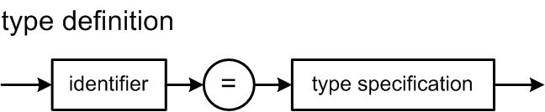
Review: Type Definitions
Sample type definitions:
TYPE
e = (alpha, beta, gamma);
sr = alpha..beta;
ar = ARRAY [1..10] OF sr;
rec = RECORD
x, y : integer
END;
How can we represent type specification information in our symbol table
and associate the correct type specification with an identifier?

Slide 12
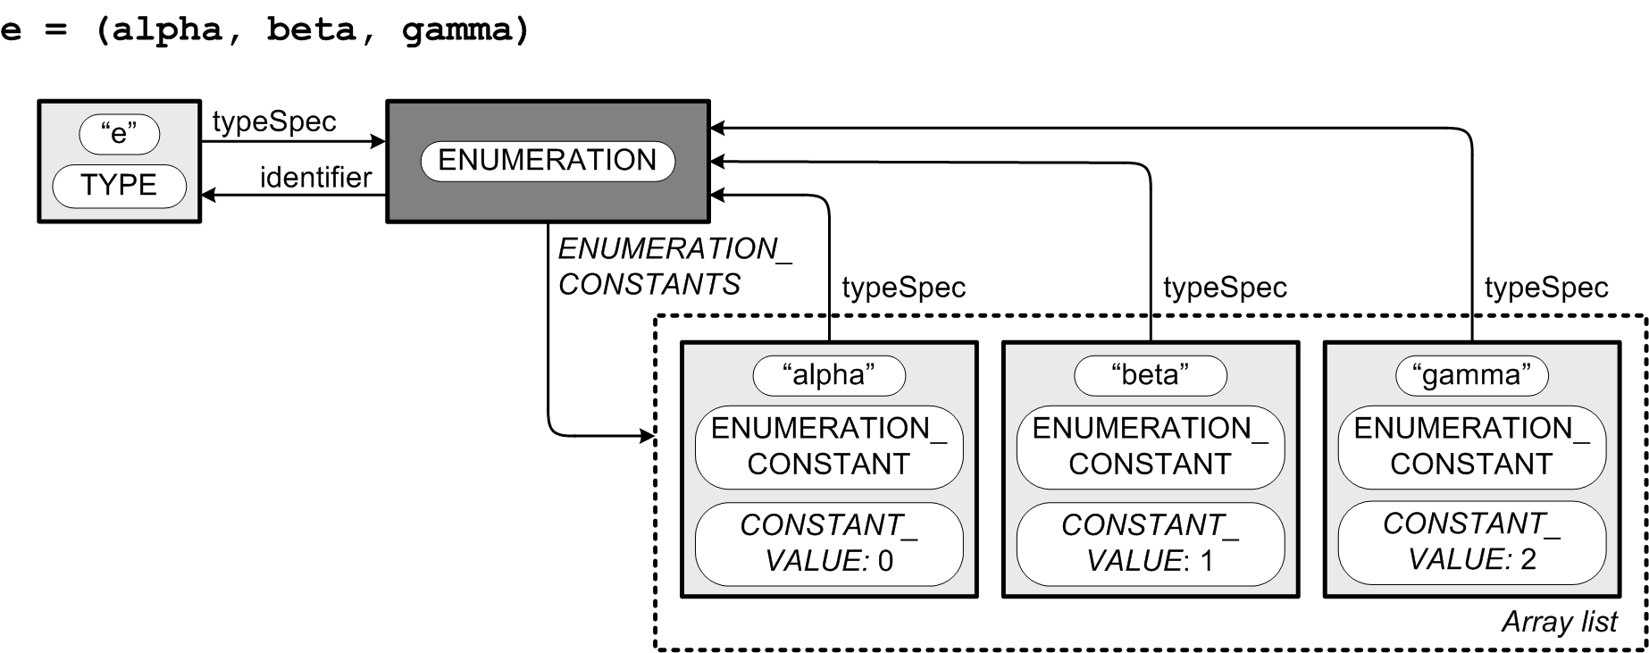
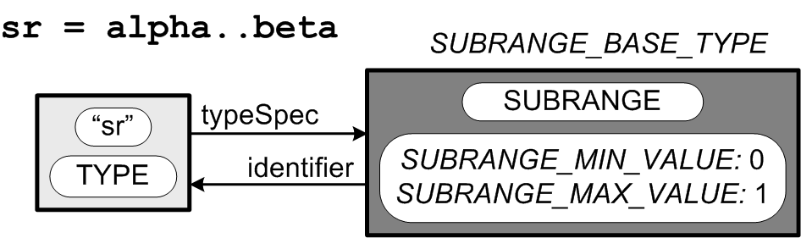
Type Definition Structures
type specification
(class Typespec)
symbol table entry
(class SymTabEntry)
typespec
typespec
constants
typespec
typespec
symbol table entry
(class SymTabEntry)
vector<SymtabEntry *> *constants;
Each symbol table entry has a
pointer to a type specification.
Each type specification of a
named type has a pointer to the
type identifier’s symbol table entry.

Slide 13
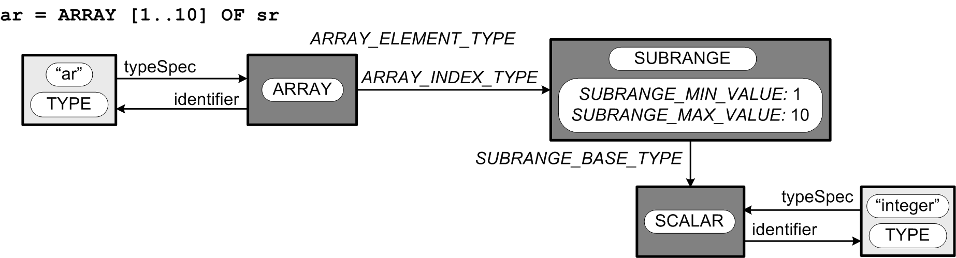
Type Definition Structures, cont’d
When it is parsing declarations,
the parser builds
type specification structures.
When it is parsing
executable statements,
the parser builds parse trees.
Unnamed type
Is there an unnamed type?

Slide 14
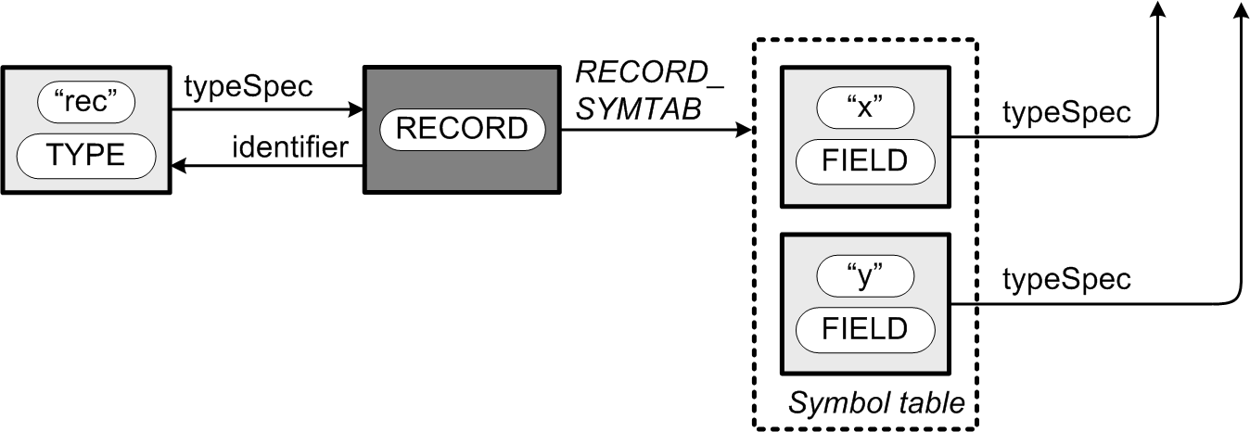
Type Definition Structures, cont’d
elementType
ARRAY_ELMT_TYPE
indexType
minValue: 1
maxValue: 10
baseType
typespec
rec = RECORD x,y : integer END
Each record type has its own
symbol table to contain
its record field identifiers.

Slide 15
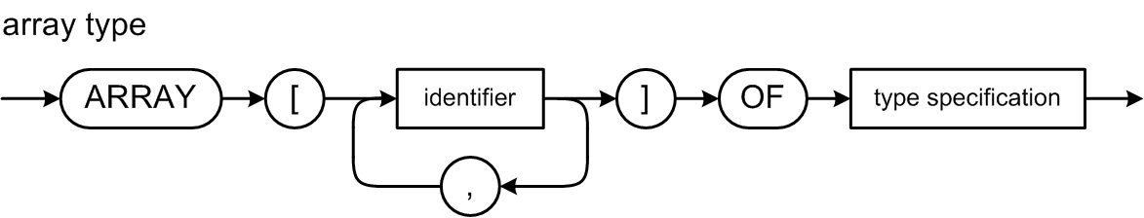
Pascal Array Type
elementType
typespec
indexType
minValue: 1
maxValue: 10
baseType
typespec

Slide 16
Pascal Multidimensional Array
These definitions are all equivalent:
  dim3 = ARRAY [1..3, 'a'..'z', boolean] OF real;
  dim3 = ARRAY [1..3] OF ARRAY ['a'..'z']
  OF ARRAY [boolean] OF real;
  dim3 = ARRAY [1..3, 'a'..'z'] OF ARRAY [boolean] OF real;
  dim3 = ARRAY [1..3] OF ARRAY ['a'..'z, boolean] OF real;
Therefore, they must all generate
the same type specification structure.

Slide 17
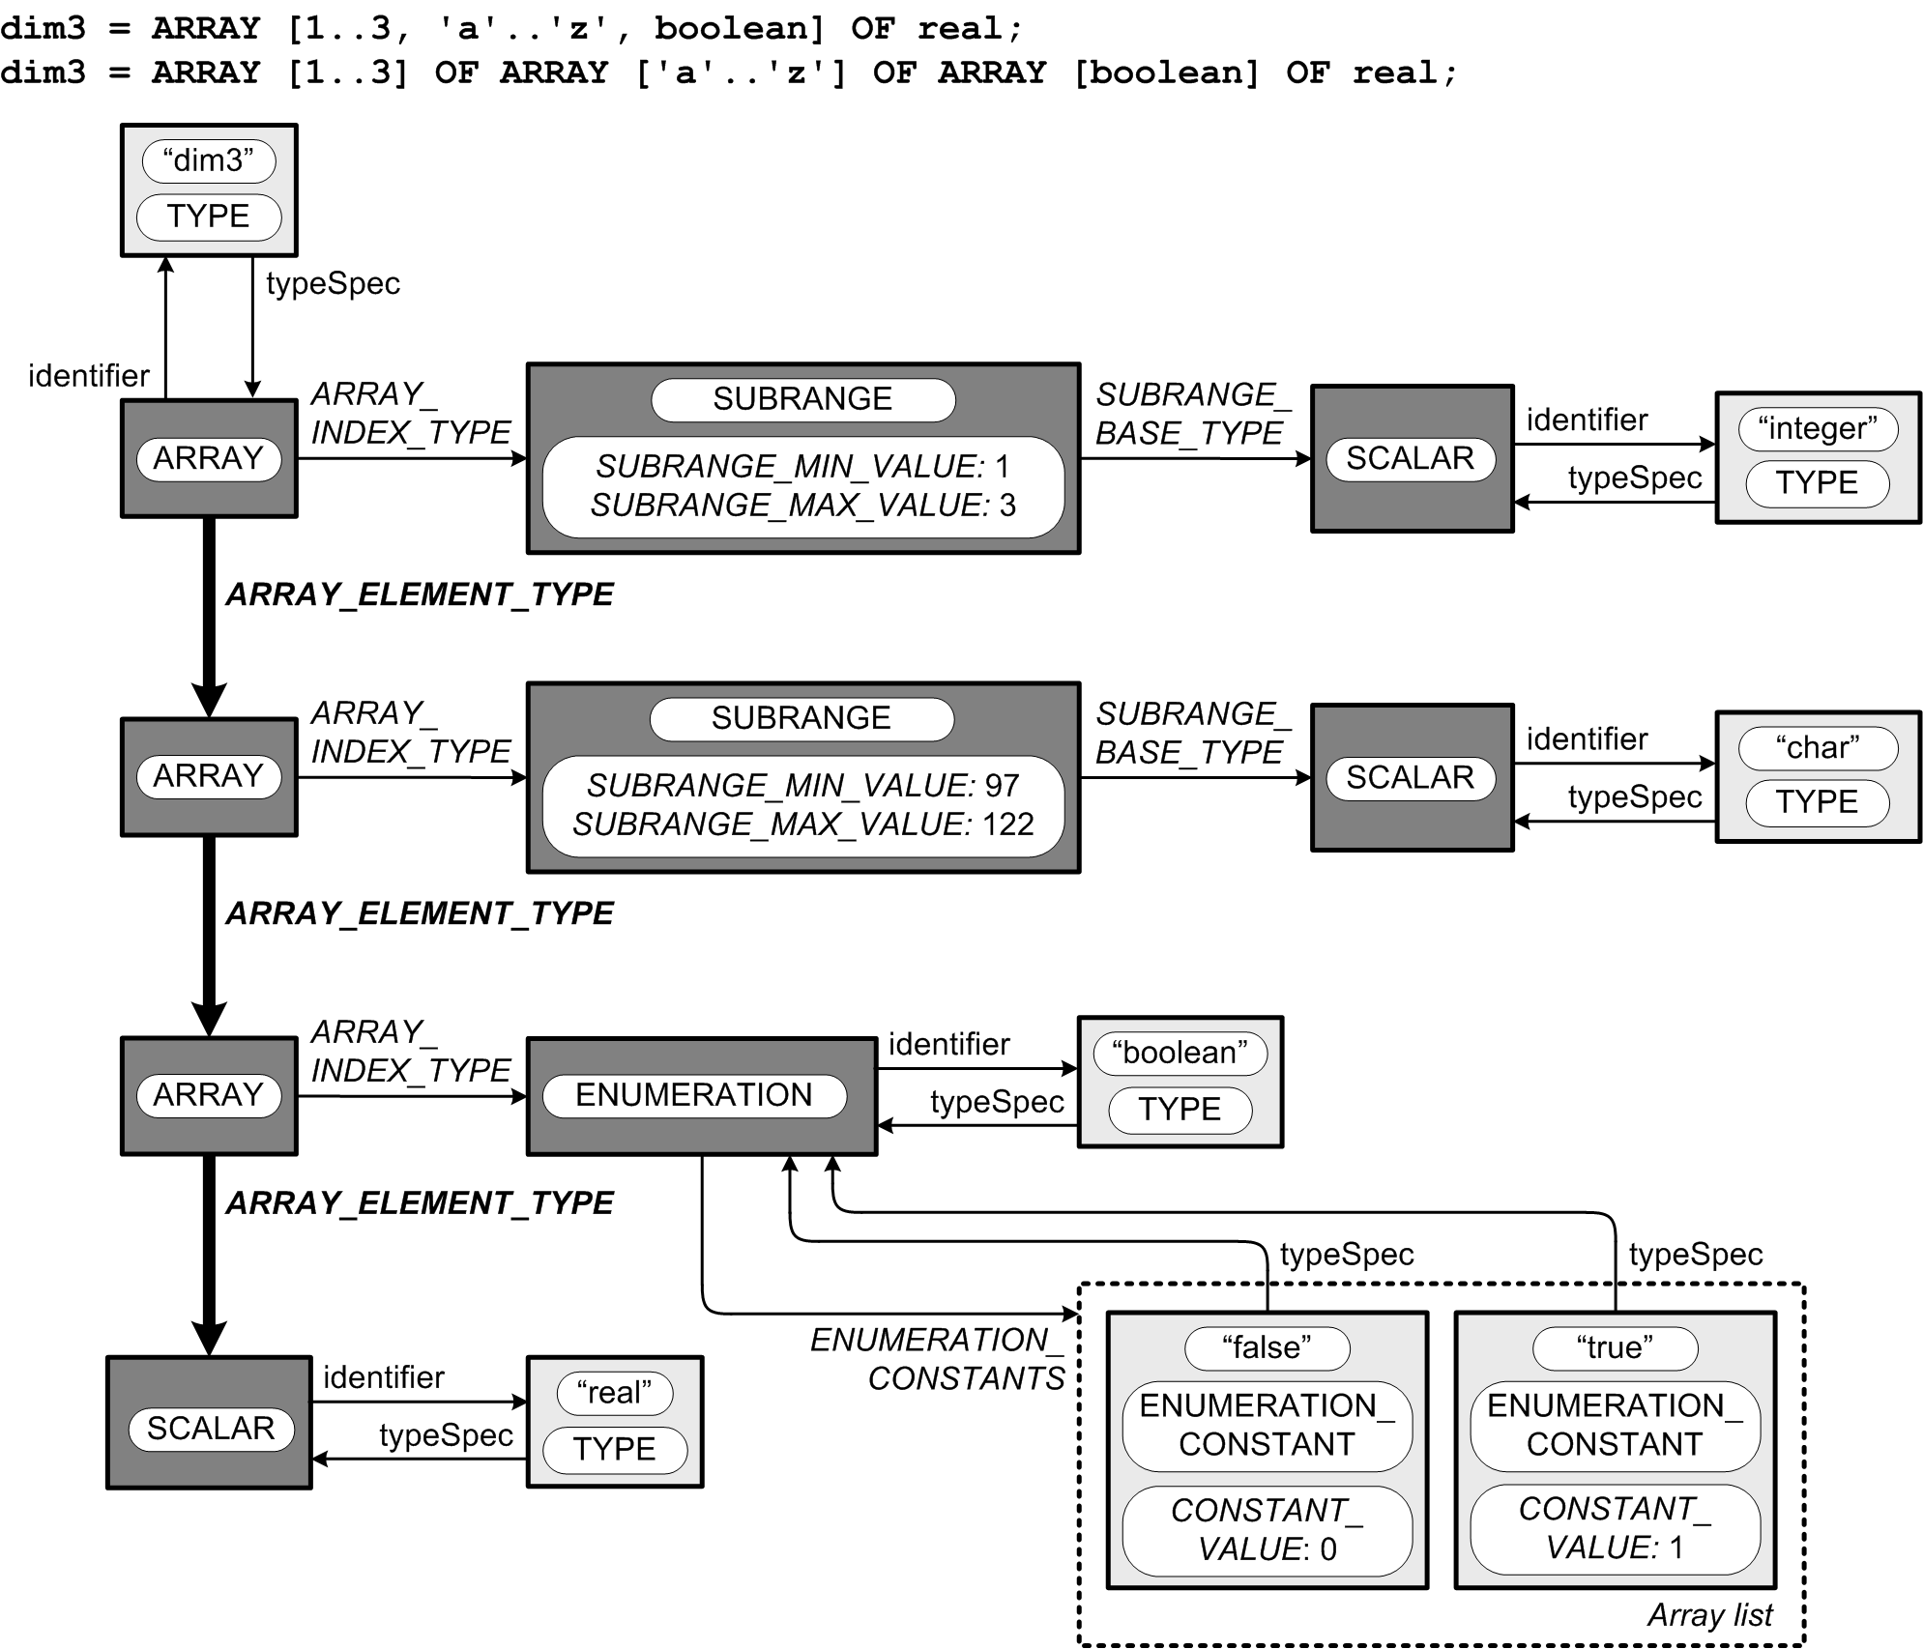
Pascal Multidimensional Array
typespec
indexType
baseType
minValue: 1
maxValue: 3
typespec
elementType
The first two
element types
are arrays,
and the third
element type
is real scalar.
indexType
baseType
minValue: 97
maxValue: 122
typespec
elementType
indexType
typespec
elementType
typespec
typespec
constants
typespec
constants
constants

Slide 18
Predefined Scalar Types
namespace intermediate { namespace symtab {
...
class Predefined
{
public:
// Predefined types.
static Typespec *integerType;
static Typespec *realType;
static Typespec *booleanType;
static Typespec *charType;
static Typespec *stringType;
static Typespec *undefinedType;
// Predefined identifiers.
static SymtabEntry *integerId;
static SymtabEntry *realId;
static SymtabEntry *booleanId;
static SymtabEntry *charId;
static SymtabEntry *stringId;
static SymtabEntry *falseId;
static SymtabEntry *trueId;
static SymtabEntry *readId;
static SymtabEntry *readlnId;
static SymtabEntry *writeId;
static SymtabEntry *writelnId;
...
intermediate::symtab::Predefined

Slide 19
Predefined Scalar Types, cont’d
void Predefined::initializeTypes(SymtabStack *symtabStack)
{
// Type integer.
integerId = symtabStack->enterLocal("integer", TYPE);
integerType = new Typespec(SCALAR);
integerType->setIdentifier(integerId);
integerId->setType(integerType);
// Type real.
realId = symtabStack->enterLocal("real", TYPE);
realType = new Typespec(SCALAR);
realType->setIdentifier(realId);
realId->setType(realType);
// Type boolean.
booleanId = symtabStack->enterLocal("boolean", TYPE);
booleanType = new Typespec(ENUMERATION);
booleanType->setIdentifier(booleanId);
booleanId->setType(booleanType);
...
}
intermediate::symtab::Predefined

Slide 20
Predefined Scalar Types, cont’d
void Predefined::initializeConstants(SymtabStack *symtabStack)
{
// Boolean enumeration constant false.
falseId = symtabStack->enterLocal("false", ENUMERATION_CONSTANT);
falseId->setType(booleanType);
falseId->setValue(0);
// Boolean enumeration constant true.
trueId = symtabStack->enterLocal("true", ENUMERATION_CONSTANT);
trueId->setType(booleanType);
trueId->setValue(1);
// Add false and true to the boolean enumeration type.
vector<SymtabEntry *> *constants = new vector<SymtabEntry *>;
constants->push_back(falseId);
constants->push_back(trueId);
booleanType->setEnumerationConstants(constants);
}
intermediate::symtab::Predefined

Slide 21
Type Checking
Another Pass 2 semantics operation
while visiting the parse tree.
Check for
  operands are type-compatible with their operands
  values are assignment-compatible with their targets
  values are comparison-compatible
Semantic errors
  undeclared identifiers
  type incompatibility

Slide 22
Type Checking
Ensure that the types of the operands are
type-compatible with their operator.
  Example: You can only perform an integer division
  with the DIV operator and integer operands.
  Example: The relational operators AND and OR
  can only be used with boolean operands.
Ensure that a value being assigned
to a variable is assignment-compatible
with the variable.
  Example: You cannot assign a string value
  to an integer variable.

Slide 23
Assignment and Comparison Compatible
In Pascal, a value is assignment-compatible
with a target variable if:
  both have the same type
  the target is real and the value is integer
  they are both strings
Two values are comparison-compatible
(they can be compared with relational operators) if:
  both have the same type
  one is integer and the other is real
  they are both strings

Slide 24
Class TypeChecker
Static boolean functions for type checking:
  isInteger()
  areBothInteger()
  areBothString()
  isReal()
  isIntegerOrReal()
  isAtLeastOneReal()
  isBoolean()
  areBothBoolean()
  isChar()
  isString()
  areAssignmentCompatible()
  areComparisonCompatible()
intermediate::type::TypeChecker
Notes:
START HERE

Slide 25
Type Checking Expressions
Pass 2 must perform type checking of
every expression as part of its semantic actions.
Add type checking to the appropriate
Pass 2 visit methods.
Flag type errors similarly to syntax errors.

Slide 26
Pass 2 Visit Functions for Type Definitions
Pass 2 visits the parse tree to build the type definition structures and enter them into the symbol table.
  visitTypeDefinition()
  visitTypeIdentifier()
  visitSimpleTypespec()
  visitArrayTypespec()
  visitRecordTypespec()
  visitTypeIdentifierTypespec()
  visitEnumerationTypespec()
  visitSubrangeTypespec()

Slide 27
New Fields for Parse Tree Nodes
We want the Pass 2 visit of the parse tree to leave useful information in the tree nodes for use by Pass 3 when the latter pass revisits
the parse tree.
  Nodes for identifiers: Add an entry field
  to point to the symbol table entry of the identifier.
  Nodes where datatype matters: Add a type field
  to point to a type specification structure.
  Nodes for constants: Add a value field to hold the constant value.

Slide 28
Grammar Pcl6.g4
constantIdentifier locals [ Typespec *type = nullptr, SymtabEntry *entry = nullptr ]
: IDENTIFIER ;
constant locals [ Typespec *type = nullptr, Object value = nullptr ]
: sign? ( IDENTIFIER | unsignedNumber )
| characterConstant
| stringConstant
;
typesPart : TYPE typeDefinitionsList ;
typeDefinitionsList : typeDefinition ( ';' typeDefinition )* ;
typeDefinition : typeIdentifier '=' typeSpecification ;
typeIdentifier locals [ Typespec *type = nullptr, SymtabEntry *entry = nullptr ]
: IDENTIFIER ;
typeSpecification locals [ Typespec *type = nullptr ]
: simpleType # simpleTypespec
| arrayType # arrayTypespec
| recordType # recordTypespec
;
Tell ANTLR 4 to add these member variables as new fields in the parse tree node.

Slide 29
Grammar Pcl6.g4, cont’d
variableIdentifier locals [ Typespec *type = nullptr, SymtabEntry *entry = nullptr ]
: IDENTIFIER ;
expression locals [ Typespec *type = nullptr ]
: simpleExpression (relOp simpleExpression)? ;
simpleExpression locals [ Typespec *type = nullptr ]
: sign? term (addOp term)* ;
term locals [ Typespec *type = nullptr ]
: factor (mulOp factor)* ;
factor locals [ Typespec *type = nullptr ]
: variable # variableFactor
| number # numberFactor
| characterConstant # characterFactor
| stringConstant # stringFactor
| NOT factor # notFactor
| '(' expression ')' # parenthesizedFactor
;
variable locals [ Typespec *type = nullptr, SymtabEntry *entry = nullptr ]
: IDENTIFIER ;
Demo

