Slide 1


CMPE 152: Compiler Design
September 10 Class Meeting
Department of Computer Engineering
San Jose State University
Fall 2020
Instructor: Ron Mak
www.cs.sjsu.edu/~mak

Slide 2
Backus Naur Form (BNF)
A text-based way to describe
source language syntax.
  Named after John Backus and Peter Naur.
Text-based means it can also be read
by a program.
  Example: A compiler-compiler that can
  automatically generate a parser and
  a scanner for a source language after
  reading the language’s syntax rules
  written in BNF.

Slide 3
Backus Naur Form (BNF), cont’d
Uses certain meta-symbols.
  Symbols that are part of BNF itself
  but are not necessarily part of the
  syntax of the source language.
::= | “is defined as”
| | “or”
< > | Surround names of nonterminal (not literal) items

Slide 4
BNF Example: U.S. Postal Address
<postal-address> ::= <name-part> <street-part> <city-state-part>
<name-part> ::= <first-part> <last-name>
| <first-part> <last-name> <suffix>
<first-part> ::= <first-name> | <capital-letter> .
<suffix> ::= Sr. | Jr. | <roman-numeral>
<street-part> ::= <house-number> <street-name>
| <house-number> <street-name> <apartment-number>
<city-state-part > ::= <city-name> , <state-code> <ZIP-code>
<first-name> ::= <name>
<last-name> ::= <name>
<street-name> ::= <name>
<city-name> ::= <name>
<house-number> ::= <number>
<apartment-number> ::= <number>
<state-code> ::= <capital-letter> <capital-letter>
<capital-letter> ::= A|B|C|D|E|F|G|H|I|J|K|L|M
|N|O|P|Q|R|S|T|U|V|W|X|Y|Z
<name> ::= …
<number> ::= …
etc.
Mary Jane
123 Easy Street
San Jose, CA 95192

Slide 5
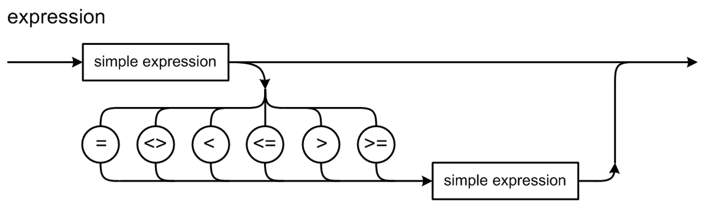
BNF: Optional and Repeated Items
To show optional items in BNF,
use the vertical bar |.
  Example: “An expression is a
  simple expression optionally followed
  by a relational operator and
  another simple expression.”
  <expression> ::=
  <simple expression>
  | <simple expression> <rel op> <simple expression>
<rel op> ::= = | <> | < |<= | > | >=

Slide 6
BNF: Optional and Repeated Items
BNF uses recursion for repeated items.
Example: “A digit sequence is a digit
followed by zero or more digits.”
  <digit sequence> ::= <digit>
  | <digit> <digit sequence>
Right
recursive
  <digit sequence> ::= <digit>
  | <digit sequence> <digit>
Left
recursive
Be wary of left recursion in practice.

Slide 7
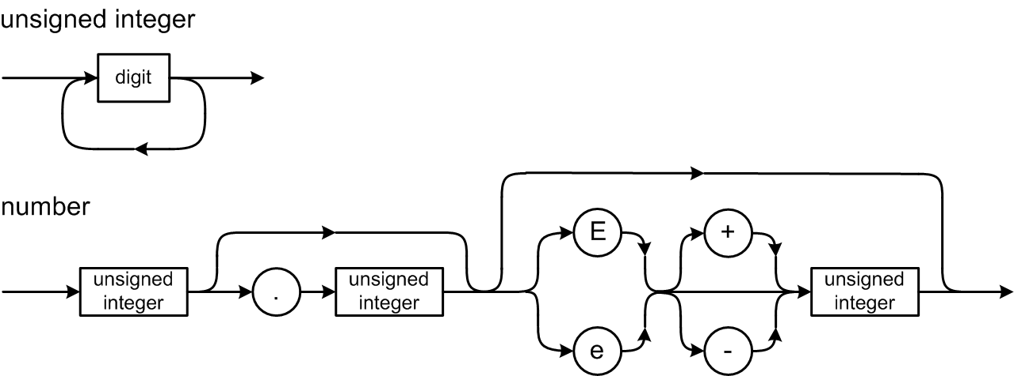
BNF Example: Pascal Number
<digit sequence> ::= <digit>
| <digit> <digit sequence>
<unsigned integer> ::= <digit sequence>
<unsigned real> ::= <unsigned integer>.<digit sequence>
| <unsigned integer>.<digit sequence> <e> <scale factor>
| <unsigned integer > <e> <scale factor>
<scale factor> ::= <unsigned integer> | <sign> <unsigned integer>
<e> ::= E | e
<sign> ::= + | -
<number> ::= <unsigned integer> | <unsigned real>
Repetition via recursion.
The sign
is optional.

Slide 8
BNF Example: Pascal IF Statement
<if statement> ::= IF <expression> THEN <statement>
| IF <expression> THEN <statement> ELSE <statement>
It should be straightforward to write
a parsing method from either
the syntax diagram or the BNF.

Slide 9
Grammars and Languages
A grammar defines a language.
Grammar: The set of all the BNF rules
(or syntax diagrams)
Language: The set of all the legal strings of tokens according to the grammar
Legal string of tokens: A syntactically correct statement.

Slide 10
Grammars and Languages
A statement is in the language
(it’s syntactically correct) if it can be
derived by the grammar.
Each grammar rule can produce
a token string in the language.
  AKA production rule
The sequence of productions required to arrive at a syntactically correct token string is the derivation of the string.

Slide 11
Grammars and Languages, cont’d
Example: A very simplified
expression grammar:
What strings (expressions) can we derive
from this grammar?
<expr> ::= <digit>
| <expr> <op> <expr>
| ( <expr> )
<digit> ::= 0|1|2|3|4|5|6|7|8|9
<op> ::= + | *

Slide 12
Derivations and Productions
Is (1 + 2)*3 valid in our expression language?
DERIVATION
GRAMMAR RULE
<expr> ➔ <expr> <op> <expr>
<expr> ::= <expr> <op> <expr>
➔ <expr> <op> <digit>
<expr> ::= <digit>
➔ <expr> <op> 3
<digit> ::= 3
➔ <expr>*3
<op> ::= *
➔ ( <expr> )*3
<expr> ::= ( <expr> )
➔ ( <expr> <op> <expr> )*3
<expr> ::= <expr> <op> <expr>
➔ ( <expr> <op> <digit> )*3
<expr> ::= <digit>
➔ ( <exp> <op> 2 )*3
<digit> ::= 2
➔ ( <expr> + 2 )*3
<op> ::= +
➔ ( <digit> + 2 )*3
<expr> ::= <digit>
➔ ( 1 + 2 )*3
<digit> ::= 1
Yes! The expression is valid.
  We successfully derived it from the grammar.
<expr> ::= <digit>
| <expr> <op> <expr>
| ( <expr> )
<digit> ::= 0|1|2|3|4|5|6|7|8|9
<op> ::= + | *

Slide 13
Extended BNF (EBNF)
Extended BNF (EBNF) adds
meta-symbols { } and [ ]
{ } | Surround items to be repeated zero or more times.
[ ] | Surround optional items.
Originally developed by Niklaus Wirth.
  Inventor of Pascal.
  Early user of syntax diagrams.

Slide 14
Extended BNF (EBNF)
Repetition (one or more):
  BNF:
  EBNF:
  <digit sequence> ::= <digit>
  | <digit> <digit sequence>
  <digit sequence> ::= <digit> { <digit> }

Slide 15
Extended BNF, cont’d
Optional items.
  BNF:
  EBNF:
  <if statement> ::= IF <expression> THEN <statement>
  | IF <expression> THEN <statement>
  ELSE <statement>
  <if statement> ::= IF <expression> THEN <statement>
  [ ELSE <statement> ]

Slide 16
Extended BNF, cont’d
Optional items.
  BNF:
  EBNF:
  <expression> ::= <simple expression>
  | <simple expression>
  <rel op> <simple expression>
  <expression> ::= <simple expression>
  [ <rel op> <simple expression> ]

Slide 17
Compiler-Compilers
Professional compiler writers generally
do not write scanners and parsers
from scratch.
A compiler-compiler is a tool
for writing compilers.
It can include:
  A scanner generator
  A parser generator
  Parse tree utilities

Slide 18
Compiler-Compilers, cont’d
Feed a compiler-compiler a grammar
written in a textual form such as BNF or EBNF.
The compiler-compiler generates a scanner, parser, and a parse tree utilities implemented
in a high-level language.
  Such as Java and C++

Slide 19
Popular Compiler-Compilers
Yacc
  “Yet another compiler-compiler”
  Generates a bottom-up parser written in C.
  GNU version: Bison
Lex
  Generates a scanner written in C.
  GNU version: Flex
JavaCC
  Generates a scanner and a top-down parser written in Java.
ANTLR4
  Generates a table-driven scanner, top-down parser, and parse tree routines written in Java or C++ (or other languages such as Python).
The code generated by a
compiler-compiler can be in a
high level language such as
Java, C, or C++. However, you
may find that code to be ugly
and hard to read.

Slide 20
ANTLR 4 Compiler-Compiler
Feed ANTLR 4 the grammar for a source language and it will automatically generate a scanner and a parser for that language.
  Define the source language’s tokens
  with regular expressions
  ➔ ANTLR 4 generates a scanner
  for the source language.
  Specify the grammar’s productions
  in a notation based on EBNF
  ➔ ANTLR 4 generates a parser
  for the source language.

Slide 21
ANTLR 4 Compiler-Compiler, cont’d
The generated scanner and parser
are written in Java or C++.
  ANTLR calls the scanner a “lexer”.
A command-line option specifies C++.
  Otherwise, the default implementation language is Java.
Some of the tools only work with the Java code, so even if you want C++ code, you may also want to generate the Java code.

Slide 22
Download and Install
Download and install ANTLR 4:
http://www.antlr.org/
ANTLR 4 book:
The Definitive ANTLR 4 Reference
by Terence Parr
https://www.amazon.com/Definitive-ANTLR-4-Reference/dp/1934356999/ref=sr_1_1?s=books&ie=UTF8&qid=1508372536&sr=1-1&keywords=antlr4

Slide 23
Windows 10
If you are on Windows 10, I strongly recommend that you use the Windows Subsystem for Linux and install Ubuntu:
  https://docs.microsoft.com/en-us/windows/wsl/install-win10
  https://ubuntu.com/tutorials/tutorial-ubuntu-on-windows#1-overview

Slide 24
ANTLR 4 Plug-ins for IDEs
http://www.antlr.org/tools.html
Eclipse plugin: https://github.com/antlr4ide/antlr4ide
  Scroll down for installation instructions.
  The instructions specify old versions of the software. Use the latest versions.

Slide 25
My Tutorials
Go to http://www.cs.sjsu.edu/~mak/tutorials/index.html
  “Install Ubuntu on Windows 10”
  “Configure Ubuntu for Software Development”
  “Install Eclipse for Java and C++ Development”
  “Install and Configure ANTLR 4 for Ubuntu and MacOS X”
  “Install and Configure ANTLR 4 for C++”
There is an ANTLR 4 plug-in for CLion.
Go online for the latest installation instructions.

Slide 26
Review: DFA for a Pascal Identifier or Number
private static final int matrix[][] = {
/* letter digit + - . E other */
/* 0 */ { 1, 4, 3, 3, ERR, 1, ERR },
/* 1 */ { 1, 1, -2, -2, -2, 1, -2 },
/* 2 */ { ERR, ERR, ERR, ERR, ERR, ERR, ERR },
/* 3 */ { ERR, 4, ERR, ERR, ERR, ERR, ERR },
/* 4 */ { -5, 4, -5, -5, 6, 9, -5 },
/* 5 */ { ERR, ERR, ERR, ERR, ERR, ERR, ERR },
/* 6 */ { ERR, 7, ERR, ERR, ERR, ERR, ERR },
/* 7 */ { -8, 7, -8, -8, -8, 9, -8 },
/* 8 */ { ERR, ERR, ERR, ERR, ERR, ERR, ERR },
/* 9 */ { ERR, 11, 10, 10, ERR, ERR, ERR },
/* 10 */ { ERR, 11, ERR, ERR, ERR, ERR, ERR },
/* 11 */ { -12, 11, -12, -12, -12, -12, -12 },
/* 12 */ { ERR, ERR, ERR, ERR, ERR, ERR, ERR },
};
Negative numbers
in the matrix are
accepting states.
letter
0
letter
1
[other]
2
digit
+
-
digit
E
digit
digit
digit
digit
.
+
3
4
6
digit
7
E
9
10
digit
11
[other]
12
digit
-
[other]
[other]
5
8

Slide 27
The ANTLR Lexer
The ANTLR-generated lexer (scanner)
is a DFA created from the regular expressions in the grammar file that describe the tokens.

Slide 28
Example ANTLR Grammar File
Expr.g4
grammar Expr;
program: statement+ ; // at least one statement
statement : expr NEWLINE
| IDENTIFER '=' expr NEWLINE
| NEWLINE
;
expr: expr ('*'|'/') expr
| expr ('+'|'-') expr
| INTEGER
| IDENTIFER
| '(' expr ')'
;
IDENTIFER : [a-zA-Z]+ ;
INTEGER : [0-9]+ ;
NEWLINE : '\r'? '\n' ;
WS : [ \t]+ -> skip ; // skip whitespace
input.txt
193
a = 5
b = 6
a+b*2
(1+2)*3

Slide 29
A C++ Main Program for ANTLR
#include <iostream>
#include <fstream>
#include "antlr4-runtime.h"
#include "ExprLexer.h"
#include "ExprParser.h"
using namespace antlrcpp;
using namespace antlr4;
using namespace std;
int main(int argc, const char *args[])
{
ifstream source;
source.open(args[1]);
ANTLRInputStream input(source);
ExprLexer lexer(&input);
CommonTokenStream tokens(&lexer);
tokens.fill();
ExprMain.cpp
Create the input stream
from the source file.
Create a lexer to scan
the input stream and fill
the token stream.

Slide 30
A C++ Main Program for ANTLR, cont’d
cout << "Tokens:" << endl;
for (Token *token : tokens.getTokens())
{
std::cout << token->toString() << std::endl;
}
ExprParser parser(&tokens);
tree::ParseTree *tree = parser.program();
cout << endl << "Parse tree (Lisp format):" << endl;
std::cout << tree->toStringTree(&parser) << endl;
return 0;
}
Print the
token stream.
Create a parser to parse
the token stream and
build a parse tree.
Print the
parse tree
in Lisp format.
Demo

Slide 31
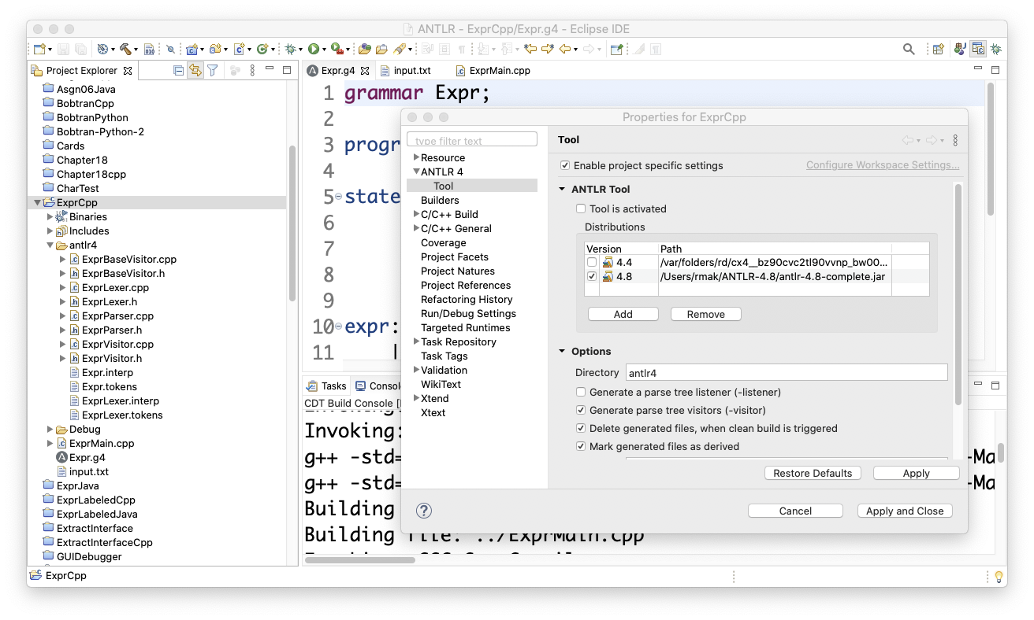
ANTLR Project Properties
Latest .jar file.
Where to put the generated files.

Slide 32
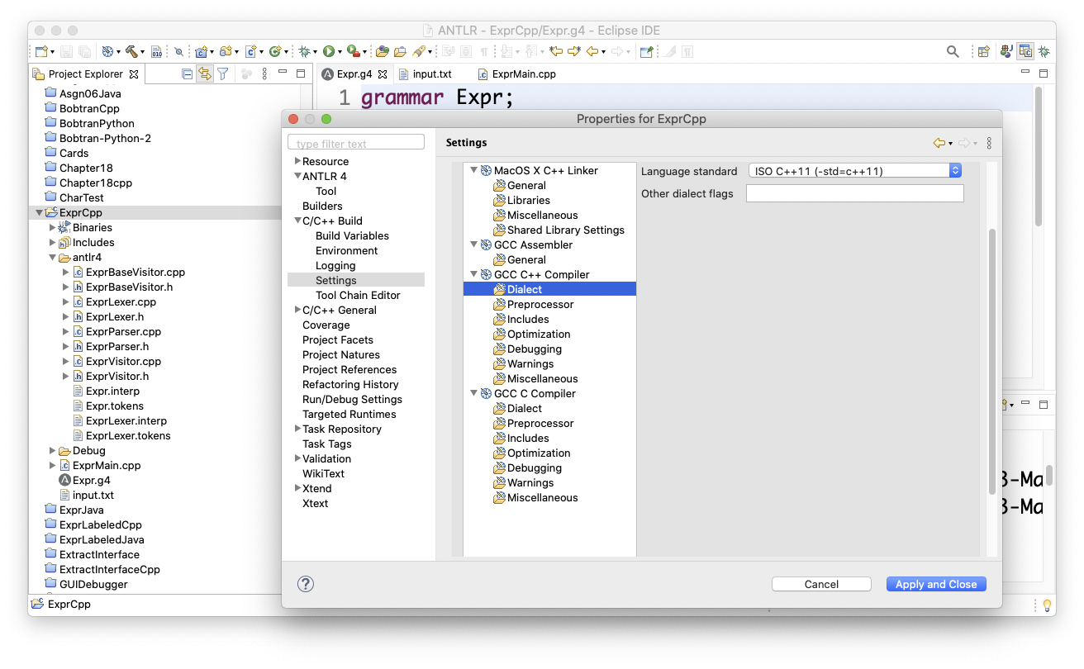
ANTLR Project Properties, cont’d
Dialect should be C++ 2011.

Slide 33
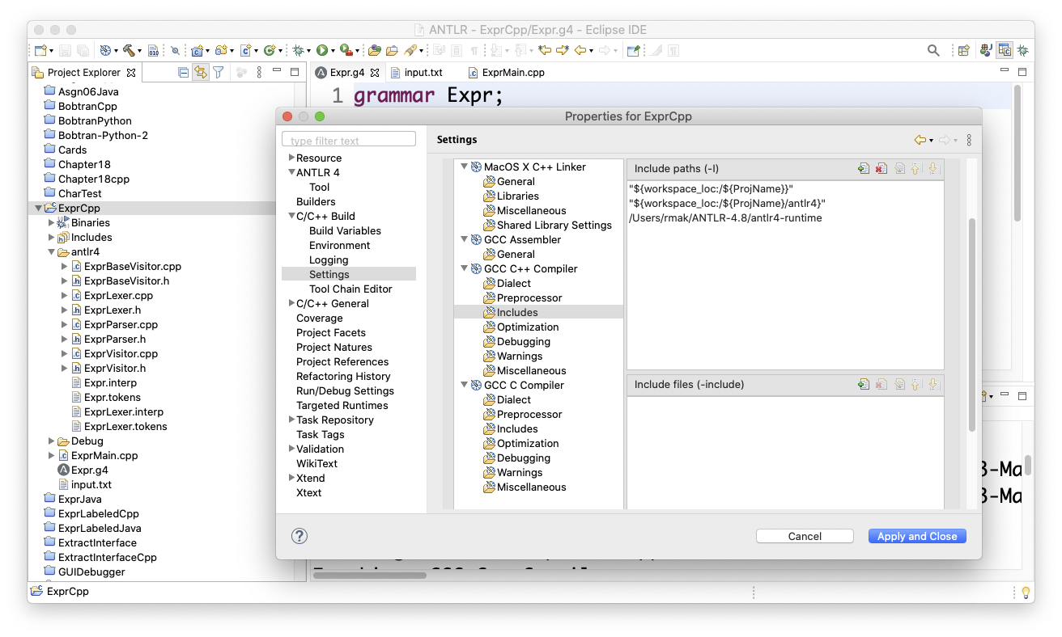
ANTLR Project Properties, cont’d
Directories containing
the included header files.

Slide 34
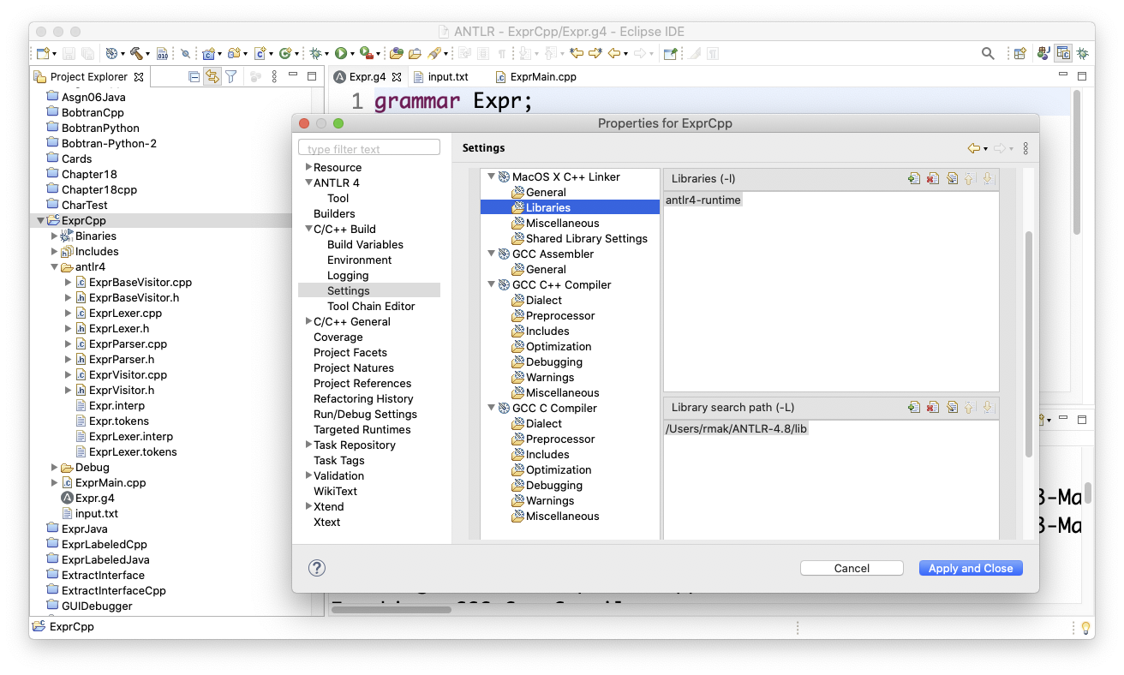
ANTLR Project Properties, cont’d
Use ANTLR’s C++ library.
Directory that contains
ANTLR’s C++ library.

Slide 35
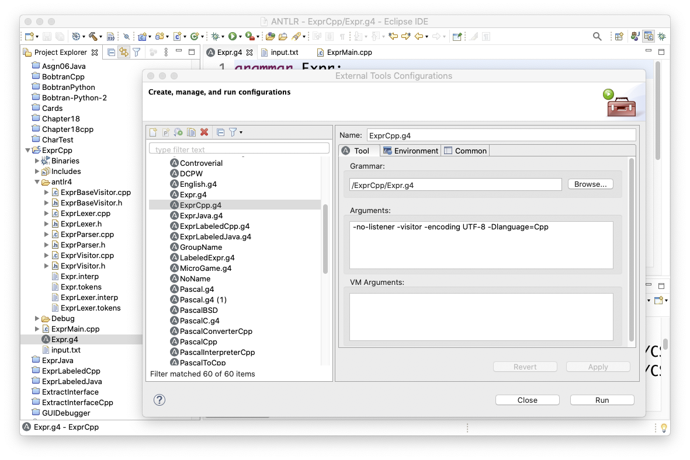
ANTLR Project Properties, cont’d
Right-click the .g4 grammar file name in the left panel and select Run As ➔ External Tools Configurations...
  Arguments:
  -no-listener -visitor -encoding UTF-8 -Dlanguage=Cpp

Slide 36
Generate, Compile, and Run
Right-click the .g4 grammar file name in the left panel and select Run As ➔ Generate ANTLR Recognizer to generate the parser and the lexer.
Compile and run.

Slide 37
Syntax Diagram and Parse Tree in Eclipse
Window ➔ Show View ➔ Other...
Under ANTLR 4:
  Open Syntax Diagram
  Open Parse Tree
“Syntax Diagram” and “Parse Tree”
tabs will be created.

Slide 38
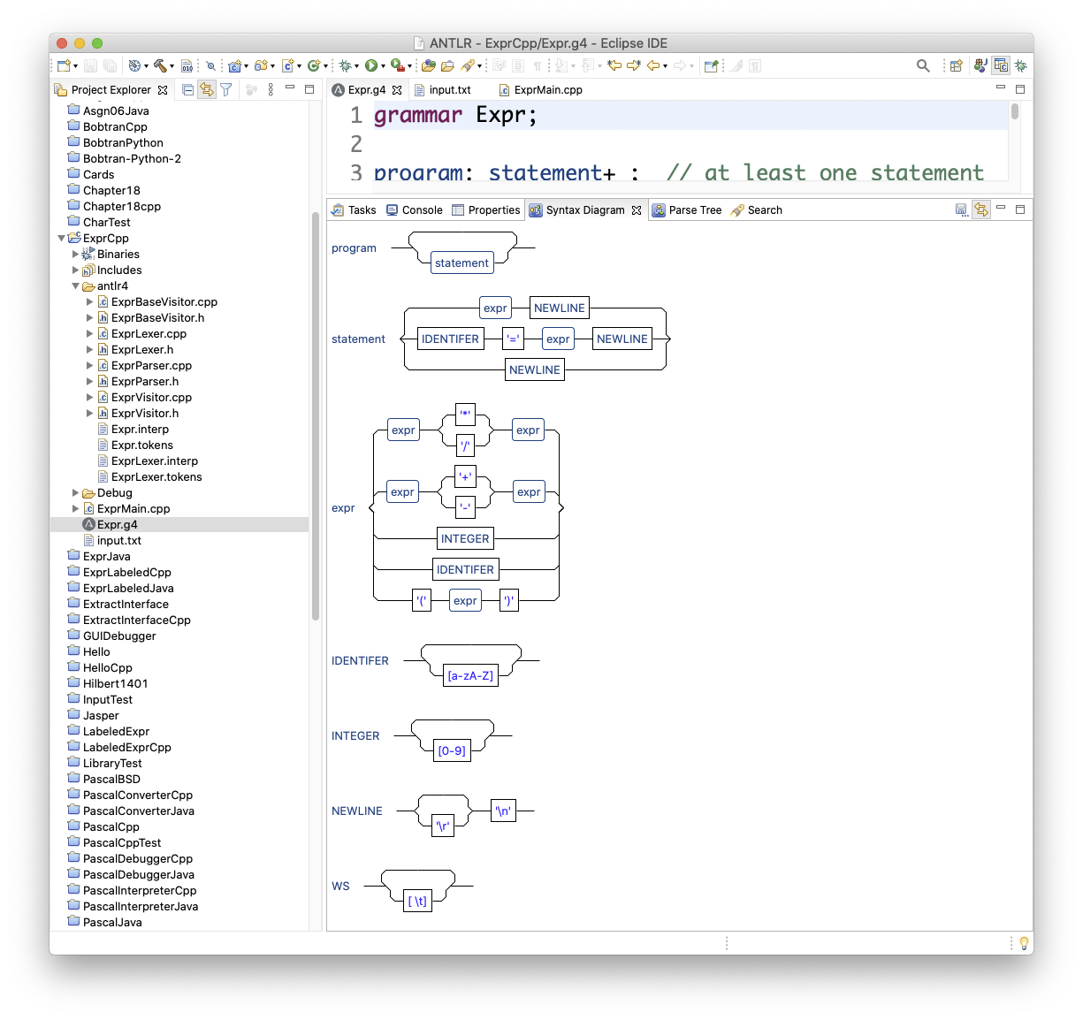
Syntax Diagram and Parse Tree, cont’d
The grammar file should
be open in the edit pane.

Slide 39
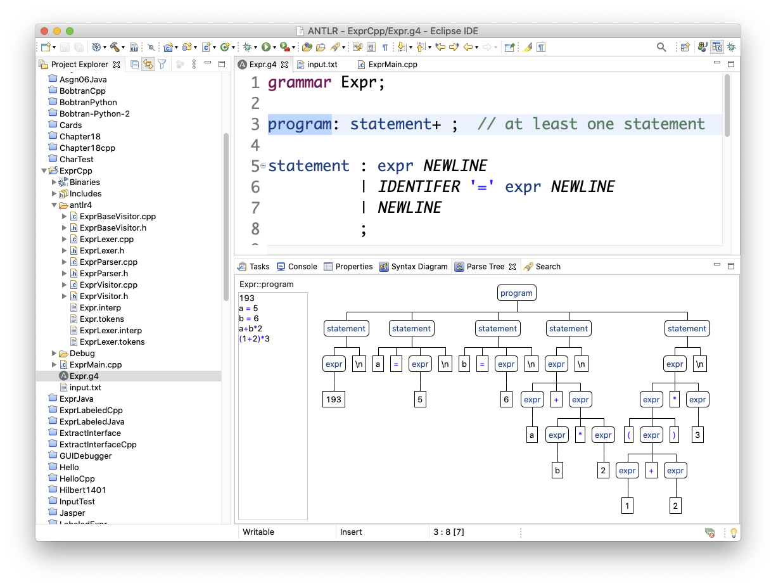
Syntax Diagram and Parse Tree, cont’d
Select the topmost rule.
Paste
source
text.

Slide 40
Environment Setup
First set up your environment,
or create equivalent shell scripts.
  Use your own file paths, of course.
ANTLR itself is implemented in Java.
Important Java archive (zipped library):
antlr-4.8-complete.jar
Useful program for debugging grammars:
java org.antlr.v4.gui.TestRig
export ANTLR_JAR="$HOME/ANTLR-4.8/"
export CLASSPATH="$CLASSPATH:$ANTLR_JAR"
alias antlr4="java -jar $ANTLR_JAR"
alias grun='java org.antlr.v4.gui.TestRig'
Notes:
START HERE

Slide 41
On the Command Line
In order to run the generated parser and lexer (written in C++), you must first build and install ANTLR’s C++ runtime library antlr4-runtime.
ANTLR-ExprTestCpp: ls
Expr.g4 ExprMain.cpp input.txt
ANTLR-ExprTestCpp: antlr4 -Dlanguage=Cpp Expr.g4
ANTLR-ExprTestCpp: ls
Expr.g4 ExprBaseListener.cpp ExprLexer.h ExprListener.cpp ExprParser.cpp
Expr.interp ExprBaseListener.h ExprLexer.interp ExprListener.h ExprParser.h
Expr.tokens ExprLexer.cpp ExprLexer.tokens ExprMain.cpp input.txt
ANTLR-ExprTestCpp: g++ -std=c++11 -I/Users/rmak/ANTLR-4.8/antlr4-runtime \
-L/Users/rmak/ANTLR-4.8/lib -lantlr4-runtime -o Expr Expr*.cpp
Generate the parser and lexer in C++.
Run the parser
and lexer.
The directory that
contains the library:
-L
Use this library:
-l (lowercase ell)
The latest version of
ANTLR 4 is 4.9.1
(January 5, 2021)

Slide 42
On the Command Line, cont’d
ANTLR-ExprTestCpp: ./Expr input.txt
Tokens:
[@0,0:2='193',<9>,1:0]
[@1,3:3='\n',<10>,1:3]
[@2,4:4='a',<8>,2:0]
[@3,6:6='=',<1>,2:2]
[@4,8:8='5',<9>,2:4]
[@5,9:9='\n',<10>,2:5]
[@6,10:10='b',<8>,3:0]
[@7,12:12='=',<1>,3:2]
[@8,14:14='6',<9>,3:4]
[@9,15:15='\n',<10>,3:5]
[@10,16:16='a',<8>,4:0]
[@11,17:17='+',<4>,4:1]
[@12,18:18='b',<8>,4:2]
[@13,19:19='*',<2>,4:3]
[@14,20:20='2',<9>,4:4]
[@15,21:21='\n',<10>,4:5]
[@16,22:22='(',<6>,5:0]
[@17,23:23='1',<9>,5:1]
[@18,24:24='+',<4>,5:2]
[@19,25:25='2',<9>,5:3]
[@20,26:26=')',<7>,5:4]
[@21,27:27='*',<2>,5:5]
[@22,28:28='3',<9>,5:6]
[@23,29:29='\n',<10>,5:7]
[@24,30:29='<EOF>',<-1>,6:0]
Parse tree (Lisp format):
(program (statement (expr 193) \n) (statement a = (expr 5) \n) (statement b = (expr 6) \n)
(statement (expr (expr a) + (expr (expr b) * (expr 2))) \n)
(statement (expr (expr ( (expr (expr 1) + (expr 2)) )) * (expr 3)) \n))
input.txt
193
a = 5
b = 6
a+b*2
(1+2)*3

Slide 43
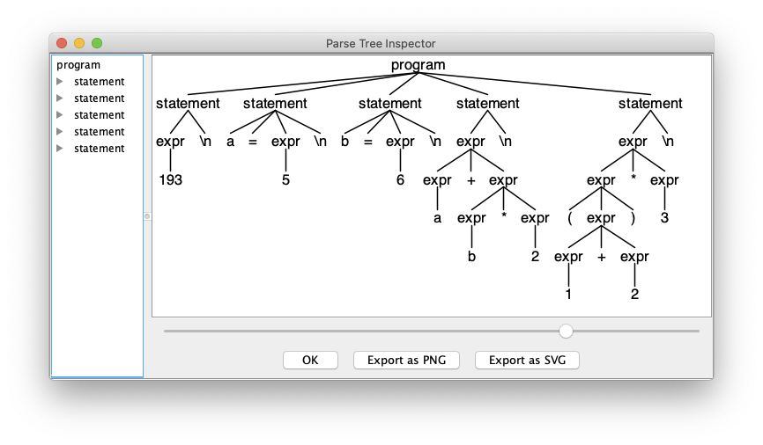
The Java grun Tool
ANTLR-ExprTestCpp: antlr4 Expr.g4
ANTLR-ExprTestCpp: ls
Expr ExprBaseListener.cpp ExprLexer.h ExprListener.cpp ExprParser.cpp
Expr.g4 ExprBaseListener.h ExprLexer.interp ExprListener.h ExprParser.h
Expr.interp ExprBaseListener.java ExprLexer.java ExprListener.java ExprParser.java
Expr.tokens ExprLexer.cpp ExprLexer.tokens ExprMain.cpp input.txt
ANTLR-ExprTestCpp: javac *.java
ANTLR-ExprTestCpp: grun Expr program -gui input.txt
Generate the parser and lexer in Java (default).
Compile the Java files.

Slide 44
Railroad Diagrams (RRD) for ANTLR
On the command line, generate very nice syntax diagram that you view in a web browser.
Download the Java-based rrd tool:
https://github.com/bkiers/rrd-antlr4
On the command line:
java -jar rrd-antlr4-0.1.2.jar Expr.g4

Slide 45
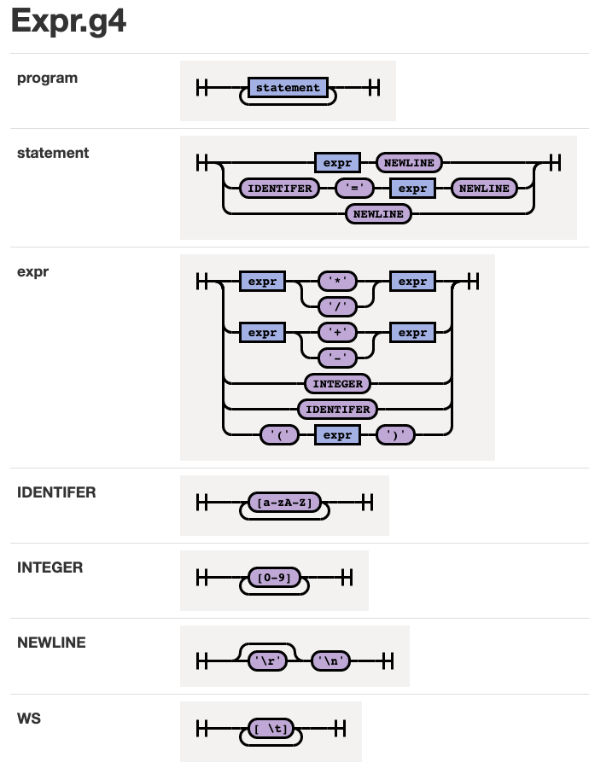
Railroad Diagrams (RRD) for ANTLR, cont’d

