Slide 1


CMPE 152: Compiler Design
February 16 Class Meeting
Department of Computer Engineering
San Jose State University
Spring 2021
Instructor: Ron Mak
www.cs.sjsu.edu/~mak

Slide 2
Assignment #3: Parser and Executor
Modify the frontend parser to parse and build trees for the following Pascal statements:
  while
  if
  for
  case
You may need to add new node types
in the intermediate tier.
Add new visit methods to the backend executor to execute the above statements.
Some simple Pascal source files
are forthcoming to test your interpreter.

Slide 3
Assignment #3, cont’d
You can start Assignment #3 using the code you wrote for Assignment #2, or you can use the suggested solution: http://www.cs.sjsu.edu/~mak/CMPE152/assignments/2/solution/Asgn02Cpp.zip
(C++ version).
There are simple Pascal input test files for you to test the statements that you’re implementing.
  You should make up simpler tests files before attempting these.

Slide 4
An Executor Improvement
The suggested solution to Assignment #2 implements a significant improvement.
The main no longer passes the symbol table
to the backend executor.
  In SimpleCpp, the symbol table was passed to the constructor of class Executor.
Since we’re using the hack of storing the runtime values of variables in symbol table entries, how is this possible?

Slide 5
Scanner and Parser Rules of Thumb
Scanner
  At any point in the source file,
  extract the longest possible token.
  Example:
    <= is a single less-than-or-equal token
    Not a greater-than token followed by an equal token
Parser
  At any point in the source file,
  parse the longest possible statement.
“maximum munch”

Slide 6
Maximum Munch and the “Dangling” ELSE
According to Pascal syntax,
the nested IF statement is
the THEN statement of the outer IF statement
IF i = 3 THEN IF j = 2 THEN t := 500 ELSE f := -500
Therefore, the ELSE pairs with the closest
(i.e., the second) THEN.
Maximum munch!

Slide 7
Syntax and Semantics
Syntax refers to the rules of the grammar
of a source language.
The rules prescribe the proper form
of its programs.
The parser “knows” the grammar.
  Rules can be described by syntax diagrams.
Syntax checking
  Does this sequence of tokens follow
  the syntax rules?
  Performed by the frontend parser.

Slide 8
Syntax and Semantics, cont’d
Semantics refers to the meaning of syntactically correct token sequences of the source language.
Example: Certain sequences of tokens constitute an IF statement according to the language’s grammar.
The semantics of the statement determine
  How the interpreter will execute the statement, or
  How the compiler or converter will generate object code for the statement.

Slide 9
Syntax and Semantics, cont’d
Semantic actions by the frontend parser based on the meanings of statements and expressions:
  Building proper parse trees.
  Building symbol tables.
  Type checking (which we’ll do later).
The parse trees encode type checking and
operator precedence in their structures.

Slide 10
Syntax and Semantics, cont’d
Semantic actions in the back end:
  Interpreter: The executor runs the program and performs actions according to the meanings of the statements and expressions.
  Compiler and converter: The code generator emits object code that reflects the meanings of the statements and expressions.

Slide 11
Syntax Error Handling
Syntax error handling in the front end is a three-step process:
  Detect the error.
  Flag the error.
  Recover from the error.
Good syntax error handling is important!
  A hallmark of a compiler excellence.

Slide 12
Options for Error Recovery
Stop after the first error.
  No error recovery at all.
  Easiest for the compiler writer,
  annoying for the programmer.
  Worse case: The compiler crashes or hangs.
Become hopelessly lost.
  Attempt to continue parsing
  the rest of the source program.
  Spew out lots of irrelevant and
  meaningless error messages.
  No error recovery here, either …
    … but the compiler writer doesn’t admit it!

Slide 13
Options for Error Recovery, cont’d
Skip tokens after the erroneous token until …
  The parser finds a token it recognizes, and ...
  It can safely resume syntax checking
  the rest of the source program.
For now, we’ve implemented
very simple syntax error handling.
  Will our parser get lost attempting to recover?
  Will our parser crash?

Slide 14
Top-Down Recursive-Descent Parsing
The term is very descriptive of
how the parser works.
Start by parsing the topmost
source language construct.
  Example: The program
Have separate parser member functions
for the various language constructs.
  Examples: parseProgram(), parseAssignmentStatement(), parseExpression(), etc.

Slide 15
Top-Down Recursive-Descent Parsing, cont’d
Drill down (descend) by parsing
the sub-constructs.
  Parse methods call lower-level parse functions.
  statement →assignment statement → expression →variable → etc.
Use recursion on the way down.
  statement →WHILE statement → statement → etc.

Slide 16
Top-Down Recursive-Descent Parsing, cont’d
This is the technique for hand-coded parsers.
  Very easy to understand and write.
  The source language’s grammar is encoded in the
  structure of the parser’s member functions.
    Example: The structure of parseRepeatStatement() reflects the grammar of the REPEAT statement.
  Close correspondence between the parser code
  and the syntax diagrams.
Disadvantages
  Can be tedious coding.
  Ad hoc error handling.
  Big and slow!

Slide 17
Top-Down Recursive-Descent Parsing, cont’d
Bottom-up parsers can be smaller and faster.
  Error handling can still be tricky.
  To be covered later this semester.

Slide 18
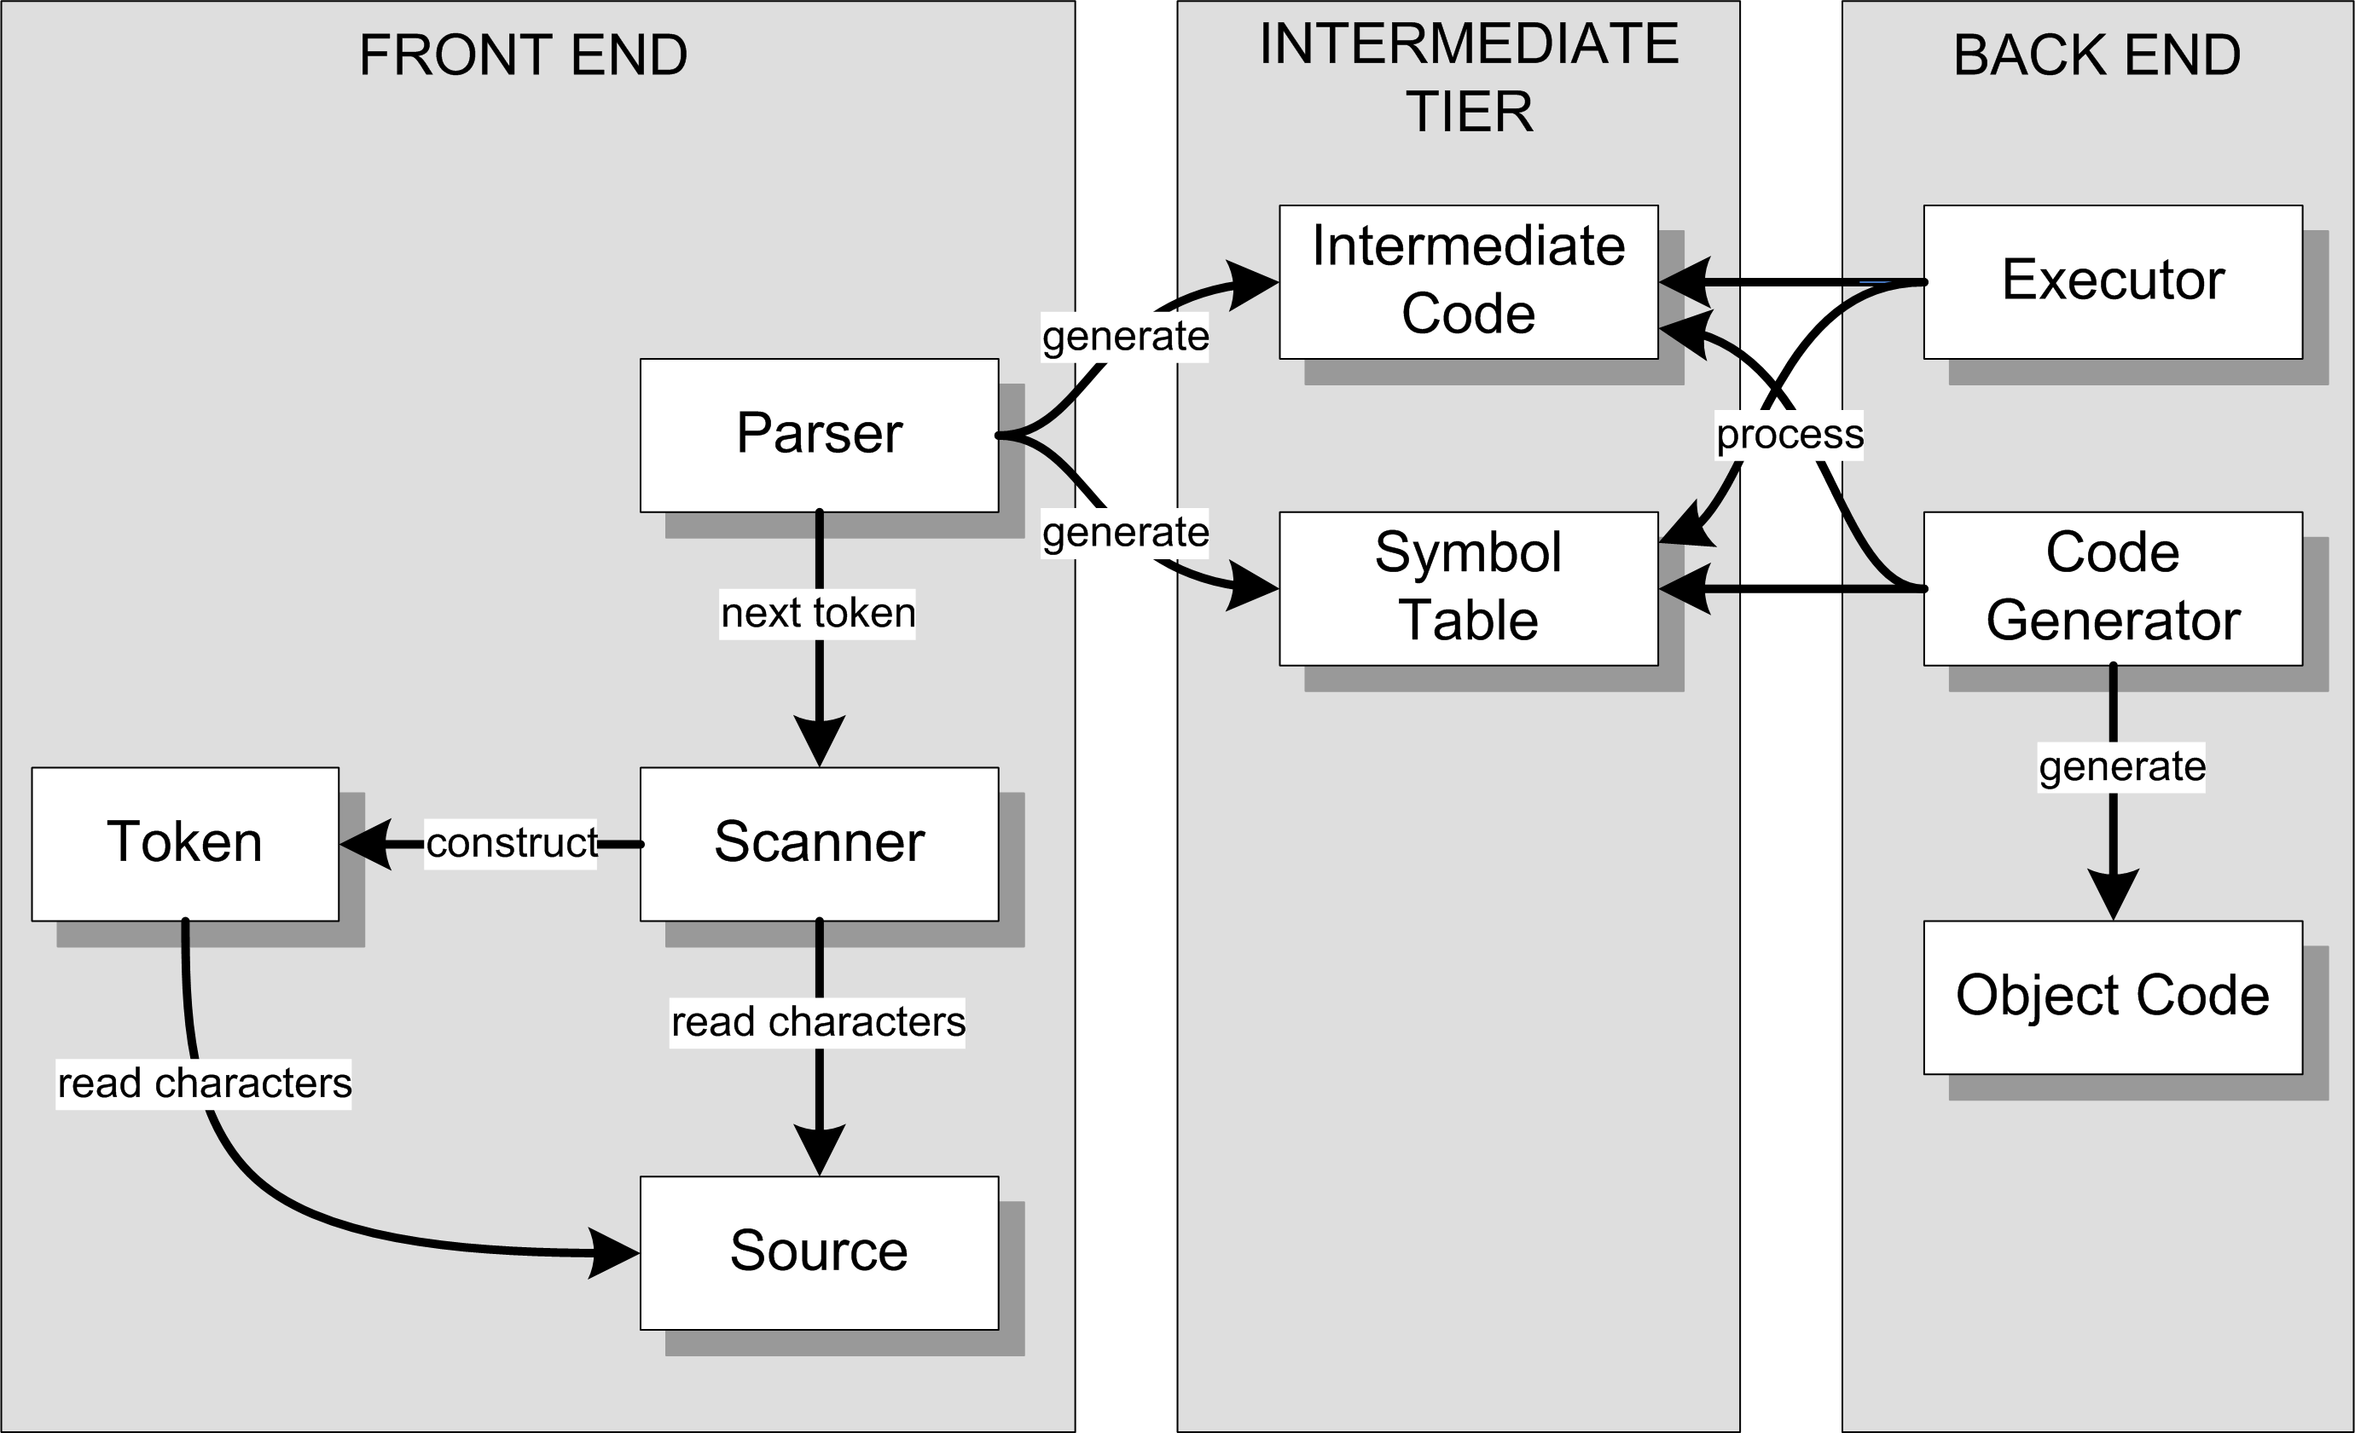
Our Accomplishments So Far
Interpreter
Compiler or
converter

Slide 19
Our Accomplishments So Far, cont’d
Overall structure of a language translator.
  Front end, intermediate tier, and back end.
Parser, scanner, and tokens in the front end.
Parse trees and symbol tables in the intermediate tier.
An interpreter for simple Pascal with
a working executor in the back end.

Slide 20
Scripting Engine
We now have a simple scripting engine!
We can execute:
  Expressions
  Assignment statements
  Control statements
  Compound statements
  Scalar and string variables that are untyped

Slide 21
Temporary Hacks for Now
Only one parse tree and one symbol table.
  There will be several parse trees and symbol tables.
Variables are scalars (not records or arrays)
but otherwise have no declared type.
  We haven’t parsed any Pascal declarations yet!
We consider a variable to be “declared”
(and we enter it into the symbol table)
the first time it appears on the left-hand side
of an assignment statement.
We store runtime values of variables in the symbol table.

Slide 22
Can We Build a Better Scanner?
Our scanner in the front end is relatively
easy to understand and follow.
  Separate token member functions for each token type:
  word(), number(), specialSymbol(), etc.
However, like our parser, it’s big and slow.
  Creates lots of token objects.
  Makes lots of function calls.
Write a more compact and faster scanner.
  However, it may be harder to understand and follow.

Slide 23
Deterministic Finite Automata (DFA)
Pascal identifier
  Regular expression: <letter> ( <letter> | <digit> )*
  Implement the regular expression with a
  finite automaton (AKA finite state machine):
letter
1
letter
2
[other]
3
digit

Slide 24
Deterministic Finite Automata (DFA)
This automaton is a deterministic finite automaton (DFA).
  At each state, the next input character
  uniquely determines which transition
  to take to the next state.
start state
letter
accepting state
1
letter
2
[other]
3
transition
digit

Slide 25
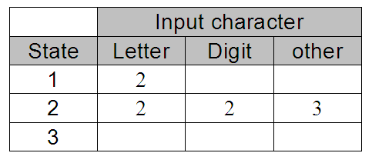
State-Transition Matrix
letter
1
letter
2
[other]
3
digit
Represent the behavior of a DFA by a
state-transition matrix:

Slide 26
DFA for a Pascal Number
E
digit
digit
digit
digit
.
+
0
+
3
digit
4
6
digit
7
E
9
10
digit
11
[other]
12
-
-
digit
[other]
[other]
5
8
Note that this diagram allows only an upper-case E for an exponent.
What changes are required to also allow a lower-case e?

Slide 27
DFA for a Pascal Identifier or Number
const int SimpleDFAScanner::matrix[13][7] = {
/* letter digit + - . E other */
/* 0 */ { 1, 4, 3, 3, ERR, 1, ERR },
/* 1 */ { 1, 1, -2, -2, -2, 1, -2 },
/* 2 */ { ERR, ERR, ERR, ERR, ERR, ERR, ERR },
/* 3 */ { ERR, 4, ERR, ERR, ERR, ERR, ERR },
/* 4 */ { -5, 4, -5, -5, 6, 9, -5 },
/* 5 */ { ERR, ERR, ERR, ERR, ERR, ERR, ERR },
/* 6 */ { ERR, 7, ERR, ERR, ERR, ERR, ERR },
/* 7 */ { -8, 7, -8, -8, -8, 9, -8 },
/* 8 */ { ERR, ERR, ERR, ERR, ERR, ERR, ERR },
/* 9 */ { ERR, 11, 10, 10, ERR, ERR, ERR },
/* 10 */ { ERR, 11, ERR, ERR, ERR, ERR, ERR },
/* 11 */ { -12, 11, -12, -12, -12, -12, -12 },
/* 12 */ { ERR, ERR, ERR, ERR, ERR, ERR, ERR },
};
Negative numbers
in the matrix are the
accepting states.
letter
0
letter
1
[other]
2
digit
+
-
digit
E
digit
digit
digit
digit
.
+
3
4
6
digit
7
E
9
10
digit
11
[other]
12
digit
-
[other]
[other]
Notice how the
letter E is handled!
5
8

Slide 28
A Simple DFA Scanner
SimpleDFAScanner.h
class SimpleDFAScanner
{
public:
SimpleDFAScanner(string source_path);
virtual ~SimpleDFAScanner();
/**
* Scan the source file.
*/
void scan() throw(string);
private:
// Input characters.
static const int LETTER = 0;
static const int DIGIT = 1;
static const int PLUS = 2;
static const int MINUS = 3;
static const int DOT = 4;
static const int E = 5;
static const int OTHER = 6;
// Error state.
static const int ERR = -99999;

Slide 29
A Simple DFA Scanner, cont’d
// State-transition matrix (acceptance states < 0)
static const int matrix[13][7];
char ch; // current input character
int state; // current state
ifstream reader;
string line;
int line_number;
int line_pos;
string next_token() throw(string);
int type_of(char ch);
void next_char() throw(string);
};
SimpleDFAScanner.h

Slide 30
A Simple DFA Scanner, cont’d
int SimpleDFAScanner::type_of(char ch)
{
return (ch == 'E') ? E
: isalpha(ch) ? LETTER
: isdigit(ch) ? DIGIT
: (ch == '+') ? PLUS
: (ch == '-') ? MINUS
: (ch == '.') ? DOT
: OTHER;
}
SimpleDFAScanner.cpp

Slide 31
A Simple DFA Scanner, cont’d
string SimpleDFAScanner::next_token() throw(string)
{
// Skip blanks.
while (isspace(ch)) next_char();
// At EOF?
if (reader.fail()) return "";
state = 0; // start state
string buffer;
// Loop to do state transitions.
while (state >= 0) // not acceptance state
{
state = matrix[state][type_of(ch)]; // transition
if ((state >= 0) || (state == ERR))
{
buffer += ch; // build token string
next_char();
}
}
return buffer;
}
This line is the heart
of the scanner.
Table-driven scanners
can be very fast!
SimpleDFAScanner.cpp

Slide 32
A Simple DFA Scanner, cont’d
void SimpleDFAScanner::scan() throw(string)
{
next_char();
while (ch != 0) // EOF?
{
string token = next_token();
if (token != "")
{
cout << "=====> \"" << token << "\" ";
string token_type =
(state == -2) ? "IDENTIFIER"
: (state == -5) ? "INTEGER"
: (state == -8) ? "REAL (fraction only)"
: (state == -12) ? "REAL"
: "*** ERROR ***";
cout << token_type << endl;
}
}
}
How do we know which token we just got?
Demo

