Slide 1
CMPE 152: Compiler Design September 1 Class Meeting
Department of Computer Engineering San Jose State University Fall 2020 Instructor: Ron Mak
www.cs.sjsu.edu/~mak

Slide 2
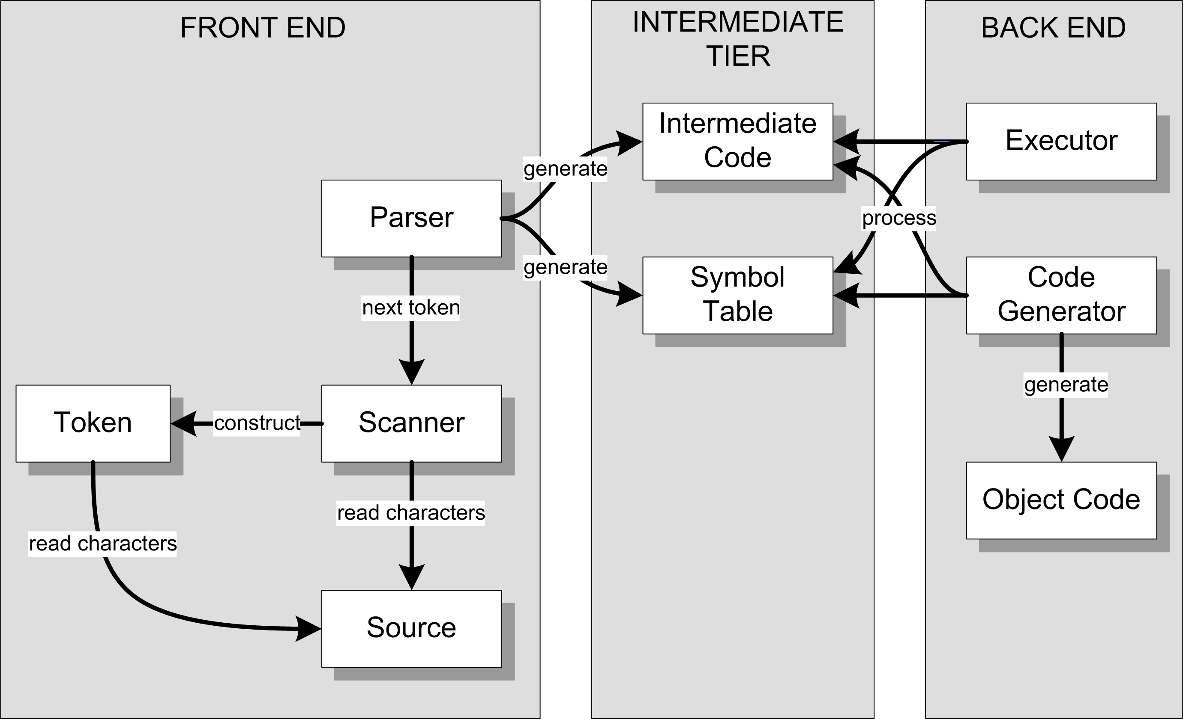
Review: Conceptual Design
Interpreter
Compiler or
converter

Slide 3
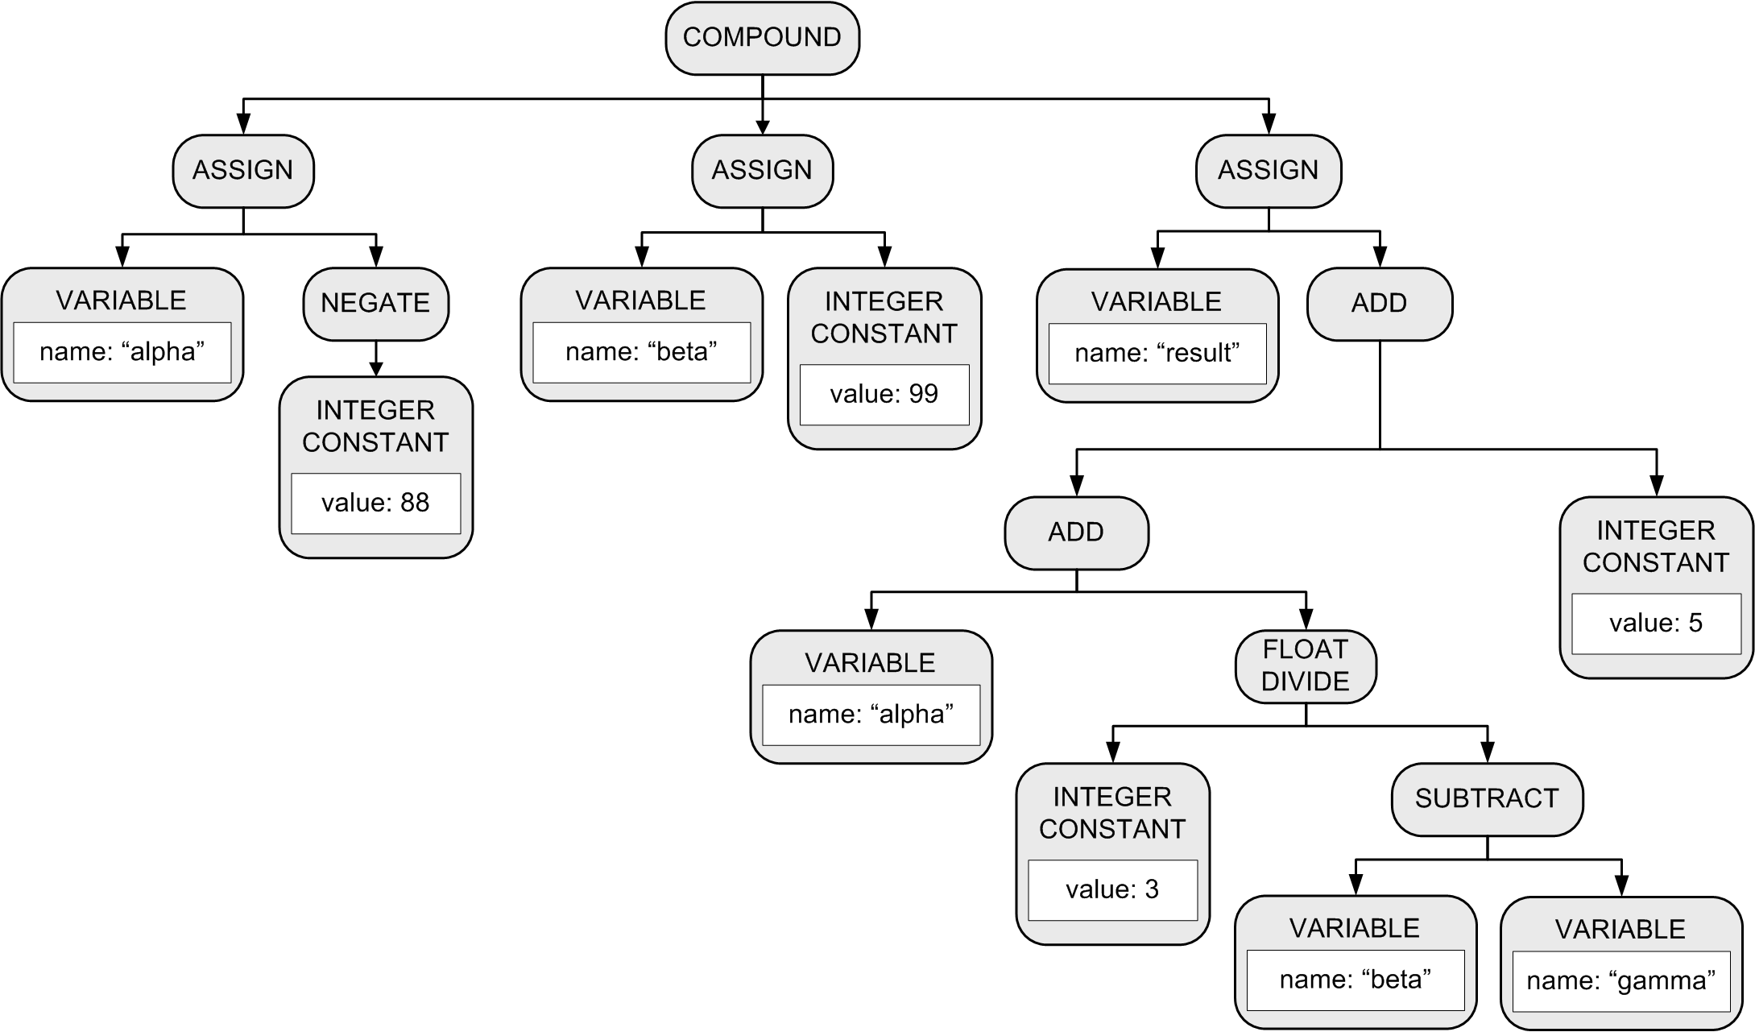
Parse Tree: Conceptual Design
More accurately called an
abstract syntax tree (AST).
BEGIN
alpha := -88;
beta := 99;
result := alpha + 3/(beta – gamma) + 5
END

Slide 4
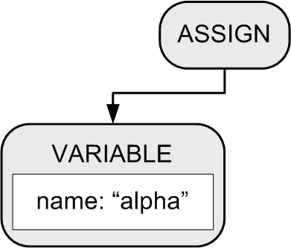
Building a Parse Tree
Example:
BEGIN
alpha := 10;
beta := 20
END
Function parseCompoundStatement() method creates a COMPOUND node.
2. Function parseAssignmentStatement() creates an ASSIGN node and a VARIABLE node, which the ASSIGN node adopts as its first child.

Slide 5
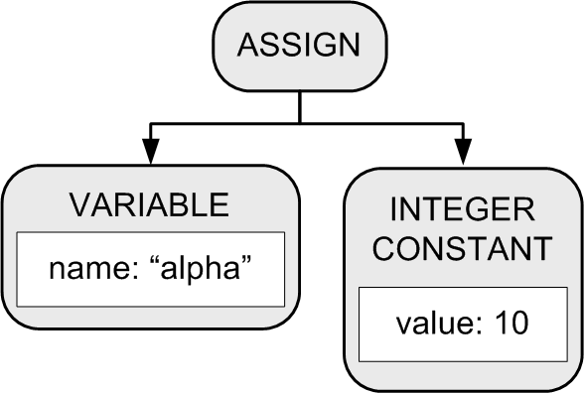
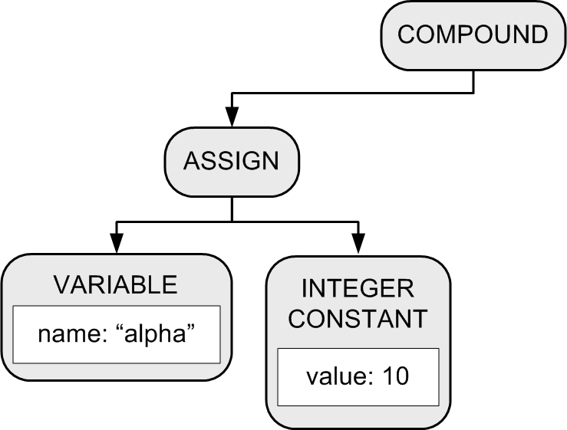
Building a Parse Tree
3. Function parseExpression() creates an INTEGER CONSTANT node which the ASSIGN node adopts as its second child.
BEGIN
alpha := 10;
beta := 20
END
4. The COMPOUND node adopts the ASSIGN node as its first child.

Slide 6
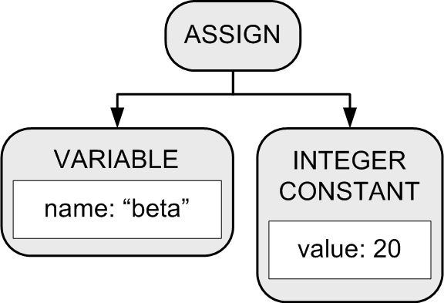
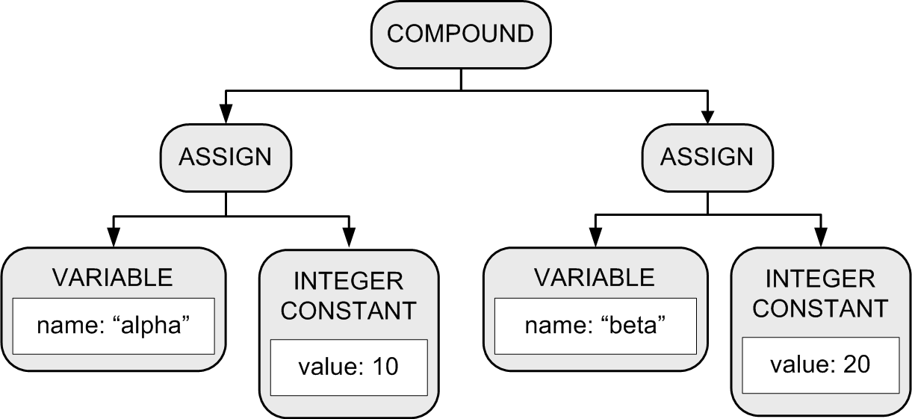
Building a Parse Tree
Another set of calls to functions parseAssignmentStatement() and parsExpression() builds another assignment statement subtree.
6. The COMPOUND node
adopts the subtree
as its second child.
BEGIN
alpha := 10;
beta := 20
END

Slide 7
Example: HelloWorld.txt
PROGRAM HelloWorld;
BEGIN
i := 0;
REPEAT
i := i + 1;
write('#'); write(i);
writeln(': Hello, world!');
UNTIL i = 5;
END.
<PROGRAM HelloWorld>
<COMPOUND line 3>
<ASSIGN line 4>
<VARIABLE i />
<INTEGER_CONSTANT 0 />
</ASSIGN>
<LOOP line 6>
<ASSIGN line 7>
<VARIABLE i />
<ADD>
<VARIABLE i />
<INTEGER_CONSTANT 1 />
</ADD>
</ASSIGN>
<WRITE line 8>
<STRING_CONSTANT '#' />
</WRITE>
<WRITE line 8>
<VARIABLE i />
</WRITE>
<WRITELN line 9>
<STRING_CONSTANT ': Hello, world!' />
</WRITELN>
<TEST line 10>
<EQ>
<VARIABLE i />
<INTEGER_CONSTANT 5 />
</EQ>
</TEST>
</LOOP>
</COMPOUND>
</PROGRAM>
PROGRAM
COMPOUND
ASSIGN
LOOP
ASSIGN
WRITE
WRITE
WRITELN
TEST

Slide 8
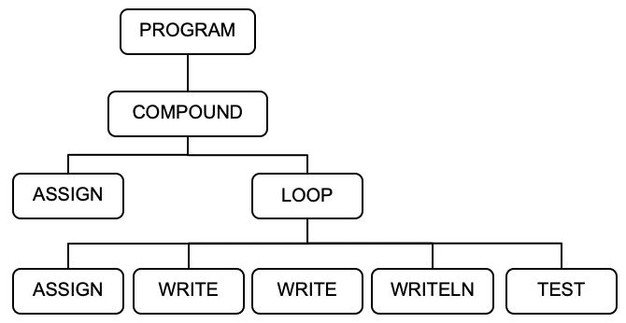
The parseProgram() Member Function
Parser.cpp
Node *Parser::parseProgram()
{
Node *programNode = new Node(NodeType::PROGRAM);
currentToken = scanner->nextToken(); // first token!
if (currentToken->type == TokenType::PROGRAM)
{
currentToken = scanner->nextToken(); // consume PROGRAM
}
else syntaxError("Expecting PROGRAM");
if (currentToken->type == IDENTIFIER)
{
string programName = currentToken->text;
symtab->enter(programName);
programNode->text = programName;
currentToken = scanner->nextToken(); // consume program name
}
else syntaxError("Expecting program name");
PROGRAM HelloWorld;
BEGIN
i := 0;
REPEAT
i := i + 1;
write('#'); write(i);
writeln(': Hello, world!');
UNTIL i = 5;
END.
namespace frontend

Slide 9
The parseProgram() Function, cont’d
Parser.cpp
if (currentToken->type == SEMICOLON)
{
currentToken = scanner->nextToken(); // consume ;
}
else syntaxError("Missing ;");
if (currentToken->type != BEGIN) syntaxError("Expecting BEGIN");
// The PROGRAM node adopts the COMPOUND tree.
programNode->adopt(parseCompoundStatement());
if (currentToken->type != PERIOD) syntaxError("Expecting .");
return programNode;
}
PROGRAM
PROGRAM HelloWorld;
BEGIN
i := 0;
REPEAT
i := i + 1;
write('#'); write(i);
writeln(': Hello, world!');
UNTIL i = 5;
END.
COMPOUND
ASSIGN
LOOP
ASSIGN
WRITE
WRITE
WRITELN
TEST

Slide 10
The parseCompoundStatement() Function
Parser.cpp
Node *Parser::parseCompoundStatement()
{
Node *compoundNode = new Node(COMPOUND);
compoundNode->lineNumber = currentToken->lineNumber;
currentToken = scanner->nextToken(); // consume BEGIN
parseStatementList(compoundNode, END);
if (currentToken->type == END)
{
currentToken = scanner->nextToken(); // consume END
}
else syntaxError("Expecting END");
return compoundNode;
}
PROGRAM
COMPOUND
PROGRAM HelloWorld;
BEGIN
i := 0;
REPEAT
i := i + 1;
write('#'); write(i);
writeln(': Hello, world!');
UNTIL i = 5;
END.
ASSIGN
LOOP
ASSIGN
WRITE
WRITE
WRITELN
TEST

Slide 11
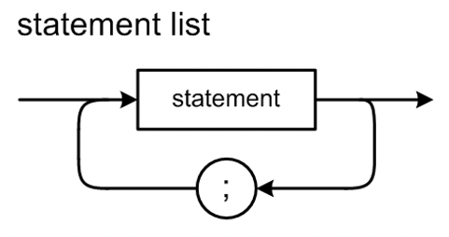
The parseStatementList() Function
void Parser::parseStatementList(Node *parentNode, TokenType terminalType)
{
while ( (currentToken->type != terminalType)
&& (currentToken->type != END_OF_FILE))
{
Node *stmtNode = parseStatement();
if (stmtNode != nullptr) parentNode->adopt(stmtNode);
// A semicolon separates statements.
if (currentToken->type == SEMICOLON)
{
while (currentToken->type == SEMICOLON)
{
currentToken = scanner->nextToken(); // consume ;
}
}
else if (statementStarters.find(currentToken->type) !=
statementStarters.end())
{
syntaxError("Missing ;");
}
}
}
Did we see the start of the next statement
without having seen a semicolon?
PROGRAM HelloWorld;
BEGIN
i := 0;
REPEAT
i := i + 1;
write('#'); write(i);
writeln(': Hello, world!');
UNTIL i = 5;
END.
Parser.cpp

Slide 12
Statement Starter Tokens
set<TokenType> Parser::statementStarters;
...
void Parser::initialize()
{
// Tokens that can start a statement.
statementStarters.insert(BEGIN);
statementStarters.insert(IDENTIFIER);
statementStarters.insert(REPEAT);
statementStarters.insert(TokenType::WRITE);
statementStarters.insert(TokenType::WRITELN);
...
}
Parser.cpp

Slide 13
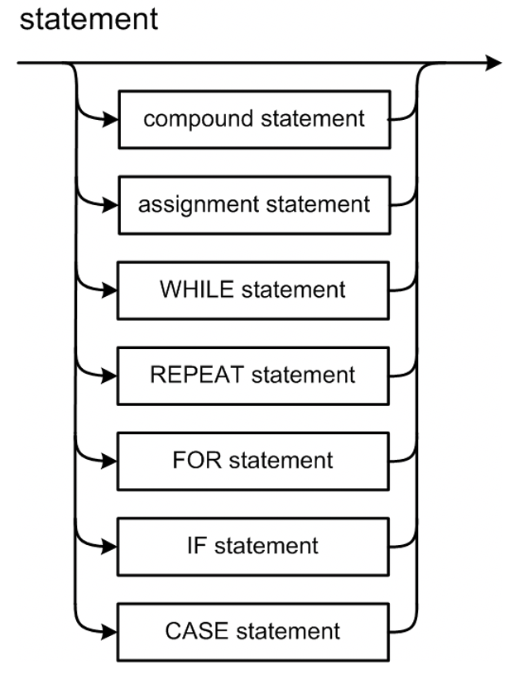
The parseStatement() Function
Node *Parser::parseStatement()
{
Node *stmtNode = nullptr;
int savedLineNumber = currentToken->lineNumber;
lineNumber = savedLineNumber;
switch (currentToken->type)
{
case IDENTIFIER : stmtNode = parseAssignmentStatement(); break;
case BEGIN : stmtNode = parseCompoundStatement(); break;
case REPEAT : stmtNode = parseRepeatStatement(); break;
case WRITE : stmtNode = parseWriteStatement(); break;
case WRITELN : stmtNode = parseWritelnStatement(); break;
case SEMICOLON : stmtNode = nullptr; break; // empty statement
default : syntaxError("Unexpected token");
}
if (stmtNode != nullptr) stmtNode->lineNumber = savedLineNumber;
return stmtNode;
}
Parser.cpp

Slide 14
Review: Conceptual Design
Interpreter
Compiler or
converter

Slide 15
The Symbol Table: Basic Concepts
Purpose
To store information about certain tokens during the translation process (i.e., parsing and scanning)
What information to store?
Anything that’s useful!
For an identifier:
name
data type
kind (variable name, type name, function name, etc.)

Slide 16
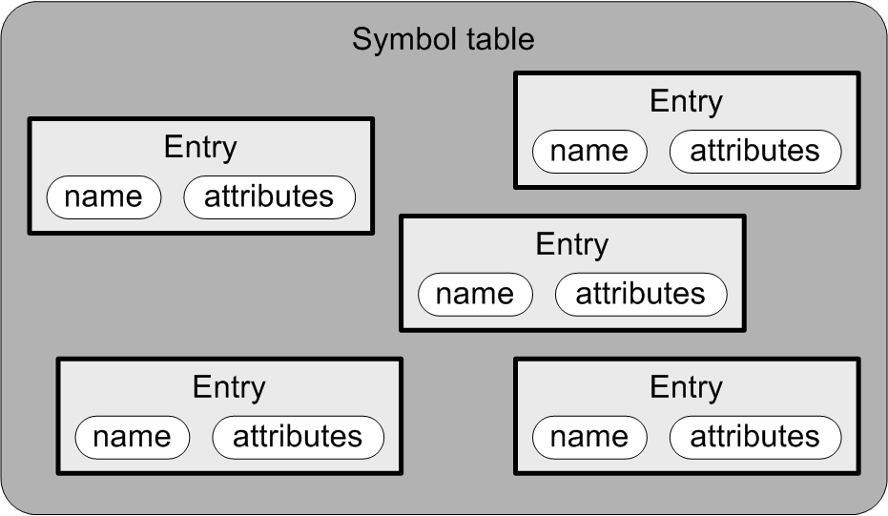
The Symbol Table: Conceptual Design
Goal: The symbol table
should be source language
independent.
Each entry in the symbol table has
a name
attributes

Slide 17
The Symbol Table: Basic Operations
Enter new information.
Look up existing information.
Update existing information.
The parser performs these operations whenever it gets an identifier token from the scanner.
The symbol table should probably be more accurately called the identifier table or the name table.

Slide 18
What Needs a Symbol Table?
A Pascal program
Identifiers for constant, type, variable, procedure, and function names.
A Pascal procedure or function
Identifiers for constant, type, variable, procedure, and function names.
Identifiers for formal parameter names.
A Pascal record type
Identifiers for field names.

Slide 19
Symbol Table Entries
SymtabEntry.h
class SymtabEntry
{
private:
string name;
double value;
public:
SymtabEntry(string name) : name(name), value(0.0) {}
string getName() const { return name; }
double getValue() const { return value; }
void setValue(const double value) { this->value = value; }
};
For now, we’ll store all numeric values
as datatype double.
namespace intermediate

Slide 20
The Symbol Table
Symtab.h
class Symtab
{
private:
map<string, SymtabEntry *> contents;
public:
SymtabEntry *enter(string name)
{
SymtabEntry *entry = new SymtabEntry(name);
contents[name] = entry;
return entry;
}
SymtabEntry *lookup(string name)
{
return contents.find(name) != contents.end() ? contents[name]
: nullptr;
}
};
Return nullptr if the name
is not contained in the map.
namespace intermediate

Slide 21
A Hack!
So far, we haven’t parsed any variable declarations.
The hack:
When a variable appears on the left-hand-side of an assignment statement (i.e., it’s the target of the assignment) and it’s not already in the symbol table, enter it into the symbol table.
When a variable appears in an expression, check to see if it’s in the symbol table.
The variable is undeclared if it isn’t in the symbol table.

Slide 22
The parseAssignmentStatement() Function
Parser.cpp
Node *Parser::parseAssignmentStatement()
{
// The current token should now be the left-hand-side (LHS) variable name.
Node *assignmentNode = new Node(ASSIGN);
// Enter the variable name into the symbol table
// if it isn't already in there.
string variableName = currentToken->text;
SymtabEntry *variableId = symtab->lookup(toLowerCase(variableName));
if (variableId == nullptr) variableId = symtab->enter(toLowerCase(variableName));
// The assignment node adopts the variable node as its first child.
Node *lhsNode = new Node(VARIABLE);
lhsNode->text = variableName;
lhsNode->entry = variableId;
assignmentNode->adopt(lhsNode);
currentToken = scanner->nextToken(); // consume the LHS variable;
Why the case downshifts?
namespace frontend

Slide 23
parseAssignmentStatement(), cont’d
Parser.cpp
if (currentToken->type == COLON_EQUALS)
{
currentToken = scanner->nextToken(); // consume :=
}
else syntaxError("Missing :=");
// The assignment node adopts the expression node as its second child.
Node *rhsNode = parseExpression();
assignmentNode->adopt(rhsNode);
return assignmentNode;
}

Slide 24
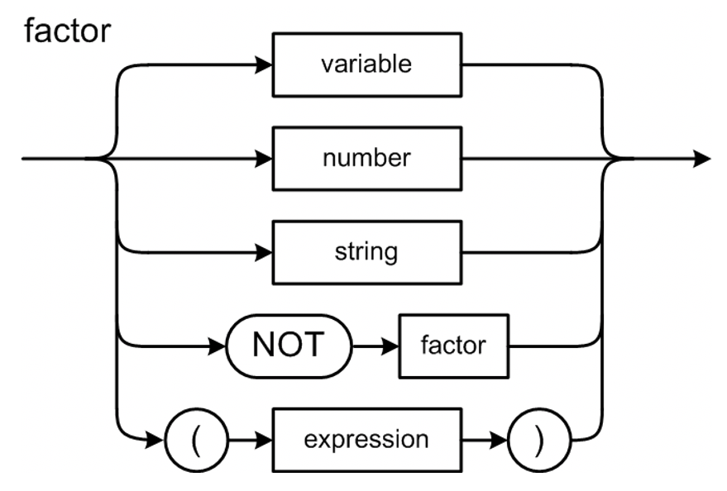
The parseFactor() Function
Node *Parser::parseFactor()
{
// The current token should now be an identifier or a number or (
if (currentToken->type == IDENTIFIER) return parseVariable();
else if (currentToken->type == INTEGER) return parseIntegerConstant();
else if (currentToken->type == REAL) return parseRealConstant();
else if (currentToken->type == LPAREN)
{
currentToken = scanner->nextToken(); // consume (
Node *exprNode = parseExpression();
if (currentToken->type == RPAREN)
{
currentToken = scanner->nextToken(); // consume )
}
else syntaxError("Expecting )");
return exprNode;
}
else syntaxError("Unexpected token");
return nullptr;
}
Parser.cpp

Slide 25
The parseVariable() Function
Parser.cpp
Node *Parser::parseVariable()
{
// The current token should now be an identifier.
// Has the variable been "declared"?
string variableName = currentToken->text;
SymtabEntry *variableId = symtab->lookup(toLowerCase(variableName));
if (variableId == nullptr) semanticError("Undeclared identifier");
Node *node = new Node(VARIABLE);
node->text = variableName;
currentToken = scanner->nextToken(); // consume the identifier
return node;
}

Slide 26
The parseRepeatStatement() Function
Node *Parser::parseRepeatStatement()
{
// The current token should now be REPEAT.
// Create a LOOP node.
Node *loopNode = new Node(LOOP);
currentToken = scanner->nextToken(); // consume REPEAT
parseStatementList(loopNode, UNTIL);
if (currentToken->type == UNTIL)
{
// Create a TEST node. It adopts the test expression node.
Node *testNode = new Node(TEST);
lineNumber = currentToken->lineNumber;
testNode->lineNumber = lineNumber;
currentToken = scanner->nextToken(); // consume UNTIL
testNode->adopt(parseExpression());
// The LOOP node adopts the TEST node as its final child.
loopNode->adopt(testNode);
}
else syntaxError("Expecting UNTIL");
return loopNode;
}
Parser.cpp
Demo

Slide 27
Example Parse Tree
<PROGRAM HelloWorld>
<COMPOUND line 3>
<ASSIGN line 4>
<VARIABLE i />
<INTEGER_CONSTANT 0 />
</ASSIGN>
<LOOP line 6>
<ASSIGN line 7>
<VARIABLE i />
<ADD>
<VARIABLE i />
<INTEGER_CONSTANT 1 />
</ADD>
</ASSIGN>
<WRITE line 8>
<STRING_CONSTANT '#' />
</WRITE>
<WRITE line 8>
<VARIABLE i />
</WRITE>
<WRITELN line 9>
<STRING_CONSTANT ': Hello, world!' />
</WRITELN>
<TEST line 10>
<EQ>
<VARIABLE i />
<INTEGER_CONSTANT 5 />
</EQ>
</TEST>
</LOOP>
</COMPOUND>
</PROGRAM>
1
2
3
4
5
6
7
8
9
10
11
PROGRAM HelloWorld;
BEGIN
i := 0;
REPEAT
i := i + 1;
write('#'); write(i);
writeln(': Hello, world!');
UNTIL i = 5;
END.

Slide 28
Simple Interpreter
Now that we have a basic parse tree and a rudimentary symbol table, we can start the backend tier.
Recall the the backend components only work with the intermediate tier components.

Slide 29
Review: Conceptual Design
Interpreter
Compiler or
converter
Can an interpreter’s backend executor
run a Pascal program using only
the parse tree and the symbol table?

