Slide 1


CMPE 142
Operating Systems
April 30 Class Meeting
Department of Computer Engineering
San Jose State University
Spring 2021
Instructor: Ron Mak
www.cs.sjsu.edu/~mak

Slide 2
Virtual Machines
Abstract the hardware of a
single computer system.
Create several different
execution environments.
Each environment can have
its own operating system.
Each environment believes it has
the entire physical system.
Processes
Processes
Processes
Kernel
Kernel
Kernel
VM1
VM2
VM3
Virtual Machine Manager
Host Operating System
Physical Machine

Slide 3
Virtual Machines, cont’d
The virtual machine manager (VMM)
creates and controls the virtual machines.
  AKA hypervisor
  Example:
    VirtualBox

Slide 4
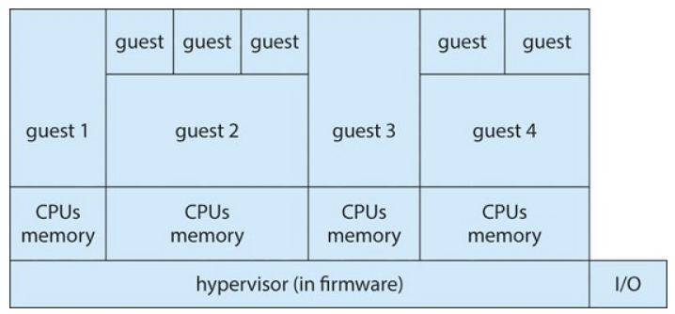
Types of Virtual Machine Managers
Type 0
  Hardware-based solution
  Commonly found in mainframe computers.
    Examples: IBM LPARs, Oracle LDOMs
Operating System Concepts, 10th edition
by Abraham Silberschatz, Greg Gagne, and Peter B. Galvin
Wiley, 2018, ISBN 978-1119456339

Slide 5
Types of Virtual Machine Managers, cont’d
Type 1
  Operating-system-like software
  provides virtualization
    Examples: VMware ESX, Joyent SmartOS,
    Citrix XenServer
  General-purpose OSes
  that provide VMM functions
    Examples: Microsoft Windows Server with HyperV,
    Red Hat Linux with KVM feature

Slide 6
Types of Virtual Machine Managers, cont’d
Type 2
  Applications that run on standard OSes to provide VMM functionality to guest operating systems.
  Examples:
    VMware Workstation and Fusion,
    Parallels Desktop, Oracle Virtual Box.

Slide 7
Types of Virtual Machine Managers, cont’d
Paravirtualization
  Modify a guest operating system to work with a VMM.
Programming-environment virtualization
  VMMs create an optimized virtual system.
  Examples:
    Java Virtual Machine (JVM), Microsoft .Net

Slide 8
Types of Virtual Machine Managers, cont’d
Emulators
  Applications written for one hardware environment (one type of CPU) can run on a very different hardware environment (another type of CPU).
Application containment
  Not really virtualization, but segregate applications
  from the host operating system.
  Examples: Oracle Solaris Zones, BSD Jails,
  IBM AIX WPARs

Slide 9
Host vs. Guest Operating Systems
Host operating system
  The OS running on the physical machine that supports (among its other tasks) a VMM
  Examples:
    Linux, Windows, Mac OS X

Slide 10
Host vs. Guest Operating Systems, cont’d
Guest operating system
  An OS running in a virtual machine
  under control of a VMM.
  Example:
    Debian running under VirtualBox on a Mac
  If there is enough physical memory and disk space,
  it is possible to run several guest OSes (and their applications) simultaneously on a single physical machine.

Slide 11
Virtualization Requirements
Fidelity
  A VMM provides an environment for programs that is essentially identical to the original machine.
Performance
  Programs running within that environment have
  only minor performance degradation.
Safety
  The VMM is in complete control of system resources
  required by the guest operating systems.

Slide 12
Brief History of Virtual Machines
1972: Virtual machines first appeared commercially.
  IBM VM370 on IBM mainframes.
Late 1990s: Intel 80x86 CPU become popular.
  Xen and VMware created VMM technologies
  for that CPU.

Slide 13
Brief History of Virtual Machines, cont’d
Today: Commercial and open-source VMMs
run on all common operating systems.
  Example VMM: VirtualBox runs on Intel x86 and AMD64 CPUs on Windows, Linux, Mac OS X,
  and Solaris.
  Example guest OSes: Versions of Windows, Linux, Solaris, BSD, MS-DOS, IBM OS/2

Slide 14
Benefits of Virtual Machines
Sharing
  Different execution environments can share
  the same physical hardware resources.
Security
  A virus that infects a guest OS is unlikely to affect
  other guest OSes or the host OS.

Slide 15
Benefits of Virtual Machines, cont’d
Suspend the running of a guest OS.
  Create a snapshot the state
  of a suspended guest OS.
  Resume the execution from the snapshot,
  possibly on different hardware.
Live migration: Move a guest from
one physical machine to another
without interrupting its operations.

Slide 16
Benefits of Virtual Machines, cont’d
Create a network of virtual machines.
  Communicate over the
  virtual communications network.
Operating system research and development.
Rapid application porting and testing
on different environments.

Slide 17
Benefits of Virtual Machines, cont’d
Resource optimization
  An organization can support multiple environments
  without the hardware investment.
Cloud computing
  Made possible by virtualization.

Slide 18
Implementation of Virtual Machines
Virtual CPU (VCPU) implementation
  Does not execute code.
  Represents the state of the CPU
  as the guest believes it to be.

Slide 19
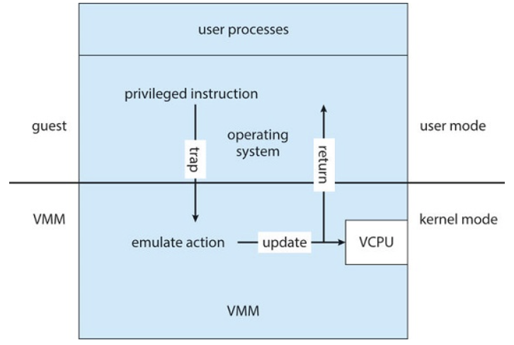
Implementation of Virtual Machines, cont’d
Trap-and-emulate
  The guest kernel attempts to execute
  a privileged instruction, such as to do I/O.
  Causes a trap to the VMM in the real machine.
  The VMM emulates the
  privileged operation.
  Therefore, privileged
  instructions create
  extra overhead.
    The guest will
    run more slowly.
Operating System Concepts, 10th edition
by Abraham Silberschatz, Greg Gagne, and Peter B. Galvin
Wiley, 2018, ISBN 978-1119456339

Slide 20
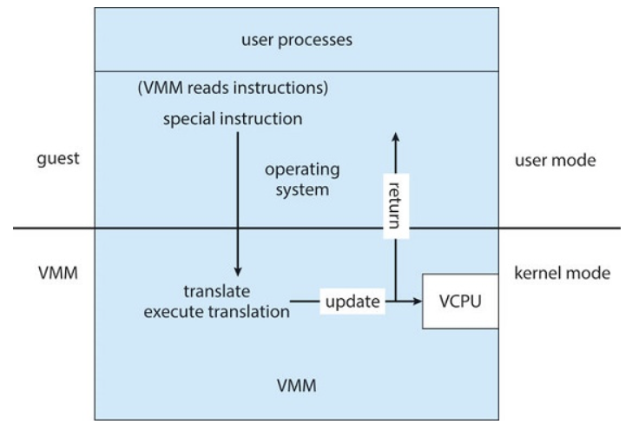
Implementation of Virtual Machines, cont’d
Binary translation
  Some x86 instructions (“special instructions”) behave differently in user mode vs. kernel mode.
  The VMM translates
  special instructions in
  the guest kernel into
  a new set of native
  instructions that
  accomplish the
  operations.
Operating System Concepts, 10th edition
by Abraham Silberschatz, Greg Gagne, and Peter B. Galvin
Wiley, 2018, ISBN 978-1119456339

Slide 21
Implementation of Virtual Machines, cont’d
Binary translation, cont’d
  The new set of instructions can be cached
  to improve performance.
  The VMM must also intercept memory paging requests by the guest kernel.
  The VMM maintains nested page tables (NPTs)
  to map guest paging operations
  to physical page table operations.

Slide 22
Implementation of Virtual Machines, cont’d
Hardware assistance
  Newest CPU chips provide more support
  for virtualization.
  2005: Intel x86 CPU family add VT-x instructions.
    Binary translation and NPTs no longer needed.
  2006: AMD processors support AMD-V technology.
  CPUs with virtualization hardware assistance can
  automatically deliver an interrupt destined for a guest to a core that is running a thread of the guest.

Slide 23
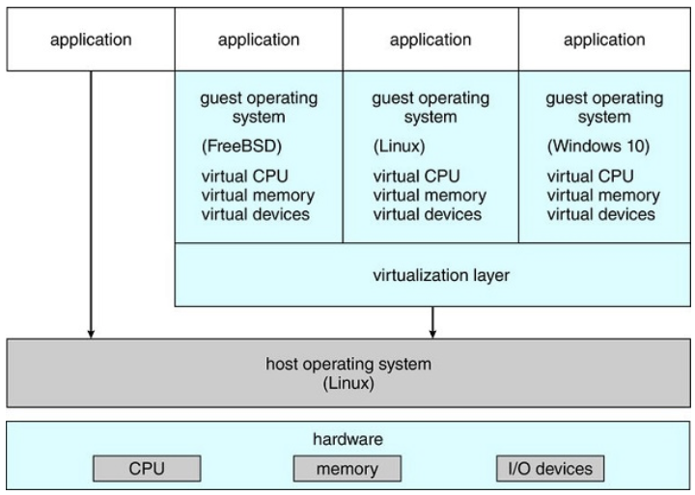
Type 2 Hypervisor
The VMM is just another process
running on the host.
  Examples: VMware, VirtualBox
The host OS
doesn’t know
that virtualization
is taking place.
Operating System Concepts, 10th edition
by Abraham Silberschatz, Greg Gagne, and Peter B. Galvin
Wiley, 2018, ISBN 978-1119456339

Slide 24
Type 2 Hypervisor, cont’d
The VMM may run as a user application.
  It might not have the administrative privileges
  to access the hardware assistance features
  of modern CPUs.
  Therefore, type 2 hypervisors can have
  poorer performance than type 0 or type 1.
No changes are required
to the host operating system.
  Any student can run VirtualBox to experiment
  and learn from different guest operating systems.

Slide 25
Virtualization Components
CPU scheduling
  There may be more virtual CPUs
  than physical CPUs.
    Overcommitment
  The VMM must share the available
  physical CPUs among the guests.

Slide 26
Virtualization Components, cont’d
Memory management
  The VMM may overcommit memory
  among the guests.
  The VMM determines how much real memory
  each guest can use.
    Each guest has the illusion that it has
    all the memory it wants.
  The VMM does its own memory page allocation.
    It works with the host system’s memory management.

Slide 27
Virtualization Components, cont’d
I/O management
  The VMM can dedicate physical I/O devices
  to guests.
    Example: Assign a physical CD ROM drive to a guest.
  The VMM can provide idealized device drivers
  to guests.
    The VMM maps guest I/O requests to a device
    to the actual device driver.

Slide 28
Virtualization Components, cont’d
Storage management
  The VMM ensures that each guest can only access
  the disk blocks allocated to it.
Networking
  The VMM provides each guest
  with at least one IP address.
  The VMM provides routing between the guest
  and the network.
  The VMM provides network address translation (NAT).

Slide 29
Assignment #10: Virtual Machine Manager
Work together as a team, but each team member must show individual results
on his or her own machine.
Install a virtual machine manager,
either VirtualBox or VMware
on each team member’s machine.
  VirtualBox: https://www.virtualbox.org
    Windows, Mac, or Linux
  VMware Workstation Player: https://www.vmware.com/in/products/workstation-player/workstation-player-evaluation.html
    Windows or Linux

Slide 30
Assignment #10, cont’d
Choose a Linux distribution (“distro”).
  Google “Linux distros”
  Each team member must choose a different distro.
Download the .iso file which is the image of the installation CD ROM for the distro.
  Install the Linux distro with the virtual machine manager using the .iso file.
Create a screen shot that clearly shows the distro running in the virtual machine manager running on the host OS.

Slide 31
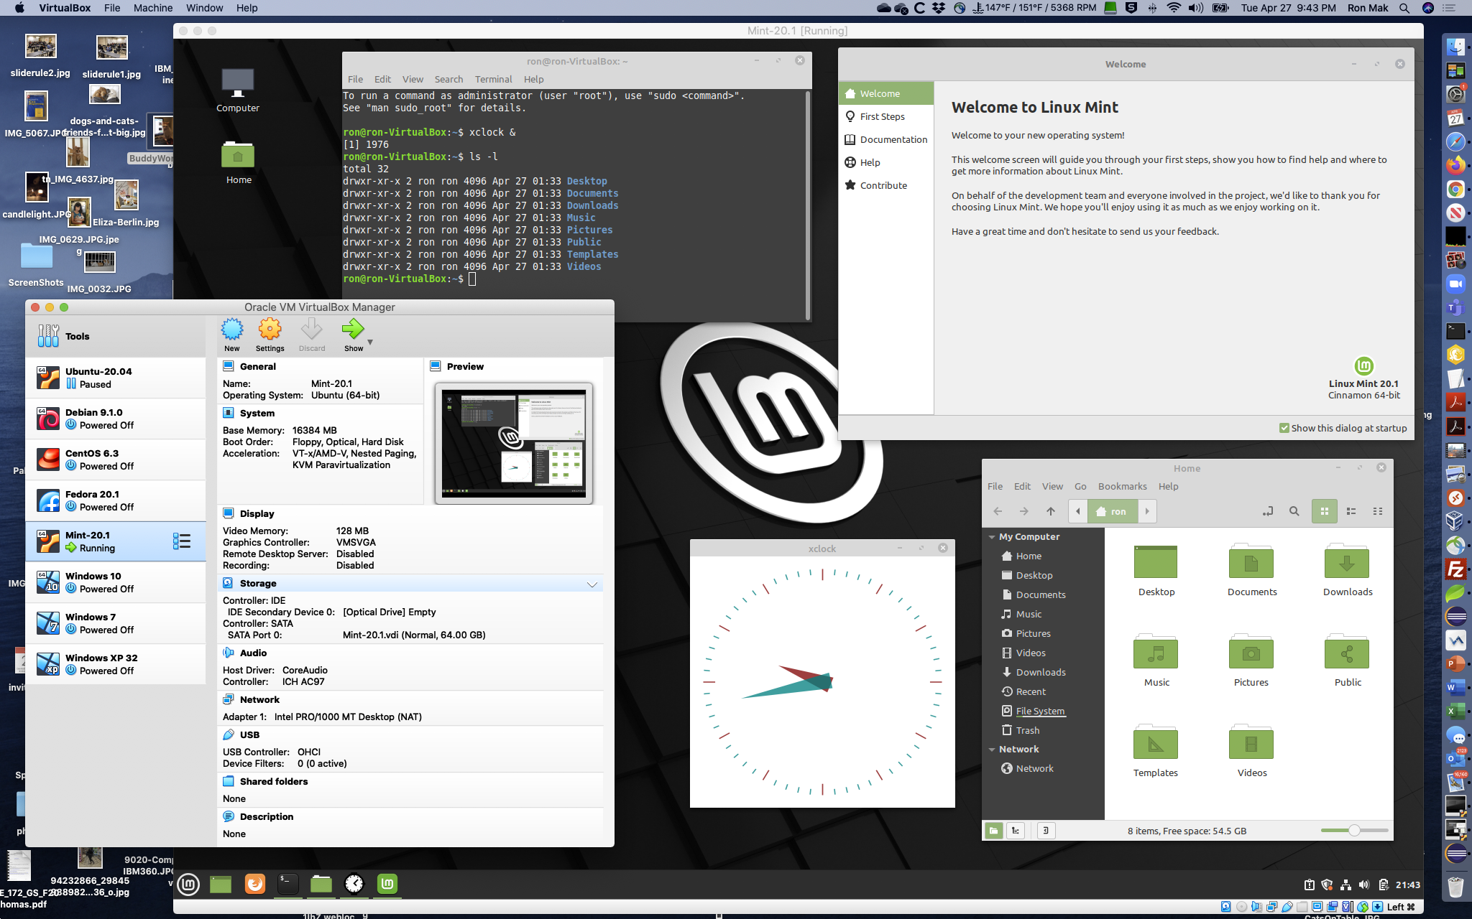
Linux Mint on VirtualBox on Mac OS

Slide 32
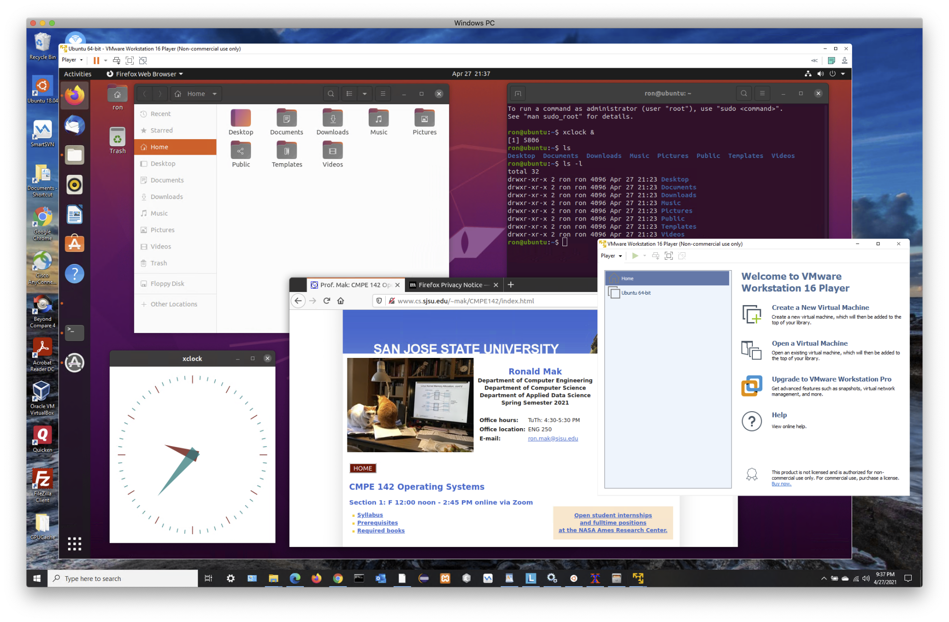
Ubuntu on VMware on Windows 10

Slide 33
Break

Slide 34
Distributed Systems
A distributed system is
  A collection of loosely coupled processors
  Interconnected by a communications network
Site: The physical location of a machine.
Node: The machine or system located at a site.
  AKA: host
Server: A node that provides resources
to other nodes.
Client: A node that consumes resources
from a server.

Slide 35
Advantages of Distributed Systems
Resource sharing
  Share and print files at remote sites.
  Process information in a distributed database.
  Use remote specialized hardware devices.
Load sharing
  Computation speedup.
  Load balancing.

Slide 36
Advantages of Distributed Systems, cont’d
Reliability
  Detect and recover from a site failure.
  Transfer functions from a failed site.
  Reintegrate a failed site.
Communication
  Message passing.
Flexibility
  Replace mainframes with networks of workstations.
  More cost effective.

Slide 37
Network Operating Systems
Users are aware of the network
and its multiplicity of machines.
Users issue commands
to log into remote machines
  telnet
  ssh
Remote desktop
  Users get a virtual view of a remote machine’s desktop on their local workstation screens.

Slide 38
Network Operating Systems, cont’d
Remote file transfer
  File transfer protocol (FTP)
  Secure FTP (SFTP)
  get: Transfer a file from a
  remote to the local machine.
  put: Transfer a file from the
  local to a remote machine.

Slide 39
Network Operating Systems, cont’d
All general-purpose operating systems today are network operating systems.
  Linux
  Mac OS
  Android

Slide 40
Distributed Operating Systems
Users are not aware that they are on a network.
Access to remote resources is similar to
access to local resources.

Slide 41
Distributed Operating Systems, cont’d
Data migration
  When a user wants to access a file at a remote site,
  the file is transferred to the user’s local machine.
    From then on, all file accesses are local.
  After the user closes the file, it is transferred back
  to the remote site.
  Another approach: Only transfer portions of the file
  that the user needs to perform a task.

Slide 42
Distributed Operating Systems, cont’d
Computation migration
  Instead of running a job locally,
  run it on a remote machine.
  Then the program can access the files locally
  on the remote machine.

Slide 43
Distributed Operating Systems, cont’d
Process migration
  Execute an entire process, or parts of it,
  at a remote site.
  Load balancing
    Distribute processes across network to even the workload.
  Computation speedup
    Child processes can run concurrently on different sites.

Slide 44
Distributed Operating Systems, cont’d
Process migration, cont’d
  Hardware preference
    Process execution may require specialized processor.
  Software preference
    Required software may be available
    at only a particular site.
  Data access
    Run process remotely, rather than transfer all data locally.

Slide 45
Network Structure
Local area network (LAN)
  Network nodes are distributed over a small area
    one building
    adjacent buildings
Wide area network (WAN)
  Network node distributed over a large area
    entire country
    internationally

Slide 46
Local Area Network (LAN)
Covers a small geographical area.
  Bus, ring, or star network.
Speeds
  1 megabit/second: AppleTalk, infrared, Bluetooth
  10 megabits/second: 10BaseT Ethernet
  100 megabits/second: 100BaseT Ethernet

Slide 47
Local Area Network (LAN), cont’d
Broadcast is fast and cheap.
  Including wifi.
Nodes:
  Usually workstations and/or personal computers
  A few (usually one or two) mainframes
  Gateway: a node that connects to other networks

Slide 48
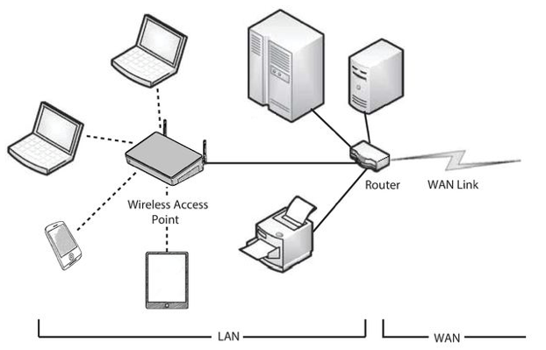
Local Area Network (LAN)
Operating System Concepts, 10th edition
by Abraham Silberschatz, Greg Gagne, and Peter B. Galvin
Wiley, 2018, ISBN 978-1119456339

Slide 49
Wide Area Network (WAN)
Links geographically separated sites.
Point-to-point connections over long-haul lines.
  Often leased from a phone company.
  Communication processors control
  communication links.

Slide 50
Wide Area Network (WAN)
Speeds
  1.544 megabits/second: T1 service
  45 megabits/second: T3 service
  40 gigabits/second: intercity backbone connections
Broadcast usually requires multiple messages.
Nodes:
  Usually a high percentage of mainframes.

Slide 51
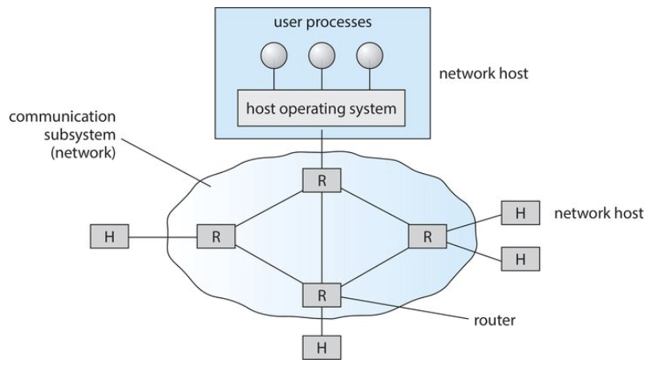
Wide Area Network (WAN)
Operating System Concepts, 10th edition
by Abraham Silberschatz, Greg Gagne, and Peter B. Galvin
Wiley, 2018, ISBN 978-1119456339

Slide 52
Communication Structure
Naming and name resolution
  How do two processes locate each other to communicate?
Routing strategies
  How are messages sent through the network?
Connection strategies
  How do two processes send a sequence of messages?

Slide 53
Communication Structure, cont’d
Contention
  The network is a shared resource.
  How do we resolve conflicting demands for its use?

Slide 54
Naming and Name Resolution
Systems on the network need to be named.
  Locally, each process has an id.
  A host on the network has no knowledge
  about processes on other hosts.
Identify processes on remote systems by a
<host-name, identifier> pair.

Slide 55
Domain Name Service (DNS)
Specifies the naming structure of the hosts.
Name to address resolution on the Internet.
  Hosts on the Internet are logically addressed
  with multipart names known as an
  IP (Internet protocol) address.
    Example: 172.7.57.62
  Map domain names such as sjsu.edu
  to their IP addresses.

Slide 56
Routing Strategies
How does a process at Site A
communicate with a process at Site B?
How is the message routed?

Slide 57
Fixed Routing
A path from A to B is specified in advance.
  The path changes only if a hardware failure
  disables it.
Since the shortest path is usually chosen, communication costs are minimized.
Fixed routing cannot adapt to load changes.
Ensures that messages will be delivered
in the order in which they were sent.

Slide 58
Virtual Routing
A path from A to B is fixed
for the duration of one session.
Different sessions involving messages
from A to B may have different paths.
Partial remedy to adapting to load changes.
Ensures that messages will be delivered
in the order in which they were sent.

Slide 59
Dynamic Routing
The path used to send a message
from site A to site B is chosen only
when a message is sent.
Usually, a site sends a message to another site
on the link least used at that particular time.
Adapts to load changes by avoiding routing messages on heavily used paths.

Slide 60
Dynamic Routing, cont’d
Messages may arrive out of order.
How to remedy this problem?
  Append a sequence number to each message.

Slide 61
Connection Strategies
Once routing has been established,
messages can reach their destinations.
Processes at different sites that want
to communicate with each other
must choose a connection strategy.

Slide 62
Connection Strategies, cont’d
Circuit switching
  A permanent physical link is established
  for the duration of the communication.
  Example: telephone system
Message switching
  A temporary link is established
  for the duration of one message transfer.
  Example: post-office mailing system

Slide 63
Connection Strategies, cont’d
Packet switching
  Messages of variable length are divided into
  fixed-length packets which are sent to the destination.
  Each packet may take a different path
  through the network.
  The packets must be reassembled
  into messages as they arrive.

Slide 64
Connection Strategies, cont’d
Circuit switching requires setup time,
but incurs less overhead for shipping each message.
  May waste network bandwidth.
Message and packet switching require
less setup time, but incur more overhead
per message.

Slide 65
Contention
Several sites may want to transmit information
over a link simultaneously, causing collisions.
CSMA/CD
  Carrier sense with multiple access (CSMA)
  Collision detection (CD)
  A site determines whether another message is currently being transmitted over that link.
  If two or more sites begin transmitting
  at exactly the same time, they register
  a CD and will stop transmitting.

Slide 66
Contention, cont’d
CSMA/CD, cont’d
  When the system is very busy,
  many collisions may occur.
    Performance may be degraded.
  CSMA/CD is used successfully
  in the Ethernet system,
  the most common network system.

Slide 67
Communications Protocols
The ISO (International Standards Organization)
7-layer model.
Layer 1: Physical layer
  Handle the mechanical and electrical details of the physical transmission of a bit stream.
Layer 2: Data-link layer
  Handle the frames, or fixed-length parts of packets.
  Error detection and recovery that occurred in the physical layer.

Slide 68
The ISO Network Model
Layer 3: Network layer
  Connect and route packets
  in the communication network.
  Handle the address of outgoing packets.
  Decode the address of incoming packets.
  Maintain routing information for proper response
  to changing load levels.
  Routers work at this level.

Slide 69
The ISO Network Model, cont’d
Layer 4: Transport layer
  Low-level network access and
  for message transfer between clients.
  Partition messages into packets.
  Maintain packet order.
  Control flow.
  Generate physical addresses.

Slide 70
The ISO Network Model, cont’d
Layer 5: Session layer
  Implement sessions, or process-to-process
  communications protocols.
Layer 6: Presentation layer
  Resolve the differences in formats
  among the various sites in the network
    Character conversions
    Half duplex/full duplex (echoing)

Slide 71
The ISO Network Model, cont’d
Layer 7: Application layer
  Interact directly with the users
  File transfer
  Remote-login protocols
  Electronic mail
  Schemas for distributed databases

Slide 72
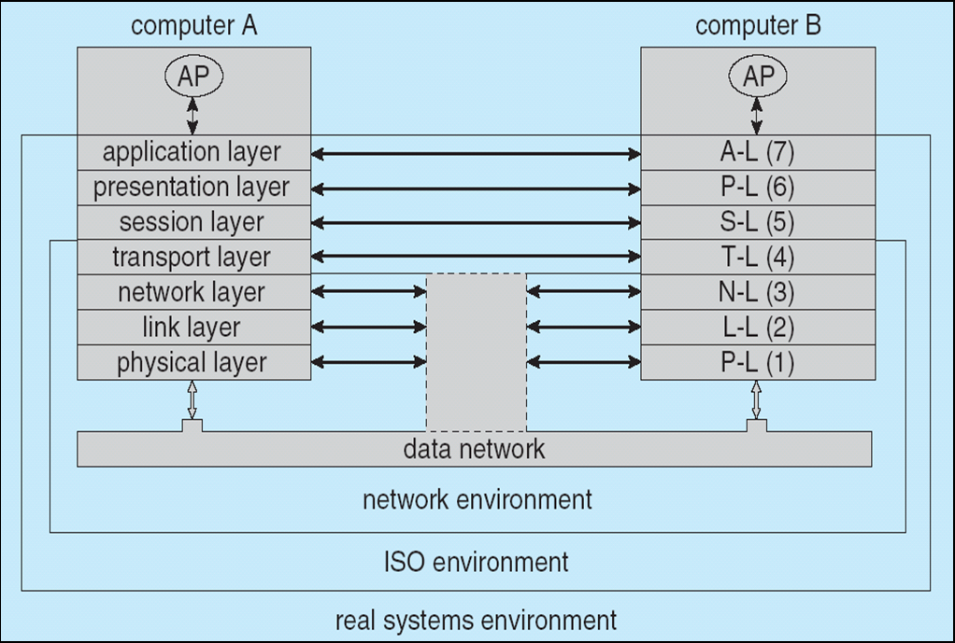
The ISO Network Model, cont’d
Operating System Concepts, 10th edition
by Abraham Silberschatz, Greg Gagne, and Peter B. Galvin
Wiley, 2018, ISBN 978-1119456339

Slide 73
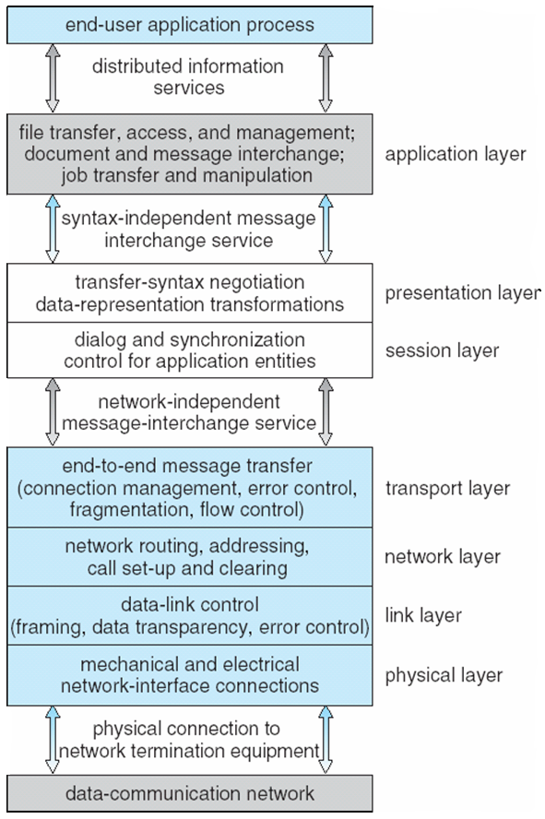
The ISO Protocol Stack
Operating System Concepts, 10th edition
by Abraham Silberschatz, Greg Gagne, and Peter B. Galvin
Wiley, 2018, ISBN 978-1119456339

Slide 74
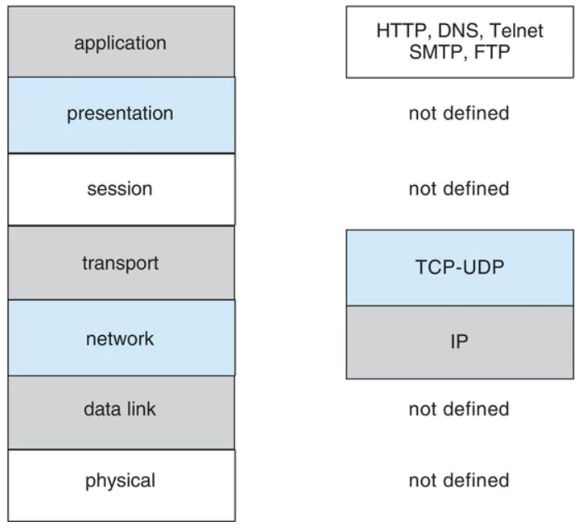
TCP/IP Protocol Layers
ISO
TCP/IP
TCP (Transmission Control Protocol): reliable and connection-oriented
IP (Internet Protocol): routes internet packets
Operating System Concepts, 10th edition
by Abraham Silberschatz, Greg Gagne, and Peter B. Galvin
Wiley, 2018, ISBN 978-1119456339

Slide 75
Ethernet Packet Transmission
Every host has a unique IP address.
  Host: a computer connected to the network.
  The Domain Name Service (DNS)
  can be used to acquire IP addresses.
Every Ethernet device has a unique
medium access control (MAC) address.
  Two devices on a LAN communicate
  using only their MAC addresses.

Slide 76
Ethernet Packet Transmission, cont’d
Address Resolution Protocol (ARP)
is used to send data to another system.
If the hosts are on the same network,
ARP can be used.
If the hosts are on different networks,
the sending host will send the packet
to a router, a device which routes
the packet to the destination network.

Slide 77
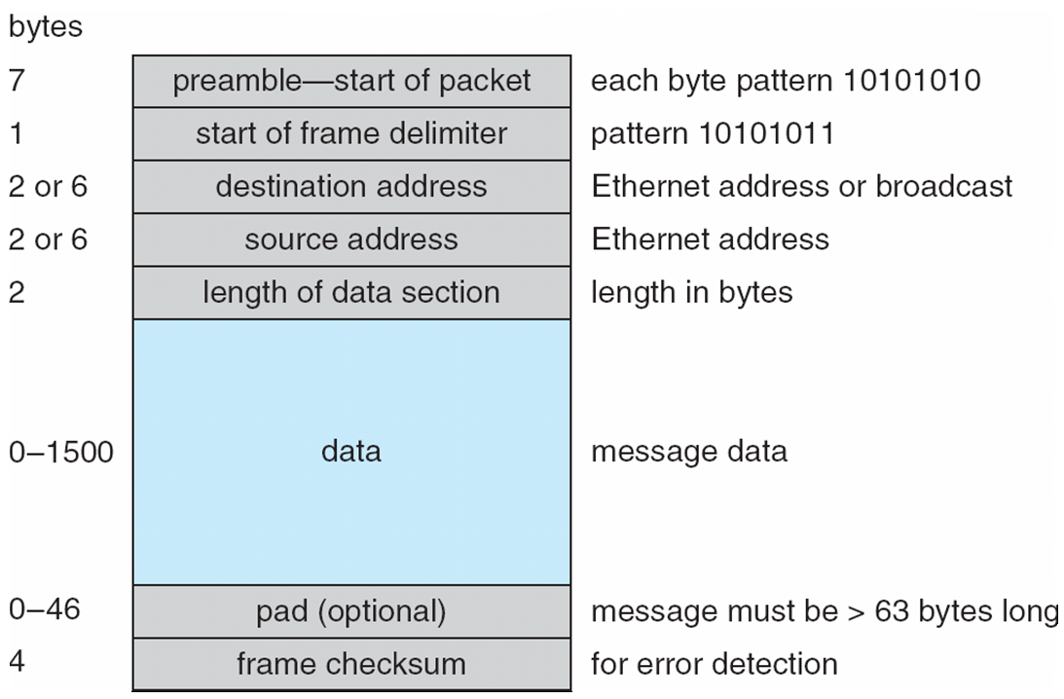
An Ethernet Packet
Operating System Concepts, 10th edition
by Abraham Silberschatz, Greg Gagne, and Peter B. Galvin
Wiley, 2018, ISBN 978-1119456339

Slide 78
Failure Detection
Detecting hardware failure is difficult.
Use a handshaking protocol
to detect link failure.
Assume Site A and Site B
have established a link.
  At fixed intervals, sites exchange
  I-am-up messages to indicate that
  they are up and running.

Slide 79
Failure Detection, cont’d
If Site A does not receive a message
within the fixed interval, it assumes either
  The other site is not up, or
  The message was lost.
Site A sends an Are-you-up? message
to Site B.
  If Site A does not receive a reply,
  it can repeat the message
  or try an alternate route to Site B.

Slide 80
Failure Detection, cont’d
If Site A does not ultimately receive a reply
from Site B, it concludes some type of failure has occurred.
Types of failures:
  Site B is down
  The direct link between A and B is down
  The alternate link from A to B is down
  The message has been lost
However, Site A cannot determine
exactly why the failure has occurred.

Slide 81
Reconfiguration
When Site A determines a failure has occurred,
it must reconfigure the system.
If the link has failed from A to B, this must be broadcast to every site in the system.
If a site has failed, every other site must also be notified that the services offered by the failed site are no longer available.

Slide 82
Reconfiguration, cont’d
When the link or the site becomes
available again, this information
must be broadcast to all other sites.

Slide 83
Network Design Issues
Transparency
  The distributed system should appear as a conventional, centralized system to the user.
Fault tolerance
  The distributed system continues to function
  after a failure.

Slide 84
Network Design Issues, cont’d
Scalability
  As demands increase, the system easily accepts
  the addition of new resources to accommodate
  the increased demand.
Clusters
  A collection of semi-autonomous machines
  acts as a single system.

