Slide 1


CMPE 142
Operating Systems
April 16 Class Meeting
Department of Computer Engineering
San Jose State University
Spring 2021
Instructor: Ron Mak
www.cs.sjsu.edu/~mak

Slide 2
Mounting a File System
Mount an external file system
in order to access it.
The external file system can be located on another disk or on some external removable medium (such as a DVD ROM).
Define a mount point in the current file system.
  Usually, it’s an empty directory.
Notes:
START HERE.

Slide 3
Mounting a File System, cont’d
Mount the external file system
onto the mount point.
Now the contents of the external file system
appear under the directory name of the mount point.
If the mount point was not an empty directory,
the files that were stored in that directory
are now hidden and inaccessible.

Slide 4
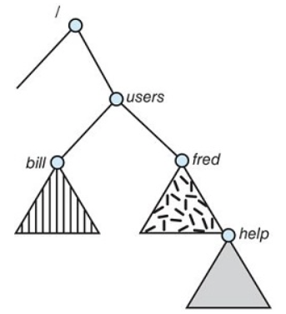
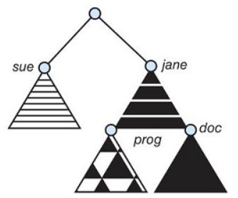
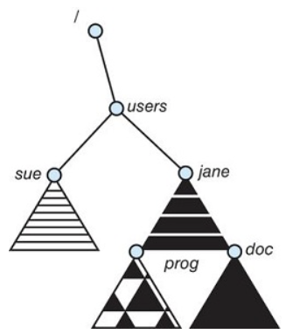
Mounting a File System, cont’d
(a)
(b)
(c)
The current file system
An unmounted volume on /devices/dsk
Mounting over /users
  The previous contents of /users
  are no longer accessible.
Operating System Concepts, 10th edition
by Abraham Silberschatz, Greg Gagne, and Peter B. Galvin
Wiley, 2018, ISBN 978-1119456339

Slide 5
File Protection
The file owner or creator should be able
to control:
  What can be done to the file
  By whom
Types of access:
  Read
  Write
  Execute
  Append
  Delete
  List

Slide 6
File Protection in UNIX
Types of access: read, write, execute (RWX)
Three classes of users and sample access:
RWX
a) owner (user) access 7 ⇒ 1 1 1
b) group access 6 ⇒ 1 1 0
c) public (other) access 4 ⇒ 1 0 0
For a particular file or directory
(such as game), define an
appropriate access with the
chmod command.
  Alternates:
owner
group
public
chmod 764 game
chmod u+rwx game
chmod g+rw game
chmod o+r game
chmod a+r game

Slide 7
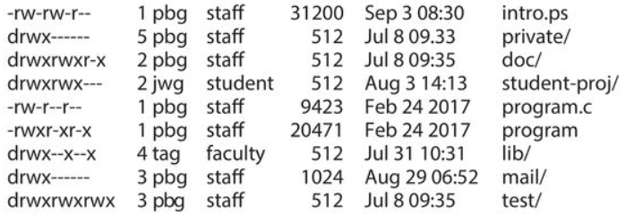
File Protection in UNIX, cont’d
Sample UNIX file listing via the ls command.
  Access rights to each file and directory
  are at the left.
Operating System Concepts, 10th edition
by Abraham Silberschatz, Greg Gagne, and Peter B. Galvin
Wiley, 2018, ISBN 978-1119456339

Slide 8
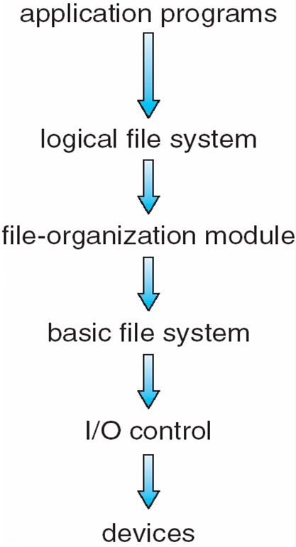
Layered File System Architecture
I/O control
  Device drivers
  Interrupt handlers
Basic file system
  Issue generic commands
  to the device drivers.
  Manage memory buffers and caches that hold file system, directory, and data blocks.
Operating System Concepts, 10th edition
by Abraham Silberschatz, Greg Gagne, and Peter B. Galvin
Wiley, 2018, ISBN 978-1119456339

Slide 9
Layered File System Architecture, cont’d
File-organization module
  Manage logical and physical blocks of files.
  Translate logical block addresses to physical block address.
Logical file system
  Manage file metadata.
  File control blocks
  (UNIX inodes)
Operating System Concepts, 10th edition
by Abraham Silberschatz, Greg Gagne, and Peter B. Galvin
Wiley, 2018, ISBN 978-1119456339

Slide 10
File System Layout on Disk
Master Boot Record (MBR)
  Located at sector 0 of the disk
  Used to boot the computer
  Contains the disk partition table
  Contains code to boot the computer
The MBR code locates the active disk partition.
  Read and execute the boot block
  of the active partition.
  Load the operating system residing
  in the partition.

Slide 11
File System Layout on Disk, cont’d
The superblock
  Contains key parameters about the file system
  that is read into main memory.
File-control blocks (UNIX inodes)
  Array of data structures, one per file.
  Information about each file:
  Where its disk blocks are located, etc.

Slide 12
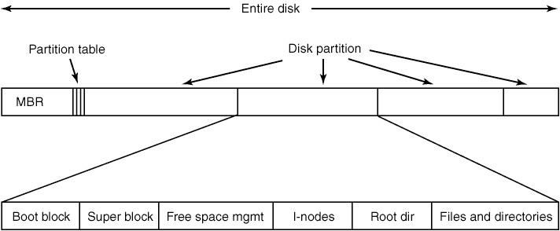
File System Layout on Disk, cont’d
Root directory
Other directories and files
Modern Operating Systems, 4th edition
by Andrew Tanenbaum & Herbert Bos
Pearson, 2014, ISBN 978-0133591620

Slide 13
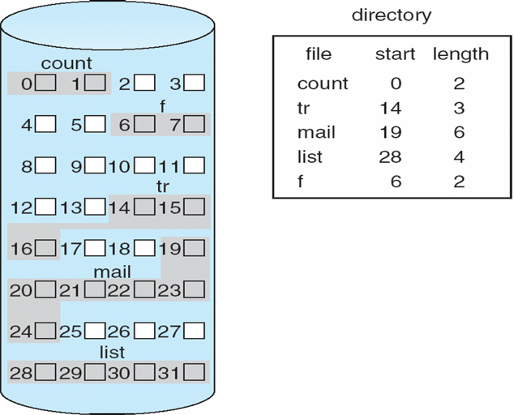
Contiguous File Allocation
Each file occupies a set of contiguous blocks.
  Usually best performance.
  Simple: Requires only the starting location (block #) and length (block count).
Problems
  Finding space for file
  Knowing the file size
  External fragmentation
  Need for compaction
Still used today on
CD ROMs and DVDs.
Operating System Concepts, 10th edition
by Abraham Silberschatz, Greg Gagne, and Peter B. Galvin
Wiley, 2018, ISBN 978-1119456339

Slide 14
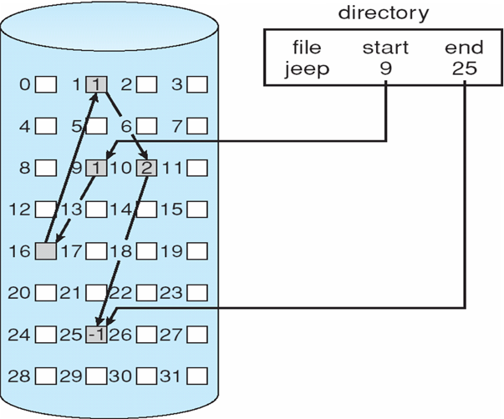
Linked File Allocation
Each file is a linked list of blocks.
  No external fragmentation.
  No compaction.
Each block contains a pointer
to the next block.
  Free space management system
  called when a new block needed.
  Improve efficiency by clustering
  blocks into groups but increases
  internal fragmentation.
Problems
  Locating a block can take many I/Os and disk seeks.
  Poor random-access performance.
  Reliability can be a problem.
Operating System Concepts, 10th edition
by Abraham Silberschatz, Greg Gagne, and Peter B. Galvin
Wiley, 2018, ISBN 978-1119456339

Slide 15
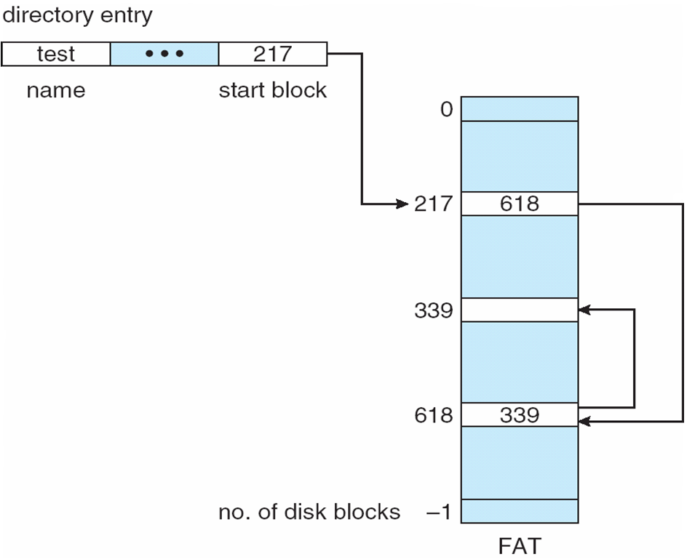
File Allocation Table (FAT)
At the beginning of a volume
  Indexed by block number
  Much like a linked list.
  Used by Microsoft Windows.
Needs to be cached in memory for performance.
Simple to allocate
a new block.
Operating System Concepts, 10th edition
by Abraham Silberschatz, Greg Gagne, and Peter B. Galvin
Wiley, 2018, ISBN 978-1119456339

Slide 16
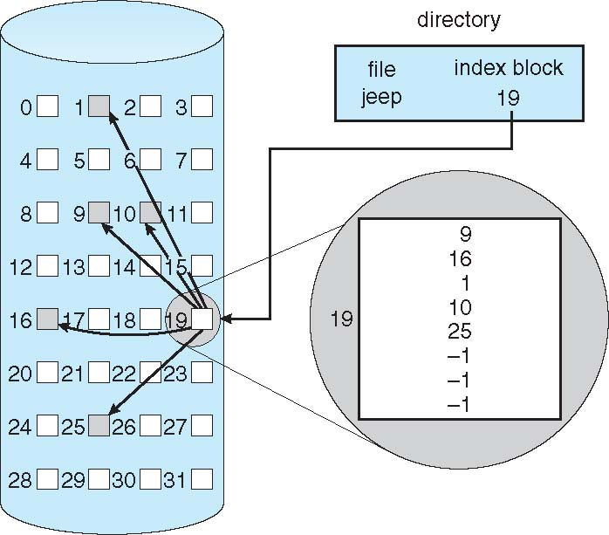
Indexed File Allocation
Each file has its own
index block, an array of disk-block addresses.
No external fragmentation.
Overhead of
the index block.
Operating Systems Concepts, 9th edition
Silberschatz, Galvin, and Gagne
(c) 2013 John Wiley & Sons. All rights reserved. 978-1-118-06333-0

Slide 17
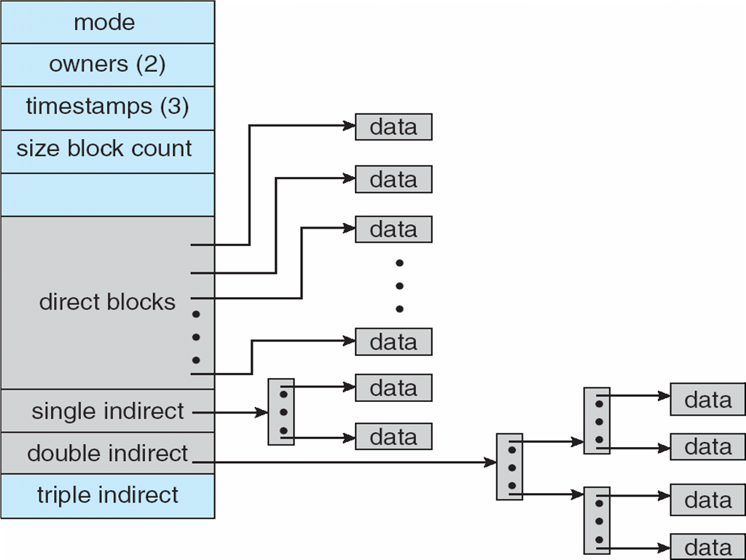
UNIX Inode
  UNIX inode has pointers to:
    direct blocks
    single indirect blocks
    double indirect blocks
    triple indirect blocks
Operating System Concepts, 10th edition
by Abraham Silberschatz, Greg Gagne, and Peter B. Galvin
Wiley, 2018, ISBN 978-1119456339

Slide 18
Implementing Directories
UNIX treats a directory exactly
the same way as a file.
  A type field indicates that it’s a directory.
The superblock on the disk gives
the location of the inodes.
The first inode points to the root directory.

Slide 19
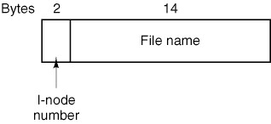
Implementing Directories, cont’d
The main function of the directory is to map
the ASCII name of a file to the information
needed to locate the file data.
  A UNIX directory entry:
Modern Operating Systems, 4th edition
by Andrew Tanenbaum & Herbert Bos
Pearson, 2014, ISBN 978-0133591620

Slide 20
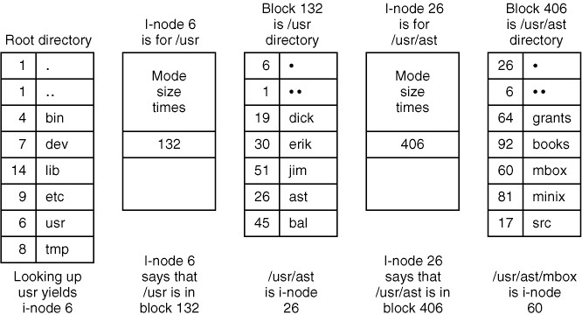
UNIX Directories
Lookup of /usr/ast/mbox:
The steps to look up /usr/ast/mbox.
Modern Operating Systems, 4th edition
by Andrew Tanenbaum & Herbert Bos
Pearson, 2014, ISBN 978-0133591620

Slide 21
Exercise #1
Create two small text files, file1.txt and file3.txt, containing different contents.
  The touch command creates a new file:
    If the file already exists, the command will simply update the file’s modification date.
  You can also create a new file and write to it at the same time without first executing touch.
    If you use >> instead, it will append to an existing file.
touch file1.txt
echo "Hello, world!" > file1.txt
echo "Goodbye, world!" > file3.txt

Slide 22
Exercise #1, cont’d
Obtain the inode numbers of file1.txt and file3.txt with the commands
What inode numbers did you get?
ls -li file1.txt
ls -li file3.txt

Slide 23
Exercise #2
The UNIX file system supports hard links and soft (symbolic) links. Enter the following command to create a hard link between file1.txt and file2.txt:
What are the inode values of file1.txt
and file2.txt?
Explain why they are the same or different.
ln file1.txt file2.txt

Slide 24
Exercise #2, cont’d
The UNIX file system supports hard links and soft (symbolic) links. Enter the following command to create a hard link between file1.txt and file2.txt:
What are the inode values of file1.txt
and file2.txt?
Explain why they are the same or different.
ln file1.txt file2.txt
The inode values should be the same.
A hard link is like an “alias” to a file.
Both names refer to the same file.

Slide 25
Exercise #3
Do file1.txt and file2.txt now have
the same or different contents?
Explain why this is so.
cat file1.txt
cat file2.txt

Slide 26
Exercise #3, cont’d
Do file1.txt and file2.txt now have
the same or different contents?
Explain why this is so.
cat file1.txt
cat file2.txt
The contents are the same
because they are the same file.

Slide 27
Exercise #4
Edit file2.txt to change its contents.
After you have done so, examine the contents of file1.txt and file2.txt.
Are the contents the same or different?
Explain why this is so.
echo "An additional line." >> file2.txt
cat file1.txt
cat file2.txt

Slide 28
Exercise #4, cont’d
Edit file2.txt to change its contents.
After you have done so, examine the contents of file1.txt.
Are the contents the same or different?
Explain why this is so.
echo "An additional line." >> text2.txt
cat text2.txt
cat text1.txt
The contents continue to be the same, since
both names file1.txt and file2.txt
refer to the same file.

Slide 29
Exercise #5
Remove file1.txt with the command
Does file2.txt still exist?
Explain why this is so.
rm file1.txt

Slide 30
Exercise #5, cont’d
Remove file1.txt with the command
Does file2.txt still exist?
Explain why this is so.
rm file1.txt
The rm command only decrements
the count of links to an inode,
and the count is still greater than zero.

Slide 31
Exercise #6
Create a symbolic link to file to file3.txt with the command
What are the inode values of file3.txt
and file4.txt?
Explain why they are the same or different.
ln –s file3.txt file4.txt

Slide 32
Exercise #6, cont’d
Create a symbolic link to file to file3.txt with the command
What are the inode values of file3.txt
and file4.txt?
Explain why they are the same or different.
ln -s file3.txt file4.txt
The inode values are system-dependent,
but they should be different numbers.
file4.txt is a separate file. It’s a special
file type that is merely a link to file3.txt.

Slide 33
Exercise #7
Edit the contents of file4.txt.
Examine the contents of file3.txt
and explain what you see.
echo "See you later!" >> file4.txt
cat file4.txt
cat file3.txt

Slide 34
Exercise #7, cont’d
Edit the contents of file4.txt.
Examine the contents of file3.txt
and explain what you see.
echo "See you later!" >> file4.txt
cat file4.txt
cat file3.txt
file3.txt will have the same
contents as file4.txt.
When you edited file4.txt,
you were really editing file3.txt.

Slide 35
Exercise #8
Remove file3.txt.
Explain what happens when
you then try to edit file4.txt.
rm file3.txt
vim file4.txt

Slide 36
Exercise #8, cont’d
Remove file3.txt.
Explain what happens when
you then try to edit file4.txt.
rm file3.txt
vim file4.txt
What happens depends on the Linux system
and what editor you used.
Either you get a message about a file no longer exits,
or you were allowed to edit a file. In the latter case,
a new file3.txt is created and that’s what you edited.

Slide 37
Exercise #9
Explain what you see from the command
ls -li file*.txt

Slide 38
Exercise #9, cont’d
Explain what you see from the command
ls –li file*.txt
If a new file3.txt was created
when you edited file4.txt,
you will see that it is a new file
with a different inode number
than the original file3.txt.

Slide 39
Break

Slide 40
The fswatch Utility Program
What work does the file manager do for each file command you enter on the command line?
The fswatch utility program monitors the operations of the file system.
  For each file command, fswatch prints messages that indicate what operations the file manager performed.
Download and install fswatch:
  Ubuntu: https://zoomadmin.com/HowToInstall/UbuntuPackage/fswatch
  Mac OS: http://support.moonpoint.com/os/os-x/homebrew/fswatch.php

Slide 41
The fswatch Utility Program, cont’d
Run fswatch in one terminal window to monitor a given directory:
  -x to print file manager events
  -t to print event timestamps
  -r to recurse to monitor subdirectories
fswatch -xtr mydirectory

Slide 42
The fswatch Utility Program, cont’d
fswatch -xtr mydirectory
On the command line in another terminal window, perform file operations inside that directory.
The output that fswatch generates for each command depends on the operating system.
  Some commands (such as cd) do not cause any file system operations, and so there won’t be any output from fswatch.
Demo

Slide 43
Assignment #8
Perform file operations programmatically using POSIX file system calls from either a C or C++ program instead of on the Bash command line.
  Examples:
Bash command | POSIX function
mkdir | mkdir()
cd | chdir()
ln | link()
rm | unlink()
echo "Hello, world" > file.txt | open() the file write to the file close() the file

Slide 44
Assignment #8, cont’d
Your program spawns a child process that runs
to monitor the current directory (.).
  As before, create a pipe for the parent process to communicate with the child process.
  The child process calls dup() or dup2() to redirect its standard output to the write end of the pipe.
  The child process calls one of the exec functions execl(), execle(), execlp(), execv(), or execvp() to execute the fswatch command.
  Output from fswatch then will go into the pipe.
fswatch –xtr .

Slide 45
Assignment #8, cont’d
After spawning the child process, the parent process uses POSIX functions to execute a series of file operations (listed on the next slide).
  After each operation, the parent reads the pipe for output from fswatch that resulted from the file operation.
  Not every file operation causes output from fswatch, and fswatch can lag a file operation by a second. Therefore, the parent process should do a nonblocking read of the pipe. If the pipe is empty, it should wait a second and try another read. If after a few tries with nothing read, it should assume fswatch didn’t write anything and go on to the next file operation.

Slide 46
Assignment #8, cont’d
The parent process should call POSIX functions to execute the equivalent of this sequence of Bash commands from the current directory:
mkdir subdir1
mkdir subdir2
cd subdir1
echo "Hello, world!" >> file1.txt (do this 5 times to write 5 lines)
cp file1.txt file2.txt
mv file2.txt ../subdir2/file2.txt
cd ../subdir2
ln file2.txt file3.txt
ln -s file2.txt file2s.txt
cd ../subdir1
rm file1.txt
cd ..
rmdir subdir1
cd subdir2
chmod a+rw file2.txt
cat file2s.txt

Slide 47
Assignment #8, cont’d
The parent process should print the equivalent Bash command, call the POSIX function(s), and then print the fswatch output it reads from the pipe.
  Example parent output:
----- mkdir subdir1
Fri Apr 16 01:02:19 2021 /Users/rmak/Asgn08-FS-Monitor/subdir1 Created IsDir
----- mkdir subdir2
Fri Apr 16 01:02:20 2021 /Users/rmak/Asgn08-FS-Monitor/subdir2 Created IsDir
----- cd subdir1
----- open file1.txt, append, close
Fri Apr 16 01:02:25 2021 /Users/rmak/Asgn08-FS-Monitor/subdir1/file1.txt Created Updated IsFile
----- cp file1.txt file2.txt
Fri Apr 16 01:02:26 2021 /Users/rmak/Asgn08-FS-Monitor/subdir1/file2.txt Created Updated IsFile
etc.

Slide 48
Assignment #8, cont’d
When the parent process is done making file system calls, it should terminate the child process.
  Which will also terminate fswatch.
Print “Done!”.

Slide 49
Assignment #8, cont’d
Tips
  After the parent process spawns the child process, the parent should sleep for a second to give the fswatch command in the child process a chance to start.
  The parent process should use a large (8K?) buffer to read the pipe. The fswatch command can generate many lines of output in response to certain file operations.
  Do not use the system() function. Call POSIX file functions.
See: https://www.mkompf.com/cplus/posixlist.html

Slide 50
Disk Block Size
Large block size
  Much wasted space due to internal fragmentation.
Small block size
  More efficient use of space.
  Each file consists of many blocks.
  Reading a file will be slow.

Slide 51
Disk Block Size
The solid curve (left-hand scale) gives the data rate of a disk.
The dashed curve (right-hand scale) gives the disk space efficiency.
All files are 2 KB.
Modern Operating Systems, 4th edition
by Andrew Tanenbaum & Herbert Bos
Pearson, 2014, ISBN 978-0133591620

Slide 52
Free Disk Space Management: Bit Vector
0
1
2
n-1
…
1 ⇒ block[i] free
0 ⇒ block[i] occupied
bit[i] =
Modern Operating Systems, 4th edition
by Andrew Tanenbaum & Herbert Bos
Pearson, 2014, ISBN 978-0133591620

Slide 53
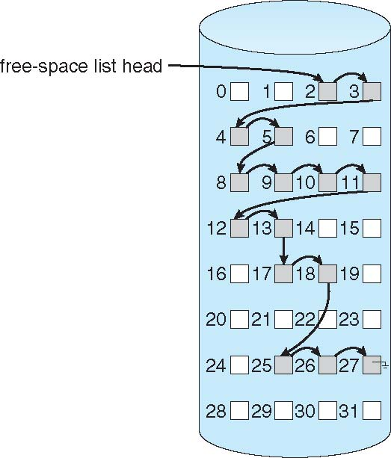
Free Disk Space Management: Linked List
Operating System Concepts, 10th edition
by Abraham Silberschatz, Greg Gagne, and Peter B. Galvin
Wiley, 2018, ISBN 978-1119456339

Slide 54
File System Reliability
Destruction of a file system can be
a greater disaster than the destruction
of a computer!
  Hardware can be replaced.
  Data often cannot easily be replaced.

Slide 55
Bad Disk Blocks
A hard disk usually contain bad blocks
even when new.
  It’s too expensive to manufacture “perfect” disks.
Spare sectors are provided on each disk.
  The disk controller replaces bad sectors with spares.
One approach:
A dummy file that contains all the bad blocks.
  Keeps the bad blocks off the free list.

Slide 56
Backups
Backups
  Recover from disaster.
  Recover from user stupidity.
Incremental backups
  Do a complete file system dump periodically.
  Frequently backup only the files that changed.

Slide 57
Dumps
Physical dump
  Dump an entire disk starting from block 0.
Logical dump
  Only dump the files located in selected directories.
  Must save all the information necessary
  to recreate the entire path to a file.

Slide 58
File System Consistency
What happens if a computer crashes
during an I/O operation?
  The file system wasn’t able to write
  all the modified blocks to disk.
  The file system is left in an inconsistent state.

Slide 59
File System Consistency, cont’d
UNIX has the fsck (file system check) utility.
Windows has the chkdsk (check disk) utility.
Consistency checks:
  How many times a disk block is present in a file.
  How many times a disk block appears in the free list.
  Make sure a data block is not present
  in two or more files.

Slide 60
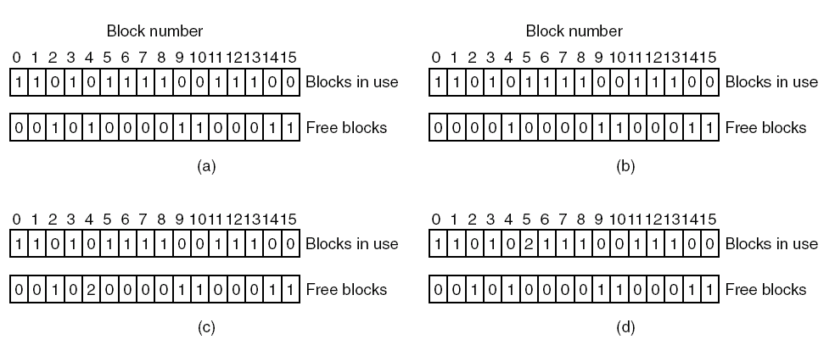
File System Consistency, cont’d
(a) Consistent.
(c) Duplicate block in free list.
(b) Missing block.
(d) Duplicate data block.
Modern Operating Systems, 4th edition
by Andrew Tanenbaum & Herbert Bos
Pearson, 2014, ISBN 978-0133591620

Slide 61
File System Performance: Block Cache
AKA buffer cache
Disk blocks are kept in memory.
  A read request first checks if the desired block
  is in memory.
Write-through cache: Modified blocks in the cache are immediately written back to the disk.

Slide 62
File System Performance: Block Read Ahead
Try to get disk blocks into the cache
before they’re needed.
If asked to read block k,
read both blocks k and k+1.
  Related to locality of reference.
Keep track of cache hits to see
if read ahead is effective.

Slide 63
File System Performance: Reduced Disk Arm Motion
Put disk blocks likely to be accessed in sequence close to each other.
  Preferably in the same cylinder.
Allocate groups of consecutive blocks.
Place inodes in the middle of the disk
instead of at the start.
Modern Operating Systems, 4th edition
by Andrew Tanenbaum & Herbert Bos
Pearson, 2014, ISBN 978-0133591620

Slide 64
Journaling File Systems
Journaling file systems record each update
to the file system as a transaction.
  Becoming common on many operating systems.
All transactions are written sequentially to a log.
  A transaction is considered committed
  once it is written to the log file.
The user process can continue execution.

Slide 65
Journaling File Systems, cont’d
The transactions in the log are asynchronously replayed to the file system structures.
  When the file system structures are modified,
  the transaction is removed from the log.
If the file system crashes, all remaining transactions in the log can be performed
after the system recovers.
Faster recovery from a crash.
  Removes the chance of inconsistency of metadata.

Slide 66
Virtual File System (VFS)
A UNIX Virtual File System (VFS) provides an
object-oriented way to implement file systems.
VFS allows the same system call interface
(the API) to be used for different types
of file systems.
Separate file-system generic operations
from implementation details.

Slide 67
Virtual File System (VFS), cont’d
The implementation can be one of many file systems types, or a network file system.
Implement vnodes which hold inodes
or network file details.
The API is to the VFS interface,
rather than any specific type of file system.
Dispatch an operation to the appropriate
file system implementation routines.

Slide 68
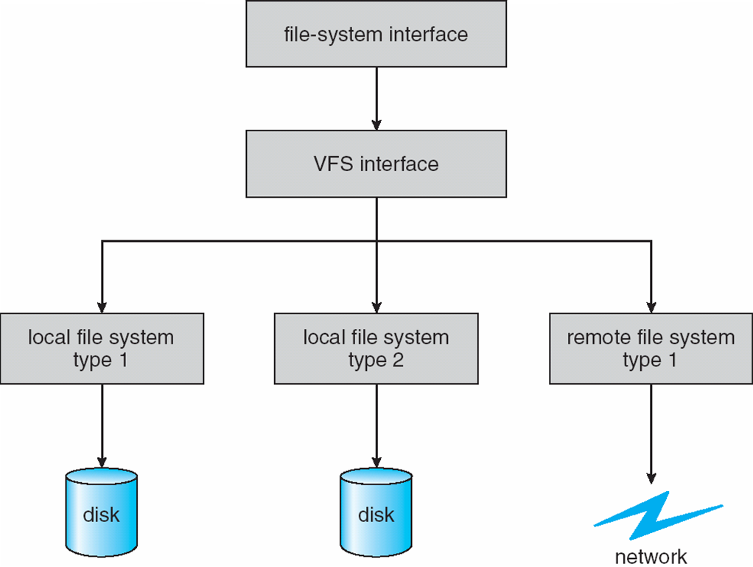
Virtual File System (VFS)
Schematic view of a virtual file system.
Operating System Concepts, 10th edition
by Abraham Silberschatz, Greg Gagne, and Peter B. Galvin
Wiley, 2018, ISBN 978-1119456339

Slide 69
Network File System (NFS)
Commonplace implementation of a
client-server file system.
Access remote files across local-area networks (LANs) or wide-area networks (WANs).
  Use the TCP or UDP/IP protocol.
Operate in a heterogeneous environment
of different machines, operating systems,
and network architectures.

Slide 70
Network File System (NFS), cont’d
Provide file sharing across a set of
independent machines and
independent file systems.
Mount a remote file system
onto a local mount point.
  Transparent sharing.

Slide 71
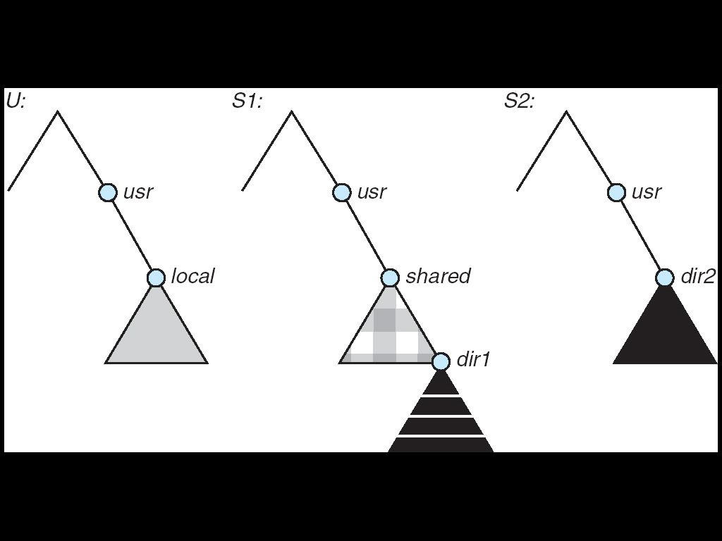
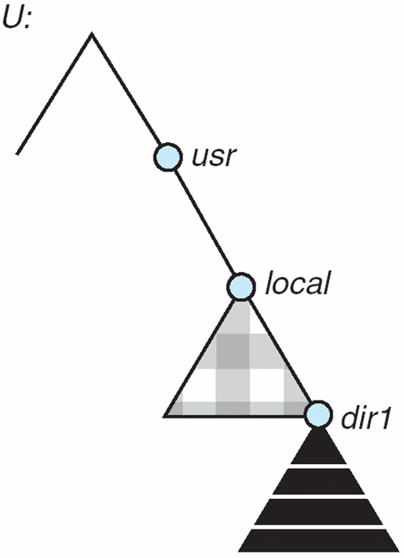
NFS Mounting
(a)
(b)
A local file system U and two remote file systems S1 and S2.
The result of mounting the remote /usr/shared from S1 onto /usr/local
Operating System Concepts, 10th edition
by Abraham Silberschatz, Greg Gagne, and Peter B. Galvin
Wiley, 2018, ISBN 978-1119456339

Slide 72
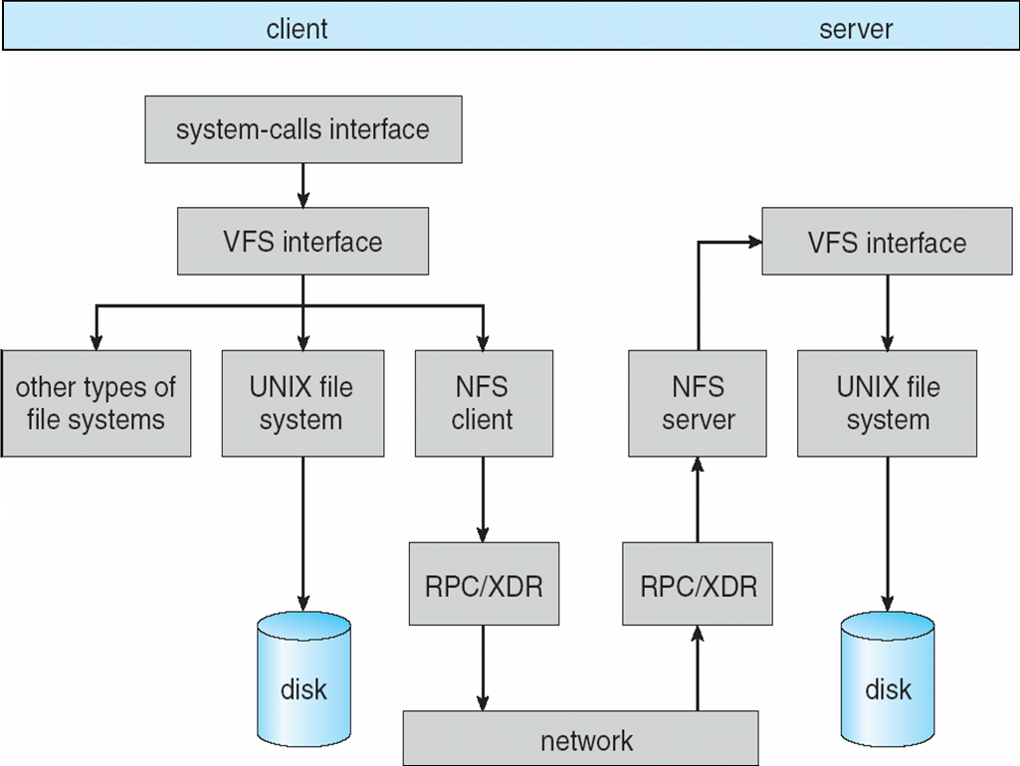
NFS Architecture
RPC: remote procedure call
XDR: external data representation
Operating System Concepts, 10th edition
by Abraham Silberschatz, Greg Gagne, and Peter B. Galvin
Wiley, 2018, ISBN 978-1119456339

Slide 73
Types of I/O Devices
Block
  Store data in fixed-sized blocks.
  Each block has a separate address.
    Common block sizes are 512 bytes to 32K bytes.
  Each block can be read or written independently.
  Example system calls: read(), write(), seek().
  Example
    disk drive

Slide 74
Types of I/O Devices, cont’d
Character
  Accept a stream of characters.
    No block structure.
  Example system calls: get(), put()
    Higher-level routines implement line-oriented I/O.
  Examples
    keyboards, printers, mice, etc.

Slide 75
Types of I/O Devices, cont’d
Sequential access
  Transfer data from storage in a fixed order
  as determined by the device.
  Examples
    tape drive, serial and parallel ports
Random access
  Seek to any storage address to read or write data.
  Example
    disk drive

Slide 76
Types of I/O Devices, cont’d
Shared
  Multiple processes can use the device concurrently.
  Example
    disk drive
Dedicated
  Only one process at a time can use the device.
  Example
    keyboard, mouse, tape drive

Slide 77
Types of I/O Devices, cont’d
Read only
  Processes can only read from the device.
  Example
    scanner
Write only
  Processes can only write to the device.
  Example
    printer

Slide 78
Types of I/O Devices, cont’d
Read-write
  Processes can both read from
  and write to the device.
  Examples
    disk drive, tape drive

Slide 79
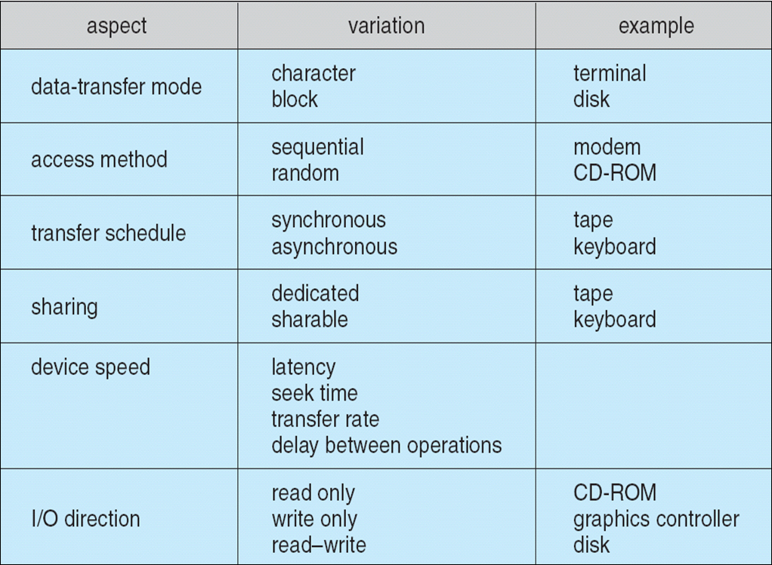
Types of I/O Devices, cont’d
Operating System Concepts, 10th edition
by Abraham Silberschatz, Greg Gagne, and Peter B. Galvin
Wiley, 2018, ISBN 978-1119456339

Slide 80
Hardware to Support I/O
Port
  A connection point in the machine where
  a device or device cable plugs in.
  Usually uses an industry-standard
  communications protocol.
  Examples: serial port, parallel port, VGA port
Bus
  A set of wires shared by multiple different devices.
  Uses a rigidly defined protocol.
  An expansion bus handles slow devices.
  Example: PCI, SCSI

Slide 81
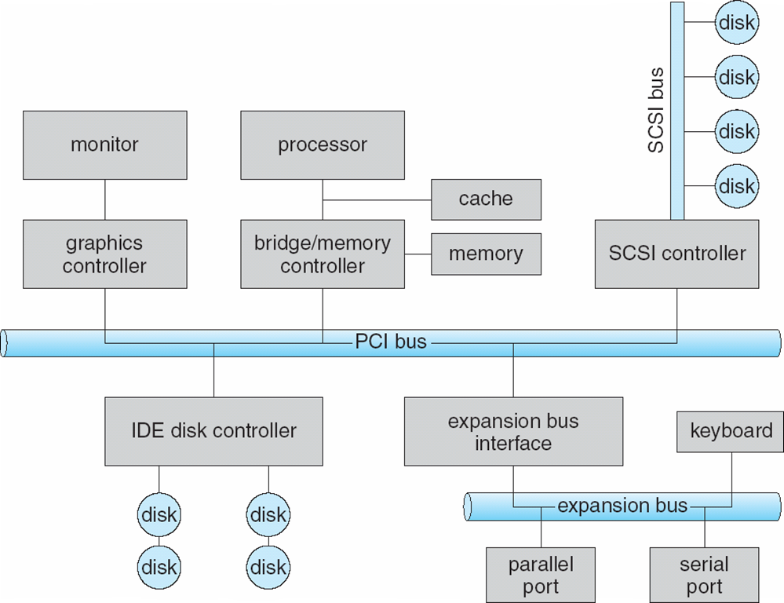
Typical Computer Bus Architecture
Operating System Concepts, 10th edition
by Abraham Silberschatz, Greg Gagne, and Peter B. Galvin
Wiley, 2018, ISBN 978-1119456339

