Slide 1


CMPE 142
Operating Systems
April 9 Class Meeting
Department of Computer Engineering
San Jose State University
Spring 2021
Instructor: Ron Mak
www.cs.sjsu.edu/~mak

Slide 2
Midterm Solutions: Question 1
prog1 < file1.txt | prog2 | prog3 > file3.txt
prog1: Reads file1.txt,
writes to the first pipe.
prog2: Reads from the first pipe,
writes to the second pipe.
prog3: Reads from the second pipe,
writes to file3.txt.

Slide 3
Midterm Solutions: Question 2
prog1 < file1.txt | prog2 | prog3 > file3.txt
The two pipes synchronize the programs:
  prog2 blocks reading the first pipe until prog1 writes to the first pipe.
  prog3 blocks reading the second pipe until prog2 writes to the second pipe.

Slide 4
Midterm Solutions: Question 3
Context switches occur only
at the beginning of a time
quantum. For each of the
following scheduling
algorithms, draw a timeline
showing which process is running during each time quantum:
  FCFS AAABBBBBBCCCCDD
  SJF AAABBBBBBDDCCCC
  SRT AAABBBBBBDDCCCC
  RR AABABCBCDBCDBCB
Process | Arrival time | Expected run time
A | 0.0 | 3
B | 1.1 | 6
C | 4.5 | 4
D | 6.6 | 2
A B C D
012345678901234
012345678901234
A B C D
At quantum 7, D has entered the ready queue,
but C is already in the queue. If you put D here,
that throws off the rest of the sequence.

Slide 5
Midterm Solutions: Question 4
#include <stdio.h>
int main()
{
fork(); // #1
fork(); // #2
fork(); // #3
return 0;
}
Process creation (----) and termination (X):
main
|
fork#1-----------------fork#2----fork#3--+
| | | |
fork#2-----fork#3--+ fork#3--+ X X
| | | | |
fork#3--+ X X X X
| |
X X
How many times is the #1 fork() called? 1
How many times is the #2 fork() called? 2
How many times is the #3 fork() called? 4
How many processes does the program create? 8

Slide 6
Midterm Solutions: Question 5
With preemptive Highest Priority First (HPF) process scheduling, how can a low priority process can end up blocking a high priority process?
  The low priority process acquires and holds a non-preemptable resource (such as the CD ROM reader), which is then needed by the high priority process. The higher priority process blocks waiting for the lower priority process to release the resource.
  This situation is called priority inversion.

Slide 7
Midterm Solutions: Question 6
const int MAX_USERS = 10;
int users = 0;
bool acquire_license()
{
if (users >= MAX_USERS)
{
return false;
}
else
{
users++;
return true;
}
}
void relinquish_license()
{
users--;
}
What is wrong with this code?
  If multiple processes call this code, each representing a user who wants a license, then any statements that access variable users is in a critical region. A race condition exists.
How to fix the code?
  Introduce a mutex that locks before executing the body of each function and unlocks before returning.

Slide 8
Midterm Solutions: Question 7
What is the bug?
  In function professor_meets_student(),
  if the office hour is not yet over (times_up
  is false), the professor thread waits on the student_available semaphore. But if no student is waiting when times_up becomes true, the professor thread is stuck waiting on the semaphore, which is not signaled again. The program hangs forever (deadlocks).

Slide 9
Midterm Solutions: Question 7, cont’d
How to fix the bug?
  Function timer_handler(), which is called
  at the end of the office hour, must signal the student_available semaphore in case the professor thread is waiting on it. Each time after waking up, the professor thread must check wait_count. If the count is 0, meaning that the semaphore was signaled not by an arriving student but by timer_handler(), the thread must return from function professor_meets_student() immediately.
You can also
check if
times_up
is true.

Slide 10
Midterm Solutions: Question 8
The process cannot enter its critical region as long as
lock is true.
In a busy loop, the value of key is repeatedly tested and then atomically set to the current value of lock by the call to SWAP().
Once another process exits its critical region and sets lock to false, then this process can enter its critical region.
void SWAP(boolean *first, boolean *second)
{
boolean temp = *first;
*first = *second;
*second = temp;
}
for (;;) {
key = TRUE;
while (key)
{
SWAP(&lock, &key);
}
// critical region here //
lock = FALSE;
// noncritical region here //
}

Slide 11
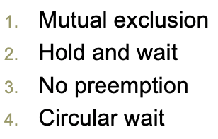
Midterm Solutions: Question 9
Philosophers 1 through 4 will each acquire the left fork first and then the right fork. Philosopher 5 must first acquire the right fork and then the left fork.
  Breaks circular wait. Philosopher 5 disrupts the order of acquiring the resources (forks).

Slide 12
Midterm Solutions: Question 9, cont’d
A more senior philosopher can take a fork away from a less senior neighbor.
  Breaks no preemption. A philosopher won’t wait for a fork if he can take it away from a neighboring less senior philosopher.
A philosopher can acquire the left and right forks only if both forks are available.
  Breaks hold and wait. No philosopher can grab one fork and then hold it while waiting for the other fork.

Slide 13
Midterm Solutions: Question 10
Holes: 100 KB, 500 KB, 200 KB, 300KB, 600 KB
Processes: 212 KB, 417 KB, 112 KB, 426 KB
First fit:
  212 KB ➔ 500 KB hole and leaves 288 KB hole
  417 KB ➔ 600 KB hole and leaves 183 KB hole
  112 KB ➔ 288 KB hole and leaves 176 KB hole
  426 KB process must wait

Slide 14
Midterm Solutions: Question 10, cont’d
Holes: 100 KB, 500 KB, 200 KB, 300KB, 600 KB
Processes: 212 KB, 417 KB, 112 KB, 426 KB
Next fit:
  212 KB ➔ 500 KB hole and leaves 288 KB hole
  417 KB ➔ 600 KB hole and leaves 183 KB hole
  112 KB ➔ 288 KB hole and leaves 176 KB hole
  426 KB process must wait

Slide 15
Midterm Solutions: Question 10, cont’d
Holes: 100 KB, 500 KB, 200 KB, 300KB, 600 KB
Processes: 212 KB, 417 KB, 112 KB, 426 KB
Best fit:
  212 KB ➔ 300 KB hole and leaves 88 KB hole
  417 KB ➔ 500 KB hole and leaves 83 KB hole
  112 KB ➔ 200 KB hole and leaves 88 KB hole
  426 KB ➔ 600 KB hole and leaves 174 KB hole

Slide 16
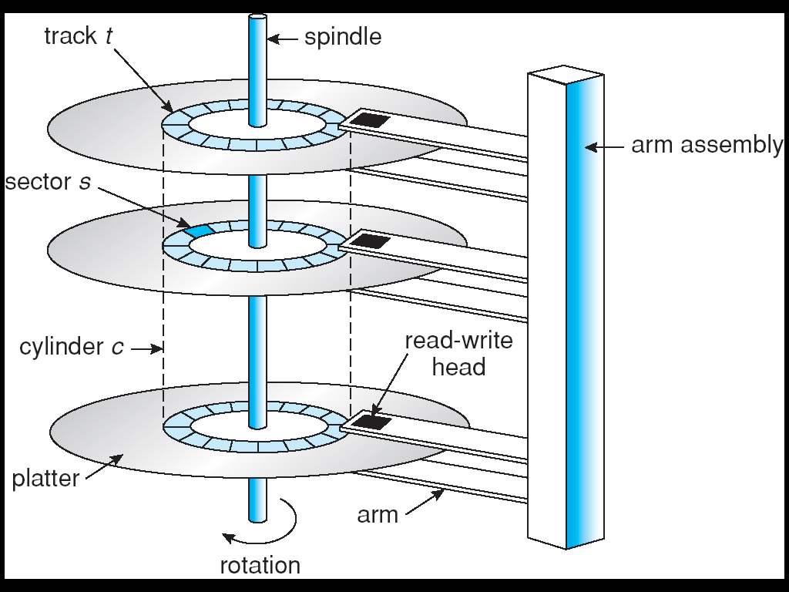
Hard Disk Drive (HDD)
Magnetic disks provide secondary storage.
Issues include:
  Transfer rate
    Rate at which data
    flows from the
    disk drive into the
    computer.
  Random-access time
    Seek time: to move
    the disk arm to the
    desired cylinder.
    +
    Rotational latency:
    time for the desired
    sector to rotate under
    the read-write head.
Operating System Concepts, 10th edition
by Abraham Silberschatz, Greg Gagne, and Peter B. Galvin
Wiley, 2018, ISBN 978-1119456339

Slide 17
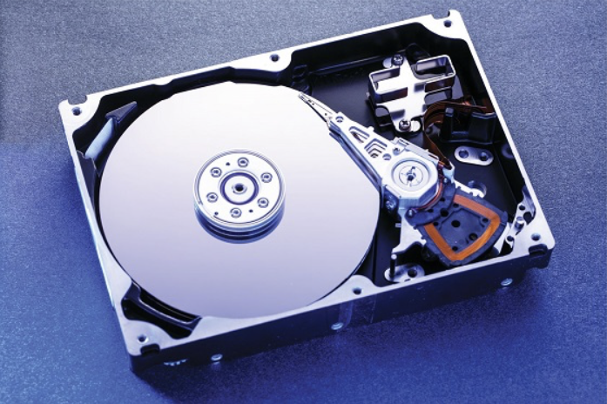
Hard Disk Drive, cont’d
Operating System Concepts, 10th edition
by Abraham Silberschatz, Greg Gagne, and Peter B. Galvin
Wiley, 2018, ISBN 978-1119456339

Slide 18
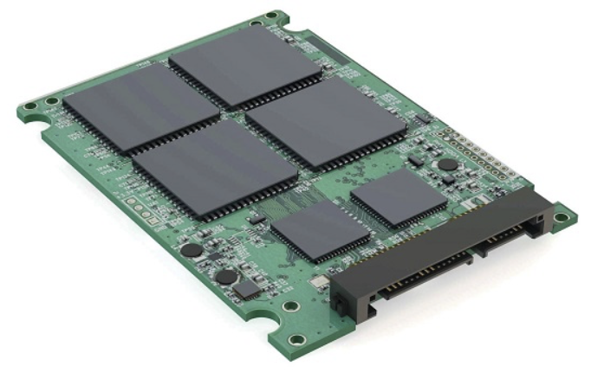
Solid State Disk (SSD)
Operating System Concepts, 10th edition
by Abraham Silberschatz, Greg Gagne, and Peter B. Galvin
Wiley, 2018, ISBN 978-1119456339

Slide 19
Secondary Storage Connection Methods
Secondary storage is attached to a computer
via an industry-standard I/O bus.
  EIDE: Enhanced Integrated Drive Electronics
  ATA: Advanced Technology Attachment
  SATA: Serial ATA
  USB: Universal Serial Bus
  FC: Fibre Channel
  SCSI: Small Computer-Systems Interface
Host controller at the computer end of the bus.
Disk controller built into each disk drive.

Slide 20
Host-Attached Storage
Accesses storage via local I/O ports.
Uses a bus architecture (IDE, SCSI, FC, etc.)

Slide 21
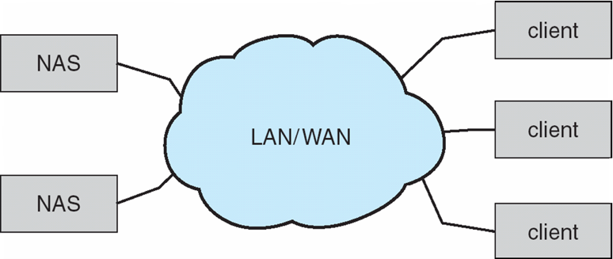
Network-Attached Storage (NAS)
Special-purpose storage system
accessed remotely over a data network.
Clients access NAS via remote procedure calls.
  Example: NFS (network file system) for UNIX systems.
  Carried via TCP (transmission control protocol) or
  UDP (user datagram protocol) over an IP (internet protocol) network.
  Storage I/O operations consume
  bandwidth on the data network.
TCP/IP
TCP: connection-based,
performs error recovery
UDP: connectionless,
no error recovery
Operating System Concepts, 10th edition
by Abraham Silberschatz, Greg Gagne, and Peter B. Galvin
Wiley, 2018, ISBN 978-1119456339
LAN: local area network
WAN: wide area network

Slide 22
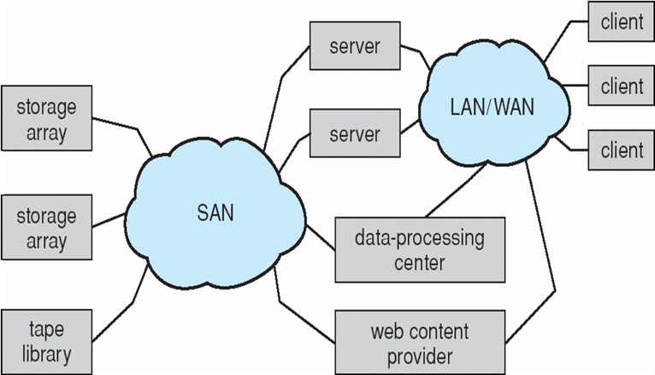
Storage-Area Network (SAN)
Private network connecting
servers and storage units.
Extremely flexible.
  Multiple hosts and multiple storage arrays
  can connect to a SAN.
  Doesn’t hog the
  regular data network.
Operating System Concepts, 10th edition
by Abraham Silberschatz, Greg Gagne, and Peter B. Galvin
Wiley, 2018, ISBN 978-1119456339

Slide 23


Storage Array
https://www.networkworld.com/article/3445863/hitachi-vantara-unveils-massively-scalable-storage-array.html
https://www.zotac.com/hk/news/storage-arrays

Slide 24
HDD Scheduling
The operating system is responsible for
fast disk access time and high disk bandwidth.
  Bandwidth: total number of bytes transferred divided by the total time between the first request for service and the completion of the last transfer.
Additional factors:
seek time and rotational latency
  Seek time: the time for the disk arm to move the heads to the cylinder containing the desired sector.
  Rotational latency: the additional time for the disk
  to rotate the desired sector under the disk head.

Slide 25
HDD Scheduling Algorithms
FCFS: First Come First Served
SSTF: Shortest Seek Time First
SCAN (AKA elevator scheduling)
C-Scan: Circular SCAN
LOOK and C-LOOK

Slide 26
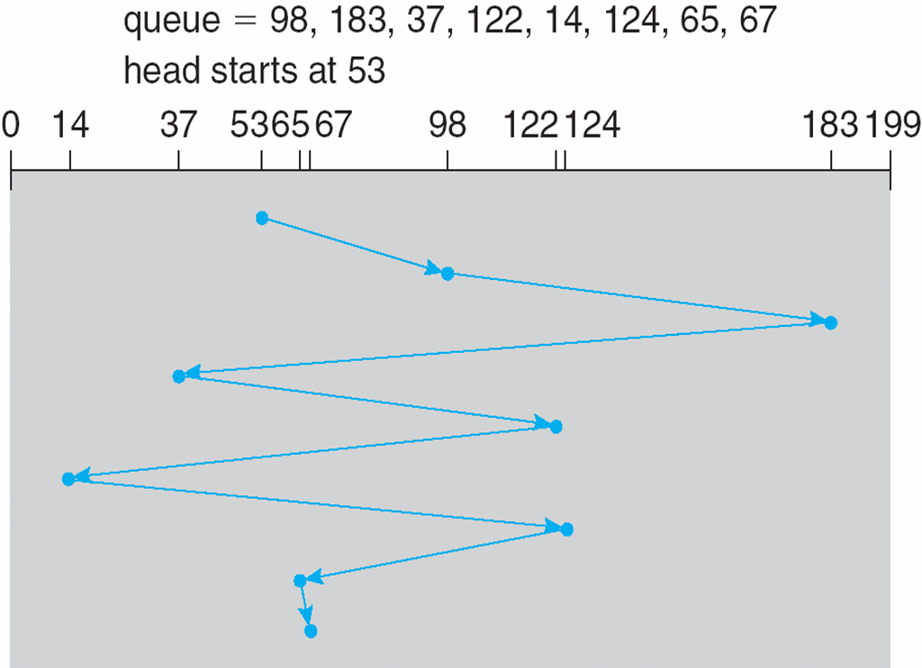
FCFS Disk Scheduling
Intrinsically fair, but generally
does not provide the best service.
  Example: total head movement of 640 cylinders
Operating System Concepts, 10th edition
by Abraham Silberschatz, Greg Gagne, and Peter B. Galvin
Wiley, 2018, ISBN 978-1119456339

Slide 27
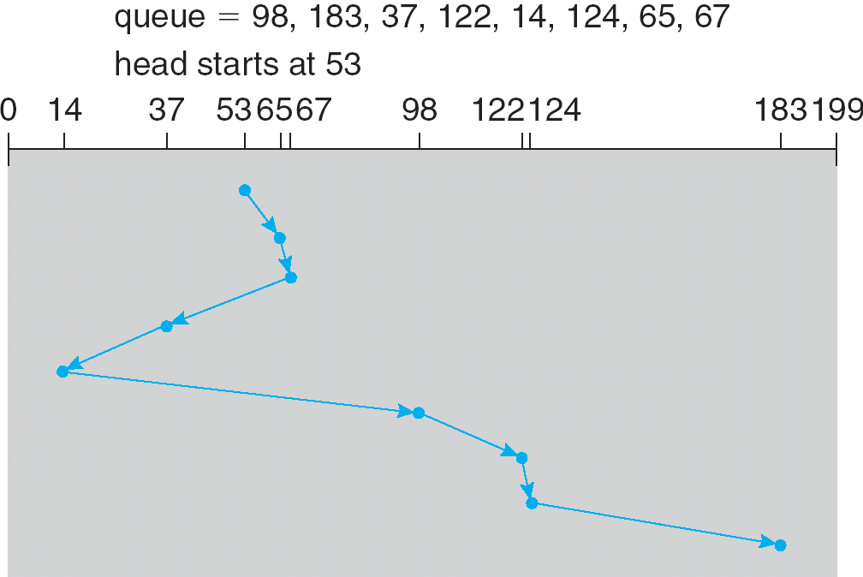
SSTF Disk Scheduling
Select the request with the least seek time from the current position of the read/write head.
  Example: total head movement of 236 cylinders
Operating System Concepts, 10th edition
by Abraham Silberschatz, Greg Gagne, and Peter B. Galvin
Wiley, 2018, ISBN 978-1119456339

Slide 28
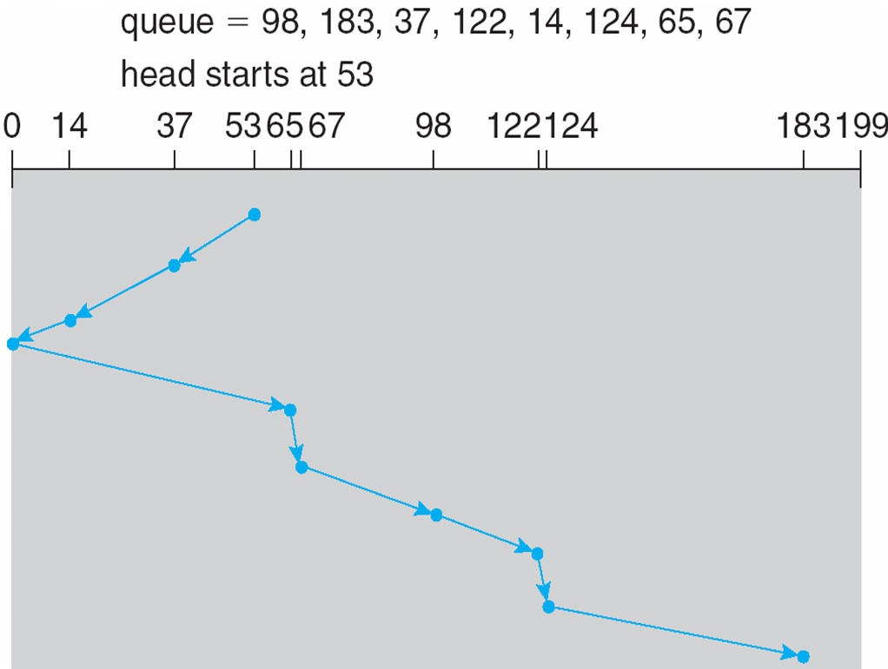
SCAN Disk Scheduling
The disk arm first moves in one direction to service requests and then in the other direction.
  Example: total head movement of 236 cylinders
Why is this
inefficient?
Operating System Concepts, 10th edition
by Abraham Silberschatz, Greg Gagne, and Peter B. Galvin
Wiley, 2018, ISBN 978-1119456339

Slide 29
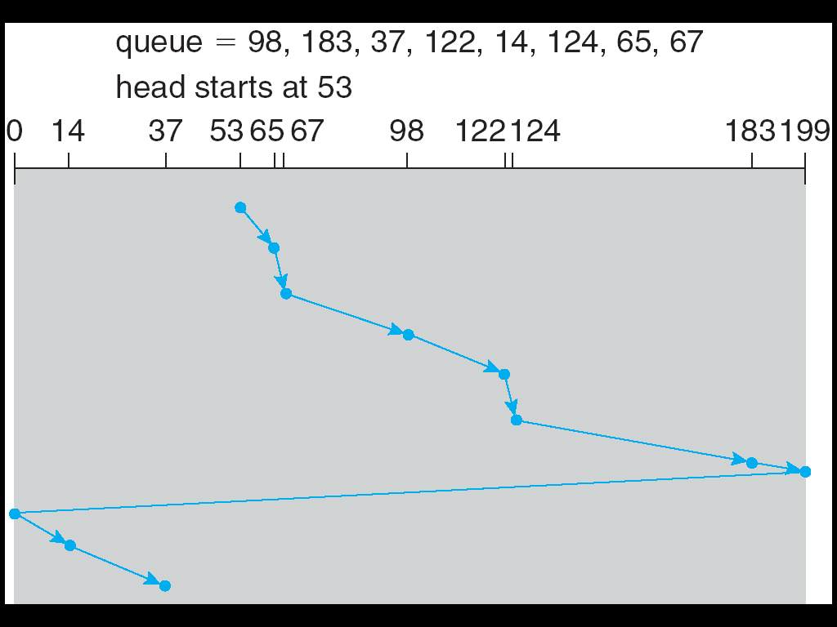
C-SCAN Disk Scheduling
Service requests by moving the disk arm in
one direction only, with wraparound at the end.
  Example: total head movement of 382 cylinders
Include the
wraparound
in the head
movement
calculation.
Operating System Concepts, 10th edition
by Abraham Silberschatz, Greg Gagne, and Peter B. Galvin
Wiley, 2018, ISBN 978-1119456339

Slide 30
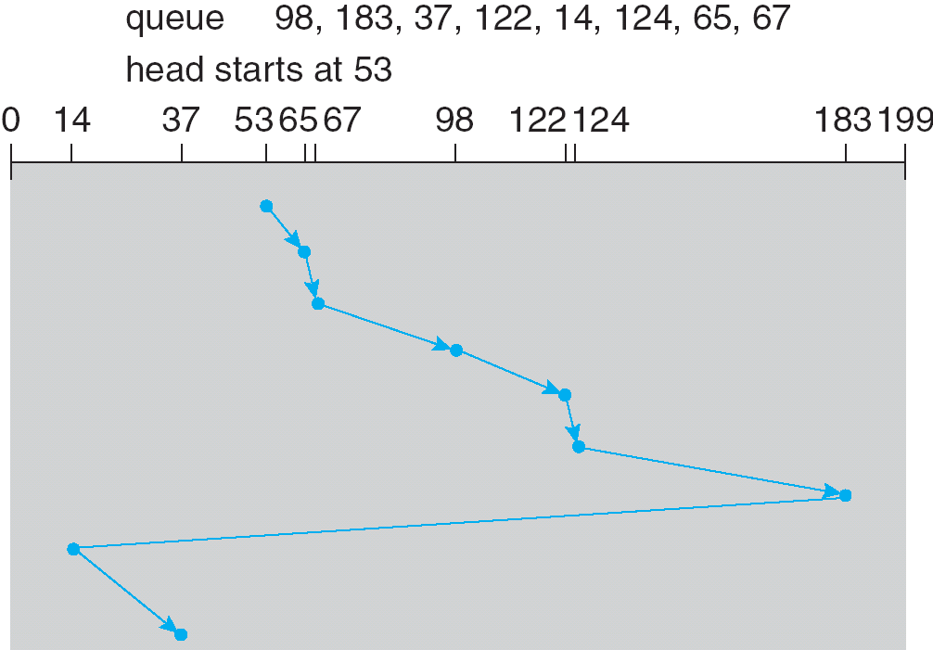
LOOK and C-LOOK Disk Scheduling
Like SCAN and C-SCAN except the disk arm only goes as far as necessary before returning.
  Example: total head movement of 322 cylinders
Operating System Concepts, 10th edition
by Abraham Silberschatz, Greg Gagne, and Peter B. Galvin
Wiley, 2018, ISBN 978-1119456339

Slide 31
HDD Scheduling Choices
Disk manufacturers implement disk-scheduling algorithms in the controller hardware.
  Take advantage of hardware features.
  The OS sends batches of requests to the controller.
OS scheduling responsibilities
  Some I/O requests are more important than others.
  Demand paging has higher priority than applications.
  The order of disk writes may be important
  for reliability.
  Manage swap space (virtual memory).

Slide 32
Assignment #7
Suppose that a disk drive has 5,000 cylinders, numbered 0 to 4999. The drive head starts at cylinder 2255. The queue of pending requests, in FIFO order, is:
For each of the following disk-scheduling algorithms, beginning with the starting head position, what is the order of cylinders visited by the head?
2055, 1175, 2304, 2700, 513, 1680, 256, 1401, 4922, 3692
FCFS
SSTF
SCAN
LOOK
C-SCAN
C-LOOK

Slide 33
Assignment #7, cont’d
What is the total distance (in cylinders) that the disk arm moves to satisfy all the pending requests for each of the disk-scheduling algorithms?
Write a program (or programs) that prints a graphical representation of the disk arm travel, similar to the diagrams in the previous slides.

Slide 34
Assignment #7, cont’d
  Example: For
  Print something like
1 2
0....1....2....3....4....5....6....7....8....9....0....1....2....3....4....5....6....7....8....9....0
*53
*98
*183
*37
*122
*14
*124
*65
*67
Total head movement: 640 cylinders

Slide 35
Break

Slide 36
Storage Device Management
Low-level (physical) formatting
  Divide a storage device into sectors that the controller can read and write.
  Often done by the manufacturer at the factory.
Partitioning
  Subdivide a disk so that each partition can be treated by the OS as a separate device.
Volume creation and management
  Place a file system into a partition.

Slide 37
Storage Device Management, cont’d
Logical formatting
  Create the file system.
Boot (system) disk
  Has the boot partition which contains the OS
  and the device drivers.
  At system startup, read into memory by the boot loader stored in read-only memory (ROM).

Slide 38
Error Detection and Management
Add error-correcting code (ECC) to each disk sector.
  Contains information that enables the controller
  to identify incorrect bits.
  If only a few bits are bad, the ECC information
  can be used to correct the incorrect bits (soft error).
Bad blocks
  The controller maintains a list of bad blocks.
  Low-level formatting can set aside spare sectors
  that the controller can use to replace bad sectors (sector sparing).

Slide 39
Hierarchical Storage Management (HSM)
Primary storage
  Main memory
Secondary storage
  Disk
Tertiary storage
  Removable disks and magnetic tape
HSM is often used in supercomputing centers.
  Keep small and frequently used data
  in secondary storage.
  Keep large, old, inactive data in tertiary storage.

Slide 40
RAID
Redundant Array of Independent Disks
  Improve reliability via redundancy.
  Improve performance via parallelism.
Suppose the mean time to failure of a single disk is 100,000 hours.
  Then the mean time to failure of an array of 100 disks is 100,000/100 = 1000 hours = 41.66 days.

Slide 41
RAID, cont’d
RAID increases reliability by adding redundancy.
Mirroring
  Maintain multiple copies of data.
Striping
  Spread data blocks of a file across multiple disks.
Error correcting codes (ECC)
  Use parity bits and checksums.

Slide 42
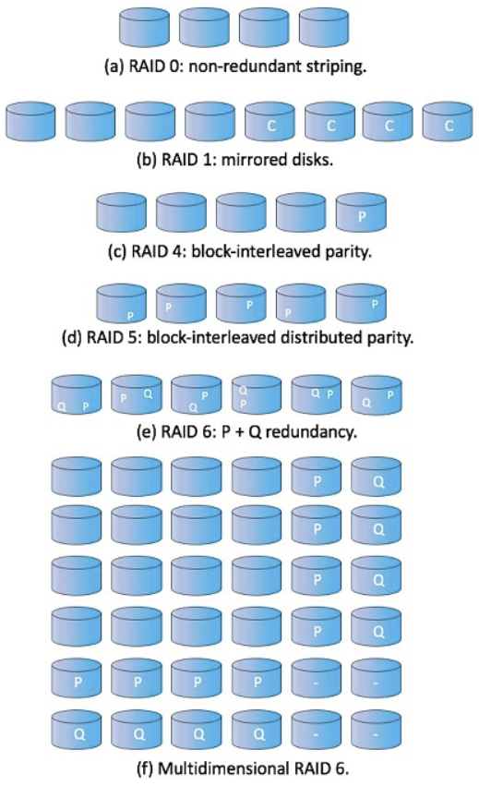
RAID, cont’d
Different levels of RAID have different levels of reliability and performance costs.
  RAID levels 0 through 6
  RAID levels 0+1 and 1+0
Example: 4 disks of data
  P: error-correcting bits
  C: copy of the data
Operating System Concepts, 10th edition
by Abraham Silberschatz, Greg Gagne, and Peter B. Galvin
Wiley, 2018, ISBN 978-1119456339

Slide 43
RAID, cont’d
RAID tutorial:
http://www.thegeekstuff.com/2010/08/raid-levels-tutorial/

Slide 44
File Systems
How we store data on external media
(such as disks).
Three essential requirements for
long-term information storage:
  It must be possible to store a very large amount
  of information.
  Nonvolatile: The information must survive
  the termination of the process using it.
  Concurrent access by multiple processes.

Slide 45
Files
From the user’s and programmer’s perspective, a file is the smallest allotment of secondary storage.
You cannot write data to a disk
unless the data is within a file.

Slide 46
Files, cont’d
The operating system maps files
onto secondary storage.
Generally, you don’t need to worry about
where or how the data is stored.
  You just access the file by its name.
Therefore, the file system is an
abstraction of physical storage.

Slide 47
Types of Files
Most common
  ASCII (text) files
  Binary files
Every operating system must recognize
an executable file that it can load and run.
UNIX: A “magic number” stored at the beginning of the file indicates its type.
Windows: A “file extension” (a suffix to the file name) indicates the file type.

Slide 48
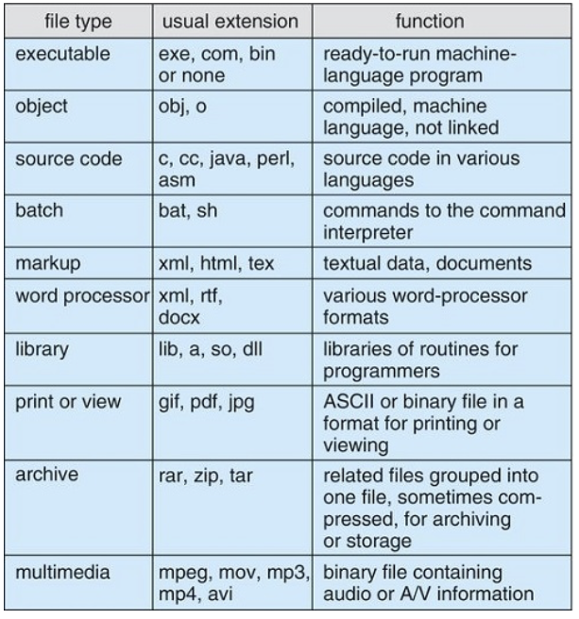
Common File Types
Operating System Concepts, 10th edition
by Abraham Silberschatz, Greg Gagne, and Peter B. Galvin
Wiley, 2018, ISBN 978-1119456339

Slide 49
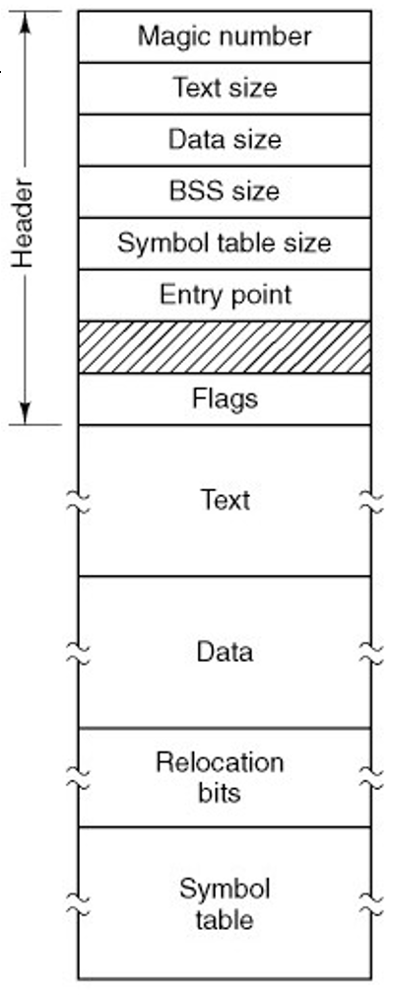
File Types, cont’d
An executable file
Modern Operating Systems, 4th edition
by Andrew Tanenbaum & Herbert Bos
Pearson, 2014, ISBN 978-0133591620

Slide 50
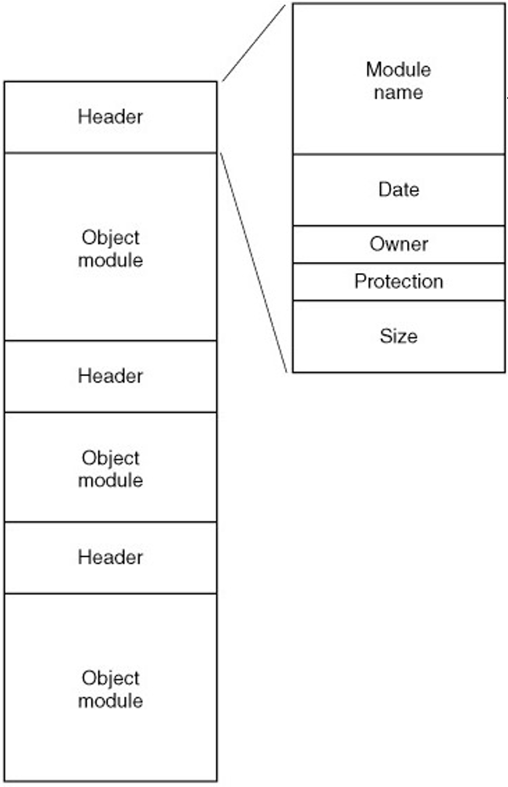
File Types, cont’d
An archive
(library) file
Modern Operating Systems, 4th edition
by Andrew Tanenbaum & Herbert Bos
Pearson, 2014, ISBN 978-0133591620

Slide 51
File Attributes (Metadata)
Name: the only human-readable information
Identifier: unique tag (number) identifies file within file system
Type: needed to support different types
Location: pointer to file location on device
Size: current file size
Protection: controls who can do reading,
writing, executing
Time, date, and user identification: data for protection, security, and usage monitoring

Slide 52
File Attributes (Metadata), cont’d
Information about files are kept in the
directory structure maintained on the disk.
Many variations, including
extended file attributes
such as file checksum.

Slide 53
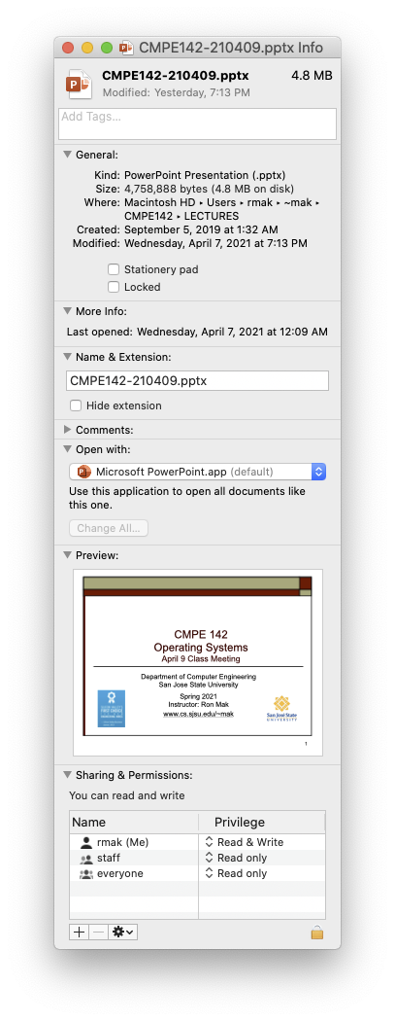
File Attributes, cont’d
Mac OS X file attributes display

Slide 54
File Operations
A file is an abstract data type (ADT).
The OS supports various operations on files:
Create
Delete
Open
Close
Read
Write
Append
Seek
Get attributes
Set attributes
Rename
Lock

Slide 55
Opening a File
Most file operations involve an
expensive search of file directories.
Avoid this search by caching in memory
the directory information about a file
when the file is opened.

Slide 56
Open File Table
Contains information about all open files.
When a file is opened, a pointer into this table
is returned.
When a file operation is requested,
information about the file is obtained
via the pointer.

Slide 57
Two Levels of Internal File Tables
Per process
  File pointer
    Keep track of the last position read or written
  What files a process has open.
  Access rights and other accounting information.
System wide
  File location, access dates, size, etc.
  File-open count
    Number of times a file is open.
    Allows removal of data from the open-file table
    when the last process using the file closes it.

Slide 58
File Locking
Provided by some operating systems
and file systems.
Mediates access to a file.
Shared lock
  Similar to a reader lock.
  Several processes can acquire concurrently.
Exclusive lock
  Similar to a writer lock.

Slide 59
File Locking, cont’d
Mandatory lock
  Once a process acquires an exclusive lock,
  the OS prevents any other process from
  accessing the locked file.
Advisory lock
  Software developers ensure that locks
  are properly acquired and released.

Slide 60
File Structure
UNIX supports a minimal set of file structures.
  A file is simply a stream of bytes.
  Each byte is addressable by its offset
  from the file beginning or end.
  User programs can organize these bytes
  into fixed- or variable-length records.
Other operating systems (especially on older machines) supported other file structures.

Slide 61
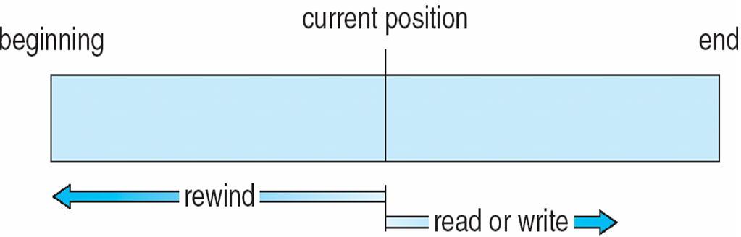
Sequential Access Method
Programs access the records in forward order,
one after another.
The file pointer keeps track of the I/O location.
  Read the next record.
  Append to the end of the file.
  Rewind to the beginning of the file.
  Skip to record n
Operating System Concepts, 10th edition
by Abraham Silberschatz, Greg Gagne, and Peter B. Galvin
Wiley, 2018, ISBN 978-1119456339

Slide 62
Direct (Random) Access Method
Programs can read or write records rapidly
in any order.
  Each record has a position which is a relative block number n relative to the beginning of the file.
  Fixed-length records.
  read(n)
  write(n)
  position_to(n)
  read_next()
  write_next()
  rewrite(n)
Why?

Slide 63
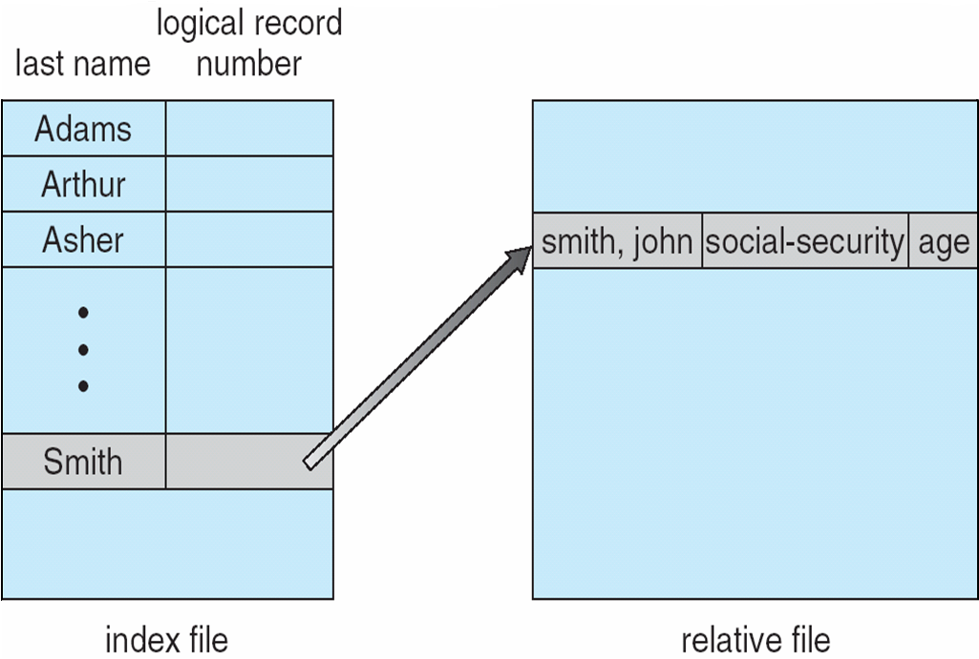
Other Access Methods
Build other access methods
on top of direct-access.
  Example: An indexed access method.
Operating System Concepts, 10th edition
by Abraham Silberschatz, Greg Gagne, and Peter B. Galvin
Wiley, 2018, ISBN 978-1119456339

Slide 64
Disk Structure
A disk can be subdivided into partitions.
  Disks or partitions can be RAID-protected
  against failure.
Raw disk or partition: without a file system
Formatted: with a file system
Volume: An entity containing a file system.
  Each volume tracks its file system’s information
  in a device directory or volume table of contents.

Slide 65
Disk Structure, cont’d
Along with general-purpose file systems,
there are many special-purpose file systems.
Frequently, all the file systems reside within
the same operating system or computer.

Slide 66
Directories
A directory is a container (“folder”) of files.
Provides a way to organize
a collection of files on disk.

Slide 67
Directory Operations
Efficiency
  Locate a file quickly.
Naming
  Convenient to users.
  Two users can have same name for different files.
  The same file can have several different names.
Grouping
  Logical grouping of files by properties.

Slide 68
Directory Operations, cont’d
Operations
  Create a file
  Delete a file
  Search for a file
  Rename a file
  List a directory
  Traverse the file system

Slide 69
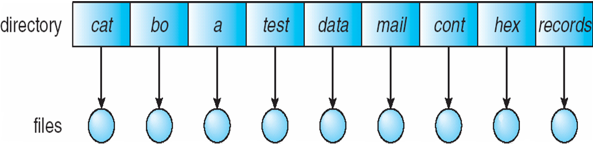
Single-Level Directory
A single directory for all users.
Disadvantages:
  Naming
  Grouping
Operating System Concepts, 10th edition
by Abraham Silberschatz, Greg Gagne, and Peter B. Galvin
Wiley, 2018, ISBN 978-1119456339

Slide 70
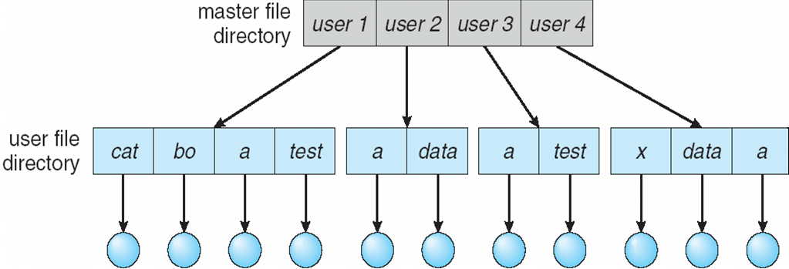
Two-Level Directory
The operating system maintains
a master file directory.
Each user has a user file directory.
Operating System Concepts, 10th edition
by Abraham Silberschatz, Greg Gagne, and Peter B. Galvin
Wiley, 2018, ISBN 978-1119456339

Slide 71
Two-Level Directory, cont’d
Advantages
  Different users can use the same file names.
  More efficient searching.
Disadvantages
  No grouping.
Operating System Concepts, 10th edition
by Abraham Silberschatz, Greg Gagne, and Peter B. Galvin
Wiley, 2018, ISBN 978-1119456339

Slide 72
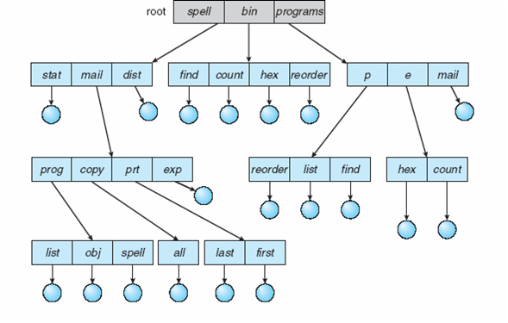
Tree-Structured Directories
Users can create their own subdirectories.
Operating System Concepts, 10th edition
by Abraham Silberschatz, Greg Gagne, and Peter B. Galvin
Wiley, 2018, ISBN 978-1119456339

Slide 73
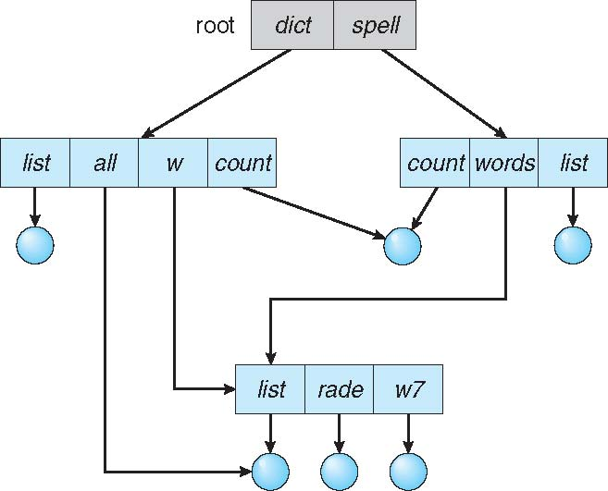
Acyclic-Graph Directories
Allow shared directories and files.
Links
  Resolve a link by locating the actual file or directory.
  Symbolic links
Operating System Concepts, 10th edition
by Abraham Silberschatz, Greg Gagne, and Peter B. Galvin
Wiley, 2018, ISBN 978-1119456339

Slide 74
File Path Names
Absolute path name
  Begins with the root /
  Example: /usr/local/make
Relative path name
  Search begins with the current directory
  . current directory
  .. parent directory
  Example:
  cd /usr
  ls local/make

Slide 75
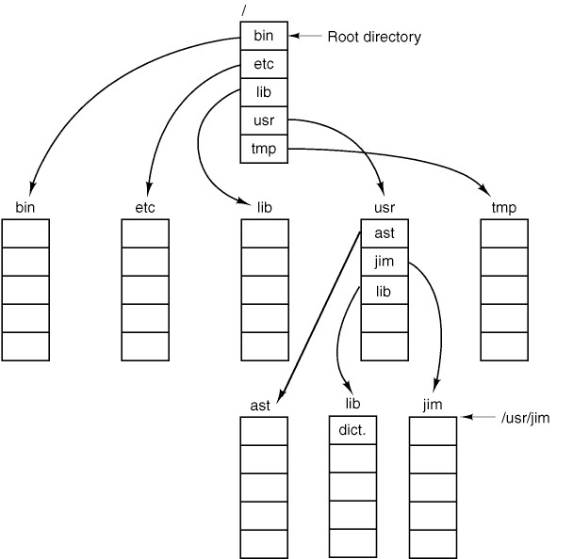
File Path Names, cont’d
Modern Operating Systems, 4th edition
by Andrew Tanenbaum & Herbert Bos
Pearson, 2014, ISBN 978-0133591620

Slide 76
Mounting a File System
Mount an external file system
in order to access it.
The external file system can be located on another disk or on some external removable medium (such as a DVD ROM).
Define a mount point in the current file system.
  Usually, it’s an empty directory.

Slide 77
Mounting a File System, cont’d
Mount the external file system
onto the mount point.
Now the contents of the external file system
appear under the directory name of the mount point.
If the mount point was not an empty directory,
the files that were stored in that directory
are now hidden and inaccessible.

Slide 78
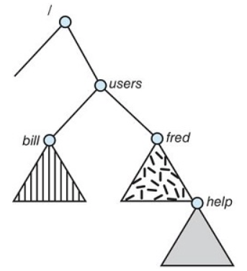
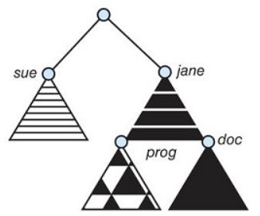
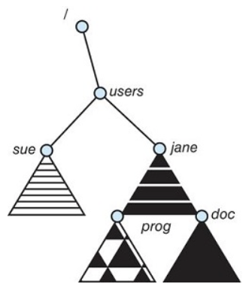
Mounting a File System, cont’d
(a)
(b)
(c)
The current file system
An unmounted volume on /devices/dsk
Mounting over /users
  The previous contents of /users
  are no longer accessible.
Operating System Concepts, 10th edition
by Abraham Silberschatz, Greg Gagne, and Peter B. Galvin
Wiley, 2018, ISBN 978-1119456339

Slide 79
File Protection
The file owner or creator
should be able to control:
  What can be done to the file
  By whom
Types of access:
  Read
  Write
  Execute
  Append
  Delete
  List

Slide 80
File Protection in UNIX
Types of access: read, write, execute (RWX)
Three classes of users and sample access:
RWX
a) owner access 7 ⇒ 1 1 1
b) group access 6 ⇒ 1 1 0
c) public access 4 ⇒ 1 0 0
For a particular file or directory
(such as game), define an
appropriate access with the
chmod command.
owner
group
public
chmod 764 game

Slide 81
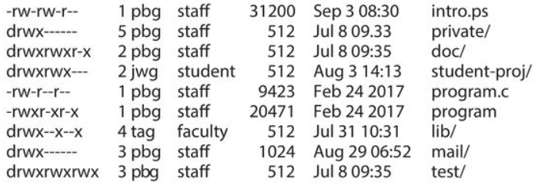
File Protection in UNIX, cont’d
Sample UNIX file listing via the ls command.
  Access rights to each file and directory
  are at the left.
Operating System Concepts, 10th edition
by Abraham Silberschatz, Greg Gagne, and Peter B. Galvin
Wiley, 2018, ISBN 978-1119456339

