Slide 1


CMPE 142
Operating Systems
March 12 Class Meeting
Department of Computer Engineering
San Jose State University
Spring 2021
Instructor: Ron Mak
www.cs.sjsu.edu/~mak

Slide 2
External Memory Fragmentation
Free memory space is broken into small pieces.
  Free spaces are not contiguous.
Such external fragmentation refers to
unused memory outside of processes.
Fragmentation depends on
the memory allocation algorithm.
  With first fit, up to one-third of memory
  may be unusable.

Slide 3
Internal Memory Fragmentation
Internal memory fragmentation refers to
unused memory that is internal to a process.
When allocating memory in fixed-size blocks,
the amount allocated to a process may be
more than what the process requested.
  The last block allocated to a process
  may only be partially filled.
  Larger block sizes cause more internal fragmentation.

Slide 4
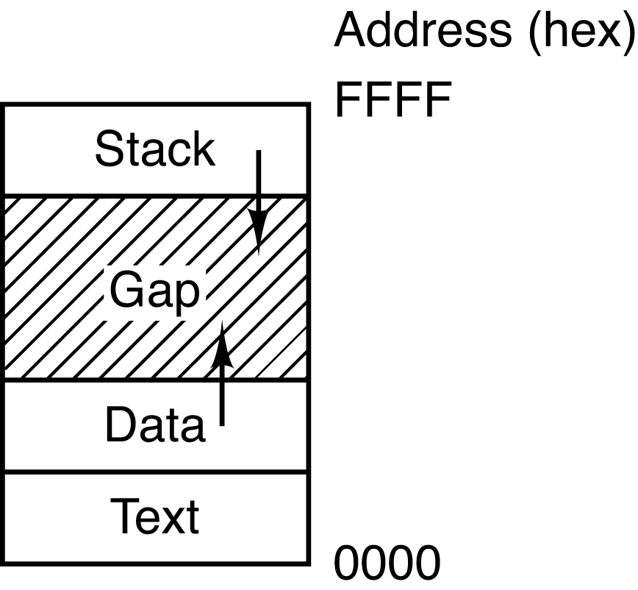
Dynamically Allocated Memory
The same memory management algorithms (first fit, next fit, etc.) apply to heap memory that a process allocates and frees dynamically in its data segment.
  Allocation requests can
  come in different sizes.
Modern Operating Systems, 4th edition
by Andrew Tanenbaum & Herbert Bos
Pearson, 2014, ISBN 978-0133591620

Slide 5
Internal or External Fragmentation?
Variable-sized partitions
  Entire processes occupy contiguous partitions
  of physical memory.
Fixed-sized page frames
  Parts of processes occupy page frames distributed throughout physical memory.
P3
P1
P2
P3
P2
P1
P
3
P2
P
1
P
2
P1

Slide 6
Paging
Paging is a memory management scheme
that allows the physical address space of a process to be noncontiguous.
No external fragmentation.
  Can still have internal fragmentation.
No need for memory compaction.
Helps solve the problem of allocating
various sizes of memory blocks to a process.
  Fragmentation can occur on the
  swapping backing store.

Slide 7
Paging, cont’d
Used by most operating systems.
Superior to previous memory management schemes.
Paging support traditionally was handled by hardware.
On 64-bit microprocessors, paging is often implemented by a combination of hardware
and operating system.

Slide 8
Paging, cont’d
Divide physical memory into fixed-sized frames.
  AKA page frames
  Size is a power of 2,
  between 512 bytes and 8192 bytes.
Divide logical memory into pages of same size.
  Logical memory is what the process operates in.
  The process acts as if it is directly using physical memory.

Slide 9
Paging, cont’d
The memory manager keeps track
of all free frames.
To run a program of size n pages,
the memory manager needs to find
n free frames into which to load the program.
A page table translates logical addresses
to physical addresses.
  Each process has a page table.

Slide 10
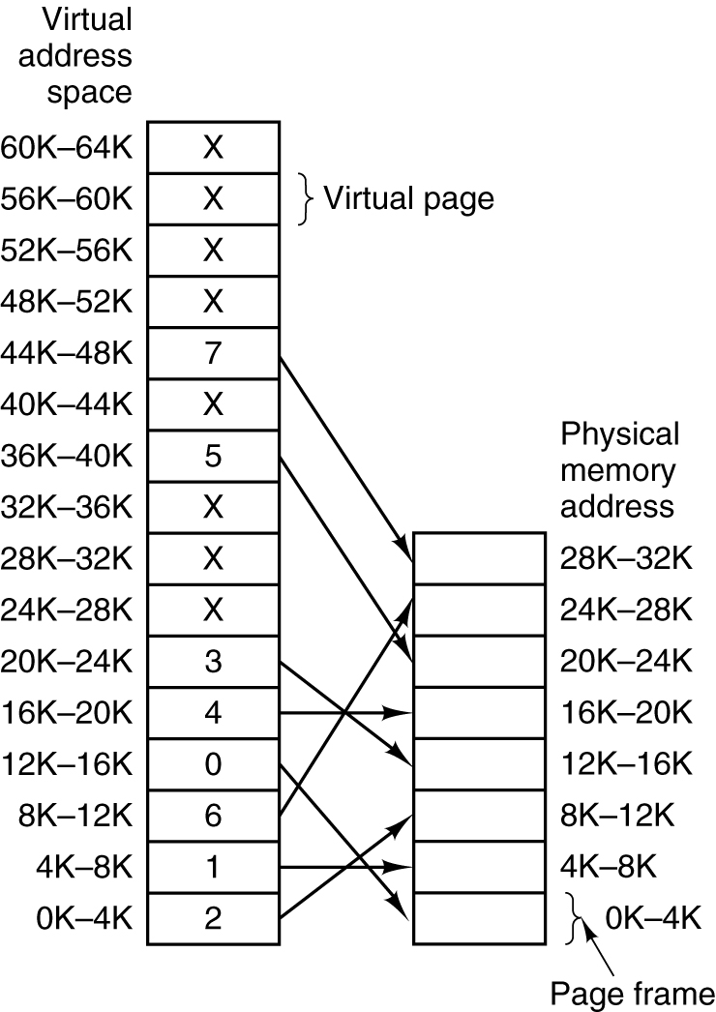
Paging, cont’d
Page table mapping of logical (virtual) addresses to physical addresses.
Modern Operating Systems, 4th edition
by Andrew Tanenbaum & Herbert Bos
Pearson, 2014, ISBN 978-0133591620

Slide 11
Paging, cont’d
Every logical address generated by the CPU
has two parts:
  page number p
  page offset d
The page number is the page table index.
  The page table entry contains the base address
  of each page in physical memory.
The base address + the page offset
together map to the physical address.
  This mapping must be fast.

Slide 12
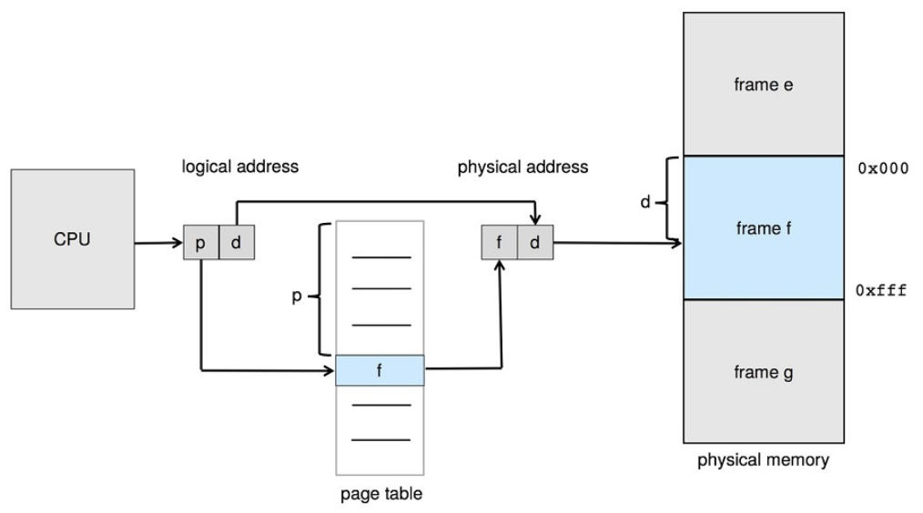
Paging, cont’d
Operating System Concepts, 10th edition
by Abraham Silberschatz, Greg Gagne, and Peter B. Galvin
Wiley, 2018, ISBN 978-1119456339

Slide 13
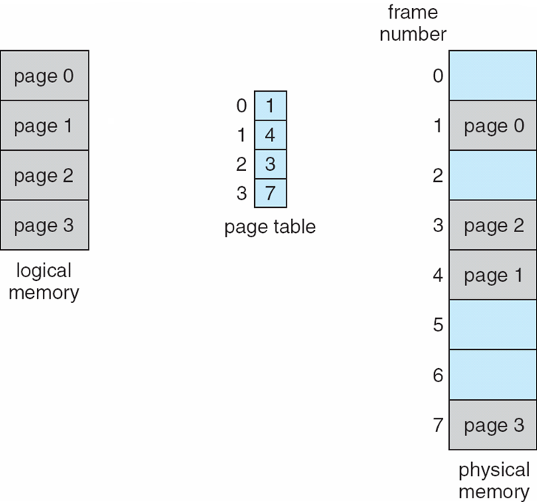
Paging, cont’d
Operating System Concepts, 10th edition
by Abraham Silberschatz, Greg Gagne, and Peter B. Galvin
Wiley, 2018, ISBN 978-1119456339

Slide 14
Paging, cont’d
Why a power of 2 for the page and frame size?
If the size of the logical address space is 2^{m}
and the page size is 2^{n}, then the high-order m-n bits of a logical address are the page number and the low-order n bits are the page offset.
page number
page offset
p
d
m - n
n

Slide 15
Shared Pages
Paging enables shared code.
  One copy of a reentrant code module in memory.
  Shared code must appear in same location in the logical address space of all processes.
Private code and data.
  Each process keeps a separate copy of its
  private code and data pages.
  The pages for the private code and data
  can appear anywhere in the logical address space.

Slide 16
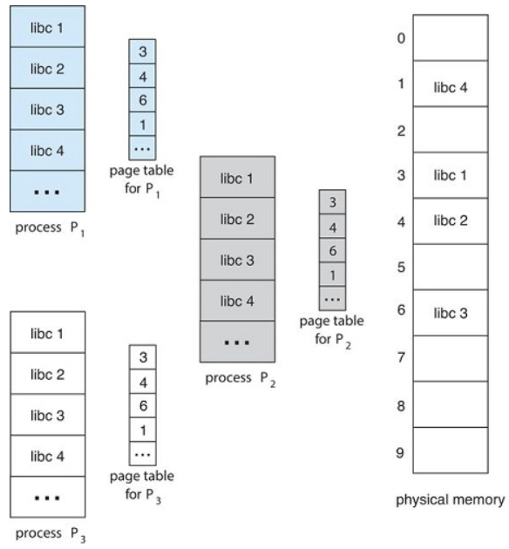
Shared Pages, cont’d
Operating System Concepts, 10th edition
by Abraham Silberschatz, Greg Gagne, and Peter B. Galvin
Wiley, 2018, ISBN 978-1119456339

Slide 17
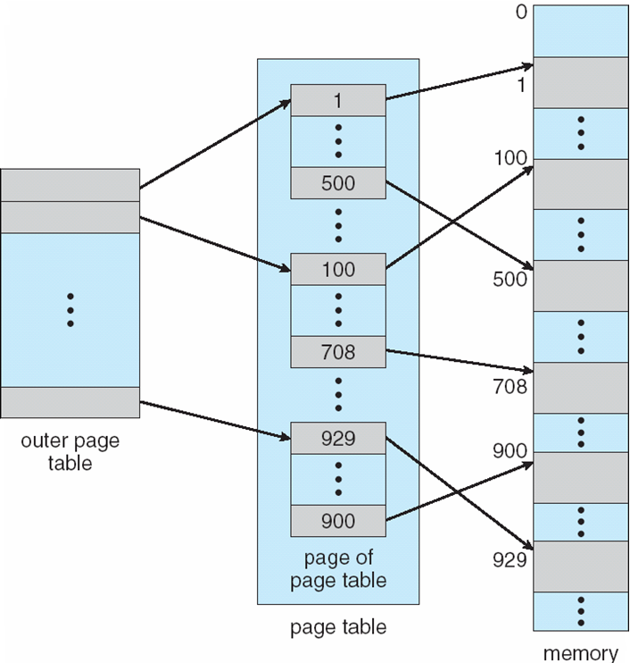
Multilevel Page Tables
Multilevel page tables avoid keeping
all the page tables
in memory all the time.
A virtual address has
two page table fields
along with the offset.
Operating System Concepts, 10th edition
by Abraham Silberschatz, Greg Gagne, and Peter B. Galvin
Wiley, 2018, ISBN 978-1119456339

Slide 18
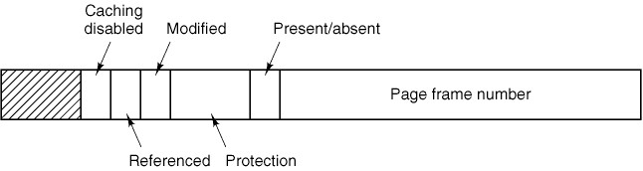
Common Fields of a Page Table Entry
Page frame number
Present/absent bit
  0 = virtual page not currently in memory
  Page fault if attempt to access this page.
Protection bits
  Read, write, execute privileges
Modified (“dirty”) bit
  Is the disk copy still valid?
Referenced
  OK to evict this page from memory?
Caching
  On or off
Modern Operating Systems, 4th edition
by Andrew Tanenbaum & Herbert Bos
Pearson, 2014, ISBN 978-0133591620

Slide 19
Translation Lookaside Buffer (TLB)
Hardware device that rapidly maps
virtual addresses to physical addresses.
Bypass the page table.
Usually inside the memory management unit (MMU).
AKA associative memory.

Slide 20
Translation Lookaside Buffer (TLB), cont’d
Takes advantage of locality of reference.
A program generally only uses a small percentage of its page table entries.
  Spatial locality: Address references tend to cluster.
  Temporal locality: An address that was referenced will tend to be referenced again soon.
The TLB usually contains only 8 to 64 entries.

Slide 21
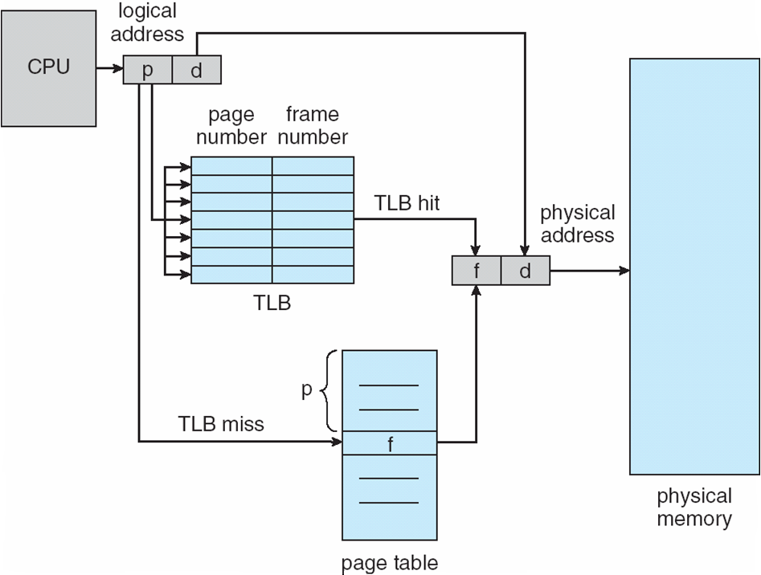
Translation Lookaside Buffer (TLB), cont’d
Operating System Concepts, 10th edition
by Abraham Silberschatz, Greg Gagne, and Peter B. Galvin
Wiley, 2018, ISBN 978-1119456339

Slide 22
Search TLB Entries in Parallel
If the desired page is not in the TLB
(a TLB miss), then go to the page table.
After a miss, enter the page into the TLB so that
it can be a TLB hit the next time.
Hit ratio: The percentage of times that a desired page number is found in the TLB.

Slide 23
TLB Hit Ratio Example
Suppose it takes 20 nsec to search the TLB
and 100 nsec to access main memory.
  Therefore, if the desired page is in the TLB,
  it will take 120 nsec to access memory.
If the page is not in the TLB, it will take
  20 nsec to search the TLB,
  100 nsec to access the page table
  100 nsec to access main memory
  Total: 220 nsec.

Slide 24
TLB Hit Ratio Example
Effective access time (EAT) for an 80% hit ratio:
(0.80 X 120 nsec) + (0.20 X 220 nsec) = 140 nsec
Effective access time for a 98% hit ratio:
(0.98 X 120 nsec) + (0.02 X 220 nsec) = 122 nsec
Increasing the hit ratio by 23%
decreased EAT by 13%

Slide 25
Inverted Page Tables
Traditional page table:
One entry per virtual page.
On 64-bit computers, the virtual address space is 2⁶⁴ bytes.
With size 4 KB (2¹²) pages, a page table would need 2⁵² entries.

Slide 26
Inverted Page Tables, cont’d
An inverted page table has one entry per
page frame in physical memory.
Each entry consists of:
  The virtual address of the page
  stored in that page frame.
  Information about the process
  that owns that page.

Slide 27
Inverted Page Tables, cont’d
Decreases the memory needed
to store each page table.
But increases time needed to search the table
for each page reference.
  Use a hash table to search the table faster.
  Or use the TLB.

Slide 28
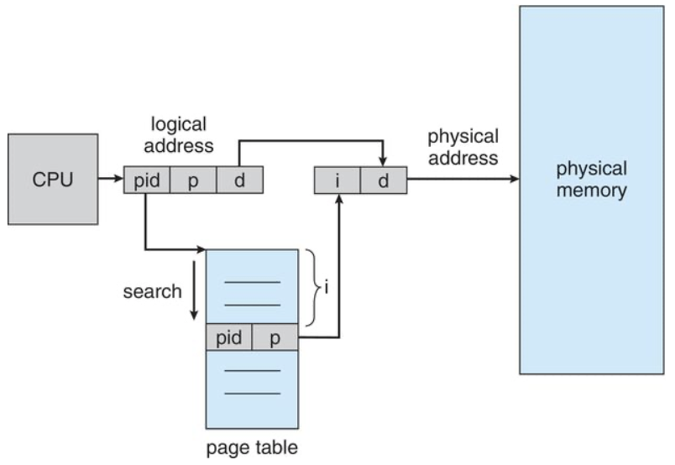
Inverted Page Tables, cont’d
Operating System Concepts, 10th edition
by Abraham Silberschatz, Greg Gagne, and Peter B. Galvin
Wiley, 2018, ISBN 978-1119456339

Slide 29
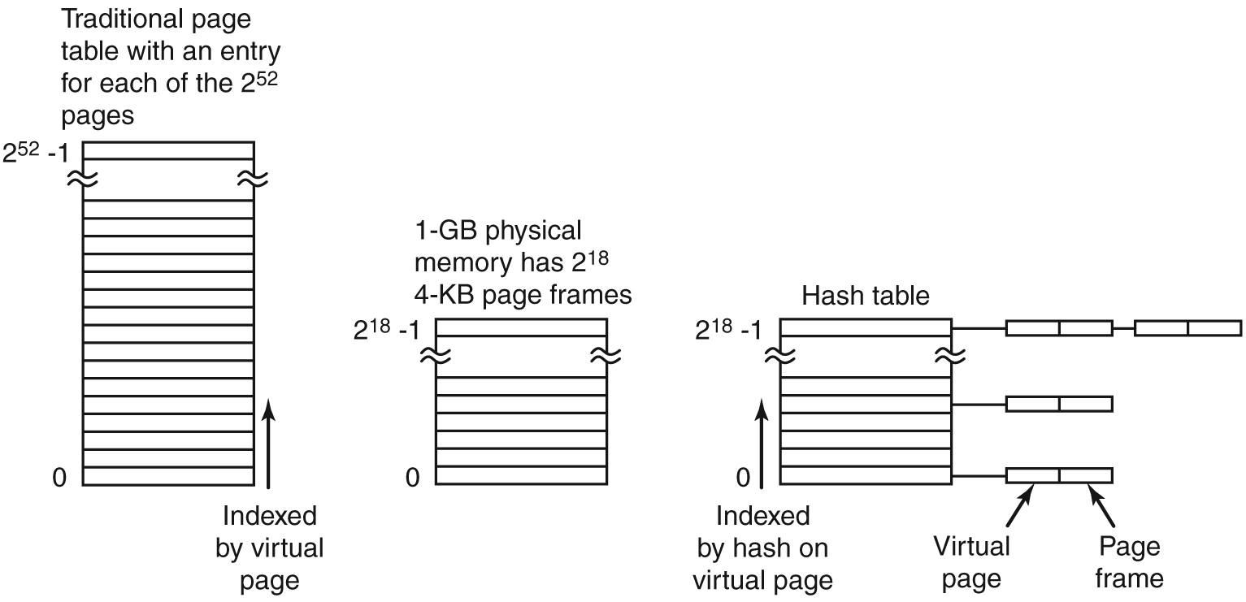
Inverted Page Tables, cont’d
Comparison of a traditional page table
with an inverted page table.
Modern Operating Systems, 4th edition
by Andrew Tanenbaum & Herbert Bos
Pearson, 2014, ISBN 978-0133591620

Slide 30
Segmentation
Programmers think of their programs
as consisting of segments, not one
linear address space.
Segmentation memory management scheme
  The logical address space is
  a collection of segments.
  Each segment has a name or number,
  and a length.
  A logical address specifies the segment name or number, and an offset within the segment.

Slide 31
The Segment Table
Each table entry has a segment base
and a segment limit.
  The segment base is the
  starting physical address.
  The segment limit specifies
  the length of the segment.

Slide 32
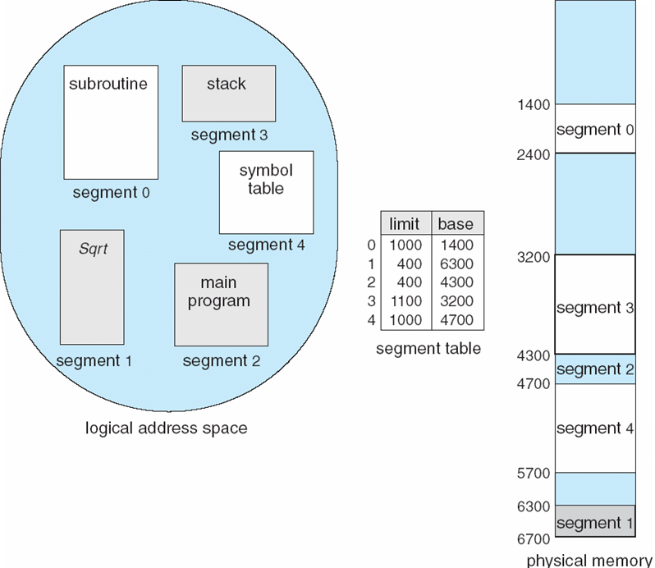
The Segment Table, cont’d
Operating System Concepts, 10th edition
by Abraham Silberschatz, Greg Gagne, and Peter B. Galvin
Wiley, 2018, ISBN 978-1119456339

Slide 33
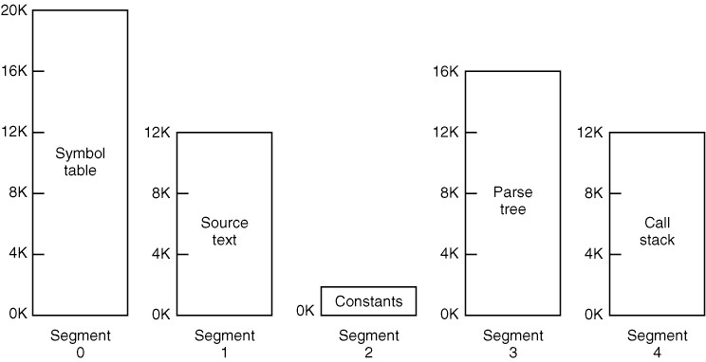
Segmentation, cont’d
Segmented memory allows each segment to
grow and shrink independently of the others.
  Example: Segments of a compiler:
Modern Operating Systems, 4th edition
by Andrew Tanenbaum & Herbert Bos
Pearson, 2014, ISBN 978-0133591620

Slide 34
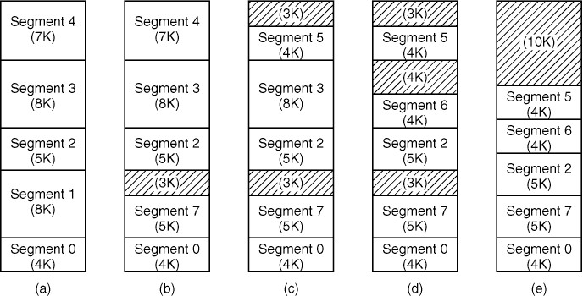
Segmentation, cont’d
Segmentation can cause
external fragmentation.
  AKA checkerboarding
  Remove with memory compaction.
Modern Operating Systems, 4th edition
by Andrew Tanenbaum & Herbert Bos
Pearson, 2014, ISBN 978-0133591620

Slide 35
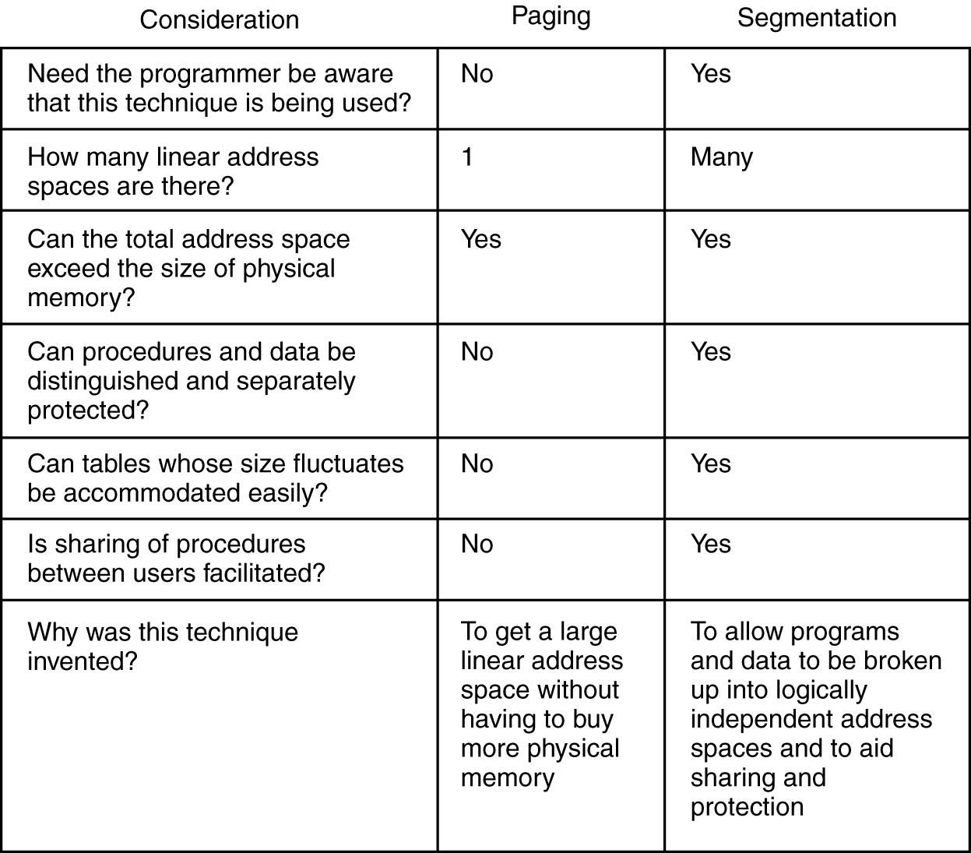
Paging vs. Segmentation
Modern Operating Systems, 4th edition
by Andrew Tanenbaum & Herbert Bos
Pearson, 2014, ISBN 978-0133591620

Slide 36
Break
1:25

Slide 37
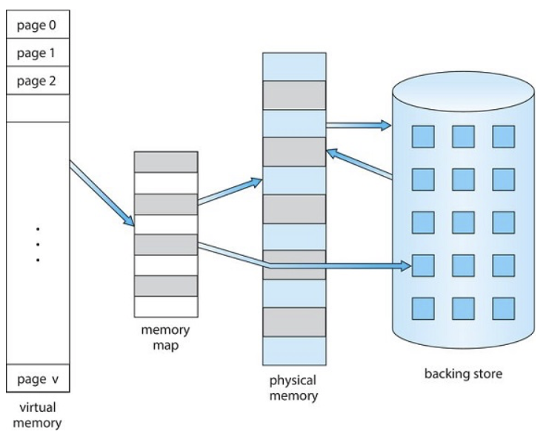
Virtual Memory
Use paging to create virtual memory that is
larger than physical memory.
Operating System Concepts, 10th edition
by Abraham Silberschatz, Greg Gagne, and Peter B. Galvin
Wiley, 2018, ISBN 978-1119456339

Slide 38
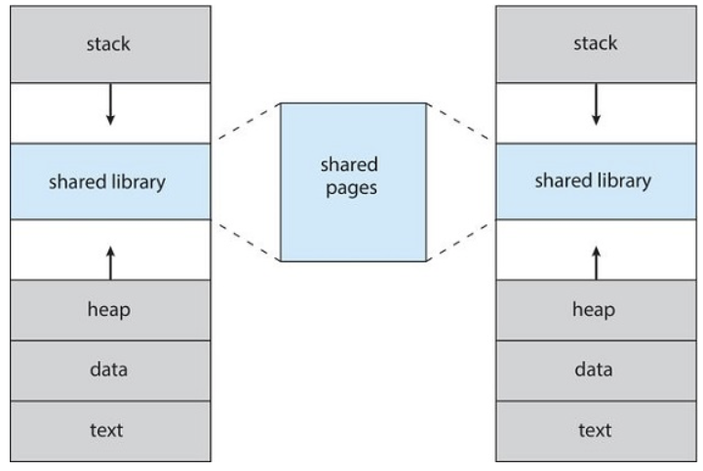
Virtual Memory, cont’d
Shared library using virtual memory
Operating System Concepts, 10th edition
by Abraham Silberschatz, Greg Gagne, and Peter B. Galvin
Wiley, 2018, ISBN 978-1119456339

Slide 39
Demand Paging
Unlike swapping, not all of a program
needs to be loaded into memory at once.
Only load program pages when needed.
Pages that are never accessed
are never loaded.

Slide 40
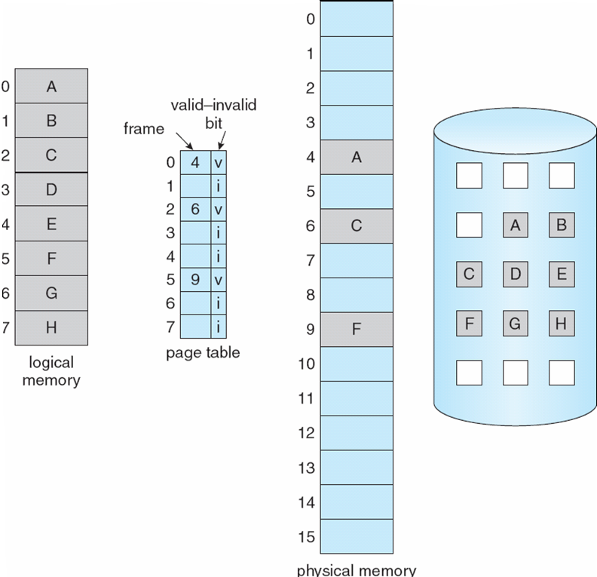
Demand Paging, cont’d
Operating System Concepts, 10th edition
by Abraham Silberschatz, Greg Gagne, and Peter B. Galvin
Wiley, 2018, ISBN 978-1119456339

Slide 41
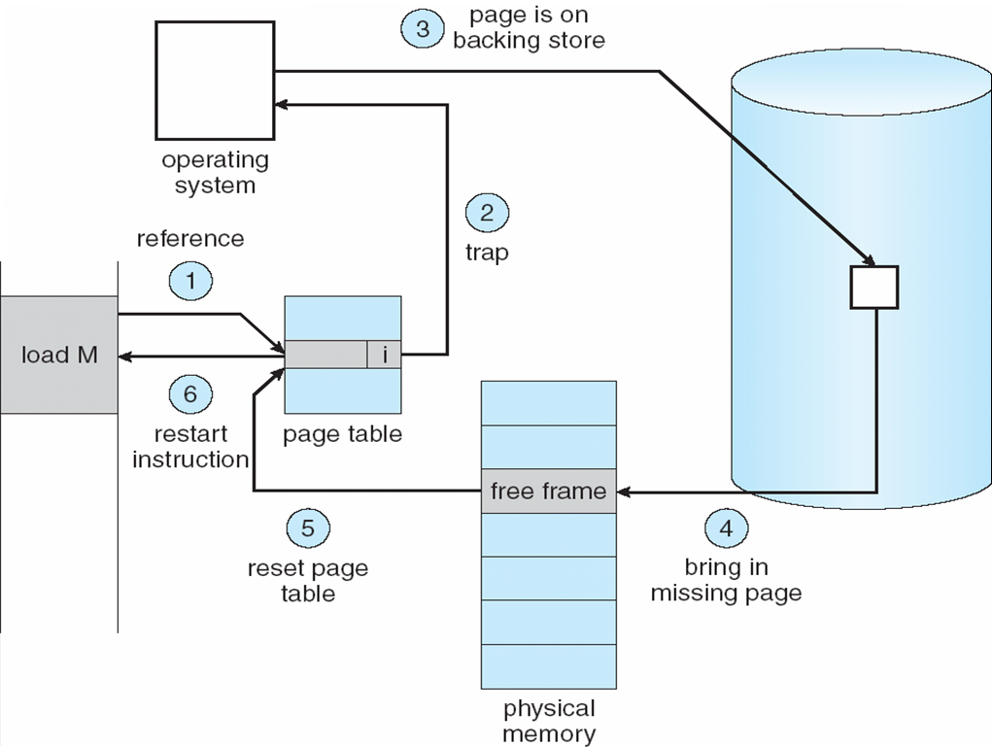
Page Fault
A page fault occurs
whenever a program
tries to access
a page that is
not currently
in memory.
Operating System Concepts, 10th edition
by Abraham Silberschatz, Greg Gagne, and Peter B. Galvin
Wiley, 2018, ISBN 978-1119456339

Slide 42
Copy-on-Write
After a call to fork()
  Both parent and child share
  the same pages in memory.
  Recall that we said that after forking, the parent
  and child processes have separate memory.
As soon as one process attempts
to modify a page:
  A copy of the page is created.
  The copied page is mapped into the address space of the process that wants to write to the page.

Slide 43
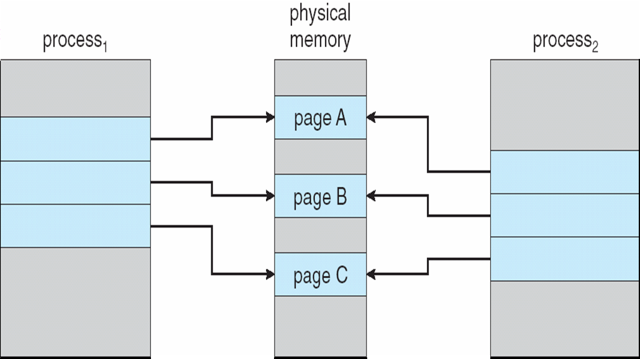
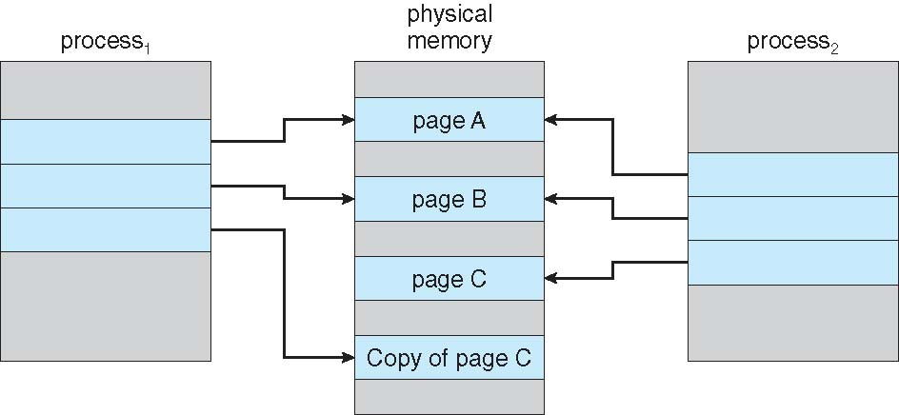
Copy-on-Write, cont’d
Just after the
fork() call:
After process₁ has
written to page C:
Operating System Concepts, 10th edition
by Abraham Silberschatz, Greg Gagne, and Peter B. Galvin
Wiley, 2018, ISBN 978-1119456339

Slide 44
Page Replacement
When a page fault occurs, the operating system must choose a “victim” page to evict from memory to make room for the page to be loaded from disk.
If the victim page has not been modified,
then its copy on disk is up-to-date.

Slide 45
Page Replacement, cont’d
If the victim page has been modified,
then the page must be written to disk.
  Overwrite the old page.
Which page should be evicted from memory?
  Several algorithms to decide.

Slide 46
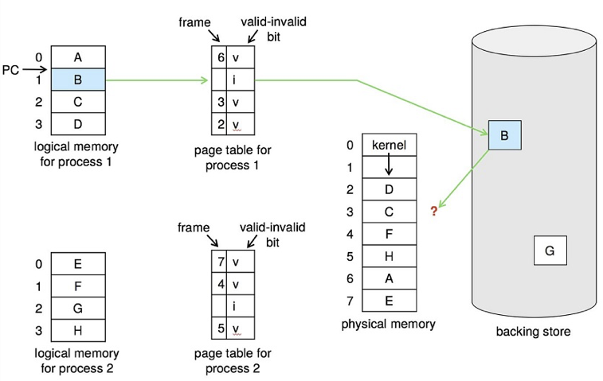
Page Replacement, cont’d
No room to
load page B.
Operating System Concepts, 10th edition
by Abraham Silberschatz, Greg Gagne, and Peter B. Galvin
Wiley, 2018, ISBN 978-1119456339

Slide 47
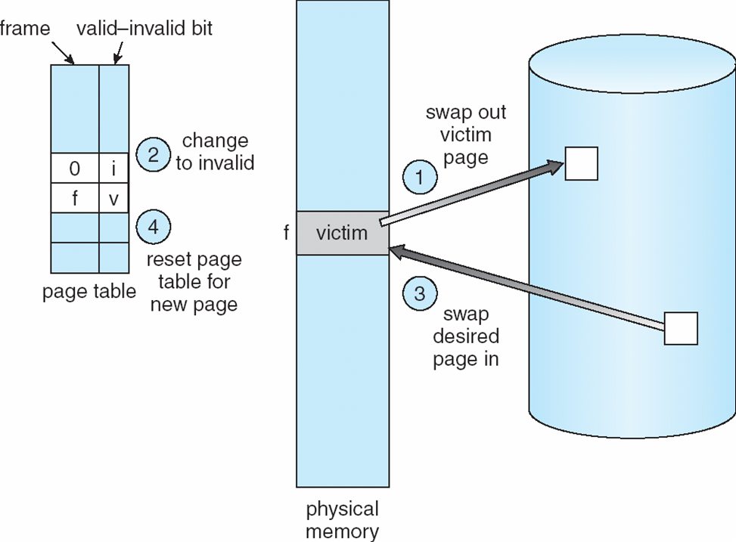
Page Replacement, cont’d
Operating System Concepts, 10th edition
by Abraham Silberschatz, Greg Gagne, and Peter B. Galvin
Wiley, 2018, ISBN 978-1119456339

Slide 48
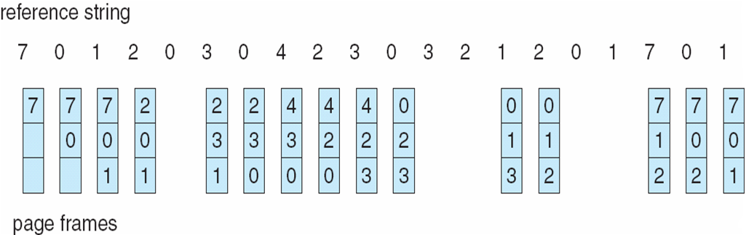
First-In, First-Out (FIFO)
Pages are evicted from memory in the order
that they were loaded into memory.
Operating System Concepts, 10th edition
by Abraham Silberschatz, Greg Gagne, and Peter B. Galvin
Wiley, 2018, ISBN 978-1119456339

Slide 49
Second Chance
Modification of FIFO.
Before evicting the oldest page,
check its reference bit.
If the page is not being referenced, evict it.
If it is being referenced, put it back at the tail of the queue as if it were a new page just loaded (the second chance).
  Clear the reference bit.
  Reset its load time to the current time.

Slide 50
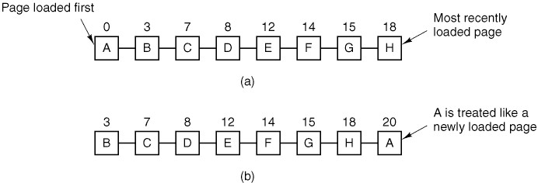
Second Chance, cont’d
Modern Operating Systems, 4th edition
by Andrew Tanenbaum & Herbert Bos
Pearson, 2014, ISBN 978-0133591620

Slide 51
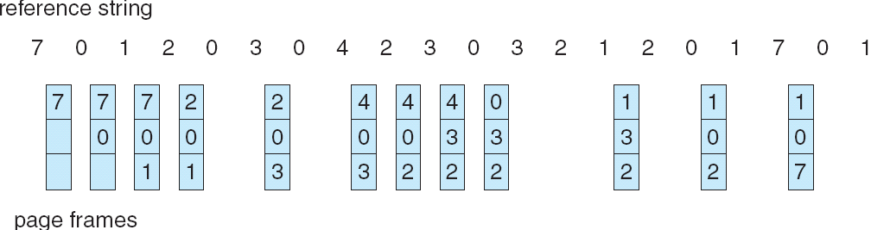
Least Recently Used (LRU)
The victim page is the one that
hadn’t been referenced the longest.
Need to keep track of the time
when each page was last referenced.
Operating System Concepts, 10th edition
by Abraham Silberschatz, Greg Gagne, and Peter B. Galvin
Wiley, 2018, ISBN 978-1119456339

Slide 52
Least Frequently Used (LFU)
Evict the page that has the lowest use count.
Problems:
  If a page was heavily used at the beginning of a program’s execution, it may stay in memory
  even if it’s never referenced again.
  A page that was just loaded may be the least frequently used page. Reference locality says
  it will be used again soon.

Slide 53
Most Frequently Used (MFU)
Evict the page that has the highest use count.
Pages with the smallest use count probably just got loaded, and they will be used again soon.

Slide 54
Random Pick
Randomly pick a page to evict.
  This can have surprisingly good results!

Slide 55
Optimal Page Replacement
If we could replace the page that will not be used for the longest period of time into the future, such a page-replacement algorithm would guarantee the lowest possible page-fault rate for a fixed number of frames.
  But how can we look into the future?
This is a theoretical algorithm that we simulate by generating the reference string in advance.
  Compare actual algorithms against this theoretical one to see how closely they come to being optimal.

Slide 56
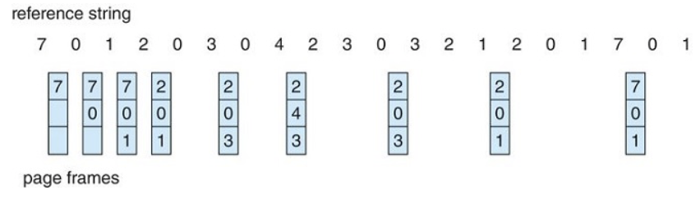
Optimal Page Replacement, cont’d

Slide 57
Working Set
The set of pages a process is currently using.
If a process’s working set can fit in memory,
there will be few page faults.

Slide 58
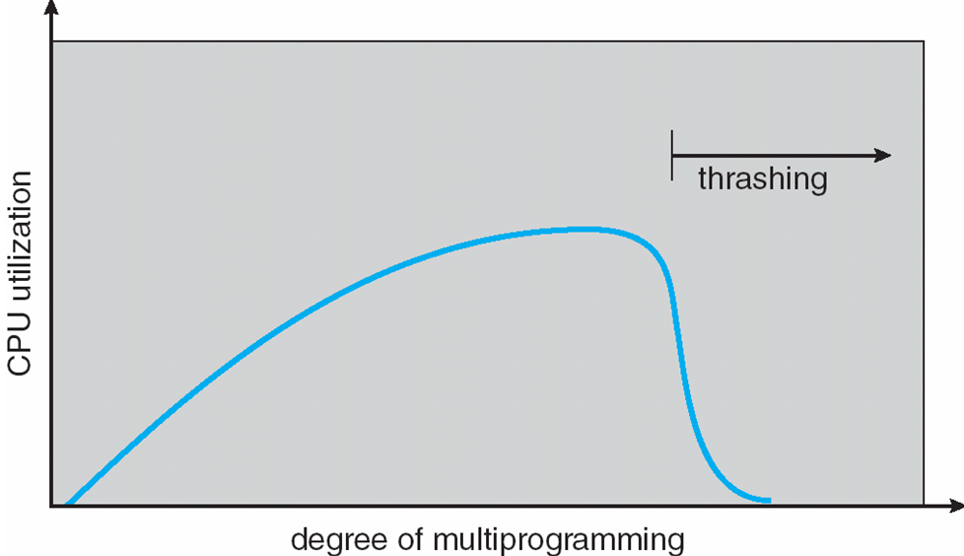
Thrashing
A process’s working set cannot fit
into available memory.
  Many page faults – one every few instructions.
Pages are constantly being
loaded and evicted.
  Disk I/O is very slow
  compared to the speed
  of the CPU.
  The process spends
  more time paging
  than executing.
Operating System Concepts, 10th edition
by Abraham Silberschatz, Greg Gagne, and Peter B. Galvin
Wiley, 2018, ISBN 978-1119456339

Slide 59
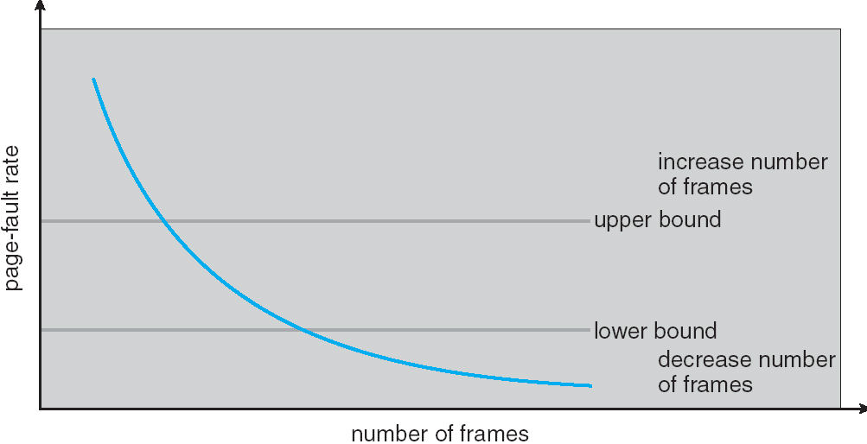
Page Fault Frequency (PFF)
To prevent thrashing, we need to control the
page fault frequency (PFF) of a process.
  Too high: The process needs more page frames,
  or it will thrash.
  Too low: The process has too many page frames.
Operating System Concepts, 10th edition
by Abraham Silberschatz, Greg Gagne, and Peter B. Galvin
Wiley, 2018, ISBN 978-1119456339

Slide 60
Assignment #6: Paging
You are running a process that consists of
8 pages numbered 0 through 7.
Physical memory has 3 page frames.
There are 8 page frames always available
on disk.
The process makes random references
to its pages. Due to locality of reference,
after referencing a page i, there is a
60% probability that the next reference
will be to page i-1, i, or i+1.

Slide 61
Assignment #6: Paging, cont’d
TIP: Given page reference i, to compute the next page reference, first generate a random number r from 0 through 9.
  If r is 0 or 1, then the next reference is i-1.
  If r is 2 or 3, then the next reference is i.
  If r is 4 or 5, then the next reference is i+1.
  If r is 6, 7, 8, or 9, then randomly make the next reference a value other than i-1, i, or i+1.
  The value of i should wrap around from 7 to 0.

Slide 62
Assignment #6: Paging, cont’d
Simulate the page replacement algorithms FIFO, LRU, LFU, MFU, random pick, and optimal.
Generate a string of 100 page references and run all six algorithms using the same string of references.
  For each algorithm, compute the hit ratio of pages already in memory, and count how many times there was a page swap.
  Repeat 5 times with a different string of page references each time to get averages.

Slide 63
Assignment #6: Paging, cont’d
When the process starts, none of its pages
are in memory.
Then for each subsequent reference in the generated string of page references, print the page numbers of the pages in memory and
(if any) which page needed to be paged in
and which page was evicted.

Slide 64
Assignment #6: Paging, cont’d
Print the page references down the page and the corresponding page frames horizontally.
  Therefore,
  instead of:
  Print:
Ref Frames Action
7 7
0 7 0
1 7 0 1
2 2 0 1 7 evicted, 2 entered
0
3 2 3 1 0 evicted, 3 entered
etc.

