Slide 1


CMPE 142
Operating Systems
March 5 Class Meeting
Department of Computer Engineering
San Jose State University
Spring 2021
Instructor: Ron Mak
www.cs.sjsu.edu/~mak

Slide 2
Deadlock Strategies
Ignore the problem altogether.
Do detection and recovery.
Avoid by careful resource allocation.
Prevent by negating one of the four necessary conditions for deadlocks.
  Mutual exclusion
  Hold and wait
  No preemption
  Circular wait

Slide 3
Ignore Deadlocks
Deadlocks may be unavoidable
when there are limited resources.
The OS can impose draconian measures
to prevent deadlocks that happen only occasionally.
If there are too many restrictions on the use of resources, the cost in inconvenience is too high.
Users may rather tolerate
infrequent system lockups.

Slide 4
Deadlock Detection and Recovery
The OS monitors resource
requests and releases.
  It maintains an internal resource allocation graph.
  If it detects any cycles, it starts to kill processes
  one by one until the cycle is broken.
The OS periodically checks to see if any processes have been continuously blocked
for a long time.
  Kill off such processes.

Slide 5
Deadlock Prevention
Relax mutual exclusion.
Never assign a resource
exclusively to a process.
  Example: Instead of processes
  contending for the use of a printer,
  use spooling instead.
But not all resources can be spooled.
  Mutual exclusion
  Hold and wait
  No preemption
  Circular wait

Slide 6
Deadlock Prevention, cont’d
Require all processes to
request all their resources
before starting execution.
A process waits if any one resource is unavailable.
No process will hold some resources
and block waiting for others.
  Mutual exclusion
  Hold and wait
  No preemption
  Circular wait

Slide 7
Deadlock Prevention, cont’d
Require that a process that
requests a resource:
  First release all the resources
  that it currently holds.
  Then try to acquire all its required resources
  all at once.
  Mutual exclusion
  Hold and wait
  No preemption
  Circular wait

Slide 8
Deadlock Prevention, cont’d
But not all process know what
resources they need ahead of time.
Poor use of resources.
  Example: A process reads data from a shared tape drive, processes the data for an hour, and writes results to the tape drive. It locks up the tape drive for an hour.
  Mutual exclusion
  Hold and wait
  No preemption
  Circular wait

Slide 9
Deadlock Prevention, cont’d
Forcibly take a resource away
from a process if a higher priority
process requests that resource.
  Can you interrupt a print job
  for a higher priority one?
  Mutual exclusion
  Hold and wait
  No preemption
  Circular wait

Slide 10
Deadlock Prevention, cont’d
Allow a process only
one resource at a time.
  Too restrictive.
Global numbering of all resources.
  Processes can request all the resources they want,
  but only in numerical order.
  Mutual exclusion
  Hold and wait
  No preemption
  Circular wait
Modern Operating Systems, 3rd ed.
Andrew Tanenbaum
(c) 2008 Prentice-Hall, Inc.. 0-13-600663-9
All rights reserved

Slide 11
Deadlock Prevention, cont’d
Global numbering of all resources:
  Process A requests Resource i.
  Process B requests Resource j.
  If i > j, then process A cannot request Resource j.
  if i < j, then process B cannot request Resource i.
  Therefore, no deadlock can occur.
It may be hard to devise a workable ordering.
Modern Operating Systems, 4th edition
by Andrew Tanenbaum & Herbert Bos
Pearson, 2014, ISBN 978-0133591620

Slide 12
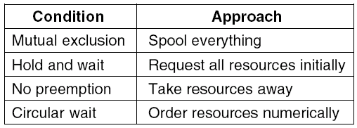
Deadlock Prevention, cont’d

Slide 13
Deadlock Avoidance
In most systems, processes request resources
one at a time.
Decide: Is it safe for the system to grant a resource?
  Allocate a resource only when it is safe.
Can the system avoid deadlocks by always making the right decision whether or not to grant a resource?

Slide 14
Deadlock Avoidance, cont’d
Deadlock avoidance algorithms are
based on the concept of safe states.
No deadlocks will occur if the system
always remains in a safe state.

Slide 15
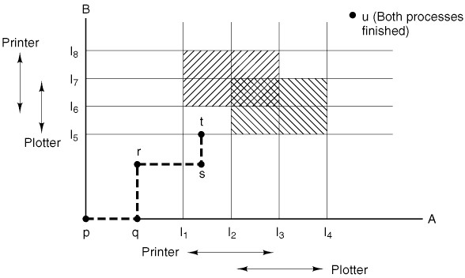
Resource Trajectories
A and B contend for the printer and the plotter.
  The horizontal axis is Process A’s execution timeline.
  The vertical axis is Process B’s execution timeline.
Modern Operating Systems, 4th edition
by Andrew Tanenbaum & Herbert Bos
Pearson, 2014, ISBN 978-0133591620

Slide 16
Resource Trajectories, cont’d
Not a usable
algorithm, but
good for getting
an intuitive feel
for the problem.
Dangerous
box!
Process B
requests plotter.
Process A
has printer.
The dashed line is the execution path of the
two processes A and B in a single-CPU system.
  Deadlock if the path reaches (I₂, I₆).
  At t, suspend B and only let A run.
Modern Operating Systems, 4th edition
by Andrew Tanenbaum & Herbert Bos
Pearson, 2014, ISBN 978-0133591620

Slide 17
Banker’s Algorithm for a Single Resource
A small-town bank has customers A, B, C, and D
who want to borrow a total of $22K.
  The banker knows the customers don’t need all the money at once, so he allocates only $10K for loans.
The diagrams below show three allocation states.
Modern Operating Systems, 4th edition
by Andrew Tanenbaum & Herbert Bos
Pearson, 2014, ISBN 978-0133591620

Slide 18
Banker’s Algorithm for Single, cont’d
States (a) and (b) are safe.
  There is a sequence of further states
  that leads all customers to getting their full loans.
State (b): There is $2K left to loan.
  The banker can let Customer C get his full amount.
  After C repays the loan, the banker has funds
  to service B or D fully.
Modern Operating Systems, 4th edition
by Andrew Tanenbaum & Herbert Bos
Pearson, 2014, ISBN 978-0133591620

Slide 19
Banker’s Algorithm for Single, cont’d
State (c) is unsafe.
  If all the customers ask for the rest of their loan amounts, none can be satisfied, and then the system deadlocks.
Therefore, the banker must check each loan request to ensure that it leads to a safe state.
Modern Operating Systems, 4th edition
by Andrew Tanenbaum & Herbert Bos
Pearson, 2014, ISBN 978-0133591620

Slide 20
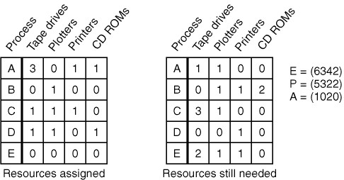
Banker’s Algorithm for Multiple Resources
Resource vectors E, P, and A.
  E: Existing resources (6 tape drives, 3 plotters, etc.)
  P: Possessed resources
  A: Available resources
Modern Operating Systems, 4th edition
by Andrew Tanenbaum & Herbert Bos
Pearson, 2014, ISBN 978-0133591620

Slide 21
Banker’s Algorithm Multiple, cont’d
Look for a row R in the second table
whose unmet resource needs are
all smaller than resource vector A.
  Deadlock occurs if no such row exists,
  since no process can run to completion.
Modern Operating Systems, 4th edition
by Andrew Tanenbaum & Herbert Bos
Pearson, 2014, ISBN 978-0133591620

Slide 22
Banker’s Algorithm Multiple, cont’d
If row R does exist, assume that the row’s process will request all its needed resources.
  The process can then run until it terminates
  and adds all its resources to resource vector A.
Modern Operating Systems, 4th edition
by Andrew Tanenbaum & Herbert Bos
Pearson, 2014, ISBN 978-0133591620

Slide 23
Banker’s Algorithm Multiple, cont’d
Repeat these steps until:
  All processes complete: The initial state was safe.
  Deadlock occurs: The initial state was unsafe.
Modern Operating Systems, 4th edition
by Andrew Tanenbaum & Herbert Bos
Pearson, 2014, ISBN 978-0133591620

Slide 24
Banker’s Algorithm Multiple, cont’d
Wonderful algorithm in theory.
Useless in practice.
  Processes rarely know in advance
  what their maximum resource requirements are.
  The number of processes can be dynamic.
  Resources can suddenly vanish (i.e., break down).
Few operating systems actually use the
banker’s algorithm to prevent deadlocks.

Slide 25
Two-Phase Locking
A special-purpose algorithm commonly used by database systems.
Phase 1: A database process tries to lock all the records that it needs. No work is done in this phase.
  If some records are not available,
  release all locks and start over.
  If Phase 1 succeeds, proceed to Phase 2.
Phase 2: Perform operations on the locked records, and then release the locks.

Slide 26
Two-Phase Locking, cont’d
Not a practical algorithm in general.
It’s not always possible to terminate a process
just because a resource is not available
and then start over.

Slide 27
Summary of Deadlock Handling
Prevention schemes
  Can be overly restrictive.
Avoidance schemes
  May require information that is usually not available.
Still a topic of research!

Slide 28
Break

Slide 29
Memory Management
Memory is an important resource that the
operating system must manage carefully.
Your laptop has several thousand times
as much memory as the IBM 7094 “supercomputer” of the early 1960s.
The IBM 1401 small business computer
had a maximum of 16,000 memory locations.
  Each 8-bit memory location (they weren’t called bytes back then) could contain one character and costs about $25 in today’s dollars.

Slide 30
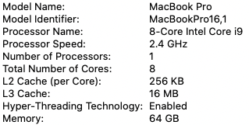
Computer System Architecture
The first IBM PC had a maximum of 640K
  40 times the memory of the IBM 1401.
  Who can use so much memory?
You can never have “too much” memory.
  My MacBook Pro laptop has 64 GB of memory – more than a company’s entire computer center of not too long ago!

Slide 31
Computer System Architecture, cont’d
System memory design is affected by:
  Speed of the processor
  Speed of the I/O devices
  Types of applications
  Degree of concurrency
  Granularity of machine instructions
    RISC architectures execute more instructions
  Size of the systems software
    Example: the OS kernel

Slide 32
Computer System Architecture, cont’d
A major disparity exists between
CPU speed and memory speed.
  CPU technology is advancing
  faster than memory technology.
  The CPU can process data faster than it can be fetched from compatibly priced main memory units.
Main memory is the bottleneck
in terms of system speed and cost.
Systems need to include very fast and expensive cache memory.

Slide 33
Memory Hierarchy
Small amount of very fast, expensive,
volatile cache memory.
  volatile: contents lost when the power goes off
Gigabytes of medium-speed, medium-price,
volatile main memory.
  RAM: random access memory
Gigabytes or terabytes of slow, cheap,
non-volatile disk storage.

Slide 34
Memory/Storage Speed Comparisons
Suppose your computer ran at human speeds.
  1 CPU cycle: 1 second
Then the time to retrieve one byte from:
  SRAM
  (cache memory)
    5 seconds
  DRAM
  (main memory)
    2 minutes
  Flash drive
    1 day
  Hard drive
    2 months
  Tape
    1,000 years

Slide 35
Memory Manager
The memory manager manages
the memory hierarchy.
  Resides in the OS kernel.
Keep track of which parts of memory are in use.
Allocate memory to processes.
Deallocate the memory
when the processes complete.
Swap the contents of main memory to and from disk when main memory isn’t large enough to hold all the active processes.

Slide 36
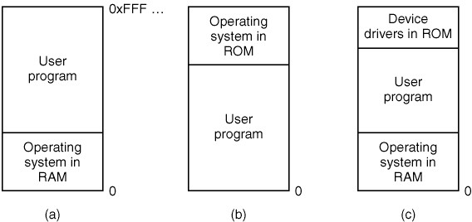
Monoprogramming Systems
Used today by some embedded systems.
  Formerly used by mainframes, minicomputers, early PCs, and mobile devices.
Modern Operating Systems, 4th edition
by Andrew Tanenbaum & Herbert Bos
Pearson, 2014, ISBN 978-0133591620

Slide 37
Multiprogramming with Fixed Partitions
Modern OS’s allow multiple processes
to run at the same time.
  An easy memory management scheme is to
  divide main memory into fixed-size partitions
  (possibly unequal-sized).
  Partition sizes and boundaries can be configured.
When a process is scheduled to execute,
it is entered into the queue for the smallest memory partition large enough to hold it.
  Any memory left over in the partition is wasted.

Slide 38
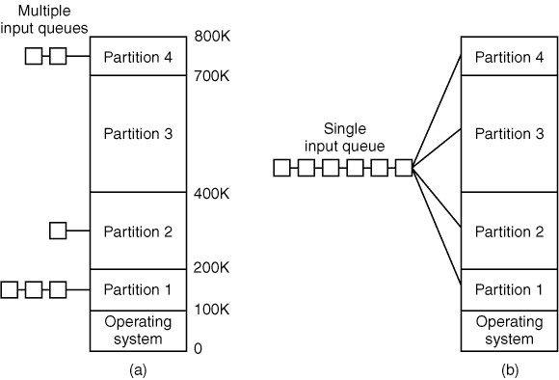
Multiprogramming Fixed Partitions, cont’d
What’s inefficient about this scheme?
  If a larger partition is available but processes are queued for a smaller partition,
  the available partition isn’t used.
Modern Operating Systems, 4th edition
by Andrew Tanenbaum & Herbert Bos
Pearson, 2014, ISBN 978-0133591620

Slide 39
Multiprogramming Fixed Partitions, cont’d
Use a single queue for all memory partitions.
  When a partition becomes free, search the queue for a process that can best use
  the partition size.
Smaller processes
may starve.
  Always have small partitions available.
  Use an aging algorithm.
Modern Operating Systems, 4th edition
by Andrew Tanenbaum & Herbert Bos
Pearson, 2014, ISBN 978-0133591620

Slide 40
Process Relocation
How can the OS enable processes
to run in any part of main memory?
Compiled programs can refer to
memory addresses.
You generally do not want a process
to be able to run only at specific
memory addresses.

Slide 41
Process Relocation Solutions
Whenever a process is loaded into main memory, modify all the addresses used by the code.
  No longer done on today’s computer systems.
Base and limit registers in the hardware.
  Whenever a process is loaded, put the address of the
  start of its partition in the process’s base register and the size of the partition in the limit register.
  All memory references by the process are relative
  to the base register and checked against the limit register.
  Slows down each memory reference.

Slide 42
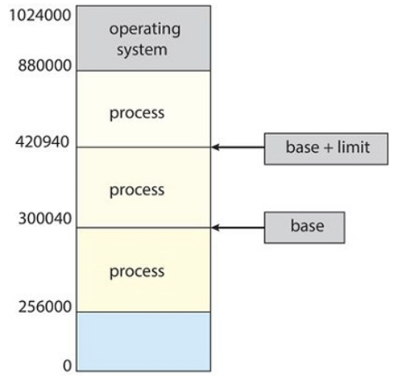
Process Relocation Solutions, cont’d
The OS must
protect processes
from each other.
  Do not allow the code of one process to access
  the memory of another process.
  But the processes agree to use
  shared memory.
Operating System Concepts, 10th edition
by Abraham Silberschatz, Greg Gagne, and Peter B. Galvin
Wiley, 2018, ISBN 978-1119456339

Slide 43
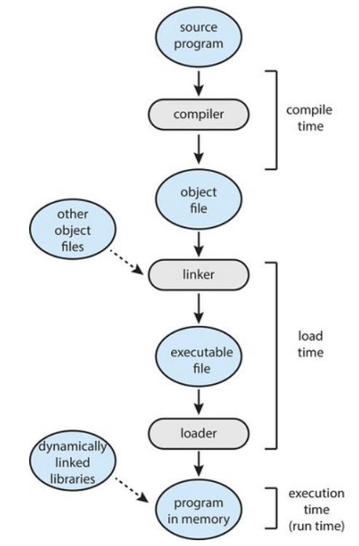
Address Binding
A programming language compiler will bind
symbolic addresses
used in a program to
relocatable addresses.
Operating System Concepts, 10th edition
by Abraham Silberschatz, Greg Gagne, and Peter B. Galvin
Wiley, 2018, ISBN 978-1119456339

Slide 44
Address Binding, cont’d
Example: The memory location of variable X
is 124 bytes from the beginning of the code module.
  The “address” 124 is relocatable because
  it’s relative to the start of the code module.
At run time, the code module can be
placed anywhere in main memory,
but variable X will always be 124 bytes
from the beginning of the module.

Slide 45
Compile-Time Binding
Suppose it is known at program compile time exactly where in physical main memory the program will run.
The compiler can generate absolute code with physical memory addresses.
If the program needs to run elsewhere in main memory, it will have to be recompiled.

Slide 46
Load-Time Binding
The compiler generates relocatable code.
Final address binding is delayed until load time.
If the starting address changes, just reload the program to incorporate the changed address.

Slide 47
Execution-Time Binding
Dynamic linking
  Shared libraries (AKA DLLs in Windows) are linked to a process when it is run.
  Programs no longer need to statically link to their own copies of libraries.
  Saves disk and runtime memory space.
  A good way to issue library updates.
Special hardware can enable a process
to move during its execution from one
memory segment to another.
  Most general-purpose operating systems
  use this feature.

Slide 48
Logical vs. Physical Address Space
Logical address (AKA virtual address)
  A memory address generated by the CPU
  while a process is running.
Physical address
  A memory address seen by the memory manager,
  such as in the memory-address register.
  A process never directly uses physical addresses.

Slide 49
Logical vs. Physical Address Space, cont’d
Logical address space
(AKA virtual address space)
  The set of all logical addresses generated by a program.
Physical address space
  The set of all physical addresses
  corresponding to the logical addresses.
Memory-management unit (MMU)
  A hardware device that does the runtime mapping
  from virtual to physical address.

Slide 50
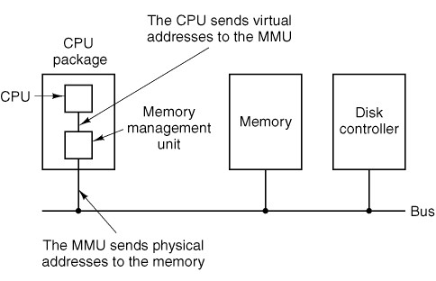
Logical vs. Physical Address Space, cont’d
Modern Operating Systems, 4th edition
by Andrew Tanenbaum & Herbert Bos
Pearson, 2014, ISBN 978-0133591620

Slide 51
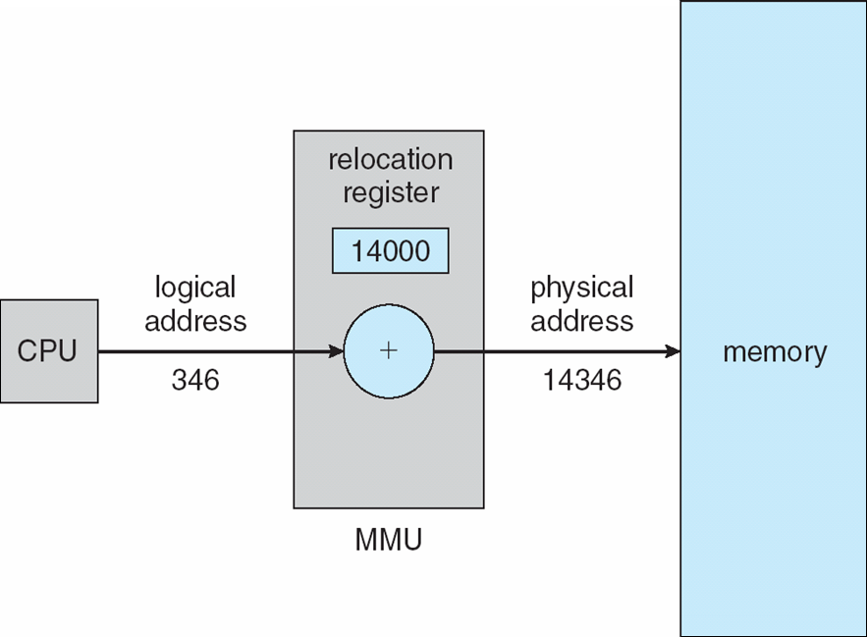
Logical vs. Physical Address Space, cont’d
Dynamic relocation using a relocation register.
Operating System Concepts, 10th edition
by Abraham Silberschatz, Greg Gagne, and Peter B. Galvin
Wiley, 2018, ISBN 978-1119456339

Slide 52
Dynamic Loading
Dynamic loading allows only part of a program
to be loaded into memory at run time.
  Routines are kept on disk as relocatable code.
  A routine is not loaded until it’s called.
When a routine that’s already in memory
calls another routine:
  The OS first checks if the desired routine
  is already in memory.
  If not, the relocatable linking loader loads the
  desired routine into memory and updates the process’s address tables.
  Then control passes to the newly loaded routine.

Slide 53
Swapping
What if there isn’t sufficient main memory to hold all the currently active processes?
Swapping: The process scheduler works with the memory manager to load a process in its entirety from disk into main memory before the process can execute.

Slide 54
Swapping, cont’d
Whenever the process blocks, the process scheduler and memory manager can decide to write the entire process back onto disk.
  Free up the process’s memory resources
  to be available for other processes.
Swapping requires a backing store,
usually a very fast hard disk.

Slide 55
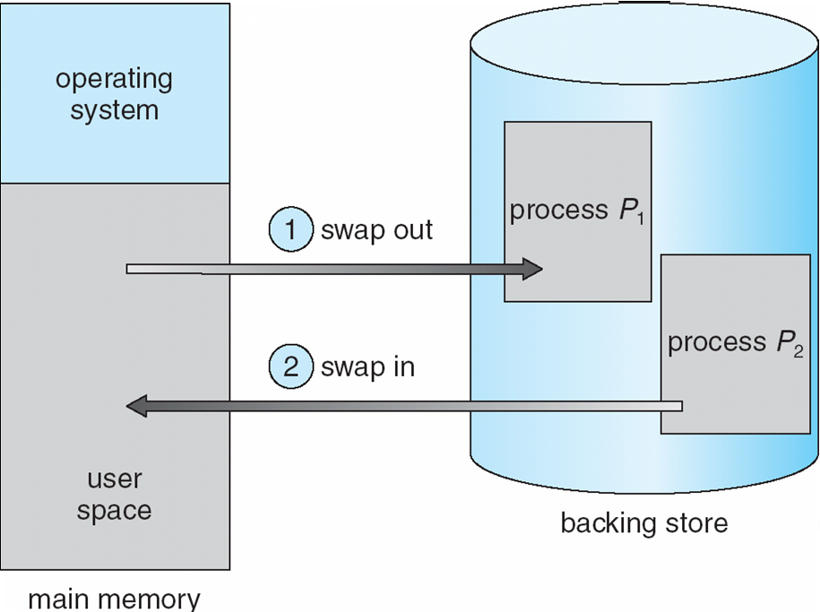
Swapping, cont’d
Operating System Concepts, 10th edition
by Abraham Silberschatz, Greg Gagne, and Peter B. Galvin
Wiley, 2018, ISBN 978-1119456339

Slide 56
Swapping, cont’d
The OS maintains a ready queue of processes
whose memory images are either
  On the backing store, or
  Already in main memory and are ready to run.

Slide 57
Swapping, cont’d
Whenever the process scheduler decides
to execute a process, it calls the dispatcher.
  The dispatcher checks whether the next process
  in the ready queue is in memory.
  If the process is not in memory and main memory
  is already full, the dispatcher can swap out
  a process currently in memory and swap in
  the desired process.
Context-switch time can be very expensive.
  Swapping is disk I/O.

Slide 58
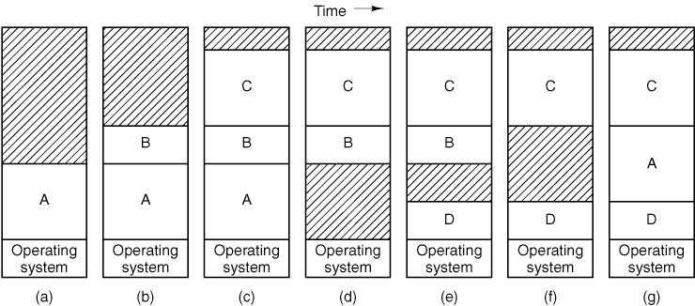
Variable Partition Scheme
The number, location, and sizes of the partitions
vary dynamically as processes come and go.
  More flexible than fixed partitions,
  but more complex to manage.
Modern Operating Systems, 4th edition
by Andrew Tanenbaum & Herbert Bos
Pearson, 2014, ISBN 978-0133591620

Slide 59
Memory Compaction
Swapping can create multiple “holes”
in main memory.
Memory compaction can occur in order to
slide processes over to eliminate the holes.
Compaction time may be disruptive to some applications, especially real-time applications that can’t tolerate interruptions.

Slide 60
Memory Demands
A process may demand more memory
during execution.
  Its data segment, stack, or both may grow.
  Allocate memory to a process with extra “headroom”.
If a process requests more main memory but none is available and the swap area on disk is full, the process must block waiting for memory to become available or be killed by the OS.

Slide 61
Memory Allocations
Main memory is divided into allocation units.
  AKA blocks
A unit can be as small as a few words to several kilobytes.
  Smaller units means more units to manage.
  Larger units result in more wasted memory.

Slide 62
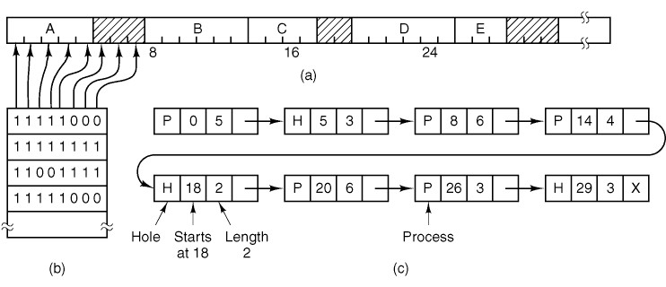
Keeping Track of Memory
The memory manager can maintain either a bitmap or a linked list of allocated and free memory segments.
  A segment is either consecutive blocks allocated to a process or a hole between allocations.
Modern Operating Systems, 4th edition
by Andrew Tanenbaum & Herbert Bos
Pearson, 2014, ISBN 978-0133591620

Slide 63
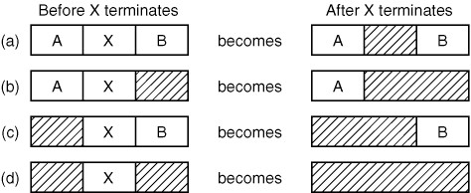
Keeping Track of Memory, cont’d
A linked list entry changes from “process” to “hole” when the process terminates.
Two adjacent hole entries can coalesce
into a single entry for a (larger) hole.
Modern Operating Systems, 4th edition
by Andrew Tanenbaum & Herbert Bos
Pearson, 2014, ISBN 978-0133591620

Slide 64
Memory Allocation Algorithms
When a process is loaded into memory,
a large enough hole must be found for it.
First fit: The memory manager searches its linked list of memory segments from the beginning until it finds the first hole big enough.
  It breaks the hole into two parts, one to allocate to the process and the other part to be a (smaller) hole.
  Fast algorithm: shortest possible search.

Slide 65
Memory Allocation Algorithms, cont’d
Next fit: Each search for a hole in the linked list of memory segments starts from where the previous search ended.
  Simulations show slightly worse performance
  than first fit.
Best fit: Search the linked list of memory segments for the smallest hole where the process will fit.
  Slower: longer search
  Results in more wasted memory.
  Fills memory with tiny, useless holes.
Why?

Slide 66
Memory Allocation Algorithms, cont’d
Some optimizations are possible.
  Maintain separate linked lists for
  processes and holes.
  Sort the holes by size.
Quick fit: Maintain separate linked lists for the
most commonly requested allocation sizes.
  Hard to find neighboring holes to coalesce
  when processes terminate.
  Fills memory with tiny, useless holes.

Slide 67
External Memory Fragmentation
Free memory space is broken into small pieces.
  Free spaces are not contiguous.
Such external fragmentation refers to unused memory outside of processes.
Fragmentation depends on
the memory allocation algorithm.
  With first fit, up to one-third of memory
  may be unusable.

Slide 68
Internal Memory Fragmentation
Internal memory fragmentation refers to unused memory that is internal to a process.
When allocating memory in fixed-size blocks,
the amount allocated to a process may be
more than what the process requested.
  Larger block sizes cause more internal fragmentation.

Slide 69
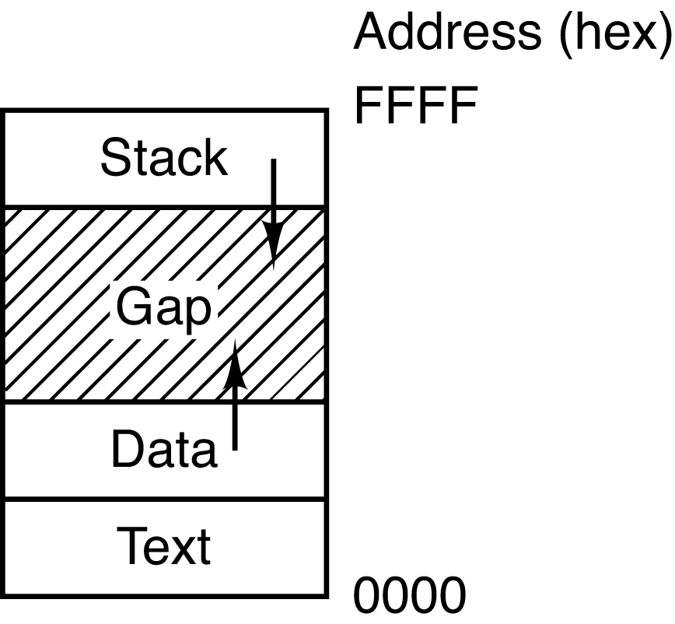
Dynamically Allocated Memory
The same memory management algorithms (first fit, next fit, etc.) apply to objects in the heap memory that a process allocates and frees dynamically in its data segment.
Allocation requests can
come in different sizes.
Modern Operating Systems, 4th edition
by Andrew Tanenbaum & Herbert Bos
Pearson, 2014, ISBN 978-0133591620

Slide 70
Assignment #5
Use simulations to explore
memory allocation algorithms.
  First fit, next fit, best fit
  Which makes the most efficient use of memory?
Create a “memory manager” process that keeps track of around 3000 memory blocks.
Create several “requester” processes that ask the memory manager to allocate and deallocate memory segments of various sizes.

Slide 71
Assignment #5, cont’d
Each requester process sends requests to the memory manager process via a named pipe.
Each allocation request consists of
  A unique request id, process name, block size
  Allocation block sizes will be prime numbers.
  After an allocation request, the requester process must wait until it is fulfilled by the memory manager.
Each deallocation request consists of
  The request id, process name
  No need to wait after a deallocation request.

Slide 72
Assignment #5, cont’d
Each requester keeps track of its allocations.
Make allocation requests ~60% of the time and deallocation requests ~40% of the time.
Eventually, the memory will “fill up” and the memory manager process will no longer be able to satisfy any more requests.
  There are no more free segments that can satisfy allocation requests.

Slide 73
Assignment #5, cont’d
The memory manager keeps track of allocated and free segments.
It reads requests from the named pipe (FIFO).
It can either immediately service an allocation request, or it must put put the request on hold until a sufficiently large segment is freed.
  It should immediately service deallocation requests.
  Allocation requests on hold should have priority over new incoming allocation requests.

Slide 74
Assignment #5, cont’d
When it satisfies an allocation request, the memory manager must signal the requester process.
  The requester has been waiting since sending the allocation request.
The memory manager maintains a dynamic display of its “memory map” of allocated and
free segments.
  Write the name of the process that owns each block.
  Use the ncurses package to do a text-based display.

Slide 75
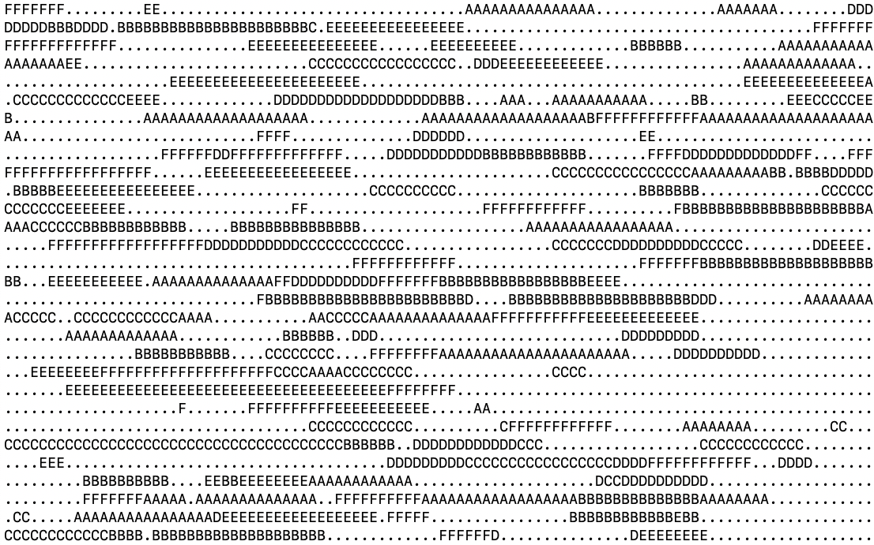
Assignment #5, cont’d
Example memory map display.
  Update dynamically after each
  allocation and deallocation.

Slide 76
Assignment #5, cont’d
Each simulation ends when the memory manager process can no longer service any more allocation requests.
How many allocation requests did the memory manager successfully service?
  How many were serviced immediately?
  How many had to first be put on hold?
How do the various allocation algorithms compare?

Slide 77
Assignment #5, cont’d
ncurses may already be installed in your Ubuntu or Mac platform.
  To find out, enter this command in a terminal window to see if you have the library libncurses:
To install in Ubuntu:
To install on a Mac:
find / -name libncurses\.\* 2> /dev/null
sudo apt-get install libncurses5-dev libncursesw5-dev
brew install ncurses

Slide 78
Assignment #5, cont’d
To compile and run the sample ncurses program:
cc -o das DotsAndStars.c -lncurses
./das
Due Friday, March 12

